Slide 1
Predicting which songs Andreas likes
FRTN65 Lab 1, Andreas Olsson, October 2026
Notes:
One sentence version: four tree ensembles tie at 0.83, the rule I wrote first picks bagging as the simplest of them, I handed in the forest on the numerical features for the competition.

Slide 2
In short
Data: 736 songs after dropping 14 duplicates, 13 features (10 numerical, 3 categorical), 60% liked
Modelling: 12 methods tried in 51 variants, all through one evaluation protocol
Result: four tree ensembles (xgboost, random forest, bagging, boosting) are indistinguishable on this data, around 0.83 accuracy
The rule I set up before seeing any numbers picks bagging, the simplest of the equally good ones
Handed in: random forest on the 10 numerical features, 0.833 ± 0.018 cross-validated accuracy. Why not bagging is on slide 20
Notes:
The whole lab in four lines. The override (rf_numeric instead of bagging) is said as an override, slide 20 has the why.

Slide 3
In practice
I did the lab in two notebooks instead of a python project: initial_exploration.ipynb (unstructured on purpose) and modelling.ipynb (structured on purpose)
The exploration decides what to try: distributions, correlations, and a cross-validated decision tree screen of which features and feature pairs seem to matter
The modelling decides how to compare, and never changes that mid way. Preprocessing and classifier variants are defined as dicts, and one evaluator runs the same grid search and cross validation on all of them
This made 51 variants super cheap: adding one is one line, and it gets the same folds, tables and plots as everything else
Everything that varies between methods is a dict entry, everything that must not vary (folds, seed, metric, tuning inside the folds) is one function
Notes:
The point of the split: the exploration is allowed to be messy, the comparison is not. The structure is what made 51 variants affordable.

Slide 4
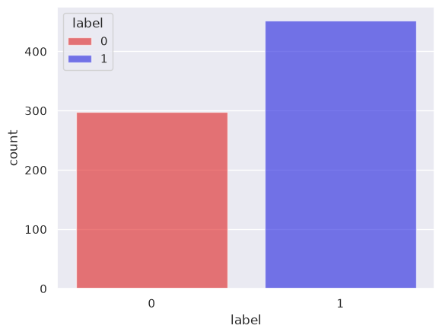
The data
750 rows, 14 exact duplicates dropped, 736 songs left. No missing values
13 Spotify audio features per song
10 numerical: acousticness, danceability, duration, energy, instrumentalness, liveness, loudness, speechiness, tempo, valence
3 categorical: key, mode, time_signature
443 liked, 293 disliked. Always guessing "like" gives 0.60 accuracy, so that is the floor every number is measured from
Class balance in the raw file, 0 = dislike, 1 = like.
Notes:
The duplicates matter: the same song in both the training and the validation part of a split makes the score look better than it is. The 0.60 floor is what every number is measured from.

Slide 5
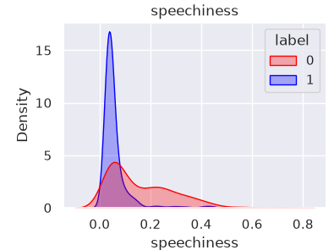
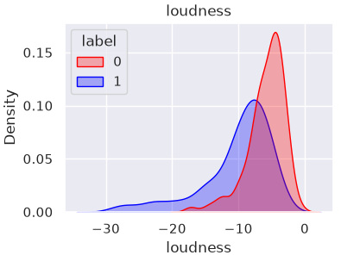
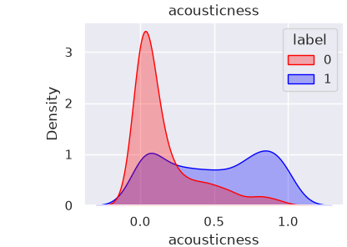
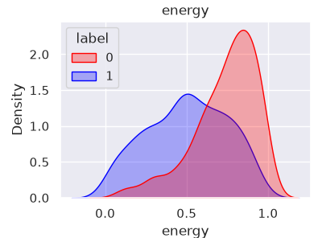
The data, the four features that matter
Liked songs are quiet, acoustic and have almost no speech. Disliked songs are loud, energetic and speechy
The densities are per class, so the 60/40 does not show up as separation here
speechiness: the liked songs are one spike near zero, the disliked ones spread out into a tail. duration, instrumentalness and liveness have the same spike plus tail shape, which is why scaling becomes a question later
Notes:
Densities are normalised per class, so the 60/40 does not read as separation. The spike plus tail shape is why robust, quantile and log scaling became variants later.

Slide 6
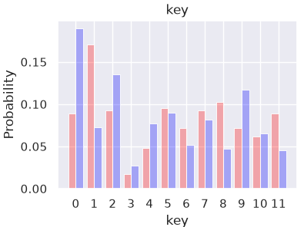
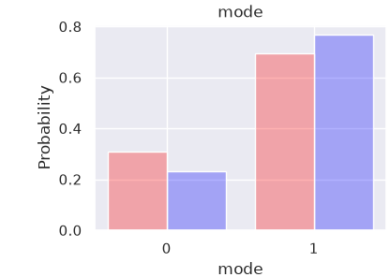
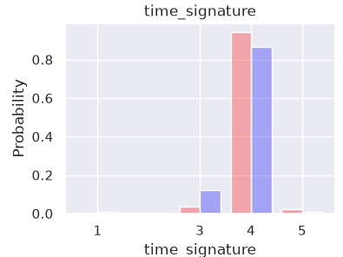
The data, the categorical ones
key 11 is not "more" than key 0, so these three are treated as qualitative and one-hot encoded (18 columns)
They barely separate the classes here, and it turns out later that no method uses them (slide 22)
The other six numerical features (danceability, duration, instrumentalness, liveness, tempo, valence) separate a little or not at all, they are in initial_exploration.ipynb
Notes:
key 11 is not more than key 0, hence one-hot. The remaining six numerical features are in the exploration notebook; danceability separates a bit, the rest barely.

Slide 7
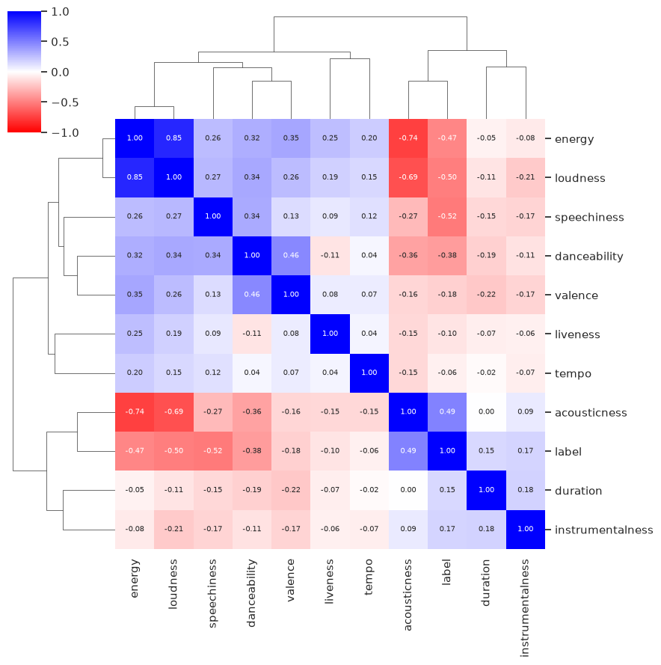
Feature correlations
Spearman (rank) correlation, bc of the tails. Clustered so the blocks show
energy, loudness and acousticness are one block (energy to loudness 0.85, energy to acousticness −0.74): three columns, one direction
speechiness has the strongest single relation to the label (−0.52) and sits outside that block
tempo, liveness, duration, instrumentalness: near zero against everything
Correlation only sees pairwise monotone relations, not interactions, so the next slide asks a decision tree instead
Notes:
Spearman because of the tails: ranks instead of values. Correlation is pairwise and monotone, it cannot see interactions, which is why the tree screen on the next slide exists. Also why a heavily regularised line does well: the main axis is linear and L2 shares the weight over the three correlated columns.

Slide 8
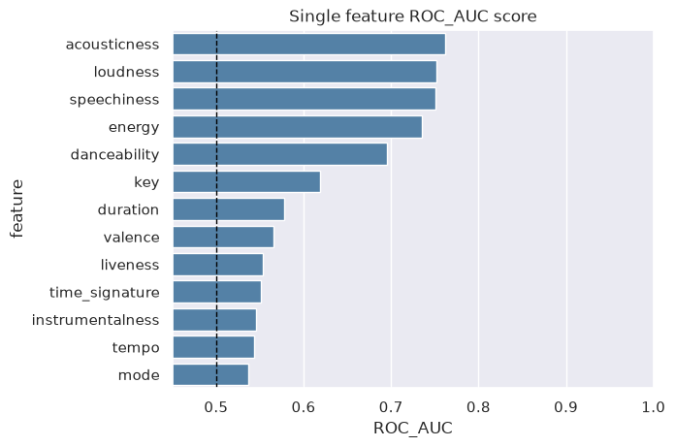
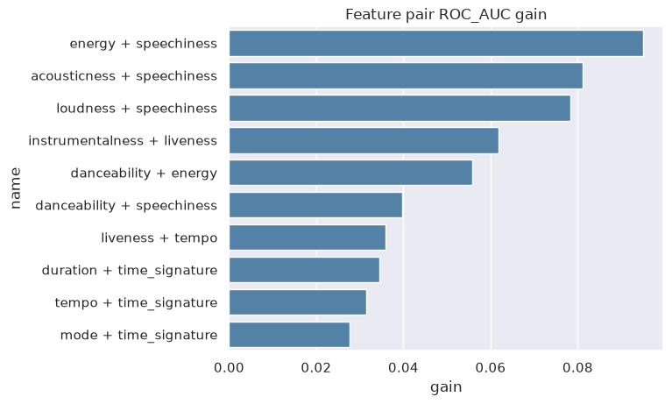
Feature screen with decision trees
A depth-limited decision tree, 5-fold cross validation, ROC AUC, on each feature alone (left) and on each pair (right). Gain = pair minus the better of its two singles. Every single feature is above 0.5, and every big pair gain has speechiness in it.
Notes:
Same depth for singles and pairs. I also ran it with repeated folds and a shuffled copy of each feature as a null: the top gains survive, the null never gets above about +0.02, so the small gains at the bottom of the bar chart are noise.

Slide 9
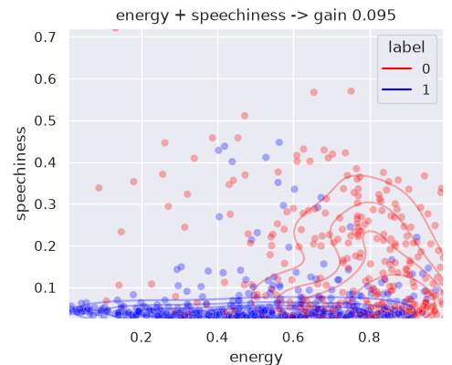
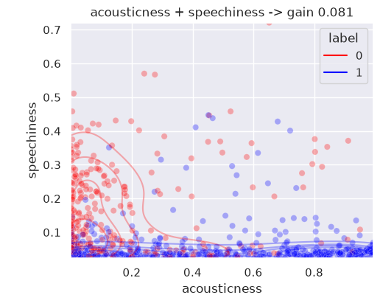
The two best pairs
speechiness splits the songs that the loud/acoustic axis cannot, and the other way round. One model at one depth, so I read it as a hint and not a fact; in the modelling notebook the same question is asked of every method instead (permutation importance, slide 22).
Notes:
This is where the top4 and interactions variants came from. Be ready for: is the gain just extra depth? No, singles and pairs ran at the same depth.

Slide 10
Preprocessing
All 13 features go in by default: the 10 numerical ones standardised (z-score), the 3 categorical ones one-hot. 28 columns reach the model
Scaling only matters for the methods that measure distances or penalise coefficients (knn, svm, logreg, lda, qda). Trees do not care, so they get the raw columns
Variants on top of that: robust and quantile scaling, log1p on the spiky four, rare levels grouped, categoricals dropped, only the four strong features, pairwise products of the numerical ones
All of it lives inside the sklearn Pipeline, so scaler and encoder are fit on the training part of each fold only, never on the validation part (important)
The test file is read once, at the very end, by the model that was handed in
Notes:
Rubric point (2): which inputs, qualitative or quantitative, what preprocessing. The pipeline is the whole point: nothing is fit on a validation fold, ever.

Slide 11
The methods
method | what it is | tuned by the grid search
dummy | always answers "like", the floor | nothing
logreg | one linear boundary, L2 penalty on the coefficients | C
lda | linear too, gaussian classes with one shared covariance | nothing
qda | a covariance per class, so a quadratic boundary | reg_param
knn | vote among the k closest songs in the scaled space | k, weights
tree | one tree of threshold splits, readable, high variance | max_depth, min leaf
svm_linear | like logreg but hinge loss, maximises the margin | C
svm_rbf | kernel trick, a nonlinear boundary | C, gamma
bagging | 300 trees on bootstrap samples, averaged | min leaf
rf | bagging plus a random feature subset at every split | max_features, min leaf
boosting | shallow trees in sequence, each fixing the last ones' errors | learning rate, depth, iterations
adaboost | boosting with stumps and exponential loss | learning rate, n trees
xgboost | gradient boosting again, outside the course list, a check | learning rate, depth, min child weight
Notes:
Rubric point (1). xgboost is outside the course list, kept as a check on the boosting implementation. Tuned = what the inner grid search picks per split; the count is also what simplicity means later.

Slide 12
The evaluation protocol
Metric: accuracy, bc that is what the leaderboard measures. Balanced accuracy and ROC AUC are reported beside it but never decided on
Splits: 5-fold stratified cross validation, repeated 5 times with one seed, so 25 outer splits. Every method sees exactly the same 25, so every comparison is paired
Tuning: grid search with 5 inner folds inside the outer training part only. The validation fold never sees the search (nested cross validation)
Uncertainty: the 25 splits share most of their songs, so std / √25 is too small. I use the Nadeau-Bengio corrected standard error, std · √(1/25 + n_val / n_train), on the scores and on the paired differences
Notes:
Rubric (2) and (3), the slide the examiner will ask about. Nested loop: for each of 5 outer folds, grid search with 5 inner folds on the outer training part, refit the best, score once on the outer validation fold. Repeated 5 times.

Slide 13
Why the corrected standard error
25 scores that come from mostly the same songs are not 25 independent measurements. Treat them as independent and every small difference looks significant
The ordinary variance σ² / n assumes independence. Nadeau and Bengio keep the paired t-test but inflate the variance to (1/n + n_val / n_train) · σ², where σ² is the sample variance of the paired per-split differences
Here n_val / n_train = 1/4, and that term does not shrink with more repeats. 5 repeats give 93% of the precision infinite repeats would (√(1/4) over √(1/25 + 1/4)), so I stopped at 5
51 variants would be over 1000 pairs, so everything is tested against the best one only
Notes:
Intuition first: the 25 scores are not 25 independent measurements. The 1/4 term is the price of reusing the songs and no amount of repeats pays it off, which is also the answer to why not 10 repeats.

Slide 14
Deciding between equally good methods
Candidates: every variant within one corrected standard error of the best (the error of the paired gap, not of the means)
Among the candidates: the one with the fewest tuned hyperparameters. Ties by an order fixed in advance: a line < a density model < a distance model < one tree < a kernel < an ensemble of trees
Why fewest tuned and not fewest parameters: among methods the data cannot tell apart, I prefer the one whose score had the fewest chances to look good by search. Parameter count measures capacity, and for ensembles it is a bad guide (more trees do not overfit more)
The band (one error) and the rule were written down before any number came out. slide 19 shows what two errors, or best mean alone, would have picked instead
Notes:
Simplicity = fewest tuned hyperparameters, not fewest parameters. Parameter count measures capacity and misleads for ensembles. The order for ties is a stated preference, and here it agrees with the tuned count.

Slide 15
Managing 51 variants
Running every variant at 5 repeats would take hours, so every variant is first screened at 2 repeats (same seed, so the same first two repeats as the full run)
Promotion, per method: its best variant gets the full 5 repeats, but only if it beats its own base by more than the error of the gap
Screen numbers are never shown next to full numbers. 18 variants ended up at 5 repeats
Every outer split is one row in modelling_results.csv (variant, repeats, fold, scores, the params the inner search picked), so the notebook loads the cache instead of retraining, and every table and plot regenerates from it
Hardware for the record: python 3.12, scikit-learn 1.9, 22 cores with n_jobs = -1
Notes:
Screen and promote. The screen shares its first two repeats with the full run, so a promoted variant's full numbers include the screen's splits. Screen numbers never sit next to full numbers in a table.

Slide 16
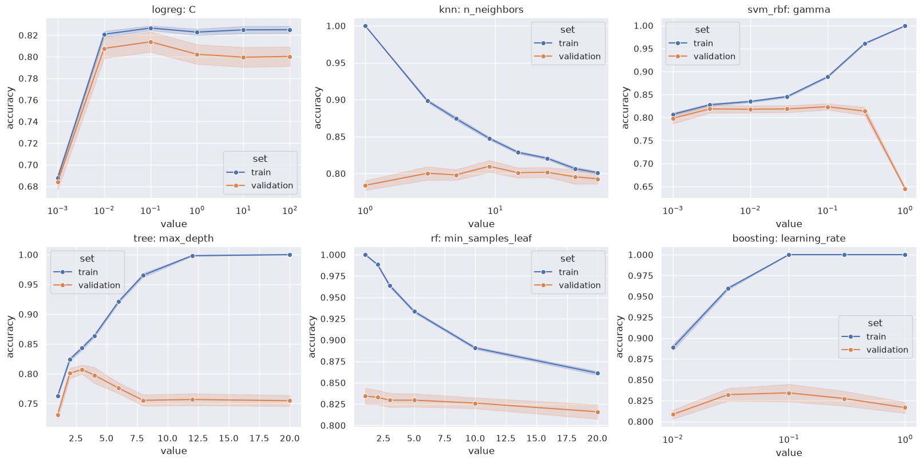
What the grid search chose
One hyperparameter at a time with the rest at defaults, on the screen folds. The linear models want heavy shrinkage (C = 0.01 picked on 13 of 25 splits for logreg and 19 of 25 for the linear svm). knn's validation line is flat from k = 5 to 50 while the training line collapses. The rbf gamma is flat and then falls off a cliff at 1 (every song its own island). Trees want to be shallow alone (depth 2) and deep when averaged (rf: leaf 1, a quarter of the features per split).
Notes:
Validation curves on the screen folds, one knob at a time with the rest at defaults. Modal picks over the 25 splits: logreg C=0.01 (13/25), svm_linear C=0.01 (19/25), svm_rbf C=1 gamma=0.1 (8/25), knn k=11 distance, tree depth 2, bagging leaf 3 (9/25), rf max_features 0.25 leaf 1 (10/25), xgboost lr 0.03 depth 3.

Slide 17
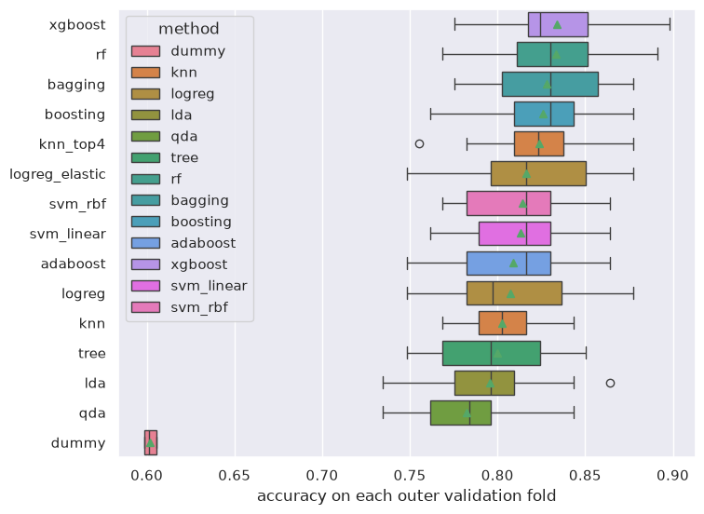
Every method on the same 25 splits
One box per variant: its 25 validation accuracies, best mean on top
Every real method is 18 to 23 points above the dummy
From xgboost down to logreg the boxes overlap. Most of that spread is which songs landed in which fold, and every method shares that
Which is why the comparison has to be paired (next two slides)
Notes:
Read the boxes, not the means: from xgboost down to logreg they overlap. The spread is mostly which songs landed in which fold, which every method shares, and the paired test removes that part.

Slide 18
Results, 5 repeats
variant | accuracy ± corrected error | balanced accuracy | ROC AUC | tuned
xgboost | 0.834 ± 0.016 | 0.824 | 0.905 | 3
rf_numeric | 0.833 ± 0.018 | 0.825 | 0.912 | 2
rf | 0.833 ± 0.018 | 0.825 | 0.911 | 2
bagging | 0.828 ± 0.017 | 0.819 | 0.905 | 1
boosting | 0.826 ± 0.015 | 0.814 | 0.902 | 3
svm_rbf_top4 | 0.824 ± 0.016 | 0.808 | 0.878 | 2
knn_top4 | 0.824 ± 0.015 | 0.805 | 0.880 | 2
svm_rbf_numeric | 0.821 ± 0.016 | 0.804 | 0.881 | 2
logreg_elastic | 0.817 ± 0.018 | 0.805 | 0.888 | 1
svm_rbf | 0.814 ± 0.016 | 0.801 | 0.887 | 2
svm_linear | 0.813 ± 0.017 | 0.800 | 0.888 | 1
adaboost | 0.809 ± 0.017 | 0.796 | 0.890 | 2
logreg | 0.807 ± 0.019 | 0.794 | 0.887 | 1
knn | 0.802 ± 0.012 | 0.776 | 0.883 | 2
tree | 0.800 ± 0.017 | 0.786 | 0.845 | 2
lda | 0.795 ± 0.016 | 0.782 | 0.879 | 0
qda | 0.783 ± 0.017 | 0.788 | 0.879 | 1
Mean over the 25 outer splits ± Nadeau-Bengio corrected standard error. Bold: what the rule picks. Blue: what was handed in. dummy (always "like"): 0.602.
Notes:
Rubric (3). Mean over the 25 outer splits, corrected standard error. Balanced accuracy and ROC AUC are there to read, not to decide on. Dummy: 0.602.

Slide 19
Paired against the best, and the rule applied
variant | gap to xgboost | corrected error | within 1 error | within 2 errors
rf_numeric | −0.001 | 0.007 | yes | yes
rf | −0.001 | 0.007 | yes | yes
bagging | −0.006 | 0.008 | yes | yes
boosting | −0.008 | 0.009 | yes | yes
svm_rbf_top4 | −0.010 | 0.013 | yes | yes
knn_top4 | −0.010 | 0.016 | yes | yes
svm_rbf_numeric | −0.013 | 0.013 | no | yes
logreg_elastic | −0.017 | 0.011 | no | yes
svm_rbf | −0.020 | 0.011 | no | yes
svm_linear | −0.021 | 0.010 | no | no
logreg | −0.027 | 0.012 | no | no
lda | −0.039 | 0.011 | no | no
The rule (one error, fewest tuned hyperparameters) picks bagging: seven candidates, bagging tunes one hyperparameter. At two errors logreg_elastic joins and the rule would pick it instead. Best mean alone would pick xgboost.
Notes:
Per split difference to xgboost, corrected error on the differences. Seven candidates inside one error; bagging tunes one hyperparameter, the others two or three. Two errors would let logreg_elastic in, and the rule would take it (one tuned, and a line comes first in the order).

Slide 20
Why I handed in rf_numeric and not bagging
Under the rule: bagging. That string is submission_best_choice.txt
The leaderboard counts accuracy only, so for the competition I took the highest expected score among the methods the data cannot tell apart, and gambled
rf_numeric is the forest without key, mode and time_signature. Same mean as the full forest (gap +0.000 ± 0.007 on the screen, 0.833 for both at 5 repeats) and the best balanced accuracy and ROC AUC of all the course methods (0.825, 0.912)
Dropping the three categorical columns costs nothing the data can detect, and every diagnostic rates them at zero (slide 22)
Not xgboost: outside the course list, and not better than the forest by anything measurable
The two strings differ on 10 of the 200 test songs
Notes:
Say it as an override. Under the rule: bagging. For the competition: the forest without the three columns no model uses. Both strings are in the zip. If asked why not xgboost: not a course method, and not better than the forest by anything measurable.

Slide 21
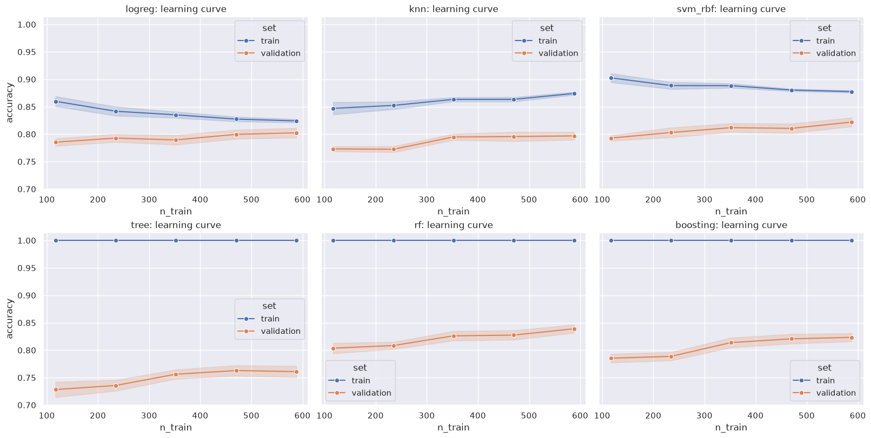
Learning curves
Bias on the left, variance on the right. Train and validation accuracy against training set size, defaults, screen folds. tree, rf and boosting train at 1.0 bc at their defaults they fit until the leaves are pure, so read the validation line. logreg: the two lines have met, bias limited, more data will not help. tree: the biggest gap, variance limited, 0.76. rf: the same memorised training set, validation at 0.84 and still climbing at 590 songs. Averaging bought eight points from the same kind of tree.
Notes:
The bias-variance motivation for the ensembles in one picture. Training accuracy 1.0 is not a bug: at their defaults tree, rf and boosting grow until the leaves are pure.

Slide 22
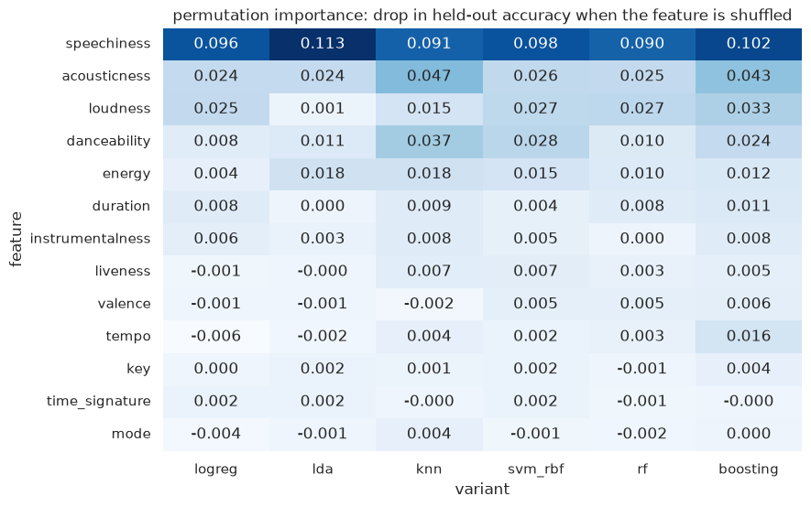
What every method leans on
Permutation importance: the drop in held-out accuracy when one feature is shuffled, per method
speechiness is the one feature every method leans on (0.09 to 0.11), then acousticness and loudness
key, mode and time_signature are zero for every method. This is the evidence for dropping them in rf_numeric
knn and boosting also use danceability a bit. Nobody uses tempo, valence or liveness
Notes:
Permutation importance on held-out folds: shuffle one column, see how much accuracy drops. The bottom three rows are the evidence for rf_numeric.

Slide 23
What the variants taught
Feature choice: knn on the four strong features +0.022 ± 0.013, the 18 one-hot axes drown the distance. The rbf svm on the four: +0.020, on the numerical ones only: +0.019
Regularisation: L1 and elastic net logreg +0.018 / +0.019 over L2. Pairwise products alone +0.005, with L1 on them +0.017, so the products need the penalty
Scaling: robust scaling costs knn and the rbf svm four points (−0.039, −0.041), the IQR of the spiky columns is tiny so the tails explode. log1p on the spiky four helps logreg +0.015. Trees: tree_noscale equals tree split for split
Ensembles: no variant of rf or xgboost helped (−0.001 to −0.010), they were already fine
Screen numbers (2 repeats), gap to the method's own base on the same splits ± corrected error.
Notes:
Screen numbers, 2 repeats, gap to the method's own base on the same splits. These are the regularisation, scaling and feature engineering motivations, each with a number.

Slide 24
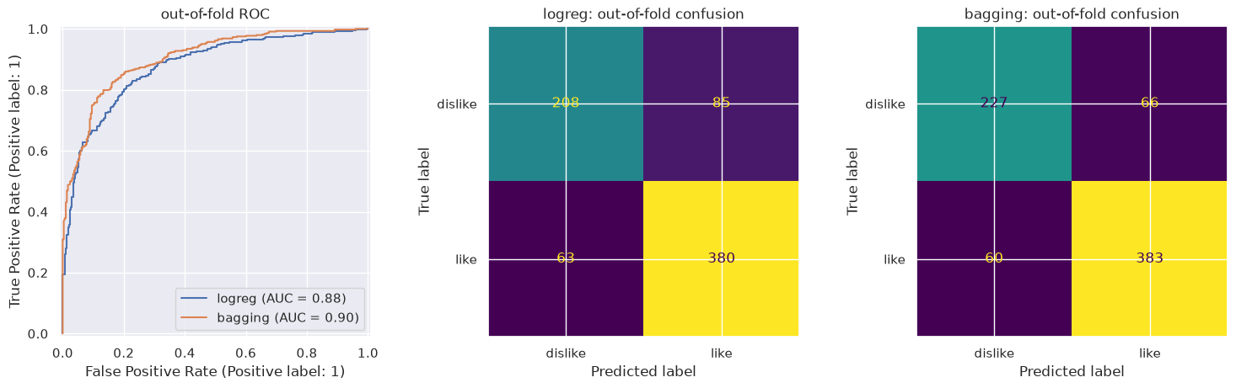
The production model
rf_numeric refit on all 736 songs with the same grid search (300 trees, a quarter of the features per split, min leaf 1). 128 of the 200 test songs predicted as liked
Out-of-fold ROC and confusion, logreg against bagging (rf_numeric is within a hair of bagging): the ensemble's gain over the line is mostly on the disliked songs, 227 right against 208
What to expect on the 200 songs: 0.80 to 0.86
Notes:
Refit once on all 736 songs with the same grid search. The honest range: 0.833 ± 0.018 cross-validated, and 200 test songs is a small set, so 0.80 to 0.86.

Slide 25
Conclusions
Four tree ensembles tie at 0.83 and nothing beats them. By the rule the simplest of them, bagging, wins. For the competition, the forest on the numerical features
The data has one strong axis (loud and energetic against quiet and acoustic) plus speechiness. A heavily regularised line already gets 0.81, pairs and trees buy the last two points
Scaling only matters where distances or penalties are, and the wrong scaler costs four points. The three categorical columns carry nothing
Pairing the splits and correcting the standard error is what made "equally good" a statement instead of a feeling
AI (Claude) was used to understand how professional ML projects structure the explore, protocol and compare steps, for help with some of the plotting code, and for the paired comparison logic (corrected standard error, decision rule). The exploration, the modelling notebook, the variant choices, the runs and the conclusions are my own.
Notes:
Rubric (4). Then the disclosure, said plainly. Zip: both notebooks executed, modelling_results.csv, figures/, both submission strings, a short README.

