Slide 1
Predicting which songs Andreas likes
FRTN65 Lab 1, Andreas Olsson, October 2026
Notes:
One sentence version: four tree ensembles tie at 0.83, the rule I wrote first picks bagging as the simplest of them, I handed in the forest on the numerical features for the competition.

Slide 2
In short
Data: 736 songs after dropping 14 duplicates, 13 features (10 numerical, 3 categorical), 60% liked
Modelling: 12 methods tried in 51 variants, all through one evaluation protocol
Result: four tree ensembles (xgboost, random forest, bagging, boosting) are indistinguishable on this data, around 0.83 accuracy
The rule I set up before seeing any numbers picks bagging, the simplest of the equally good ones
Handed in: random forest on the 10 numerical features, 0.833 ± 0.018 cross-validated accuracy. Why not bagging is on slide 13
Notes:
The whole lab in four lines. The override (rf_numeric instead of bagging) is said as an override, slide 13 has the why.

Slide 3
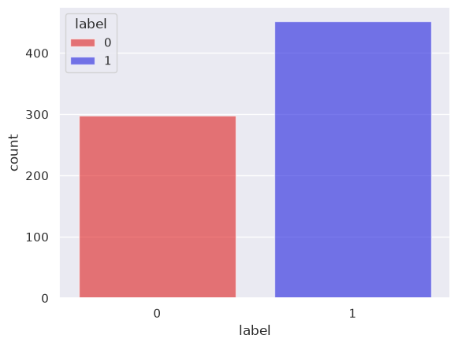
The data
750 rows, 14 exact duplicates dropped, 736 songs left. No missing values
13 Spotify audio features per song
10 numerical: acousticness, danceability, duration, energy, instrumentalness, liveness, loudness, speechiness, tempo, valence
3 categorical: key, mode, time_signature
443 liked, 293 disliked. Always guessing "like" gives 0.60 accuracy, so that is the floor every number is measured from
Class balance in the raw file, 0 = dislike, 1 = like.
Notes:
The duplicates matter: the same song in both the training and the validation part of a split makes the score look better than it is. The 0.60 floor is what every number is measured from.

Slide 4
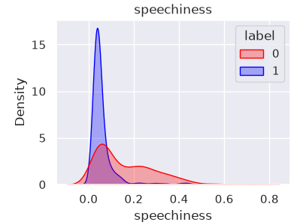
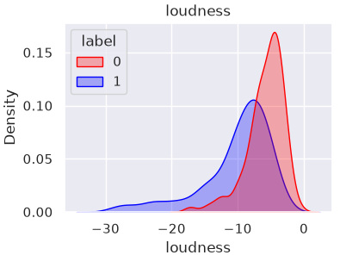
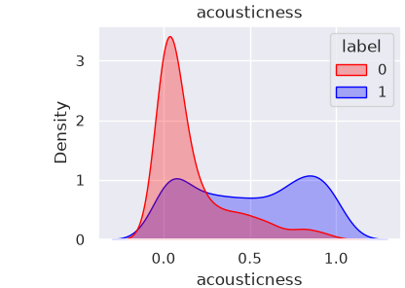
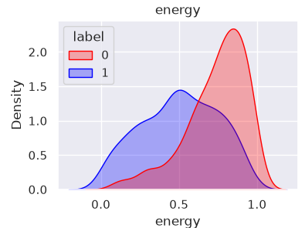
The data, the four features that matter
Liked songs are quiet, acoustic and have almost no speech. Disliked songs are loud, energetic and speechy
The densities are per class, so the 60/40 does not show up as separation here
speechiness: the liked songs are one spike near zero, the disliked ones spread out into a tail. duration, instrumentalness and liveness have the same spike plus tail shape, which is why scaling becomes a question later
Notes:
Densities are normalised per class, so the 60/40 does not read as separation. The spike plus tail shape is why robust, quantile and log scaling became variants later.

Slide 5
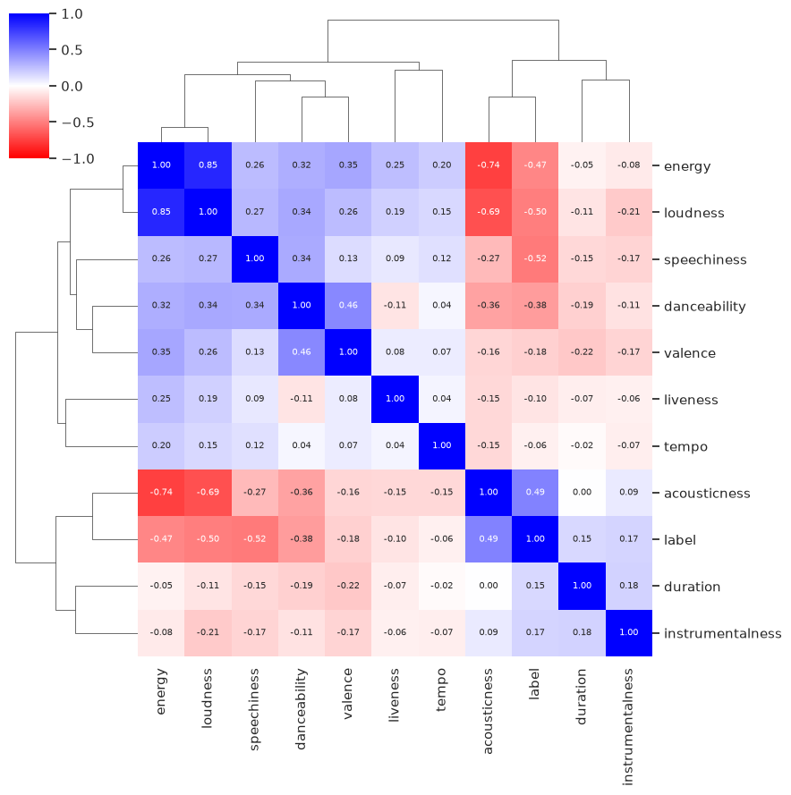
Feature correlations
Spearman (rank) correlation, bc of the tails. Clustered so the blocks show
energy, loudness and acousticness are one block (energy to loudness 0.85, energy to acousticness −0.74): three columns, one direction
speechiness has the strongest single relation to the label (−0.52) and sits outside that block
tempo, liveness, duration, instrumentalness: near zero against everything
Correlation only sees pairwise monotone relations, not interactions, so the next slide asks a decision tree instead
Notes:
Spearman because of the tails: ranks instead of values. Correlation is pairwise and monotone, it cannot see interactions, which is why the tree screen on the next slide exists. Also why a heavily regularised line does well: the main axis is linear and L2 shares the weight over the three correlated columns.

Slide 6
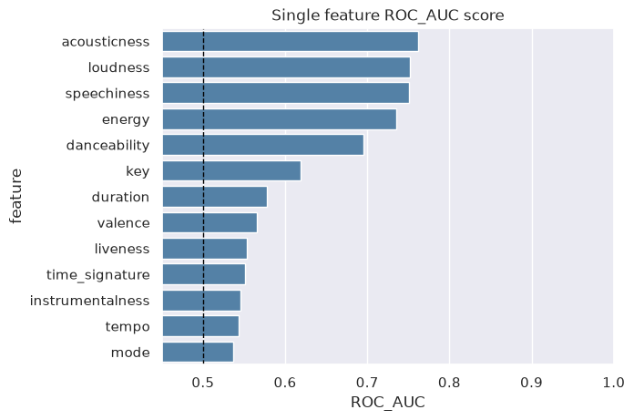
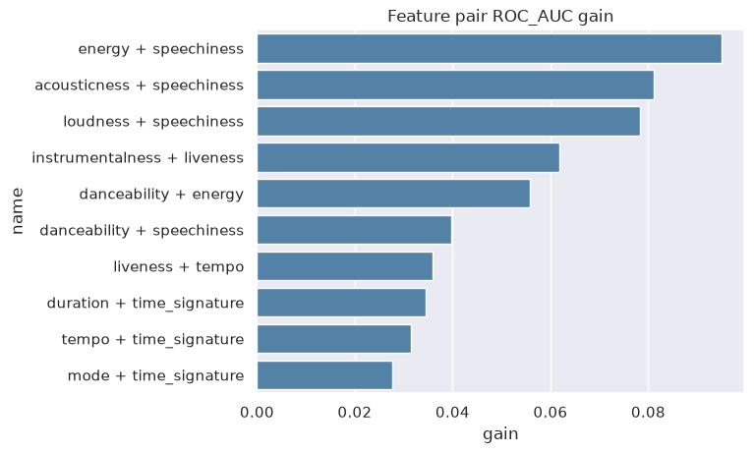
Feature screen with decision trees
A depth-limited decision tree, 5-fold cross validation, ROC AUC, on each feature alone (left) and on each pair (right). Gain = pair minus the better of its two singles. Every single feature is above 0.5, and every big pair gain has speechiness in it.
Notes:
Same depth for singles and pairs. I also ran it with repeated folds and a shuffled copy of each feature as a null: the top gains survive, the null never gets above about +0.02, so the small gains at the bottom of the bar chart are noise.

Slide 7
Preprocessing
All 13 features go in by default: the 10 numerical ones standardised (z-score), the 3 categorical ones one-hot. 28 columns reach the model
Scaling only matters for the methods that measure distances or penalise coefficients (knn, svm, logreg, lda, qda). Trees do not care, so they get the raw columns
Variants on top of that: robust and quantile scaling, log1p on the spiky four, rare levels grouped, categoricals dropped, only the four strong features, pairwise products of the numerical ones
All of it lives inside the sklearn Pipeline, so scaler and encoder are fit on the training part of each fold only, never on the validation part (important)
The test file is read once, at the very end, by the model that was handed in
Notes:
Rubric point (2): which inputs, qualitative or quantitative, what preprocessing. The pipeline is the whole point: nothing is fit on a validation fold, ever.

Slide 8
The methods
method | what it is | tuned by the grid search
dummy | always answers "like", the floor | nothing
logreg | one linear boundary, L2 penalty on the coefficients | C
lda | linear too, gaussian classes with one shared covariance | nothing
qda | a covariance per class, so a quadratic boundary | reg_param
knn | vote among the k closest songs in the scaled space | k, weights
tree | one tree of threshold splits, readable, high variance | max_depth, min leaf
svm_linear | like logreg but hinge loss, maximises the margin | C
svm_rbf | kernel trick, a nonlinear boundary | C, gamma
bagging | 300 trees on bootstrap samples, averaged | min leaf
rf | bagging plus a random feature subset at every split | max_features, min leaf
boosting | shallow trees in sequence, each fixing the last ones' errors | learning rate, depth, iterations
adaboost | boosting with stumps and exponential loss | learning rate, n trees
xgboost | gradient boosting again, outside the course list, a check | learning rate, depth, min child weight
Notes:
Rubric point (1). xgboost is outside the course list, kept as a check on the boosting implementation. Tuned = what the inner grid search picks per split; the count is also what simplicity means later.

Slide 9
The evaluation protocol
Metric: accuracy, bc that is what the leaderboard measures. Balanced accuracy and ROC AUC are reported beside it but never decided on
Splits: 5-fold stratified cross validation, repeated 5 times with one seed, so 25 outer splits. Every method sees exactly the same 25, so every comparison is paired
Tuning: grid search with 5 inner folds inside the outer training part only. The validation fold never sees the search (nested cross validation)
Uncertainty: the 25 splits share most of their songs, so std / √25 is too small. I use the Nadeau-Bengio corrected standard error, std · √(1/25 + n_val / n_train), on the scores and on the paired differences
Notes:
Rubric (2) and (3), the slide the examiner will ask about. Nested loop: for each of 5 outer folds, grid search with 5 inner folds on the outer training part, refit the best, score once on the outer validation fold. Repeated 5 times.

Slide 10
Deciding between equally good methods
Candidates: every variant within one corrected standard error of the best (the error of the paired gap, not of the means)
Among the candidates: the one with the fewest tuned hyperparameters. Ties by an order fixed in advance: a line < a density model < a distance model < one tree < a kernel < an ensemble of trees
Why fewest tuned and not fewest parameters: among methods the data cannot tell apart, I prefer the one whose score had the fewest chances to look good by search. Parameter count measures capacity, and for ensembles it is a bad guide (more trees do not overfit more)
The band (one error) and the rule were written down before any number came out. slide 12 shows what two errors, or best mean alone, would have picked instead
Notes:
Simplicity = fewest tuned hyperparameters, not fewest parameters. Parameter count measures capacity and misleads for ensembles. The order for ties is a stated preference, and here it agrees with the tuned count.

Slide 11
Results, 5 repeats
variant | accuracy ± corrected error | balanced accuracy | ROC AUC | tuned
xgboost | 0.834 ± 0.016 | 0.824 | 0.905 | 3
rf_numeric | 0.833 ± 0.018 | 0.825 | 0.912 | 2
rf | 0.833 ± 0.018 | 0.825 | 0.911 | 2
bagging | 0.828 ± 0.017 | 0.819 | 0.905 | 1
boosting | 0.826 ± 0.015 | 0.814 | 0.902 | 3
svm_rbf_top4 | 0.824 ± 0.016 | 0.808 | 0.878 | 2
knn_top4 | 0.824 ± 0.015 | 0.805 | 0.880 | 2
svm_rbf_numeric | 0.821 ± 0.016 | 0.804 | 0.881 | 2
logreg_elastic | 0.817 ± 0.018 | 0.805 | 0.888 | 1
svm_rbf | 0.814 ± 0.016 | 0.801 | 0.887 | 2
svm_linear | 0.813 ± 0.017 | 0.800 | 0.888 | 1
adaboost | 0.809 ± 0.017 | 0.796 | 0.890 | 2
logreg | 0.807 ± 0.019 | 0.794 | 0.887 | 1
knn | 0.802 ± 0.012 | 0.776 | 0.883 | 2
tree | 0.800 ± 0.017 | 0.786 | 0.845 | 2
lda | 0.795 ± 0.016 | 0.782 | 0.879 | 0
qda | 0.783 ± 0.017 | 0.788 | 0.879 | 1
Mean over the 25 outer splits ± Nadeau-Bengio corrected standard error. Bold: what the rule picks. Blue: what was handed in. dummy (always "like"): 0.602.
Notes:
Rubric (3). Mean over the 25 outer splits, corrected standard error. Balanced accuracy and ROC AUC are there to read, not to decide on. Dummy: 0.602.

Slide 12
Paired against the best, and the rule applied
variant | gap to xgboost | corrected error | within 1 error | within 2 errors
rf_numeric | −0.001 | 0.007 | yes | yes
rf | −0.001 | 0.007 | yes | yes
bagging | −0.006 | 0.008 | yes | yes
boosting | −0.008 | 0.009 | yes | yes
svm_rbf_top4 | −0.010 | 0.013 | yes | yes
knn_top4 | −0.010 | 0.016 | yes | yes
svm_rbf_numeric | −0.013 | 0.013 | no | yes
logreg_elastic | −0.017 | 0.011 | no | yes
svm_rbf | −0.020 | 0.011 | no | yes
svm_linear | −0.021 | 0.010 | no | no
logreg | −0.027 | 0.012 | no | no
lda | −0.039 | 0.011 | no | no
The rule (one error, fewest tuned hyperparameters) picks bagging: seven candidates, bagging tunes one hyperparameter. At two errors logreg_elastic joins and the rule would pick it instead. Best mean alone would pick xgboost.
Notes:
Per split difference to xgboost, corrected error on the differences. Seven candidates inside one error; bagging tunes one hyperparameter, the others two or three. Two errors would let logreg_elastic in, and the rule would take it (one tuned, and a line comes first in the order).

Slide 13
Why I handed in rf_numeric and not bagging
Under the rule: bagging. That string is submission_best_choice.txt
The leaderboard counts accuracy only, so for the competition I took the highest expected score among the methods the data cannot tell apart, and gambled
rf_numeric is the forest without key, mode and time_signature. Same mean as the full forest (gap +0.000 ± 0.007 on the screen, 0.833 for both at 5 repeats) and the best balanced accuracy and ROC AUC of all the course methods (0.825, 0.912)
Dropping the three categorical columns costs nothing the data can detect, and every diagnostic rates them at zero (slide 14)
Not xgboost: outside the course list, and not better than the forest by anything measurable
The two strings differ on 10 of the 200 test songs
Notes:
Say it as an override. Under the rule: bagging. For the competition: the forest without the three columns no model uses. Both strings are in the zip. If asked why not xgboost: not a course method, and not better than the forest by anything measurable.

Slide 14
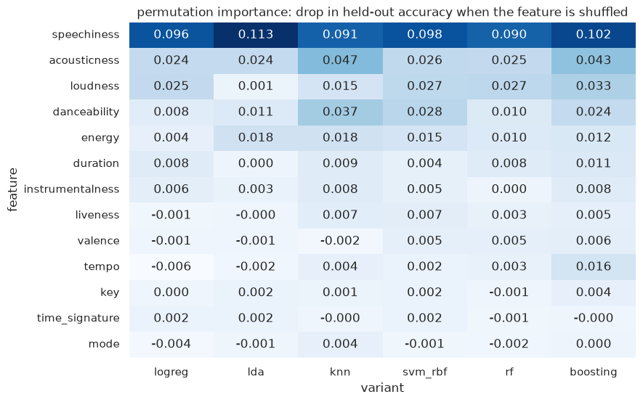
What every method leans on
Permutation importance: the drop in held-out accuracy when one feature is shuffled, per method
speechiness is the one feature every method leans on (0.09 to 0.11), then acousticness and loudness
key, mode and time_signature are zero for every method. This is the evidence for dropping them in rf_numeric
knn and boosting also use danceability a bit. Nobody uses tempo, valence or liveness
Notes:
Permutation importance on held-out folds: shuffle one column, see how much accuracy drops. The bottom three rows are the evidence for rf_numeric.

Slide 15
Conclusions
Four tree ensembles tie at 0.83 and nothing beats them. By the rule the simplest of them, bagging, wins. For the competition, the forest on the numerical features
The data has one strong axis (loud and energetic against quiet and acoustic) plus speechiness. A heavily regularised line already gets 0.81, pairs and trees buy the last two points
Scaling only matters where distances or penalties are, and the wrong scaler costs four points. The three categorical columns carry nothing
Pairing the splits and correcting the standard error is what made "equally good" a statement instead of a feeling
AI (Claude) was used to understand how professional ML projects structure the explore, protocol and compare steps, for help with some of the plotting code, and for the paired comparison logic (corrected standard error, decision rule). The exploration, the modelling notebook, the variant choices, the runs and the conclusions are my own.
Notes:
Rubric (4). Then the disclosure, said plainly. Zip: both notebooks executed, modelling_results.csv, figures/, both submission strings, a short README.

