Slide 1



Processing large-scale data efficiently:
An introduction to the R package ‘data.table’.
Research Data Scotland
Bayes Centre
University of Edinburgh
15th August 2024
Andreas Hoehn
University of Glasgow
andreas.hoehn@glasgow.ac.uk
AndreasXHoehn
0000-0002-7170-1205

Slide 2
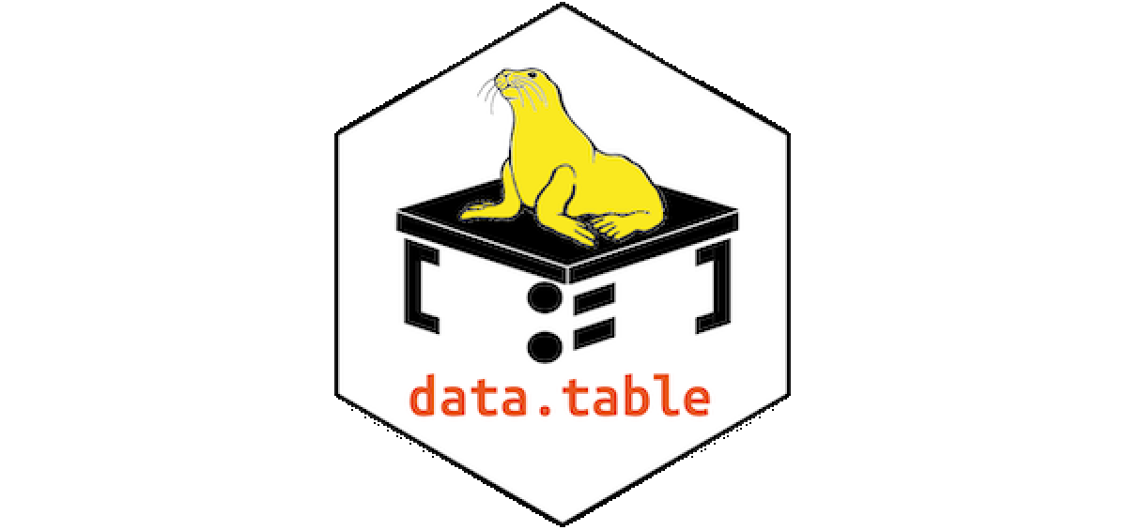
Outline
Introducing ‘data.table’
Hands-on Session
Q&A
Source: https://rdatatable.gitlab.io/data.table/

Slide 3
Introducing ‘data.table’
What will be faster: A Ferrari or a Honda?

Slide 4
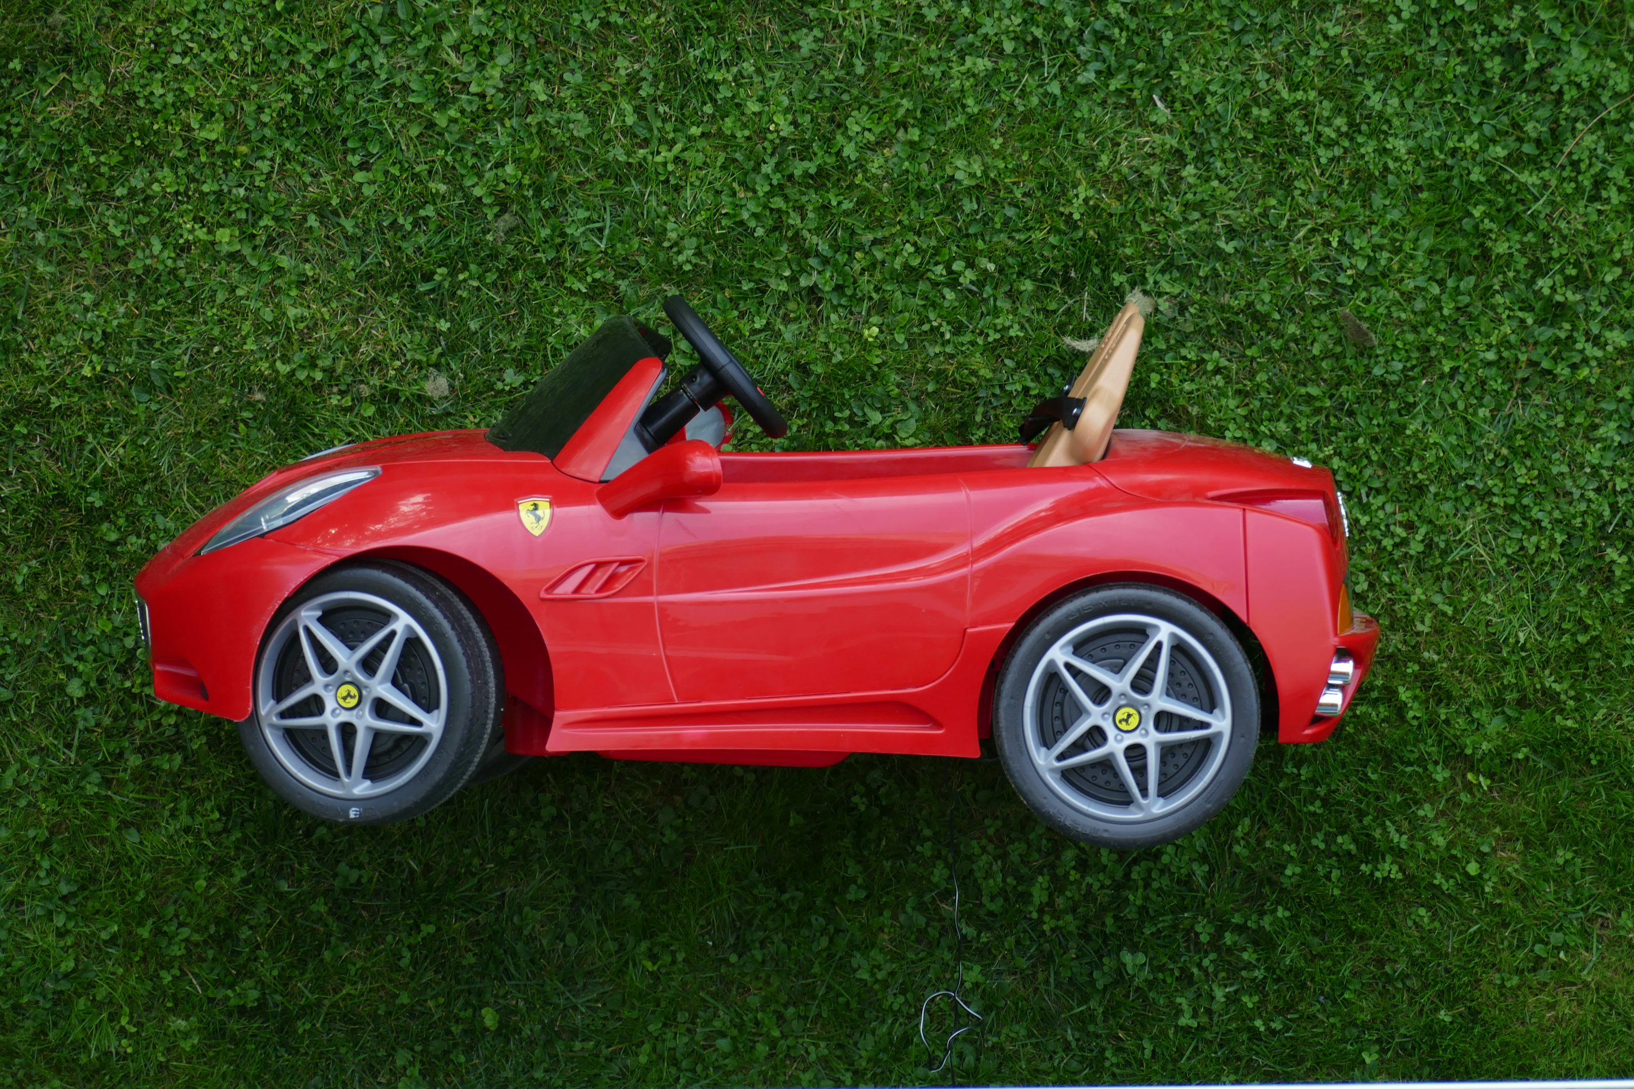

Introducing ‘data.table’
What will be faster: A Ferrari or a Honda?
vs.
Photo by Stefano Probst on Unsplash
Photo by Brad armore on Unsplash

Slide 5
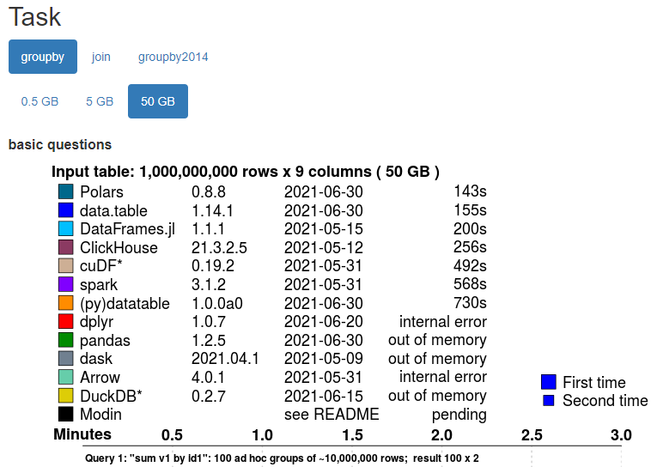
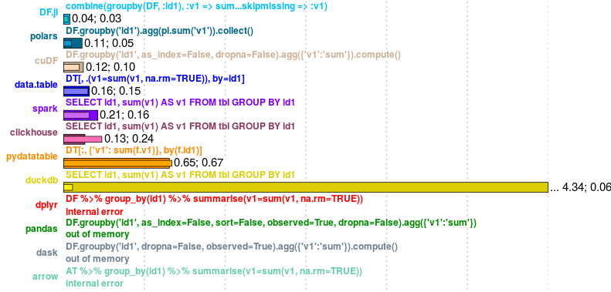
Introducing ‘data.table’
Apple-to-apple comparisons are required!
Source: https://h2oai.github.io/db-benchmark/

Slide 6
Introducing ‘data.table’
Scene Setting
1) Routinely collected data has always been large - and will only get larger (e.g. high-dimensional smart data, real-time data, omics data, CTGAN synthetic data)
2) Memory (RAM) and processing capacity (CPU) have remained limited resources
While R is a fantastic programming language, “standard” R (e.g. through base or tidyverse) is not an efficient/safe/futureproof/portable/updateable/….. way of working
Even worse! The limitations of “standard” R will fuel the problems that come from 1) and 2)

Slide 7
Introducing ‘data.table’
“Standard” R’s limitations
1) By default, R uses 1 core – but many more are available on most machines (→ CPU + time)
2) By default, R has a “copy-on-modify behaviour” (→ RAM + time)
3) Dependencies, portability, backward compatibility: Updates vs. old code (→ lots of time ….)
4) R Code can get long, especially when using long chains of pipes (→ even more time …)

Slide 8
Introducing ‘data.table’
“Standard” R’s limitations vs. data.table
1) By default, R uses 1 core – but many more are available on most machines (→ CPU + time)
data.table parallelises whenever this is easily done, running compiled C/C++ underneath
2) By default, R has a “copy-on-modify behaviour” (→ RAM + time)
data.table modifies on reference ( “ := “ ) and uses pointers, requiring less working RAM
3) Dependencies, portability, backward compatibility: Updates vs. old code (→ lots of time ….)
data.table has no dependencies other than R >= Version 3.1 (10+ years old)
4) R Code can get long, especially when using long chains of pipes (→ even more time …)
data.table has short and expressive code, similar to high-level programming languages

Slide 9
Introducing ‘data.table’
What is data.table?
1) A selection of functions, optimised to work efficiently with large amounts of data (e.g., fread, fwrite, or for reshaping long-wide / wide-long )
2) A separate dialect for R, with some degree of similarity to SQL or C/C++ code
3) A unique chance to learn about R and computing, with the aim of improving processes and futureproofing our work
Source: https://rdatatable.gitlab.io/data.table/

Slide 10
Introducing ‘data.table’
Standard ‘data.table’ notation
Standard format 1: data[ i , j ] → basic format when not operating on groups
Standard format 2: data[ i , j , by] → when operating by group
“data” is our dataset
“i” subset of “data” based on row information (“subset on observations/rows”)
“j” states what to execute for the columns (“execute on variables/columns”)
“by” defines whether “i” and “j” should be done by groups

Slide 11
Introducing ‘data.table’
How to read data.table?
data[sex == “Male”, ] → subset where sex is “Male”, nothing to execute
data[, V2 := V1+1] → nothing to subset, create a new variable “V2” which is “V1+1”
data[sex == “Male”, V2 := V1+1] → subset where sex is “Male”, then create V2…
data[sex == “Male”, .(V2 = max(V1))] → subset where sex is “Male”, then return a new variable
data[, .(V2 = max(V1)), by = c(“sex”)] → no subset, return new variable by group (“sex” variable)

Slide 12
Introducing ‘data.table’
Any guesses?
Situation: A three-variable dataset (ID, age, income) reflecting yearly income data (repeated obs.)
data2 <- data[age >= 16, .(income_median = median(income)), by = c(“ID”)]

Slide 13
Introducing ‘data.table’
Any guesses?
Situation: A three-variable dataset (ID, age, income) reflecting yearly income data (repeated obs.)
data2 <- data[age >= 16, .(income_median = median(income)), by = c(“ID”)]
… assign to a new object data2 something that comes out of data, new data will have 1 row per ID
… subset is what comes before the comma: select those aged 16 or older
… the new variable “income_median” is the median income of all recorded incomes of the subset
… which was established separately for all “IDs” (e.g., there are multiple income records per “ID”)

Slide 14
Hands-on Session
All course materials are available on GitHub!
No account required, a .zip bundle can be downloaded
Repository: 2024_RDS_DT
https://github.com/AndreasxHoehn/2024_RDS_DT

Slide 15
Hands-on Session
Objectives: Big Picture + Transferable Skills + Strong Foundation
1) Benchmarking time: ‘microbenchmark::microbenchmark()’
2) Benchmarking memory: ‘object.size()’ and variable types
3) Tracing the location of objects within ‘tracemem()’
4) Introduction to ‘data.table’ - basic functions, subsets, creating new variables, group by operations, reshaping data “wide to long” & “long to wide”

Slide 16
Further Resources
data.table on cran: https://cran.r-project.org/web/packages/data.table/
Benchmarking data.table operations: https://tysonbarrett.com//jekyll/update/2019/10/06/datatable_memory/
Benchmarking joins: https://tysonbarrett.com/jekyll/update/2019/10/11/speed_of_joins/
A good basic data.table intro: https://atrebas.github.io/post/2020-06-17-datatable-introduction/
The official data.table FAQ: https://cran.r-project.org/web/packages/data.table/vignettes/datatable-faq.html

Slide 17
Q&A
Questions – Comments – Feedback?

Slide 18
THANK YOU FOR LISTENING
Find out more
Website: www.sipher.ac.uk
Email: sipher@Glasgow.ac.uk
Twitter: @SipherC

