Slide 1
Montecarlo Simulations
for CI Actual Coverage
Wald & Wilson
Autori:
Innocenti Andrea 7201956
Zanni Niccolò 7205639

Slide 2


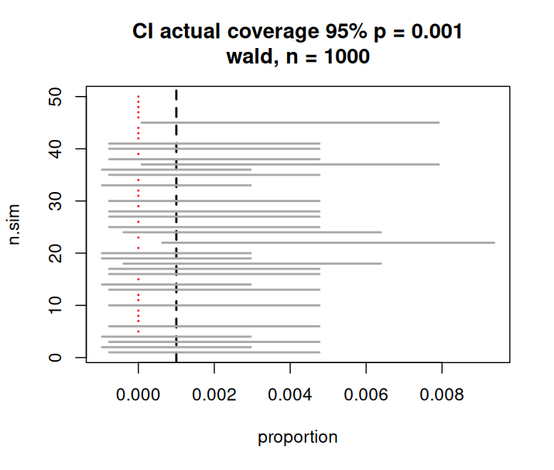
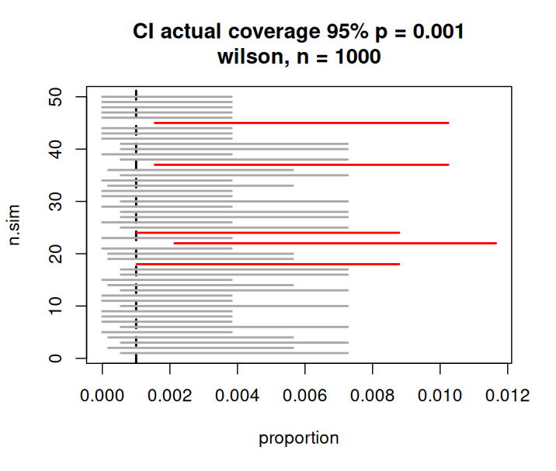
CI segment plots
Wald CI:
Wilson CI:
Wald CIs fail for very small values of p
Wilson CIs always falls in [0,1]

Slide 3
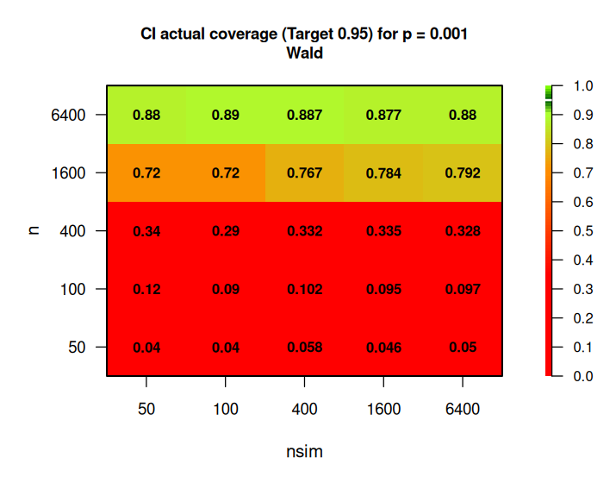
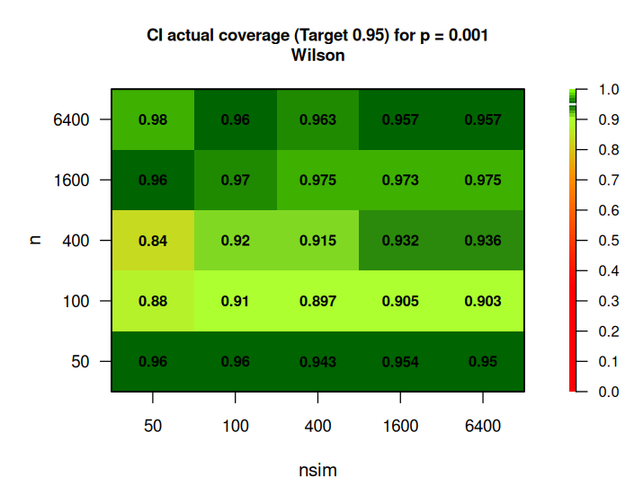
Heatmap Plot
CI heatmap for wald. The best results are
obtained with a big number of samplings.
Wilson test manages to obtain better actual
coverage with small values of p and n.
1 Data Exploration

Slide 4
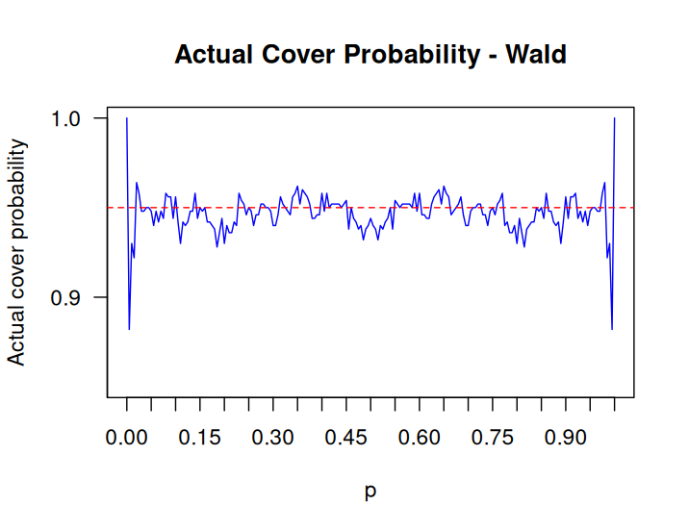
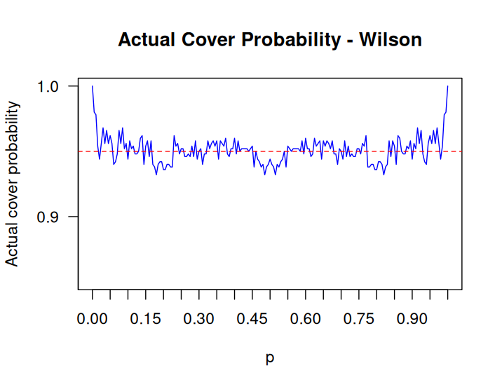
Actual Coverage Plot
Wald actual cover for varying p n = 1000, n_sim = 500.
Wilson actual cover for varying p n = 1000, n_sim = 500.
Wald has a worst actual cover probability for values
of p closed to the edge compared to Wilson.
For values of p far from the edges Wilson and
Wald obtain the same actual cover probability.

Slide 5
Conclusions
Overall Wilson performs better than Wald, especially for values of p near the edges of the domain.
References:
Alessandra, Mattei (2025). Slides05_HyphotesisTests [Slide di PowerPoint].
Alessandra, Mattei (2025). Slides06_CI [Slide di PowerPoint].
Anna, Gottard (2026). slides01_FSL [Slide di PowerPoint].
Anna, Gottard (2026). Lab01 [File Html].
Claude: https://claude.com
Gemini: https://gemini.google.com

