Slide 1

Diagnostic Prediction:
Let’s make age just a number
. . .
Final Project Data Science Bootcamp 03.08.2023

Slide 2
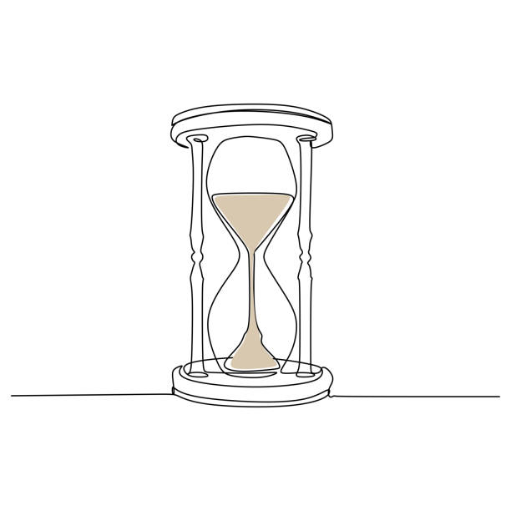
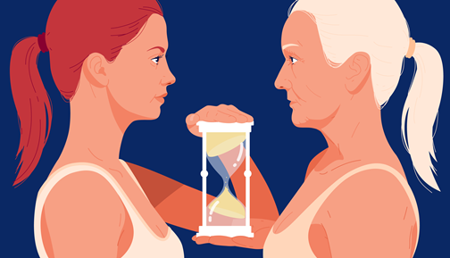
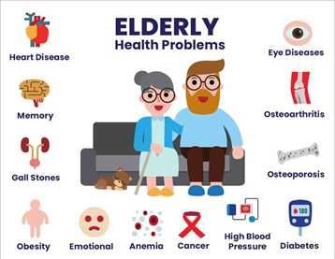
Aging
Physical and mental capacity
Risk of disease
There are common health conditions associated with ageing.
The diversity seen in older age is not random.
https://www.who.int/news-room/fact-sheets/detail/ageing-and-health
Notes:
At the biological level, ageing results from the impact of the accumulation of a wide variety of molecular and cellular damage over time. This leads to a gradual decrease in physical and mental capacity, a growing risk of disease and ultimately death. These changes are neither linear nor consistent, and they are only loosely associated with a person’s age in years. The diversity seen in older age is not random. Beyond biological changes, ageing is often associated with other life transitions such as retirement, relocation to more appropriate housing and the death of friends and part
Common health conditions associated with ageing
Common conditions in older age include hearing loss, cataracts and refractive errors, back and neck pain and osteoarthritis, chronic obstructive pulmonary disease, diabetes, depression and dementia. As people age, they are more likely to experience several conditions at the same time.
Older age is also characterized by the emergence of several complex health states commonly called geriatric syndromes. They are often the consequence of multiple underlying factors and include frailty, urinary incontinence, falls, delirium and pressure ulcers.
ners.

Slide 3
Data science as method to predict aging-related diseases
Research using data science focused on:
slow down
reverse
prevent major age-related diseases
improve healthcare outcomes
Wassan, J.T. et al, Role of Deep Learning in Predicting Aging-Related Diseases: A Scoping Review. Cells 2021, 10, 2924.

Slide 4


Kaggle competition
Goal: predict if a person has any of three medical conditions based on health characteristics.
Dataset:
Id Unique identifier for each observation.
AB-GL: 56 anonymized health characteristics.
Class: - 1 subject has been diagnosed with one of the three conditions
- 0 no medical conditions
https://www.kaggle.com/competitions/icr-identify-age-related-conditions/overview

Slide 5


Prediction
Machine Learning Algorithms
DATASET

Slide 6
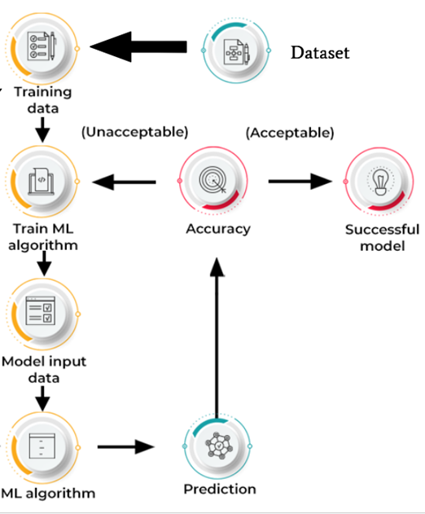

Machine Learning
Try new features
Try new ML model

Slide 7
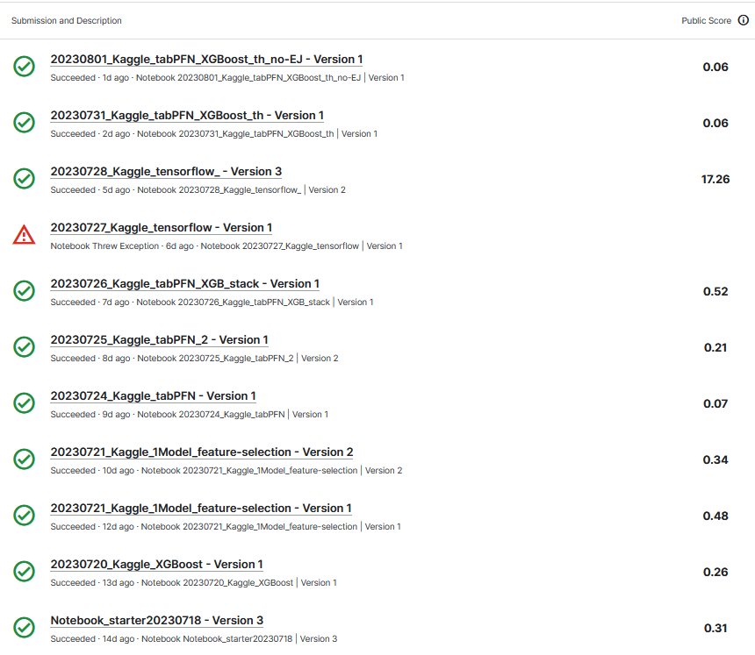
Results: Kaggle submissions
Code Competition:
- Log loss lower as possible
- Score = 0.00 was achieved
- 58% of test set is hidden
- Final standings may be different
Present Results:
- Best score = 0.06
- Place ~1200 out of 6300 teams
- 8 days to go

Slide 8

Amazing time!
Thank you!
😊DATA 17 Team
😊Henrik
😊Vasil
😊WBS Community

Slide 9
Extra slides

Slide 10
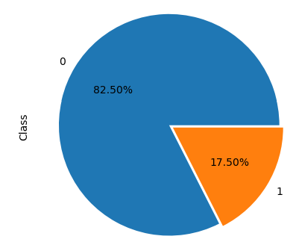
Dataset is heavily imbalanced
Total: 617

Slide 11
Best ML model
Best_Result_tabPFN-XGBoost-stack_score=0.06
Random undersampling for the balance the "Class" distribution (train dataframe).
Two cross-validation strategies using K-Fold in order to get a more reliable estimate of the model's performance on unseen data and avoid overfitting.
Ensemble model that combines the predictions of two classifiers: XGBClassifier from XGBoost and TabPFNClassifier from the TabNet framework.
Training function was performed by training and evaluation of a given model using nested cross-validation.
Random oversampling with respect to the greeks dataframe.
Final training on the balanced dataset that assess the model's performance and returns the best trained model.
Best trained model was used to make predictions on test data.

Slide 12
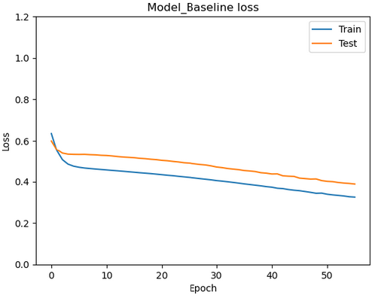
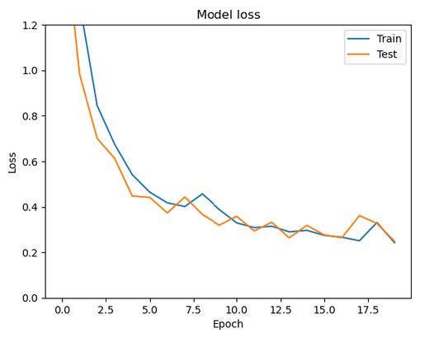
Dive into Neural Network - not really beneficial
score: 17.26
Sequential with 2 layers, 1000 neurons/layer, epochs = 56
Train accuracy: 86%
Test accuracy: 79%
Sequential with 3 layers, 1000 neurons/layer, epochs = 20, regularizer, dropout
Train accuracy: 96%, loss: 0.2153
Test accuracy: 85%, loss: 0.3008

