Slide 1


Knowledge Mining in Scientific Articles
Student: Andreea-Ioana Dan
Supervisor 1: Dimka Karastoyanova
Supervisor 2: Mirela Riveni
External Supervisor: Dennis Mulder

Slide 2
Table of contents
Introduction
Methods
Results
Discussion
Conclusion

Slide 3
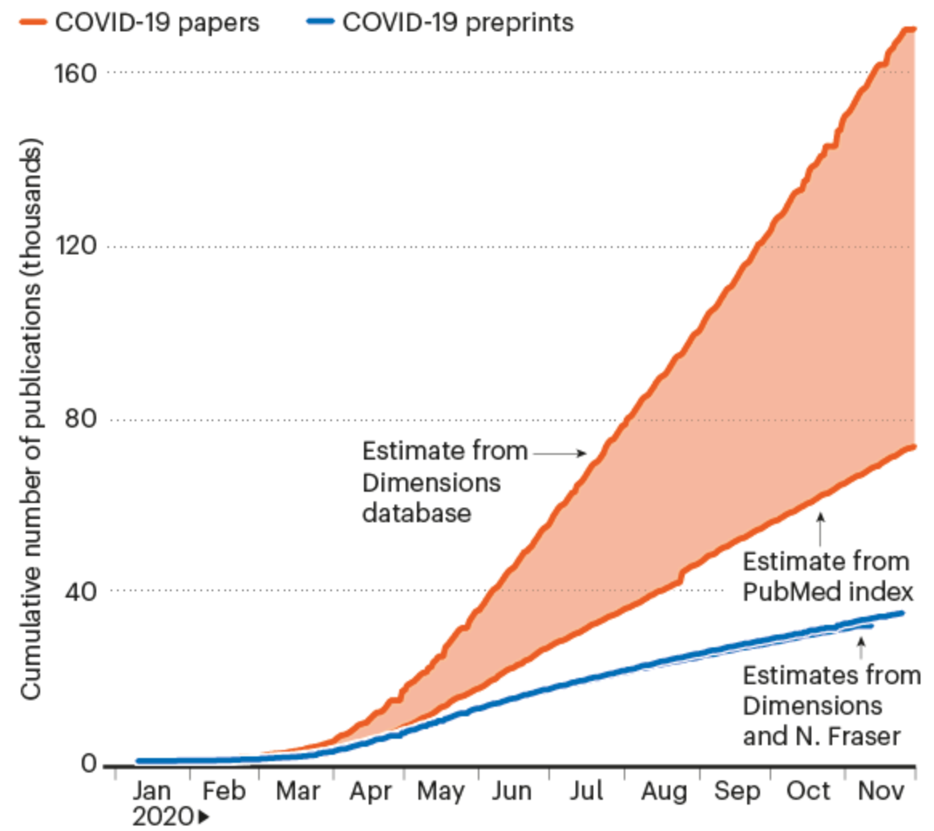
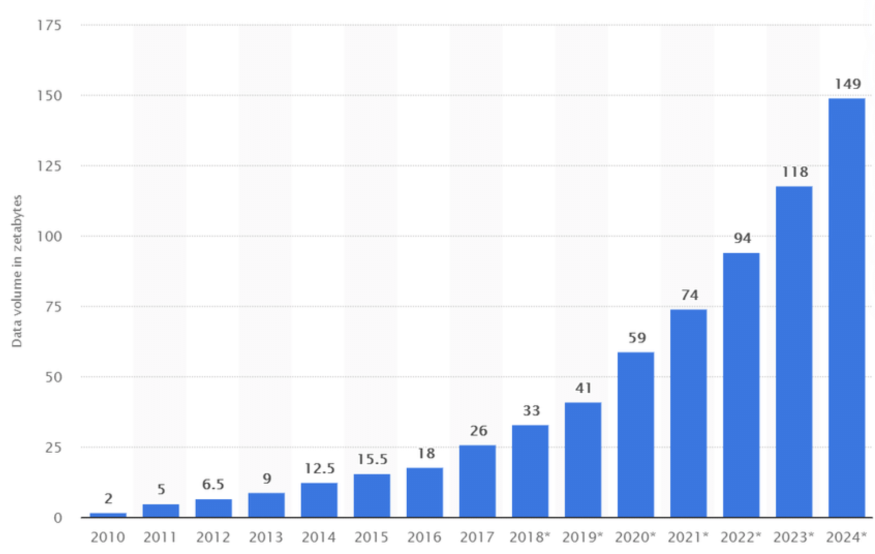
1. Introduction
Fraser, Nicholas; Kramer, Bianca (2020): covid19_preprints. figshare. Software. https://doi.org/10.6084/m9.figshare.12033672.v58
Berisha, Blend & Mëziu, Endrit. (2021). Big Data Analytics in Cloud Computing: An overview. 10.13140/RG.2.2.26606.95048.

Slide 4
Research questions
How can a scientific article in the field of healthcare/health/medicine research be summarized in a structured database schema?
Can we design a program that is able to extract unstructured data and transform it into a persistent structured data source?
What are the applications of such a program?
What are the limitations of such a program?

Slide 5
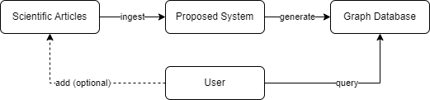
Proposal
Project scope

Slide 6
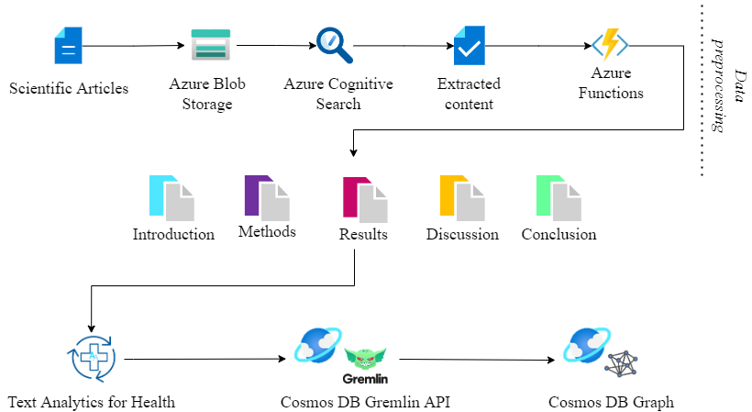
System architecture
2. Methods

Slide 7



Main technologies

Slide 8
Article Selection

Slide 9


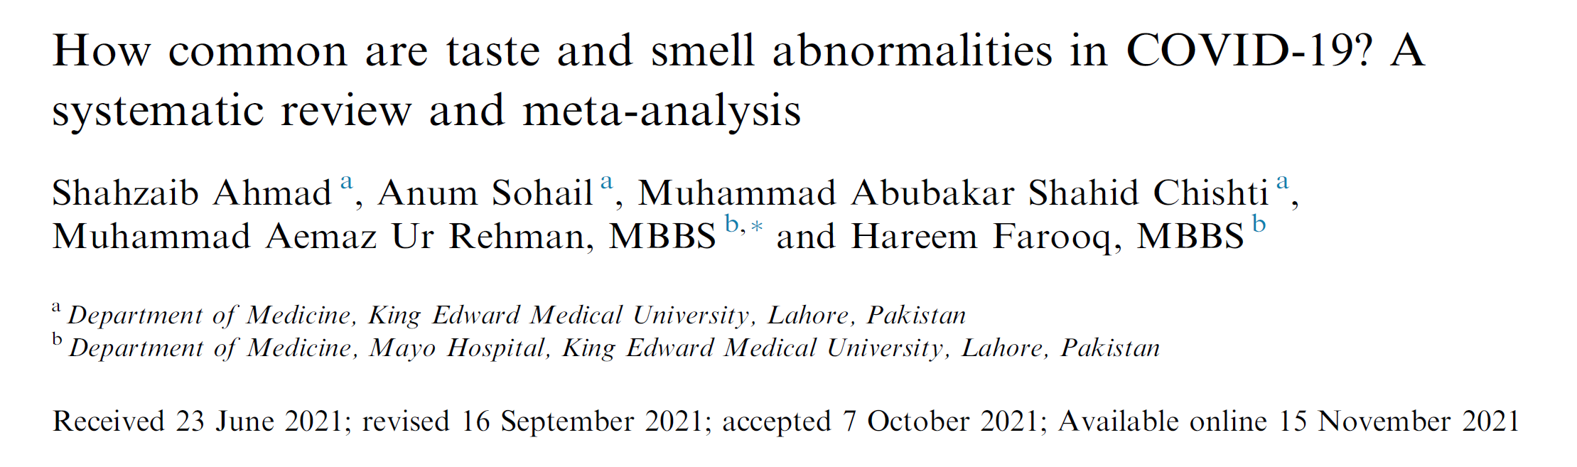



Slide 10
Article Storage

Slide 11

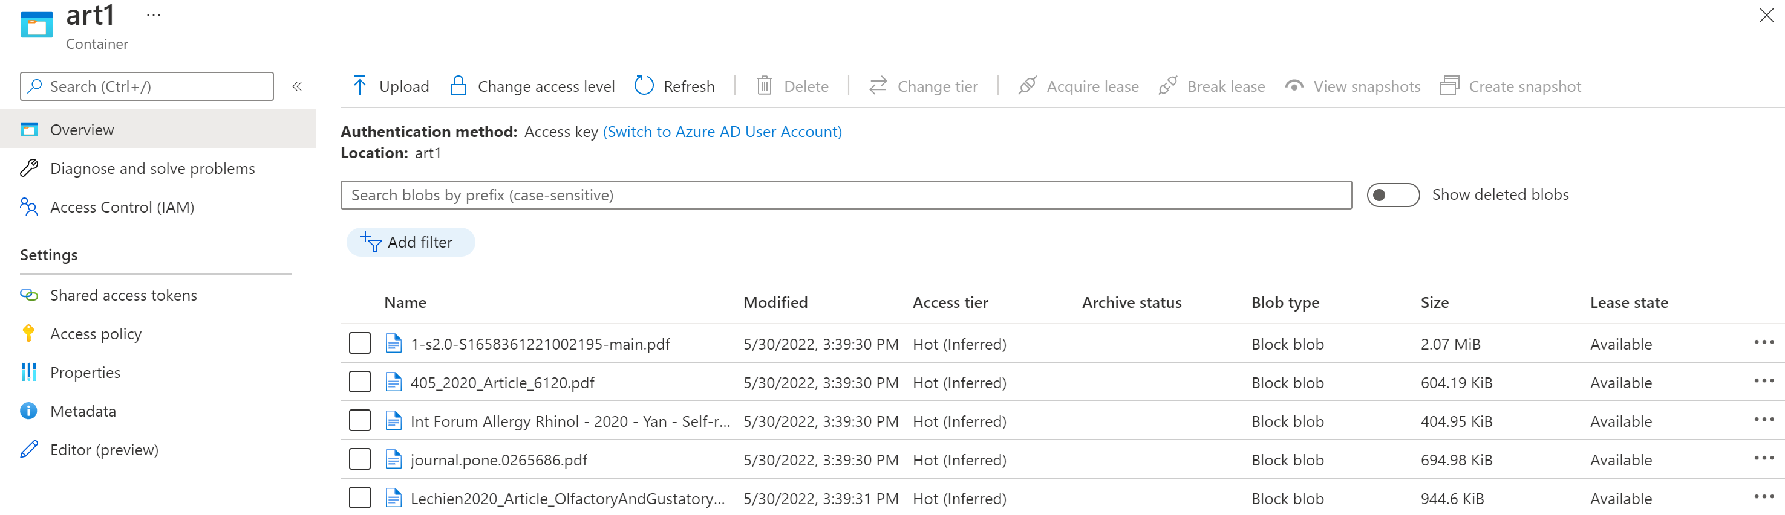
Blob Storage

Slide 12
Content Extraction

Slide 13
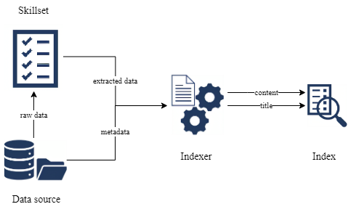

Cognitive Search

Slide 14
Section Identification

Slide 15

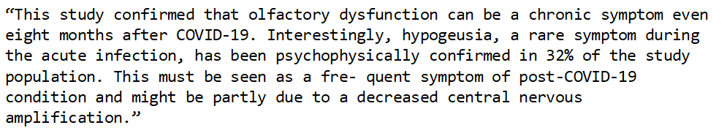
Azure functions

Slide 16
Medical entity and relationship recognition

Slide 17

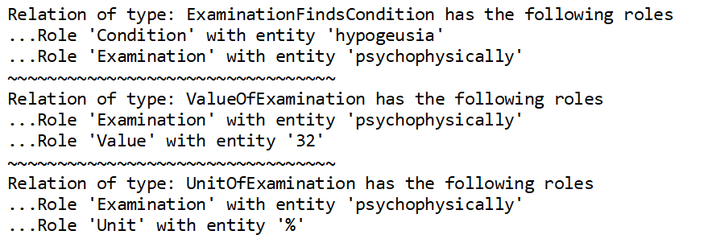
Text Analytics for Health

Slide 18
Graph creation and population

Slide 19
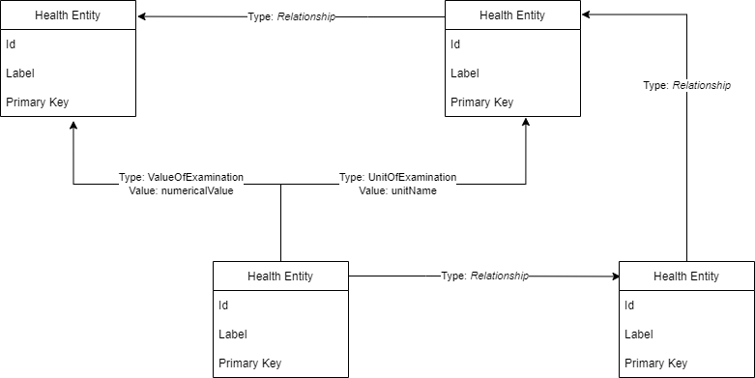


Cosmos DB Gremlin API for graphs
def powershell_create_graphs(graph_count, path):
for index in range(graph_count):
graph_name = "art_" + str(index)
# run powershell script
subprocess.Popen(['powershell.exe', '-ExecutionPolicy', 'Unrestricted', '-File’, path + '\\create_container.ps1','-graphName' , graph_name])
$database = Get-AzCosmosDBGremlinDatabase -ResourceGroupName $resourceGroupName -AccountName $accountName -Name $databaseName
Write-Host "Creating graph $graphName"
New-AzCosmosDBGremlinGraph -ParentObject $database `
-Name $graphName -Throughput $graphRUs `
-PartitionKeyKind Hash -PartitionKeyPath $partitionKeys

Slide 20
3. Results
Architecture of the data processing pipeline

Slide 21
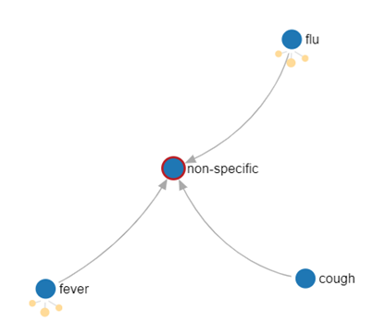
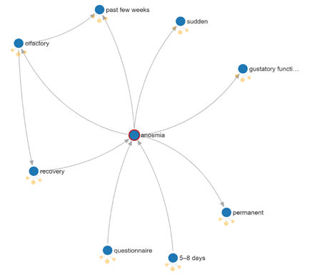
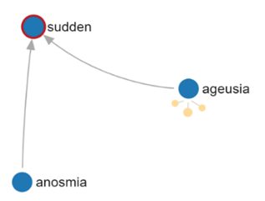
Source: content from 1 entire article
Source: content from 5 article conclusions

Slide 22
Use cases
4. Discussion
Information verification/ validation
E.g. Twitter messages: information/ misinformation
Generic solutions for machine learning applications
E.g. Estimate rate of success per treatment/ experiment
Statistical applications
E.g. Frequency of similar approaches
Various industry applications
E.g. Applications outside the healthcare sphere
Notes:
Potential use cases because we left them open
Potentially other

Slide 23
Open issues
Future directions
Spelling inconsistencies
E.g. Covid-19 OR Covid- 19
Abbreviation
E.g. Polymerase Chain Reaction or PCR
Word separation
E.g. Current situation OR Cur-rent situation
Inconsistent article structure
E.g. Methods OR Material and Method
Improving data processing
E.g. fix inaccurate relationship detection
Enable faster qualitative preprocessing
E.g. solving the open issues
Graph visualization
E.g. Edge labels
Use case related visualization and querying
E.g. User friendly data manipulation

Slide 24

5. Conclusion
Data conversion from unstructured to structured form
Suitable schema for research article
Identifying use cases
Identifying software limitations

Slide 25
Thank you!

