Slide 1



Slide 2
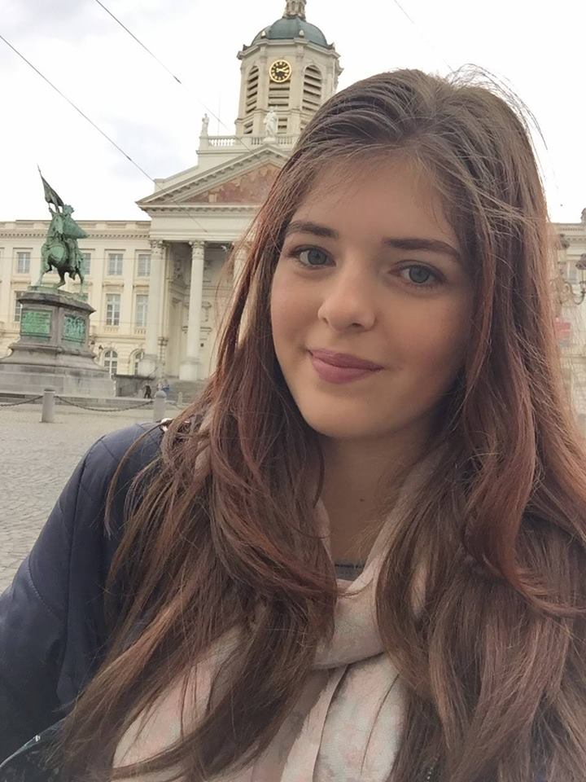

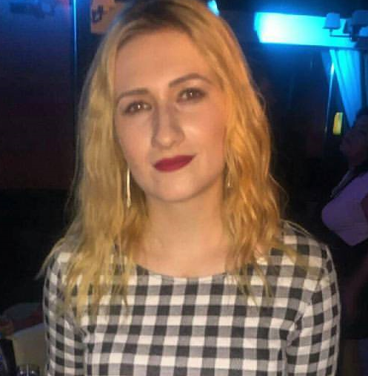


Our Team
Andreea Gavrilă
Design
Anastasia Smarandi
Production
Andreea Butucaru
Research and
Development
Miruna Tudoreanu
Accounting and Finance
Irina Moisă
Marketing

Slide 3
Mission
Increase honey consumption
Educate the users about its benefits
Facilitate access to natural honey

Slide 4
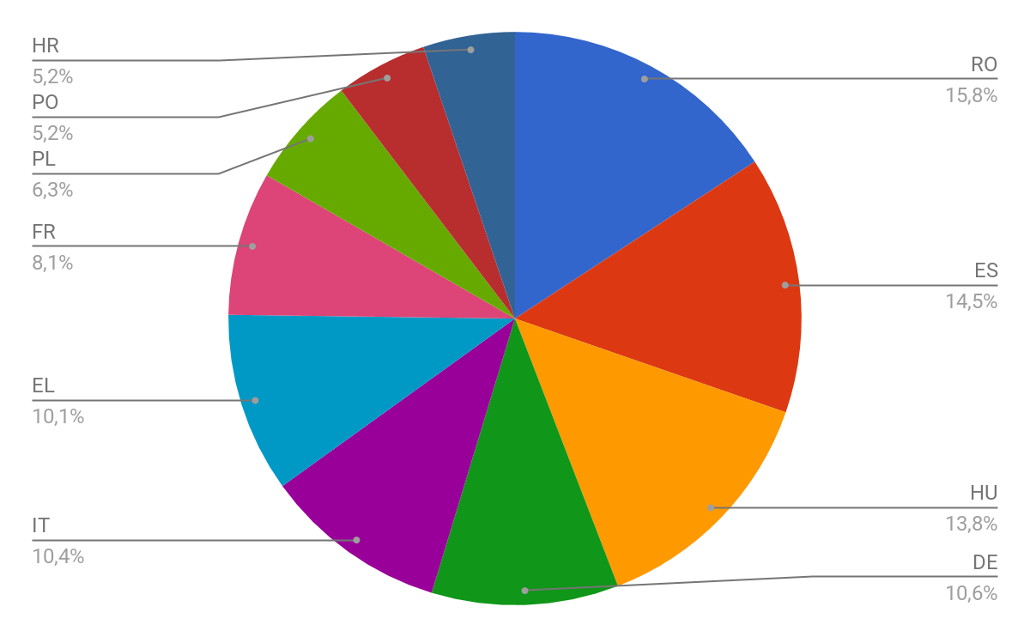
Honey production levels in Europe - 2015

Slide 5
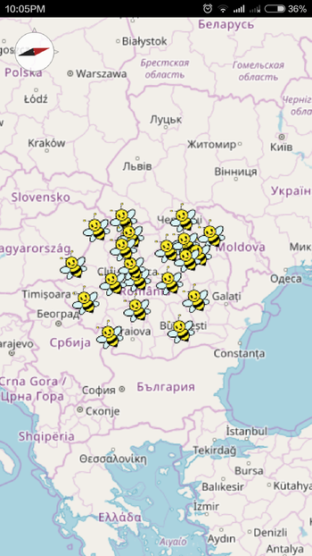
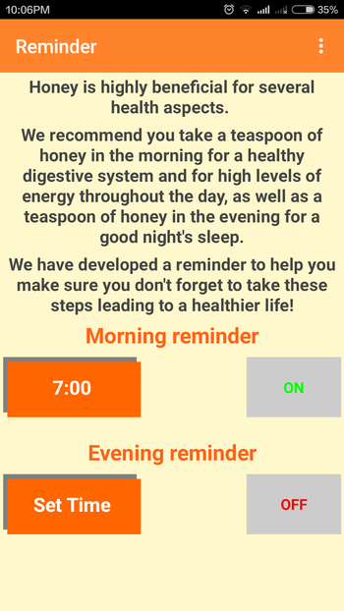
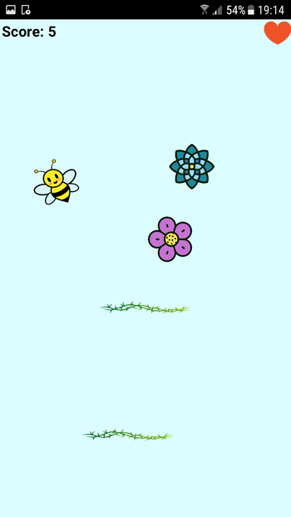
What we offer
Interactive map
Information page
Reminder
Mini-game

Slide 6
Business Model
We will sell our app for $0.69 in the App Store and Magazin Play
The beekepers will have to pay an annual fee of 100$ for being pinned on our map
The first 20 beekeepers will get a 100% discount

Slide 7
Market Plan
Initially, we will make a presentation tour to show people what is our app`s potential
Share our website on social media
We plan to call 100 people a day to tell them about our revolutionary content
Gathering sponsors to promote our product, using a discount code, which means they get paid every time their followers use that code
We will Create a customer loyalty email list in order to send an email weekly or monthly, offering exclusive sales or information on upcoming products.
The internet has an infinite number of invaluable ways to build a loyal customer base and retain those who want more of your product and to hear about future products

Slide 8
Competitive Analysis
What our app brings to the market in addition to our competitors is that we provide not only the means to bring more honey in your life, but also the reasons to do so
The app is ideal for people dedicated to live a healthier life
It provides professional quality services

Slide 9
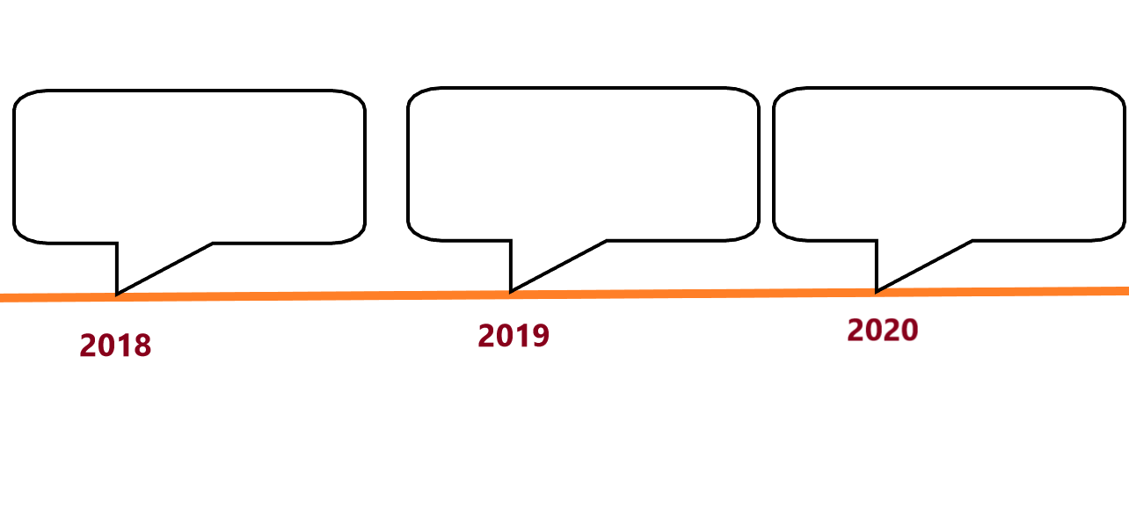
Projections and Milestones
Prototype &
expanding at European level
Hiring people as the number of the beekepers grows
Expanding at
global level

