Slide 1
Madrid Market
Analysis
HousingAnywhere Platform Performance · 2023–2025
Data Analysis · Part 3

Slide 2
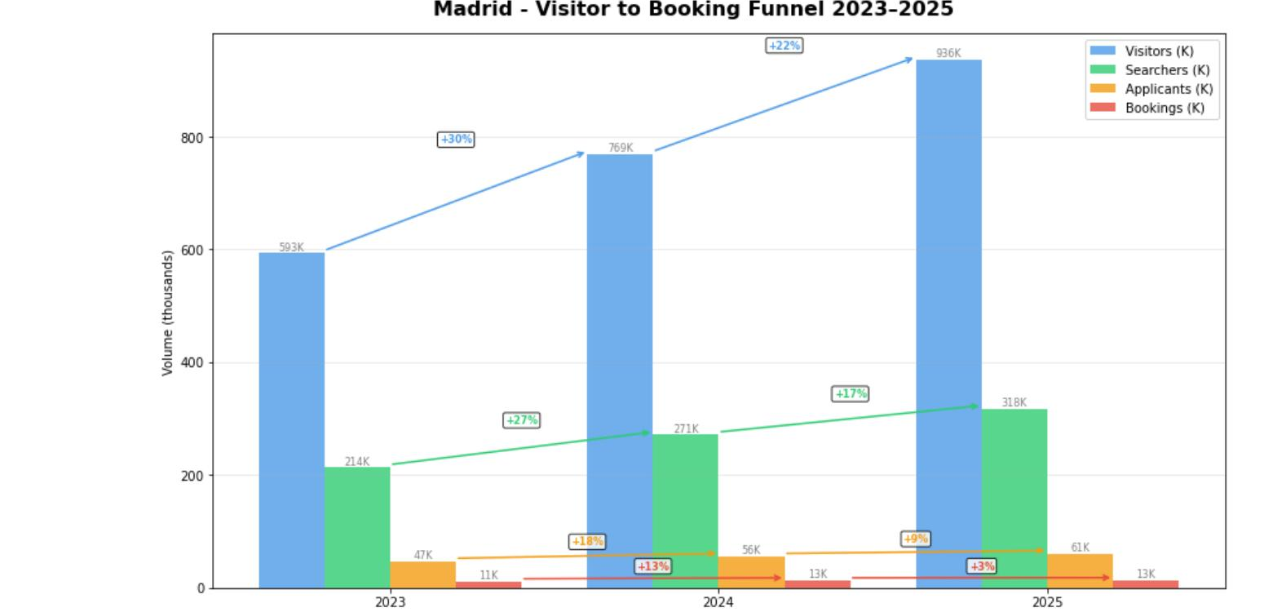
Funnel Performance 2023–2025
Strong top-of-funnel growth - but conversion collapses before booking
+58%
Visitors grew
593K → 936K
+49%
Searchers grew
214K → 318K
+29%
Applicants grew
47K → 61K
+17%
Bookings grew
11K → 13K
⚡ Key Insight: Visitor growth (+58%) massively outpaces booking growth (+17%) - signalling friction in matching, supply quality, or affordability.

Slide 3
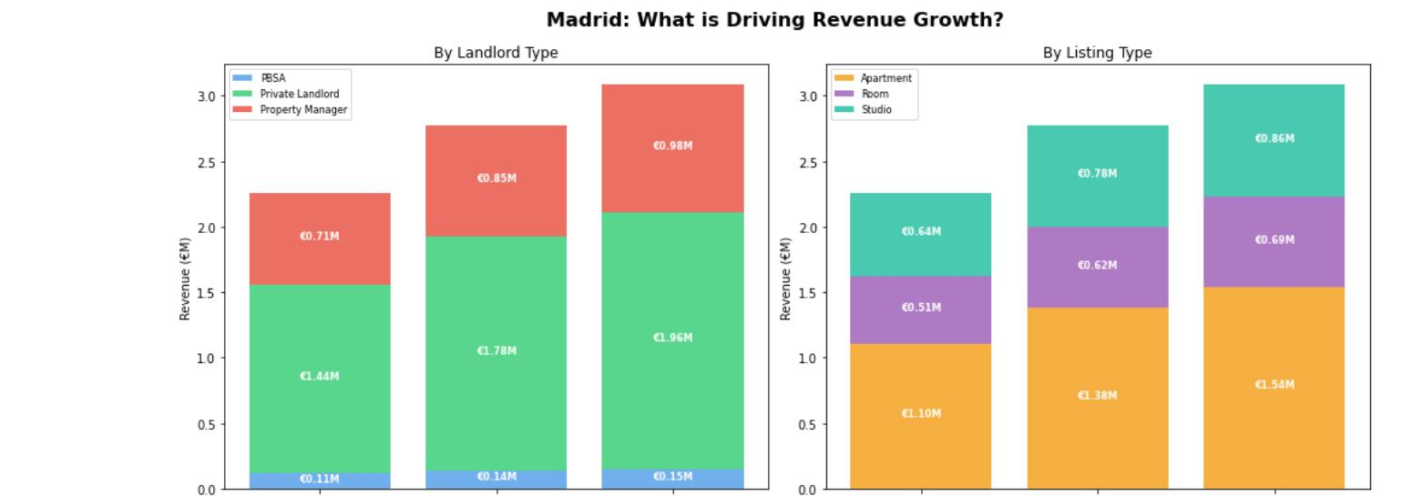
Revenue Growth: Earning More Per Booking
Revenue grew 2× faster than bookings - driven by higher-value listings and rising rent
+36.6%
+17.0%
€204
€238
Revenue Growth · 2023→2025
Booking Growth · 2023→2025
Rev/Booking 2023 · avg
Rev/Booking 2025 · +17% uplift

Slide 4
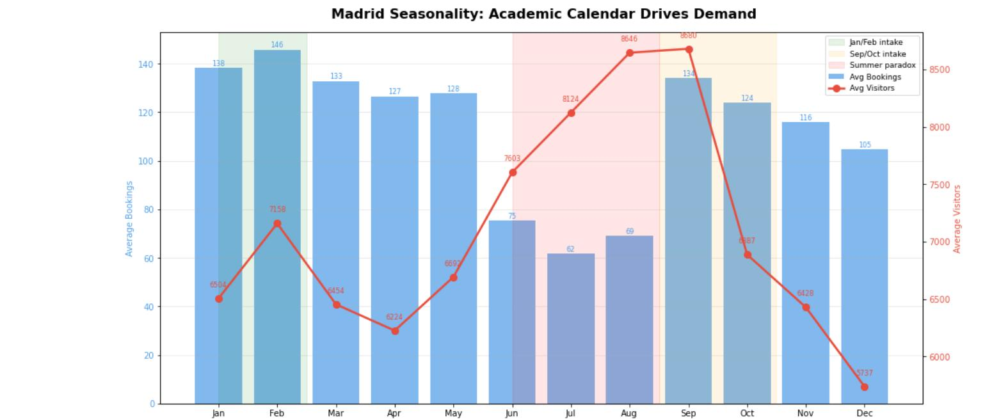
Seasonality: Academic Calendar Drives Demand
Two clear peaks align with semester starts - summer brings browsers, not bookers
📅 Jan / Feb Intake
Spring semester start. Average bookings reach 138–146/month - the second strongest period of the year.
🎓 Sep / Oct Intake
Most important period. September: 134 avg bookings AND highest visitor traffic (8,680/month).
☀️ The Summer Paradox
Visitors peak at 8,600+/month but bookings hit annual lows (62–75). Summer traffic = browsers, not buyers.

Slide 5
Supply vs. Demand: A Growing Mismatch
Supply grew 75% - but listing utilisation dropped from 43% to 28%
⚠ Key Insight: The challenge in Madrid is no longer supply shortage - it is supply quality. In 2023, 43 in every 100 listings received a booking. By 2025, only 28 did.

Slide 6
Rising Rents: The Affordability Gap
Average rents rose +21% in two years - pricing out the core student and young professional audience
⚡ Supply +75%, Rents +21%, but Applicants only +29% → Rising rents are directly contributing to declining utilisation (43%→28%). Tenants browse but can't afford to commit.

Slide 7
Three Priority Recommendations
Based on the Madrid 2023–2025 analysis
Improve Funnel Conversion Through Listing Quality
01
Introduce a listing quality score (completeness, photos, response time, pricing). Prioritise high-scoring listings in search and send landlords optimisation nudges.
→ ~3,000 additional bookings/year from a 5% applicant conversion lift
Align Acquisition & Marketing with Academic Calendar
02
Concentrate landlord acquisition in May–Jul ahead of the September peak. Launch tenant re-engagement campaigns in Jun–Aug to convert summer browsers into autumn bookings.
→ 800+ additional bookings in Sep peak from capturing 10% of summer browsers
Address the Affordability Gap
03
Introduce a budget-friendly listing filter. Incentivise landlords to price competitively via featured placement or reduced commission for below-market listings.
→ Reduces price-driven funnel drop-off and reactivates growing unlisted supply

Slide 8
Key Takeaways
Madrid visitor growth (+58%) far outpaces booking growth (+17%) - the funnel is leaking.
Revenue grew 2× faster than bookings (€204 → €238 per booking) driven by apartments & property managers.
Demand is academic-calendar driven - Sep/Oct and Jan/Feb are the critical windows.
Supply grew +75% but utilisation fell from 43% → 28% - quality and matching are the bottleneck, not quantity.
Rents rose +21% in two years, creating an affordability gap that is pricing out the core audience.
Source: HousingAnywhere Madrid dataset 2023–2025 · Analysis: Python / pandas

