Slide 1
Automatic classification of AIR fronts
Muscalagiu Anca & Ploscar Andreea

Slide 2
AGENDA
Motivation
Domain Context
AI Model
Results
Application
SWOT Analysis

Slide 3
Motivation
Why do we need air front detection?
Weather Forecasting
Analysis of Medical Impact on the Human Body
Why do we need the process to be automated?
Accurate analysis over sequences of days
Simplify the complex process of prediction

Slide 4
Domain context

Slide 5
ATMOSPHERICAL FRONTS
A weather front is a boundary separating air masses for which several characteristics differ, such as air density, wind, temperature, and humidity.
POSSIBLE IMPACTS:
Disturbed and unstable weather
Thunderstorms
Precipitations
Fog

Slide 6




TYPES
Warm Front
Poleward Movement
Representation
Cold Front
West to East Movement
Representation
Mixed Front
Subtypes:
Occluded Front
Stationary Front

Slide 7
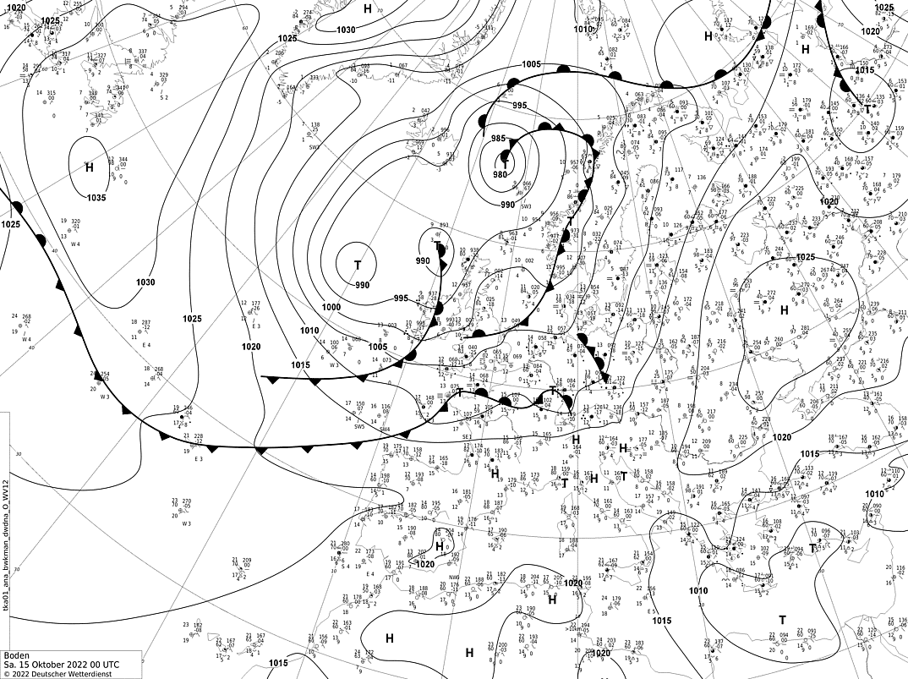
SYNOPTIC MAPS
SOURCES:
Metheorological Institutes
Weather Services

Slide 8
AI ALGORITHM - CLASSIFICATION
Confusion Matrix, Accuracies, Losses
INPUT
Small area extracted from a synoptic map
OUTPUT
Type of air front found in input image:
DATASETS
300 images covering small areas of synoptic maps
Supervised Learning using Convolutional Neural Network
PERFORMANCE
METHODOLOGY
Warm
Cold
Mixed
No front

Slide 9
LEARNING
IMAGE PREPROCESSING
Split synoptic map images into 16 smaller images
Manual labeling
TRAINING
Train model over 100 epochs
Decrease learning rate
TESTING
Test model after each epoch to assess the performance on new data and optimize the model
PERFORMANCE ASSESMENT
Compute confusion matrix, training and testing accuracies and losses

Slide 10
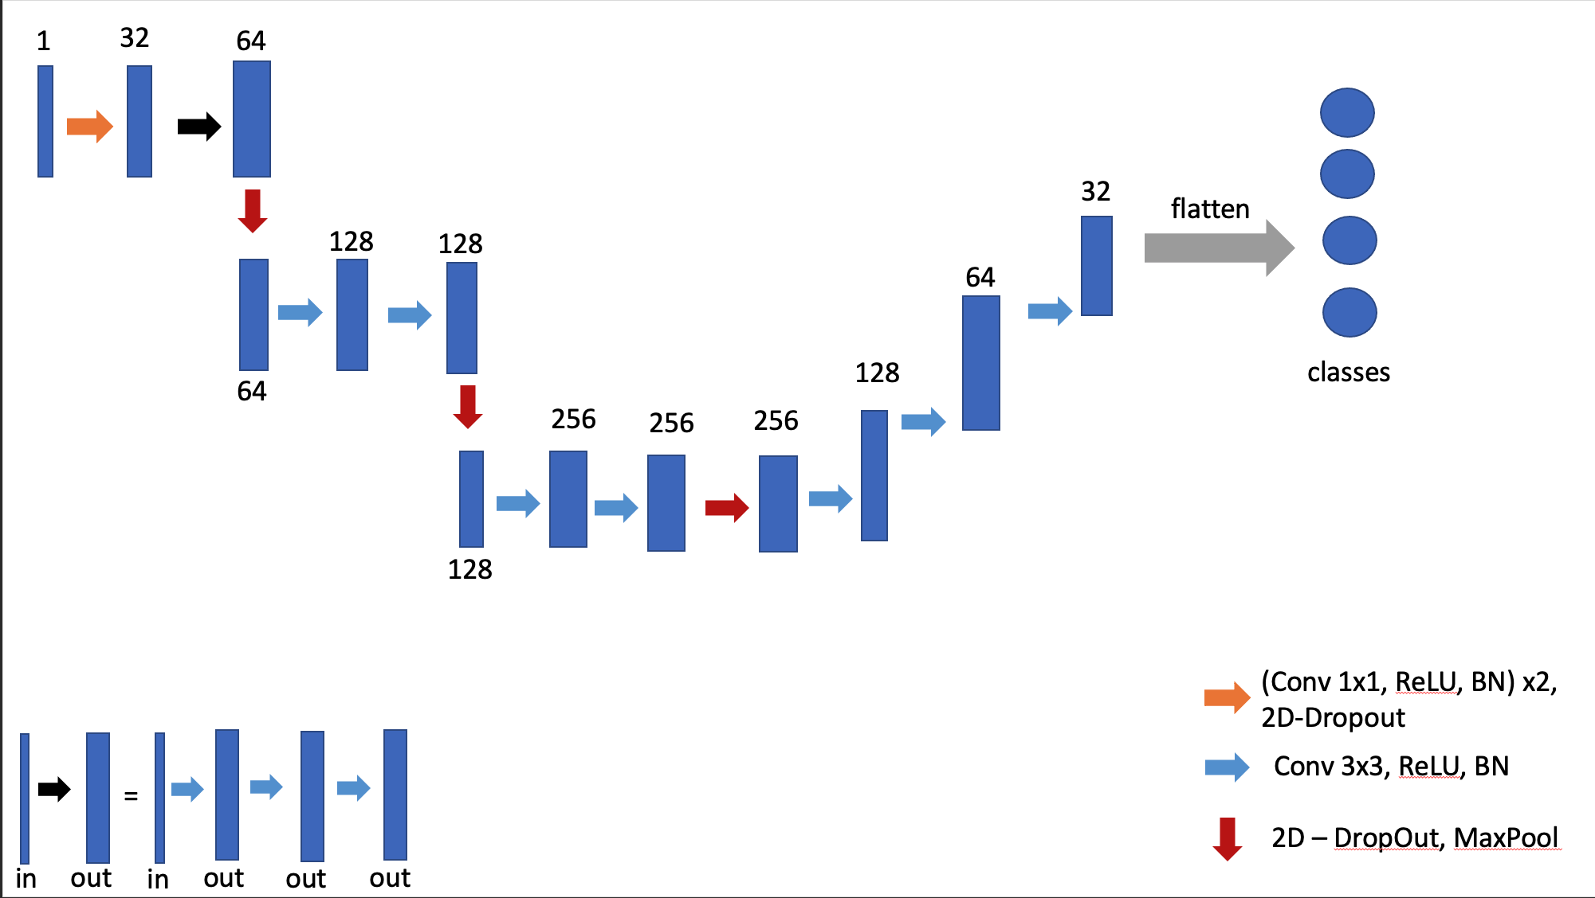
LAYERS

Slide 11
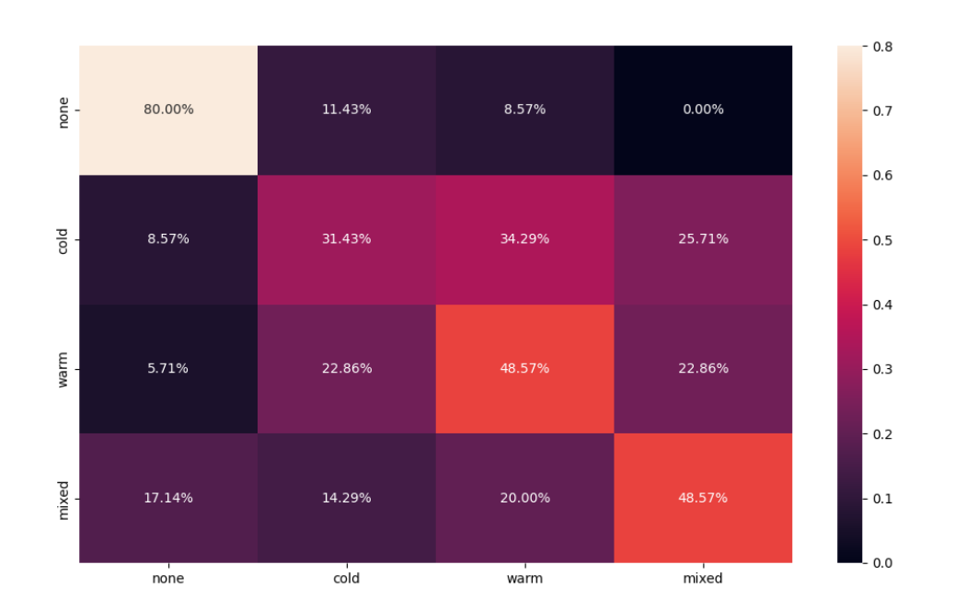
RESULTS

Slide 12
APPLICATION

Slide 13
We pave the path for further research and new approaches in the domain
S
w
The datasets used by the AI algorithm are hard to obtain and label
Improve weather forecasting, find correlations between weather and diseases
T
We depend on synoptic maps and their consistency
O
T

Slide 14


MEET OUR TEAM
MUSCALAGIU ANCA
PLOSCAR ANDREEA

Slide 15
THANK YOU!

