Slide 1

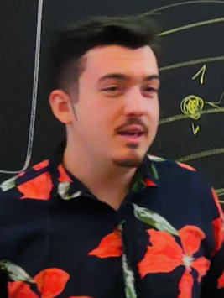

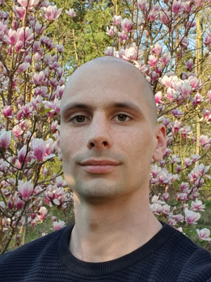

DISC 2024
Unifying Partial Synchrony
Andrei Constantinescu
Diana Ghinea
JAKUB SLIWINSKI
Roger Wattenhofer
ETH Zürich – Distributed Computing
Notes:
Hello distributed humans, I’m Kobi and you’re watching Kobi’s clocks.

Slide 2
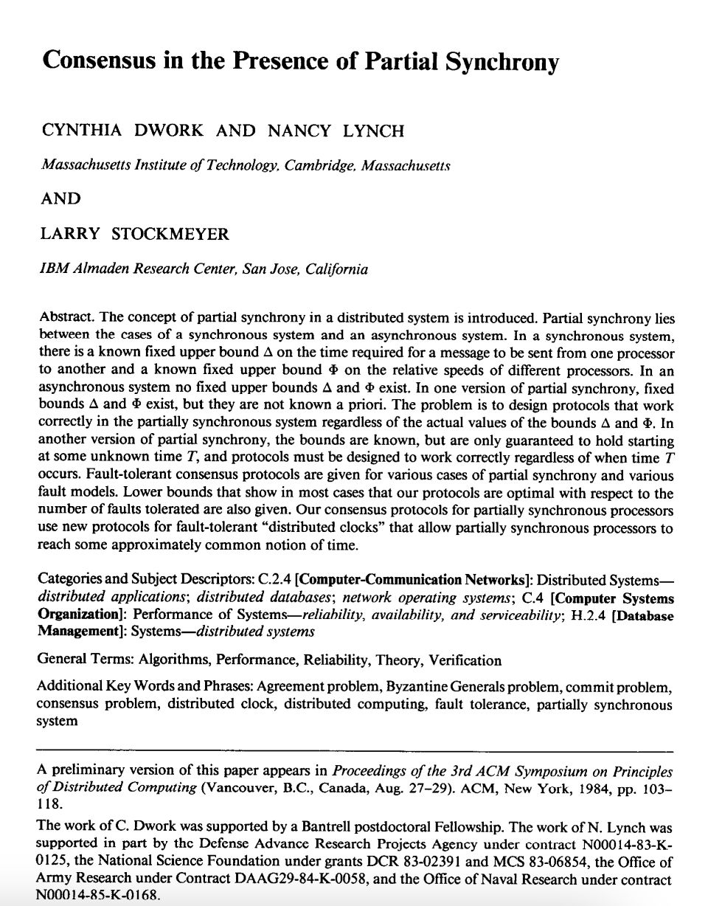
Notes:
Partial Synchrony is everywhere. It is all around us. Even now, in this very room.

Slide 3

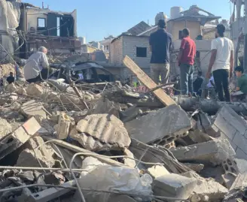

partial
synchrony
synchrony
asynchrony
Notes:
How is it so omnipresent? One can say that partial synchrony is where we actually live - somewhere between the utopia of synchrony and the warzone of asynchrony.

Slide 4
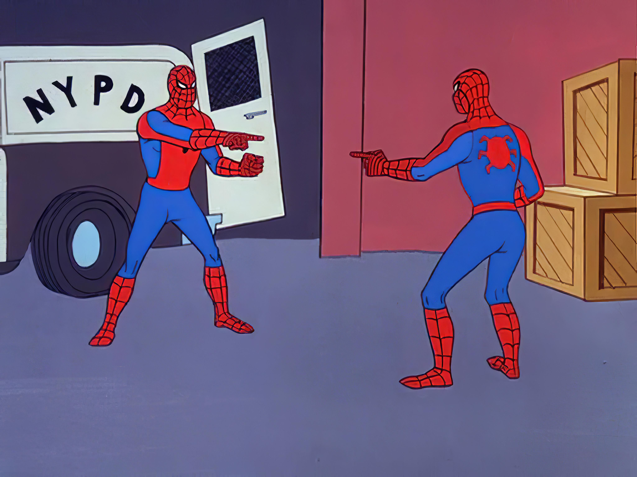
Global Stabilization Time
Unknown
Latency (𝚫)
Notes:
But what do you even mean by partial synchrony Kobi? There have been two models of partial synchrony, separated at birth in the original paper.

Slide 5

Global Stabilization Time
𝚫
GST
Notes:
What are they? The model of Global Stabilization Time assumes we need to be able to survive the warzone of asynchrony, and at some point we can enjoy synchrony.

Slide 6
Global Stabilization Time
Unknown 𝚫
𝚫
𝚫 ?
GST
Notes:
On the other hand, the Unknown Delta model says there is an ever-present bound on the message delay, but we don’t know it (it can be anything).

Slide 7
Unknown 𝚫?
GST?
synchrony
asynchrony
Notes:
So it’s two models. Is one stronger than the other in its assumptions? Is the Unknown Delta harder to make a protocol for than GST?

Slide 8
Unknown 𝚫?
GST?
synchrony
asynchrony
Notes:
Or is GST harder?

Slide 9


Unknown 𝚫?
GST?
synchrony
asynchrony
Notes:
We can quickly note the latter cannot be.

Slide 10

Global Stabilization Time
Unknown 𝚫
𝚫
𝚫 = ?
GST
Notes:
Take some algorithm working in the Unknown Delta model. Suppose we’re actually in the GST model though and the devil specifies some GST.

Slide 11

Global Stabilization Time
Unknown 𝚫
𝚫
𝚫 = GST
GST
Notes:
However, if the unknown Delta is equal to this GST from the other model

Slide 12
Global Stabilization Time
Unknown 𝚫
𝚫
𝚫 = GST
GST
Notes:
We note our protocol has to be good as well for the GST model. That’s a bit cheesy, but means if we can do something time-agnostic in here, we can do it in here as well.

Slide 13
Unknown 𝚫?
GST?
synchrony
asynchrony
Notes:
Is it the other way around then? Is Unknown Delta harder than GST?

Slide 14
Global Stabilization Time
Unknown 𝚫
𝚫
𝚫 ?
GST
Notes:
Let’s see if we can make a protocol for Unknown Delta given a protocol for GST.

Slide 15

Global Stabilization Time
Unknown 𝚫
𝚫
𝚫 ?
GST
Notes:
One popular technique is to increase some timeout thing in our protocol if things are not working out.

Slide 16
Global Stabilization Time
Unknown 𝚫
𝚫
𝚫 ?
GST
Notes:
Your uncle used this technique many times and it worked, but in general we cannot assume that in every protocol there is some sanitized point in time where we can increase the Delta parameter and things don’t explode.

Slide 17

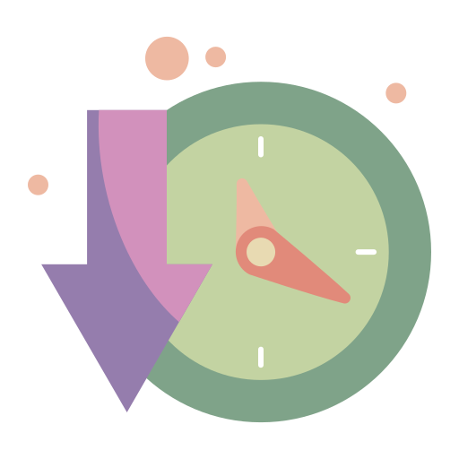
Global Stabilization Time
Unknown 𝚫
𝚫
𝚫 ?
GST
Notes:
This is where we come in.

Slide 18
Global Stabilization Time
Unknown 𝚫
𝚫
𝚫 ?
GST
Notes:
What we can do in a way that is agnostic to any protocol, is to transform the clock inputs before they are used by the algorithm. We’ll just continuously slow down the clock.

Slide 19

Global Stabilization Time
Unknown 𝚫
𝚫
𝚫 ?
GST
Notes:
The algorithm will think it uses the Delta parameter from the beginning forever,

Slide 20

Global Stabilization Time
Unknown 𝚫
𝚫
𝚫 ?
GST
Notes:
but actually the effective needed Delta will get bigger and bigger.

Slide 21
Global Stabilization Time
Unknown 𝚫
𝚫
𝚫 ?
GST
Notes:
Eventually the effective Delta has to overtake the Unknown Delta that the devil specified in the other model.

Slide 22

Global Stabilization Time
Unknown 𝚫
𝚫
𝚫 ?
GST
Notes:
As a result I’m happy to say that the long separated models are unified.

Slide 23

Thanksies!
Unknown𝚫
GST
Notes:
Thanks!

