Slide 1

Scientific Papers Reranker
Andrei – Răzvan, JOLDEA

Slide 2
Goal
Create a Reranker capable enough to be used for writing academic papers.
  Take a query as input (up to a few sentences / small paragraph).
  Have a candidate pool of K scientific papers (e.g. K = 100).
  Rerank the papers ascendingly based on their relevance for the query.
Pair the Reranker with the best performing retriever to increase results.

Slide 3
LITSEARCH
Benchmark containing 597 realistic literature search queries about recent ML and NLP papers.
Queries can have 1-5 target papers (vast majority have 1).
Forked the official repo and made changes to the existing framework:
  Added support for inference using local LLMs.
  Added support for additional retrievers (e.g. MiniLM, Qwen3).
  Adjusted reranking pipeline for better answer extraction, additional prompts etc.
  Added evaluation script to compute metrics.

Slide 4
Dataset creation
DORIS-MAE (Scientific Document Retrieval using Multi-level Aspect-based Queries):
  Corpus contains 363,133 scientific paper abstracts.
  100 queries
    3-9 aspects
    0-6 sub-aspect
    ~100 candidates

Slide 5
Dataset creation
{
"query_text": "Additionally, I am looking for models that are able to analyze sequential patterns and utilize time-based statistics and thus can calculate accurate event probability.",
"aspect_id": "542",
"original_query_type": "ML",
"candidate_pool": [42500, 259088, 195089, 304657, … , 18935, 19450],
"candidate_scores": [1, 0, 0, 1, … , 2, 1]
}
100 queries → 1501 input sequences

Slide 6
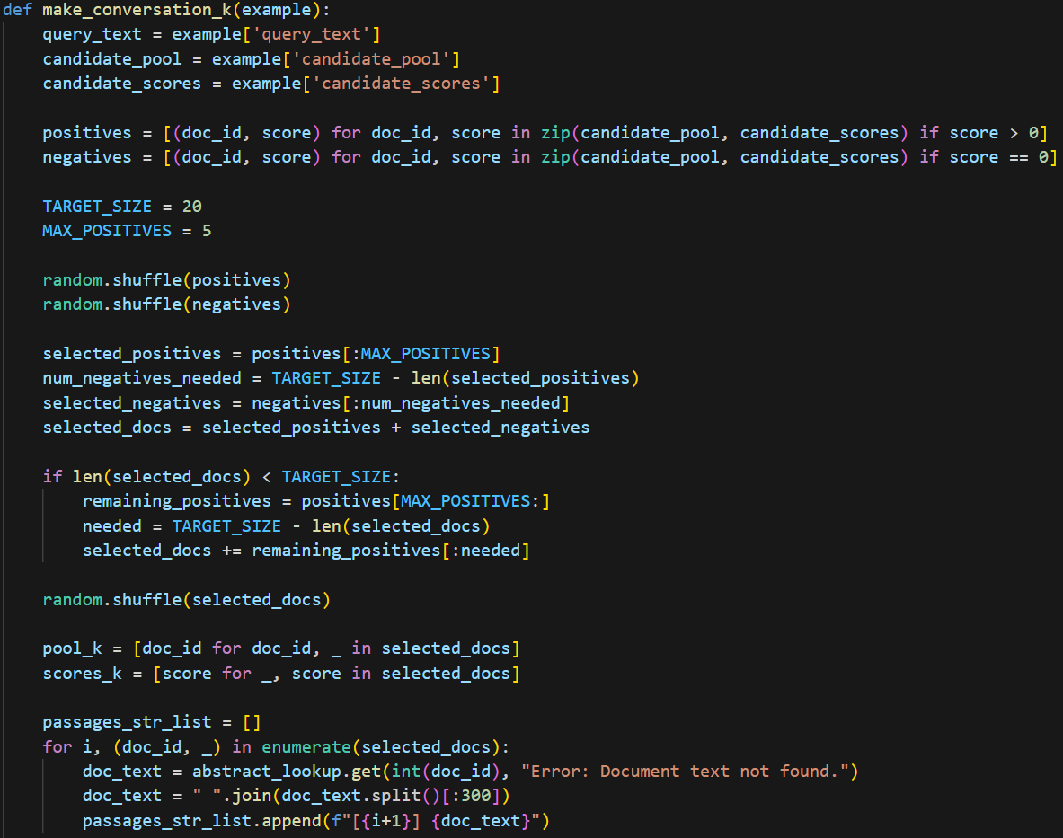
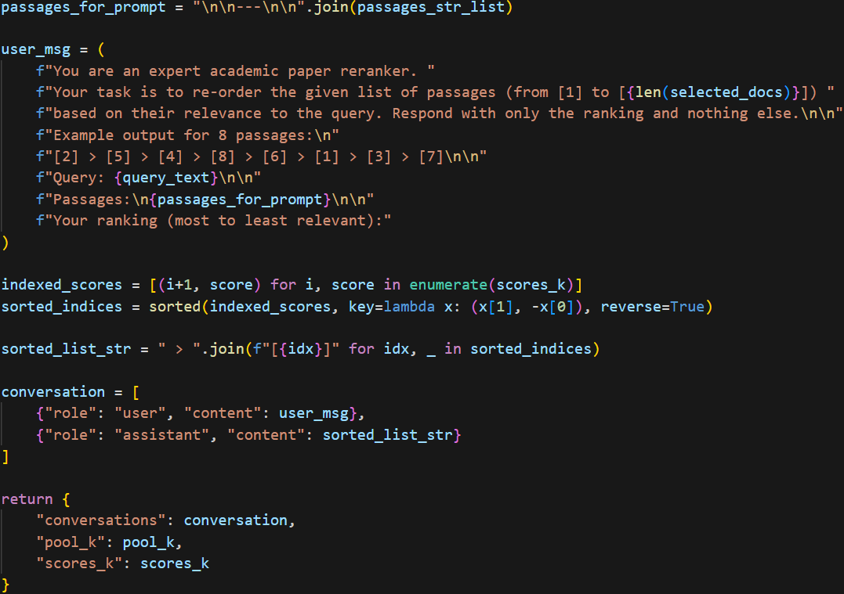
Finetuning

Slide 7
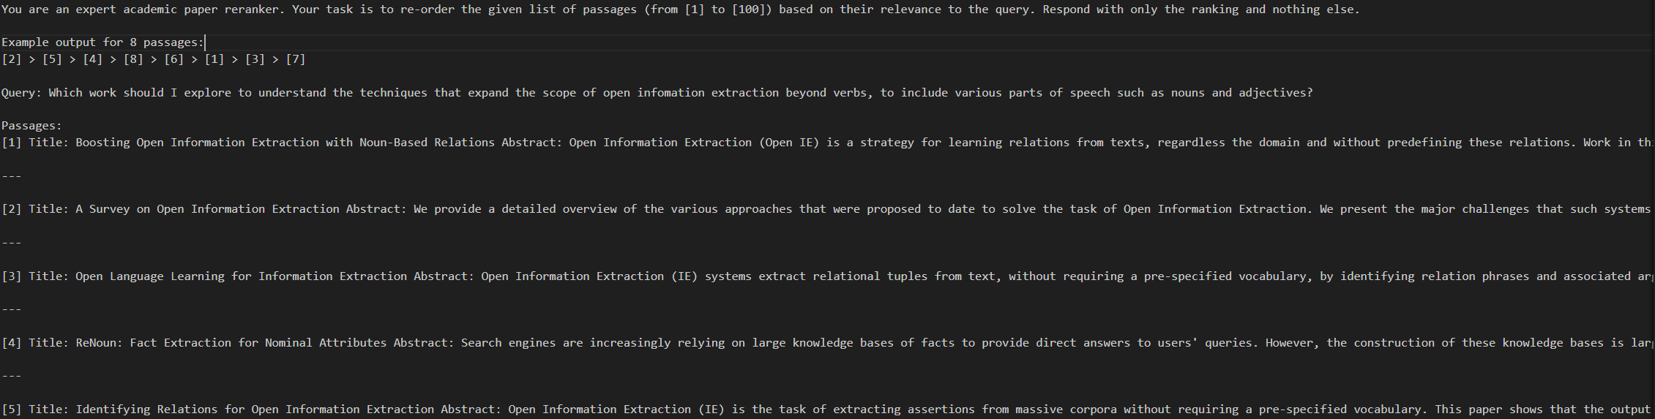
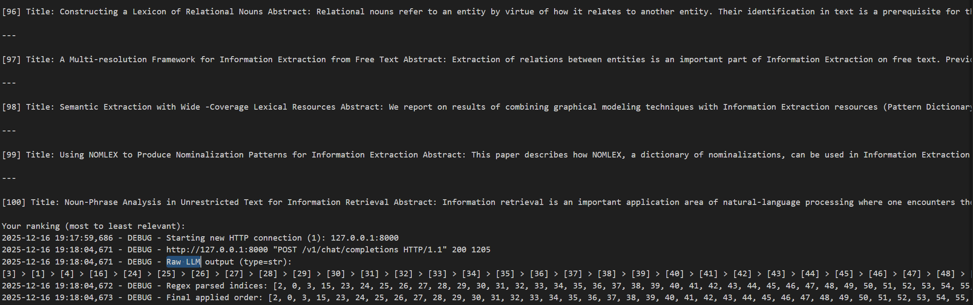

Slide 8
Results (GEMMA-3 4B)
BM25
Category | R@20 (Base) | R@20 (FT) | R@5 (Base) | R@5 (FT) | NDCG@20 (Base) | NDCG@20 (FT) | NDCG@5 (Base) | NDCG@5 (FT)
inline_broad | 33.25 | 37.83 | 23.78 | 30.44 | 19.83 | 25.87 | 16.87 | 23.56
inline_specific | 53.90 | 55.63 | 42.86 | 43.94 | 31.74 | 40.55 | 28.54 | 37.14
author_broad | 51.43 | 57.14 | 37.14 | 40.00 | 32.64 | 41.44 | 28.41 | 36.46
author_specific | 72.51 | 74.88 | 59.72 | 67.77 | 46.77 | 60.23 | 42.89 | 58.27
Overall Avg | 56.18 | 58.94 | 44.65 | 49.42 | 34.71 | 44.61 | 31.26 | 41.84
K = 100
Category | R@20 (Base) | R@20 (FT) | R@5 (Base) | R@5 (FT) | NDCG@20 (Base) | NDCG@20 (FT) | NDCG@5 (Base) | NDCG@5 (FT)
inline_broad | 37.42 | 37.42 | 27.53 | 31.69 | 22.60 | 27.11 | 19.83 | 25.30
inline_specific | 55.84 | 55.84 | 43.72 | 45.24 | 35.57 | 41.27 | 32.25 | 38.13
author_broad | 48.57 | 48.57 | 31.43 | 45.71 | 29.12 | 40.61 | 24.48 | 39.75
author_specific | 73.46 | 73.46 | 55.92 | 69.19 | 49.58 | 62.63 | 44.84 | 61.36
Overall Avg | 57.94 | 57.94 | 44.06 | 51.01 | 37.54 | 45.94 | 33.75 | 43.86
K = 20

Slide 9
Results (GEMMA-3 4B)
GTR
Category | R@20 (Base) | R@20 (FT) | R@5 (Base) | R@5 (FT) | NDCG@20 (Base) | NDCG@20 (FT) | NDCG@5 (Base) | NDCG@5 (FT)
inline_broad | 44.92 | 43.25 | 31.72 | 35.03 | 25.35 | 30.68 | 21.45 | 27.98
inline_specific | 50.65 | 52.60 | 42.42 | 42.86 | 31.07 | 39.75 | 28.59 | 36.86
author_broad | 34.29 | 37.14 | 34.29 | 34.29 | 25.37 | 32.62 | 25.37 | 31.60
author_specific | 54.03 | 55.92 | 42.18 | 51.18 | 36.15 | 45.04 | 32.80 | 43.68
Overall Avg | 49.73 | 50.99 | 39.71 | 43.72 | 31.38 | 39.38 | 28.45 | 37.18
K = 100
Category | R@20 (Base) | R@20 (FT) | R@5 (Base) | R@5 (FT) | NDCG@20 (Base) | NDCG@20 (FT) | NDCG@5 (Base) | NDCG@5 (FT)
inline_broad | 45.75 | 45.75 | 33.39 | 39.22 | 29.27 | 33.77 | 25.68 | 31.67
inline_specific | 51.52 | 51.52 | 39.39 | 44.37 | 33.67 | 41.53 | 30.13 | 39.43
author_broad | 37.14 | 37.14 | 28.57 | 31.43 | 24.74 | 31.57 | 22.60 | 29.80
author_specific | 55.92 | 55.92 | 46.45 | 52.61 | 40.48 | 48.11 | 37.87 | 47.12
Overall Avg | 51.07 | 51.07 | 40.04 | 45.49 | 34.67 | 41.71 | 31.53 | 40.02
K = 20

Slide 10
Results (GEMMA-3 4B)
GRIT
Category | R@20 (Base) | R@20 (FT) | R@5 (Base) | R@5 (FT) | NDCG@20 (Base) | NDCG@20 (FT) | NDCG@5 (Base) | NDCG@5 (FT)
inline_broad | 64.18 | 64.11 | 50.33 | 52.28 | 36.42 | 49.59 | 31.96 | 45.84
inline_specific | 74.24 | 78.14 | 62.12 | 68.18 | 43.21 | 61.99 | 39.46 | 59.17
author_broad | 68.57 | 74.29 | 51.43 | 60.00 | 42.66 | 53.62 | 37.85 | 49.92
author_specific | 86.73 | 87.20 | 78.20 | 78.67 | 60.99 | 72.18 | 58.31 | 69.54
Overall Avg | 76.30 | 78.30 | 64.81 | 68.21 | 48.10 | 62.61 | 44.52 | 59.61
K = 100
Category | R@20 (Base) | R@20 (FT) | R@5 (Base) | R@5 (FT) | NDCG@20 (Base) | NDCG@20 (FT) | NDCG@5 (Base) | NDCG@5 (FT)
inline_broad | 69.74 | 69.74 | 40.89 | 54.08 | 36.81 | 50.76 | 28.64 | 45.93
inline_specific | 77.92 | 77.92 | 44.16 | 67.32 | 41.84 | 62.31 | 32.69 | 59.04
author_broad | 74.29 | 74.29 | 51.43 | 57.14 | 40.63 | 54.15 | 34.42 | 48.80
author_specific | 89.10 | 89.10 | 62.09 | 79.15 | 54.97 | 73.79 | 47.58 | 70.63
Overall Avg | 80.01 | 80.01 | 50.26 | 68.24 | 45.40 | 63.57 | 37.24 | 59.90
K = 20

Slide 11
Results (GEMMA-3 4B)
QWEN3
Category | R@20 (Base) | R@20 (FT) | R@5 (Base) | R@5 (FT) | NDCG@20 (Base) | NDCG@20 (FT) | NDCG@5 (Base) | NDCG@5 (FT)
inline_broad | 61.31 | 69.11 | 49.50 | 55.72 | 37.02 | 51.48 | 33.28 | 47.33
inline_specific | 75.97 | 77.71 | 61.26 | 69.48 | 44.30 | 62.76 | 39.80 | 60.35
author_broad | 74.29 | 77.14 | 51.43 | 62.86 | 43.23 | 57.14 | 36.65 | 53.33
author_specific | 85.31 | 87.68 | 73.93 | 80.57 | 52.54 | 74.62 | 49.05 | 72.41
Overall Avg | 76.23 | 79.47 | 62.80 | 70.25 | 45.68 | 64.36 | 41.57 | 61.58
K = 100
Category | R@20 (Base) | R@20 (FT) | R@5 (Base) | R@5 (FT) | NDCG@20 (Base) | NDCG@20 (FT) | NDCG@5 (Base) | NDCG@5 (FT)
inline_broad | 69.25 | 69.25 | 40.56 | 51.42 | 36.26 | 50.32 | 28.38 | 44.81
inline_specific | 80.30 | 80.30 | 49.35 | 69.05 | 43.71 | 63.95 | 35.31 | 60.51
author_broad | 71.43 | 71.43 | 42.86 | 57.14 | 35.83 | 54.42 | 28.65 | 50.10
author_specific | 88.63 | 88.63 | 58.77 | 80.09 | 51.67 | 75.72 | 43.94 | 73.09
Overall Avg | 80.50 | 80.50 | 50.53 | 68.71 | 44.56 | 64.81 | 36.58 | 61.19
K = 20

Slide 12
Results (GEMMA-3 12B)
QWEN3
Category | R@20 (Base) | R@20 (FT) | R@5 (Base) | R@5 (FT) | NDCG@20 (Base) | NDCG@20 (FT) | NDCG@5 (Base) | NDCG@5 (FT)
inline_broad | 67.44 | 67.03 | 55.03 | 56.56 | 47.46 | 52.51 | 43.67 | 49.32
inline_specific | 77.27 | 73.81 | 70.35 | 67.32 | 61.69 | 61.16 | 59.54 | 59.14
author_broad | 68.57 | 68.57 | 62.86 | 57.14 | 51.56 | 55.00 | 50.17 | 51.50
author_specific | 85.31 | 87.20 | 77.73 | 83.89 | 69.70 | 76.98 | 67.27 | 76.02
Overall Avg | 77.63 | 76.87 | 69.44 | 70.41 | 61.07 | 64.65 | 58.53 | 62.68
K = 100
Category | R@20 (Base) | R@20 (FT) | R@5 (Base) | R@5 (FT) | NDCG@20 (Base) | NDCG@20 (FT) | NDCG@5 (Base) | NDCG@5 (FT)
inline_broad | 69.25 | 69.25 | 52.25 | 56.14 | 45.29 | 52.65 | 39.91 | 48.71
inline_specific | 80.30 | 80.30 | 68.18 | 69.05 | 57.98 | 63.22 | 54.49 | 59.77
author_broad | 71.43 | 71.43 | 57.14 | 65.71 | 43.91 | 59.26 | 39.52 | 57.58
author_specific | 88.63 | 88.63 | 75.83 | 85.31 | 67.09 | 79.06 | 63.48 | 78.05
Overall Avg | 80.50 | 80.50 | 67.04 | 72.00 | 57.82 | 66.46 | 53.86 | 63.88
K = 20

