Slide 1
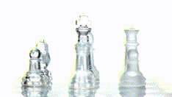
Entrepreneurship – General Principles & Trends
Dr Breda Kenny & Mr. Gerard O’Donovan, Munster Technological University, Cork, Ireland.

Slide 2

Creative Economy
“The creative economy is the part of the economy that tells our stories and the creative works we leave behind as a society are likely to define how future generations understand us.”
Deloitte, 2021.

Slide 3
Entrepreneurship in the cultural and creative sector (def.)
Entrepreneurship in these sectors means to have creative ideas and to pursue them in a commercial way, with the purpose to make a profit. However, the profit alone is not the driver; it is the creativity and the possibility to build something, the self-fulfilment or being able to pursue your own creative interests. There is a mix between the entrepreneurial side and the creative side.”
Further readings:
  Combrie, D., & Hagoort, G. (2010). The entrepreneurial dimension of the cultural and creative industries. Hogeschool vor de Kunsten Utrecht, European Commission, Utrecht, 1-237
  Klamer, A. (2011). Cultural Entrepreneurship. The Review of Austrian Economics, 24(2),

Slide 4

The Creative Entrepreneur
“creative entrepreneurship” has become a term which refers to the business activity of entrepreneurs belonging to the creative industries.
The creative entrepreneur is the type of entrepreneur concerned with the creation and exploitation of creative or intellectual capital. He or she is an investor in his or her talent, but also in that of others.
Bujor and Avasilcai (2016)

Slide 5
How large is the creative economy?
The creative economy has a cultural impact beyond its economic contribution.
Includes a number of different occupations and industries that are not grouped together in standard classifications of economic activity.
Its contribution is therefore often not reported and easy to understate.
According to Deloitte - The creative economy employs nearly 20 million people across the nine economies studied. This represents more than 7% of total employment in those countries. In some countries, this share was higher, up to nearly 13% of total employment.
Crucially, the creative economy has been growing in every country studied, both in absolute terms and as a share of total employment – adding 4 million jobs from 2011 to 2018

Slide 6
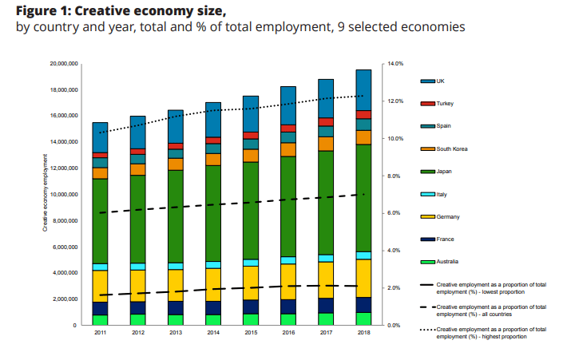

Slide 7
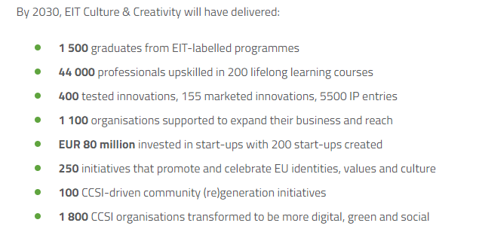

Slide 8
WHY ENTREPRENEURSHIP?
Create self employment
Promote innovation
Build communities
Helps to create value/wealth
Contribute to the economy
Opportunities and support are available

Slide 9
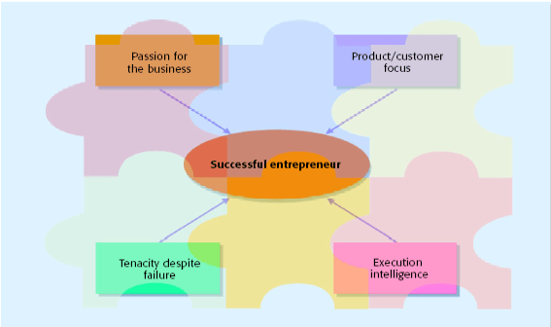
Characteristics of Successful Entrepreneurs
Four Primary Characteristics of Successful Entrepreneurs
Barringer & Ireland, p.33

Slide 10
The Entrepreneurial Process
Changing Demographics
Emergence of New Market
New Technologies
Regulatory Change
Social Change
New Product/Services
New Processes
Enter New Markets
New Organizational Structures/Forms
Use New Technologies
Use Sales or Distribution Channels
Start Writing the Plan
1. Identify an Opportunity
2. Develop the Concept and write the plan

Slide 11
Need for:
Marketing and Sales Expertise
Technical Expertise
Financing Needs
Distribution Channels
Sources of Supply
Licenses, Patents, & Legal Protection
Complete the Business Plan
Debt Supplier Financing
Equity Joint Ventures
Outsourcing Partnerships
Leasing
3. Determine the Required Resources
4. Acquire the Necessary Financing/Partners

Slide 12
Implementation of Plan/Pilot Program
Monitor Performance
Payback to Resources Providers
Reinvestment
Expansion
Achievement of Performance Goals
Licensing of Rights
Growth
Sell or Merge
Go Public
Shut down Venture
5. Implement and Manage
6. Harvest the Venture

Slide 13
Innovation is a process of defining, designing, and delivering new value
Notes:
8:45am

Slide 14

CREATING VALUE and CAPTURING VALUE

Slide 15

CREATING VALUE
Value Creation (also called Value Added)
Value is created anytime an action is taken for which the benefits exceed the costs, or anytime an action is “prevented” for which the costs exceed the benefits.
This applies to several aspects of production: quantity, quality, entry, innovation, method of production. Also applies to relationships between the firm and its employees, e.g., job safety.

Slide 16

CAPTURING VALUE
The concept of value creation says nothing about profit. The benefits are measured to the consumer; the costs to the firm—you can’t determine profit just from that.
The selling price determines the amount of value that is “captured” by the firm—that contributes to the firm’s profits. (Producer Surplus)
The other value isn’t lost. It is retained by the consumer. It is the difference between what the consumer would have been willing to pay and the price. (Consumer Surplus)
Notes:
“Pretty Woman” example.

Slide 17

Defining Value
Economic
Social
Environmental
Cultural
Others……?

Slide 18
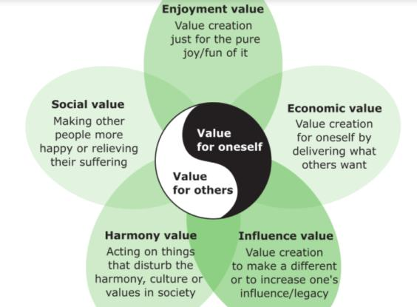
Value - for whom?

Slide 19
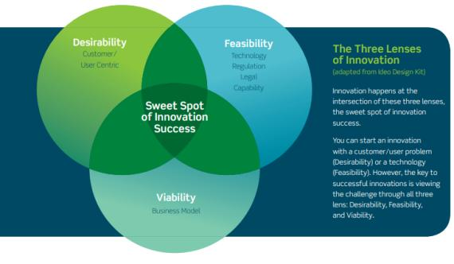
The Three Lenses of Innovation – systemic thinking from earlier

Slide 20
