Slide 1

The Impacts of Digitalisation in the Music Markets
Daniel Nordgård
Timisoara, 2023
University of Agder

Slide 2


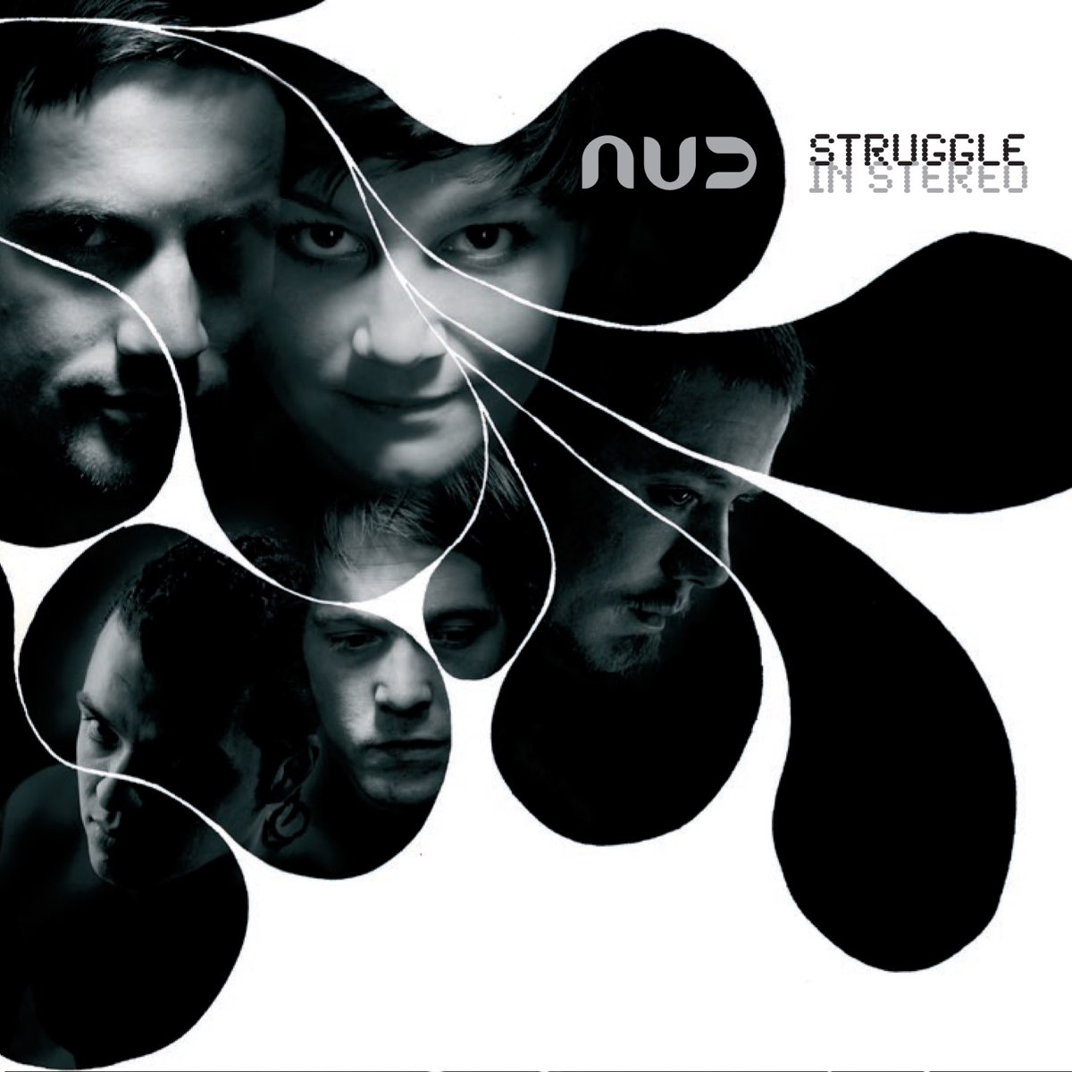

Backdrop: A quick detour
NUD
The Quart Festival

Slide 3


Slide 4
Outline
The changing music industries
Music streaming and micro-economics
Music entrepreneurship and changing frameworks conditions

Slide 5
Defining The Music Industries
To understand how the music industries are changing, we need to define two important concepts:
  The Music industries
  Change

Slide 6
Defining The Music Industries
What is the music industry?

Slide 7


Slide 8


Slide 9
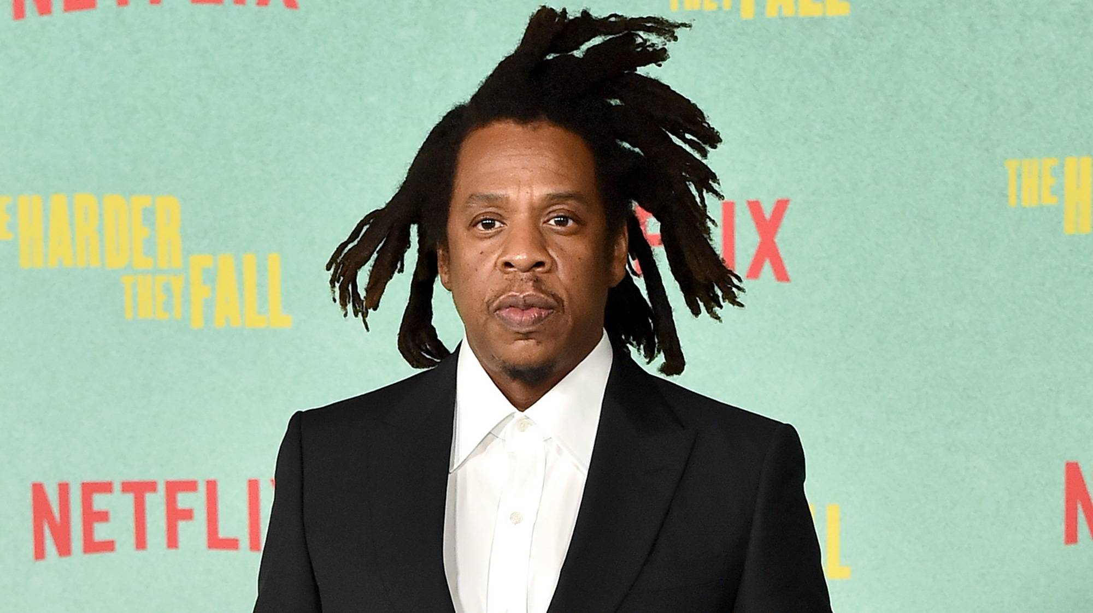

Slide 10


Slide 11
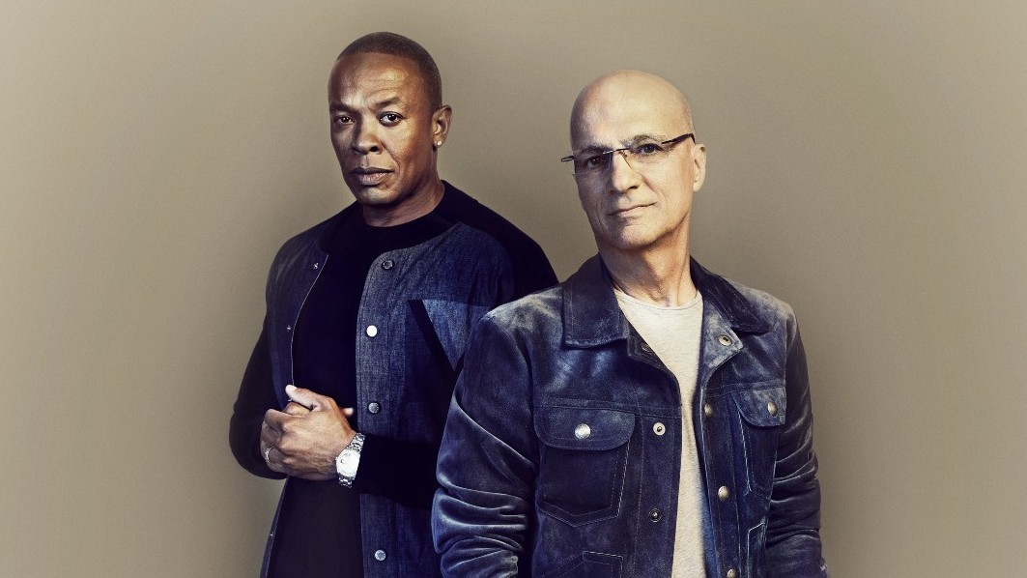

Slide 12


Slide 13


Slide 14


Slide 15
Defining The Music Industries
Whatever exists in the space between artist and fan?
A
?
B

Slide 16
Defining The Music Industries
Important notions:
The music industry performs particular functions (Nordgård, 2018)
  Makes possible to differentiate between stakeholders
  Makes possible to draw lines
The music industry is plural – with different logics and structures
  Often referred to as three sectors:
    Live music
    Recorded music
    Publishing

Slide 17
Defining Change
What is changing?
Digital change has a lot of hype around it
Important to address it soberly and carefully
Many parties have big interests in the game
Many reasons to over-sell both problems AND solutions!

Slide 18
Defining Change
The challenge is, change has always been an integral part of the music industries
  A defining part?
  -Pop music as we know it now has been shaped by the problems of making music a commodity and the challenges of adapting moneymaking to changing technologies. (Frith 2001: 26)
Question is: Does anything separate these changes from prior changes?

Slide 19
Three Important Changes
New modes for discovery and artist-fan relations
New economic logics
More flexibility in infrastructure and value chain functions

Slide 20
Music Streaming – light in the tunnel
Music streaming represents a significant change!
Kristiansand Roundtable Conference (2007-2010):
  Depressed and defeated
  You can’t compete with free!
  Only three options on the table: ad-based, levy financed or bundled

Slide 21
Music Streaming – light in the tunnel
Music streaming has reconnected the affectionate value with the economic value.
People are paying for recorded music again!
Difficult to underestimate the significance of this!

Slide 22
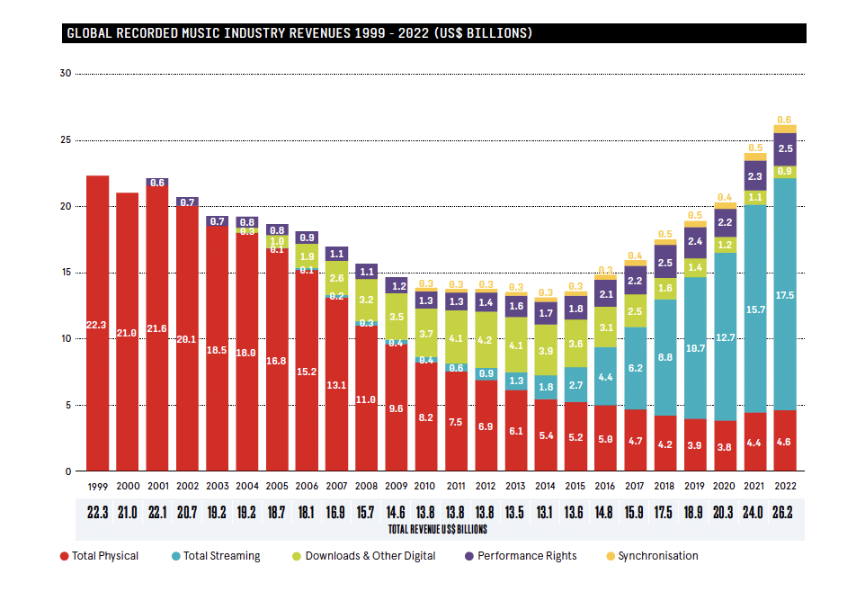

Slide 23
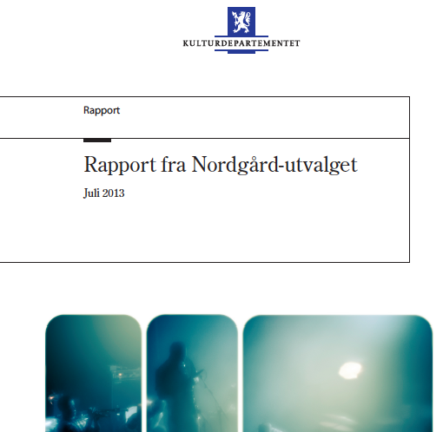
”Nordgård-Committee”

Slide 24
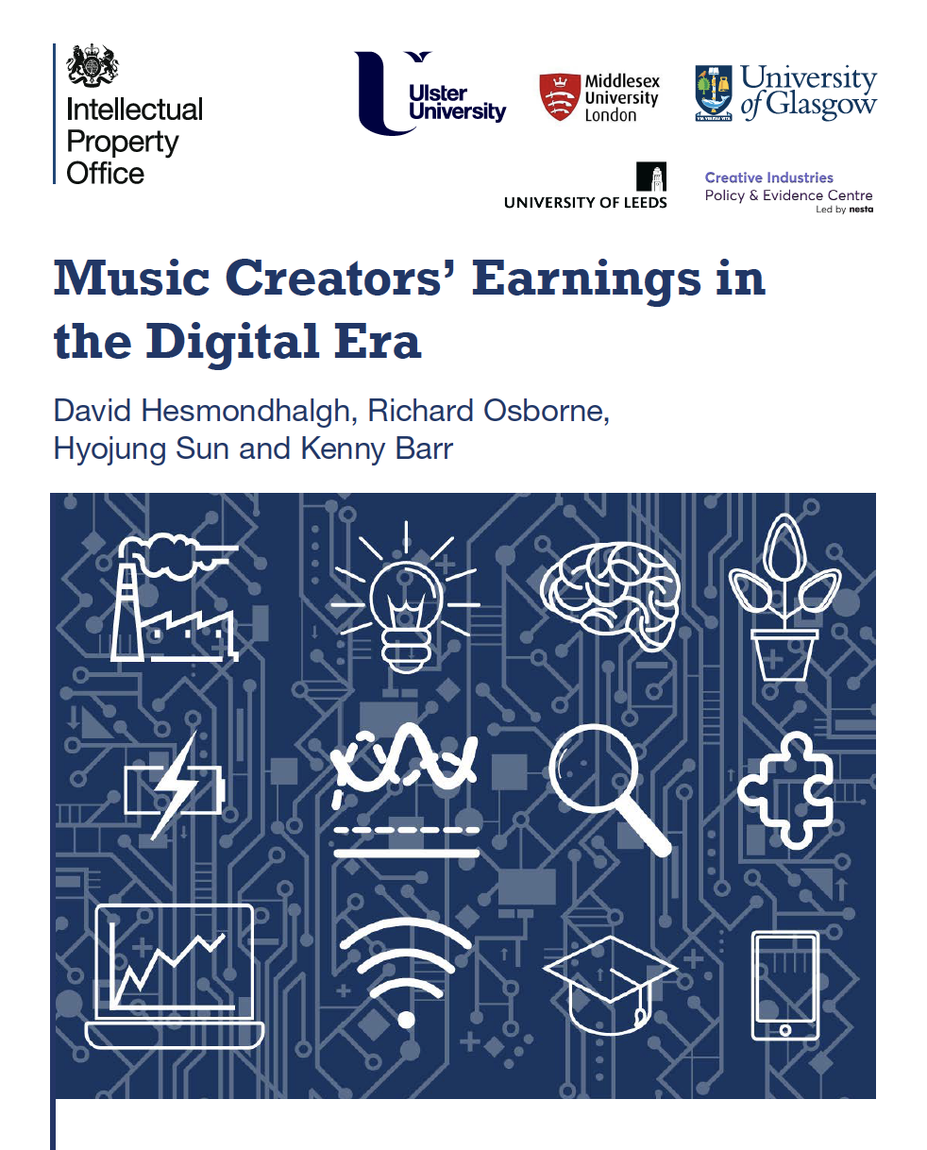

Slide 25
Concentration of popularity over time: tracks
A relatively stable pattern of concentration of streaming popularity has been established:
Top 0.1% most popular tracks achieved more than 40% of all streams in all years
Top 0.4% of tracks accounted for more than 65% of all streams from 2016 onwards
Top 1% of tracks account for between 75 & 80%
Top 10 per cent for 95-97%, in all years from 2016 to 2020
(Hesmondhalgh et al. 2021)

Slide 26
Music Streaming – light in the tunnel
Why are we seeing these developments?
  Contradicts early assumptions and expectations
    (Theories of disruptive innovations)
Three possible explanations:
  The economic models
  The paradox of choice
  ARPU

Slide 27
#1: The economic models
Pro-Rata model
All subscriptions, divided on all streams
= per stream price
Artists streams multiplied by per stream price
= royalty
Seems fair! What’s the problem?

Slide 28


Slide 29


Slide 30


Slide 31
#1: The economic models
The origin of the Pro-Rata model: Kristiansand Roundtable Conference
Perhaps new and “better” models will emerge?
One potential is User-centric:
  Money divided by subscriber!
Another is a minute-based model
  Money distributed based on time

Slide 32
#1: The economic models
But what is “fair”?
Both user-centric and pro-rata represents strong arguments of fair distribution.
What is the product being purchased?
  Access?
  Consumption?
Minute-based payments
  Effect on genre
  Hungarian scam

Slide 33
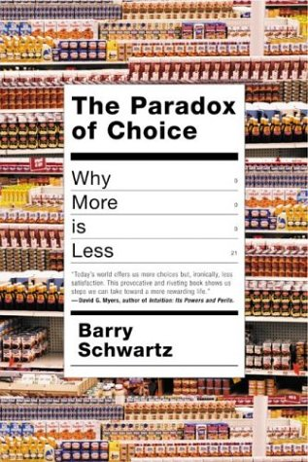
#2: The Paradox of Choice

Slide 34
#2: The Paradox of Choice
The paradox of choice indicates two familiar features in digital music:
  Traditional marketing and heavy budgets
    Familiarity and brand-recognition
  Playlists
    Choose not to choose
    Curated experiences!

Slide 35
#2: The Paradox of Choice
Playlists and algorithms
Curatorial system: The syndicate
Algorithms and metadata
  Ex: Indie label club track
  Ex: Major artist, Norwegian indie

Slide 36
#3: ARPU
Average
Revenue
Per
User

Slide 37
#3: ARPU
Tiered level pricing
Value propositions
Curation

Slide 38
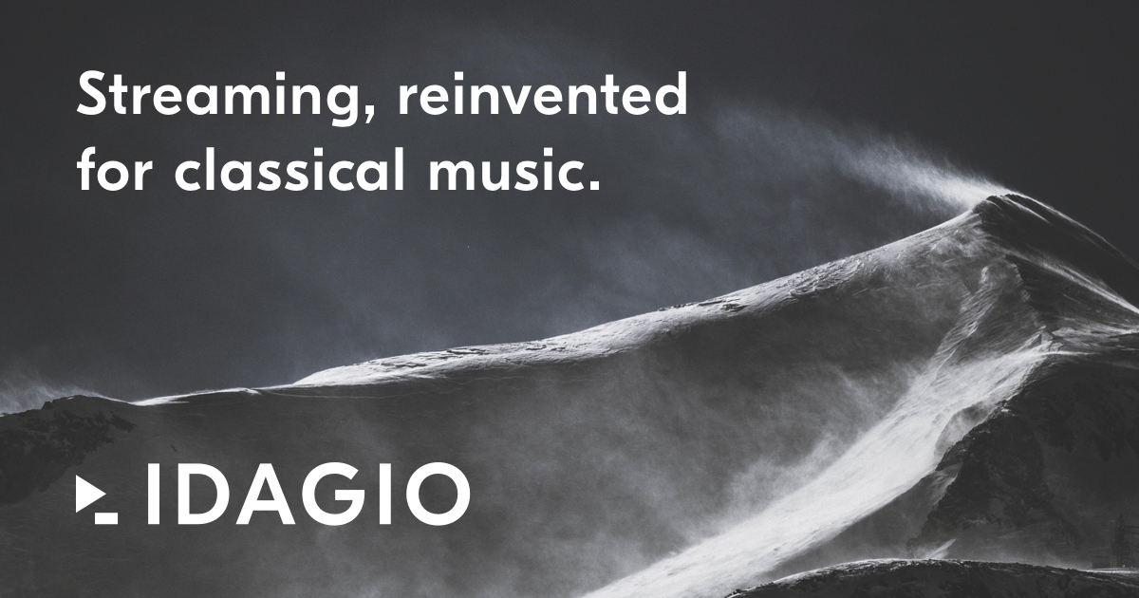

Slide 39
Music entrepreneurship
Growth in so-called DIY-culture (Do It Yourself), or increased amateur activity (Wikström, 2020), and a more artist-centred economy (Tschmuck, 2017).
Spilker, 2012/2018: The networked artists, DIY potential, but professional collaborations preferable.
Major opportunities to create, distribute and market your music
But also potential hidden costs (Nordgård, 2022)
  Requires specialized skills
  Increasing focus on mental health (Gross and Musgrave, 2020)
Dr. George Musgrave: The lure of entrepreneurship
  Are we seeing innovation and entrepreneurship, or are we seeing forced adoption of functions

Slide 40



Slide 41
CreaTeME
CreaTeME: Norwegian Centre For Excelence in Creative use of Technology in Music Education
Five-year project (with potential additionally 5 years), with €8 mill. to develop a national and international hub for the development of innovative artistic and pedagogical approaches to technology in higher music education.

Slide 42
CreaTeME
WP4: Objective: Explore entrepreneurship as an integrated part of music education, allowing students to develop an entrepreneurial mindset fruitful to cope with emerging markets.
Must be viewed in light of the digital turn
Must be adapted to the contexts of musicianship
  Music Entrepreneurship sometimes defies the laws of gravity…..
Must be updated to the changes continually taking place in the music industries.

Slide 43
Thank you!
Daniel Nordgård
  Universitetet i Agder
  daniel.nordgard@uia.no
  @danielnordgard
Book out: The Music Business and Digital Impacts

