Slide 1
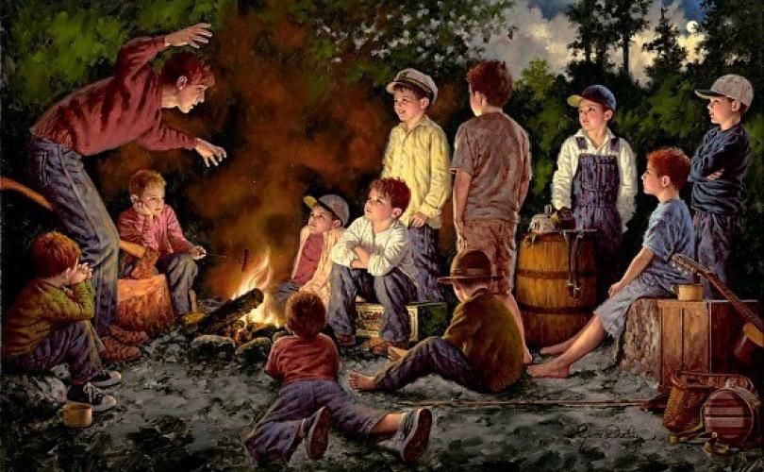

Storytelling and pitching for the business environment

Slide 2
Change how you think about writing

Slide 3
Write more effectively
Clearly communicate your written ideas
Get more people to accept what you write
Have your writing read

Slide 4
You are not just writing about subjects…

Slide 5
You are communicating them

Slide 6

Storytelling

Slide 7
Why do we tell stories?
Storytelling is hardwired into our brains

Slide 8
Neat narratives arrange complex reality into tidy parcels
Without them our lives would be a mess of details
We create meaningful patterns to avoid overwhelm

Slide 9
Joining the dots
The experiencing self
The narrating self

Slide 10
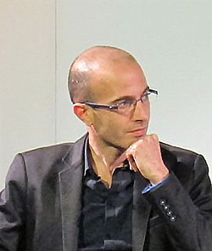
“Most of us identify with our narrating self. When we say ‘I’, we mean the story in our head, not the onrushing stream of experiences we undergo. We identify with the inner system that takes the crazy chaos of life and spins out of it seemingly logical and consistent yarns”
Yuval Noah Harari - “Homo Deus”

Slide 11
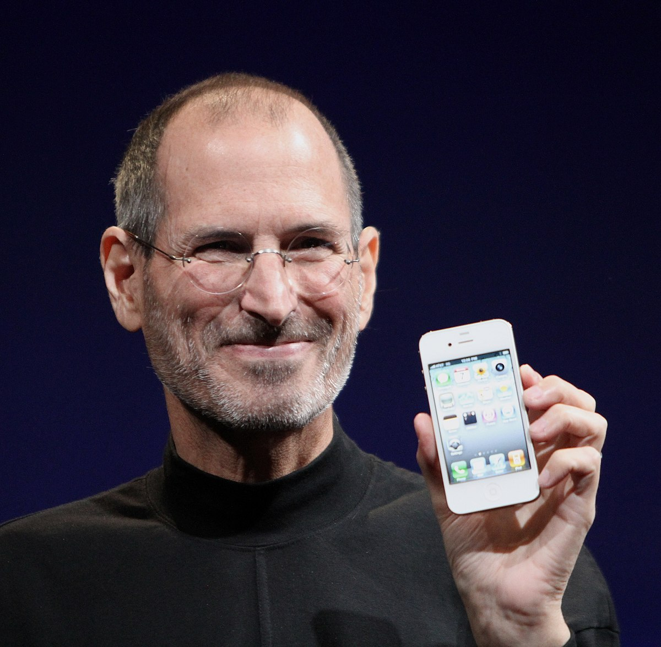
Steve Jobs – Stanford Address 2005
https://www.youtube.com/watch?v=UF8uR6Z6KLc

Slide 12
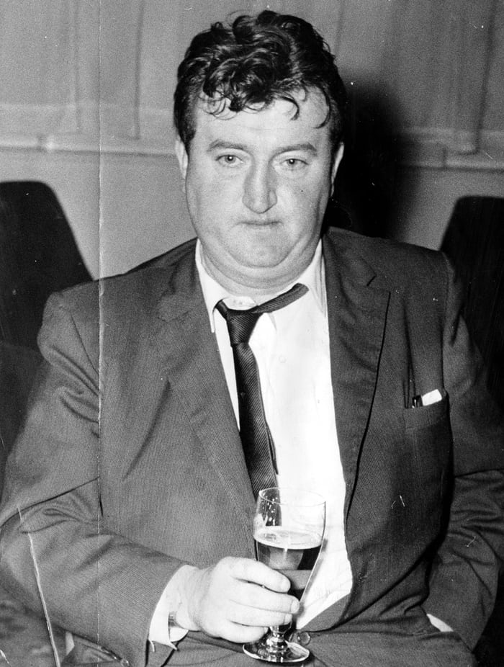
Narrative and story
All stories are narratives
Thankfully, many of our narratives are stories
Narratives tend to be flat, bland, boring and repetitive - ‘I did this, then that, then this..’
Stories are engrossing, engaging

Slide 13
Everybody likes to hear stories
Our brains are more active when we hear stories
Language, visual and other sensory elements are activated

Slide 14
Story telling is central to media, business, brands, business pitches and interviews

Slide 15
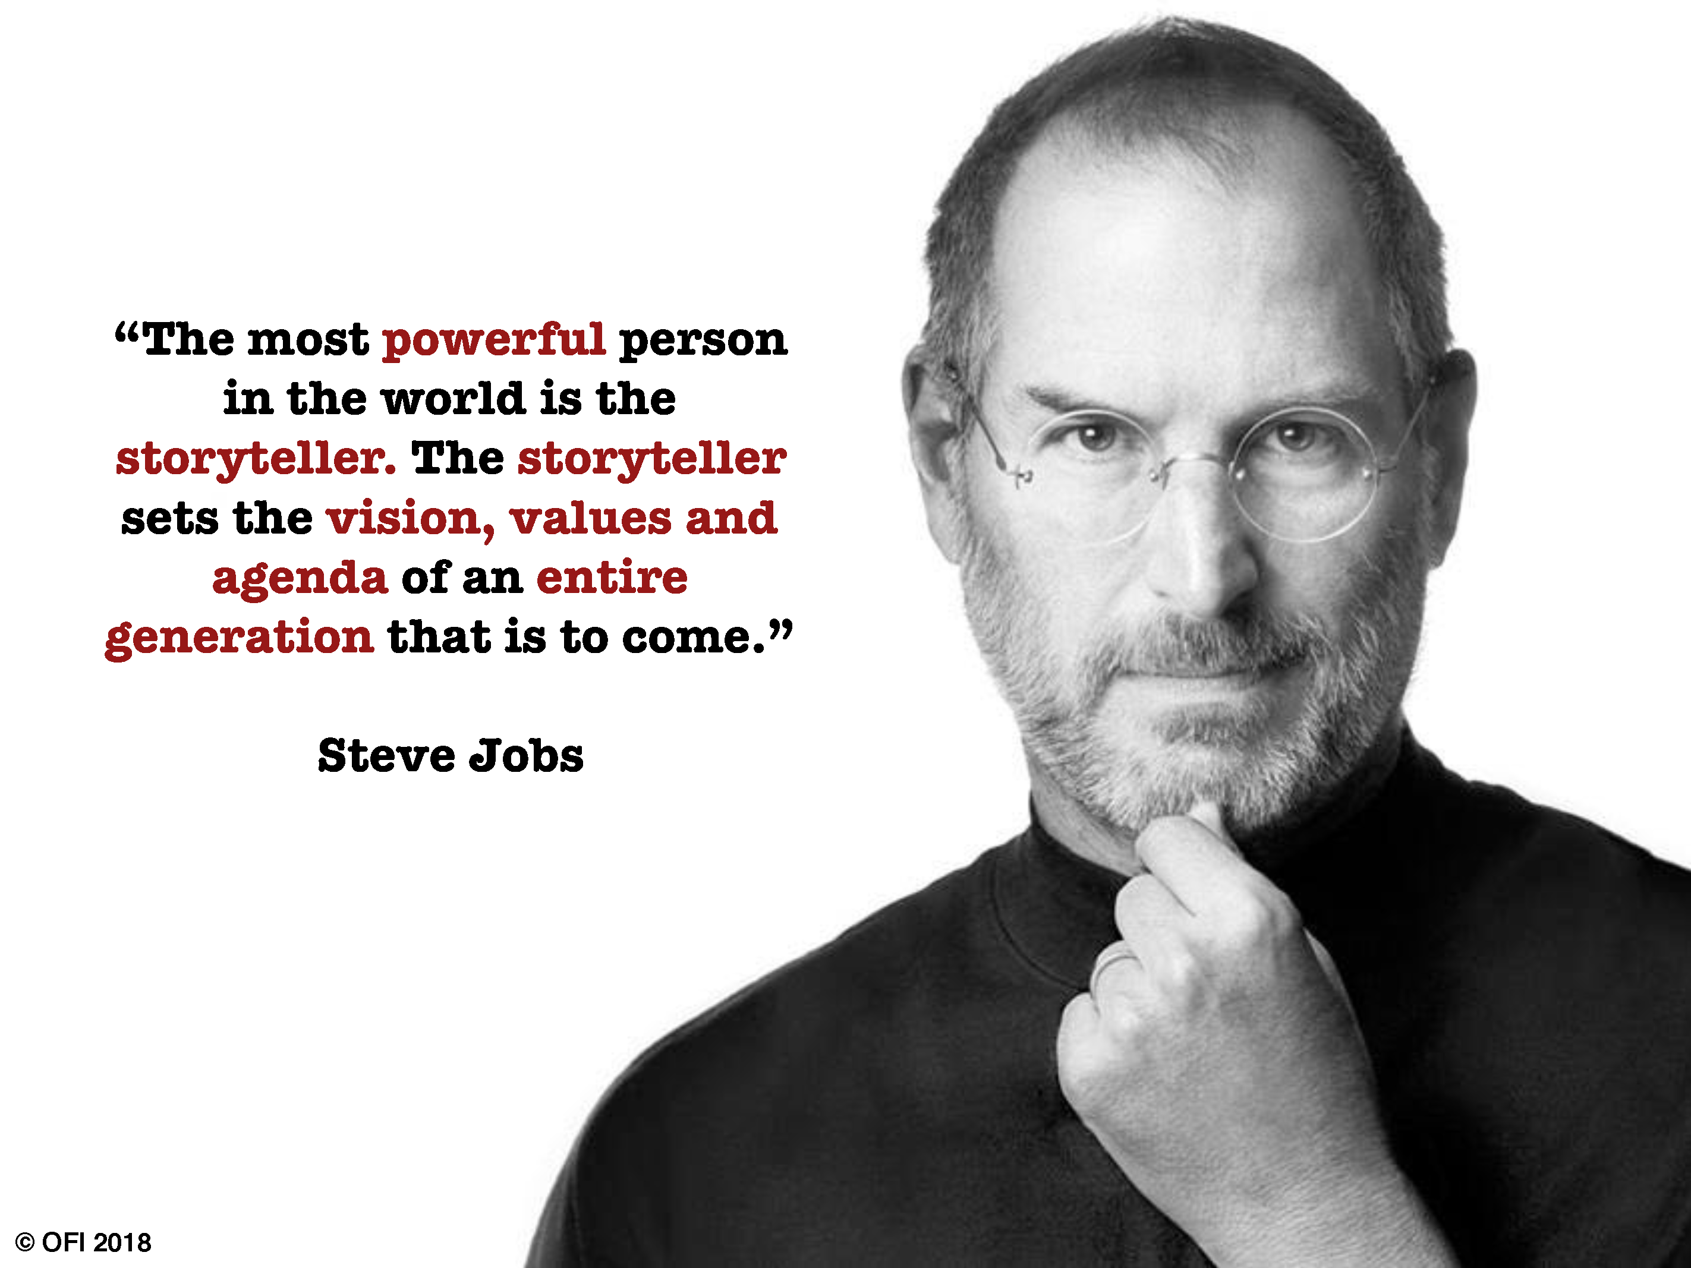

Slide 16
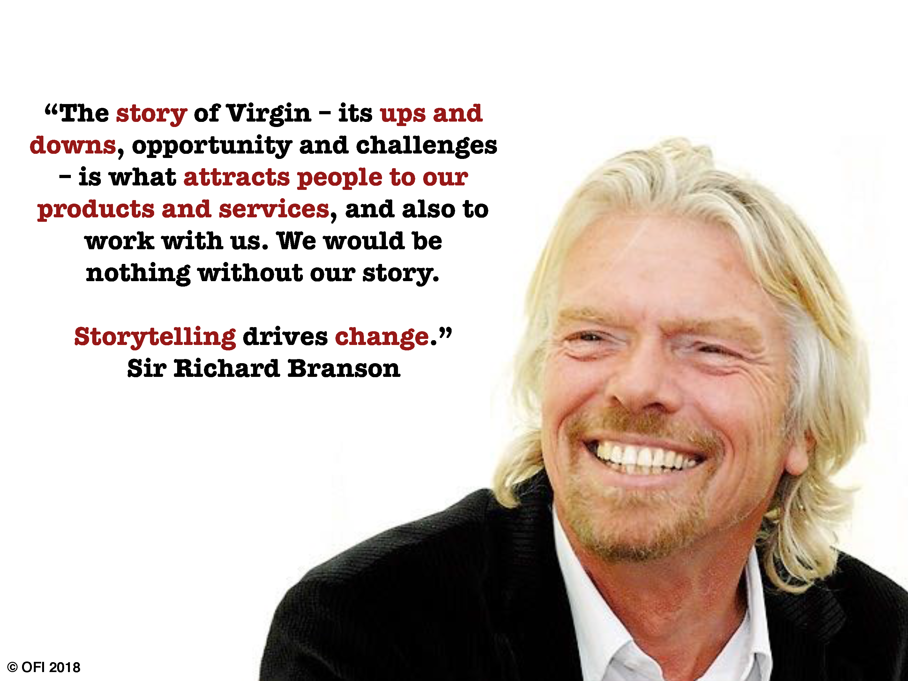

Slide 17
Why tell stories?
Positioning: The stories you tell help to position you (or your client/company) in the best way possible
Create emotions: stories are designed to create emotions in the audience
Memory: stories allow us to remember information more easily (London School of Business study)

Slide 18
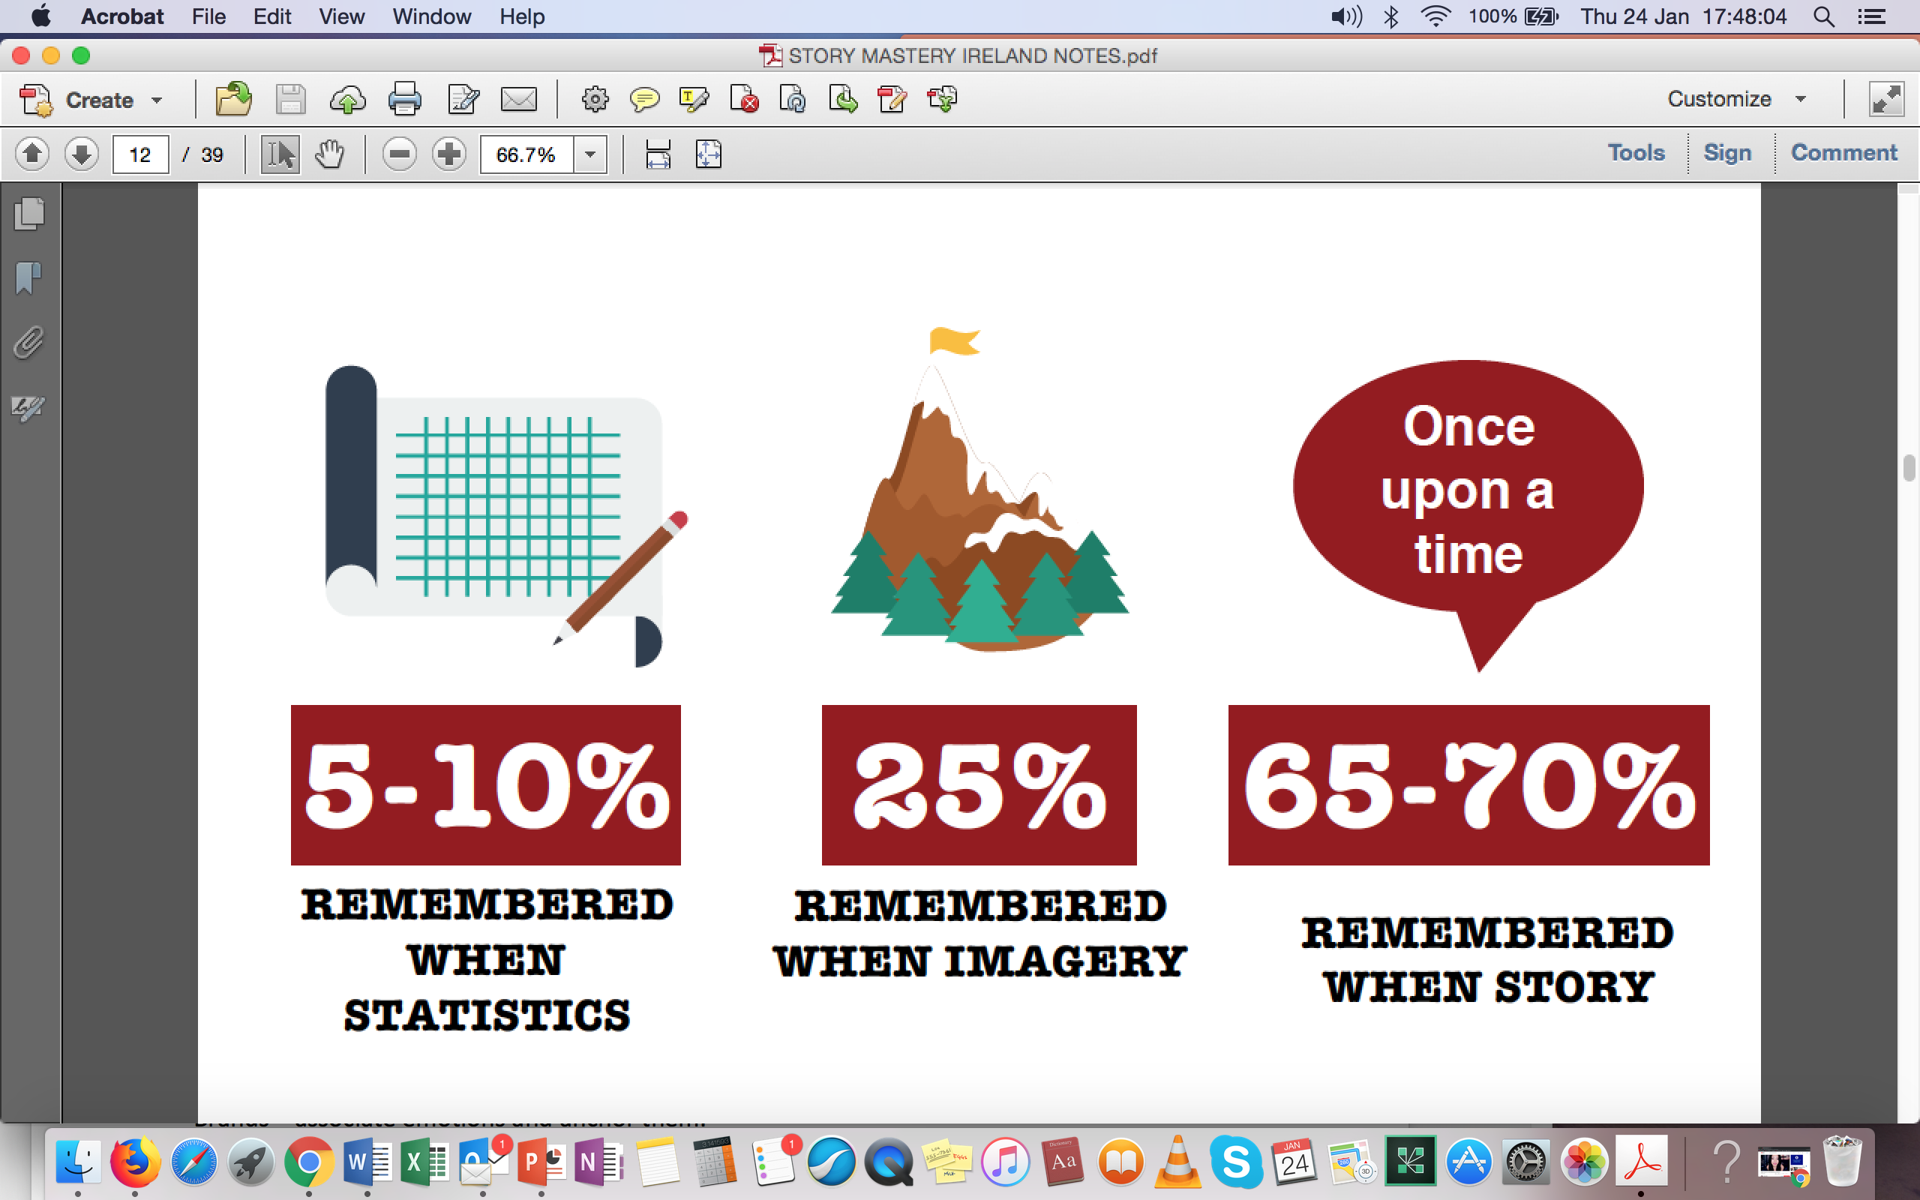

Slide 19
Three types of story:
Personal (make them descriptive and rich in imagery so audience can imagine it)
Stories about other people (turning abstract concepts into tangible, emotional and memorable ideas)
Stories about brand success

Slide 20
Types of business stories
Origin story: a story about how the company was formed, it positions the personality and credibility of the organisation
Evolution story: tells how the company has changed and adapted to particular circumstances
Visionary story: this outlines where the company is going in the future and why

Slide 21
Types of business stories
Brand story: a brand story creates the feeling the overall brand is meant to create in the mind of the audience
Product story: explains how an individual product or service was developed for the customer

Slide 22
Joining the dots 2
Process of selection
Editing – what to leave in, what to leave out

Slide 23
Create a story
Business/product/service – what’s the story?
Personal brand – what’s your story?

Slide 24
The three-act structure

Slide 25


Slide 26


Slide 27
Three-act structure
Act 1 – beginning (set up)
Act 2 – middle (conflict/confrontation)
Act 3 – end (resolution)

Slide 28
Act 1 is the set up
Set up the story, establish characters, tell us what the story is about, show the circumstances surrounding the action, create relationships between the main character and the other characters

Slide 29
Act 2 is conflict/confrontation
The main character faces obstacles that stop him/her from getting what s/he wants – to win, gain, get or achieve

Slide 30
Act 3 is resolution
Resolution doesn’t mean ending, it means solution. This resolves the story. Does the main character get what s/he wants or not? Do they succeed or fail?

Slide 31
“All drama is conflict. Without conflict you have no action; without action you have no character; without character you have no story”
(Syd Field, Screenplay)

Slide 32

The story of Apple

Slide 33
Act 1 is the set up
Set up the story, establish characters, tell us what the story is about, show the circumstances surrounding the action, create relationships between the main character and the other characters
Steve Jobs and Steve Wozniak co-founded Apple in Jobs’ parents’ garage in 1977, introducing first the Apple I and then the Apple II. Apple went public in 1980 with Jobs the blazing visionary and Wozniak the shy genius executing his vision.

Slide 34
Act 2 is conflict/confrontation
The main character faces obstacles that stop him/her from getting what s/he wants – to win, gain, get or achieve
Executive John Scully was added in 1983 and in 1985, Apple's Board ousted the combative Jobs in favour of Scully.

Slide 35
Act 3 is resolution
Resolution doesn’t mean ending, it means solution. This resolves the story. Does the main character get what s/he wants or not? Do they succeed or fail?
Away from Apple, Jobs invested in and developed Pixar and then founded NeXT to create high-end computers; NeXT eventually led him back to Apple in the late 1990s, where he revamped the company and transformed technology and communication in the process.

Slide 36
When it comes to storytelling, suit the story to the medium
News/press releases
Feature articles
Interviews with key people
Profiles of companies, organisations, people
Video
Audio/podcast
Print or online

Slide 37
Writing – you just can’t get away from it
Many people don’t like writing - why?

Slide 38
Writing is hard
Research, data collection, data analysis - cool
“Writing is frustrating, complicated, and un-fun” - Dr Paul Silvia
“If you find that writing is hard, it’s because it is hard” - William Zinsser, On Writing Well

Slide 39
Yet writing is is part of life
And it’s fundamental to all communication
Academic content
Creative writing/fication – short stories, novels, plays
Film – screenplay
Journalism – news, features
Video – story structure, dialogue
Audio/podcast – story structure/script
Presentation/pitch – story structure/pitch

Slide 40
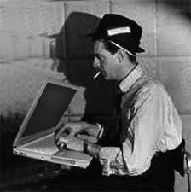
The style of News Writing

Slide 41
Simplicity
Study the news writing style
It teaches you to write simply and directly

Slide 42
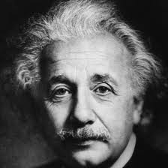
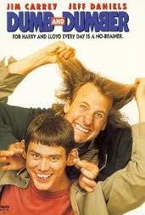
News has to be understood by all

Slide 43
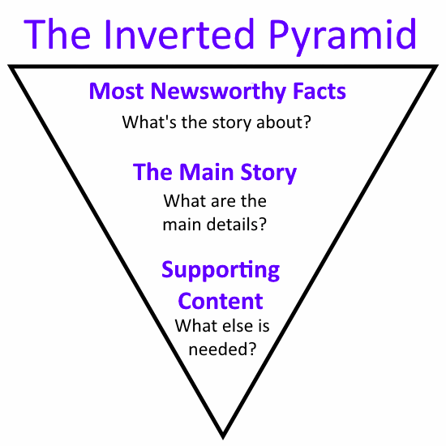
Key Structure – The Inverted Pyramid

Slide 44
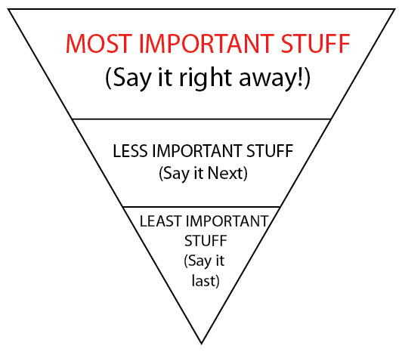

Slide 45
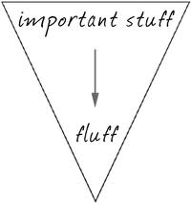
Inverted Pyramid

Slide 46
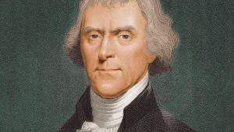
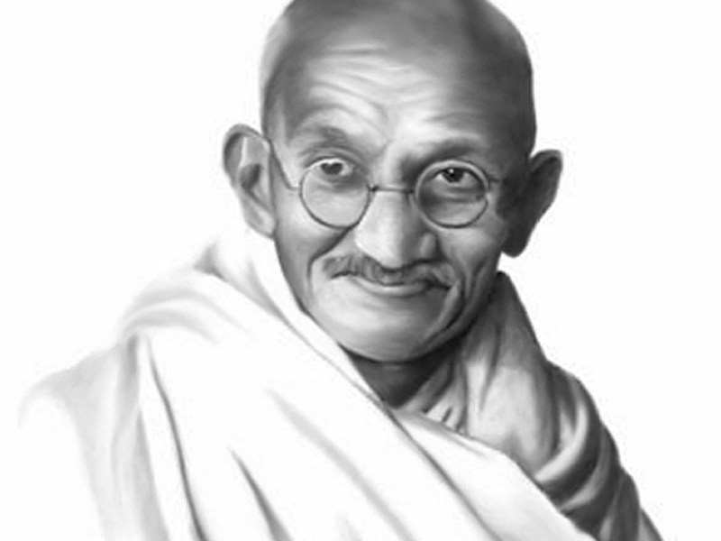
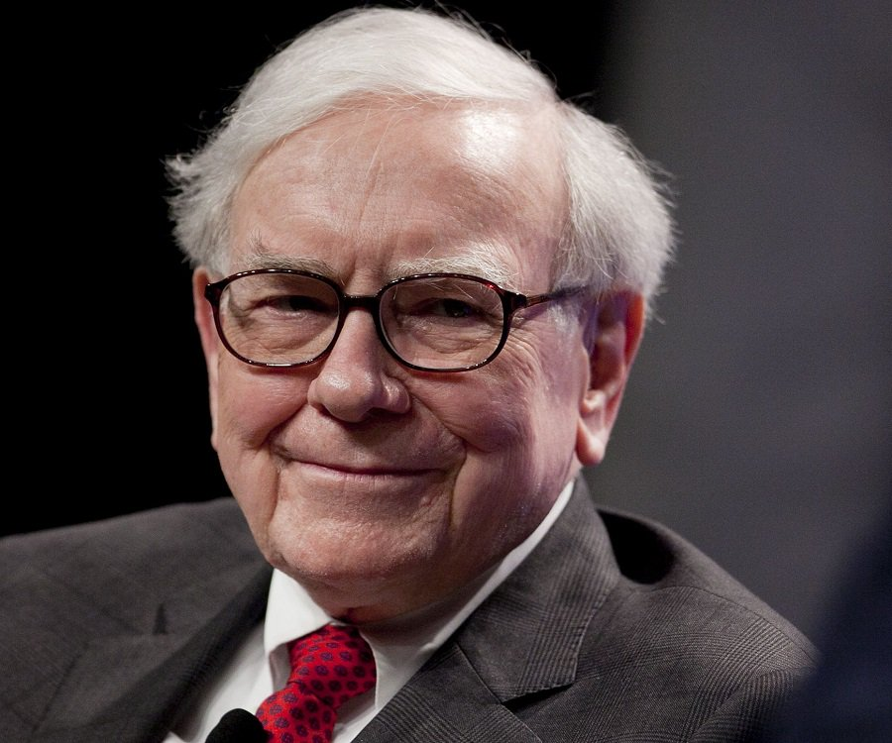
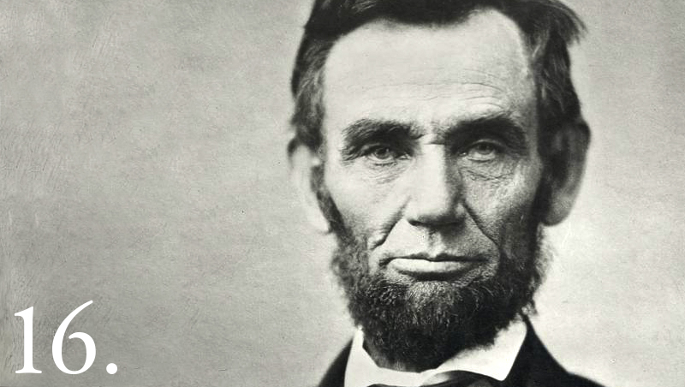

Slide 47
Two Important Points
It’s about persuasion/influence
The skills can be learned

Slide 48
Tips for overcoming nervousness
Remember the value of your content
Vividly imagine yourself succeeding
You are in control
Uncomfortable moments are OK!

Slide 49
Preparing the pitch
Creating structured content – The Three P’s
Plotting: the messages/audience/feelings
Planning: introduction/body/conclusion
Preparation: rehearse delivery vividly

Slide 50
Plotting: what you are going to say?
The messages/audience/feelings
Brainstorming: What message(s) do you want the audience to take away?
Who’s your audience? What do they want from you?
How do you want your audience to feel when you are finished talking – motivated, entertained, informed, fired up, relaxed….?

Slide 51
Planning/Writing the Pitch
Introduction/body/conclusion
Primacy effect/recency effect
Compelling, dramatic intro, powerful conclusion
Body: Use ideas/messages you came up with during the plotting

Slide 52
Delivering the Pitch
3 to 5 key messages
Deliver messages using examples/stories/stats
Conclusion - review key messages, what audience has learned and what they must do next

Slide 53
Rehearse in your mind as vividly as possible

Slide 54

Non-Verbal Communication

Slide 55


Slide 56
Powerful gestures
The Steeple
The Prince Charles

Slide 57
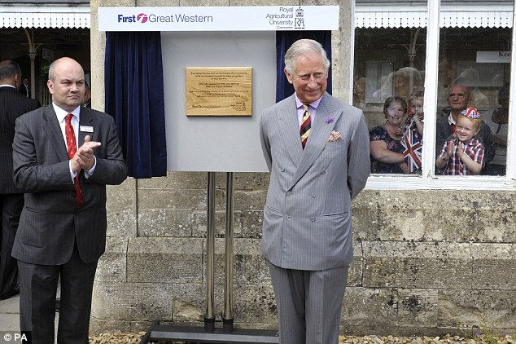

Slide 58
YES sets
COMPLIANCE sets
Calibration

Slide 59
People will eventually forget what you said and people will eventually forget what you did. But people will never forget how you made them feel.

Slide 60


