Slide 1

Fantasy

Slide 2
Summary:
Controllers
Dtos and validation
Security
Tests
Documentation
The motive
Expectation vs reality
Use cases
ERD Diagram
Repos & services

Slide 3


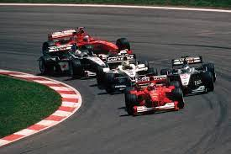
The motive
Since I was a kid, I was watching every other weekend a race of Formula 1. The passion stuck with me, although I had some periods when I wasn’t very involved.
When I’ve heard the we can choose our project’s domain, I wanted to choose something different, so I figured I want to make it about F1.

Slide 4
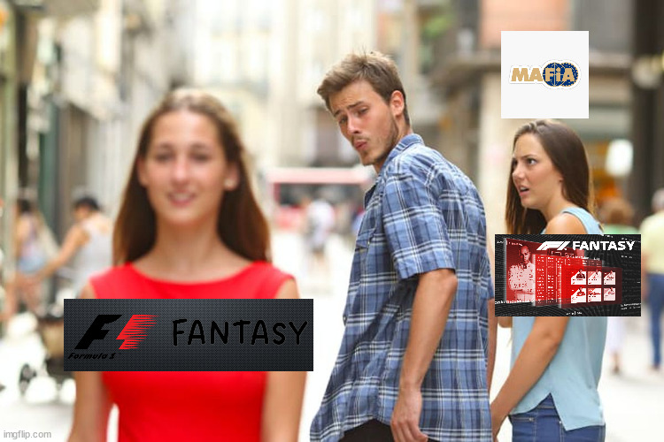
Expectation

Slide 5
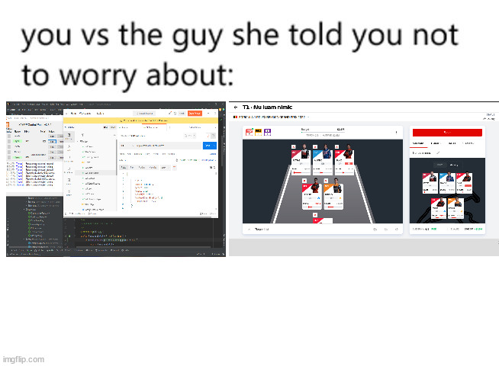
Reality

Slide 6
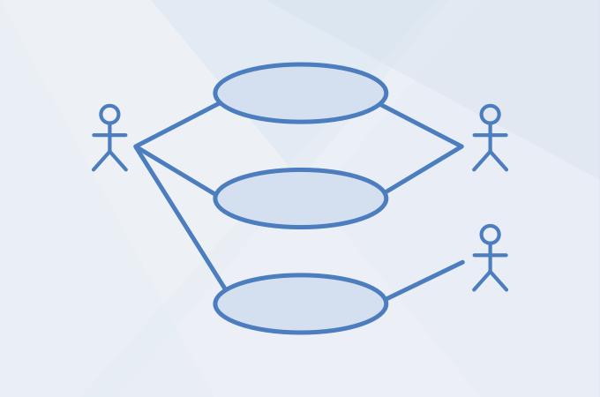
Use cases
You can create a user to play the game
The user can see details about all the drivers
The user can see details about all the constructors
The user can create a team
The user can see stats about his/her team
The user can modify his team (constructor / drivers)
The user can create leagues
The user can join a league
The user can see a leagues leaderboard
The admin can change the number of points / the cost of constructors / drivers
And others..

Slide 7
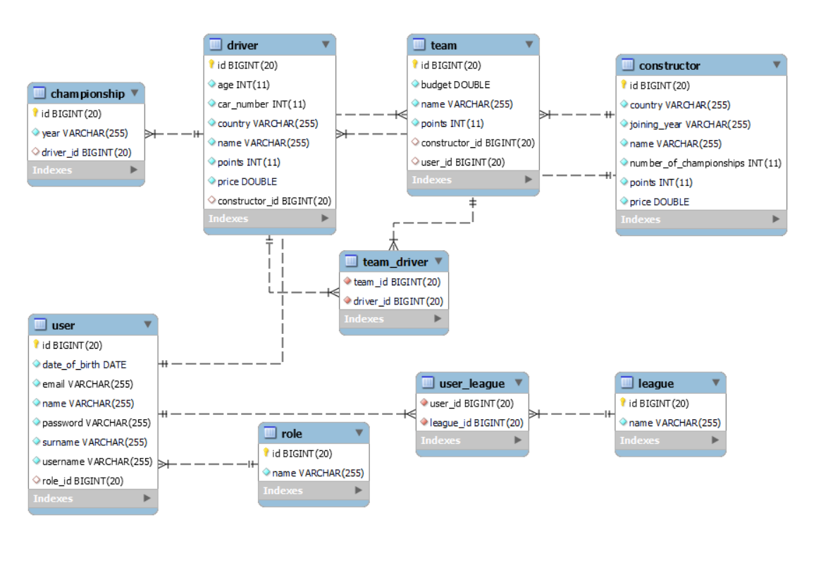
ERD Diagram

Slide 8
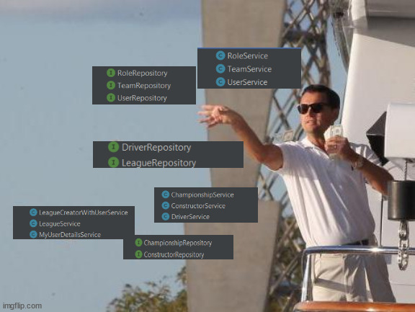
Repos & services

Slide 9
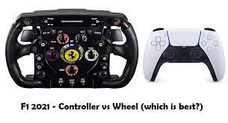
Controllers
I focused on the GET, POST, PUT and PATCH mapping and I used all the methods that you can send information on the request:
  Path variable
  Request param
  Request body

Slide 10
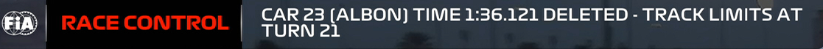
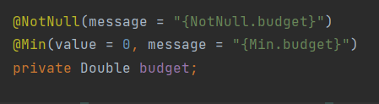
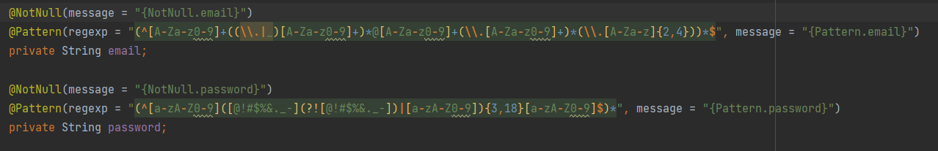
Dtos and validation
I created dtos for every POST and PUT method.
For validation, I used the annotations @NotNull, @Pattern (for the love of regex) and @ Min
The messages were configured in a different file named messages.properties

Slide 11
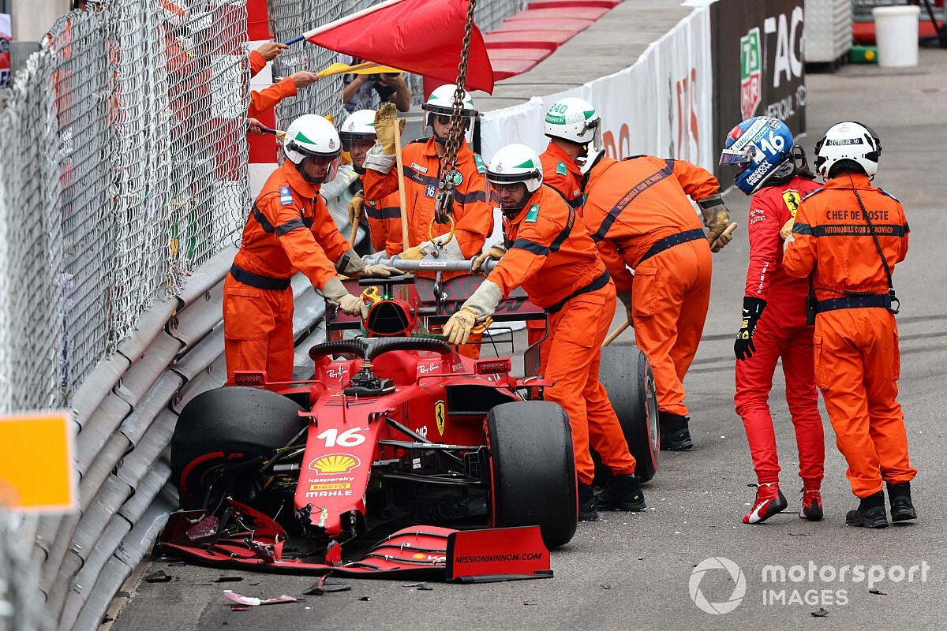
Security
For the security part, I adapted the users and roles in security objects that implement granted authority and user details.
The passwords are encrypted with a BScryptEncoder and the permissions are restricted based on the role
Every action / method can be accessed by everyone, only by the logged users or only by admins

Slide 12
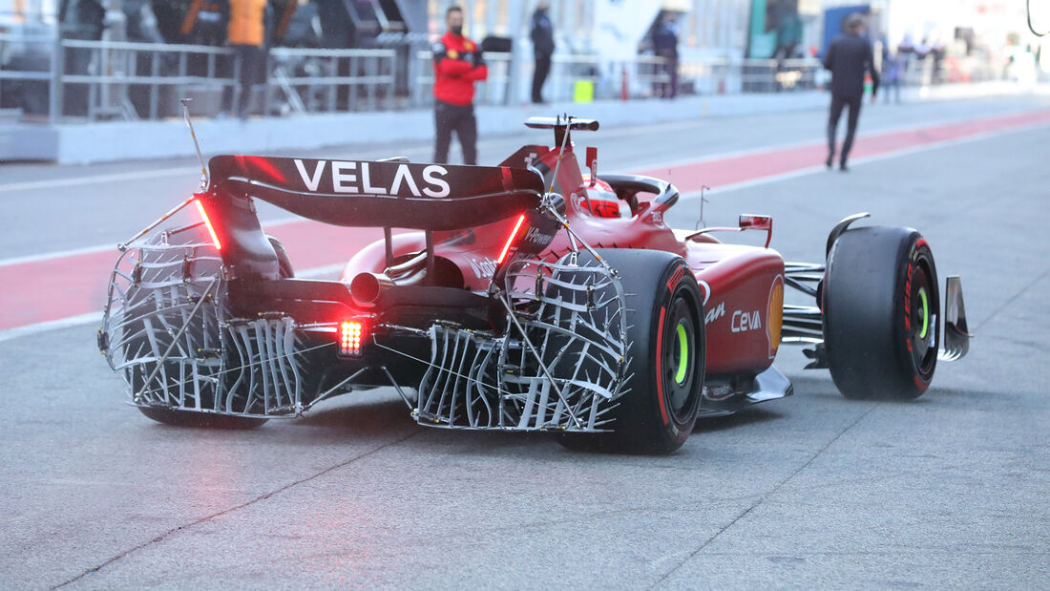

Tests
Ah..The thing I hated the most during this project
I made a couple of test for each category: unit tests, integration tests and api tests.

Slide 13
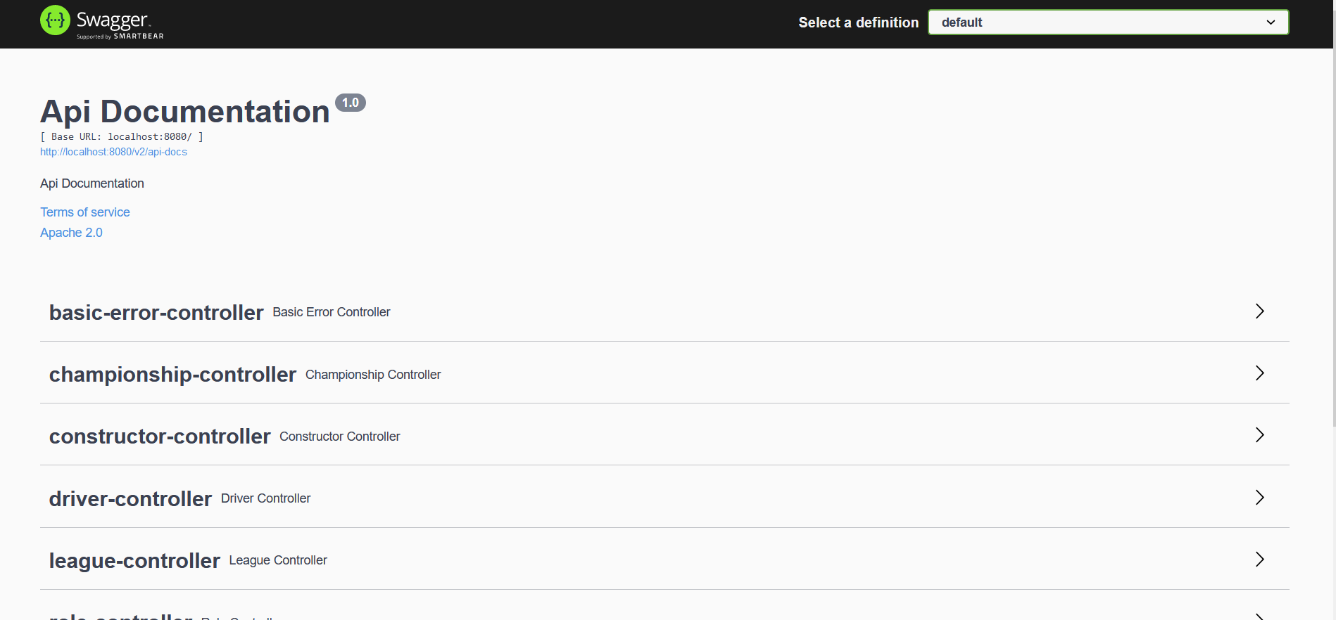
Documentation

Slide 14
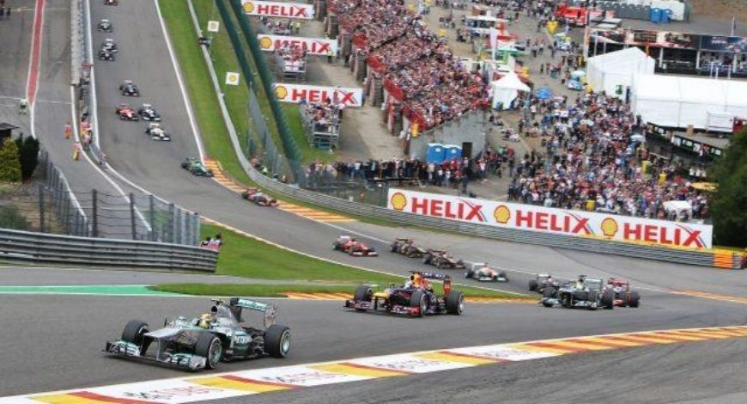
?

Slide 15
Thank you for attention!

