Slide 1
Abusive language detection in social media
Dumitrescu Andrei
Ionescu Diana

Slide 2
Abusive language in social media
Social media is a common way to communicate and to express your thoughts.
Abusive language is usually used to undermine others’ opinions.
We would like to build a system that can detect and classify the use of abusive language in social media content.

Slide 3
Research
Metrics
Datasets
Architectures

Slide 4
Metrics
Metrics
Macro F1-Score
Precision
Recall

Slide 5
Datasets
Conv Abuse
Made of conversations with 3 different chatbots: ELIZA, Alana V2, Carbon Bot.
Made from 6837 samples with 20,710 ratings.
27% of the samples are classified as abusive.
Toxic Comment Dataset
Combines 43 datasets publicly available with comments, mainly Twitter.
Contains 126 distinct labels.
The dataset can be split in abusive / non-abusive samples.
812,920 samples from which: 519,076 non-toxic and 293,844 toxic.
Abusive Language on YouTube
Contains 20,215 YouTube comments, from which 11.42% are abusive.
Three video topics: Gender Identification, Veganism, Workplace Diversity
Three video categories: personal videos, reaction videos, official videos.
Uses a 7-point scale for annotation.

Slide 6
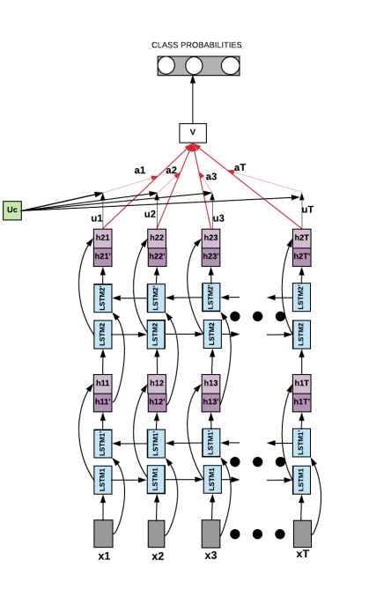
State-of-the-art Approaches (1)
Stacked Bi-LSTMs with Attention
Uses Bi-LSTMs based architecture.
Uses word-embeddings for data representation.
Compares two types of attention: contextual attention and self-attention.

Slide 7
State-of-the-art Approaches (2)
HateBERT
Retrains BERT on a custom dataset RAL-E using the Masked Language Model task.
RAL-E incorporates 1,492,720 abusive comments extracted from banned communities from Reddit.
Fine-tunes HateBERT for the abusive language task and compares it to the classical BERT.

Slide 8
Our Roadmap
Datasets
Decide on different datasets to use.
Baselines
Train different baselines on the selected datasets.
Possible Baselines: Logistic Regression, SVMs, NNs.
First Iteration
Experiment with the previous described SOTA architectures.
Compare them with the Baselines.
Second Iteration
Datasets must incorporate different contexts of social media.
Combine the ideas behind HateBERT and contextual attention.
Train the resulting model and compare it with the previous experiments.

Slide 9
Papers
Curry, A. C., Abercrombie, G., & Rieser, V. (2021, November). ConvAbuse: Data, Analysis, and Benchmarks for Nuanced Detection in Conversational AI. In Proceedings of the 2021 Conference on Empirical Methods in Natural Language Processing (pp. 7388-7403).
Risch, J., Schmidt, P., & Krestel, R. (2021, August). Data integration for toxic comment classification: Making more than 40 datasets easily accessible in one unified format. In Proceedings of the 5th Workshop on Online Abuse and Harms (WOAH 2021) (pp. 157-163).
Bertaglia, T., Grigoriu, A., Dumontier, M., & van Dijck, G. (2021, August). Abusive Language on Social Media Through the Legal Looking Glass. In Proceedings of the 5th Workshop on Online Abuse and Harms (WOAH 2021) (pp. 191-200).
Chakrabarty, T., Gupta, K., & Muresan, S. (2019, August). Pay “attention” to your context when classifying abusive language. In Proceedings of the Third Workshop on Abusive Language Online (pp. 70-79).
Caselli, T., Basile, V., Mitrović, J., & Granitzer, M. (2020). Hatebert: Retraining bert for abusive language detection in english. arXiv preprint arXiv:2010.12472.

Slide 10
Thank you for your attention!

