Slide 1
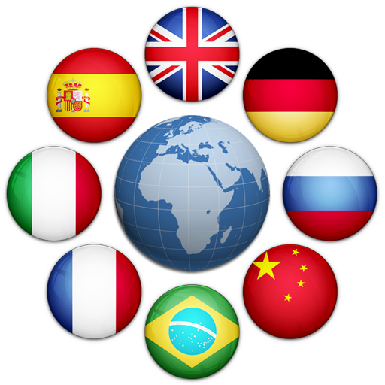

Language Translator App
Andrei Galca, Aisha Mahmoud, Nate Peterson

Slide 2
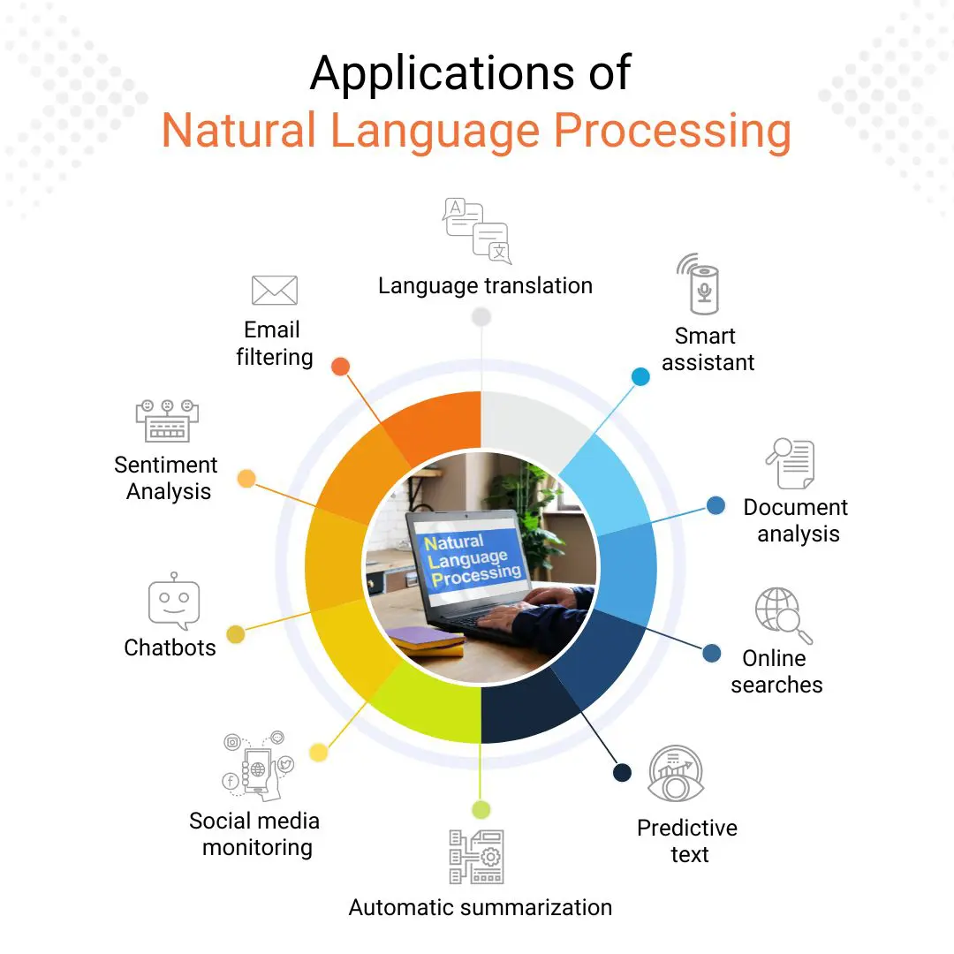
(NLP) Natural language Processing
Natural Language Processing (NLP) refers to the branch of computer science and more specifically, the branch of (AI) Artificial Intelligence concerned with giving computers the ability to understand text and spoken words in much the same way human beings can.

Slide 3

1911- Professor Ferdinand de Saussere developed an approach describing languages as systems where a sound represents a concept. This laid the foundation for the seeing language through the structuralist approach.
1950- Alan Turing and a test for a “thinking” machine, if a machine could be part of a conversation
1952 - Hodgkin-Huxley model showed how brain uses neurons to form an electrical network
1957- Naom Chomsky concluded that for a computer to understand a language, the sentence structure has to be changed. He created Phase-Structure grammar
1964- ELIZA was created to imitate a psychiatrist.
1964 - US. National Research Council (NRC) created Automatic Language Processing Advisory Committee (ALPAC) to evaluate progress of NLP research
1966- NRC and ALPAC halted the funding of research on NLP/machine translation; it was too expensive and getting nowhere. Many thought that this was the end of AI and NLP research. Was it?!
1980- Machine learning algorithms were developed…
1990s - Statistical models were used a lot for natural language processes analyses. (N-grams)
1992- The first public machine translation was created (English to German)
1995- An online, free program that could automatically translate text into several languages was introduced. (Babel Fish Altavista)
1997- Recurrent Neural Net (RNN) models used for first time
2001 - First Neural “language” model using feed-forward neural network
2011- “Siri” from Apple was one of the world’s first successful NLP/AI assistants.
2010s, 2020s… - It’s been growing ever since!

Slide 4

IMPORTANCE OF LANGUAGE AND TRANSLATION
Translating your website for these 4 countries is estimated to give you access to 50% of worldwide sales potential: United States, China, Japan, and Germany.
Translating your website to the following languages enables you reach 80% of the online purchasing power globally: English, Chinese, Japanese, Spanish, German, French, Portuguese, Italian.
Around 40% of internet users said they will never buy from websites that are not in their native language. 65% of non-native English speakers prefer content in their native tongue, even though they are highly proficient in English.
Fortune 500 companies were reported to be 2.04 times more likely to improve profits and 1.27 times more likely to generate more earnings per share when they invested in translation.
The machine translation market alone was valued at USD 650 million in 2020 and is expected to reach USD 3 billion by 2027. In 2020, the demand for translation in healthcare increased by 49% due to the need to dispense COVID-19 healthcare information
Among those who use translation software, the 3 main areas of expertise were reportedly Tech/Engineering (34%), Business/Financial (15%), and Marketing (12%)
Google Translate has over 500 million users daily

Slide 5
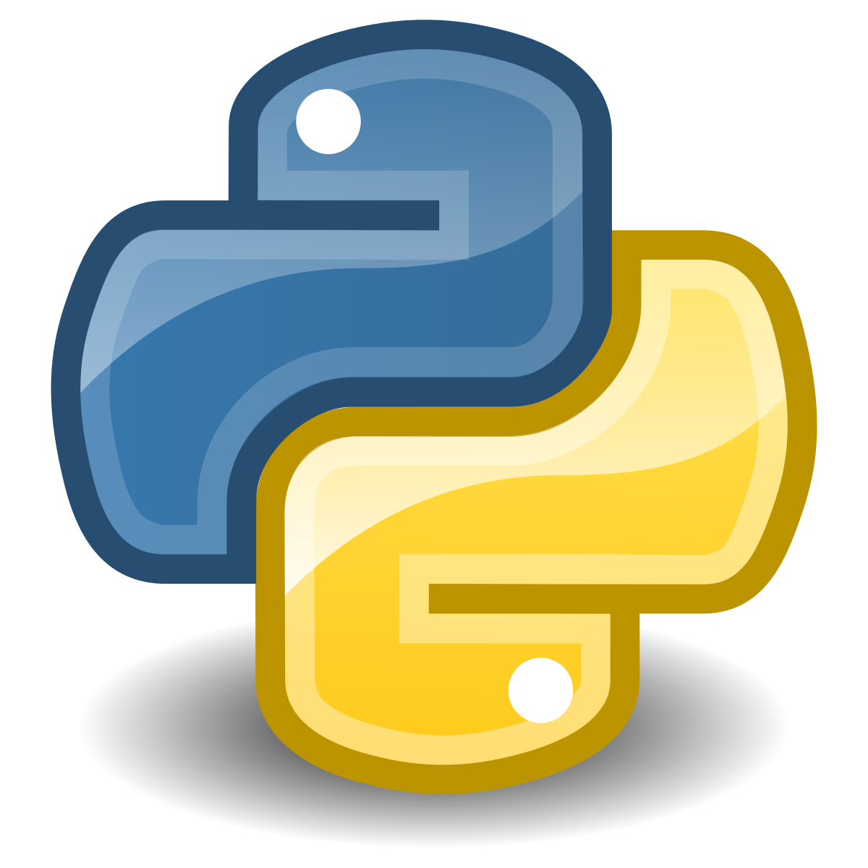

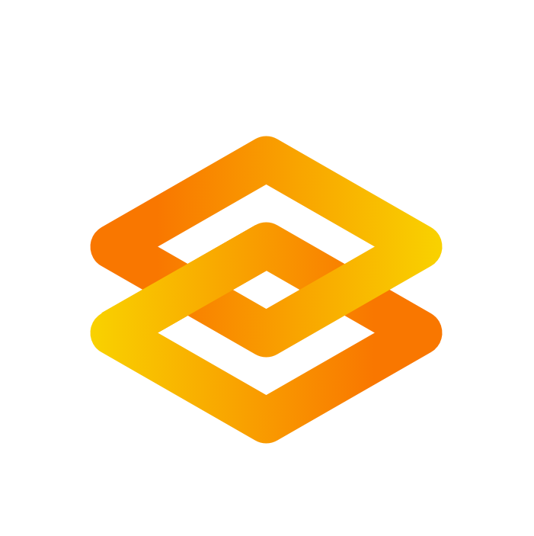

Our Application
Is a language translation tool that utilizes state-of-the-art transformer models from the Hugging Face's transformers library.
It employs the Gradio library to create a user-friendly interface. Users can input English text into a textbox, choose their desired target language from a dropdown menu (German, French, or Romanian), and receive the translated text in real-time.
The application streamlines the translation process, making it accessible and interactive through a web-based interface.
Also, to mention that we chose google collab as our environment to work since it’s very easy to share between us and work at the same time!

Slide 6

STEPS TO BUILD OUR APPLICATION !

Slide 7

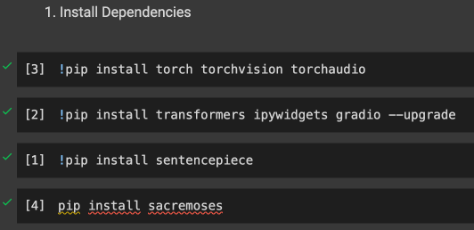
1. Install dependencies
This code installs several Python packages using the pip package manager:
torch, torchvision, torchaudio: Installs the PyTorch deep learning framework along with its vision and audio libraries.
transformers, ipywidgets, gradio: Installs the transformers library for natural language processing, ipywidgets for interactive widgets, and Gradio for creating UIs for machine learning models. The --upgrade flag ensures that the packages are updated to the latest versions.
sentencepiece: Installs SentencePiece, a library for text tokenization.
sacremoses: Installs SacreMoses, a library for processing and tokenizing multilingual text.

Slide 8
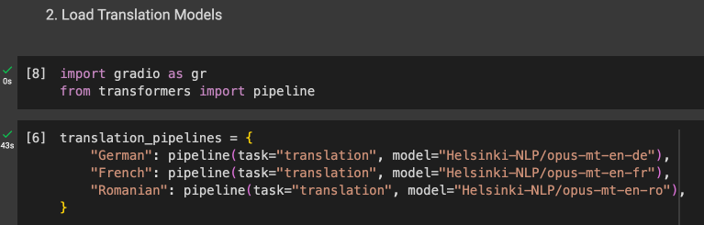
2. Load translation models and define functions
In the second step, we use the Gradio library and the Transformers library to create translation pipelines for three languages: German, French, and Romanian. Here's a breakdown:
Import Libraries:
gr: This imports the Gradio library, which is used for creating user interfaces for machine learning models.
pipeline from transformers: This imports a generic function from the transformers library that makes it easy to use pre-trained models for various natural language processing tasks.
Translation Pipelines:
Three translation pipelines are created for different languages using the pipeline function.
The specified translation models are from the Helsinki NLP model hub and are trained for English to German, English to French, and English to Romanian translation.
The pipelines are stored in a dictionary named translation pipelines, where the keys are the target languages ("German," "French," "Romanian").

Slide 9
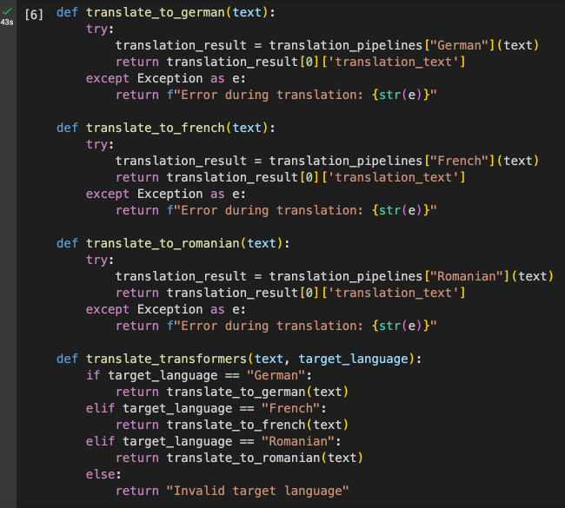
This code defines four functions for translating text using pre-trained translation models from the transformers library. Here's a brief explanation:
translate_to_german(text): Translates the input text to German using the translation pipeline for the German language. If an error occurs during translation, it catches the exception and returns an error message.
It does the exact same thing with the French and Romanian.
translate_transformers(text, target_language): This function serves as a wrapper for the previous three functions. It takes the input text and a target language as parameters. Depending on the specified target language, it calls the corresponding translation function (translate_to_german, translate_to_french, or translate_to_romanian).
If the target language is not one of the specified options, it returns an "Invalid target language" message.

Slide 10
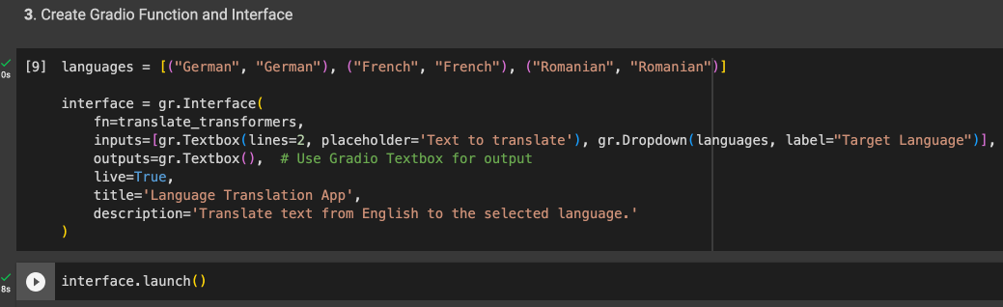
3. Create Gradio function and interface
interface = gr.Interface(...): This creates a Gradio interface for the language translation application.
fn=translate_transformers: Specifies the function that will be used for translation. In this case, it's the translate_transformers function defined earlier.
inputs: Specifies the input components for the interface. It includes a textbox for entering the text to be translated and a dropdown for selecting the target language.
outputs=gr.Textbox(): Specifies the output component of the interface, which is a textbox where the translated text will be displayed.
live=True: Enables live updates, meaning the translation occurs as the user interacts with the input components.
title and description: Set the title and description for the interface.
interface.launch(): This launches the Gradio interface, making it accessible for users to input text and

Slide 11
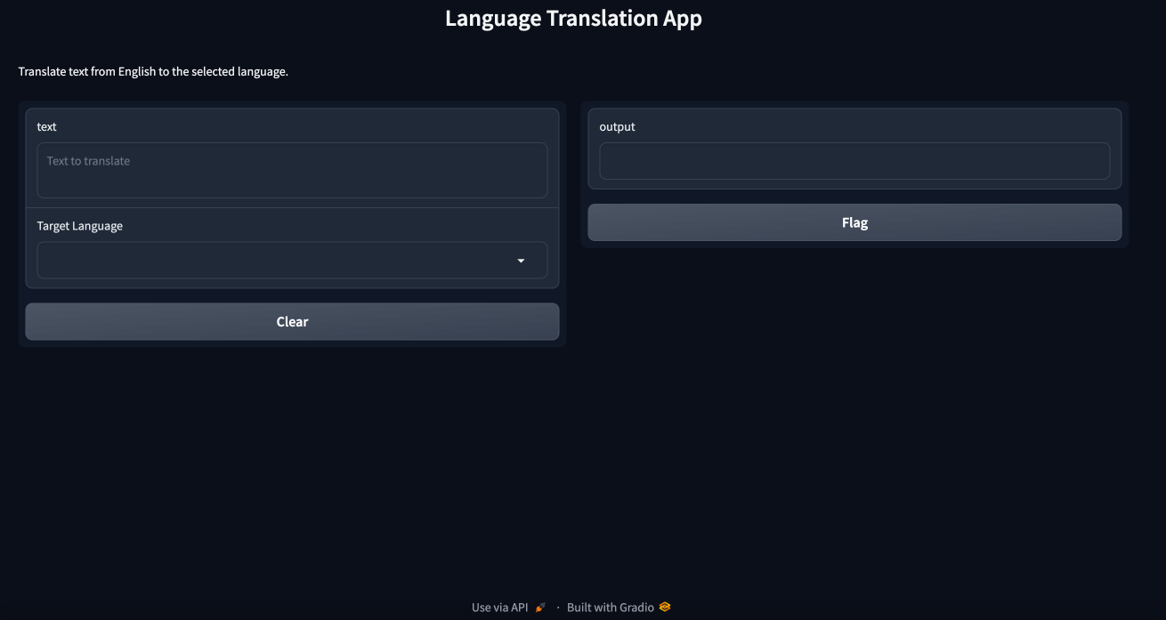

Slide 12
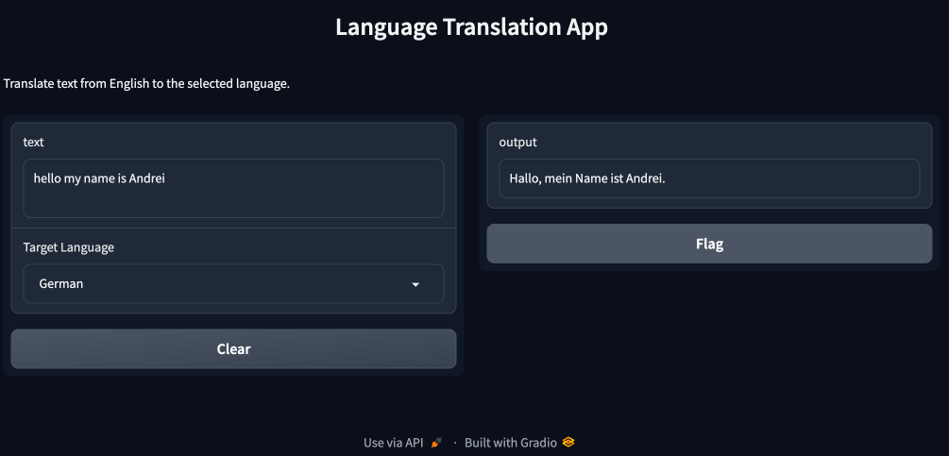

Slide 13
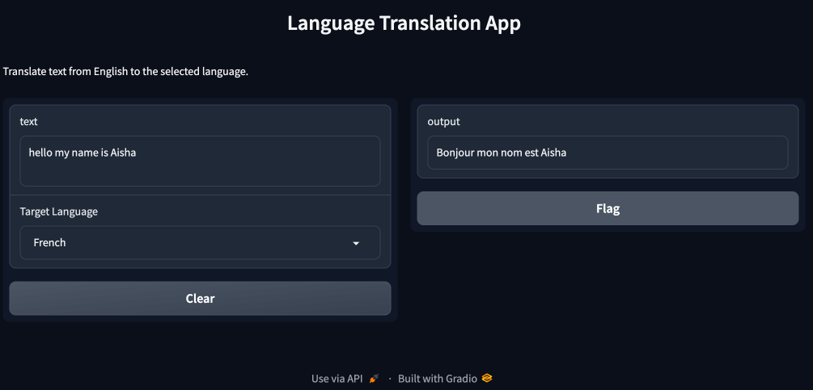

Slide 14


Slide 15
SUMMARY
Overall:
Install necessary Python packages.
Load translation models for German, French, and Romanian.
Define functions for translation to each language and a dispatcher function.
Create a Gradio interface with input text box, language dropdown, and output text box.
Launch the Gradio interface, making the translation application accessible through a web interface.
Essentially you will create a simple language translation application using Gradio and Hugging Face's transformers library. Users can input English text, select a target language, and get the translated text as output through a user-friendly web interface! (approx. 50 lines of code in total)

Slide 16

Now, let’s have some fun!
We will share the link on the zoom chat and you guys can play with the application.
In the case that you guys encounter some errors (like a word that is not defined) just rewrite the sentence and it will fix it in most cases!

Slide 17
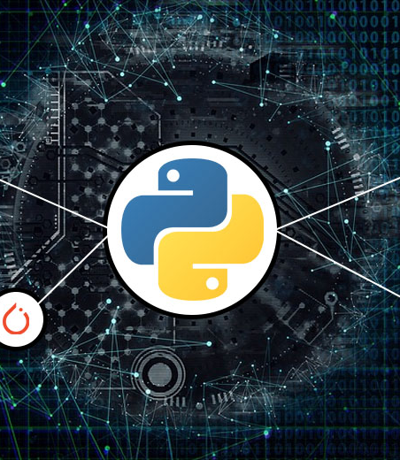
References
Build a Simple Language Translation App using Python for Beginners. (n.d.). Www.youtube.com. Retrieved December 4, 2023, from https://youtu.be/feA-H6blwr4?si=abijEtEfIcL-VYwb
Foote, K. D. (2019, May 22). A Brief History of Natural Language Processing (NLP). DATAVERSITY. https://www.dataversity.net/a-brief-history-of-natural-language-processing-nlp/
‌Google Colaboratory. (n.d.). Colab.research.google.com. https://colab.research.google.com/?utm_source=scs-index
IBM. (2023). What is Natural Language Processing? | IBM. IBM. https://www.ibm.com/topics/natural-language-processing
Kudo, T. (n.d.). sentencepiece: SentencePiece python wrapper. PyPI. https://pypi.org/project/sentencepiece/
Lim, S. N. (2021, June 8). 2021 Translation Industry Trends and Stats. Redokun. https://redokun.com/blog/translation-statistics
‌Pipelines. (n.d.). Huggingface.co. https://huggingface.co/docs/transformers/main_classes/pipelines
‌Python. (2019, May 29). Python. Python.org; Python.org. https://www.python.org/
‌PyTorch. (2023). PyTorch. Pytorch.org. https://pytorch.org/
‌ Sacremoses: SacreMoses. (n.d.). PyPI. Retrieved December 4, 2023, from https://pypi.org/project/sacremoses/
Team, G. (n.d.). Quickstart. Gradio.app. https://www.gradio.app/guides/quickstart‌

