Slide 1
Application of k-means clustering in video games
Author: Ghiran Andrei
Scientific coordinator: Prof. Lector. Dr. Moruz Alex

Slide 2
Summary
Unity engine
Application
The AI Agent
K-means clustering
A-star path finding
The Player Character
Movement system
The potential of Machine Learning

Slide 3
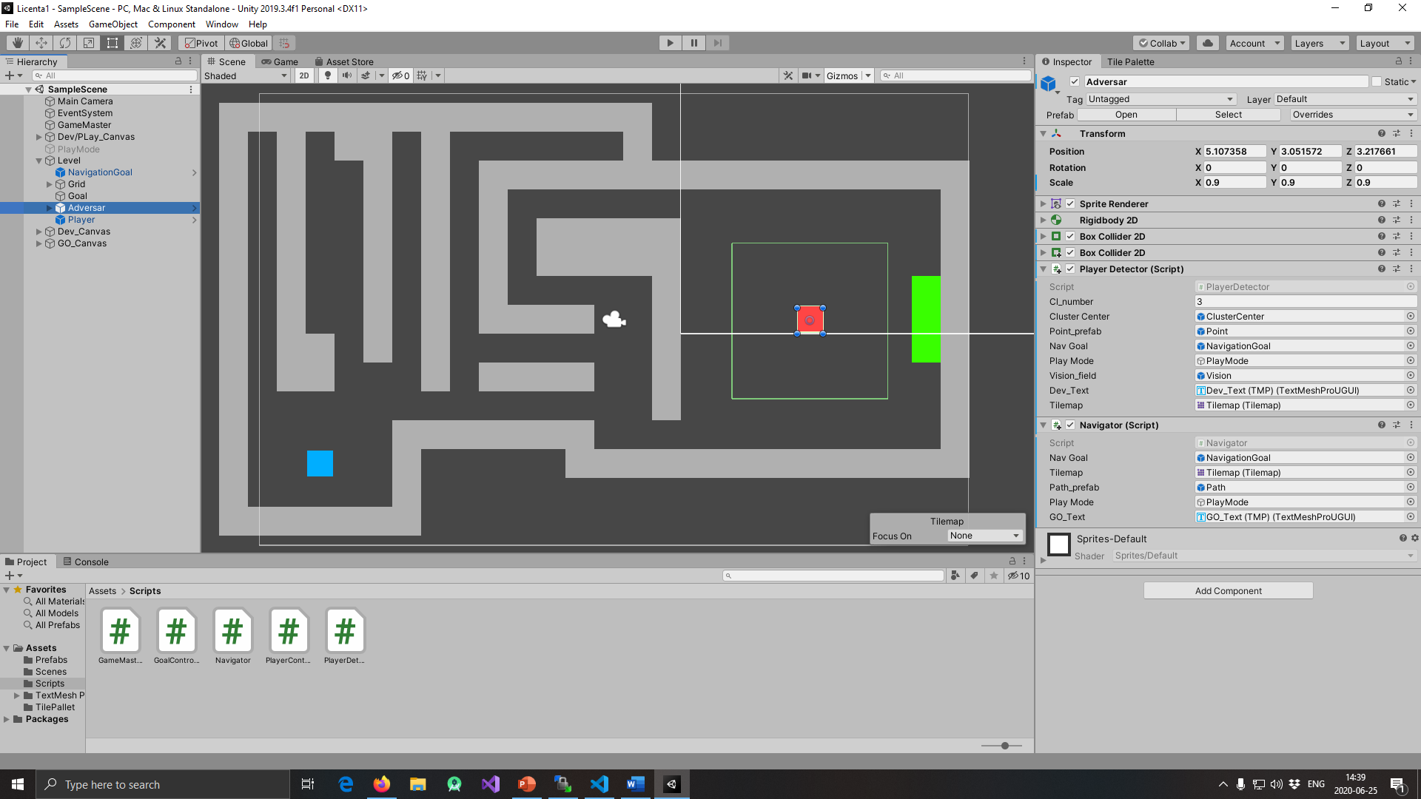
Unity Game engine

Slide 4
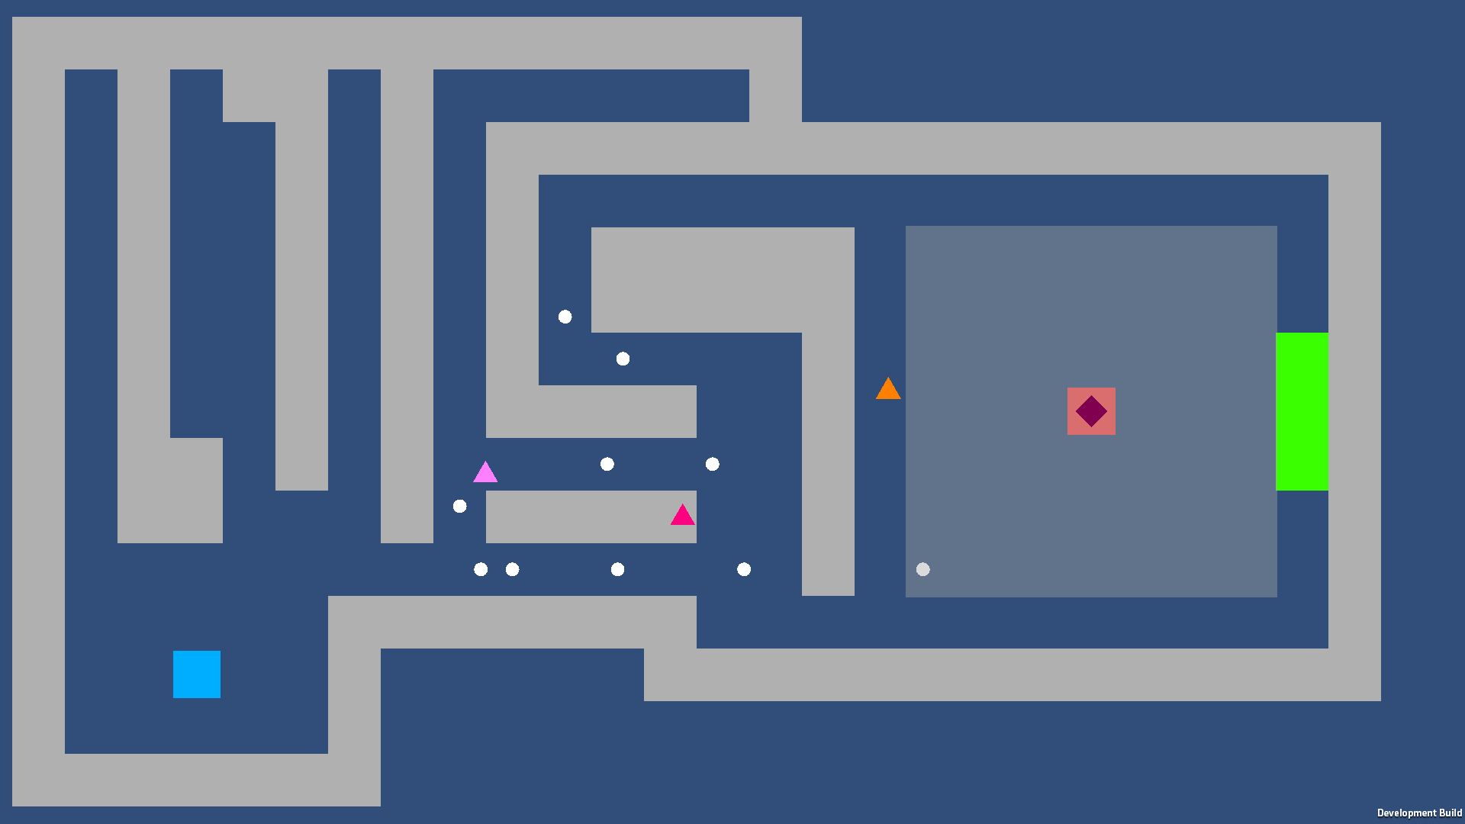
Application
After just 4 sessions the AI has found a bottleneck

Slide 5
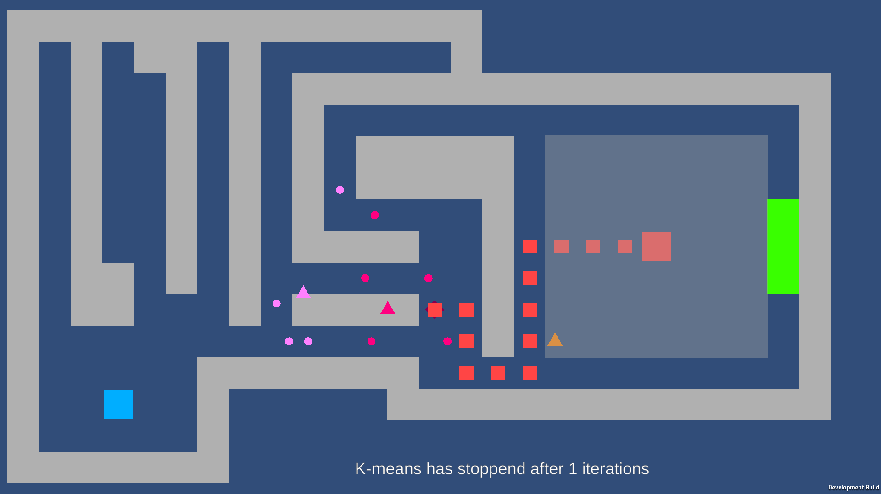
Application
After just 4 sessions the AI has found a bottleneck

Slide 6
Application
The AI after further training

Slide 7
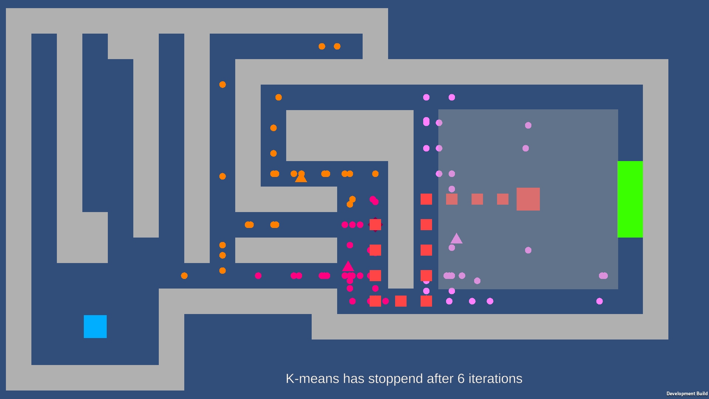
Application
The AI after further training

Slide 8
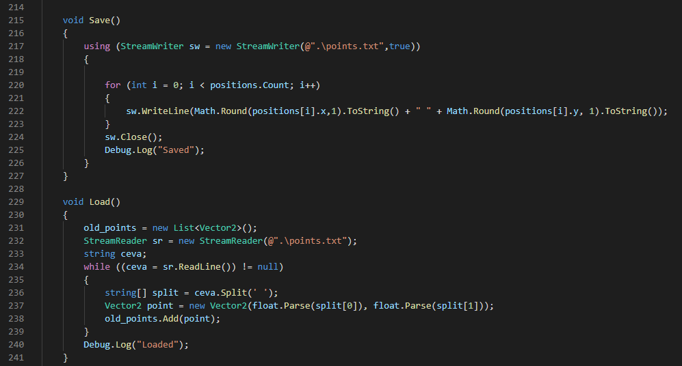
K-means algorithm
Save and Load handles the training data

Slide 9
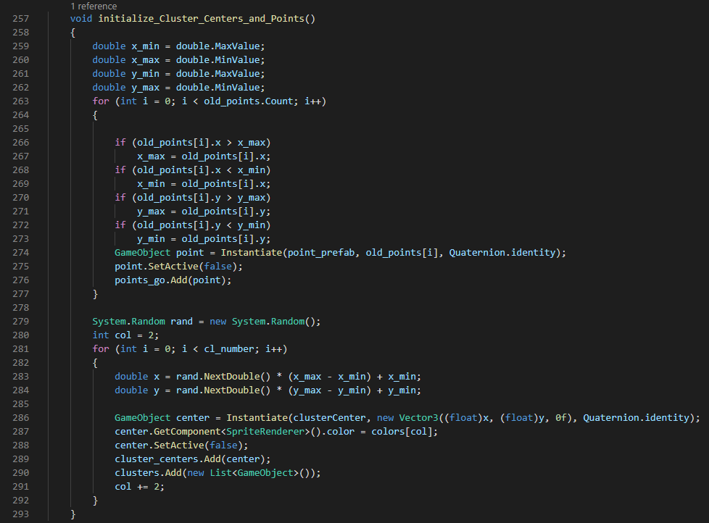
K-means algorithm
Initializing the gameObjects

Slide 10
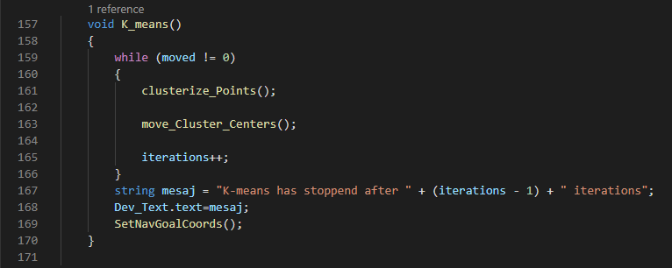
K-means algorithm
The algorithm is divided into the 2 steps

Slide 11
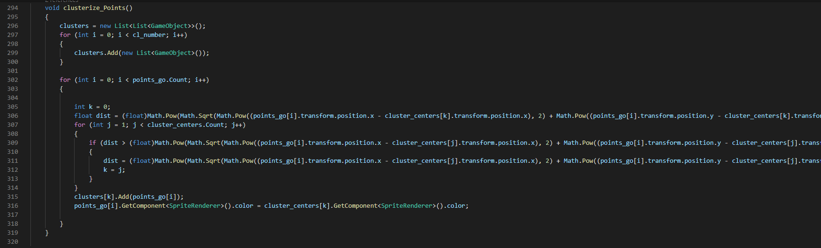
K-means algorithm
The Assignment Step

Slide 12
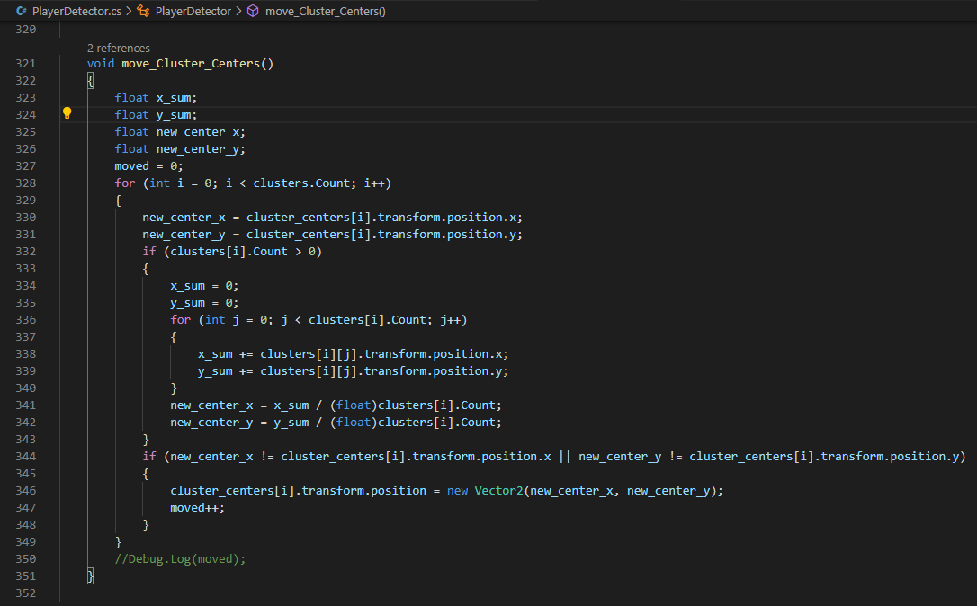
K-means algorithm
The Update Step

Slide 13
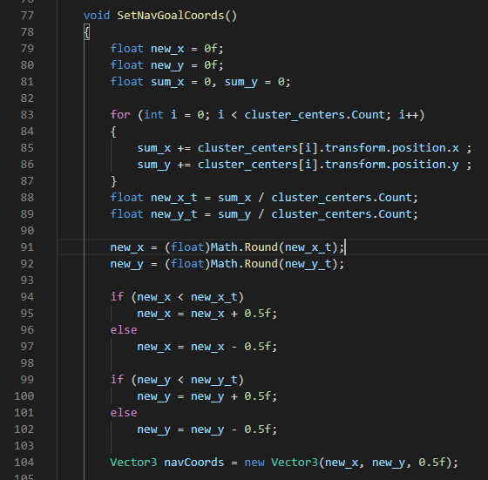
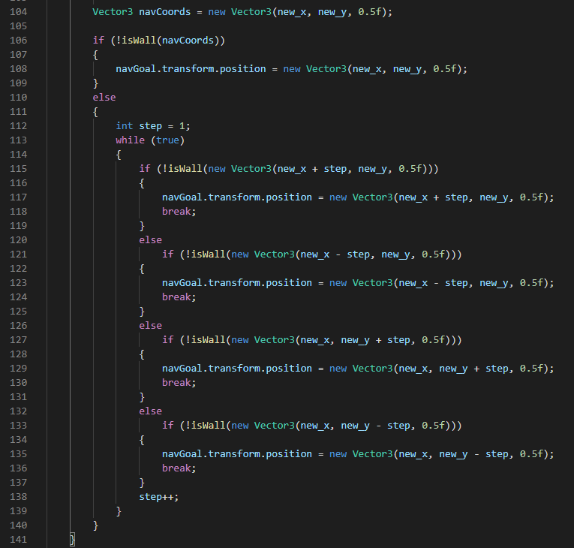
K-means algorithm
Moving the navigation goal

Slide 14
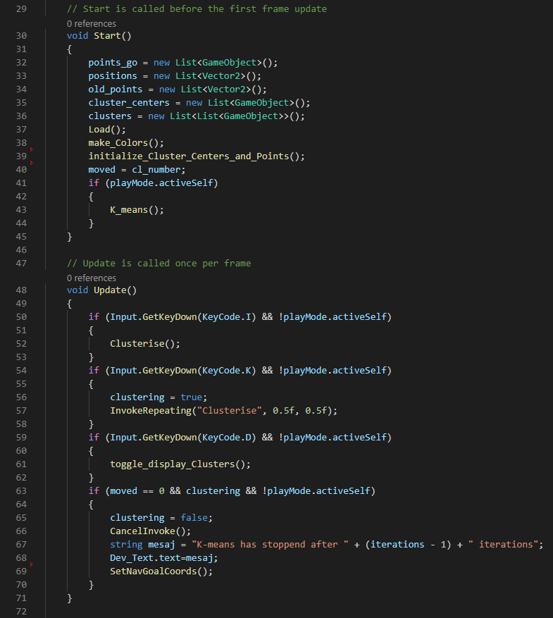
K-means algorithm
Calling k-means() when in PlayMode

Slide 15
K-means algorithm
In Developer Mode k-means is called with a keyboard input and InvokeRepeating

Slide 16
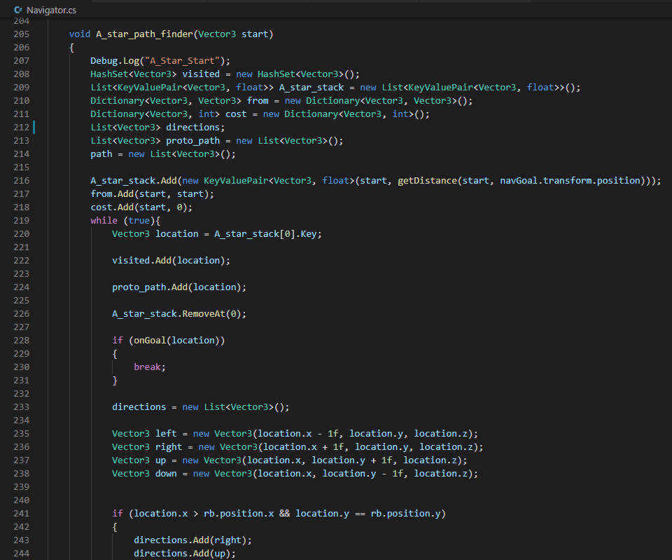
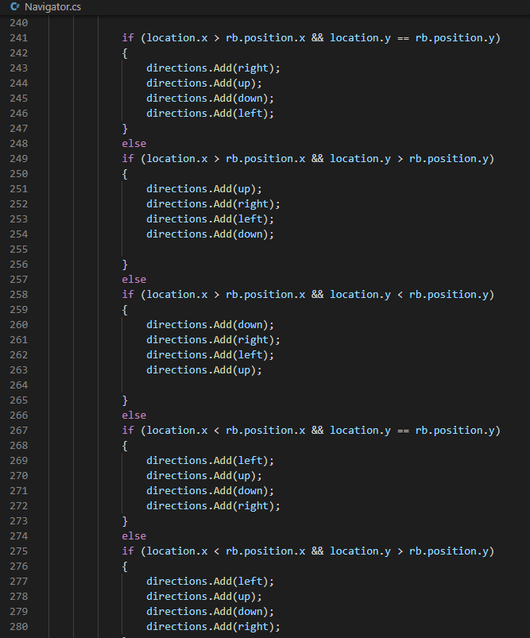
A-STAR PATH FINDING
The graph is not pre built, only the nodes visited are initialized, changing the order of directions to optimise searching

Slide 17
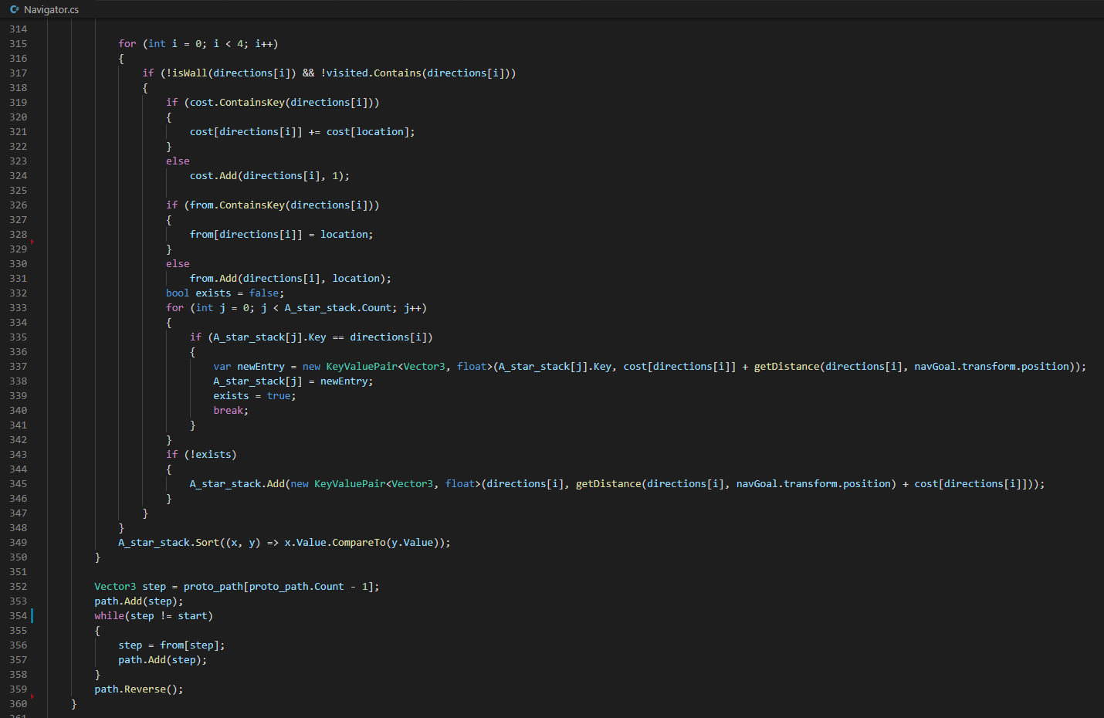
A-STAR PATH FINDING
Updating the stack and after A* is done reverse trough the predecessors to obtain the path

Slide 18
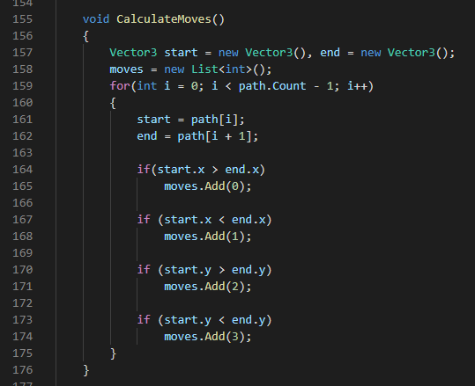
A-STAR PATH FINDING
Turning the path coordinates into moves

Slide 19
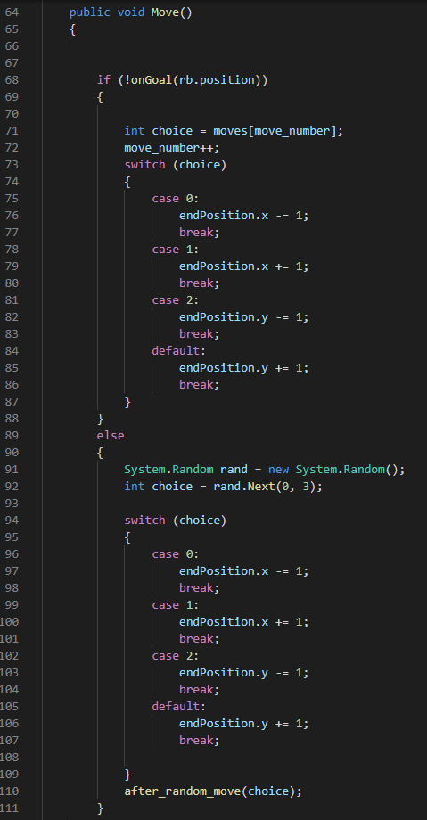
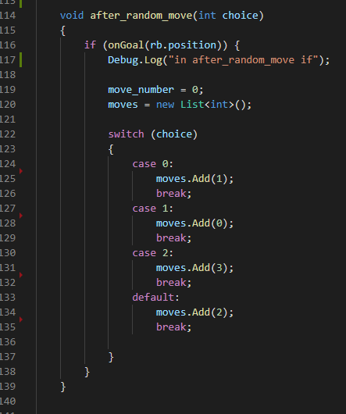
A-STAR PATH FINDING
Moving the AI agent

Slide 20
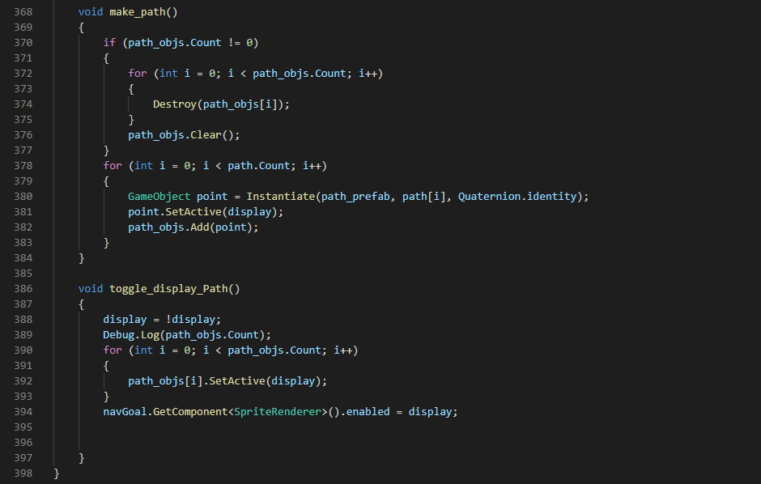
A-STAR PATH FINDING
Displaying the Path

Slide 21
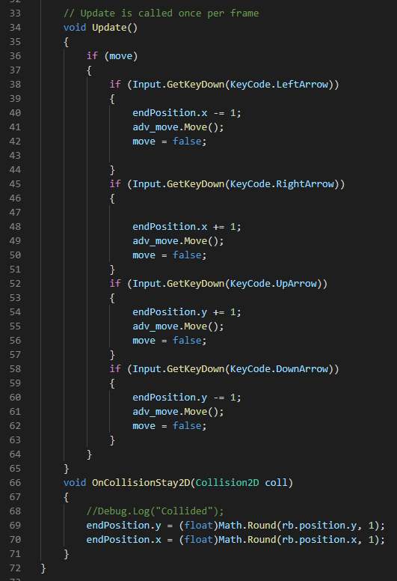
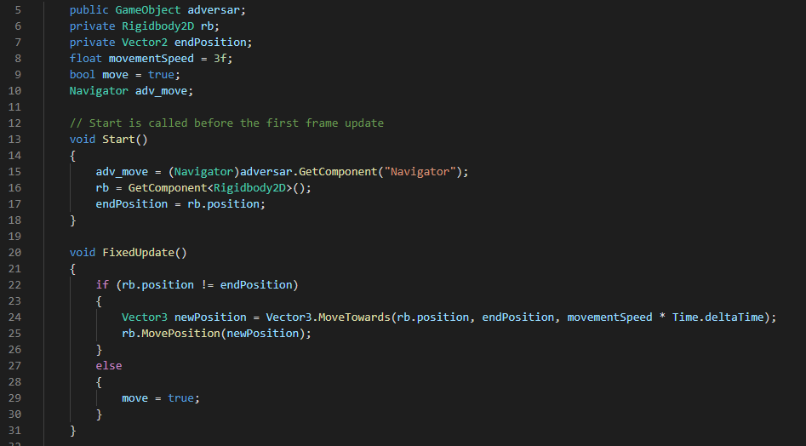
Player Character
Moving the player character

Slide 22
The Potential of Machine learning in Video Games
Training partners for professional players;
Entertainment;
Play testing single player games;
Adaptive difficulty for AI by using training data from different stages in its training;

Slide 23
Future developments
Multiple AI working together to divide multiple advantageous position among themselves;
An algorithm that determines a good( maybe even optimal) number of clusters by analyzing the layout of the maze;

