Slide 1

“A virtual car marketplace built with customer experience in mind”
Team 4D WAD project

Slide 2
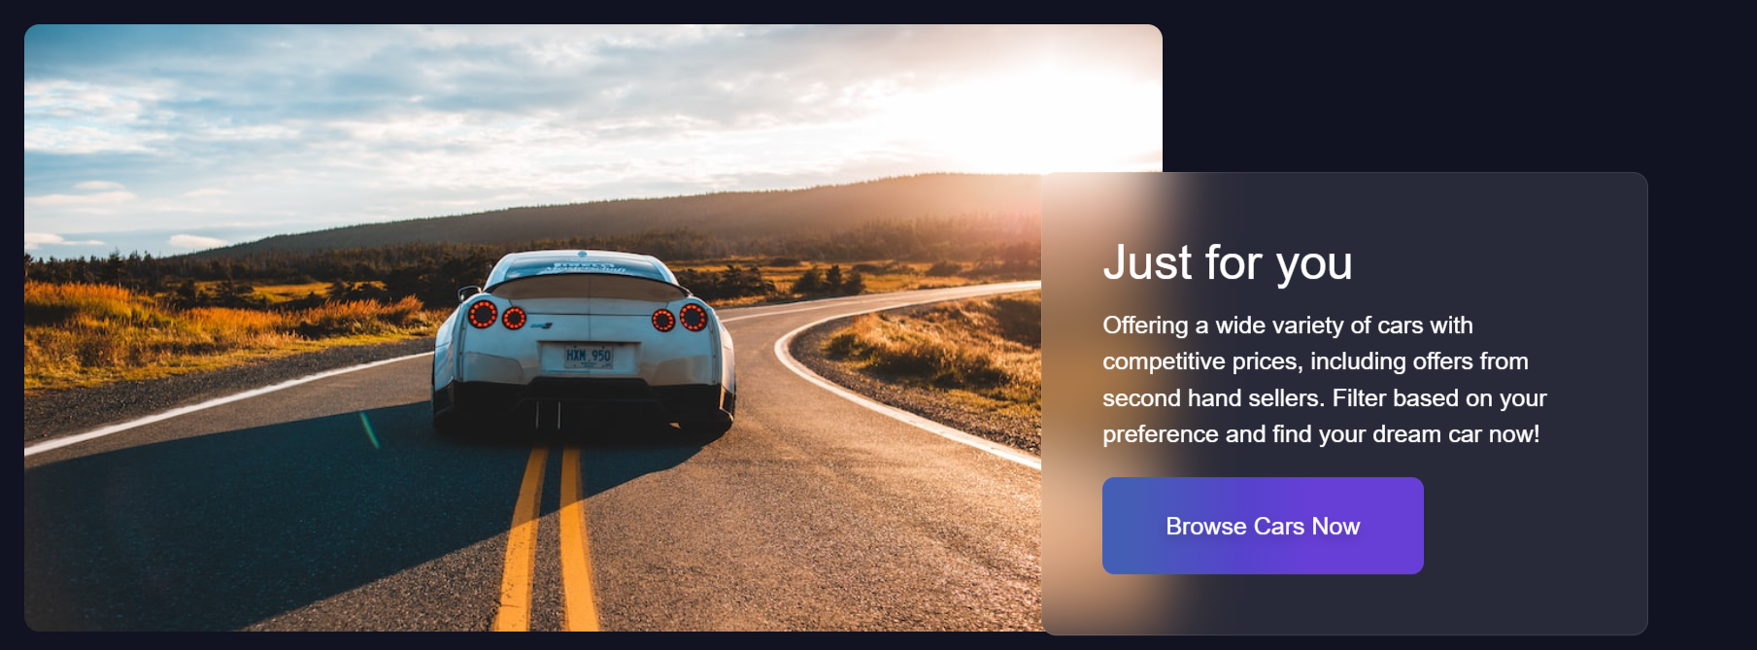
Functionality
Our aim is to provide an extensive, yet aesthetic platform to aid with the sale and purchase of cars. We aim to target a wide audience, there’s something for just about everyone!

Slide 3
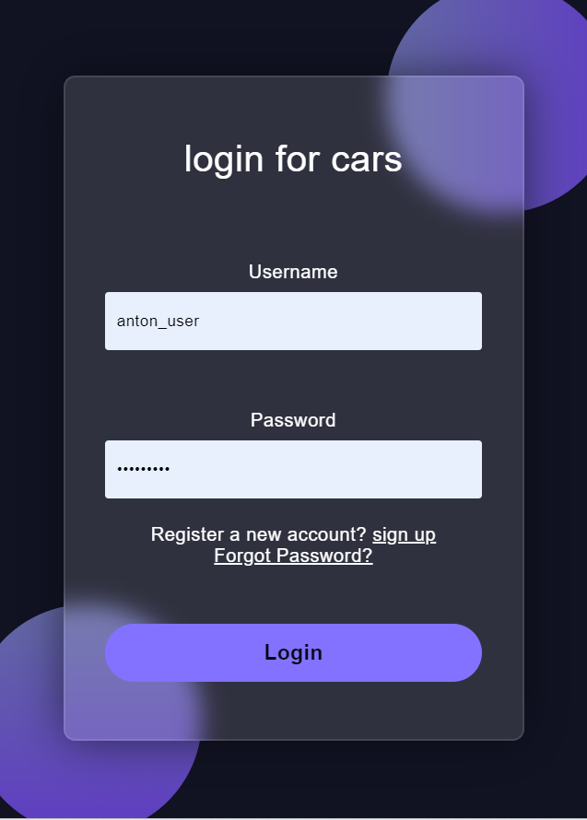
User Registration
Users will have their own account with their details stored, following registration and there is an option to reset their password if forgotten.

Slide 4
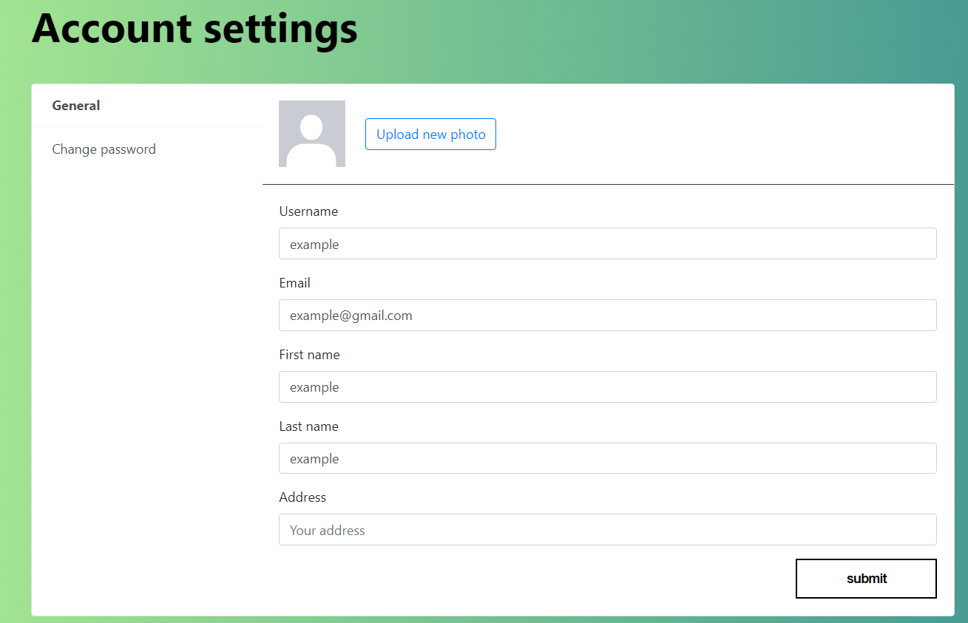
Account Settings
Their profile is highly customizable, details can be edited, and the user can upload an image for their profile from their own device.

Slide 5
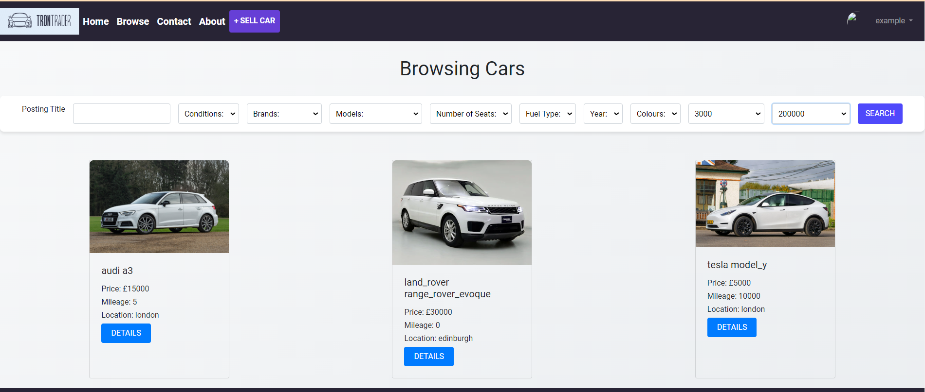
Browsing
Users can browse cars stored in a database, uploaded by other sellers. according to their individual needs, based on price, brand, condition etc.
Notes:
Sfsdfsdfsd

Slide 6
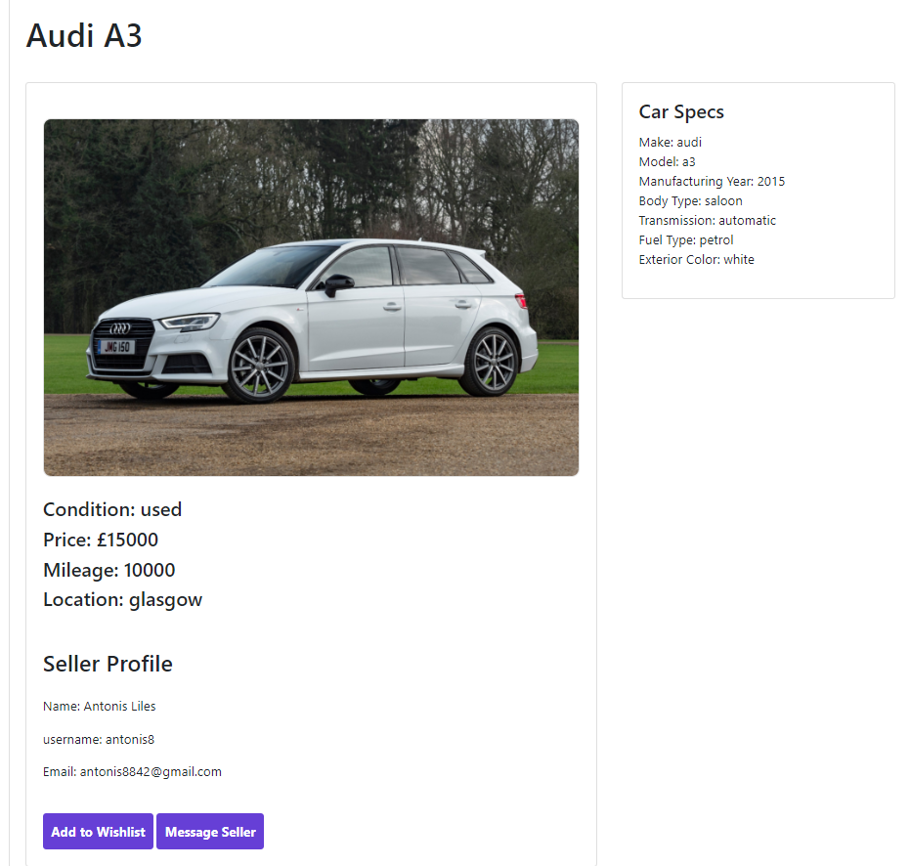
Details
If interested, users can click on the car for more details.
From there, the car can be added to a Wishlist, or the user can complete a form of interest to contact the seller
Notes:
Sfsdfsdfsd

Slide 7
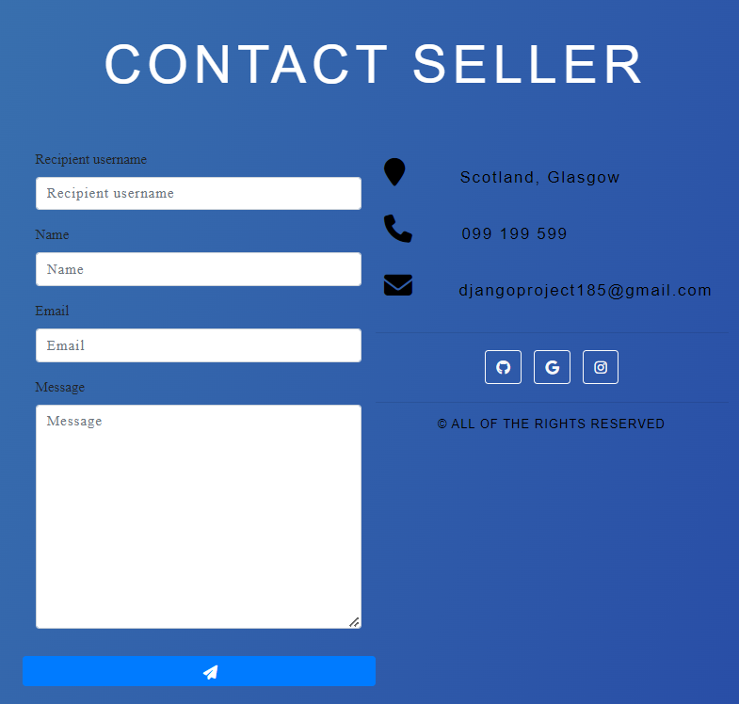
Contact Form
The user can fill out their details to enquire about a listing, and add a message that will be sent to the seller’s email address.
Notes:
Sfsdfsdfsd

Slide 8
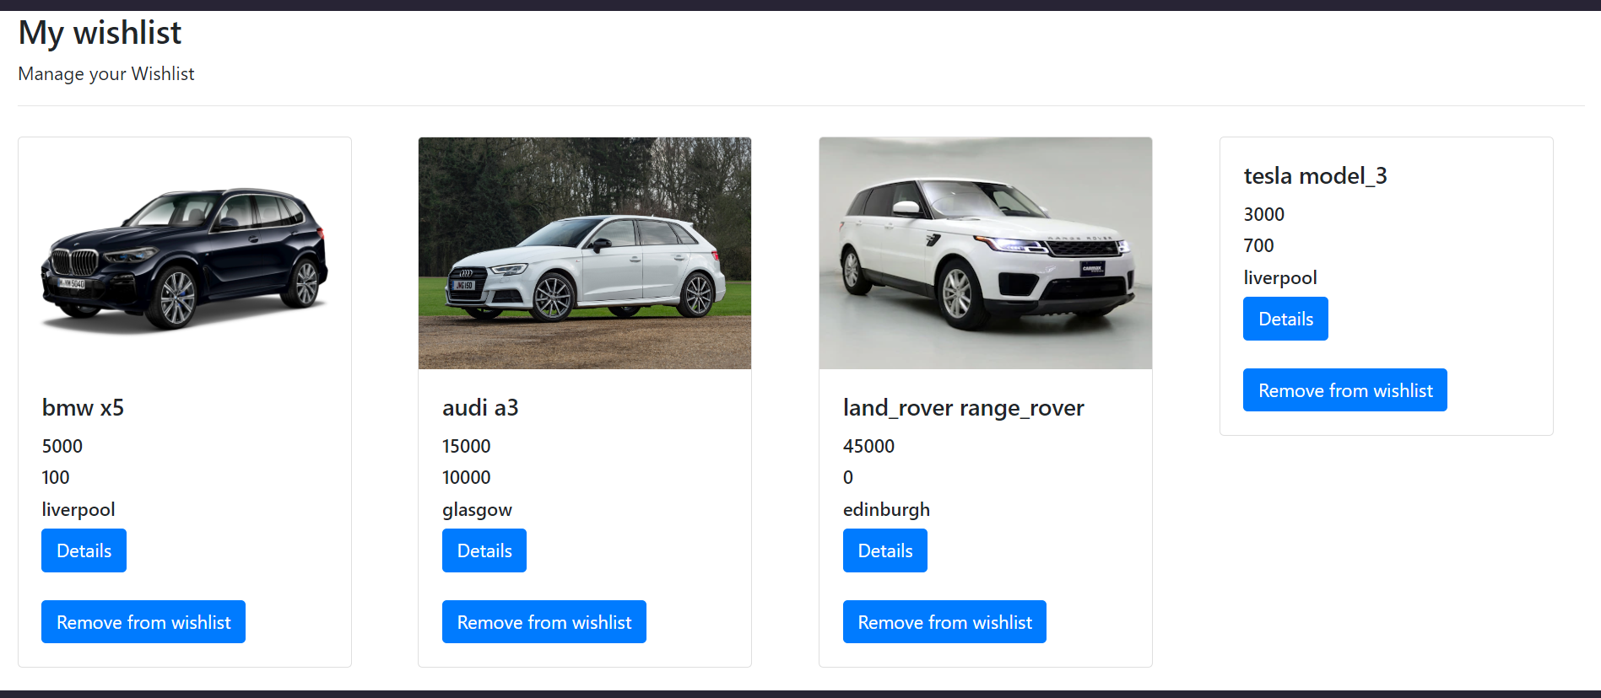
Wishlist
Cars can be added to, or removed from a Wishlist that is accessible to them later.
Notes:
Sfsdfsdfsd

Slide 9
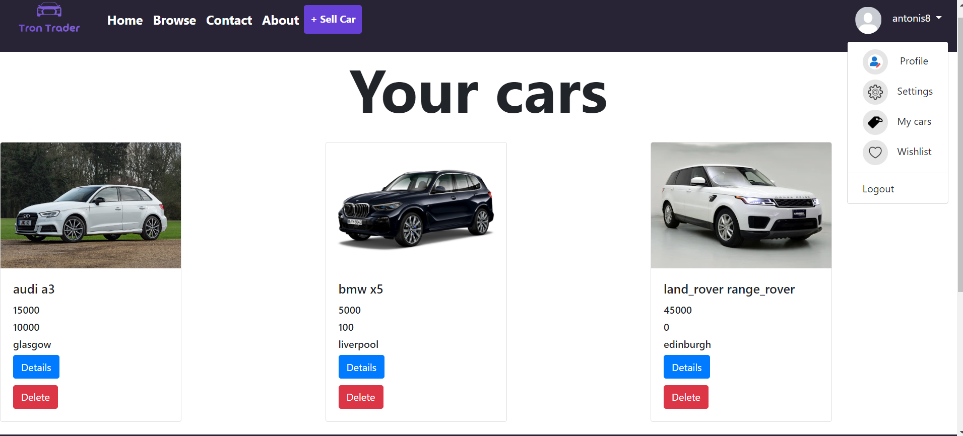
Manage your listings
Through the bar on the top left, the user can view all of their listings, and take them down if needed.
Notes:
Sfsdfsdfsd

Slide 10
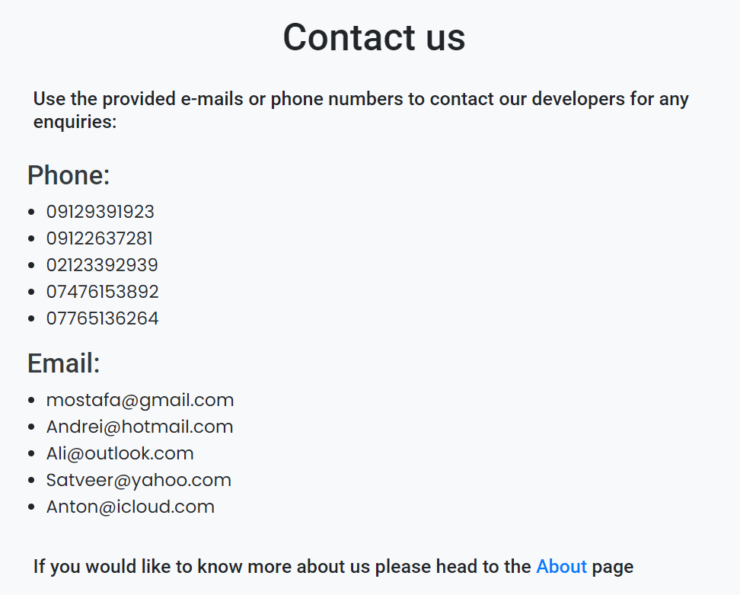
Enquiries
A contact page has also been put in place for customers that have any concerns or feedback
Notes:
Sfsdfsdfsd

Slide 11
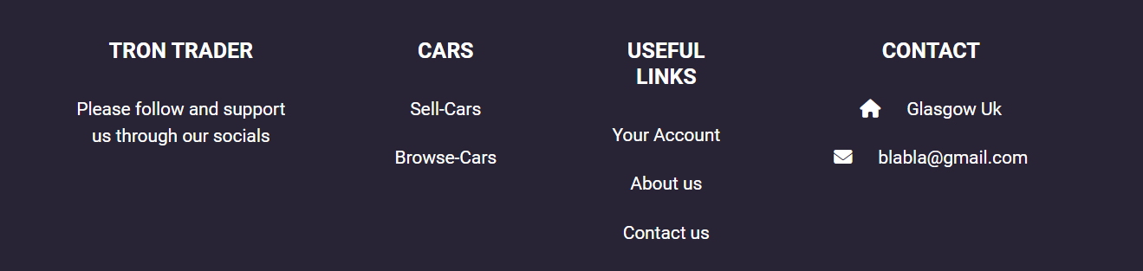
Header & Footer
Useful links with a sleek design, implemented, in a base template pages extend from.
Notes:
Sfsdfsdfsd

Slide 12
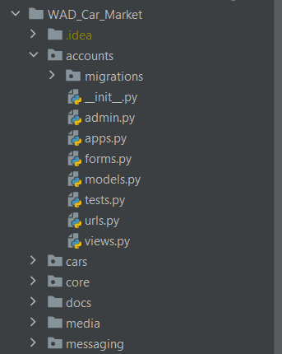
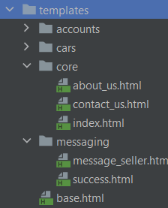
Modularity
Our marketplace was built to be flexible and modular at heart.
Our functionality was split into 4 main applications, allowing for convenient reusability and extensibility.
Notes:
Sfsdfsdfsd

Slide 13
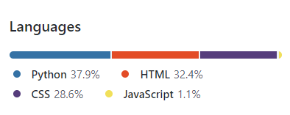
Technologies Used:
Python with Django Framework for the general development of the application, particularly for back end and session cookies.
HTML for the creation of templates.
CSS with the Bootstrap framework to build a visually appealing front end upon said templates.
JavaScript for some fancier front end work in the Index, Logout and About us pages.
Notes:
Sfsdfsdfsd

Slide 14

Contributions
Andrei: Car database, search function, filtering, populating script implementation.
Antonis: Core pages & requirements addition, information polishing, cookies implementation presentation slides & video
Ali: Car app development, messaging app implementation, car database assistance, front end work.
Satveer : Front end work with Bootstrap, unit testing, accounts app implementation, general maintenance.
Mostafa: Front end heavy-lifting and maintenance with templates & CSS, fixes in back end.
Notes:
Sfsdfsdfsd

