Slide 1

“A virtual car marketplace built with customer experience in mind”
Team 4D WAD project

Slide 2

Functionality
Our aim is to provide an extensive, yet aesthetic platform to aid with the sale and purchase of cars. We aim to target a wide audience, there’s something for just about everyone!

Slide 3
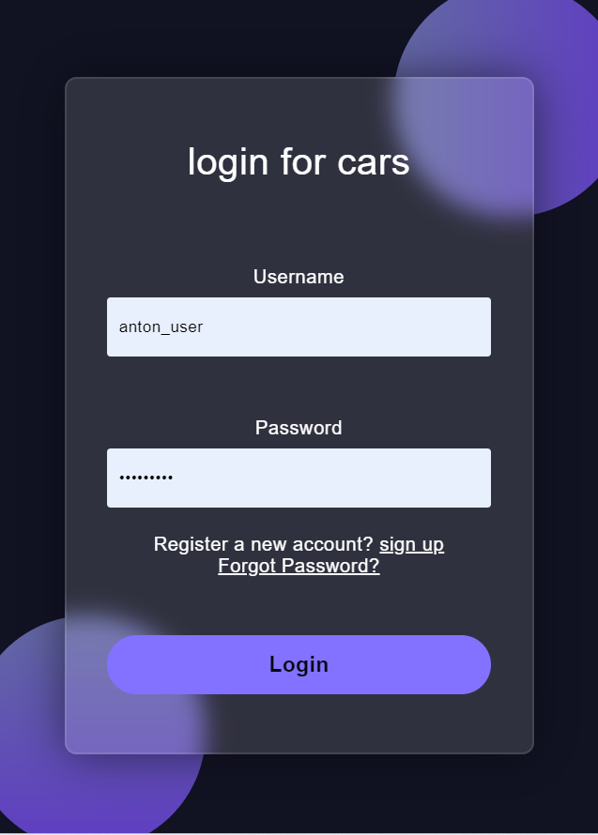
User Registration
Users will have their own account with their details stored, following registration and there is an option to reset their password if forgotten.

Slide 4
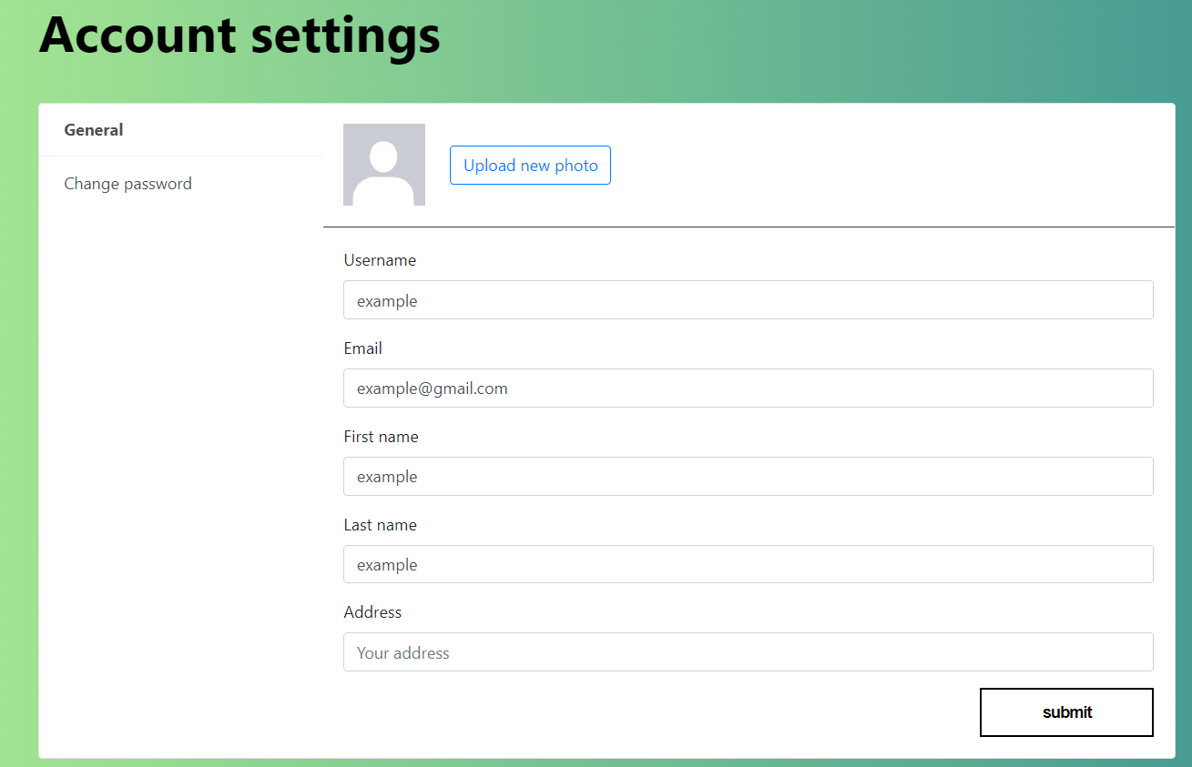
Account Settings
Their profile is highly customizable, details can be edited, and the user can upload an image for their profile from their own device.

Slide 5
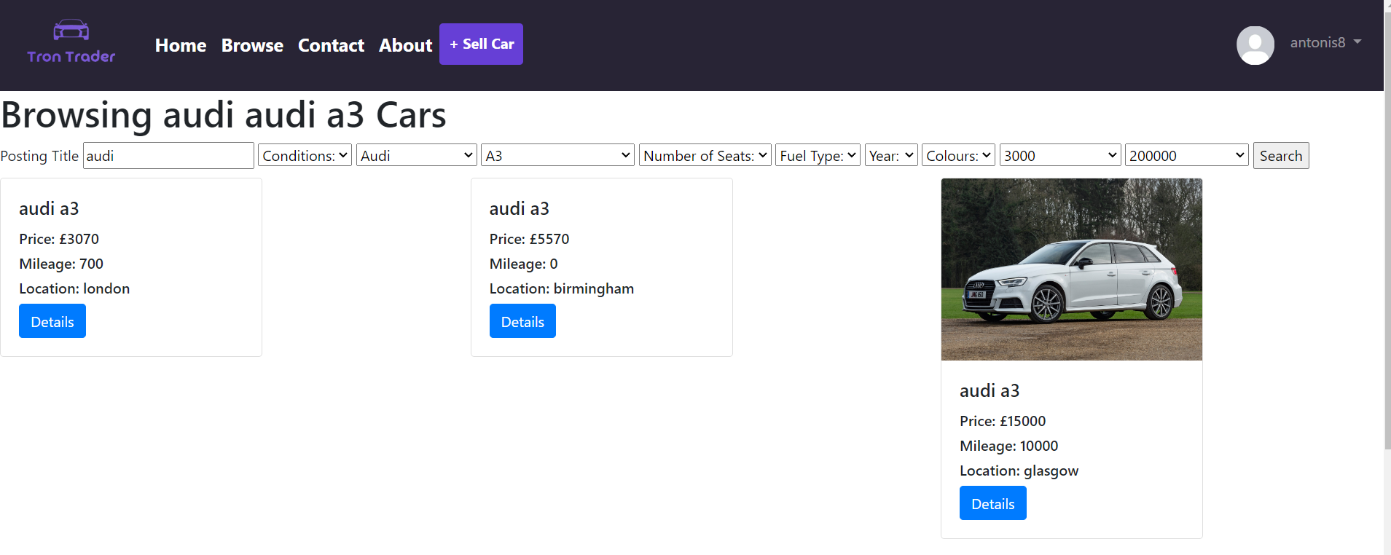
Browsing
Users can browse cars stored in a database, uploaded by other sellers. according to their individual needs, based on price, brand, condition etc.
If interested and logged in, they can contact the seller of a listing by completing a form of interest.
Notes:
Sfsdfsdfsd

Slide 6
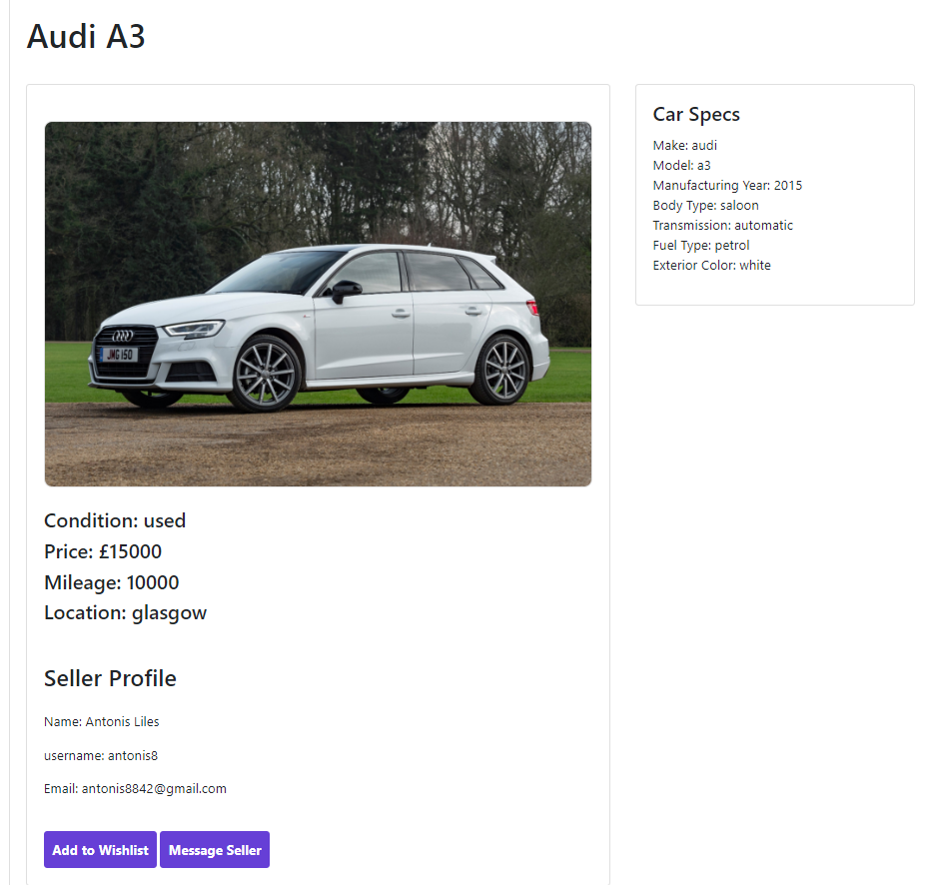
Details
If interested, users can click on the car for more details.
From there, the car can be added to a Wishlist, or the user can complete a form of interest to contact the seller
Notes:
Sfsdfsdfsd

