Slide 1
Performance Optimization

Slide 2
AGENDA
The Approach
Bottlenecks Identification
Performance Profiling and Improvement
Memory Profiling and Improvement
Database Profiling and Improvement
Web Optimization
Training Task
Q & A

Slide 3
THE APPROACH
Before we start
Non-functional requirements
Supplementary Specification
Reflects in architecture
Develop with real data

Slide 4
THE APPROACH
1. SETUP THE TEST ENVIRONMENT
2. MEASURE PERFORMANCE BASELINES
3. SET ACCEPTABLE PERFORMANCE GOALS
4. IDENTIFY BOTTLENECKS
5. OPTIMIZE
6. MEASURE THE PERFORMANCE
7. IF NOT ACCEPTABLE GO TO 4 STEP

Slide 5
THE APPROACH
Environment and Test Data
Environment – Maximum close to production
Test Data – Real data
Build Configuration – Release
Performance Benchmarking Tools
LoadUI, Apache JMeter, etc.
Custom Auto tests

Slide 6
BOTTLENECKS IDENTIFICATION
Resources usage
CPU
Memory
IO
Network

Slide 7
BOTTLENECKS IDENTIFICATION
Tools
Task Manager
Resource Monitor
Performance Monitor
Server Monitoring
Application Insights
New Relic
Custom Logging
Etc.

Slide 8
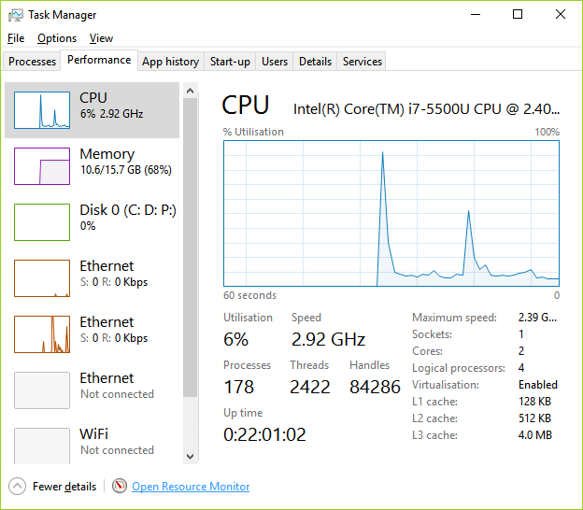
BOTTLENECKS IDENTIFICATION

Slide 9
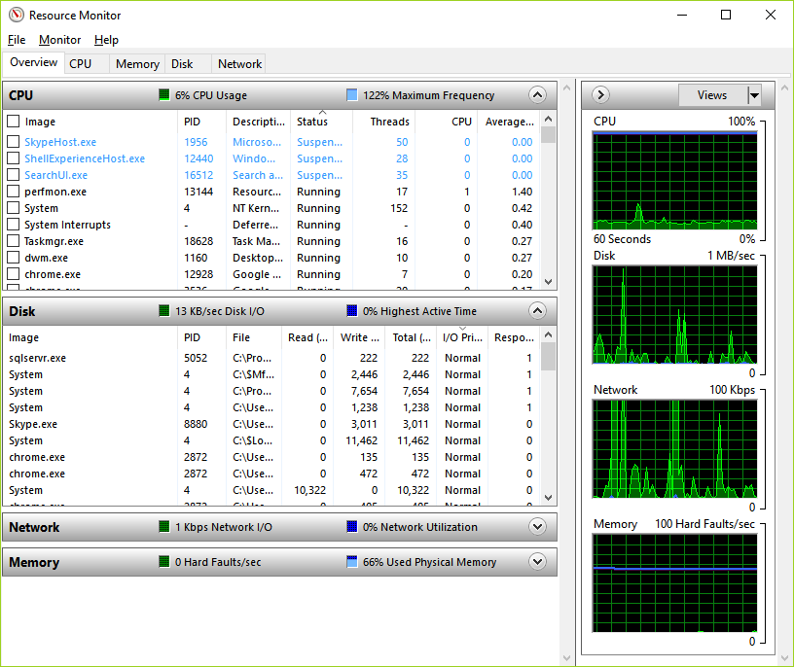
BOTTLENECKS IDENTIFICATION

Slide 10
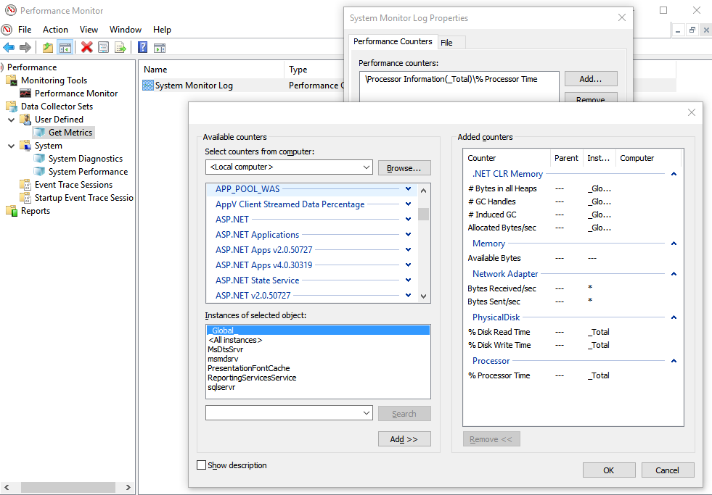
BOTTLENECKS IDENTIFICATION

Slide 11
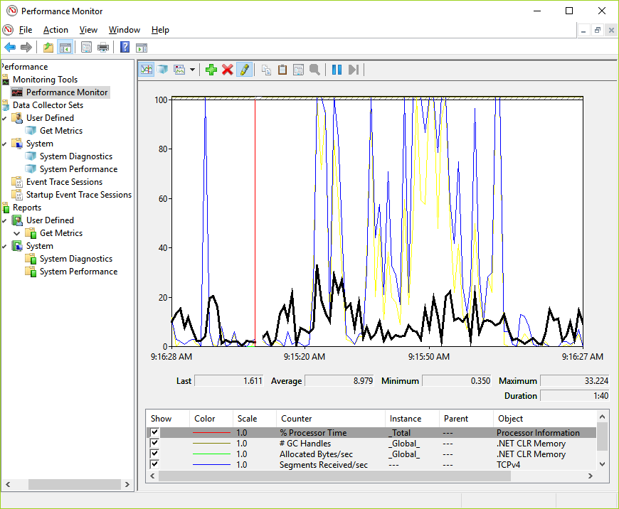
BOTTLENECKS IDENTIFICATION

Slide 12
PERFORMANCE. TOOLS
Visual Studio Performance Profiler
https://msdn.microsoft.com/en-us/library/ms182372.aspx
https://msdn.microsoft.com/en-us/library/mt210448.aspx
https://docs.microsoft.com/en-us/visualstudio/profiling/profiling-feature-tour
https://channel9.msdn.com/Shows/Visual-Studio-Toolbox/Visual-Studio-Toolbox-Performance-Profiling
JetBrains dotTrace
https://www.jetbrains.com/profiler/documentation/documentation.html
Redgate ANTS
http://www.red-gate.com/products/dotnet-development/ants-performance-profiler/

Slide 13
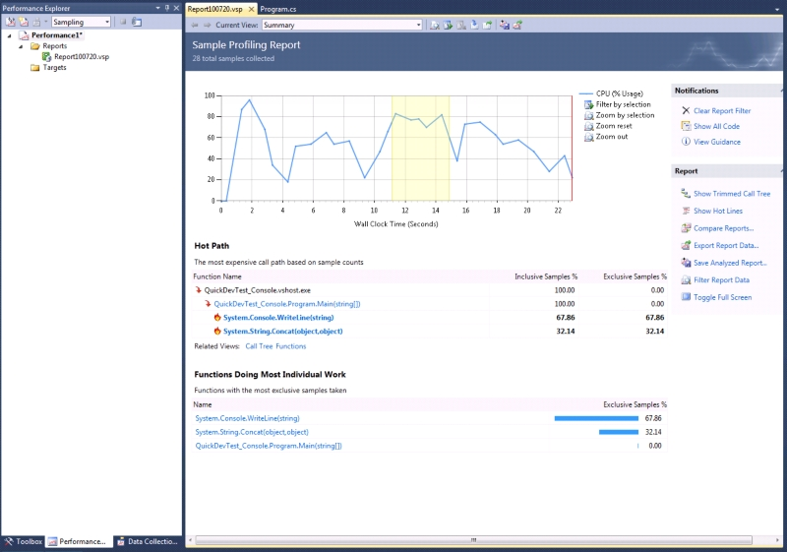
PERFORMANCE. TOOLS

Slide 14
PERFORMANCE. TIPS AND TRICKS
Logical Problems / Not optimal code
Data Structure misuse – IEnumerable, List, Array, Dictionary, HashSet
Cache – cached repositories, etc.
Concurrent or Asynchronous code – async/await, TPL, Parallel.For, Rx
Use StringBuilder
Avoid Exceptions – defensive programming
Use String Split/Join/Concat instead of LINQ and RegEx
Use XML Readers instead of LINQ to XML
Prefer for/foreach loops over lambdas
Avoid Reflection/dynamic

Slide 15
PERFORMANCE. TIPS AND TRICKS
Use memoization – if(lookup.TryGetValue(key, out value)) return value; lookup[key] = value.ToLower();
Use as operator instead of is for type checking
Do not use ref and out parameters
Reduce methods size
Prefer local variables over fields
Use static readonly fields and constants
Use static methods and fields
Dictionary order, SortedDictionary
Override GetHashCode and Equals

Slide 16
PERFORMANCE. RESOURCES
Video
\\su\store\Training-and-development\Seminars\Pluralsight\vs-intro-dbg
\\su\store\Training-and-development\Seminars\Pluralsight\web-debug
https://www.pluralsight.com/courses/measuring-dotnet-performance
https://www.pluralsight.com/courses/dotnet-performance-optimization-profiling-jetbrains-dottrace

Slide 17
PERFORMANCE. RESOURCES
.Net Performance Testing and Optimization - https://www.red-gate.com/library/net-performance-testing-and-optimization-the-complete-guide
Pro .NET Performance: Optimize Your C# Applications - http://www.apress.com/us/book/9781430244585
Writing High-Performance .NET Code - http://www.writinghighperf.net/
Advanced .NET Debugging - http://advanceddotnetdebugging.com/
.Net Internals and Advanced Debugging Techniques - book https://www.amazon.ca/Net-Internals-Advanced-Debugging-Techniques/dp/0321934717 or course https://www.pluralsight.com/courses/dotnet-internals-adv-debug
Performance Tips - https://msdn.microsoft.com/en-us/library/ms973839.aspx
52 Perf Tricks - https://www.red-gate.com/library/52-tips-tricks-to-boost-net-performance
Optimization - https://www.dotnetperls.com/optimization

Slide 18
MEMORY. TOOLS
Visual Studio Managed Memory Debugger
https://msdn.microsoft.com/en-us/library/d5zhxt22.aspx
https://blogs.msdn.microsoft.com/devops/2013/10/16/net-memory-analysis-enhancements-in-visual-studio-2013/
https://channel9.msdn.com/Shows/Visual-Studio-Toolbox/Managed-Memory-Analysis-in-Visual-Studio-2013
Visual Studio Diagnostic Tools
https://docs.microsoft.com/en-us/visualstudio/profiling/memory-usage
https://channel9.msdn.com/Shows/Visual-Studio-Toolbox/Visual-Studio-2015-Diagnostic-Tools
JetBrains dotMemory
https://www.jetbrains.com/dotmemory/
Redgate ANTS Memory Profiler
http://www.red-gate.com/products/dotnet-development/ants-memory-profiler/
Scitech .NET Memory Profiler
https://memprofiler.com/

Slide 19
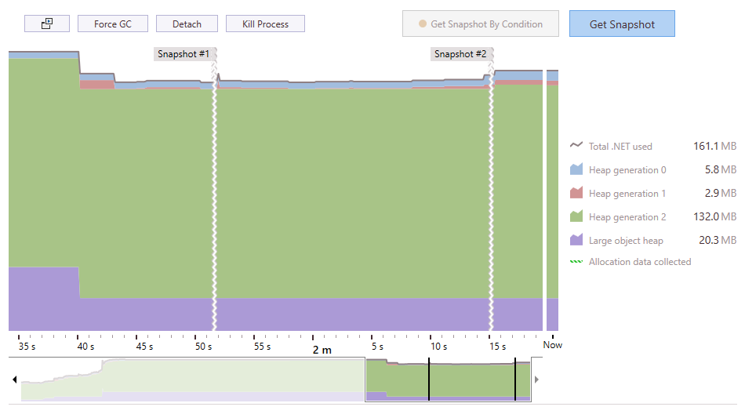
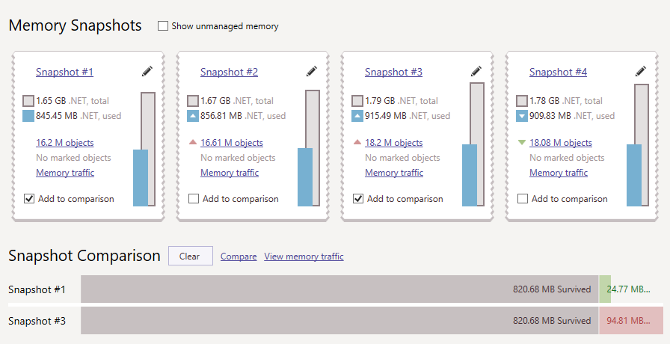
MEMORY. TOOLS

Slide 20
MEMORY. TIPS AND TRICKS
Files, Connections, etc. – IDispose pattern – Dispose(), Close(), using
Clear events subscriptions – if you see +=, then it must be -=
Use StringBuilder
Static fields/properties
Define collections capacity – var list = new List(products.Length);
Use Immutable types – only getters, private setters
Do not call GC.Collect() explicitly
Boxing/Unboxing
Clear Concurrent collection – ConcurrentBag.TryPeak()
Use WeekReferences, ConditionalWeakTable

Slide 21
MEMORY. RESOURCES
Video
\\su\store\Training-and-development\Seminars\Pluralsight\idisposable-best-practices-csharp-developers
\\su\store\Training-and-development\Seminars\Pluralsight\making-dotnet-applications-even-faster
Books
Under the Hood of .NET Memory Management - https://www.amazon.com/Under-Hood-NET-Memory-Management/dp/1906434751

Slide 22
DATABASE. TOOLS
MS SQL Profiler
https://docs.microsoft.com/en-us/sql/tools/sql-server-profiler/sql-server-profiler
https://www.red-gate.com/simple-talk/sql/performance/how-to-identify-slow-running-queries-with-sql-profiler/
https://www.mssqltips.com/sqlservertutorial/272/profiler-and-server-side-traces/
MS SQL Management Studio
https://technet.microsoft.com/en-us/library/ms191227(v=sql.105).aspx
https://www.mssqltips.com/sqlservertip/2170/more-intuitive-tool-for-reading-sql-server-execution-plans/
http://sqlmag.com/t-sql/understanding-query-plans
Redgate SQL Monitor
http://www.red-gate.com/products/dba/sql-monitor/
SentryOne Plan Explorer
https://www.sentryone.com/plan-explorer

Slide 23
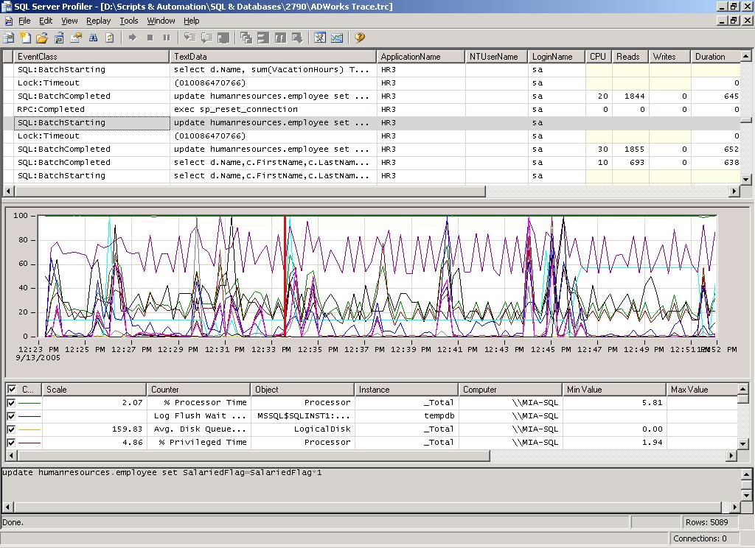
DATABASE. TOOLS

Slide 24
DATABASE. TIPS AND TRICKS
Reduce number of queries
Reduce round-trips
Retrieve only needed records - return context.Products.ToList().FirstOrDefault();
Don’t select not needed columns – SELECT * FROM Products
Entity Framework – rewrite with stored procedures
Bulk Operations – use SQLBulkCopy class
Use Cache
Use IQueryable
Do not track changes – AutoDetectChangesEnabled; db.Products.Where(p => p.InStock). AsNoTracking().ToList();
Use integer primary keys over guid

Slide 25
DATABASE. TIPS AND TRICKS
Define length for nvarchar(256) columns
Use Indexes
Seek vs Scan – like, avoid functions in WHERE
Estimated vs Actual Query Plan
Update Statistics
Parameters Sniffing – local variables, OPTION (RECOMPILE)
Avoid transactions
Avoid cursors
Normalization\Denormalization
Partitioning

Slide 26
DATABASE. RESOURCES
\\su\store\Training-and-development\Seminars\Pluralsight\sqlserver-sqltrace
\\su\store\Training-and-development\Seminars\Pluralsight\sqlserver-query-plan-analysis
https://www.mssqltips.com/sql-server-tip-category/9/performance-tuning/
http://download.red-gate.com/ebooks/SQL/sql-server-execution-plans.pdf

Slide 27
WEB OPTIMIZATION
Resources
\\su\store\Training-and-development\Seminars\Pluralsight\web-performance
https://www.udacity.com/course/website-performance-optimization--ud884
https://developers.google.com/web/fundamentals/performance/
https://dou.ua/lenta/digests/wpo-digest-0/
https://www.keycdn.com/blog/website-performance-optimization/
https://medium.com/airbnb-engineering/performance-tuning-e10ac94916df
Tools
Fiddler - http://www.telerik.com/fiddler
https://www.keycdn.com/blog/website-speed-test-tools/
http://www.softwaretestinghelp.com/performance-testing-tools-load-testing-tools/

Slide 28
TRAINING TASK
Optimize test web application
Performance optimization
Investigate memory usage
Tune database queries
Create performance optimization report
Exam – 15-20 min interview

Slide 29
Q & A

