Slide 1
Performance Optimization

Slide 2
AGENDA
The Approach
Bottlenecks Identification
Performance Profiling and Improvements
Memory Profiling and Improvements
Database Profiling and Improvements
Training Task
Q & A

Slide 3
THE APPROACH
Before we start
Non-functional requirements
Supplementary Specification
Reflects in architecture
Develop with real data
Avoid premature and micro optimization

Slide 4
THE APPROACH
1. SETUP THE TEST ENVIRONMENT
2. MEASURE PERFORMANCE BASELINES
3. SET ACCEPTABLE PERFORMANCE GOALS
4. IDENTIFY BOTTLENECKS
5. OPTIMIZE
6. MEASURE THE PERFORMANCE
7. IF NOT ACCEPTABLE GO TO 4 STEP

Slide 5
THE APPROACH
Environment and Test Data
Environment – Maximum close to production
Test Data – Real data
Build Configuration – Release
Performance Benchmarking Tools
LoadUI, Apache JMeter, etc.
Custom Auto tests
Benchmarking libraries – BenchamarkDotNet, etc

Slide 6
PERFORMANCE MEASURMENT
Measurement is important
Choose metrics to measure
Average Application Response Time
Peak Response Time
Requests Per Second
Concurrent Users
Measure under different loads

Slide 7
BOTTLENECKS IDENTIFICATION

Slide 8
BOTTLENECKS IDENTIFICATION
Sub-Optimal Design
Resources usage
CPU
Memory
IO: File System
IO: Network

Slide 9
BOTTLENECKS IDENTIFICATION
Tools
Task Manager
Resource Monitor
Performance Monitor
Server Monitoring
Application Insights
New Relic
Custom Logging
Etc.

Slide 10
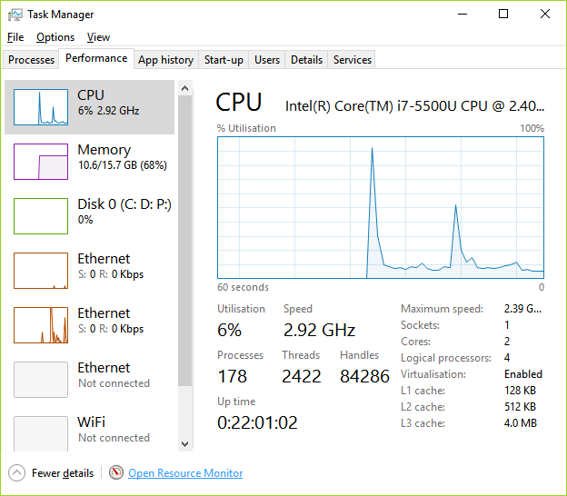
BOTTLENECKS IDENTIFICATION

Slide 11
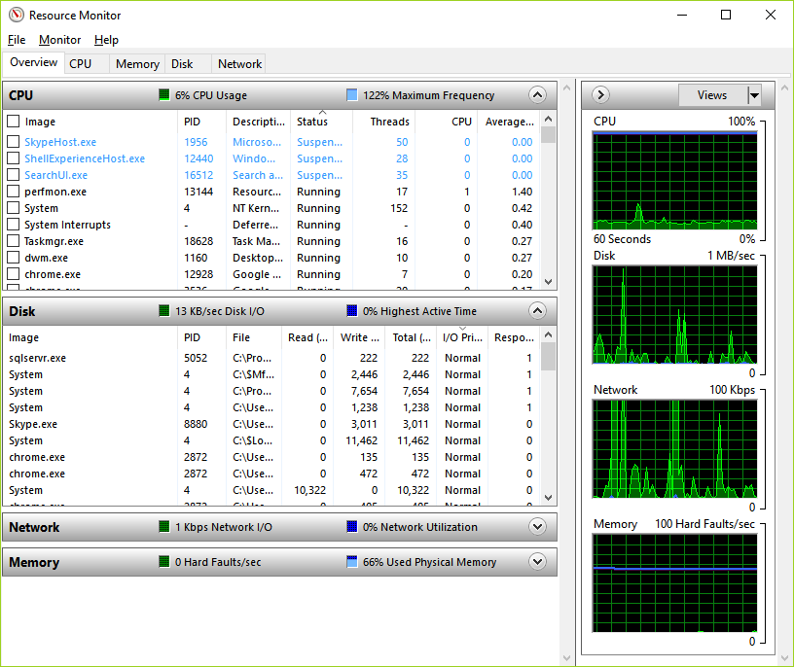
BOTTLENECKS IDENTIFICATION

Slide 12
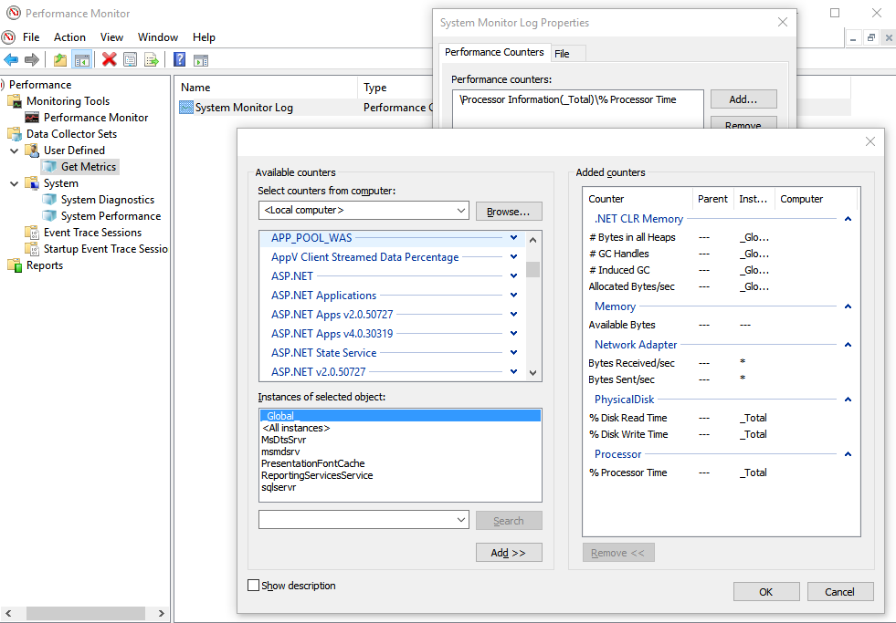
BOTTLENECKS IDENTIFICATION

Slide 13
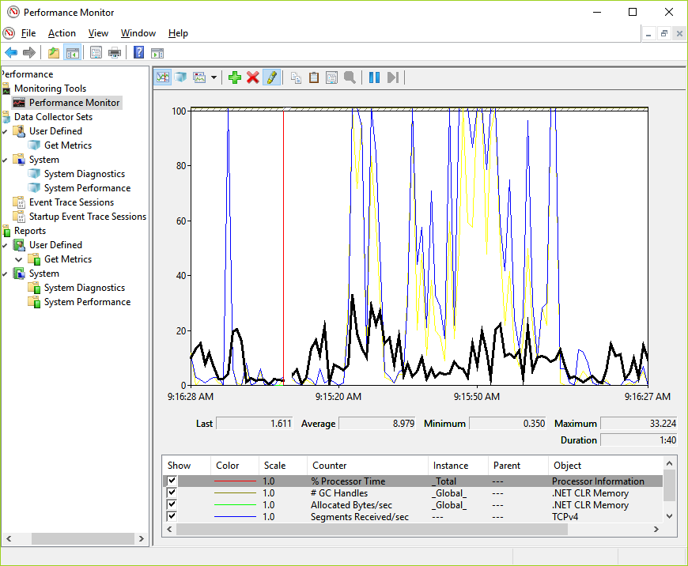
BOTTLENECKS IDENTIFICATION

Slide 14
Performance

Slide 15
PERFORMANCE. TOOLS
Visual Studio Performance Profiler
https://msdn.microsoft.com/en-us/library/ms182372.aspx
https://msdn.microsoft.com/en-us/library/mt210448.aspx
https://docs.microsoft.com/en-us/visualstudio/profiling/profiling-feature-tour
https://channel9.msdn.com/Shows/Visual-Studio-Toolbox/Visual-Studio-Toolbox-Performance-Profiling
JetBrains dotTrace
https://www.jetbrains.com/profiler/documentation/documentation.html
Redgate ANTS
http://www.red-gate.com/products/dotnet-development/ants-performance-profiler/

Slide 16
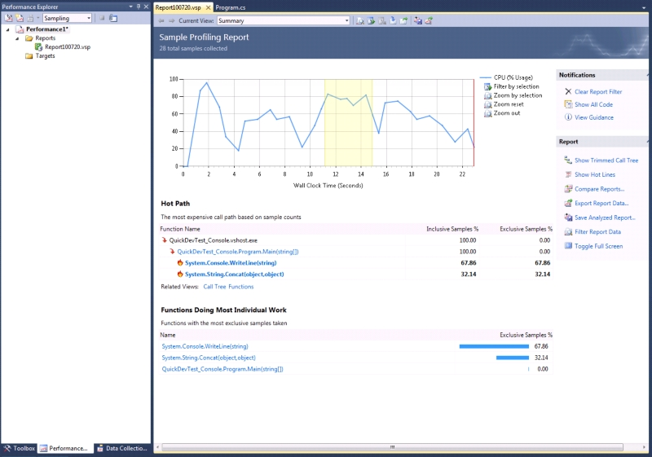
PERFORMANCE. TOOLS

Slide 17
PERFORMANCE. TIPS AND TRICKS
Logical Problems / Not optimal code
Data Structure misuse – IEnumerable, List, Array, Dictionary, HashSet
Cache – cached repositories, etc.
Concurrent or Asynchronous code – async/await, TPL, Parallel.For
Use StringBuilder
Avoid Exceptions
Use XML Readers instead of LINQ to XML
Avoid Reflection/dynamic
Use memoization – if(lookup.TryGetValue(key, out value)) return value; lookup[key] = value.ToLower();
Override GetHashCode and Equals

Slide 18
PERFORMANCE. RESOURCES
Video
\\su\store\Training-and-development\Seminars\Pluralsight\vs-intro-dbg
\\su\store\Training-and-development\Seminars\Pluralsight\web-performance
https://www.pluralsight.com/courses/measuring-dotnet-performance
https://www.pluralsight.com/courses/dotnet-performance-optimization-profiling-jetbrains-dottrace

Slide 19
PERFORMANCE. RESOURCES
.Net Performance Testing and Optimization - https://www.red-gate.com/library/net-performance-testing-and-optimization-the-complete-guide
Pro .NET Performance: Optimize Your C# Applications - http://www.apress.com/us/book/9781430244585
Writing High-Performance .NET Code - http://www.writinghighperf.net/
Advanced .NET Debugging - http://advanceddotnetdebugging.com/
.Net Internals and Advanced Debugging Techniques - book https://www.amazon.ca/Net-Internals-Advanced-Debugging-Techniques/dp/0321934717 or course https://www.pluralsight.com/courses/dotnet-internals-adv-debug
Performance Tips - https://msdn.microsoft.com/en-us/library/ms973839.aspx
52 Perf Tricks - https://www.red-gate.com/library/52-tips-tricks-to-boost-net-performance
Optimization - https://www.dotnetperls.com/optimization

Slide 20
Memory

Slide 21
MEMORY. TOOLS
Visual Studio Managed Memory Debugger
https://msdn.microsoft.com/en-us/library/d5zhxt22.aspx
https://blogs.msdn.microsoft.com/devops/2013/10/16/net-memory-analysis-enhancements-in-visual-studio-2013/
https://channel9.msdn.com/Shows/Visual-Studio-Toolbox/Managed-Memory-Analysis-in-Visual-Studio-2013
Visual Studio Diagnostic Tools
https://docs.microsoft.com/en-us/visualstudio/profiling/memory-usage
https://channel9.msdn.com/Shows/Visual-Studio-Toolbox/Visual-Studio-2015-Diagnostic-Tools
JetBrains dotMemory
https://www.jetbrains.com/dotmemory/
Redgate ANTS Memory Profiler
http://www.red-gate.com/products/dotnet-development/ants-memory-profiler/
Scitech .NET Memory Profiler
https://memprofiler.com/

Slide 22
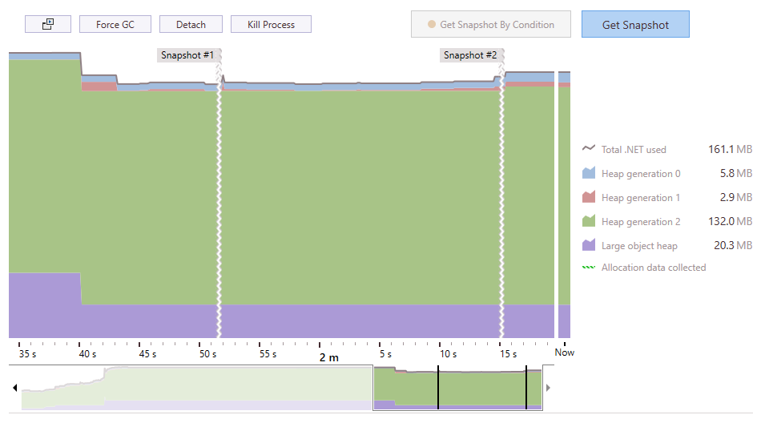
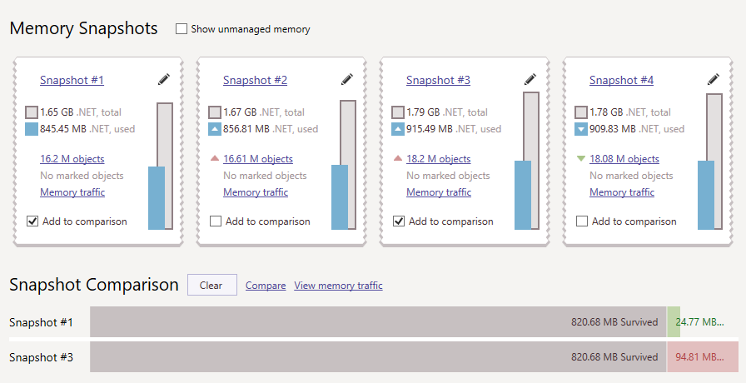
MEMORY. TOOLS

Slide 23
MEMORY. TIPS AND TRICKS
Files, Connections, etc. – IDisposable – Dispose(), Close(), using
Clear events subscriptions – if you see +=, then there must be -=
Use StringBuilder
Static fields/properties
Define collections capacity – var list = new List(products.Length);
Use structs
Do not call GC.Collect() explicitly
Boxing/Unboxing
Use WeekReferences, ConditionalWeakTable

Slide 24
MEMORY. RESOURCES
Video
\\su\store\Training-and-development\Seminars\Pluralsight\idisposable-best-practices-csharp-developers
\\su\store\Training-and-development\Seminars\Pluralsight\making-dotnet-applications-even-faster
Books
Under the Hood of .NET Memory Management - https://www.amazon.com/Under-Hood-NET-Memory-Management/dp/1906434751

Slide 25
Database

Slide 26
DATABASE TOOLS
MS SQL Profiler
https://docs.microsoft.com/en-us/sql/tools/sql-server-profiler/sql-server-profiler
https://www.red-gate.com/simple-talk/sql/performance/how-to-identify-slow-running-queries-with-sql-profiler/
https://www.mssqltips.com/sqlservertutorial/272/profiler-and-server-side-traces/
MS SQL Management Studio
https://technet.microsoft.com/en-us/library/ms191227(v=sql.105).aspx
https://www.mssqltips.com/sqlservertip/2170/more-intuitive-tool-for-reading-sql-server-execution-plans/
http://sqlmag.com/t-sql/understanding-query-plans
Redgate SQL Monitor
http://www.red-gate.com/products/dba/sql-monitor/

Slide 27
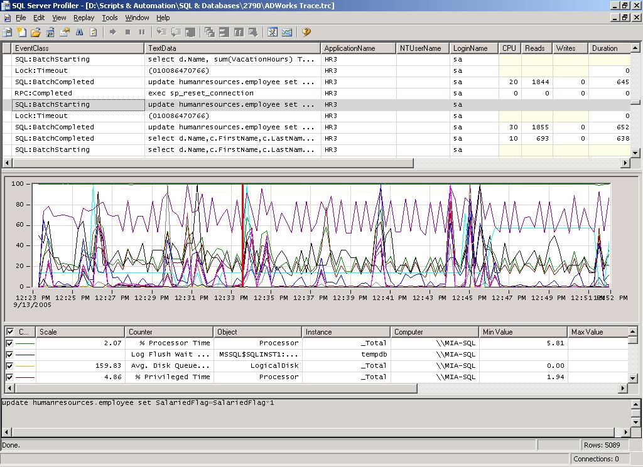
DATABASE TOOLS

Slide 28
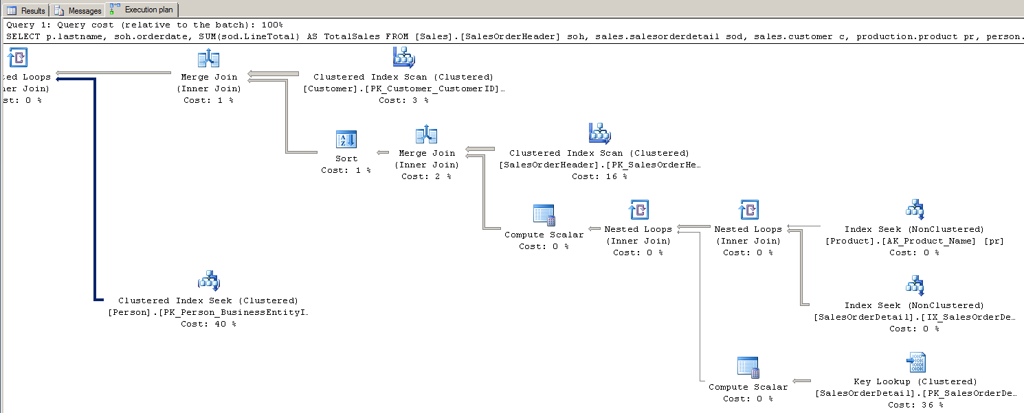
QUERY PLAN

Slide 29
DATABASE. TIPS AND TRICKS
Reduce number of queries
Use Indexes
Choose proper transaction isolation level
Retrieve only needed records - return context.Products.ToList().FirstOrDefault();
Don’t select unneeded columns – SELECT * FROM Products
Entity Framework – rewrite with stored procedures
Bulk Operations – use SQLBulkCopy class
Use Cache
Use IQueryable
Do not track changes – AutoDetectChangesEnabled; db.Products.Where(p => p.InStock). AsNoTracking().ToList();

Slide 30
DATABASE. TIPS AND TRICKS
Define length for nvarchar columns
Seek vs Scan, avoid functions in WHERE
Estimated vs Actual Query Plan
Update Statistics
Parameters Sniffing – local variables, OPTION (RECOMPILE)
Avoid transactions
Avoid cursors
Normalization\Denormalization
Partitioning

Slide 31
DATABASE. RESOURCES
\\su\store\Training-and-development\Seminars\Pluralsight\sqlserver-sqltrace
\\su\store\Training-and-development\Seminars\Pluralsight\sqlserver-query-plan-analysis
https://www.mssqltips.com/sql-server-tip-category/9/performance-tuning/
http://download.red-gate.com/ebooks/SQL/sql-server-execution-plans.pdf

Slide 32
WEB OPTIMIZATION
Resources
\\su\store\Training-and-development\Seminars\Pluralsight\web-performance
https://www.udacity.com/course/website-performance-optimization--ud884
https://developers.google.com/web/fundamentals/performance/
https://dou.ua/lenta/digests/wpo-digest-0/
https://www.keycdn.com/blog/website-performance-optimization/
https://medium.com/airbnb-engineering/performance-tuning-e10ac94916df
Tools
Fiddler - http://www.telerik.com/fiddler
https://www.keycdn.com/blog/website-speed-test-tools/
http://www.softwaretestinghelp.com/performance-testing-tools-load-testing-tools/

Slide 33
TRAINING TASK
Optimize test web application
Performance optimization
Investigate memory usage
Create performance optimization report
Exam – 15-20 min interview

Slide 34
Q & A

