Slide 1

Blockchain
Andrei ROTARU

Slide 2
Summary
Terminologies
Business Process
Wallet creation
Wallet security
Pseudo transaction
Pseudo block/in queue block
Transaction model
Account changes
Mining process
Mining Queue
Rewards and funds
Improvements/Features

Slide 3

Blockchain
High level solution

Slide 4
Terminologies
Terminology | Description
Node | Entity that stores and operates the distributed ledger
Broker | Main entity that server as nodes discovery and gateway between wallets and nodes
Miner | Node that generates new blocks
Block | Collection of valid and processed transactions
Transaction | A process that transfers assets from one account to another
Pseudo Transaction | A wallet signed transaction that needs to be validated then processed
Mempool | Collection of all unprocessed but validated pseudo transaction

Slide 5
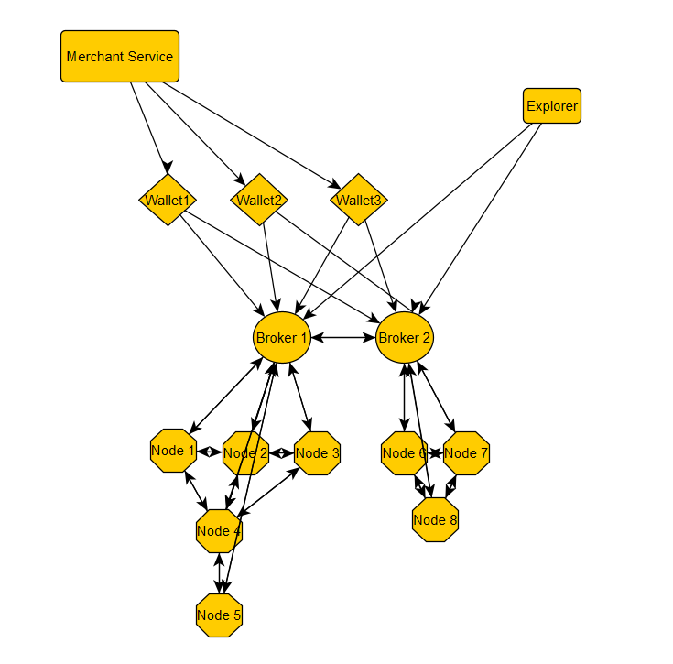
Business Process

Slide 6
Wallet security
Upon obtaining a 32-byte private key, the wallet creation process initiates by leveraging Elliptical Curve Cryptography (ECC) over the SECP256K1 curve. Once the wallet is generated, the holder retains the private key, which will be essential for signing any pseudo transaction securely.
The account address, which is a public component, is openly accessible to everyone. Additionally, the public key hash, uniquely derived through a 32-byte double SHA256 process over the public key point (x, y), is also public information. This public key hash does not affect the wallet's security and serves as an identifier for the account.

Slide 7
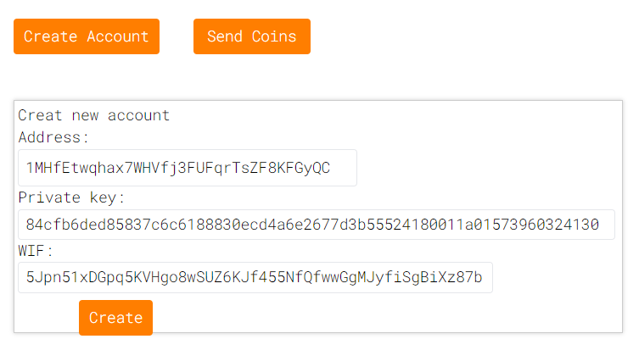
Wallet structure

Slide 8
Pseudo transaction
Once a wallet holder signs any pseudo transaction, the request goes directly to the broker for validation. The broker performs two main checks: firstly, it verifies whether the sent amount is lower or equal to the balance in the holder's account. Secondly, it validates the digital signature against the pub_key_hash.
During the signing process, the public key is not sent or used directly. Instead, the broker recovers the public key from the signature and then compares it with the pub_key_hash. This ensures that the information cannot be tampered with, as the pub_key_hash is assigned to the model before the signing process and is thus included in the signing hash. This secure mechanism ensures the integrity and authenticity of the transaction.

Slide 9
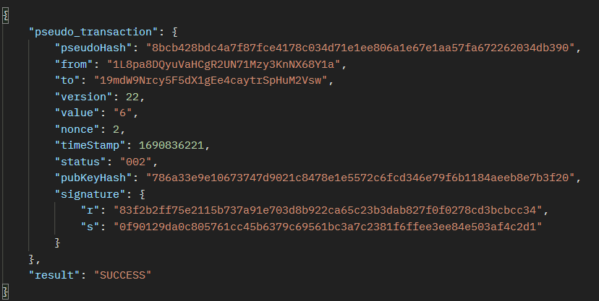
Pseudo transaction

Slide 10
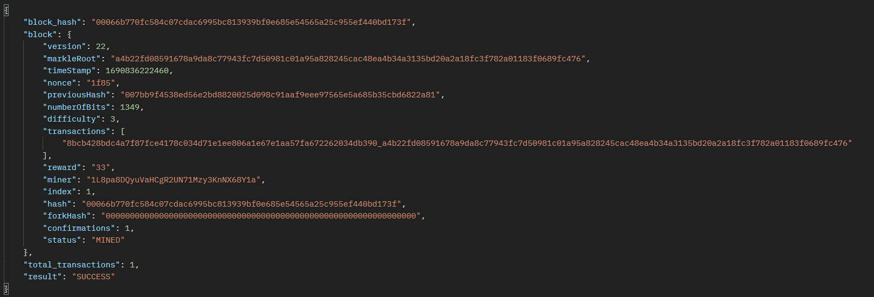
Pseudo block/in queue block

Slide 11
State chain transaction
A state chain transaction is a type of pseudo transaction that carries additional block details. Its primary purpose is to facilitate the movement of funds from one account to another within the system. These state chain transactions are added to a block and become visible in the explorer, providing transparency and visibility to all participants.
It's important to note that state chain transactions are non-mutable entities, meaning their contents cannot be altered once they are included in the block. The only aspect that can be changed is the number of confirmations, which refers to the number of blocks added on top of the block containing the transaction. However, this change in the number of confirmations does not affect the hashing of the state chain transaction or compromise its integrity.
This immutability ensures the security and reliability of the state chain transactions, as any alteration would be easily detectable, and the system maintains a tamper-resistant record of all fund transfers. The availability of these transactions in the explorer enhances transparency and provides a comprehensive view of the movement of funds within the system.

Slide 12
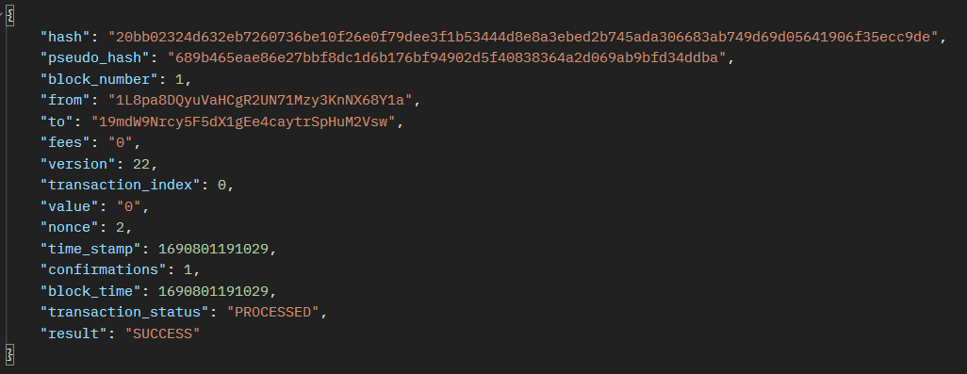
Transaction model

Slide 13
Block model
Block models share similarities with pseudo blocks, with the primary distinction lying in the transaction list. In block models, instead of storing both pseudo and state chain transaction hashes, only state chain transaction hashes are kept. These block models are made available in the explorer, allowing participants to inspect the content and details of each block.
Similar to state chain transactions, block models are also non-mutable entities. Once a block is created and added to the blockchain, its contents cannot be altered. The only aspect that can be updated is the number of confirmations, which refers to the number of subsequent blocks that are added on top of the specific block. However, this change in the number of confirmations does not impact the overall functionality of the system.
The immutable nature of block models ensures the integrity and security of the blockchain. It guarantees that the transaction history remains tamper-resistant, and any attempts to modify past blocks would be easily detectable. This immutability is crucial for maintaining a transparent, trustworthy, and reliable ledger of all state chain transactions, providing a strong foundation for the system's functionality and trustworthiness.

Slide 14
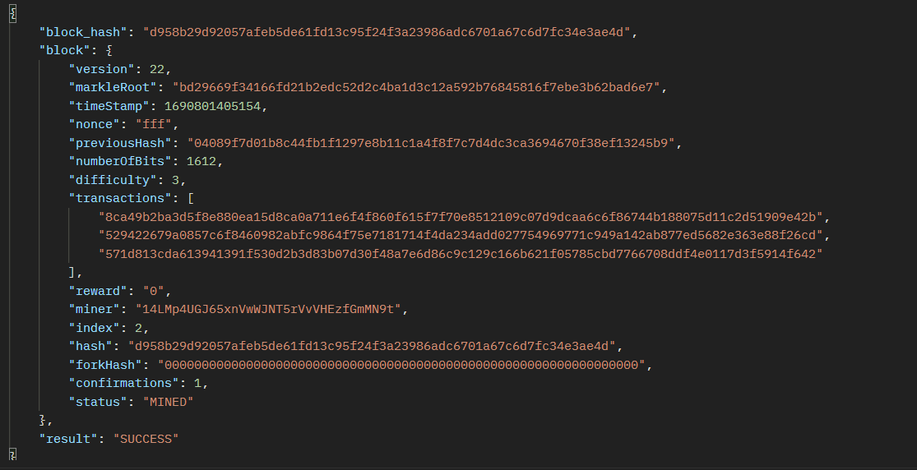
Block model

Slide 15
Account Changes
In the system, account details are accessible for each node, and data is transparent, meaning it can be accessed and viewed through the explorer. This transparency allows participants to verify the state of accounts and track transactions on the blockchain.
When a pseudo transaction is initiated, it does not immediately affect the real balance of the involved accounts. Instead, it influences only the inbound and outbound amounts associated with the transaction. These inbound and outbound balances represent the pending changes that will be applied once the pseudo transaction is fully validated and appended to a block.

Slide 16
Account Changes
After the pseudo transaction is validated and included in a block, the system proceeds to execute the transaction. At this point, the inbound and outbound balances are updated to reflect the actual changes in the accounts' real balances. These updates ensure that the transaction is executed correctly, and the changes are reflected accurately in the blockchain's state.
By adopting this two-step process, the system ensures that all transactions are verified and confirmed before impacting the actual account balances. This approach maintains the consistency and integrity of the blockchain, providing a reliable and transparent record of all account transactions. Participants can confidently rely on the explorer to access and verify the current state of accounts and the execution of transactions.

Slide 17
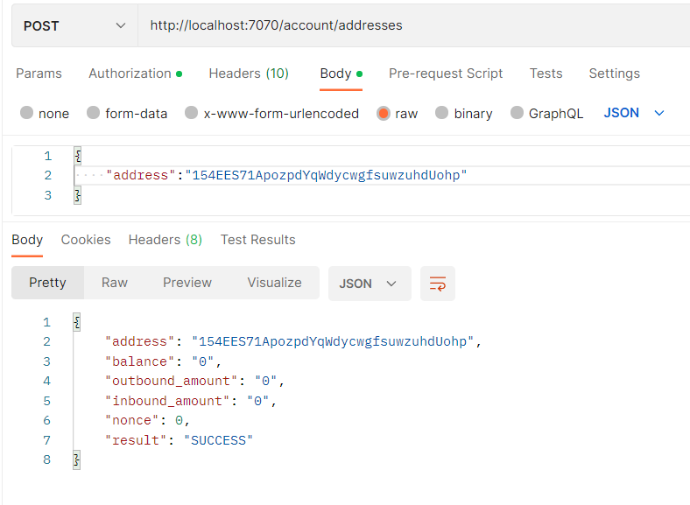
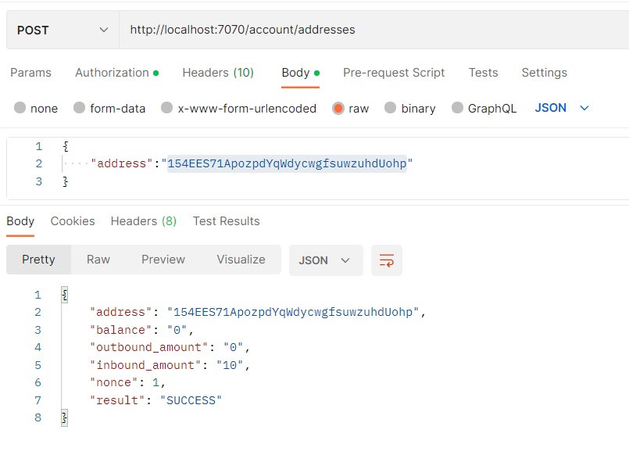
Account changes

Slide 18
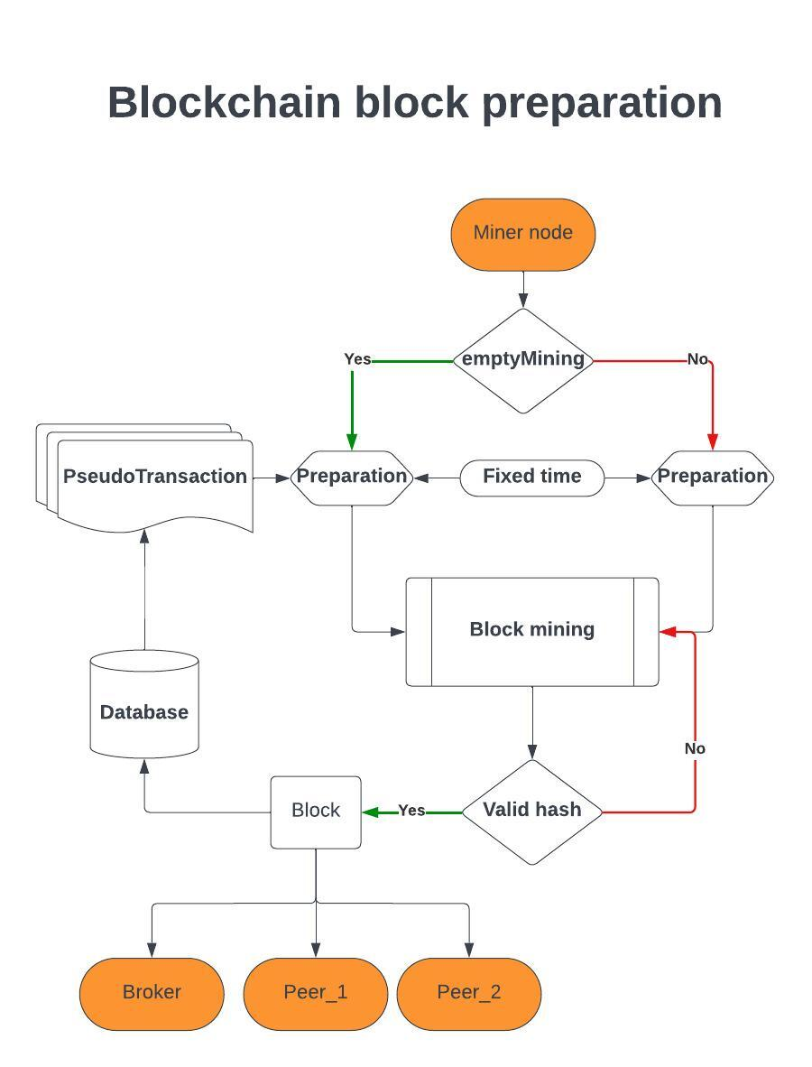
Mining process

Slide 19
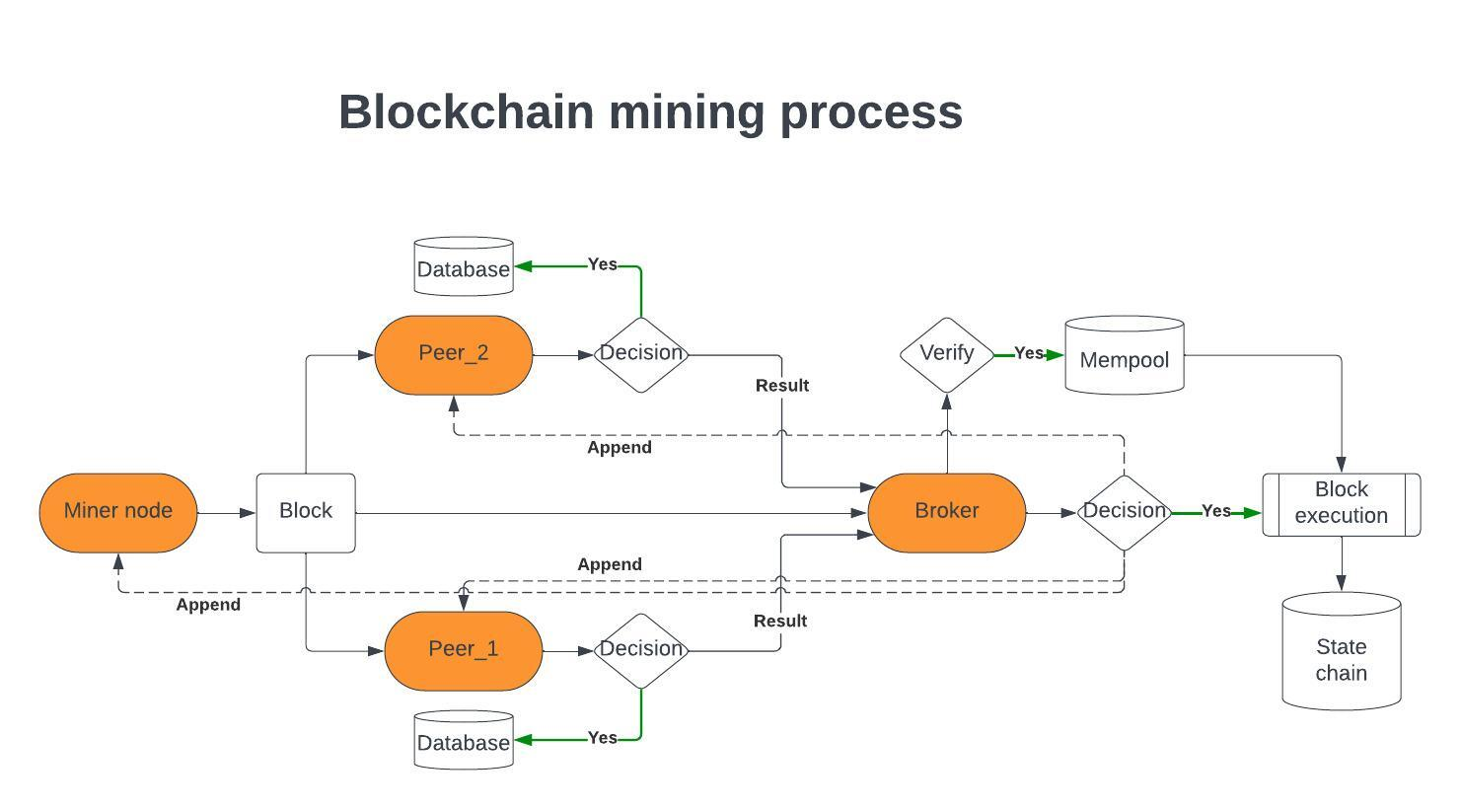
Mining process

Slide 20
Mining Queue
In the mining queue, multiple blocks can be valid for a specific index. For instance, when node A mines a block and broadcasts it, that block remains in the queue until the number of confirmations exceeds the threshold (> 50% + 1). At the same time, node B may also mine the same block for the same index, resulting in both blocks being stored in the queue. However, only the first block that surpasses the confirmation threshold will be moved to the state chain, while the other blocks under the same index will be discarded.

Slide 21
Rewards and funds
Once a block is moved to the state chain, we proceed to process every transaction within that block and allocate the funds accordingly to specific accounts. Each fund corresponds to the amount specified in the transaction, as well as the inbound and outbound amounts associated with the transaction. This meticulous process ensures that the correct amounts are allocated to the relevant accounts, accurately reflecting the financial transactions conducted within the block.

Slide 22
Improvements/Features
Implement reward for each node that gives a success confirmation for blocks
Implement secured token/key API for explorers
Refactor the API logic, to be more robust for potential application of vendor websites
Implementing quick pay via QR code and passcode
Kubernetes deployment of multiple miner nodes
Research integration of potential smart contracts same as ETH
Research if Quantum cryptography can be applied

