Slide 1

OBD AI
Review
Indexed evidence for faster, consistent embedded software reviews
Notes:
Cover image generated for this presentation. The ECU and AI review interface remain visually separate.

Slide 2
02
Purpose and scope
OBD AI Review creates a searchable technical memory for a selected repository revision.
01
Build technical memory
Current inputs
Indexes C functions, variables, macros, GRL blocks, file locations and Git revision metadata.
Repository
C source code and GRL files from a selected Git revision
02
Retrieve focused evidence
Finds exact implementations, related functions, source context and the relevant specification text.
Specification
TXT files from the module specification folder
03
Support the review
Supplies the AI with a small evidence set for findings, differences, risks and recommendations.
Planned extension
LIMAS can be added later through the specification provider interface.

Slide 3
03
Two operating modes
The database is built separately from the interactive review, so repeated questions stay fast.
01
Build or update knowledge
02
Review or query
Resolve revision
Fetch the repository and select the requested commit.
Understand request
Identify the function, behavior or requirement in scope.
Create snapshot
Read an immutable copy without changing the worktree.
Search index
Use names, exact hashes, similarity and GRL identifiers.
Parse content
Extract functions, symbols, GRL and metadata.
Load evidence
Retrieve only the relevant code and specification context.
Store index
Save relationships and fingerprints in SQLite.
Produce review
Present findings, differences, risks and recommendations.

Slide 4
04
Code matching methods
Exact reuse and structural similarity answer different review questions.
Exact implementation
Similar implementation
Normalization
Token fingerprint
Converts line endings, removes trailing spaces and trims only the outer whitespace.
Tree-sitter tokenizes C code. Comments are ignored, while names and literals are generalized.
Identity
Similarity score
SHA-256 identifies byte-equivalent normalized implementations. One record can link to several occurrences.
The engine compares 5-token shingles with Jaccard similarity and returns the shared percentage.
100%
same normalized fingerprint

Slide 5
05
Review workflow
Scripts handle deterministic work. The AI interprets the retrieved evidence and presents the review.
01
02
03
04
05
06
Repository + spec
Safe snapshot
Parse + index
SQLite
Targeted search
AI review
Selected revision
No worktree changes
Code, GRL, metadata
Indexed knowledge
Bounded evidence
Findings and risks
The scripts reduce token use because the AI reads a focused result set rather than the full repository.

Slide 6
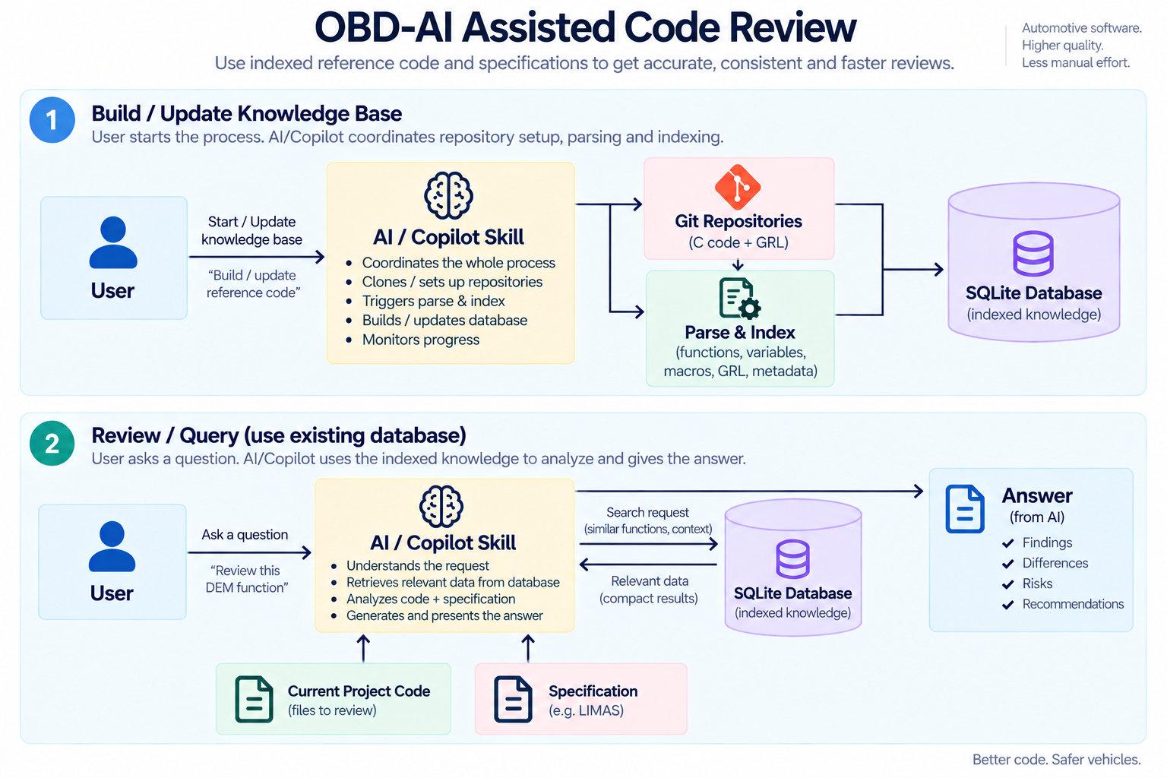
Notes:
Detailed process image provided by the user.

Slide 7
07
Design strengths
The architecture supports repeatable reviews without changing the analyzed repository.
01
Deterministic
Scripts provide repeatable indexing, lookup and comparison results.
02
Traceable
Every occurrence links to a source file, line range and Git revision.
03
Token efficient
Queries return only the functions and context needed for the review.
04
Safe
Immutable snapshots protect the repository and any local work in progress.
05
Portable
SQLite stores the index locally without a separate database server.

