Slide 1
Test the REST
Testing RESTful web services using REST Assured
An open source workshop by …
Originally created by Bas Dijkstra – bas@ontestautomation.com – http://www.testautomation.com - @_basdijkstra
Notes:
Please replace the … with your own name. I would really like it if you left the bottom line intact though, as a way of thanking me. That’s really all I’m asking for, the rest of the workshop is yours to butcher (erm, improve).

Slide 2
What are we going to do?
RESTful web services
REST Assured
Get your hands dirty
Notes:
First: an introduction to RESTful web services, how they work and where they are used
Then: an introduction to REST Assured, a Java library that can be used to write tests for RESTful web services
But most importantly: you are going to have to do some work yourself! There’s not better way to learn than by doing.

Slide 3
Preparation
Install Eclipse (or any other IDE)
Install TestNG plugin (for Eclipse)
Install m2e (or similar for any other IDE)
Import Maven project into IDE
Update project (Eclipse) or similar
Notes:
Depending on the way you deliver this workshop, this sheet can be altered or even removed. When I delivered it, I had participants bring in their own laptop and asked them to follow installation instructions. I only provided them for Eclipse and mentioned that whenever they wanted to use a different IDE, they were allowed to do so. I wanted to keep things simple and therefore did not provide installation instructions for other IDEs.

Slide 4
What are RESTful web services?
HTTP request methods (GET, POST, PUT, …)
URI’s
CRUD operations on data
POST Create
GET Read
PUT Update
DELETE Delete
Notes:
Explain the concept of RESTful web services and compare it to your browser retrieving web pages, images, etc. from a web server (or sending data back to it).

Slide 5
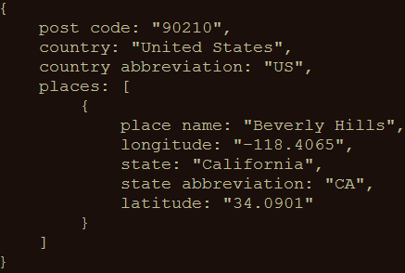
An example
GET http://api.zippopotam.us/us/90210
Result:
Notes:
A simple example. You could also perform this one live to show the participants how easy it is to invoke a RESTful web service using your browser (it really is no different from accessing a regular web page since it’s all done over HTTP)

Slide 6
Usage of RESTful web services
Mobile applications
Internet of Things
API Economy
Notes:
Explain where RESTful web services are used.
API Economy relates to software development exposing (parts of) their applications to the outside world through APIs, so that other developers can easily integrate their applications with it. For example: Google’s Gmail API, Maps API or the PayPal or LinkedIn APIs.

Slide 7
Why REST (and not SOAP, for example)?
Support for a multitude of data formats
JSON
XML
…
Smaller overhead and therefore better performance
Notes:
Explain the reasons why REST is chosen over SOAP

Slide 8
Why SOAP(and not REST, for example)?
WS-Security
WS-ReliableMessaging
WS-AtomicTransaction
Mostly used to secure banking applications
Notes:
There are some cases where using SOAP instead of REST can be useful

Slide 9
Tools for testing RESTful web services
Browser (using plugins like Postman for Chrome)
Open source (SoapUI, REST Assured)
COTS (Parasoft SOAtest, SoapUI Pro)
Notes:
Three levels of tools, ranging from the very simple to the powerful and from the free to the commercial

Slide 10
REST Assured
Java library for writing tests for RESTful web services
Removes a lot of boilerplate code
Integrates seamlessly with existing Java-based testing frameworks
JUnit, TestNG
Selenium WebDriver
Notes:
Explain what REST Assured is and why it was written
Explain how REST Assured can easily be made part of a bigger testing framework covering everything from unit to end-to-end and user interface testing

Slide 11
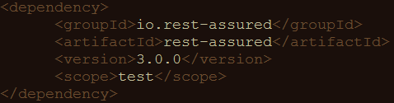
Configuring REST Assured
Download from http://rest-assured.io
Add as a dependency to your project
Maven
Notes:
Briefly discuss the options available for installing and configuring REST Assured (this should be trivial for anybody with a bit of Java development experience)

Slide 12
REST Assured documentation
Usage guide
https://github.com/rest-assured/rest-assured/wiki/Usage
Links to other documentation (JavaDoc, getting started, release notes)
http://rest-assured.io/
Notes:
Notes on where to find additional information on REST Assured

Slide 13
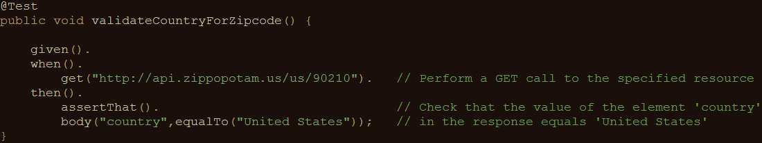
A sample test
Notes:
Demonstrate how easy it is to write a fully functional test on a RESTful web service with REST Assured. This is the only code you need. And it’s readable too!

Slide 14
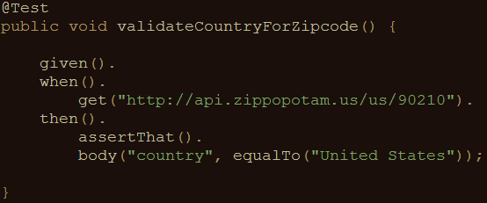
REST Assured features
Support for HTTP methods (GET, POST, PUT, …)
Support for BDD / Gherkin (Given/When/Then)
Use of Hamcrest matchers for checks (equalTo)
Use of GPath for selecting elements from JSON response
Notes:
Using the example from the previous sheet, introduce some of the basic REST Assured features

Slide 15
About Hamcrest matchers
Express expectations in natural language
Examples:
http://hamcrest.org/JavaHamcrest/javadoc/1.3/org/hamcrest/Matchers.html
equalTo(X) | Does the object equal X?
hasItem(“Rome”) | Does the collection contain an item “Rome”?
hasSize(3) | Does the size of the collection equal 3?
not(equalTo(X)) | Inverts matcher equalTo()
Notes:
Go into a little more detail with regards to Hamcrest matchers – readable matchers for creating checks

Slide 16
About GPath
GPath is a path expression language integrated into Groovy
REST Assured is built in Groovy
Similar aims and scope as XPath for XML
Documentation and examples:
http://groovy-lang.org/processing-xml.html#_gpath
http://groovy.jmiguel.eu/groovy.codehaus.org/GPath.html
Notes:
Go into a little more detail with regards to Gpath for effective selection of elements from XML and JSON responses

Slide 17
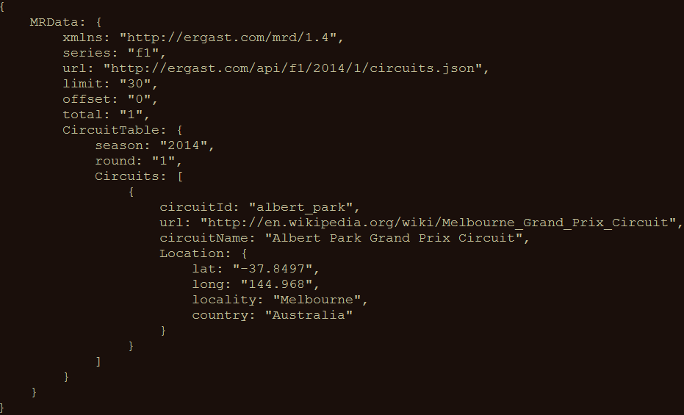
GPath example
http://goessner.net/articles/JsonPath/
Notes:
Example – also explain the [0] needed since we’re dealing with a collection of Circuits here

Slide 18
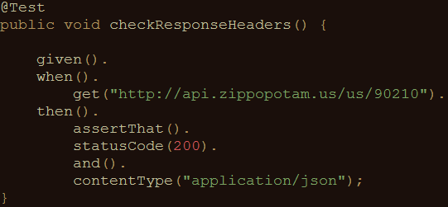
Validating technical response data
HTTP status code
MIME-type of received responses
Cookies and their value
…
Notes:
Explain how you can not only perform validations on response content, but also on response headers.

Slide 19
Our application under test
Ergast F1 API
Presents historical data of Formula 1 races, drivers, circuits, etc.
Data can be returned in JSON and XML format
API documentation at http://ergast.com/mrd/
Notes:
Explain why this API was chosen (simple, lots of features, very ‘real’ data, something lots of people can relate to)
Alternatively, you can always use your own API of course!

Slide 20
Some examples
Data for driver Max Verstappen (in JSON):
http://ergast.com/api/f1/drivers/max_verstappen.json
A list of circuits for the 2015 season (in JSON):
http://ergast.com/api/f1/2015/circuits.json
Notes:
Some basic examples on how to retrieve data from the API

Slide 21
Demo
API documentation
How to use the test suite
Executing your tests
Reviewing test results
Notes:
A quick demo before the participants start with the first series of exercises might be helpful to ensure they’ve understood everything so far and are ready to go.

Slide 22
Get your hands dirty!
RestAssuredExercises1
Simple checks
Validating individual elements
Validating collections and items therein
Validating technical response properties
RestAssuredExamples contains all examples from the presentation
Notes:
Speaks for itself, I think.

Slide 23
Parameters in RESTful web services
Path parameters
http://ergast.com/api/f1/drivers/max_verstappen.json
http://ergast.com/api/f1/drivers/hamilton.json
Query string parameters
http://md5.jsontest.com/?text=testcaseOne
http://md5.jsontest.com/?text=testcaseTwo
There is no official standard!
Notes:
Explain the difference between path and query string parameters in RESTful web services

Slide 24
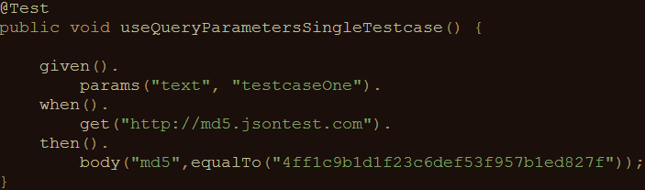
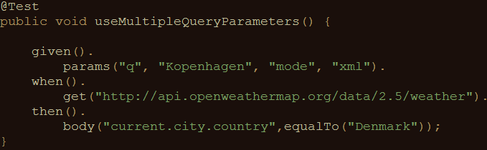
Using parameters in REST Assured
Examples for query parameters:
Call to http://md5.jsontest.com/?text=testcaseOne
Call to http://api.openweathermap.org/data/2.5/weather/?q=Kopenhagen&mode=xml
Notes:
Explain how you define query string parameters to be used when calling a service in REST Assured (using params() )

Slide 25
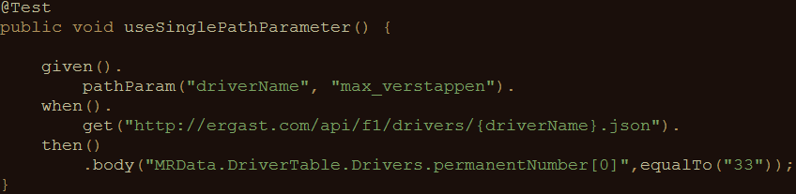
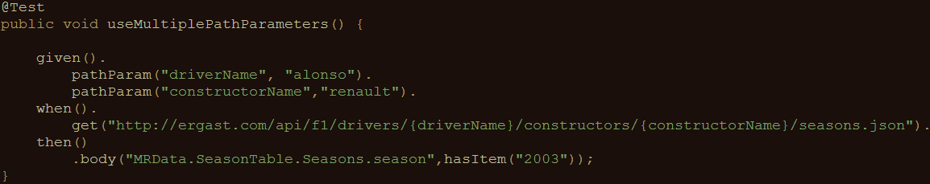
Using parameters in REST Assured
Examples for path parameters:
Call to http://ergast.com/api/f1/drivers/max_verstappen.json
Call to http://ergast.com/api/f1/drivers/alonso/constructors/renault/seasons.json
Notes:
Explain how you define path parameters to be used when calling a service in REST Assured (using pathParam() )

Slide 26
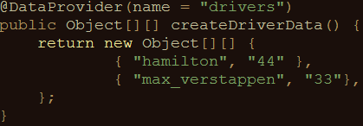
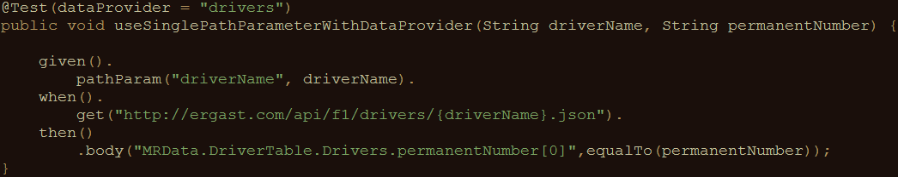
Using parameters in REST Assured
Iterating over a collection of parameter values:
Creating pairs of driver ID’s and numbers:
Using test data in API calls and validation of response data:
Notes:
Explain how to create data driven tests using the TestNG @DataProvider and (path or query string) parameters

Slide 27
Get your hands dirty!
RestAssuredExercises2
Data driven tests
Creating a test data object
Using test data in calling the right URI
Using test data in assertions
RestAssuredExamples contains all examples from the presentation

Slide 28
Authentication
Securing web services
Basic authentication (preemptive / challenged)
OAuth(2)
Digest / Form
Notes:
Explain why web services sometimes need to be secured and introduce the different authentication options for RESTful web services

Slide 29
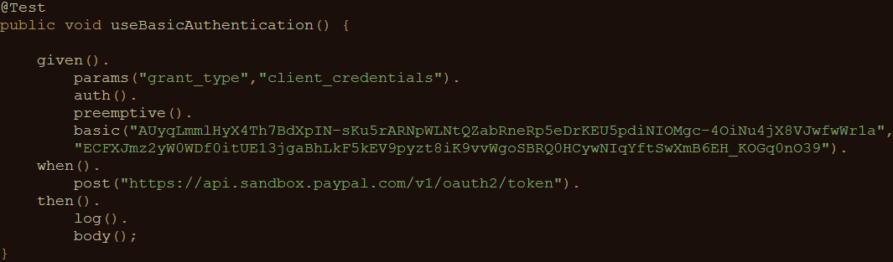
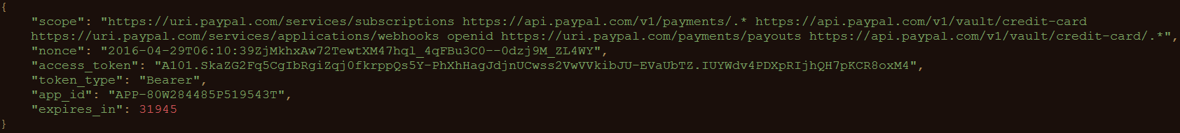
Basic authentication
Username/password sent in header for every request
Notes:
Explain Basic (username / password) authentication

Slide 30
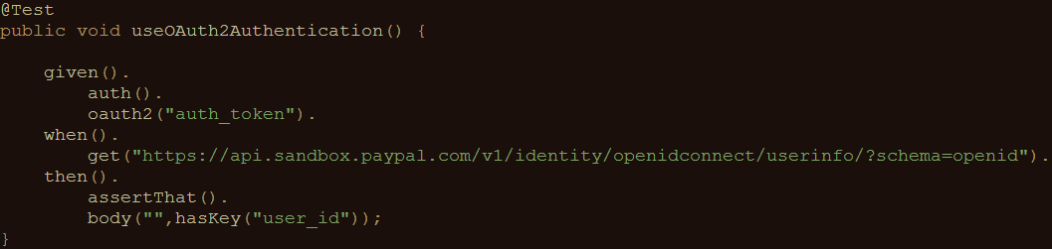
OAuth(2)
Request of authentication token based on username and password (Basic authentication)
Include authentication token in header of all subsequent requests
Notes:
Explain Oauth
Retrieve access token by calling endpoint (mostly secured using Basic authentication)
Include obtained authentication token in the header of all subsequent requests
Explain that authentication token is tied to a specific user and that it has an expiration time (after which a new token needs to be requested)

Slide 31
Measuring response times
Measuring response times for individual requests
Setting response time thresholds
Test fails when threshold is exceeded
No full-fledged performance test
First rough indication of API performance
Notes:
REST Assured can also measure very basic response times. This is in no way equal to a full-blown performance test, but it can be a rough indication for potential performance issues. For REAL validation of performance requirements, an actual performance test should be set up, using a dedicated performance test tool such as Apache JMeter

Slide 32
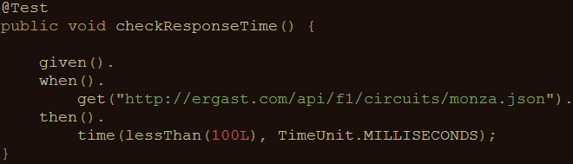
Measuring response times
An example:
Notes:
Here’s an example of how to define a response time threshold and the error generated when the actual response time exceeds this threshold

Slide 33
Get your hands dirty!
RestAssuredExercises3
Communicating with an OAuth2-secured API
Requesting authentication token
Using authentication token in subsequent requests
Measuring API response times
Execute a specific API call
Evaluate response time against predefined threshold
RestAssuredExamples contains all examples from the presentation

Slide 34
Sharing variables between tests
Example: authentication tests
Copy / paste required for OAuth2 token
Preferably: store and retrieve for reuse!
Notes:
Refer to the exercise where you needed to manually copy and paste the OAuth authentication token. This is cumbersome, especially when you want to have your tests run unattended (which you want to ;). To be able to do so, you need a way to extract response values from a certain request (in this case the authentication token) and reuse it in subsequent tests.

Slide 35
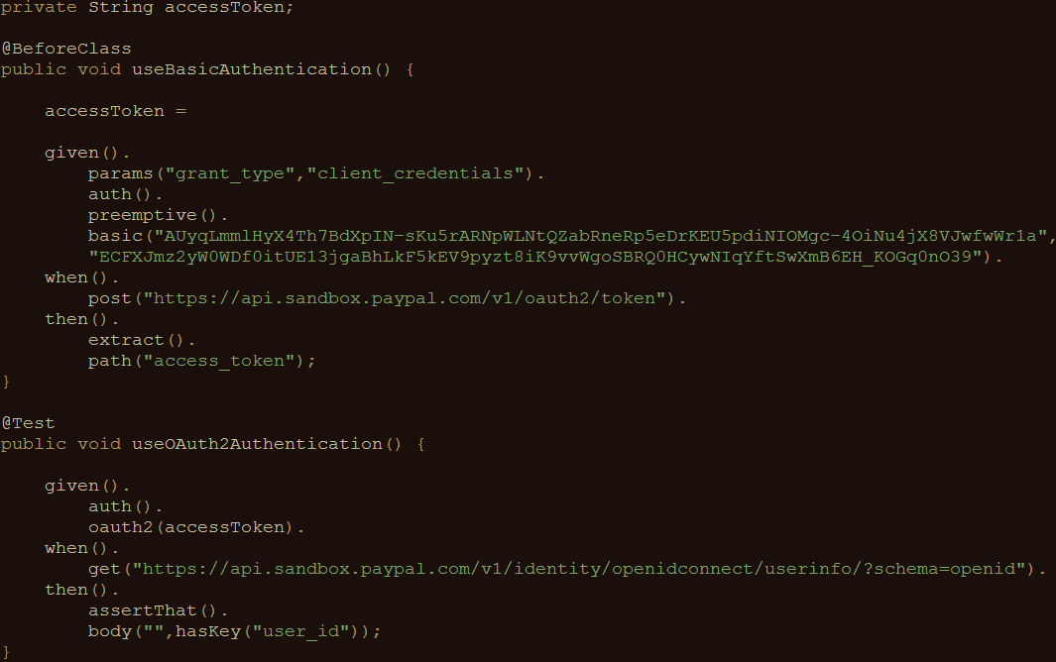
Sharing variables between tests
REST Assured
supports this
with extract()
Notes:
Explain the REST Assured extract() feature, which you can use (using GPath) to extract certain values from a response for later reuse.

Slide 36
Get your hands dirty!
RestAssuredExercises4
Try it for yourself
Can you apply this to the Formula 1 API?
RestAssuredExamplesParameterPassing contains all examples from the presentation

Slide 37
Executing tests in CI
REST Assured-tests are no different from other Java (unit) tests
Can be easily added to your CI/CD pipeline
Part of the build process
Demonstration (using Jenkins)
Notes:
The final part of this workshop is used to explain how you can integrate your REST Assured API-level tests in a Continuous Integration setting. For my workshop, I have set up a local Jenkins installation and created a simple job that executed the tests. I then showed the build result and the console output in Jenkins to prove that the tests were indeed executed.

Slide 38
Questions
?
Notes:
Any questions?

Slide 39
Contact
Email: bas@ontestautomation.com
Weblog: http://www.ontestautomation.com
Twitter: @_basdijkstra
Notes:
Here’s the part where you can shamelessly promote yourself (or give the participants your contact details in case they want more information or have any other questions, of course…). Feel free to replace this with your own contact details, you’re the one delivering the workshop after all!

