Slide 1
Test the REST
Testing RESTful web services using REST Assured
An open source workshop by …
Originally created by Bas Dijkstra – bas@ontestautomation.com – http://www.testautomation.com - @_basdijkstra

Slide 2
What are we going to do?
RESTful web services
REST Assured
Get your hands dirty

Slide 3
Preparation
Install Eclipse (or any other IDE)
Install TestNG plugin (for Eclipse)
Install m2e (or similar for any other IDE)
Import Maven project into IDE
Update project (Eclipse) or similar

Slide 4
What are RESTful web services?
HTTP request methods (GET, POST, PUT, …)
URI’s
CRUD operations on data
POST Create
GET Read
PUT Update
DELETE Delete

Slide 5
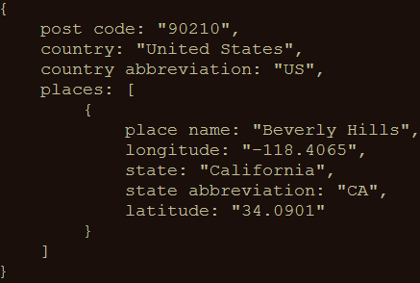
An example
GET http://api.zippopotam.us/us/90210
Result:

Slide 6
Usage of RESTful web services
Mobile applications
Internet of Things
API Economy

Slide 7
Why REST (and not SOAP, for example)?
Support for a multitude of data formats
JSON
XML
…
Smaller overhead and therefore better performance

Slide 8
Why SOAP(and not REST, for example)?
WS-Security
WS-ReliableMessaging
WS-AtomicTransaction
Mostly used to secure banking applications

Slide 9
Tools for testing RESTful web services
Browser (using plugins like Postman for Chrome)
Open source (SoapUI, REST Assured)
COTS (Parasoft SOAtest, SoapUI Pro)

Slide 10
REST Assured
Java library for writing tests for RESTful web services
Removes a lot of boilerplate code
Integrates seamlessly with existing Java-based testing frameworks
JUnit, TestNG
Selenium WebDriver

Slide 11
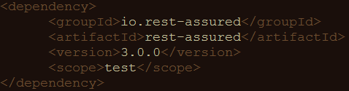
Configuring REST Assured
Download from http://rest-assured.io
Add as a dependency to your project
Maven

Slide 12
REST Assured documentation
Usage guide
https://github.com/rest-assured/rest-assured/wiki/Usage
Links to other documentation (JavaDoc, getting started, release notes)
http://rest-assured.io/

Slide 13
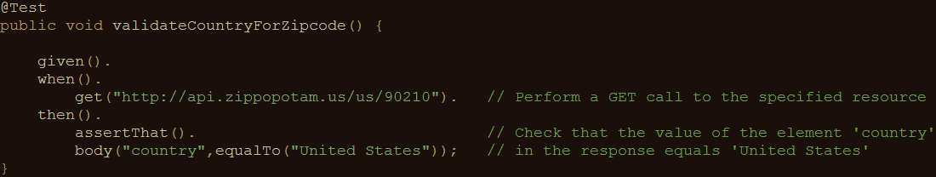
A sample test

Slide 14
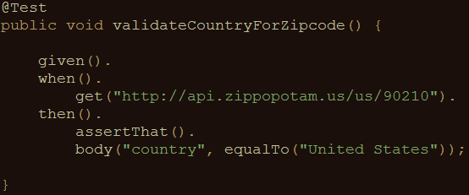
REST Assured features
Support for HTTP methods (GET, POST, PUT, …)
Support for BDD / Gherkin (Given/When/Then)
Use of Hamcrest matchers for checks (equalTo)
Use of GPath for selecting elements from JSON response

Slide 15
About Hamcrest matchers
Express expectations in natural language
Examples:
http://hamcrest.org/JavaHamcrest/javadoc/1.3/org/hamcrest/Matchers.html
equalTo(X) | Does the object equal X?
hasItem(“Rome”) | Does the collection contain an item “Rome”?
hasSize(3) | Does the size of the collection equal 3?
not(equalTo(X)) | Inverts matcher equalTo()

Slide 16
About GPath
GPath is a path expression language integrated into Groovy
REST Assured is built in Groovy
Similar aims and scope as XPath for XML
Documentation and examples:
http://groovy-lang.org/processing-xml.html#_gpath
http://groovy.jmiguel.eu/groovy.codehaus.org/GPath.html

Slide 17
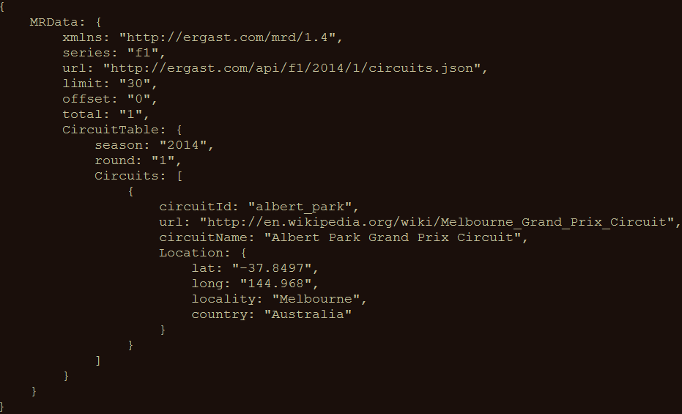
GPath example
http://goessner.net/articles/JsonPath/

Slide 18
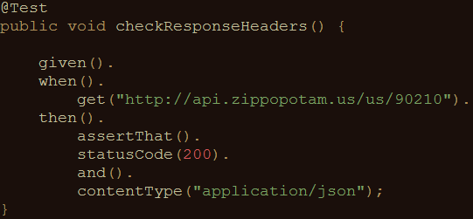
Validating technical response data
HTTP status code
MIME-type of received responses
Cookies and their value
…

Slide 19
Our application under test
Ergast F1 API
Presents historical data of Formula 1 races, drivers, circuits, etc.
Data can be returned in JSON and XML format
API documentation at http://ergast.com/mrd/

Slide 20
Some examples
Data for driver Max Verstappen (in JSON):
http://ergast.com/api/f1/drivers/max_verstappen.json
A list of circuits for the 2015 season (in JSON):
http://ergast.com/api/f1/2015/circuits.json

Slide 21
Demo
API documentation
How to use the test suite
Executing your tests
Reviewing test results

Slide 22
Get your hands dirty!
RestAssuredExercises1
Simple checks
Validating individual elements
Validating collections and items therein
Validating technical response properties
RestAssuredExamples contains all examples from the presentation

Slide 23
Parameters in RESTful web services
Path parameters
http://ergast.com/api/f1/drivers/max_verstappen.json
http://ergast.com/api/f1/drivers/hamilton.json
Query string parameters
http://md5.jsontest.com/?text=testcaseOne
http://md5.jsontest.com/?text=testcaseTwo
There is no official standard!

Slide 24
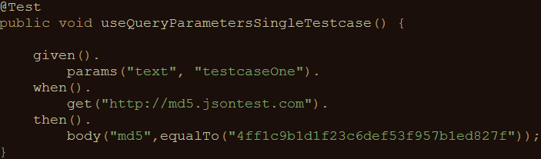
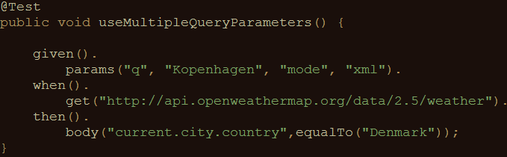
Using parameters in REST Assured
Examples for query parameters:
Call to http://md5.jsontest.com/?text=testcaseOne
Call to http://api.openweathermap.org/data/2.5/weather/?q=Kopenhagen&mode=xml

Slide 25
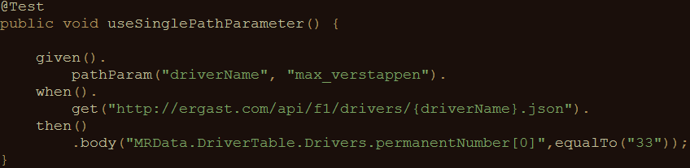
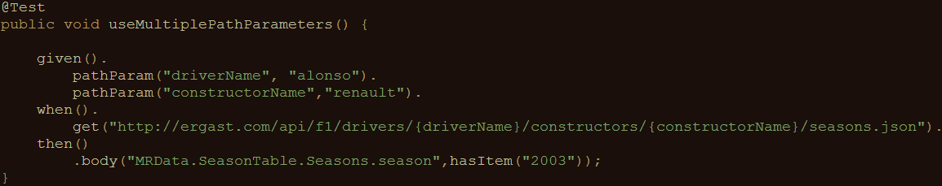
Using parameters in REST Assured
Examples for path parameters:
Call to http://ergast.com/api/f1/drivers/max_verstappen.json
Call to http://ergast.com/api/f1/drivers/alonso/constructors/renault/seasons.json

Slide 26
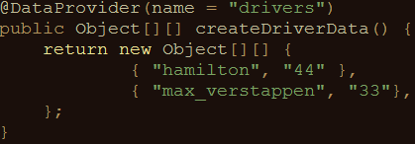
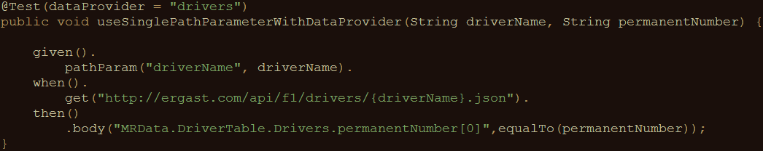
Using parameters in REST Assured
Iterating over a collection of parameter values:
Creating pairs of driver ID’s and numbers:
Using test data in API calls and validation of response data:

Slide 27
Get your hands dirty!
RestAssuredExercises2
Data driven tests
Creating a test data object
Using test data in calling the right URI
Using test data in assertions
RestAssuredExamples contains all examples from the presentation

Slide 28
Authentication
Securing web services
Basic authentication (preemptive / challenged)
OAuth(2)
Digest / Form

Slide 29
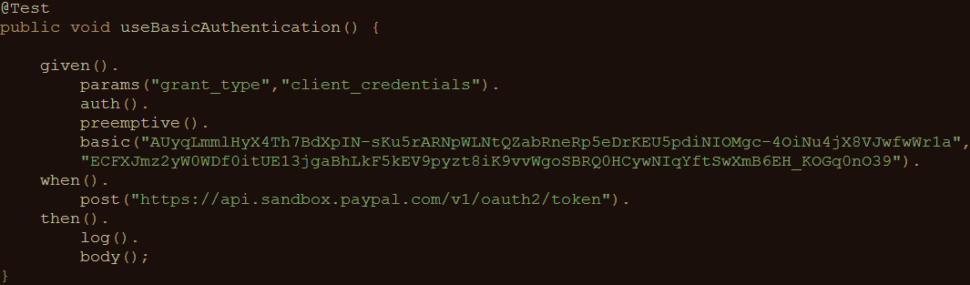
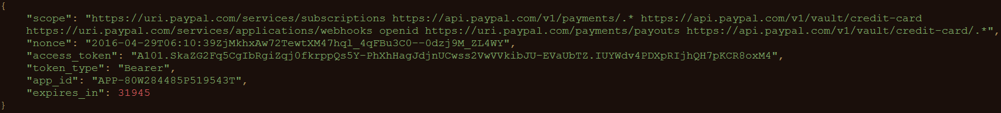
Basic authentication
Username/password sent in header for every request

Slide 30
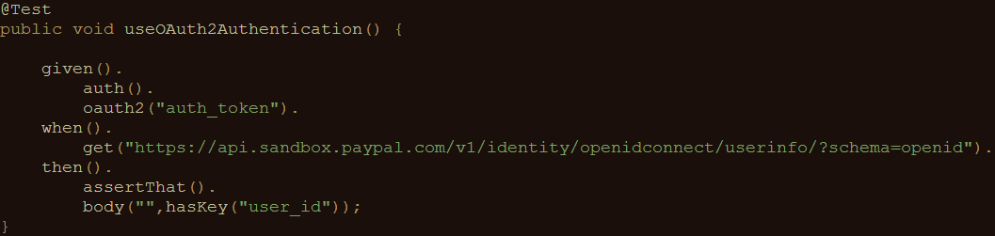
OAuth(2)
Request of authentication token based on username and password (Basic authentication)
Include authentication token in header of all subsequent requests

Slide 31
Measuring response times
Measuring response times for individual requests
Setting response time thresholds
Test fails when threshold is exceeded
No full-fledged performance test
First rough indication of API performance

Slide 32
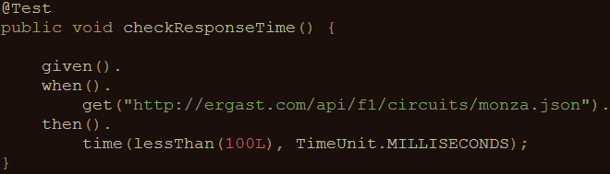
Measuring response times
An example:

Slide 33
Get your hands dirty!
RestAssuredExercises3
Communicating with an OAuth2-secured API
Requesting authentication token
Using authentication token in subsequent requests
Measuring API response times
Execute a specific API call
Evaluate response time against predefined threshold
RestAssuredExamples contains all examples from the presentation

Slide 34
Sharing variables between tests
Example: authentication tests
Copy / paste required for OAuth2 token
Preferably: store and retrieve for reuse!

Slide 35
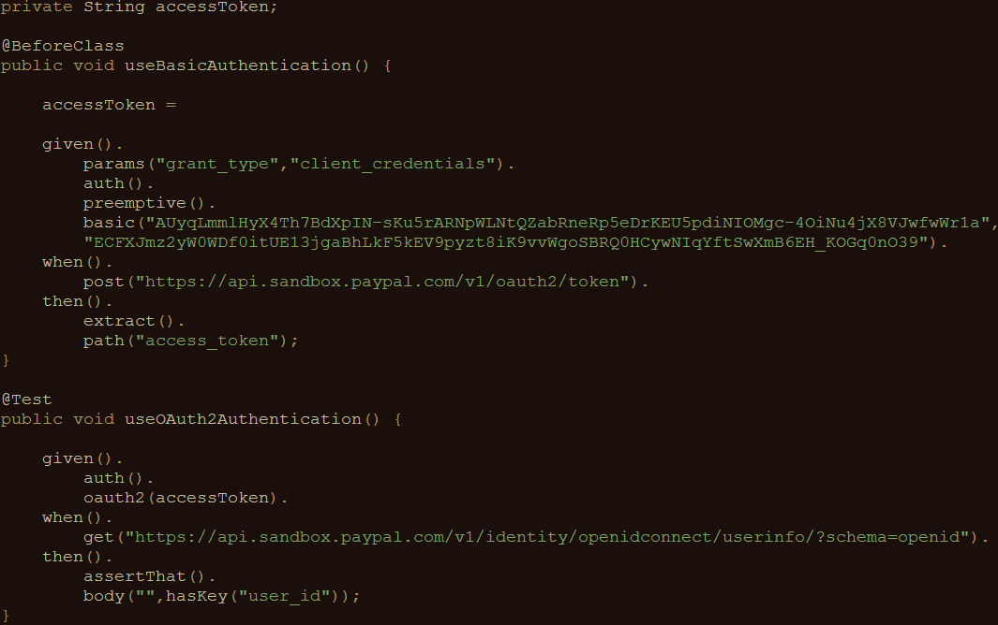
Sharing variables between tests
REST Assured
supports this
with extract()

Slide 36
Get your hands dirty!
RestAssuredExercises4
Try it for yourself
Can you apply this to the Formula 1 API?
RestAssuredExamplesParameterPassing contains all examples from the presentation

Slide 37
Executing tests in CI
REST Assured-tests are no different from other Java (unit) tests
Can be easily added to your CI/CD pipeline
Part of the build process
Demonstration (using Jenkins)

Slide 38
Questions
?

Slide 39
Contact
Email: bas@ontestautomation.com
Weblog: http://www.ontestautomation.com
Twitter: @_basdijkstra

