Slide 1

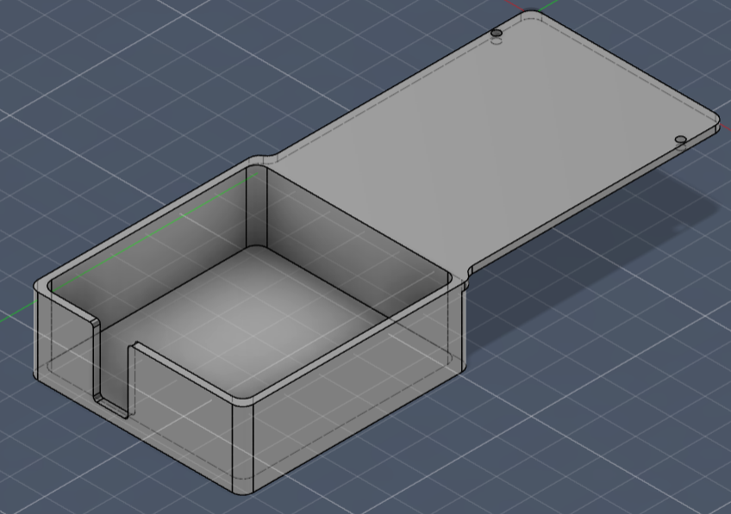
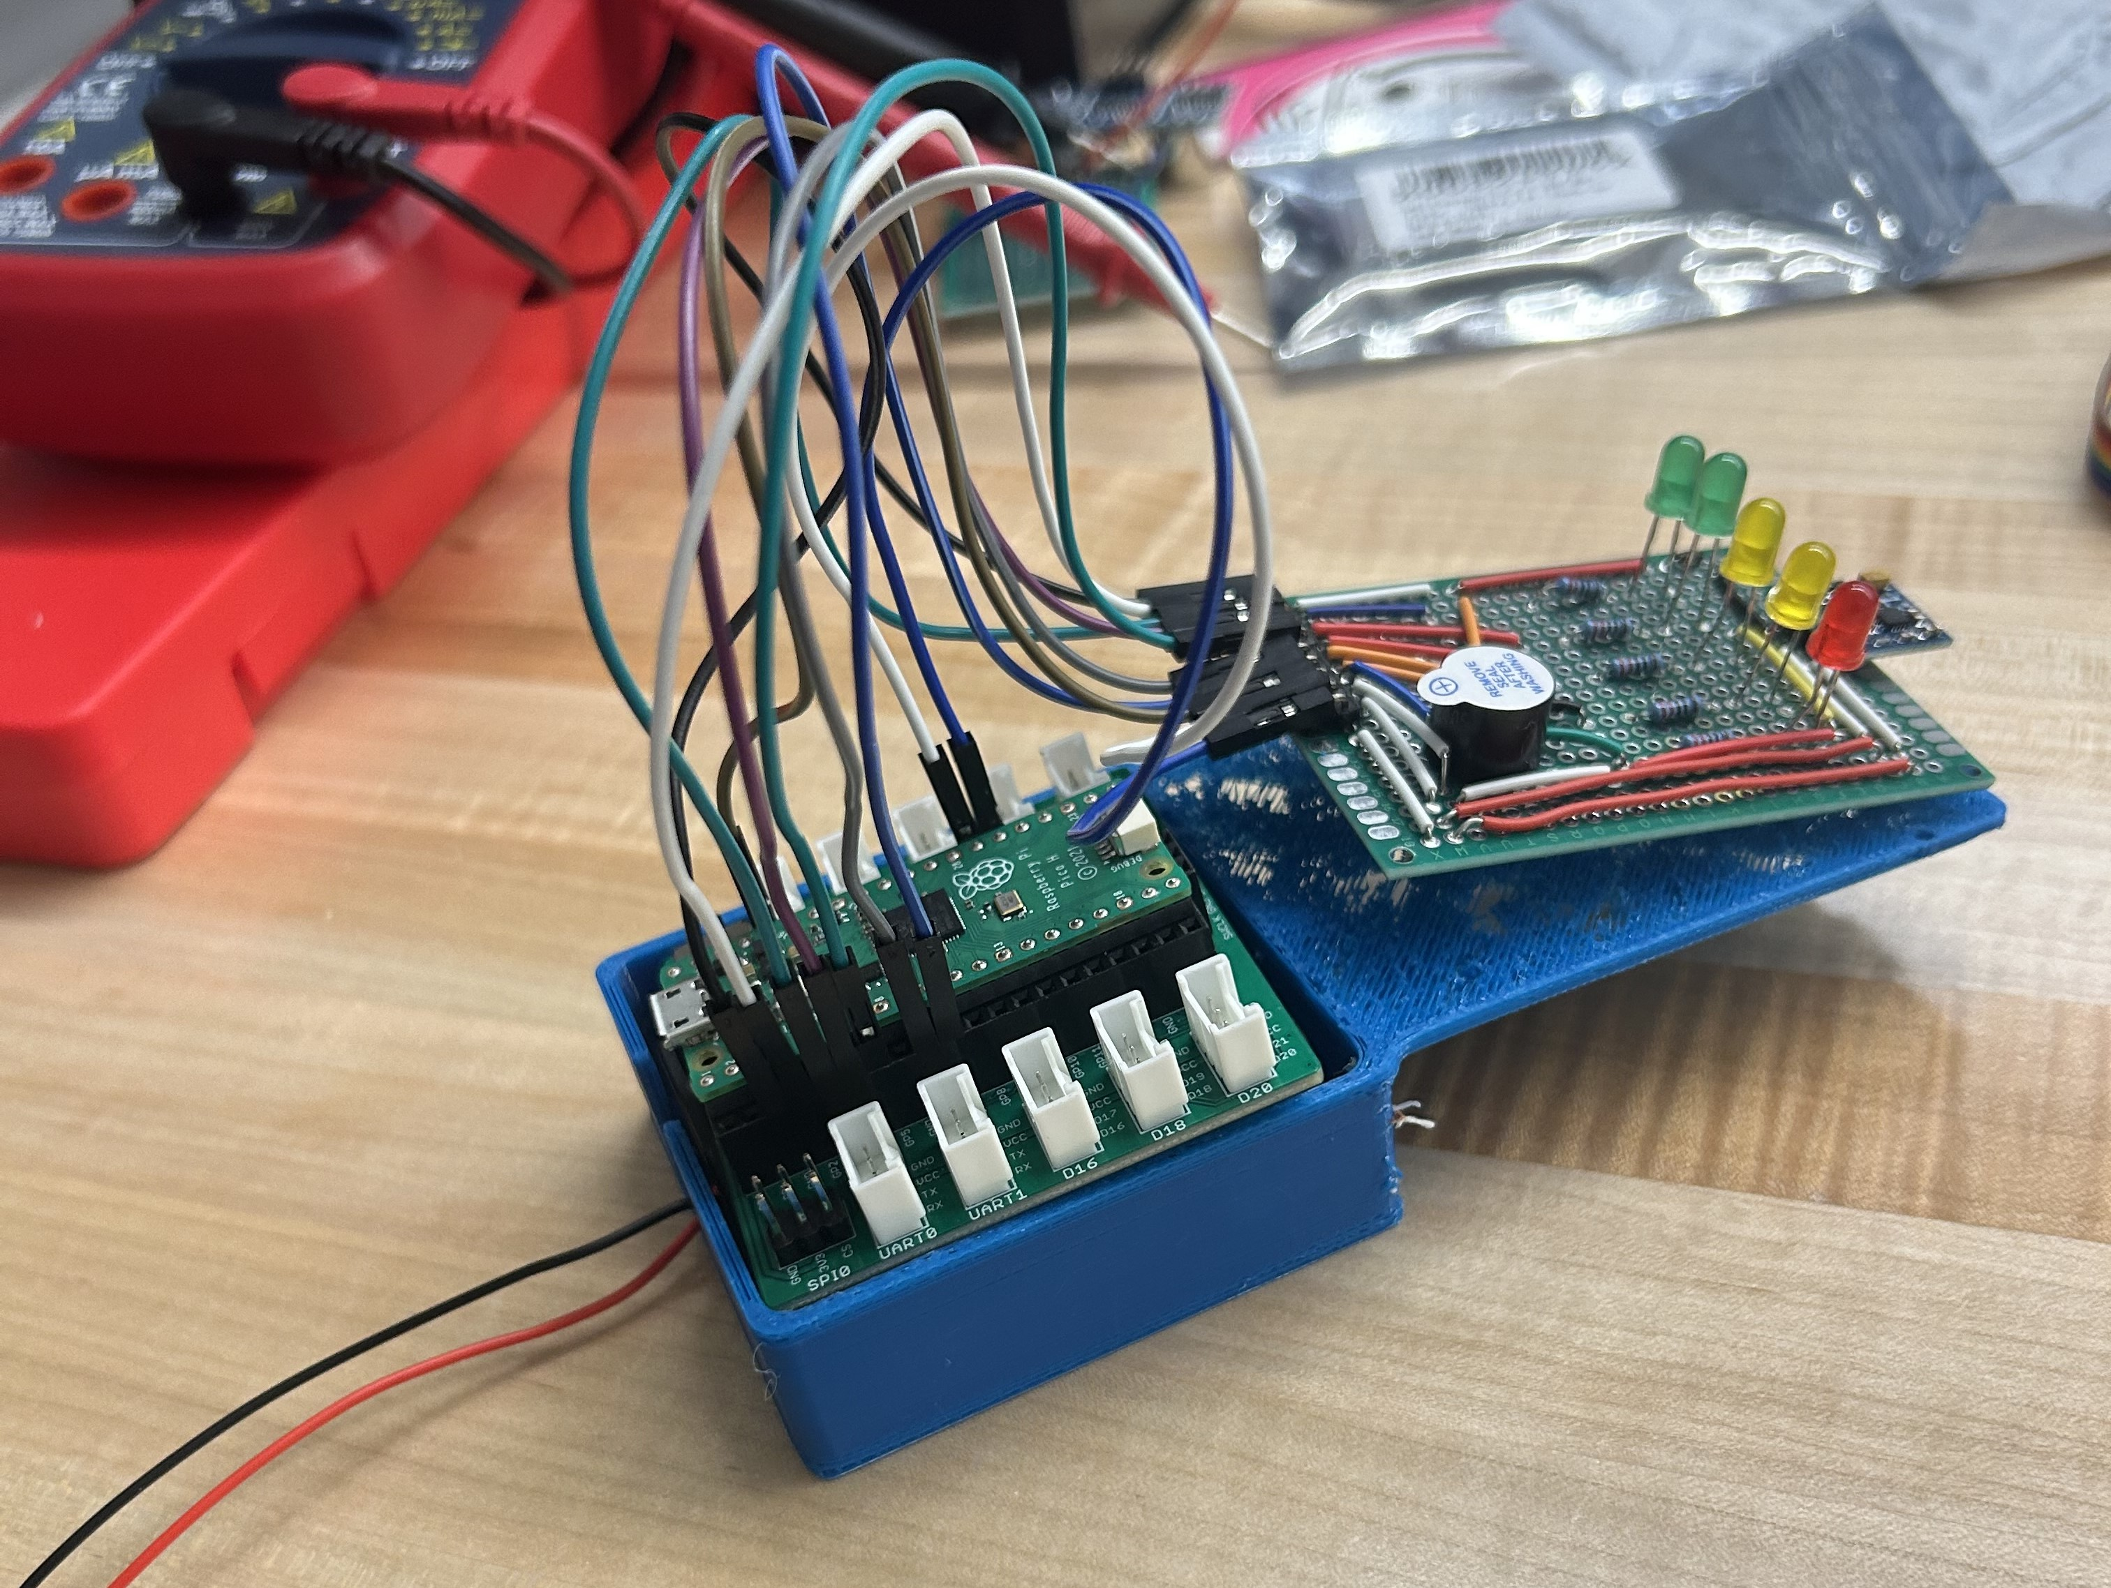
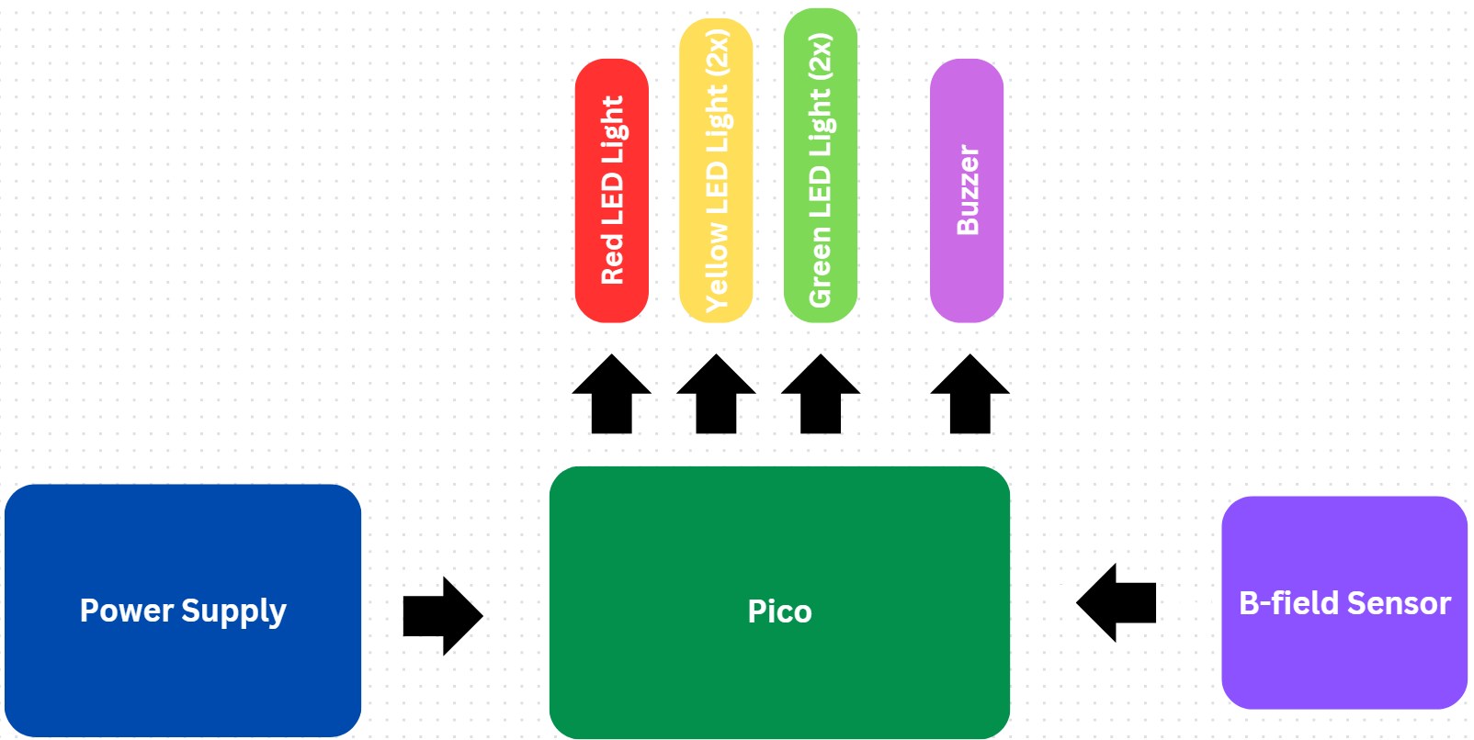
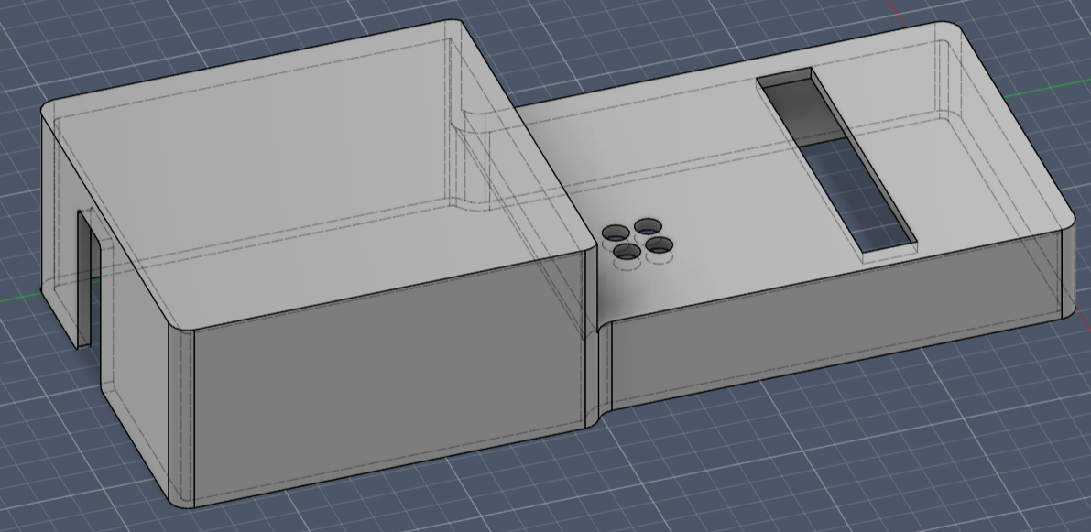

MocEMF: A Portable EMF Reader
Andreichuk, Cody; Legan, Kayli
Abstract
Models
Final Product
An emf reader is used to measure electromagnetic fields which are invisible areas of energy surrounding electrical devices. They have many purposes including measuring EMF exposure, finding EMF sources, ensuring safety and even paranormal investigation. For our project, we focused more on finding EMF sources so our EMF reader will light up and buzz according to the EMF strength reading.
Components
GY-271 Triple Axis Compass Magnetometer Sensor (~7.99 USD)
Sensor used to measure the strength of the magnetic field.
Battery Adapter (~6.99 USD)
To hold batteries.
3 AA Batteries (~3.00 USD)
An easy power source.
LED Lights (Included)
To visually display sensor reading strength.
Buzzer (Included)
To audibly display sensor reading strength.
Pico (Included)
A popular and beginner-friendly micro-controller board.
3D Printed Case (Price Varies)
Custom built to easily fit the interior components. Figures containing the final design are attached in the Models section.
Fig. 1 – Bottom of Reader
As shown above, you can see the EMF reader has 5 LED lights that show through the case and holes for the buzzing sound to escape from. Tested near several electrical devices, we can confirm that the EMF reader can determine EMF sources and their strength accordingly.
Results and Conclusion
After thorough testing, we are confident that the final product is both accurate and reliable, making it suitable for both commercial and personal use. While we did not have a reference device for direct comparison, we tested the EMF reader around a variety of devices, including wires, laptops, and battery packs. The sensor provided varying readings depending on the proximity and type of device, confirming its ability to detect electromagnetic fields with a reasonable level of accuracy.
Additionally, we found that for the user to obtain accurate results, the EMF sensor needs to be positioned within a specific proximity to the source of the electromagnetic field. Simply holding it at a distance may result in inaccurate measurements.
Methods and Overview
Fig. 2 - Block Diagram
Making this was very straightforward once we got the sensor working with our code only having a few methods and classes to make it function.
Classes:
Lights- controls lights and buzzer
Magnometer- controls magnetometer sensor
Methods Used:
read- Method that reads in data from the magnetometer
toggle_lights- Method that turns lights & buzzer off according to data from the magnometer class
With these helper methods and classes, our main.py file is a simple while true loop running both read and toggle_lights.
Acknowledgements
We thank Dr. Hoan Ngo for his guidance and support on this project.
Fig. 3 – Top of Reader

