Slide 1
Echipa235_1
DOCUMENTATIE
https://github.com/Andreimdvn/Proiect_colectiv_soimii_patriei

Slide 2
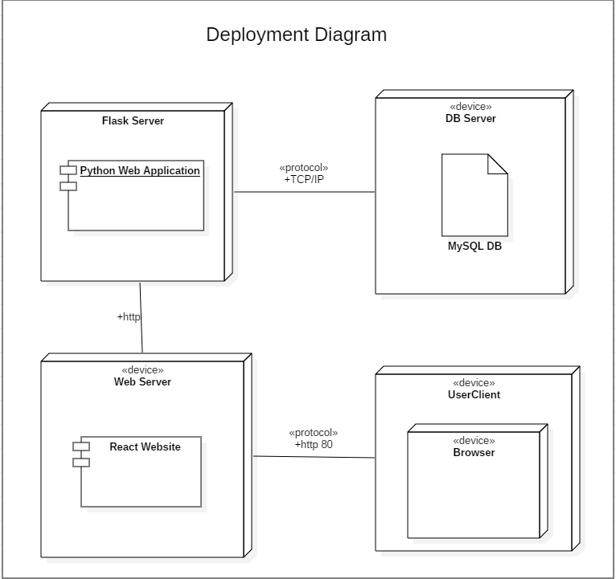

Slide 3
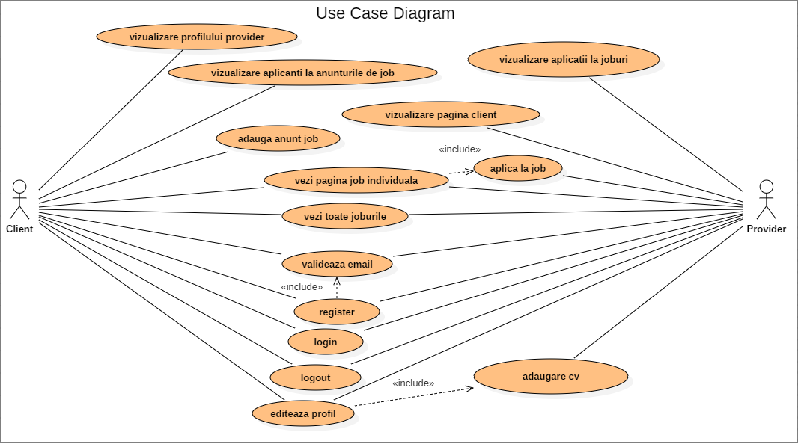

Slide 4
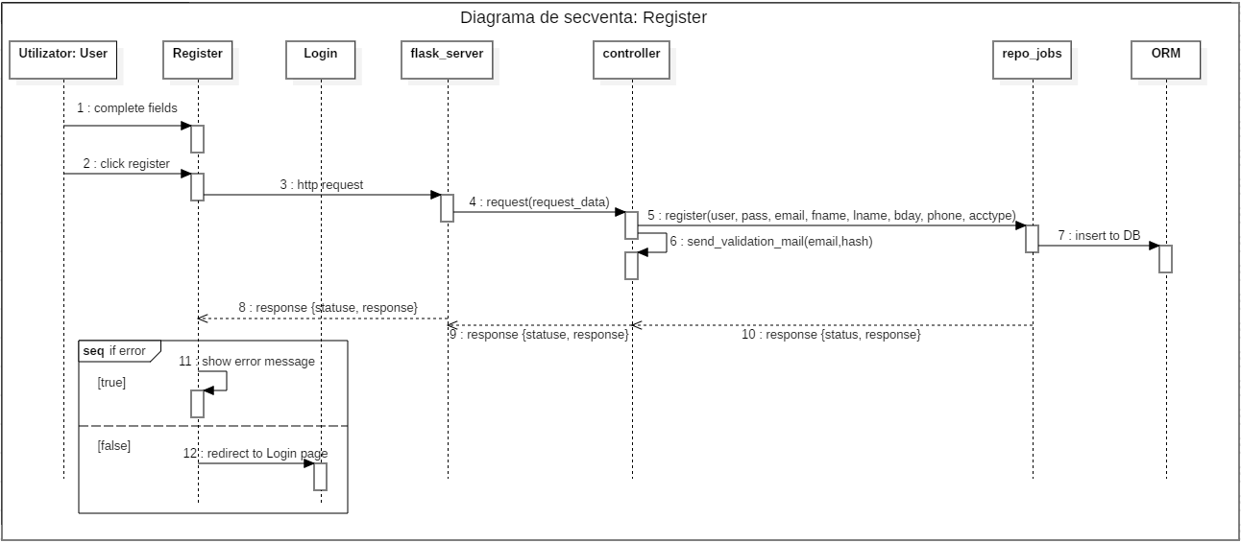

Slide 5
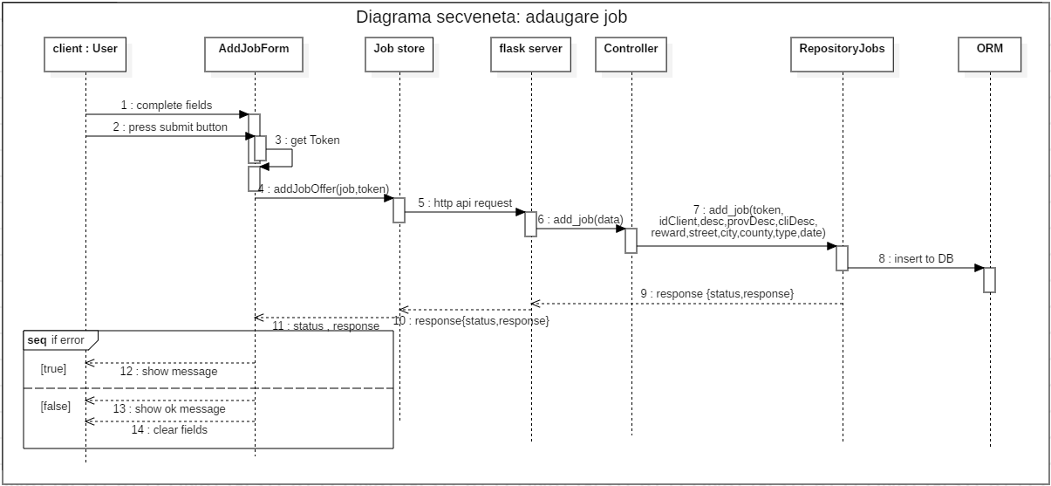

Slide 6
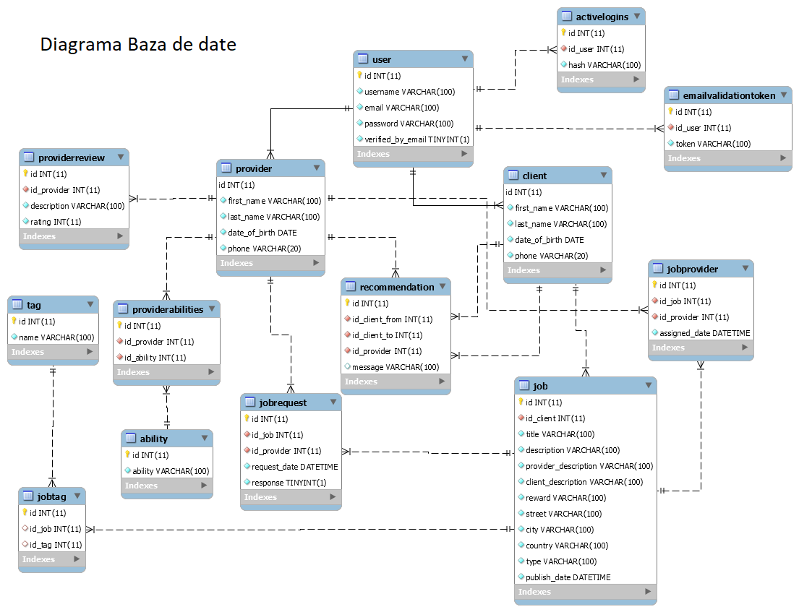

Slide 7
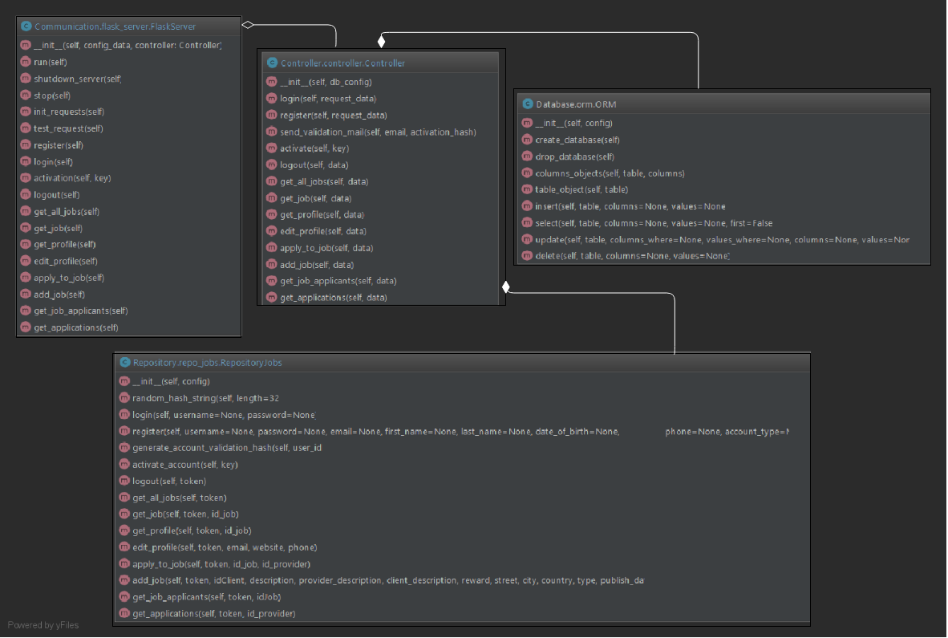
UML BACKEND

Slide 8
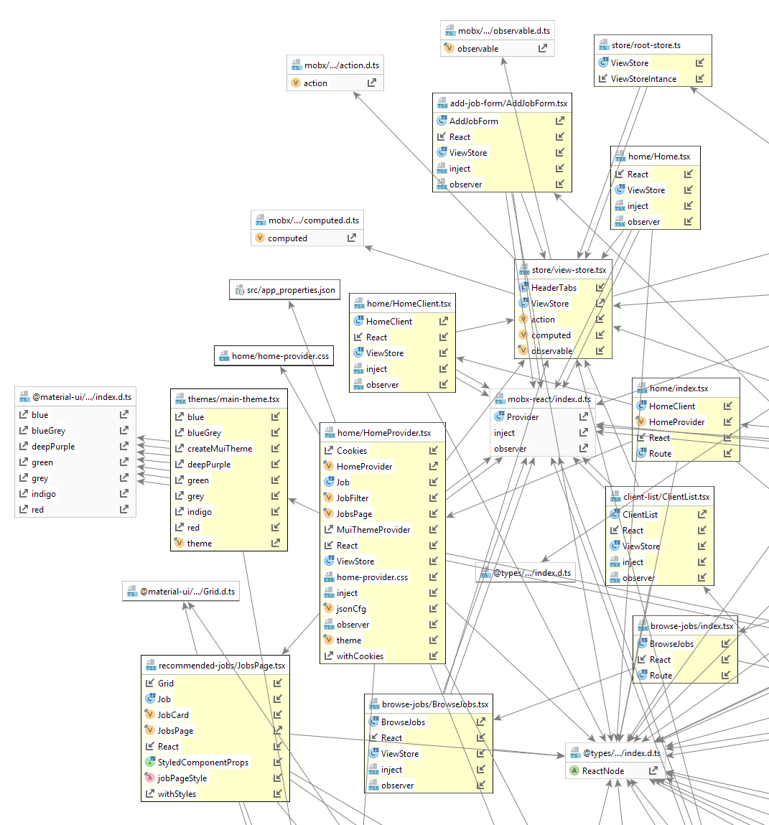
UML FRONT 1/4

Slide 9
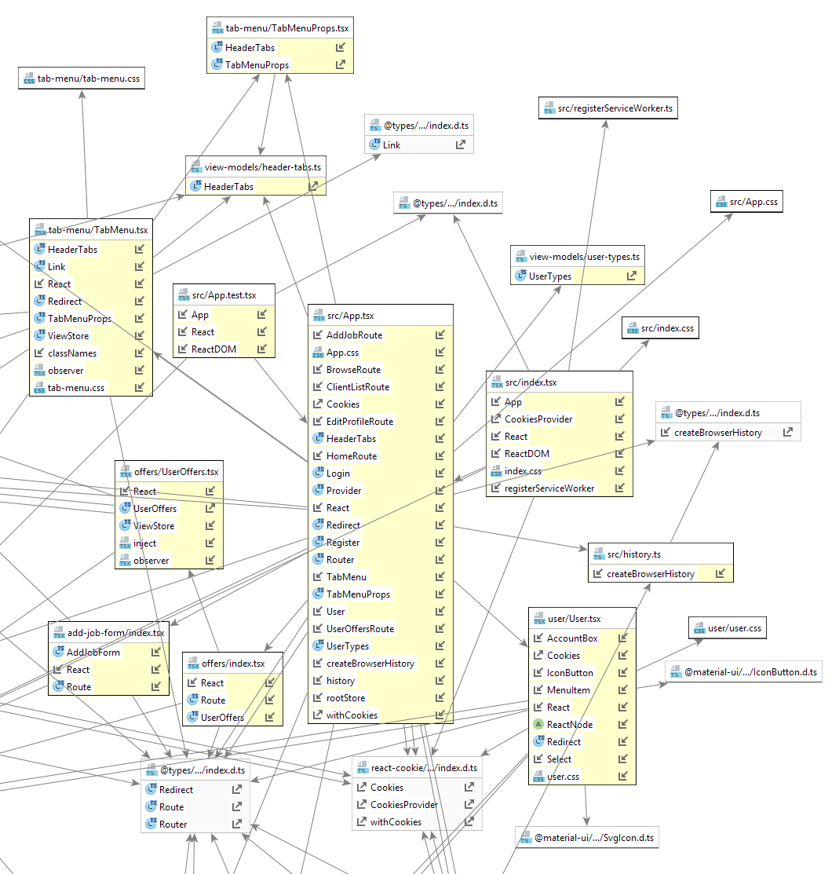
UML FRONT 2/4

Slide 10
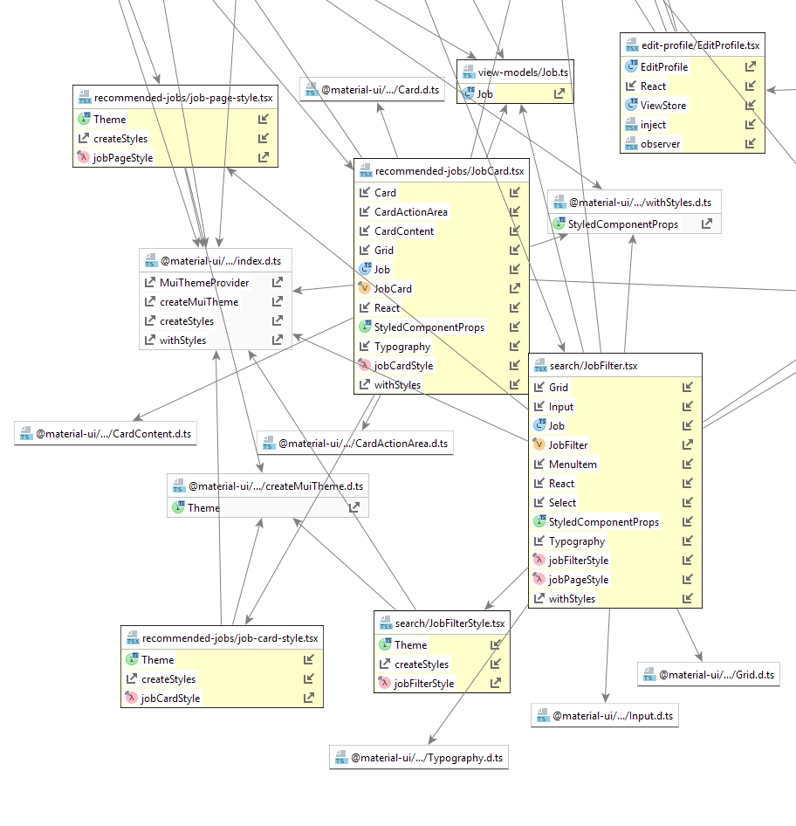
UML FRONT 3/4

Slide 11
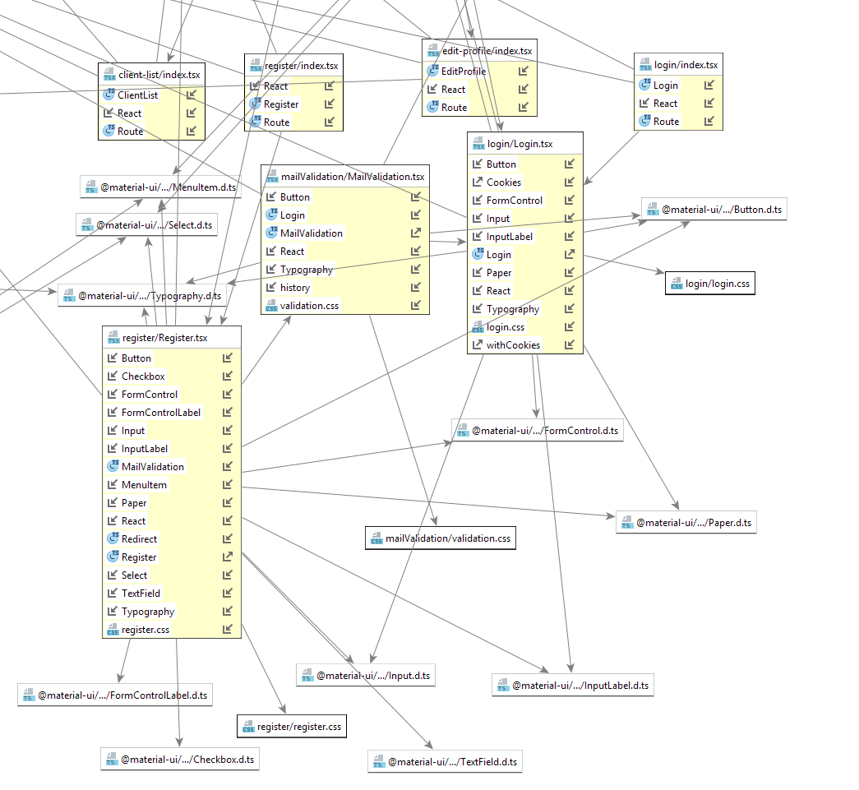
UML FRONT 4/4

Slide 12
