Slide 1
MySQL
View,Stored Procedure,
Trigger,
Information Schema
[demo/sql-is_uni/sql-kurs2-mysql-trigger-views-procs.sql]

Slide 2
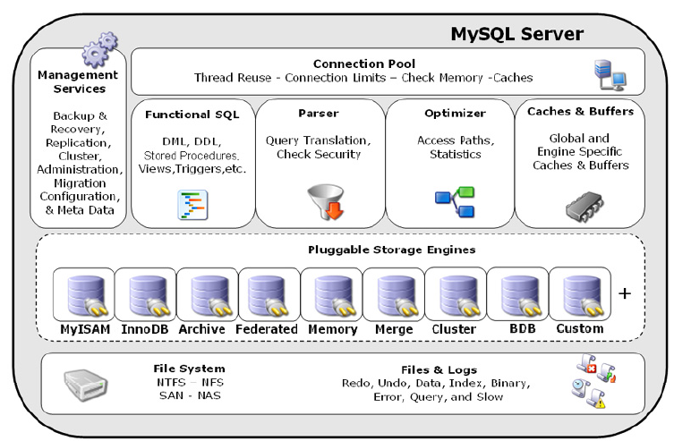
Mysql Overview

Slide 3
Views
Komplexe SQL-Anweisungen vereinfachen
Zugriffsschutz
  View enthält nur bestimmte Spalten einer Tabelle

Slide 4
Views
CREATE TABLE preis (anz INT, preis INT);
INSERT INTO preis VALUES(3, 50);
CREATE VIEW v_preis
AS
SELECT anz, preis, anz*preis AS summe
FROM preis;
mysql> SELECT * FROM v_preis;
  +------+-------+-------+
  | anz | preis |summe|
  +------+-------+-------+
  | 3 | 50 | 150 |
  +------+-------+-------+

Slide 5
Views
create VIEW v_notenliste AS
select s.matrnr stud_name, s.name,
v.vorlnr,v.titel, p.name prof_name, note
from is_studenten s,is_vorlesungen v,is_professoren p,
is_pruefen prfg
where
prfg.matrnr= s.matrnr and
prfg.vorlnr= v.vorlnr and
prfg.persnr= p.persnr;
select * from v_notenliste;
...
drop view v_notenliste;

Slide 6
Views
create or replace view v_prof_hat_viele_studenten
as
select persnr, name, count(*) as anz_studenten
from is_professoren p,
is_vorlesungen v,
is_hoeren h
where p.persnr = v.gelesenvon
and v.vorlnr = h.vorlnr
group by p.persnr, p.name
having count(*) > 4; -- mehr als 4 Hoerer

Slide 7
Stored Procedures
Code Reusability and Change Control
Fast Performance
Easier Security Administration
  access control to be handled at the procedure level rather than at the object level.

Slide 8
Stored Procedures
For example, MySQL stored procedures offer standardoutput ability for SELECT statements
  delimiter //
  create procedure sp_pruefungen()
  select s.name, v.titel, p.note
  from is_vorlesungen v, is_pruefen p,
  is_studenten s
  where p.matrnr=s.matrnr and p.vorlnr=v.vorlnr
  //
  delimiter ;
  call sp_pruefungen();

Slide 9
Stored Procedures
CREATE PROCEDURE while_endWhile()
BEGIN
DECLARE v1 INT DEFAULT 5;
  WHILE v1 > 0 DO
  ... SET v1 = v1 - 1;
  END WHILE;
END
IF search_condition THEN statement_list
  [ELSEIF search_condition THEN statement_list] ...
  [ELSE statement_list]
END IF

Slide 10
Cursors
innerhalb von
  Stored Procedures and
  Stored Functions.
Sehr schneller Zugriff auf Tabellen,..

Slide 11
Cursors
CREATE PROCEDURE sp_prof_mit_vielen_studenten_speichern()
BEGIN
DECLARE done INT DEFAULT 0;
DECLARE vpersnr INT;
DECLARE vname varchar(30);
DECLARE vanz_studenten INT;
DECLARE cur1 CURSOR FOR select persnr, name, anz_studenten from v_prof_hat_viele_studenten;
DECLARE CONTINUE HANDLER FOR SQLSTATE '02000' SET done = 1;
-- NOT FOUND
OPEN cur1;
WHILE done = 0 DO
FETCH cur1 INTO vpersnr, vname, vanz_studenten;
IF done = 0 THEN
INSERT INTO is_uni.is_prof_hat_viele_studenten values (vpersnr,vname, vanz_studenten, CURDATE());
END IF;
END WHILE;
CLOSE cur1;
END

Slide 12
Cursors
CREATE PROCEDURE curdemo()
BEGIN
DECLARE done INT DEFAULT 0;
DECLARE a CHAR(16);
DECLARE b,c INT;
DECLARE cur1 CURSOR FOR SELECT id,data FROM test.t1;
DECLARE cur2 CURSOR FOR SELECT i FROM test.t2;
DECLARE CONTINUE HANDLER FOR SQLSTATE '02000' SET done = 1;
//NOT FOUND
OPEN cur1;
OPEN cur2;
SET done= 0;
REPEAT
FETCH cur1 INTO a, b;
FETCH cur2 INTO c;
IF NOT done THEN
IF b < c THEN
INSERT INTO test.t3 VALUES (a,b);
ELSE
INSERT INTO test.t3 VALUES (a,c);
END IF;
END IF;
UNTIL done END REPEAT;
CLOSE cur1; CLOSE cur2;
END

Slide 13
SQLSTATE
SQLWARNING is shorthand for all SQLSTATE codes that begin with 01.
NOT FOUND is shorthand for all SQLSTATE codes that begin with 02.
SQLEXCEPTION is shorthand for all SQLSTATE codes not caught by SQLWARNING or NOT FOUND.

Slide 14
Trigger
delimiter //
CREATE TRIGGER trg_bi_user_insert
before insert on is_user
for each row
begin
set NEW.pw_verschluesselt= md5(NEW.pw_verschluesselt);
end;
//
delimiter ;
insert into is_user values ( ’guest’,’comein’);

Slide 15
Trigger
You can refer to columns in the table associated with the trigger by using the aliases OLD and NEW.
OLD.col_name refers to a column of a an existing row before it is updated or deleted.
NEW.col_name refers to the column of a new row to be inserted or an existing row after it is updated.

Slide 16
Trigger
CREATE TRIGGER trg_bu_keinedegradierung
Before update on is_professoren
For each row
Begin
if OLD.rang=´C4´ then
SET NEW.rang=´C4´;
end if;
if OLD.rang= ´C3´ and NEW.rang= ´C2´ then
SET NEW.rang=´C3´;
end if;
if NEW.rang is NULL then
SET NEW.rang= OLD.rang;
  end if;
End
//
-- DER USER, der den Trigger ausführt muss das GLOBALE RECHT SUPER haben!
GRANT SUPER ON *.* TO 'is_uni'@'localhost';

Slide 17
Information Schema
Der System-Katalog speichert alle Informationen (Tabellen, Views, …) zur Datenbank (auch DataDictionary genannt)
SELECT table_name, table_type, engine
FROM information_schema.tables
WHERE table_schema = 'is_uni'
ORDER BY table_name DESC;

Slide 18
Information Schema
SELECT
  T.TRIGGER_NAME, T.EVENT_MANIPULATION, T.TRIGGER_SCHEMA, T.EVENT_OBJECT_TABLE, T.ACTION_STATEMENT
FROM
  INFORMATION_SCHEMA.TRIGGERS T

Slide 19
Information Schema
SELECT
  V.TABLE_SCHEMA,
  V.TABLE_NAME,
  V.VIEW_DEFINITION
FROM
  INFORMATION_SCHEMA.VIEWS V

Slide 20
Information Schema
SELECT
    R.ROUTINE_SCHEMA,
    R.ROUTINE_NAME,
    R.ROUTINE_TYPE,
    R.ROUTINE_BODY,
    R.ROUTINE_DEFINITION,
    R.SQL_PATH,
    R.EXTERNAL_NAME,
    R.EXTERNAL_LANGUAGE,
    R.CREATED, R.LAST_ALTERED,
    R.DEFINER
FROM
    INFORMATION_SCHEMA.ROUTINES R

Slide 21
Übungen
demo/sql-is_uni/sql-kurs2-mysql-trigger-views-procs.sql

Slide 22
Oracle
Prozedurales SQL (PL/SQL)
Function, Procedure
Package

Slide 23
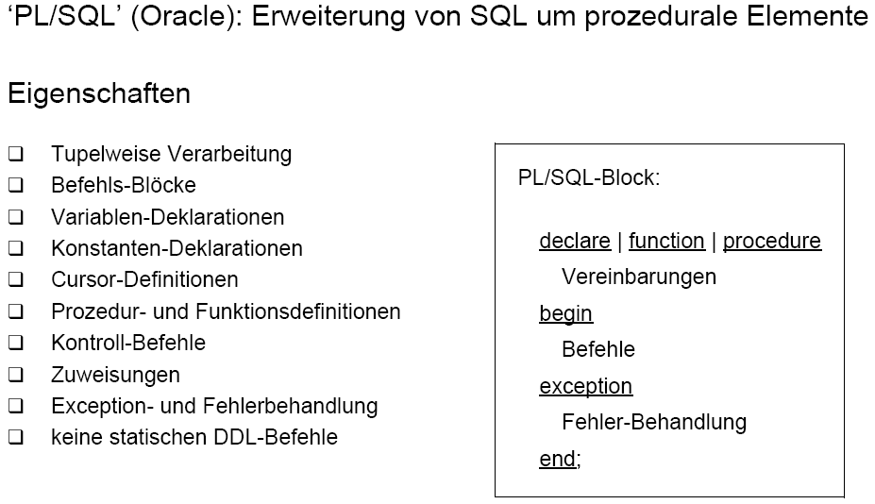
Prozedurales SQL: PL/SQL

Slide 24
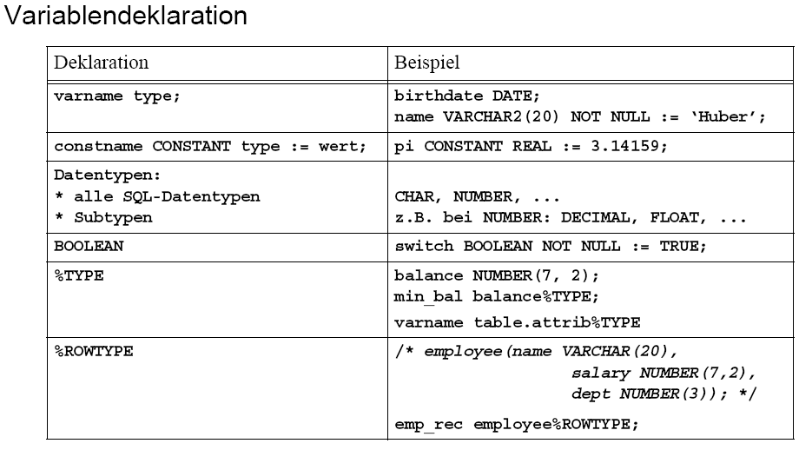
Prozedurales SQL: PL/SQL

Slide 25
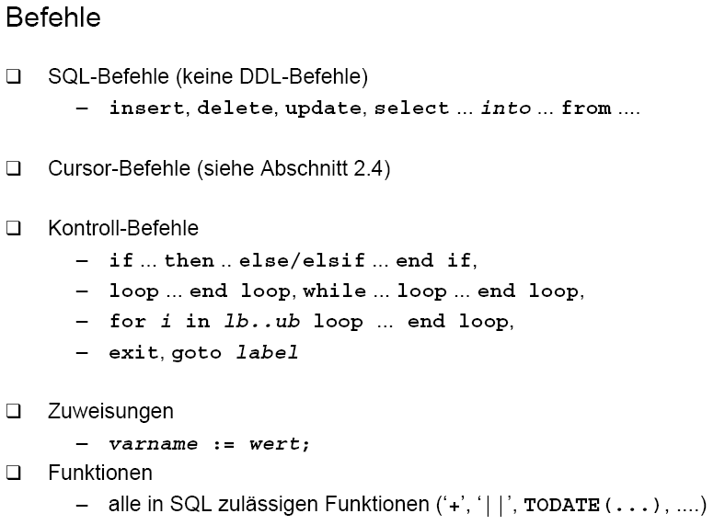
Prozedurales SQL: PL/SQL

Slide 26
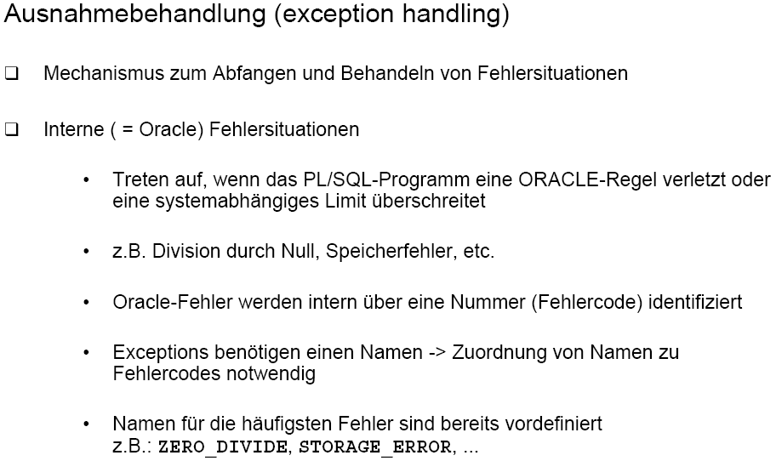
Prozedurales SQL: PL/SQL

Slide 27
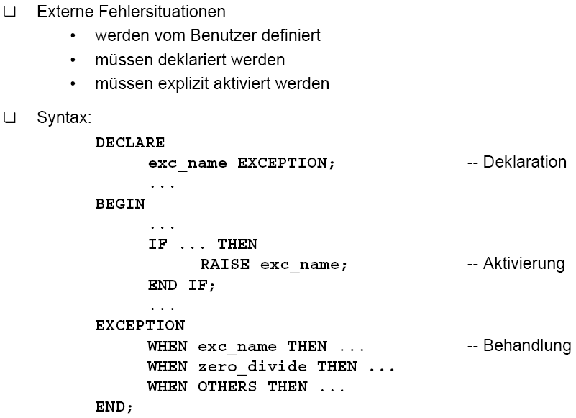
Prozedurales SQL: PL/SQL

Slide 28
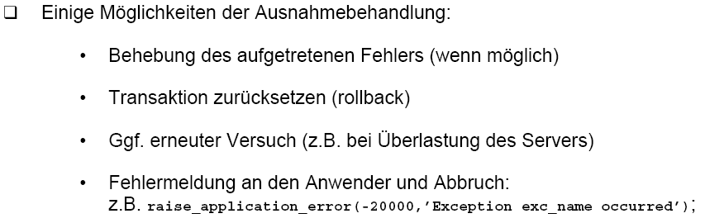
Prozedurales SQL: PL/SQL

Slide 29
Exception: Beispiel
declare
v_bezeichnung einheit.bezeichnung%TYPE;
EINHEIT_FEHLER EXCEPTION;
PRAGMA EXCEPTION_INIT (EINHEIT_FEHLER, -20100);
begin
select bezeichnung into v_bezeichnung
from einheit
where einheit_kurz = 'm';
if v_bezeichnung <> 'Meter' then
raise_application_error (-20100, 'Bezeichnung falsch');
end if;
exception when EINHEIT_FEHLER then
...
end;

Slide 30
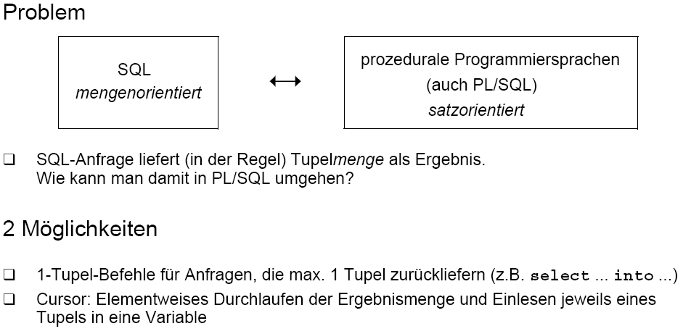
Cursor-Konzept:

Slide 31
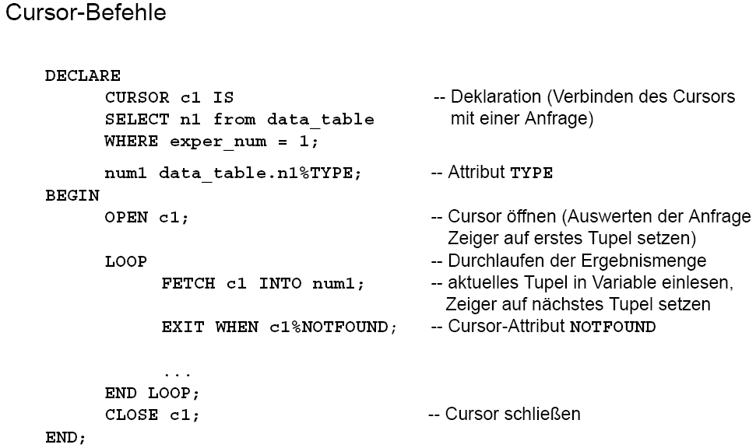

Slide 32
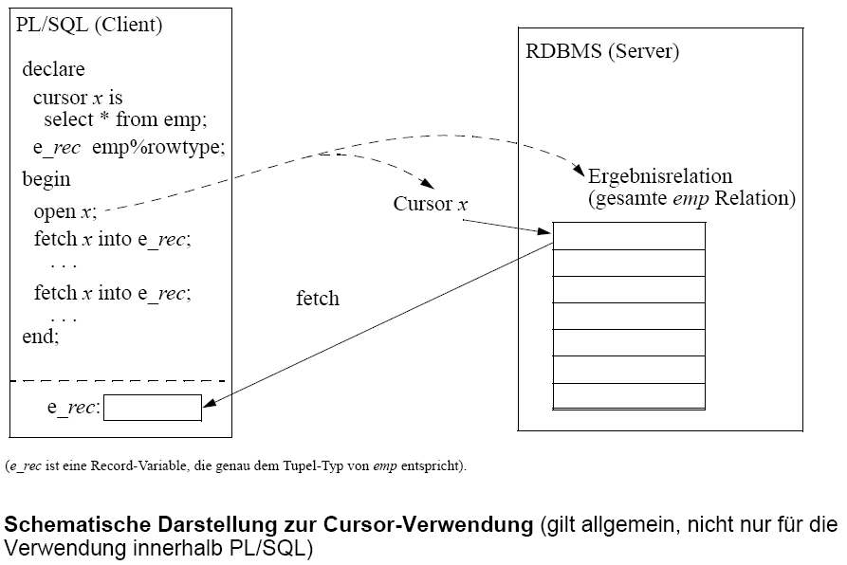

Slide 33
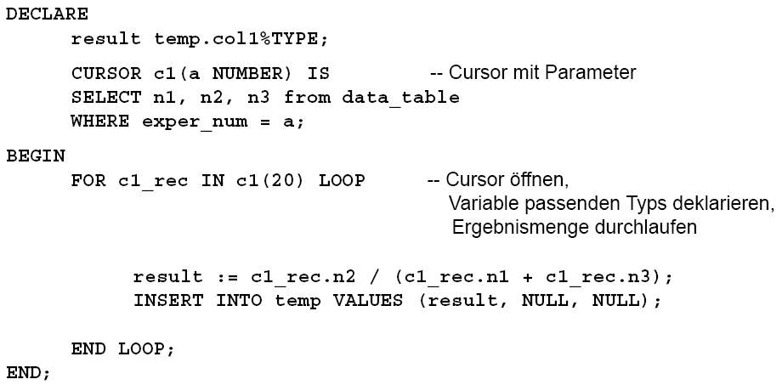
PL/SQL: Cursor-FOR-Loops

Slide 34
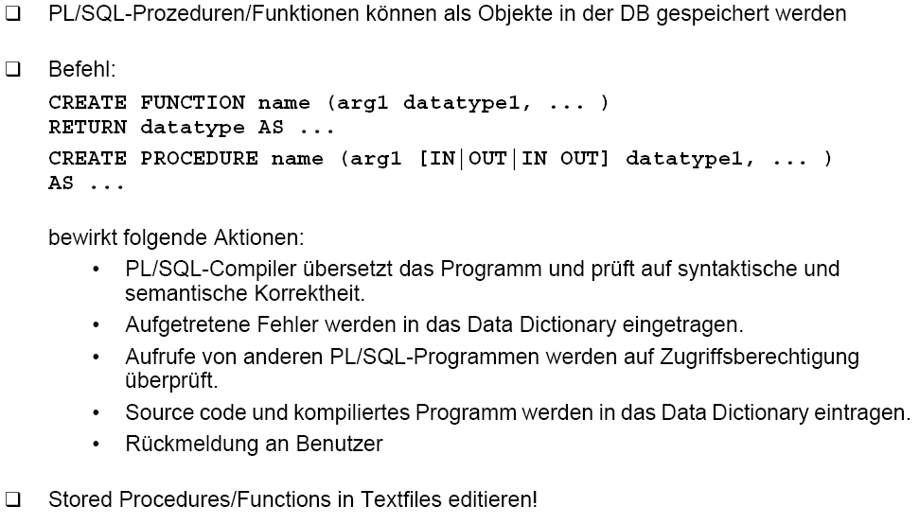
Prozedurales SQL: PL/SQL

Slide 35
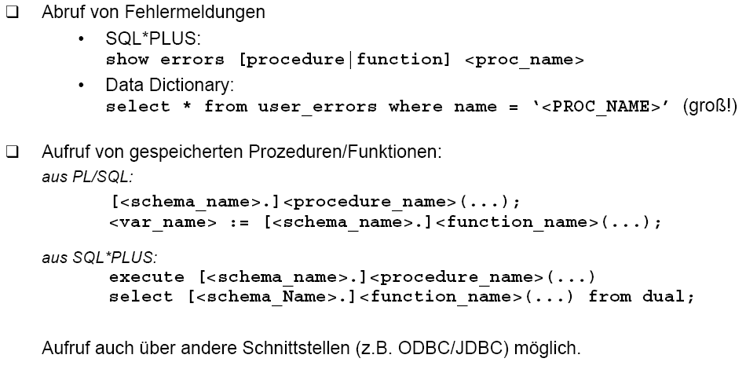
Prozedurales SQL: PL/SQL

Slide 36
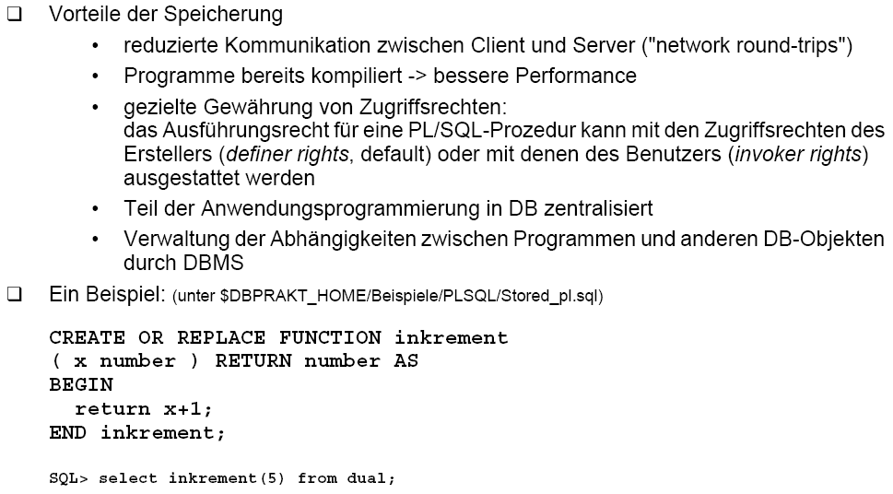
Prozedurales SQL: PL/SQL

Slide 37
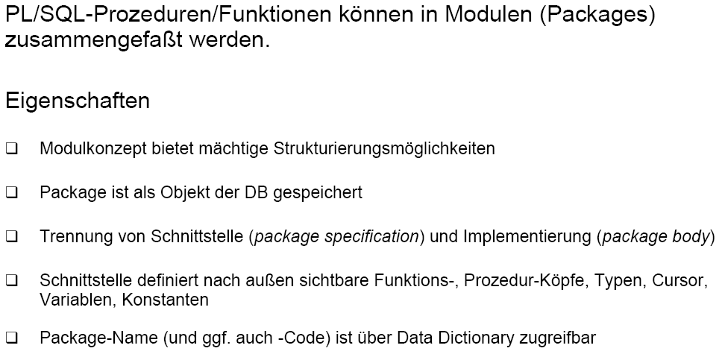
Packages: PL/SQL

Slide 38
Packages: PL/SQL Beispiel
-- SCHNITTSTELLEN BESCHREIBUNG
-- ---------------------------------------------------------------------------------
create or replace package perf as
procedure start_timer;
procedure stop_timer;
function get_time return number; -- Zeit in Sekunden
end perf;
/
-- IMPLEMENTIERUNG
-- ---------------------------------------------------------------------------------
create or replace package body perf as
SEK_JE_TAG constant number := 86400; -- Var., Cursor-Dekl.
v_start_time date := NULL; -- lokal zum body
v_stop_time date := NULL;
procedure start_timer is -- Methode start_timer
begin
v_start_time := sysdate;
v_stop_time := NULL;
end;

Slide 39
procedure stop_timer is -- Methode start_timer
begin
v_stop_time := sysdate;
end;
function get_time return number is -- Methode get_time
v_diff_time number;
begin
if v_start_time is NULL then
return NULL;
end if;
if v_stop_time is NULL then
v_diff_time := sysdate - v_start_time;
else
v_diff_time := v_stop_time - v_start_time;
end if;
return v_diff_time * SEK_JE_TAG;
end;
end perf;

Slide 40
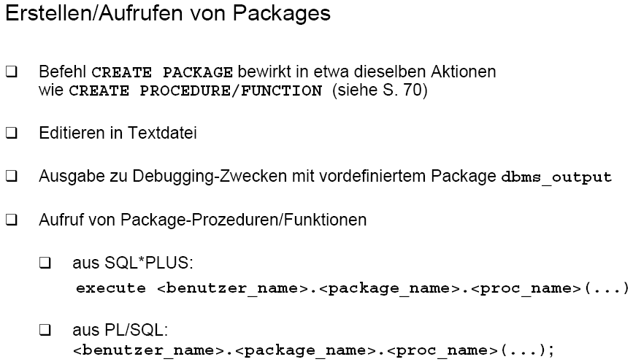

Slide 41
proc/func Aufruf mit Toad
-- so ruft man proc/func/pack im SQL-Window von Toad auf
-- alles markeiren und F9
-- es geht ein fenster auf und man gibt einen Wert für die Va. :val ein
-- dies ist ein sehr einfaches Demo
--
DECLARE
RetVal NUMBER;
BEGIN
perf.START_TIMER();
RetVal := IS_UNI.inkrement ( :val );
dbms_output.put_line('StartWert'|| RetVal);
WHILE RetVal <10000000 LOOP
RetVal := IS_UNI.inkrement ( RetVal );
END LOOP;
perf.STOP_TIMER();
dbms_output.put_line('EndWert'|| RetVal || ' ' || perf.GET_TIME() || ' Sekunden');
END;

Slide 42
Verteilte Datenbanken
Datenbanken werden über sogen. database link Verbindungen zu einer (virtuellen) verteilten Datenbank zusammengeschlossen.
Um die Ortstransparenz zu erreichen, werden
  Synonyme bzw.
  Views verwendet.
Mit einer gewöhnlichen View greift man direkt auf die remote liegenden Daten zu.
Will man lieber eine lokale Kopie, die sich selbständig in regelmäßigen Zeitabständen 'updatet', verwendet man sogen. Materialisierte Views (auch snapshots genannt)
weiteres siehe: vert. DB

Slide 43
Vert. DB: Beispiel
drop database link oraxx.sbg;
-- Database link erzeugen
create database link oraxx.sbg
connect to is_uni identified by comein
using 'oraxx.sbg' ;
-- teste den Zugriff auf die entfernte DB
select * from is_studenten@oraxx.sbg
-- ortstransparenz durch synonym
create synonym syn_is_studenten for is_studenten@oraxx.sbg
select * from syn_is_studenten
-- ortstransparenz durch view
create view v_is_studenten as
select *
from is_studenten@oraxx.sbg
select * from v_is_studenten

Slide 44
Vert. DB: Beispiel
-- materialisierte view
-- 1 Minute: 1440<= (3600*24) / 60
create materialized view mv_is_studenten
REFRESH COMPLETE
START WITH SYSDATE
NEXT sysdate + 1/1440
as
select *
from is_studenten@oraxx.sbg
select * from mv_is_studenten
-- Daten im Original einfügen
insert into is_studenten@oraxx.sbg (matrnr, name, semester)
values (12345, 'hofmann',10);
commit;
select * from v_is_studenten where name='hofmann'
select * from mv_is_studenten where name='hofmann'

Slide 45
Vert. DB: ein Join über verteilte Daten
create VIEW v_notenliste AS
select s.matrnr stud_name, s.name,
v.vorlnr,v.titel, p.name prof_name, note
from
    is_studenten@ora00.sbg s,
    is_vorlesungen@ora00.sbg v,
    is_professoren@ora01.sbg p,
is_pruefen@ora01.sbg prfg
where
prfg.matrnr= s.matrnr and
prfg.vorlnr= v.vorlnr and
prfg.persnr= p.persnr;
select * from v_notenliste;

