Slide 1
Portfolio Analysis
André le Roux

Slide 2
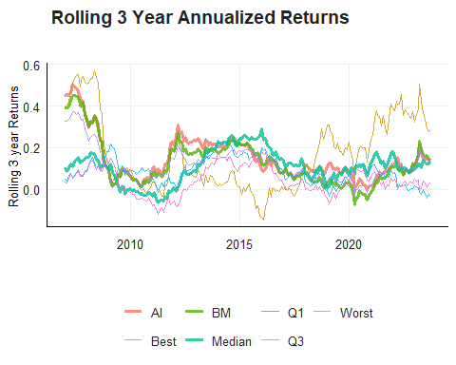
Analysis of First Moment

Slide 3
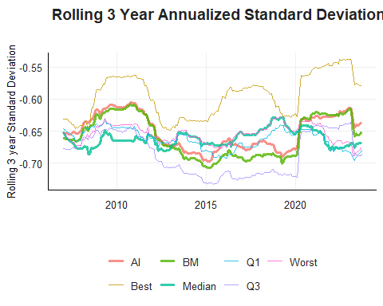
Analysis of Second Moment

Slide 4
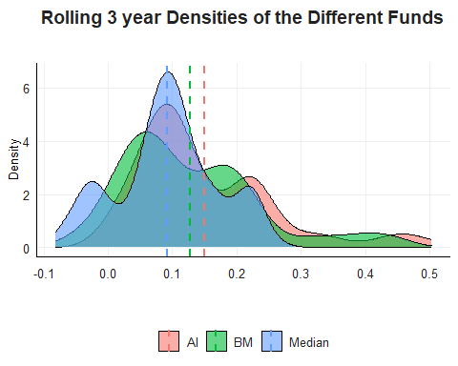
Fund Specific Distributions

Slide 5
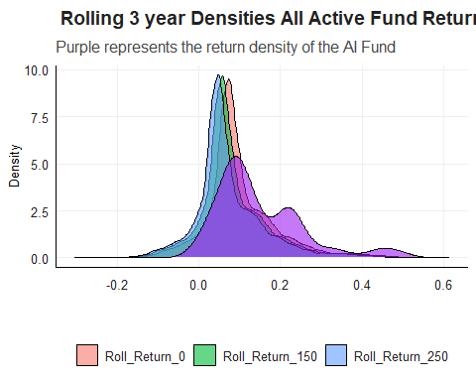
Distributions Across All Active Funds

