Slide 1
Portfolio Analysis
André le Roux

Slide 2
Analysis of Relative Risk
Measures | Result
Semi Deviation | 0.03300000
Loss Deviation | 0.02980000
Downside Deviation (Rf = 0%) | 0.02810000
Maximum Drawdown | 0.21290000
Historical VaR (95%) | -0.06820000
Historical ES (95%) | -0.09050000
Tracking Error to Benchmark | 0.04983731

Slide 3
Table Analysis
When looking at the results from the first table we see that the annualised tracking error is 5%, this is concerningly high for an Index tracker. We can also see further information of the contextual risk of the portfolio.

Slide 4
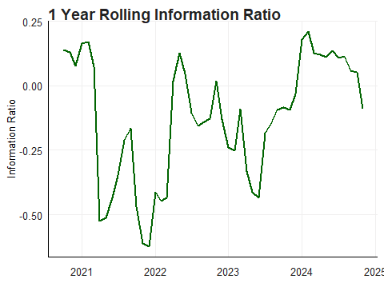
Relative Performance
This graph creates some worry as it is a relatively volatile information ratio (can stray far from benchmark) and spends a majority of the time below the y = 0 line, suggesting underperformance in terms of the benchmark.

Slide 5
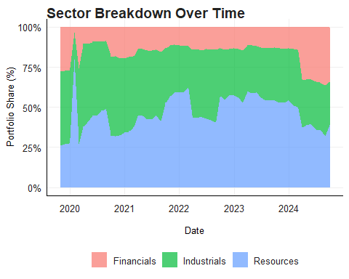
Sector Specific Breakdown
This graph displays the changes to the sector composition across the time horison off this portfolio, with resources making up the lion share of the portfolio, however the share of financials have been improving since early 2024. There is an interesting one time spike in the resources percentage in 2020.

Slide 6
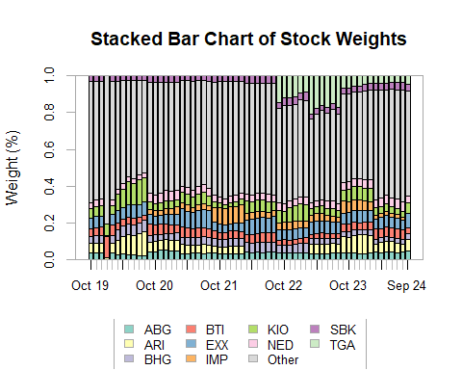
Changes in Stock Weights Across Time
This graph displays the weigths of the 10 most prevalent stocks across the time frame, as well as “Other” stocks which make up smaller percentages. Some stocks such as ABG maintain relatively consistent levels while other such as ARI alternate considerably more.

Slide 7
## $xlog ## [1] FALSE ## ## $ylog ## [1] FALSE ## ## $adj ## [1] 0.5 ## ## $ann ## [1] TRUE ## ## $ask ## [1] FALSE ## ## $bg ## [1] "white" ## ## $bty ## [1] "o" ## ## $cex ## [1] 1 ## ## $cex.axis ## [1] 1 ## ## $cex.lab ## [1] 1 ## ## $cex.main ## [1] 1.2 ## ## $cex.sub ## [1] 1 ## ## $col ## [1] "black" ## ## $col.axis ## [1] "black" ## ## $col.lab ## [1] "black" ## ## $col.main ## [1] "black" ## ## $col.sub ## [1] "black" ## ## $crt ## [1] 0 ## ## $err ## [1] 0 ## ## $family ## [1] "" ## ## $fg ## [1] "black" ## ## $fig ## [1] 0.0000000 1.0000000 0.0000000 0.1428571 ## ## $fin ## [1] 4.999999 3.999999 ## ## $font ## [1] 1 ## ## $font.axis ## [1] 1 ## ## $font.lab ## [1] 1 ## ## $font.main ## [1] 2 ## ## $font.sub ## [1] 1 ## ## $lab ## [1] 5 5 7 ## ## $las ## [1] 0 ## ## $lend ## [1] "round" ## ## $lheight ## [1] 1 ## ## $ljoin ## [1] "round" ## ## $lmitre ## [1] 10 ## ## $lty ## [1] "solid" ## ## $lwd ## [1] 1 ## ## $mai ## [1] 0.02 0.42 0.02 0.22 ## ## $mar ## [1] 5.1 4.1 4.1 2.1 ## ## $mex ## [1] 1 ## ## $mfcol ## [1] 1 1 ## ## $mfg ## [1] 1 1 1 1 ## ## $mfrow ## [1] 1 1 ## ## $mgp ## [1] 3 1 0 ## ## $mkh ## [1] 0.001 ## ## $new ## [1] TRUE ## ## $oma ## [1] 0 0 0 0 ## ## $omd ## [1] 0 1 0 1 ## ## $omi ## [1] 0 0 0 0 ## ## $pch ## [1] 1 ## ## $pin ## [1] 3.759999 2.159999 ## ## $plt ## [1] 0.1240000 0.8760000 0.2300001 0.7699999 ## ## $ps ## [1] 12 ## ## $pty ## [1] "m" ## ## $smo ## [1] 1 ## ## $srt ## [1] 0 ## ## $tck ## [1] NA ## ## $tcl ## [1] -0.5 ## ## $usr ## [1] -0.04 1.04 -0.04 1.04 ## ## $xaxp ## [1] 0 1 5 ## ## $xaxs ## [1] "r" ## ## $xaxt ## [1] "s" ## ## $xpd ## [1] FALSE ## ## $yaxp ## [1] 0 1 5 ## ## $yaxs ## [1] "r" ## ## $yaxt ## [1] "s" ## ## $ylbias ## [1] 0.2

Slide 8
End

