Slide 1
Portfolio Analysis
André le Roux

Slide 2
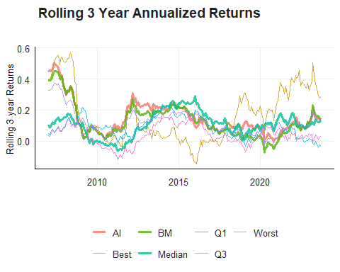
Analysis of First Moment
As can be seen in the figure, the fund with the best returns is dependent on the timing of your investment. At the most recent date the 3 year rolling returns of the AI, Benchmark and median are almost indistinguishable.

Slide 3
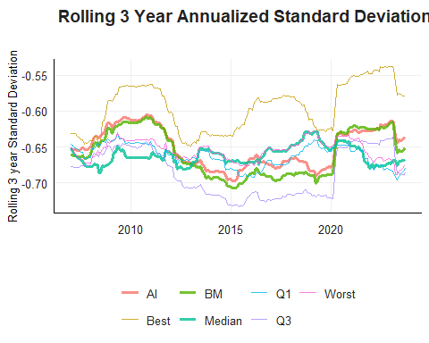
Analysis of Second Moment
The ranking of the volatility of the funds is dependent on the time frame, except for the best fund, which consistently has higher volatility. For a long time (2013 - 2020) the median fund had higher rolling standard deviations, however this has changed post 2020.

Slide 4
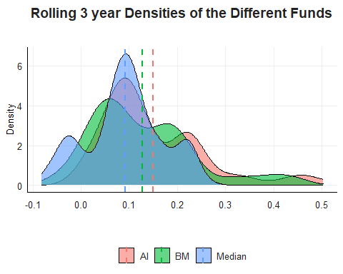
Fund Specific Distributions
We can see from the plot that the mean of the rolling returns of the AI and benchmark funds are higher than the median when taking a 1.5% fee into consideration. They also have fatter right skewed tails than the median fund.

Slide 5
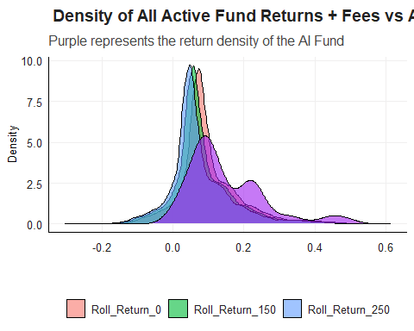
Distributions Across All Active Funds
When comparing the AI fund to the distributions of all active manager returns we see that the AI fund is more right skewed and with a higher mean. This difference only grows depending on the fee that the active manager asks.

