Slide 1

Εθνικό Και Καποδιστριακό Πανεπιστήμιο Αθηνών Μεταπτυχιακό Πρόγραμμα Σπουδών: «Βιο-στατιστική και Επιστήμη Δεδομένων Υγείας»

Slide 2
Title
Predicting early termination of clinical trials, using machine learning vs classical regression models, based on analysis of their design characteristics
Φοιτητής/τρια: Ανδρέου Ευγενία
Επιβλέπων Καθηγητής: Δεναξάς Σπύρος

Slide 3
Introduction

Slide 4
Problem
Clinical Trials
Systematic research studies conducted on human participants under controlled interventional conditions, aiming to evaluate the safety, efficacy, and effectiveness of medical interventions.
Safety and Respect of participants
Minimization of Participants’ contribution to scientific progress
Loss of funding. Especially in scaled advanced phases → Could be utilized elsewhere
Inefficient and slow scientific progress → Clinical practice impact
Unreliable scientific information → Researchers, Clinicians and Replicability, Reproducibility
Objective
Study CTs’ characteristics regarding early termination.

Slide 5
Data Source ClinicalTrials.gov

Slide 6
Electronic Health Records – EHR
Digital medical records. Complex datasets including large number of entries of any data types (images, text, ICD-10 codes, etc.). Valuable information but also more challenging for analysis with traditional statistical models
ClinicalTrials.gov Public Registry
In 2005, the International Committee of Medical Journal Editors (ICMJE) →
CTs uploaded on Public Registries → Design transparency
ClinicalTrials.gov registry is a type of EHR data regarding CTs’ information.
It was used as data source in current study
Significance of Accurate Registration
CTs’ characteristics → Registries’ Analysis → Early termination relations
Inaccurate registry → Researchers, Clinicians, Unethical

Slide 7
Data Format
Format: 1. AACT db (Variety, Structured) | 2. ClinicalTrials.gov website csv
Selected Trials
Interventional : Randomized, Non-Randomized
Dates: 2011-2024
Phases: 1, 2, 3, 4
67000 records → Phase 1: (21012, 54) | Phase 2: (19747, 54) | Phase 3: (13317, 54) | Phase 4: (12420, 54)
Study Status: Completed, Terminated | Completed, Withdrawn
Dataset Notes
Imbalanced dataset Completed/Terminated ≈ 85:15
Inaccurate registries → Missing, Optional, False inputs → Data processing complication
Real world data → Large datasets, Skewed data

Slide 8
Methodology

Slide 9
Methodology Schema per Phase
AACT db
CSV
Structured Data (Phases 1-4)
Exploratory Analysis
Imbalance Sensitive Metrics
Exploratory Analysis
One Hot Encoding
Train Set
Test Set
Roc/PR Curves
Collinearity
Sparsity Risk
Random Under Sample
Best Model
Feature Selection
HPO : K-Fold CV
Models
SHAP plots/
Logistic

Slide 10
Methodology in Detail
Data Engineering
Challenging real world data
New Features (e.g., Interactions, Formats)
Exploratory Analysis
Exploratory Analysis → Train set → X information leakage
Frequency tables
Univariable analysis: Logistic, Chi-square, Mann-Whitney test
Correlation: Spearman, X² (Phi), 1-way-Anova(η²) , Heatmaps, VIF ≥10
Sparsity Risk: EPV ≥25
Outliers
Missing: csv+bd, RegEx, Merge levels, Drop, Imputation
AIC, p values, CL
Distribution Plots (Bar, Kde, Count)
Merge levels → X rows dropped
Real world skewed data → Log scale
Feature Selection
One-Hot-Encoding: Completed = 0, Terminated / Withdrawn = 1
Random Under Sample (Imbalance)
Statistical Analysis
Classic Statistic Models
Logistic (L1), LDA, QDA
Model – Features Evaluation / Interpretation
Imbalance Sensitive metrics (MCC)
ROC/PR Curves
SHAP plots
ML models
KNN, SVC
Random Forest
Grad.Boosting, XGBoost, LightBoost
Model Pre-Processing
Min-Max Scaler
Logistic Interpret
Train-Test Split (80:20) / (80:10)
HPO : 5 K-Fold CV

Slide 11
Exploratory Analysis (Train Data)
Exploratory Analysis for feature Selection on Train set → X information leakage
Logarithmic scale-Continuous features
Distribution plots: Skewed real world data
Distance based Models : KNN, SVC
Sparsity → Merge levels
On Train-Resampled set
Levels of categorical features with too small sample size in minority class
EPV : ≥25
Correlation Heatmaps
Spearman
Chi2 (Cramer-V - Phi)
1-way-Anova (η²)
AIC
Mutual Information features (e.g., # facilities per Continents, Countries, Cities)

Slide 12
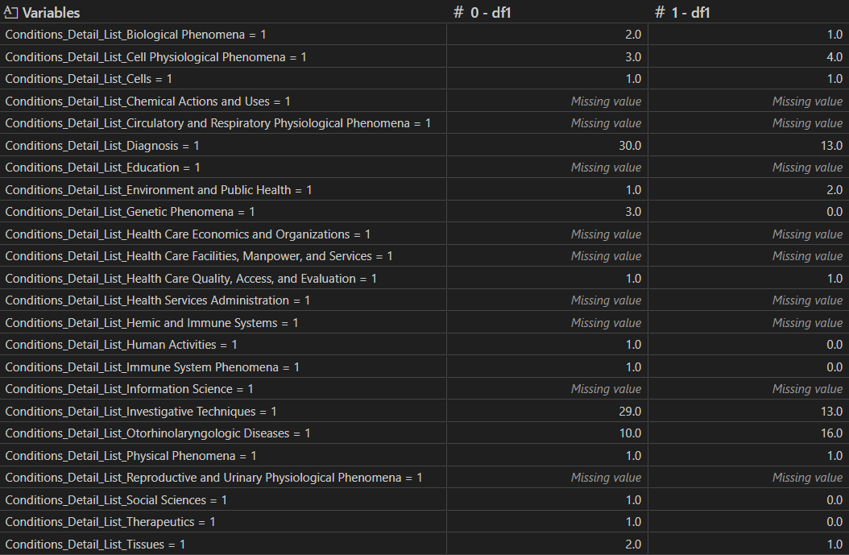
Sparsity Risk
Sparse Data
Categorical features
Small sample size levels of categorical features.
Continuous features
Small values all towards one outcome, large on the other
Zero sample size in any level of outcome → Model’s fit → Inf coefficients
Method
EPV (Events per variable for minority outcome): ≥25
Merge levels to related/general others: e.g., ‘Other’/’None’
No information dropped
Sparsity Risk & Low EPV
Sparse Data

Slide 13
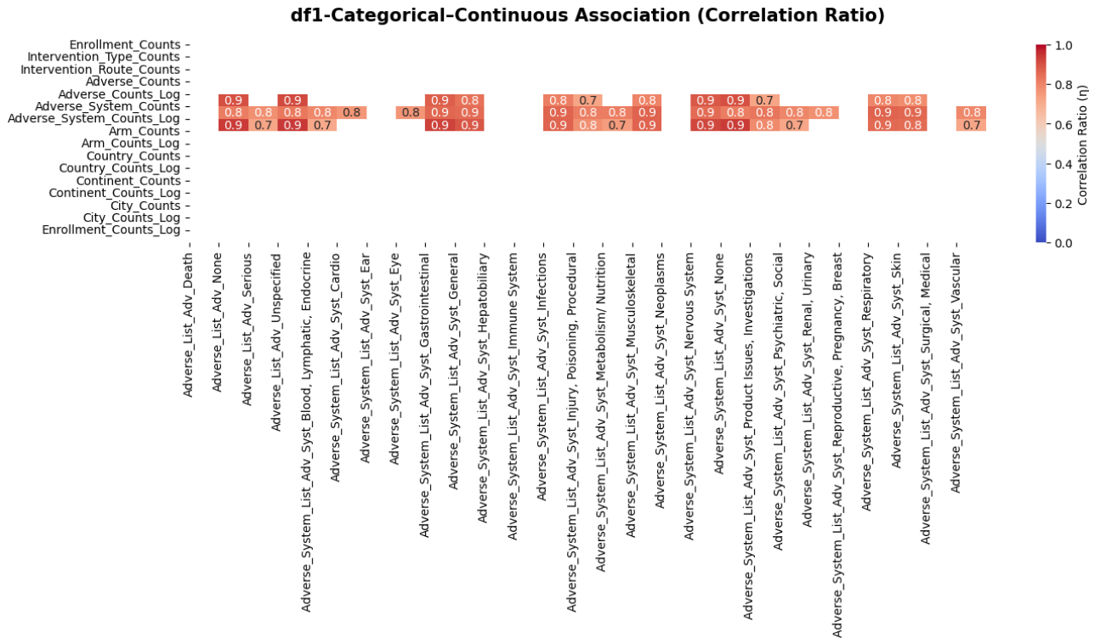
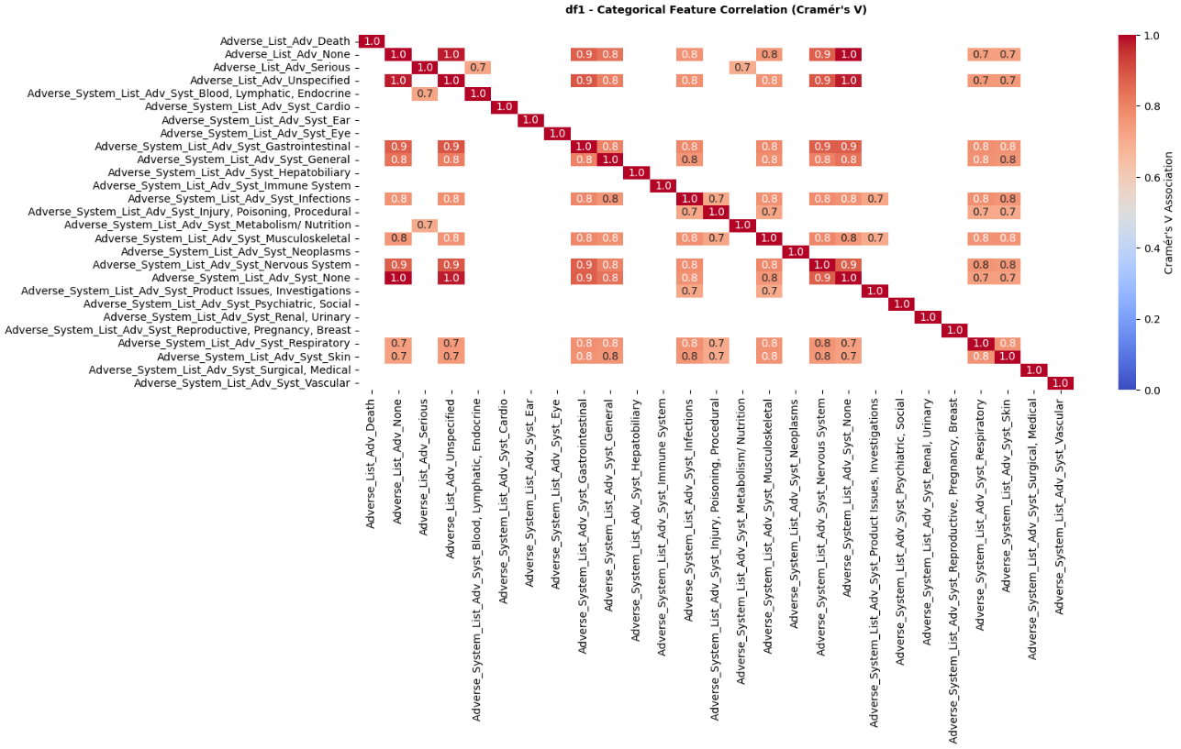
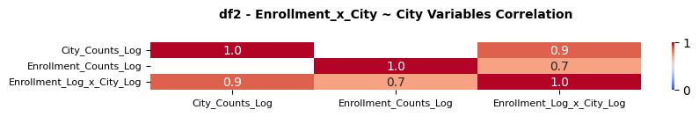
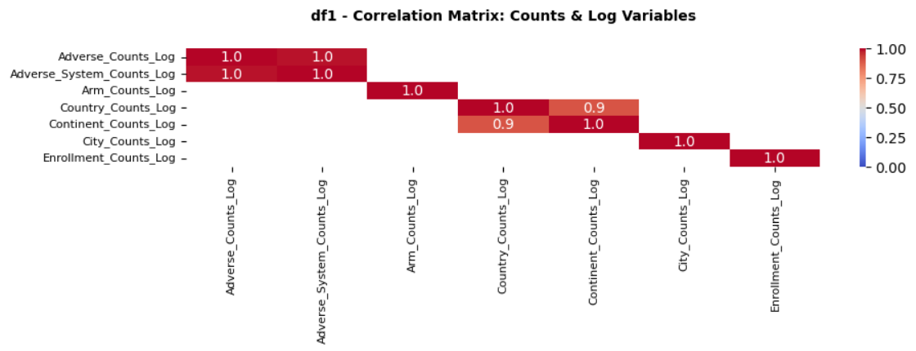
Correlation
Continues:
Normality test → Spearman
Categorical:
Chi2 → Cramer-V
Categorical-Continuous:
1-way-Anova → η²
→ Merge levels with relative others
→ Feature selection for similar information predictors

Slide 14
Results

Slide 15
Models

Slide 16
Models’ Evaluation Metrics
Imbalance Dataset → Completed : Terminated ≈ 85:15
Classification Report - Confusion Matrix
MCC, Bacc, F1: ✓ Imbalanced Dataset
ROC AUC: Unaffected by class balance changes
PR AUC : ✓ Imbalanced Dataset & Minority class events → Decreased performance

Slide 17
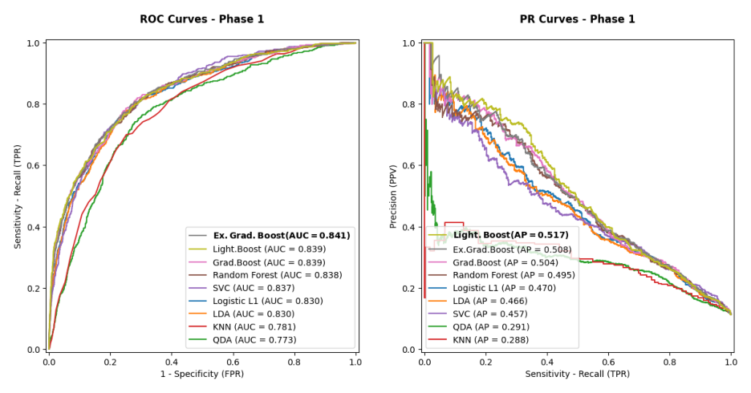
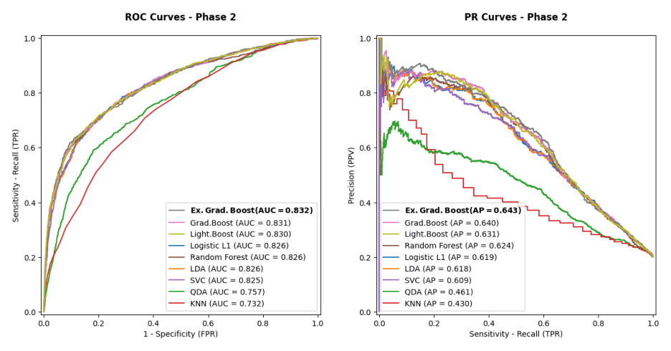
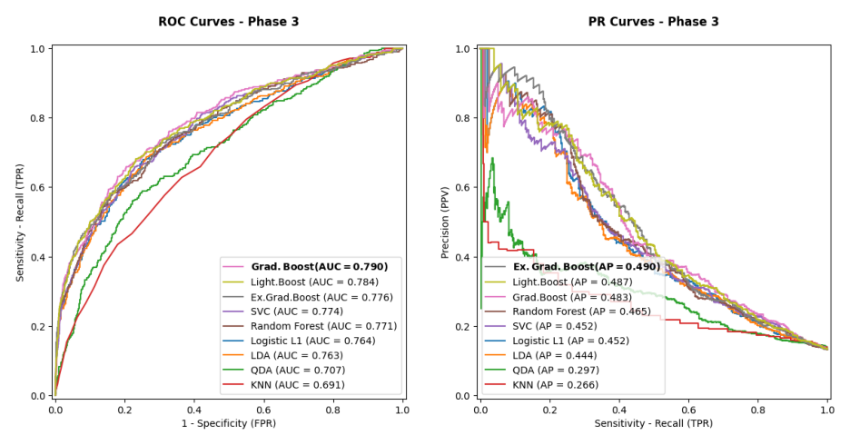
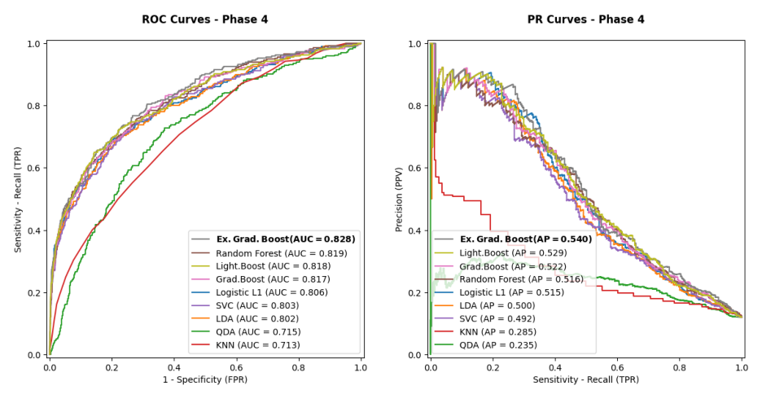
Model per Phase

Slide 18
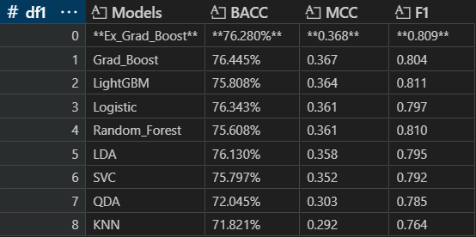
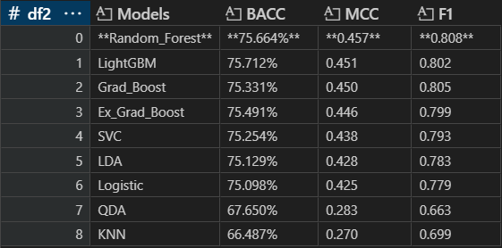
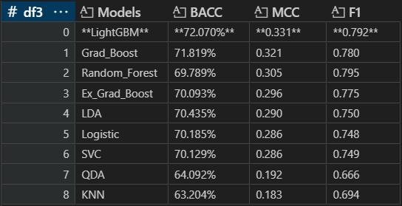
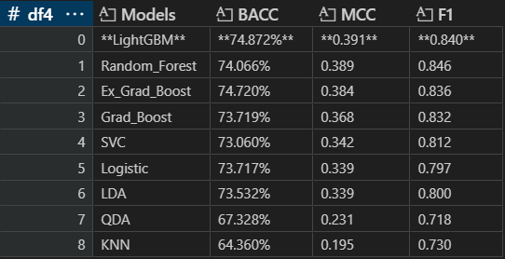
Metrics

Slide 19
Models’ Performance
Boosting Models → XGBoost, LightBoost outperformed
Stable Results in different
Methods
Dimensions
Features
Metrics: ROC PR, MCC, BA, F1
Benefits
Residuals based (no distance based, nonparametric etc.)
Real world data (Unscaled, Skewed, Missing etc.)
Faster - Large – Imbalanced Datasets
Scalable methods
Clinical practice

Slide 20
Predictors

Slide 21
Features ~ Termination ~ Phases
Phase 1: Dose-Escalation | Pharmacology
Escalating dose ~ Adverse Events (e.g, MTD)
Phase 2: Therapeutic Exploratory
Safety, Pharmaco-dynamics-kinetics
Early efficacy data (transitional to phase 3)
1st scaled phase
Phase 3: Therapeutic Confirmatory | Comparative Efficacy
Treatments vs placebo/standard/active
Frequent Adverse Events
Study Design highly important - Scaled
Phase 4: Therapeutic Use | Post-Marketing
Rare Adverse Events
Differences in dose-efficiency in population
After drug approval - Cost Estimation

Slide 22
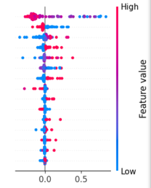
Features’ Evaluation Metrics
SHAP plots
ML interpretability
Data Points: φ values
Pink → High feature’s values
Blue → Low feature’s values
X-axis
Right → Positive contribution to termination log-Odds
Left → Negative contribution to termination log-Odds

Slide 23
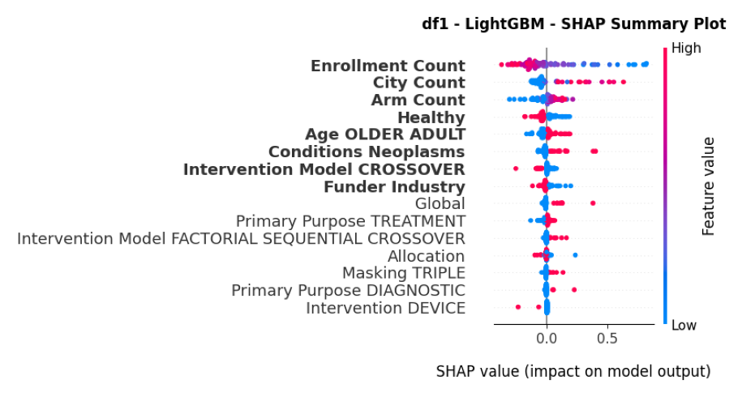
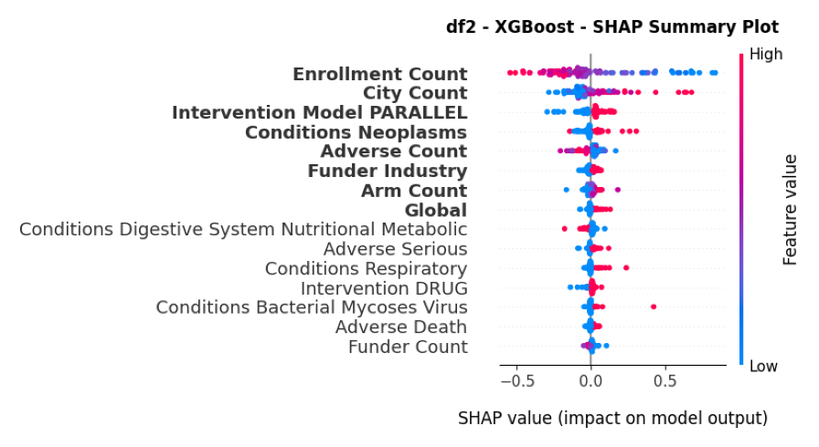
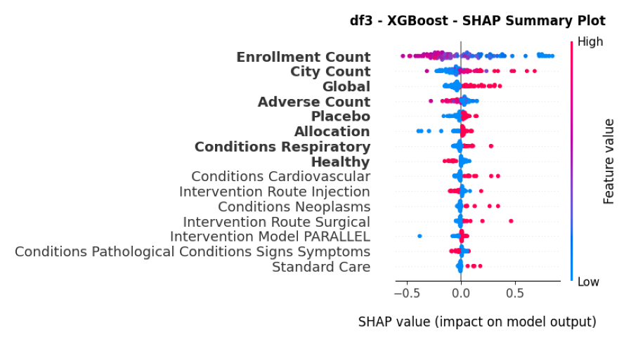
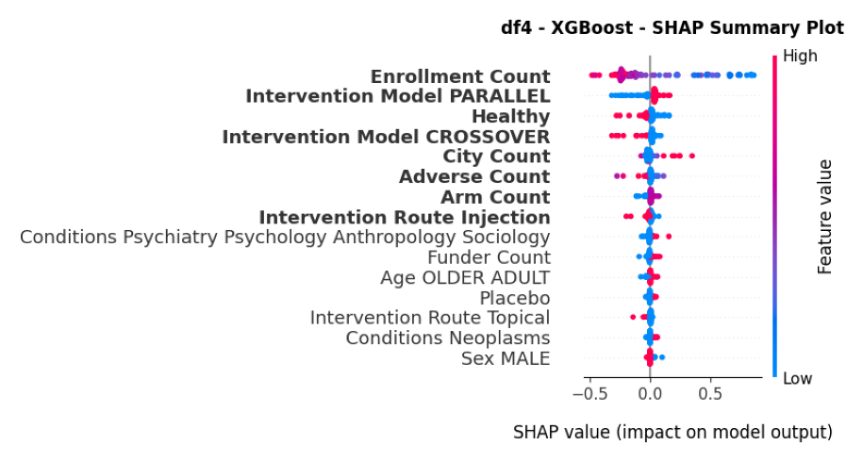
Features ~ Termination ~ Phases
Phase 1: Dose-Escalation | Pharmacology
Escalating dose ~ Adverse Events (e.g, MTD)
New treatment
Phase 2: Therapeutic Exploratory
Safety, Pharmaco-dynamics-kinetics
Early efficacy data (transitional to phase 3)
1st scaled phase → Study Design
Phase 3: Therapeutic Confirmatory | Comparative Efficacy
Treatments vs placebo/standard/active
Frequent Adverse Events
Study Design highly important - Scaled
Phase 4: Therapeutic Use | Post-Marketing
After drug approval - Cost Estimation
Rare Adverse Events
Differences in dose-efficiency in population

Slide 24
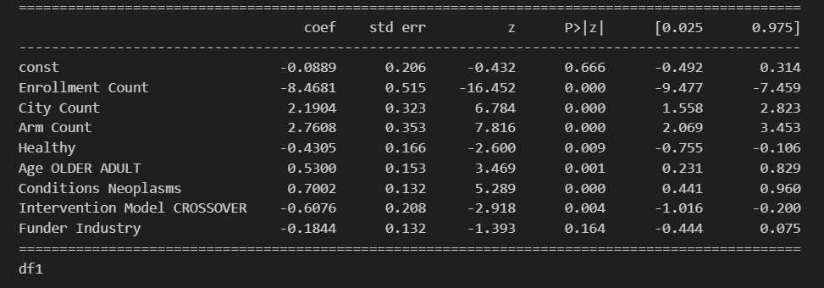
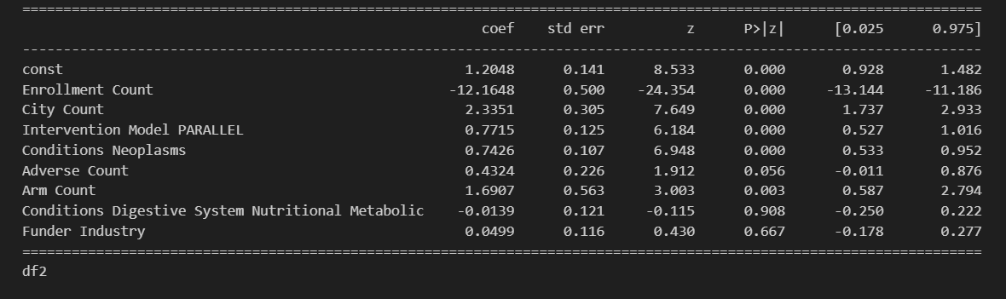
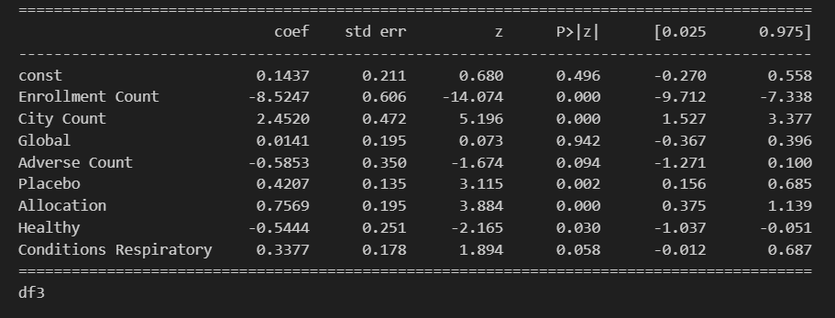
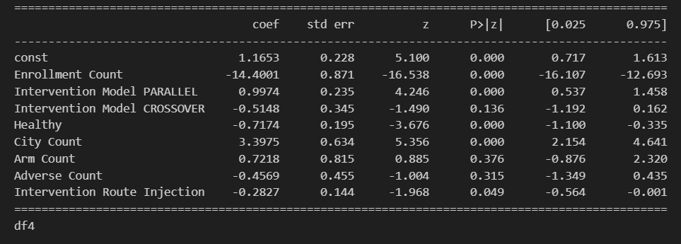
Logistic Interpretation
Top model → SHAP → 8 top features (Dimension/Noise ~ Logistic & Pattern)
SHAP ≠ Logistic Interpretation → Significance, Direction
Enrollment → Sparse effect → coeff towards inf
Adverse → Non-sig. → Non-linear relationship (SHAP overlap)

Slide 25
Features Evaluation Summary
+ : High feature’s values → Terminated
- : High feature’s values → Completed
Best Predictors
Enrollment -
# Facilities +
Conditions +
Healthy Volunteers –
# Arms +
Older age +
# Adverse –
Interv. Model: Parallel + , Crossover -
Allocation +
Placebo +
Funder Industry +
Predictors vs Phases
Phase 1: New treatment ~ Health status
Phase 2: Safety, Pharmacokinetics ~ Adverse, Therapeutic, Sponsor
Phase 3: Design, Treatment comp. ~ Design, Treatment characteristics
Phase 4: Approved Treatment ~ Intervention characteristics
Enrollment & City Counts → Strongest predictors

Slide 26
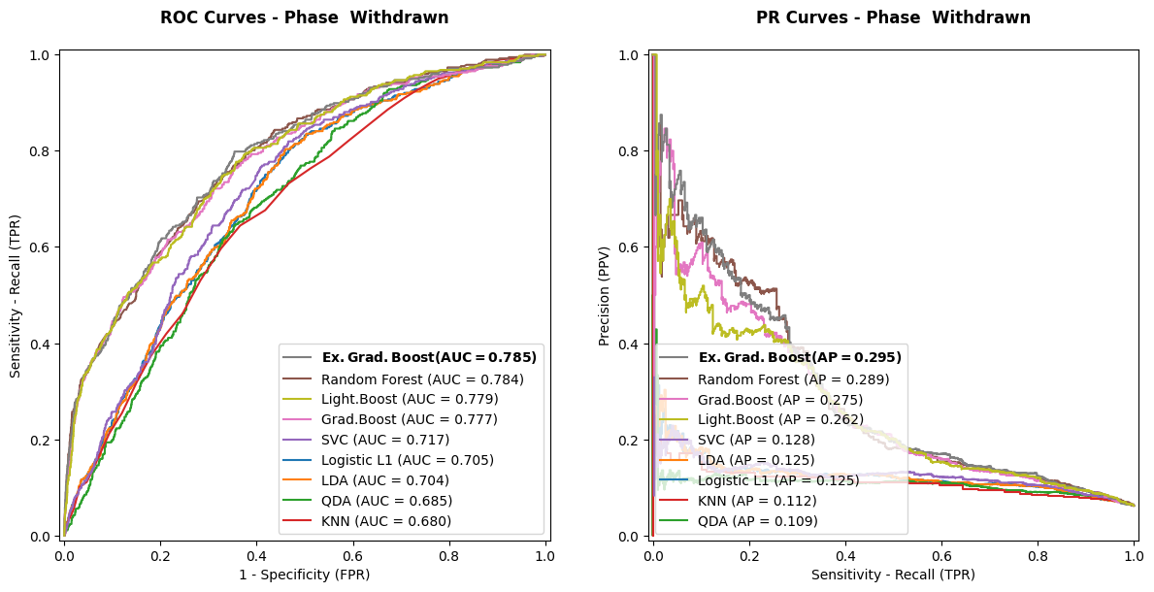
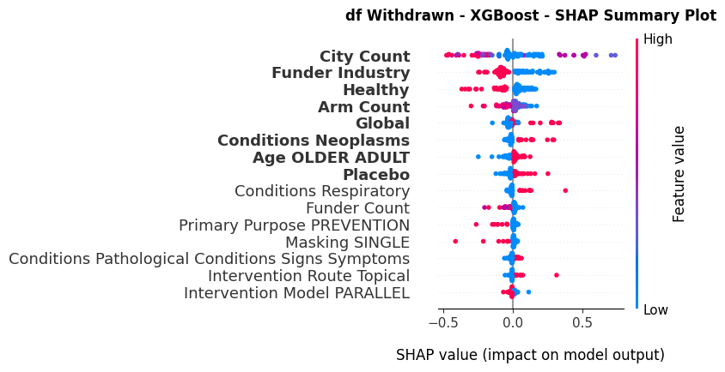
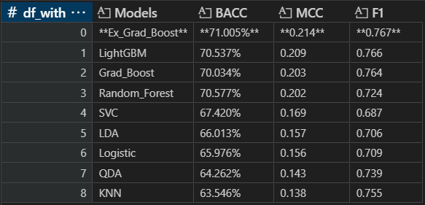
Withdrawn Analysis
Enrollment | Adverse events → Removed
Withdrawn vs Terminated → Direction
# Facilities – : Opposite sign
Funder – : Opposite sign
Healthy –
# Arms –
Global +
Condition +
Placebo +

Slide 27
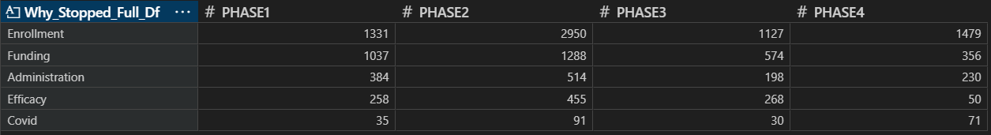
Termination & Withdrawn Descriptives
Current – Background Research Alignment
Background Research
Enrollment
Disease category (e.g., neoplasms) → Affects enrollment
Number of facilities → Also, affects enrollment
Healthy Volunteers
Number of Adverse Events
Funder type (e.g., non-Industry)
Other (e., Administrative, supplies etc.)

Slide 28
Discussion

Slide 29
Strengths & Limitations
Strengths
Limitations
Per Phases (1-4) ~ Feature
More features Interactions, New, scales etc.
More models LightBoost Clinical practice impact
Imbalance sensitive metrics MCC, BA, F1, PR Curves
Interpretability of ML SHAP plots, Logistic
Sample Size
Efficiently large: 2011-2024 , EPV
Avoid Missing data drop No Information loss
Missing data : RegEx
Random Under Sample : Information loss
EPV >25 : Inefficient for ML
No alternative classic statistics models
No field specific : High dimension
Phases excluded: 0, 1|2, 2|3, NA
Study status excluded: Suspended etc.
Inaccurate dataset registries Wrongly, optimal, Null, Sparse etc.

Slide 30
Future Research
Underlying factors → Early termination
Interactions (Enrollment x Other Features, Funder x Intervention etc.)
Enrollment, Conditions
Phase ~ Features
Study Status: Withdrawn, Terminated, Suspended etc. → Separately | Combined
Phases: 1|2, 2|3
Alternative Models of best performing Boosting method’s
Interpretability
Later years trials registrations : Less optional field completion → Accuracy
Mapping Key findings
Literature alignment, Registries
Establish well performed models/methods for real world health data
and analysis of corresponding problems

Slide 31


The End…

