Slide 1
Practical Application Development with Spring API
Module 11: Consumindo uma API existente na NUVEM
Notes:
Duration: 1 hour, 30 minutes
Content: N/A
Notes to Instructor:
This module introduces Spring MVC Module. Complete coverage of this module is highly recommended. However in case there is not sufficient time to complete case study activities the module may be skipped.

Slide 2

Agenda
Revisão do Spring Essentials
Spring BooT - Overview
Spring BooT – Introduction;
Spring BooT – Components;
Spring BooT – Features;
Funcionamento;
Construção de aplicação;
Notes:
Topic Duration: 10 minutes
Content: N/A
Notes to Instructor:
This is just a brief reminder of where you are in the module. It will help the participants to know what is coming up.
The Appendix includes reference topics that complement the module content. Faculty may use this supplementary content to answer participant questions.
J2EE Presentation Layer Technologies
Spring Web Application Development Stack
Struts MVC Vs. Spring MVC

Slide 3
Spring Boot
Aplicação
Spring BOOT para consumir uma API
Notes:
Aqui abrir uma aplicação juntamente com os alunos;

Slide 4
Spring Boot
Vamos configurar o intialzr para criar o projeto no STS;
Criar o código;
Notes:
Content: N/A
Notes to Instructor:

Slide 5
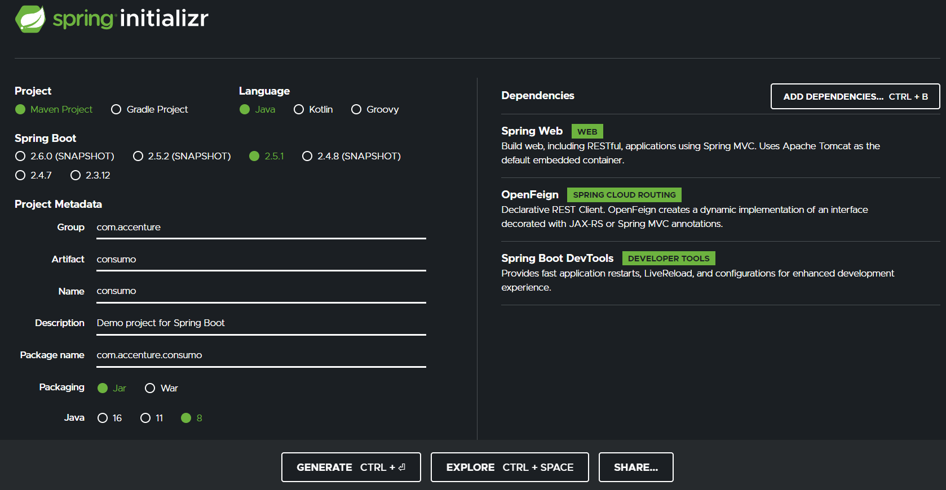
Spring Boot
Starters;

Slide 6
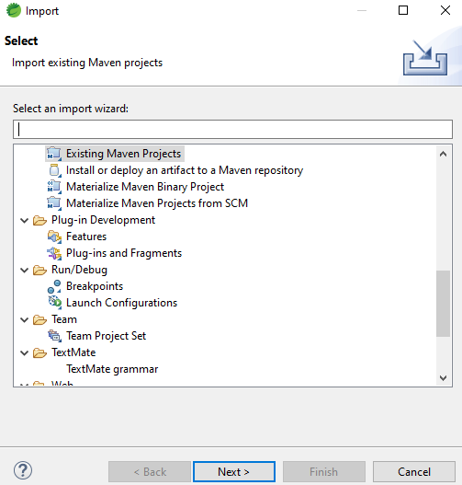
Spring Boot
FILE ->Import;
Notes:
Aqui abrir uma aplicação juntamente com os alunos;

Slide 7
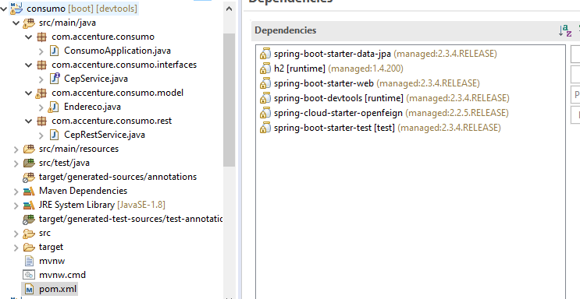
Spring Boot
Estrutura dos pacotes e dependências;
Notes:
<?xml version="1.0" encoding="UTF-8"?>
<project xmlns="http://maven.apache.org/POM/4.0.0" xmlns:xsi="http://www.w3.org/2001/XMLSchema-instance"
xsi:schemaLocation="http://maven.apache.org/POM/4.0.0 https://maven.apache.org/xsd/maven-4.0.0.xsd">
<modelVersion>4.0.0</modelVersion>
<parent>
<groupId>org.springframework.boot</groupId>
<artifactId>spring-boot-starter-parent</artifactId>
<version>2.3.4.RELEASE</version>
<relativePath/> <!-- lookup parent from repository -->
</parent>
<groupId>com.accenture</groupId>
<artifactId>consumo</artifactId>
<version>0.0.1-SNAPSHOT</version>
<name>consumo</name>
<description>Consumir um serviço externo via FeignClient </description>
<properties>
<java.version>1.8</java.version>
</properties>
<dependencies>
<dependency>
<groupId>org.springframework.boot</groupId>
<artifactId>spring-boot-starter-data-jpa</artifactId>
</dependency>
<dependency>
<groupId>com.h2database</groupId>
<artifactId>h2</artifactId>
<scope>runtime</scope>
</dependency>
<dependency>
<groupId>org.springframework.boot</groupId>
<artifactId>spring-boot-starter-web</artifactId>
</dependency>
<dependency>
<groupId>org.springframework.boot</groupId>
<artifactId>spring-boot-devtools</artifactId>
<scope>runtime</scope>
<optional>true</optional>
</dependency>
<dependency>
<groupId>org.springframework.cloud</groupId>
<artifactId>spring-cloud-starter-openfeign</artifactId>
</dependency>
<dependency>
<groupId>org.springframework.boot</groupId>
<artifactId>spring-boot-starter-test</artifactId>
<scope>test</scope>
<exclusions>
<exclusion>
<groupId>org.junit.vintage</groupId>
<artifactId>junit-vintage-engine</artifactId>
</exclusion>
</exclusions>
</dependency>
</dependencies>
<dependencyManagement>
<dependencies>
<dependency>
<groupId>org.springframework.cloud</groupId>
<artifactId>spring-cloud-dependencies</artifactId>
<version>Hoxton.SR8</version>
<type>pom</type>
<scope>import</scope>
</dependency>
</dependencies>
</dependencyManagement>
<build>
<plugins>
<plugin>
<groupId>org.springframework.boot</groupId>
<artifactId>spring-boot-maven-plugin</artifactId>
</plugin>
</plugins>
</build>
</project>

Slide 8
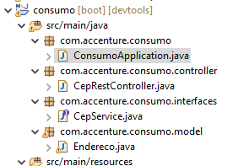
Spring Boot
Criar a classe principal
no pacote com.accenture.consumo
Notes:
package com.accenture.consumo;
import org.springframework.boot.SpringApplication;
import org.springframework.boot.autoconfigure.SpringBootApplication;
import org.springframework.cloud.openfeign.EnableFeignClients;
@SpringBootApplication
@EnableFeignClients
public class ConsumoApplication {
public static void main(String[] args) {
SpringApplication.run(ConsumoApplication.class, args);
}
}
// localhost:8080/01523040

Slide 9
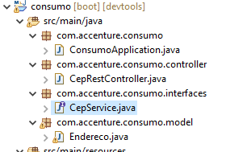
Spring Boot
Criar a classe interface
Vamos definir a interface CepService.java no pacote com.accenture.consumo.interfaces
Notes:
package com.accenture.consumo.interfaces;
import org.springframework.cloud.openfeign.FeignClient;
import org.springframework.web.bind.annotation.GetMapping;
import org.springframework.web.bind.annotation.PathVariable;
import com.accenture.consumo.model.Endereco;
@FeignClient(url= "https://viacep.com.br/ws/" , name = "viacep")
public interface CepService {
@GetMapping("{cep}/json")
Endereco buscaEnderecoPorCep(@PathVariable("cep") String cep);
}

Slide 10
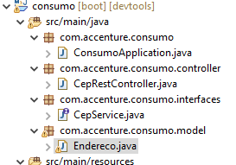
Spring Boot
Criar a classe entity
Vamos definir o model Endereco.java no pacote com.accenture.consumo.model
Notes:
package com.accenture.consumo.model;
public class Endereco {
private String cep;
private String logradouro;
private String complemento;
private String bairro;
private String localidade;
private String uf;
private String ibge;
private String gia;
private String ddd;
private String siafi;
//Construtor
public void Endereco() {
}
//gets e sets
public String getCep() {
return cep;
}
public void setCep(String cep) {
this.cep = cep;
}
public String getLogradouro() {
return logradouro;
}
public void setLogradouro(String logradouro) {
this.logradouro = logradouro;
}
public String getComplemento() {
return complemento;
}
public void setComplemento(String complemento) {
this.complemento = complemento;
}
public String getBairro() {
return bairro;
}
public void setBairro(String bairro) {
this.bairro = bairro;
}
public String getLocalidade() {
return localidade;
}
public void setLocalidade(String localidade) {
this.localidade = localidade;
}
public String getUf() {
return uf;
}
public void setUf(String uf) {
this.uf = uf;
}
public String getIbge() {
return ibge;
}
public void setIbge(String ibge) {
this.ibge = ibge;
}
public String getGia() {
return gia;
}
public void setGia(String gia) {
this.gia = gia;
}
public String getDdd() {
return ddd;
}
public void setDdd(String ddd) {
this.ddd = ddd;
}
public String getSiafi() {
return siafi;
}
public void setSiafi(String siafi) {
this.siafi = siafi;
}
@Override
public String toString() {
return "Endereco{" +
"cep='" + cep + '\'' +
", logradouro='" + logradouro + '\'' +
", complemento='" + complemento + '\'' +
", bairro=" + bairro +
", localidade='" + localidade + '\'' +
", uf='" + uf + '\'' +
", ibge='" + ibge + '\'' +
", gia='" + gia + '\'' +
", ddd='" + ddd + '\'' +
", siafi='" + siafi + '\'' +
'}';
}
}

Slide 11
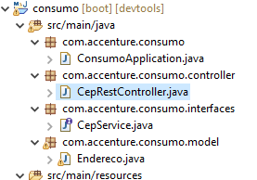
Spring Boot
Criar a classe controller
Vamos definir o repositório CepRestController.java no pacote com.accenture.consumo.controller
Notes:
package com.accenture.consumo.controller;
import org.springframework.beans.factory.annotation.Autowired;
import org.springframework.http.ResponseEntity;
import org.springframework.web.bind.annotation.GetMapping;
import org.springframework.web.bind.annotation.PathVariable;
import org.springframework.web.bind.annotation.RestController;
import com.accenture.consumo.interfaces.CepService;
import com.accenture.consumo.model.Endereco;
@RestController
public class CepRestController {
@Autowired
private CepService cepService;
@GetMapping("/{cep}")
public ResponseEntity<Endereco> getCep(@PathVariable String cep) {
Endereco endereco = cepService.buscaEnderecoPorCep(cep);
return endereco != null ? ResponseEntity.ok().body(endereco) : ResponseEntity.notFound().build();
}
}

Slide 12

Spring Boot
Testando a aplicação
Notes:
http://localhost:8080/01523040

Slide 13
Spring Boot
Desafio:
Formatar o response em uma página HTML
Gravar os dados recebidos no BD

Slide 14
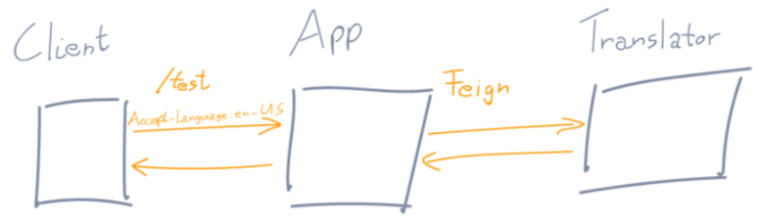
Spring Boot
Feign
O Feign foi criado com o objetivo de reduzir a complexidade para consumir API´s;
O Spring incorporou o Feign dentro da sua própria stack. Mais especificamente abaixo do projeto Spring Cloud. Que é um projeto voltado para arquitetura de micro serviços, cloud e etc.

Slide 15
Spring Boot
Feign
@EnableFeignClient
Para habilitar o Feign no projeto, fica na classe principal;
@FeignClient
É um cliente de serviço Web Java desenvolvido inicialmente pela Netflix;
Fica na classe de serviço;

Slide 16


Questions and Comments
What questions or comments
do you have?

