Slide 1
Practical Application Development with Spring BOOT
Module 9: Lista Contatos
Notes:
Duration: 1 hour, 30 minutes
Content: N/A
Notes to Instructor:
This module introduces Spring MVC Module. Complete coverage of this module is highly recommended. However in case there is not sufficient time to complete case study activities the module may be skipped.

Slide 2

Agenda
Revisão do Spring Essentials
Spring BooT - Overview
Spring BooT – Introduction;
Spring BooT – Components;
Spring BooT – Features;
Funcionamento;
Construção de aplicação;
Notes:
Topic Duration: 10 minutes
Content: N/A
Notes to Instructor:
This is just a brief reminder of where you are in the module. It will help the participants to know what is coming up.
The Appendix includes reference topics that complement the module content. Faculty may use this supplementary content to answer participant questions.
J2EE Presentation Layer Technologies
Spring Web Application Development Stack
Struts MVC Vs. Spring MVC

Slide 3

Module Objectives
Ao final deste modulo você saberá:
O que é Spring Boot 2.0.
Instalar o STS.
Desenvolver uma pequena aplicação web para listagem de contatos.
Notes:
Content: N/A
Notes to Instructor:
Briefly review the module objectives with the participants.
Take note of the learning objectives that are covered by content in the Appendix of this module presentation.

Slide 4
Spring Boot
Aplicação
Lista Contatos
Notes:
Aqui abrir uma aplicação juntamente com os alunos;

Slide 5
Projeto Listar Contatos
Iremos criar uma página para listar a tabela de contatos;
Utilizaremos o SpringInitializer;
Criaremos um banco de dados H2 (free) que irá guardar os dados do login;
Iremos utilizar o Hibernate para persistência dos dados;
Vamos configurar o Maven para criar o projeto no STS;
Configurar o Hibernate;
Criar o código;
Notes:
Content: N/A
Notes to Instructor:

Slide 6
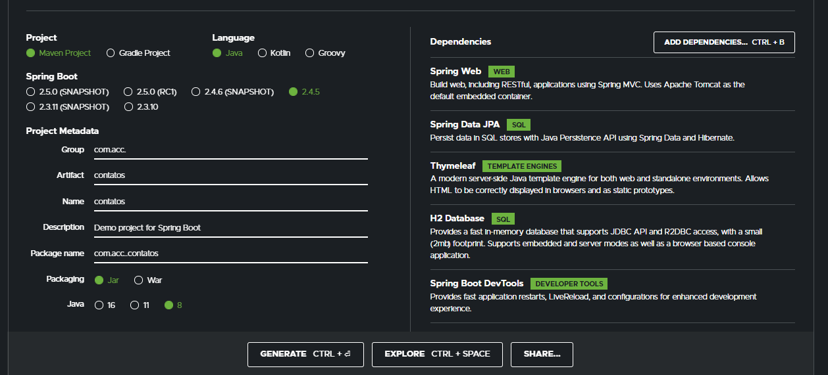
Projeto Listar Contatos
FILE ->Import;
Notes:
Aqui abrir uma aplicação juntamente com os alunos;

Slide 7
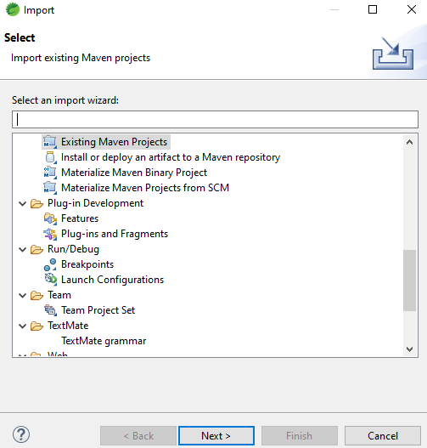
Projeto Listar Contatos
FILE ->Import;
Notes:
Aqui abrir uma aplicação juntamente com os alunos;

Slide 8
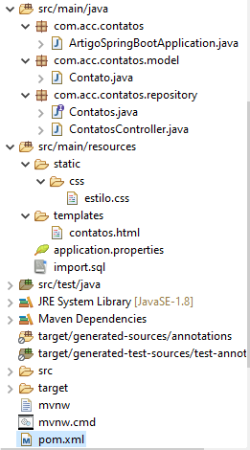
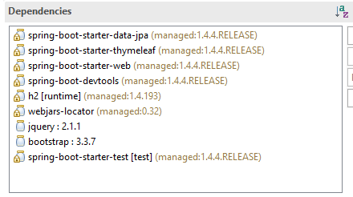
Projeto Listar Contatos
Estrutura dos pacotes e dependências;
Notes:
<?xml version="1.0" encoding="UTF-8"?>
<project xmlns="http://maven.apache.org/POM/4.0.0" xmlns:xsi="http://www.w3.org/2001/XMLSchema-instance"
xsi:schemaLocation="http://maven.apache.org/POM/4.0.0 http://maven.apache.org/xsd/maven-4.0.0.xsd">
<modelVersion>4.0.0</modelVersion>
<groupId>com.algaworks</groupId>
<artifactId>artigo-spring-boot</artifactId>
<version>1.0.0-SNAPSHOT</version>
<packaging>jar</packaging>
<name>artigo-spring-boot</name>
<description>Projeto de exemplo para o artigo.</description>
<parent>
<groupId>org.springframework.boot</groupId>
<artifactId>spring-boot-starter-parent</artifactId>
<version>1.4.4.RELEASE</version>
<relativePath/> <!-- lookup parent from repository -->
</parent>
<properties>
<project.build.sourceEncoding>UTF-8</project.build.sourceEncoding>
<project.reporting.outputEncoding>UTF-8</project.reporting.outputEncoding>
<java.version>1.8</java.version>
</properties>
<dependencies>
<dependency>
<groupId>org.springframework.boot</groupId>
<artifactId>spring-boot-starter-data-jpa</artifactId>
</dependency>
<dependency>
<groupId>org.springframework.boot</groupId>
<artifactId>spring-boot-starter-thymeleaf</artifactId>
</dependency>
<dependency>
<groupId>org.springframework.boot</groupId>
<artifactId>spring-boot-starter-web</artifactId>
</dependency>
<dependency>
<groupId>org.springframework.boot</groupId>
<artifactId>spring-boot-devtools</artifactId>
</dependency>
<dependency>
<groupId>com.h2database</groupId>
<artifactId>h2</artifactId>
<scope>runtime</scope>
</dependency>
<dependency>
<groupId>org.webjars</groupId>
<artifactId>webjars-locator</artifactId>
</dependency>
<dependency>
<groupId>org.webjars</groupId>
<artifactId>jquery</artifactId>
<version>2.1.1</version>
</dependency>
<dependency>
<groupId>org.webjars</groupId>
<artifactId>bootstrap</artifactId>
<version>3.3.7</version>
</dependency>
<dependency>
<groupId>org.springframework.boot</groupId>
<artifactId>spring-boot-starter-test</artifactId>
<scope>test</scope>
</dependency>
</dependencies>
<build>
<plugins>
<plugin>
<groupId>org.springframework.boot</groupId>
<artifactId>spring-boot-maven-plugin</artifactId>
</plugin>
</plugins>
</build>
</project>

Slide 9
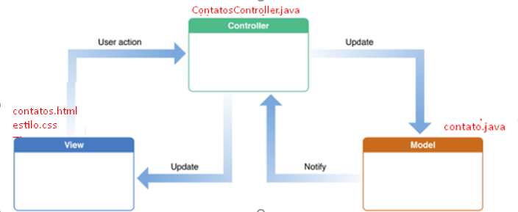
Projeto Listar Contatos
Estrutura

Slide 10
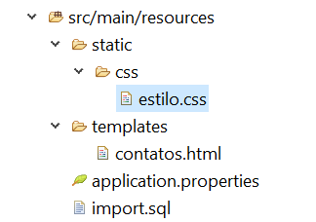
Projeto Listar Contatos
Resources
estilo.css
contatos.html
import.sql
Notes:
body {
margin-top: 50px;
}
footer {
color: #AAA
}

Slide 11
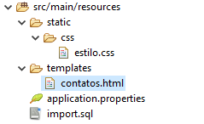
Projeto Listar Contatos
Resources
estilo.css
contatos.html
import.sql
Notes:
<!DOCTYPE html>
<html xmlns:th="http://www.thymeleaf.org">
<head>
<title>Listagem de contatos utilizando o Spring Boot</title>
<link th:href="@{/webjars/bootstrap/css/bootstrap.min.css}" rel="stylesheet" />
<link th:href="@{/webjars/bootstrap/css/bootstrap-theme.min.css}" rel="stylesheet" />
<link th:href="@{/webjars/font-awesome/css/font-awesome.min.css}" rel="stylesheet" />
<link th:href="@{/css/estilo.css}" rel="stylesheet" />
</head>
<body>
<nav class="navbar navbar-default navbar-fixed-top">
<div class="container">
<div class="navbar-header">
<button type="button" class="navbar-toggle collapsed"
data-toggle="collapse" data-target="#navbar" aria-expanded="false"
aria-controls="navbar">
<span class="sr-only">Toggle navigation</span> <span
class="icon-bar"></span> <span class="icon-bar"></span> <span
class="icon-bar"></span>
</button>
<a class="navbar-brand" th:href="@{/contatos}">Contatos</a>
</div>
<div id="navbar" class="collapse navbar-collapse">
<ul class="nav navbar-nav navbar-right">
<li class="dropdown">
<a href="#" class="dropdown-toggle"
data-toggle="dropdown" role="button" aria-haspopup="true"
aria-expanded="false">
Menu
<span class="caret"></span>
</a>
<ul class="dropdown-menu">
<li><a href="http://www.google.com" target="_blank">Site</a></li>
<li><a href="http://www.facebook.com" target="_blank">Facebook</a></li>
<li><a href="http://www.youtube.com" target="_blank">YouTube</a></li>
<li><a href="http://github.com" target="_blank">Github</a></li>
</ul>
</li>
</ul>
</div>
</div>
</nav>
<div class="container">
<div class="page-header">
<h1>Lista de contatos</h1>
</div>
<table class="table table-striped table-bordered">
<thead>
<tr>
<th>#</th>
<th>Nome</th>
<th>E-mail</th>
</tr>
</thead>
<tbody>
<tr th:each="contato: ${contatos}">
<td th:text="${contato.id}"></td>
<td th:text="${contato.nome}"></td>
<td th:text="${contato.email}"></td>
</tr>
</tbody>
</table>
</div>
<script th:src="@{/webjars/jquery/jquery.min.js}"></script>
<script th:src="@{/webjars/bootstrap/js/bootstrap.min.js}"></script>
</body>
</html>

Slide 12
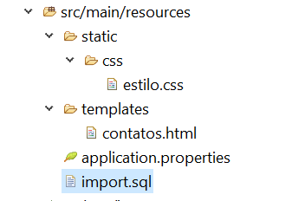
Projeto Listar Contatos
Resources
estilo.css
contatos.html
import.sql
Notes:
insert into Contato (id, nome, email) values (1, 'William Douglas', 'williamdouglas@gmail.com');
insert into Contato (id, nome, email) values (2, 'Al Ries', 'alries@hotmail.com');
insert into Contato (id, nome, email) values (3, 'Mortimer J. Adler', 'mortimeradler@gmail.com');
insert into Contato (id, nome, email) values (4, 'Christian Barbosa', 'christianbarbosa@gmail.com');

Slide 13

Projeto Listar Contatos
Application Properties
http://localhost:8080/h2-console/
Notes:
# Enabling H2 Console
spring.h2.console.enabled=true
spring.datasource.url=jdbc:h2:mem:testdb
spring.data.jpa.repositories.bootstrap-mode=default

Slide 14
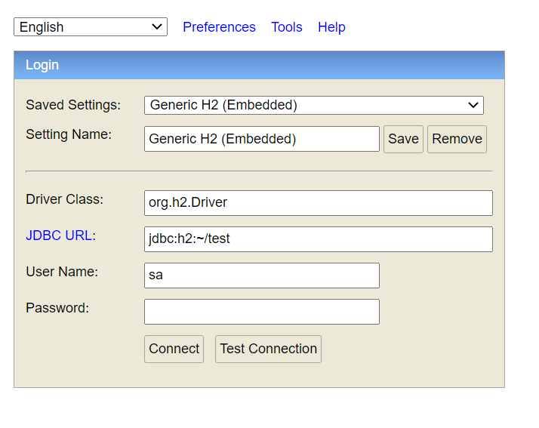
Projeto Listar Contatos
Principais Classes;
Notes:
Content: N/A
Notes to Instructor:

Slide 15
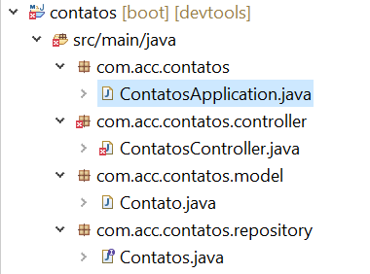
Projeto Listar Contatos
Criar a classe principal
Vamos definir a classe ContatosAppilcation.java no pacote com.acc.contatos
Notes:
package com.acc.contatos;
import org.springframework.boot.SpringApplication;
import org.springframework.boot.autoconfigure.SpringBootApplication;
@SpringBootApplication
public class ContatosApplication {
public static void main(String[] args) {
SpringApplication.run(ContatosApplication.class, args);
}
}

Slide 16
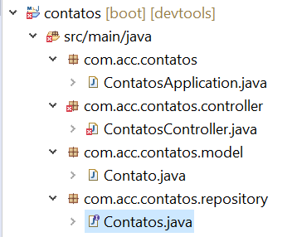
Projeto Listar Contatos
Criar a classe o repositório
Vamos definir a interface Contatos.java no pacote com.acc.contatos.repository
Notes:
package com.acc.contatos.repository;
import org.springframework.data.jpa.repository.JpaRepository;
import com.acc.contatos.model.Contato;
public interface Contatos extends JpaRepository<Contato, Long> {
}

Slide 17
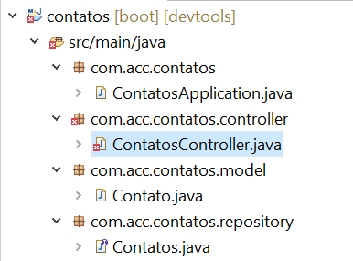
Projeto Listar Contatos
Criar a classe controller
Vamos definir a classe ContatosController.java no pacote com.acc.contatos.controller
Notes:
package com.acc.contatos.controller;
import java.util.List;
import org.springframework.beans.factory.annotation.Autowired;
import org.springframework.stereotype.Controller;
import org.springframework.web.bind.annotation.GetMapping;
import org.springframework.web.bind.annotation.RequestMapping;
import org.springframework.web.servlet.ModelAndView;
import com.acc.contatos.model.Contato;
import com.acc.contatos.repository.Contatos;
@Controller
@RequestMapping("/contatos")
public class ContatosController {
@Autowired
private Contatos contatos;
@GetMapping
public ModelAndView listar() {
List<Contato> lista = contatos.findAll();
ModelAndView modelAndView = new ModelAndView("contatos");
modelAndView.addObject("contatos", lista);
return modelAndView;
}
}

Slide 18
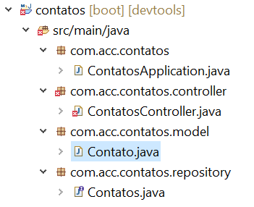
Projeto Listar Contatos
Criar a classe model
Vamos definir a classe Contato.java no pacote com.acc.contatos.model
Notes:
package com.acc.contatos.model;
import java.io.Serializable;
import javax.persistence.Entity;
import javax.persistence.GeneratedValue;
import javax.persistence.GenerationType;
import javax.persistence.Id;
@Entity
public class Contato implements Serializable {
private static final long serialVersionUID = 1L;
@Id
@GeneratedValue(strategy = GenerationType.IDENTITY)
private Long id;
private String nome;
private String email;
public Long getId() {
return id;
}
public void setId(Long id) {
this.id = id;
}
public String getNome() {
return nome;
}
public void setNome(String nome) {
this.nome = nome;
}
public String getEmail() {
return email;
}
public void setEmail(String email) {
this.email = email;
}
@Override
public int hashCode() {
final int prime = 31;
int result = 1;
result = prime * result + ((id == null) ? 0 : id.hashCode());
return result;
}
@Override
public boolean equals(Object obj) {
if (this == obj)
return true;
if (obj == null)
return false;
if (getClass() != obj.getClass())
return false;
Contato other = (Contato) obj;
if (id == null) {
if (other.id != null)
return false;
} else if (!id.equals(other.id))
return false;
return true;
}
}

Slide 19

Projeto Listar Contatos
Criar a classe model
Definição da chave primária
Notes:
package com.acc.contatos.model;
import java.io.Serializable;
import javax.persistence.Entity;
import javax.persistence.GeneratedValue;
import javax.persistence.GenerationType;
import javax.persistence.Id;
@Entity
public class Contato implements Serializable {
private static final long serialVersionUID = 1L;
@Id
@GeneratedValue(strategy = GenerationType.IDENTITY)
private Long id;
private String nome;
private String email;
public Long getId() {
return id;
}
public void setId(Long id) {
this.id = id;
}
public String getNome() {
return nome;
}
public void setNome(String nome) {
this.nome = nome;
}
public String getEmail() {
return email;
}
public void setEmail(String email) {
this.email = email;
}
@Override
public int hashCode() {
final int prime = 31;
int result = 1;
result = prime * result + ((id == null) ? 0 : id.hashCode());
return result;
}
@Override
public boolean equals(Object obj) {
if (this == obj)
return true;
if (obj == null)
return false;
if (getClass() != obj.getClass())
return false;
Contato other = (Contato) obj;
if (id == null) {
if (other.id != null)
return false;
} else if (!id.equals(other.id))
return false;
return true;
}
}

Slide 20
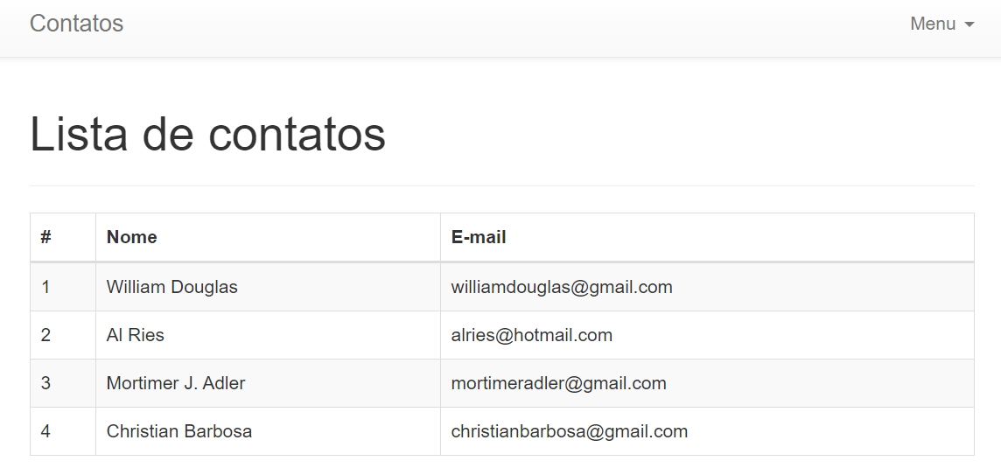
Projeto Listar Contatos
Página da Listagem
http://localhost:8080/contatos

Slide 21


Questions and Comments
What questions or comments do you have?

