Slide 1
Practical Application Development with Spring DATA
Module 13: JPA
Notes:
Duration: 1 hour, 30 minutes
Content: N/A
Notes to Instructor:
This module introduces Spring MVC Module. Complete coverage of this module is highly recommended. However in case there is not sufficient time to complete case study activities the module may be skipped.

Slide 2

Agenda
Revisão do Spring Essentials
Spring BooT - Overview
Spring BooT – Introduction;
Spring BooT – Components;
Spring BooT – Features;
Funcionamento;
Construção de aplicação;
Notes:
Topic Duration: 10 minutes
Content: N/A
Notes to Instructor:
This is just a brief reminder of where you are in the module. It will help the participants to know what is coming up.
The Appendix includes reference topics that complement the module content. Faculty may use this supplementary content to answer participant questions.
J2EE Presentation Layer Technologies
Spring Web Application Development Stack
Struts MVC Vs. Spring MVC

Slide 3
Spring JPA
Aplicação
Spring JPA
Notes:
Aqui abrir uma aplicação juntamente com os alunos;

Slide 4
Spring JPA
CRUD (acrónimo do inglês Create, Read, Update e Delete) são as quatro operações básicas (criação, consulta, atualização e destruição de dados) utilizadas em bases de dados relacionais (RDBMS) fornecidas aos utilizadores do sistema;
Notes:
Content: N/A
Notes to Instructor:

Slide 5
Spring JPA
Criaremos um banco de dados MYSQL (free);
Iremos utilizar o JPA para persistência dos dados;
Vamos configurar o intialzr para criar o projeto no STS;
Criar o código;
Notes:
Content: N/A
Notes to Instructor:

Slide 6
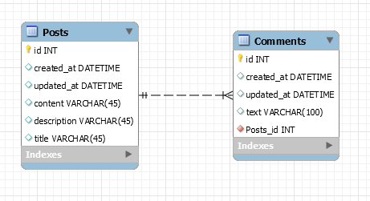
Spring JPA
Criar as classes

Slide 7
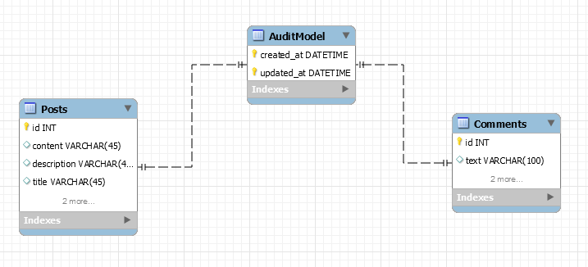
Spring JPA
Criar as classes

Slide 8
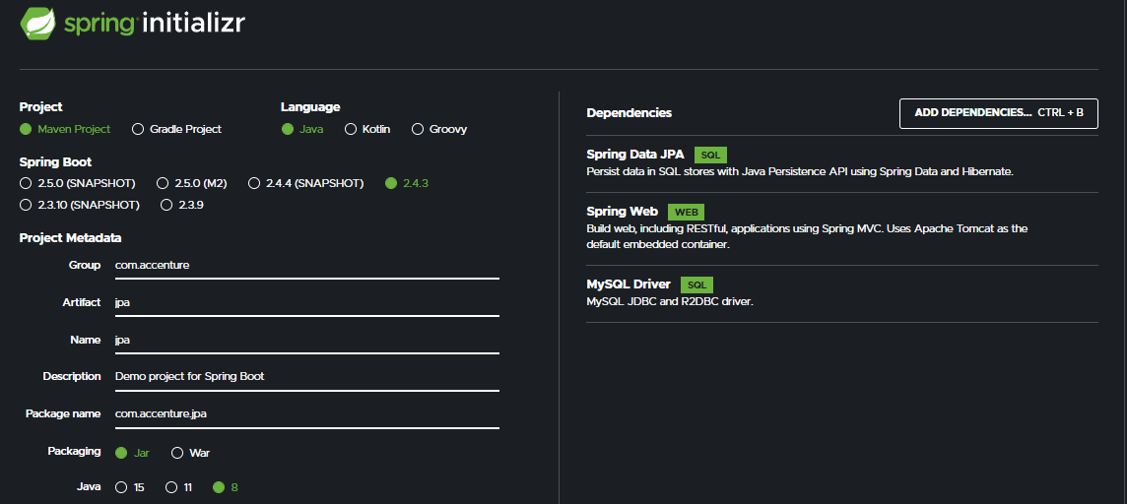
Spring JPA
Starters;

Slide 9
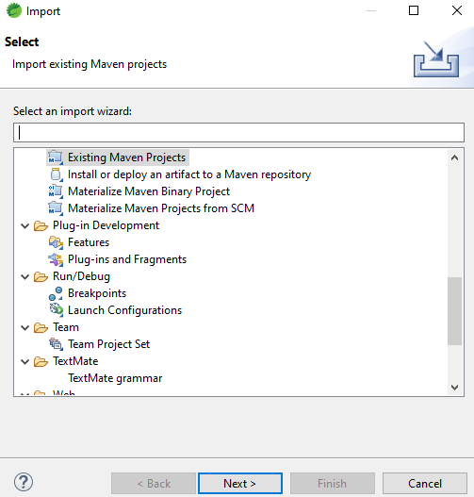
Spring JPA
FILE ->Import;
Notes:
Aqui abrir uma aplicação juntamente com os alunos;

Slide 10
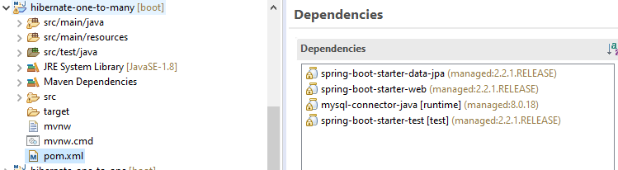
Spring JPA
Estrutura dos pacotes e dependências;
Notes:
<project xmlns="http://maven.apache.org/POM/4.0.0" xmlns:xsi="http://www.w3.org/2001/XMLSchema-instance"
xsi:schemaLocation="http://maven.apache.org/POM/4.0.0 https://maven.apache.org/xsd/maven-4.0.0.xsd">
<modelVersion>4.0.0</modelVersion>
<parent>
<groupId>org.springframework.boot</groupId>
<artifactId>spring-boot-starter-parent</artifactId>
<version>2.5.3</version>
<relativePath/> <!-- lookup parent from repository -->
</parent>
<groupId>acc.br</groupId>
<artifactId>jpa3</artifactId>
<version>0.0.1-SNAPSHOT</version>
<name>jpa3</name>
<description>Demo project for Spring Boot</description>
<properties>
<java.version>11</java.version>
</properties>
<dependencies>
<dependency>
<groupId>org.springframework.boot</groupId>
<artifactId>spring-boot-starter-data-jpa</artifactId>
</dependency>
<dependency>
<groupId>org.springframework.boot</groupId>
<artifactId>spring-boot-starter-web</artifactId>
</dependency>
<dependency>
<groupId>mysql</groupId>
<artifactId>mysql-connector-java</artifactId>
<scope>runtime</scope>
</dependency>
<dependency>
<groupId>org.springframework.boot</groupId>
<artifactId>spring-boot-starter-test</artifactId>
<scope>test</scope>
</dependency>
</dependencies>
<build>
<plugins>
<plugin>
<groupId>org.springframework.boot</groupId>
<artifactId>spring-boot-maven-plugin</artifactId>
</plugin>
</plugins>
</build>
</project>

Slide 11
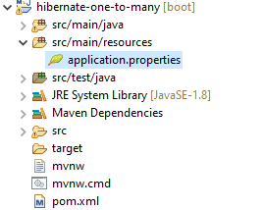
Spring JPA
application.properties
Notes:
# DATASOURCE (DataSourceAutoConfiguration & DataSourceProperties)
spring.datasource.url=jdbc:mysql://localhost:3306/mydb?useSSL=false&serverTimezone=UTC&useLegacyDatetimeCode=false
spring.datasource.username=root
spring.datasource.password=root
# Hibernate
# The SQL dialect makes Hibernate generate better SQL for the chosen database
spring.jpa.properties.hibernate.dialect = org.hibernate.dialect.MySQL5InnoDBDialect
# Hibernate ddl auto (create, create-drop, validate, update)
spring.jpa.hibernate.ddl-auto = update
logging.level.org.hibernate.SQL=DEBUG
logging.level.org.hibernate.type=TRACE

Slide 12
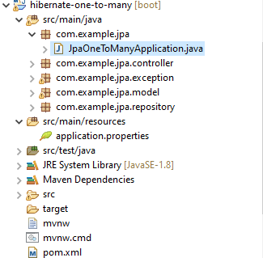
Spring JPA
Criar a classe principal
Sistema no pacote com.example.jpa
Notes:
package com.example.jpa;
import org.springframework.boot.SpringApplication;
import org.springframework.boot.autoconfigure.SpringBootApplication;
import org.springframework.data.jpa.repository.config.EnableJpaAuditing;
@SpringBootApplication
@EnableJpaAuditing
public class JpaOneToManyApplication {
public static void main(String[] args) {
SpringApplication.run(JpaOneToManyApplication.class, args);
}
}

Slide 13
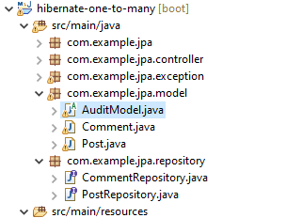
Spring JPA
Criar a classe entity
Vamos definir o model AuditModel.java no pacote com.example.jpa.model
Notes:
package com.example.jpa.model;
import com.fasterxml.jackson.annotation.JsonIgnoreProperties;
import org.springframework.data.annotation.CreatedDate;
import org.springframework.data.annotation.LastModifiedDate;
import org.springframework.data.jpa.domain.support.AuditingEntityListener;
import javax.persistence.*;
import java.io.Serializable;
import java.util.Date;
@MappedSuperclass
@EntityListeners(AuditingEntityListener.class)
@JsonIgnoreProperties(
value = {"createdAt", "updatedAt"},
allowGetters = true
)
public abstract class AuditModel implements Serializable {
/**
*
*/
private static final long serialVersionUID = 1L;
@Temporal(TemporalType.TIMESTAMP)
@Column(name = "created_at", nullable = false, updatable = false)
// @Column(name = "created_at")
@CreatedDate
private Date createdAt;
@Temporal(TemporalType.TIMESTAMP)
@Column(name = "updated_at", nullable = false)
// @Column(name = "updated_at")
@LastModifiedDate
private Date updatedAt;
public Date getCreatedAt() {
return createdAt;
}
public void setCreatedAt(Date createdAt) {
this.createdAt = createdAt;
}
public Date getUpdatedAt() {
return updatedAt;
}
public void setUpdatedAt(Date updatedAt) {
this.updatedAt = updatedAt;
}
@PreUpdate
public void preUpdate() {
// data atualização
this.setUpdatedAt(new Date());
}
@PrePersist
public void prePersist() {
final Date atual = new Date();
// data criação e atualização
this.setCreatedAt(atual);
this.setUpdatedAt(atual);
}
}

Slide 14
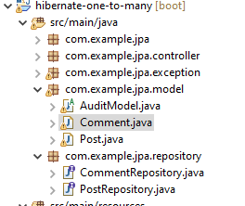
Spring JPA
Criar a classe entity
Vamos definir o model comment.java no pacote com.example.jpa.model
Notes:
package com.example.jpa.model;
import com.fasterxml.jackson.annotation.*;
import com.sun.istack.NotNull;
import javax.persistence.*;
import org.hibernate.annotations.OnDelete;
import org.hibernate.annotations.OnDeleteAction;
@Entity
@Table(name = "comments")
public class Comment extends AuditModel {
/**
*
*/
private static final long serialVersionUID = 1L;
@Id
@GeneratedValue(strategy = GenerationType.IDENTITY)
private Long id;
@NotNull
@Lob
private String text;
@ManyToOne(fetch = FetchType.LAZY, optional = false)
@JoinColumn(name = "post_id", nullable = false)
@OnDelete(action = OnDeleteAction.CASCADE)
@JsonIdentityInfo(generator=ObjectIdGenerators.PropertyGenerator.class, property="id")
@JsonIdentityReference(alwaysAsId=true)
@JsonProperty("post_id")
private Post post;
public Long getId() {
return id;
}
public void setId(Long id) {
this.id = id;
}
public String getText() {
return text;
}
public void setText(String text) {
this.text = text;
}
public Post getPost() {
return post;
}
public void setPost(Post post) {
this.post = post;
}
}

Slide 15
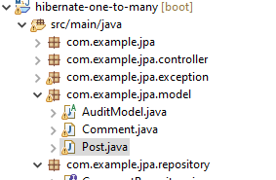
Spring JPA
Criar a classe entity
Vamos definir o model post.java no pacote com.example.jpa.model
Notes:
package com.example.jpa.model;
import javax.persistence.*;
import com.sun.istack.NotNull;
@Entity
@Table(name = "posts")
public class Post extends AuditModel {
/**
*
*/
private static final long serialVersionUID = 1L;
@Id
@GeneratedValue(strategy = GenerationType.IDENTITY)
private Long id;
@NotNull
@Column(unique = true)
private String title;
@NotNull
private String description;
@NotNull
@Lob
private String content;
public Long getId() {
return id;
}
public void setId(Long id) {
this.id = id;
}
public String getTitle() {
return title;
}
public void setTitle(String title) {
this.title = title;
}
public String getDescription() {
return description;
}
public void setDescription(String description) {
this.description = description;
}
public String getContent() {
return content;
}
public void setContent(String content) {
this.content = content;
}
}

Slide 16
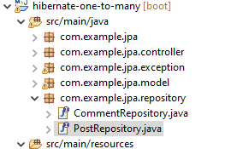
Spring JPA
Criar a classe repository
Vamos definir o repositório PostRepository.java no pacote com.example.jpa.repository
Notes:
package com.example.jpa.repository;
import com.example.jpa.model.Post;
import org.springframework.data.jpa.repository.JpaRepository;
import org.springframework.stereotype.Repository;
@Repository
public interface PostRepository extends JpaRepository<Post, Long> {
}

Slide 17
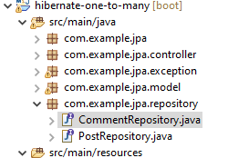
Spring JPA
Criar a classe repository
Vamos definir o repositório CommentRepository.java no pacote com.example.jpa.repository
Notes:
package com.example.jpa.repository;
import com.example.jpa.model.Comment;
import org.springframework.data.domain.Page;
import org.springframework.data.domain.Pageable;
import org.springframework.data.jpa.repository.JpaRepository;
import org.springframework.stereotype.Repository;
import java.util.Optional;
@Repository
public interface CommentRepository extends JpaRepository<Comment, Long> {
Page<Comment> findByPostId(Long postId, Pageable pageable);
Optional<Comment> findByIdAndPostId(Long id, Long postId);
}

Slide 18
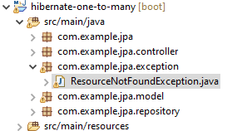
Spring JPA
Criar a classe exception
Vamos definir a classe ResourceNotFoundException.java no pacote com.example.jpa.exception
Notes:
package com.example.jpa.exception;
import org.springframework.http.HttpStatus;
import org.springframework.web.bind.annotation.ResponseStatus;
@ResponseStatus(HttpStatus.NOT_FOUND)
public class ResourceNotFoundException extends RuntimeException {
public ResourceNotFoundException() {
super();
}
public ResourceNotFoundException(String message) {
super(message);
}
public ResourceNotFoundException(String message, Throwable cause) {
super(message, cause);
}
}

Slide 19
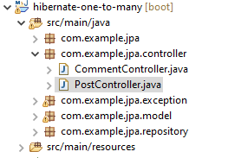
Spring JPA
Criar a classe controller
Vamos definir o controller PostCotroller.java no pacote com.example.jpa.repository
Notes:
package com.example.jpa.controller;
import com.example.jpa.exception.ResourceNotFoundException;
import com.example.jpa.model.Post;
import com.example.jpa.repository.PostRepository;
import org.springframework.beans.factory.annotation.Autowired;
import org.springframework.data.domain.Page;
import org.springframework.data.domain.Pageable;
import org.springframework.http.ResponseEntity;
import org.springframework.validation.annotation.Validated;
import org.springframework.web.bind.annotation.*;
@RestController
public class PostController {
@Autowired
private PostRepository postRepository;
@GetMapping("/posts")
public Page<Post> getAllPosts(Pageable pageable) {
return postRepository.findAll(pageable);
}
@PostMapping("/posts")
public Post createPost(@Validated @RequestBody Post post) {
return postRepository.save(post);
}
@PutMapping("/posts/{postId}")
public Post updatePost(@PathVariable Long postId, @Validated @RequestBody Post postRequest) {
return postRepository.findById(postId).map(post -> {
post.setTitle(postRequest.getTitle());
post.setDescription(postRequest.getDescription());
post.setContent(postRequest.getContent());
return postRepository.save(post);
}).orElseThrow(() -> new ResourceNotFoundException("PostId " + postId + " not found"));
}
@DeleteMapping("/posts/{postId}")
public ResponseEntity<?> deletePost(@PathVariable Long postId) {
return postRepository.findById(postId).map(post -> {
postRepository.delete(post);
return ResponseEntity.ok().build();
}).orElseThrow(() -> new ResourceNotFoundException("PostId " + postId + " not found"));
}
}

Slide 20
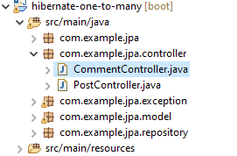
Spring JPA
Criar a classe controller
Vamos definir o controller CommentCotroller.java no pacote com.example.jpa.repository
Notes:
package com.example.jpa.controller;
import com.example.jpa.exception.ResourceNotFoundException;
import com.example.jpa.model.Comment;
import com.example.jpa.repository.CommentRepository;
import com.example.jpa.repository.PostRepository;
import org.springframework.beans.factory.annotation.Autowired;
import org.springframework.data.domain.Page;
import org.springframework.data.domain.Pageable;
import org.springframework.http.ResponseEntity;
import org.springframework.validation.annotation.Validated;
import org.springframework.web.bind.annotation.*;
@RestController
public class CommentController {
@Autowired
private CommentRepository commentRepository;
@Autowired
private PostRepository postRepository;
@GetMapping("/posts/{postId}/comments")
public Page<Comment> getAllCommentsByPostId(@PathVariable (value = "postId") Long postId,
Pageable pageable) {
return commentRepository.findByPostId(postId, pageable);
}
@PostMapping("/posts/{postId}/comments")
public Comment createComment(@PathVariable (value = "postId") Long postId,
@Validated @RequestBody Comment comment) {
return postRepository.findById(postId).map(post -> {
comment.setPost(post);
return commentRepository.save(comment);
}).orElseThrow(() -> new ResourceNotFoundException("PostId " + postId + " not found"));
}
@PutMapping("/posts/{postId}/comments/{commentId}")
public Comment updateComment(@PathVariable (value = "postId") Long postId,
@PathVariable (value = "commentId") Long commentId,
@Validated @RequestBody Comment commentRequest) {
if(!postRepository.existsById(postId)) {
throw new ResourceNotFoundException("PostId " + postId + " not found");
}
return commentRepository.findById(commentId).map(comment -> {
comment.setText(commentRequest.getText());
return commentRepository.save(comment);
}).orElseThrow(() -> new ResourceNotFoundException("CommentId " + commentId + "not found"));
}
@DeleteMapping("/posts/{postId}/comments/{commentId}")
public ResponseEntity<?> deleteComment(@PathVariable (value = "postId") Long postId,
@PathVariable (value = "commentId") Long commentId) {
return commentRepository.findByIdAndPostId(commentId, postId).map(comment -> {
commentRepository.delete(comment);
return ResponseEntity.ok().build();
}).orElseThrow(() -> new ResourceNotFoundException("Comment not found with id " + commentId + " and postId " + postId));
}
}

Slide 21
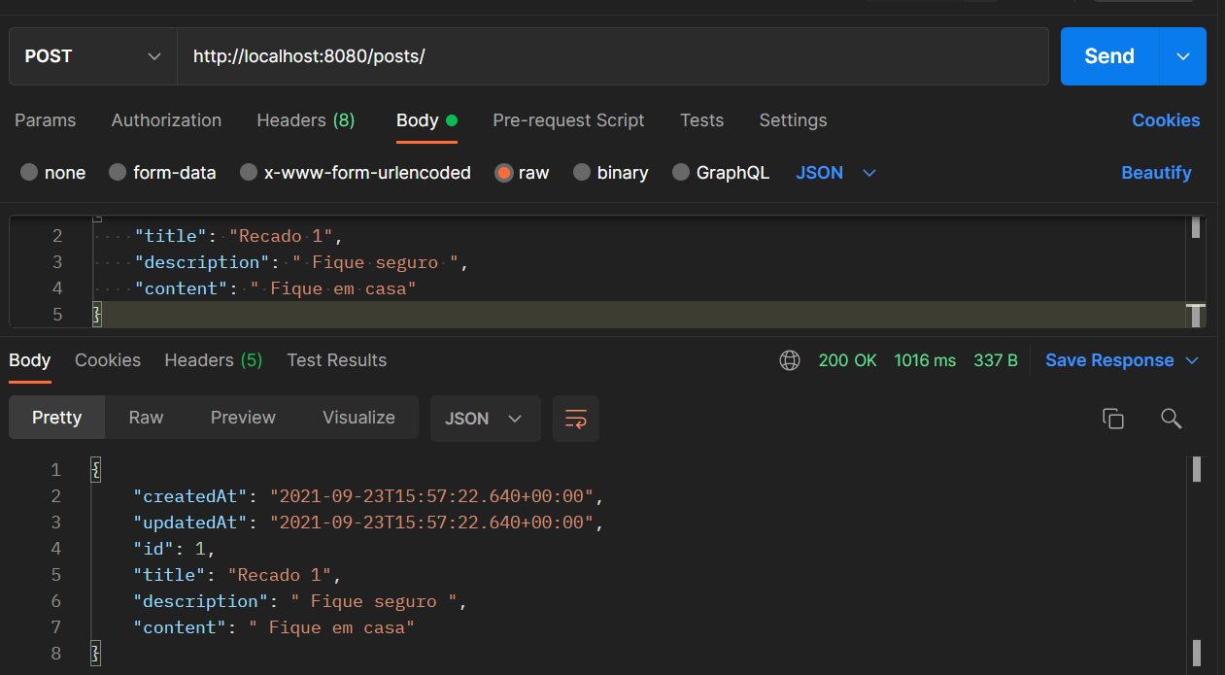
Spring JPA
Testando POST na Postagem
Notes:
http://localhost:8080/posts/
{
"title": "Recado 1",
"description": " Fique seguro ",
"content": " Fique em casa"
}

Slide 22
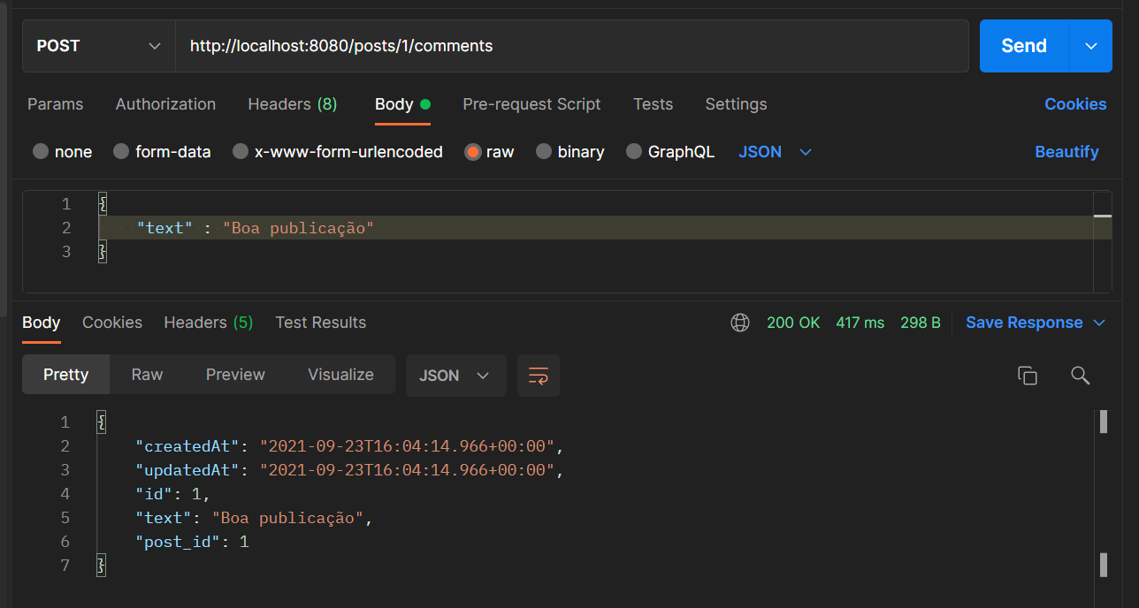
Spring JPA
Testando POST no Comentário
Notes:
http://localhost:8080/posts/1/comments
{
"text" : "Boa publicação"
}

Slide 23
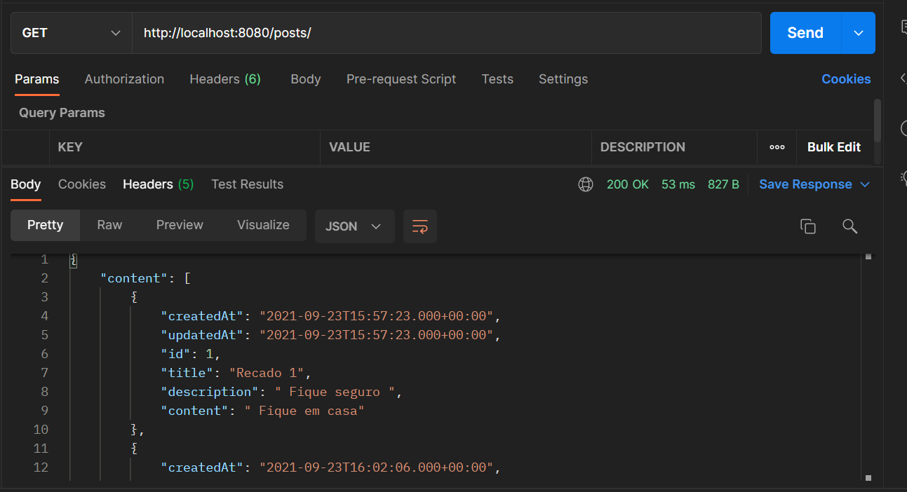
Spring JPA
Testando a consulta de uma postagem
Notes:
http://localhost:8080/posts/

Slide 24
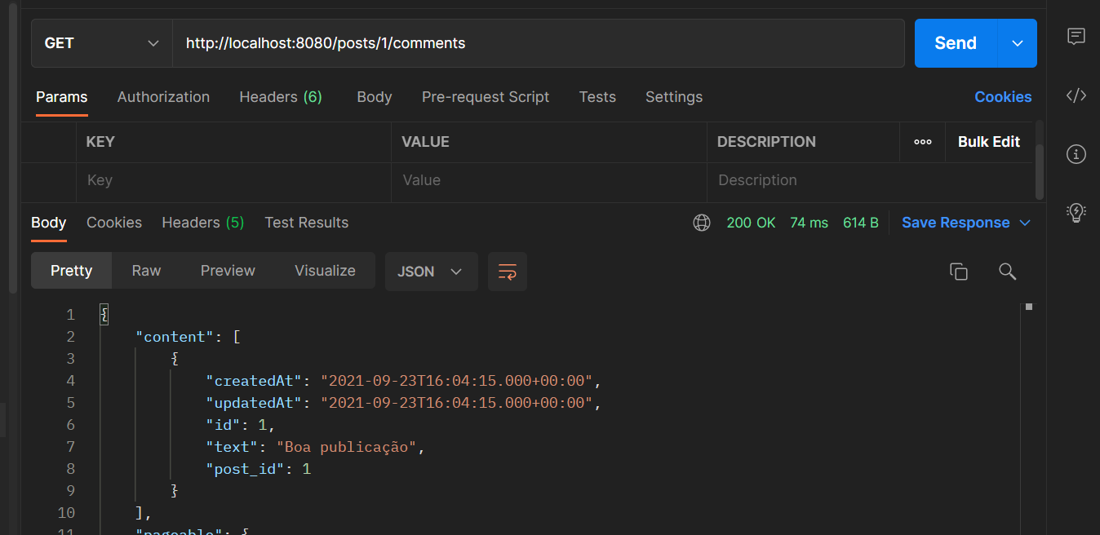
Spring JPA
Testando a consulta de um comentario
Notes:
http://localhost:8080/posts/1/comments

Slide 25
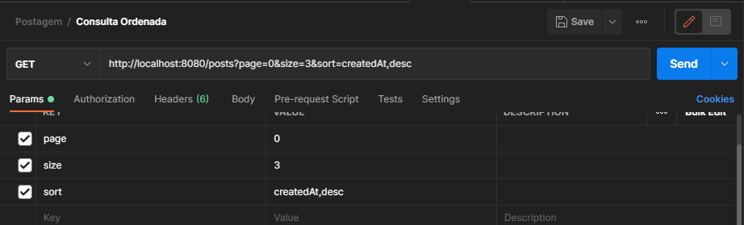
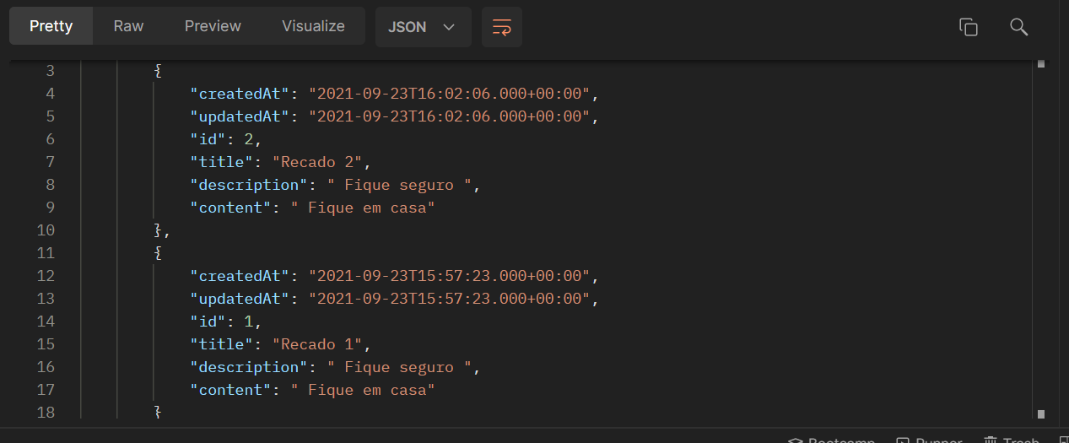
Spring JPA
Testando a consulta ordenada
Notes:
http://localhost:8080/posts?page=0&size=3&sort=createdAt,desc

Slide 26
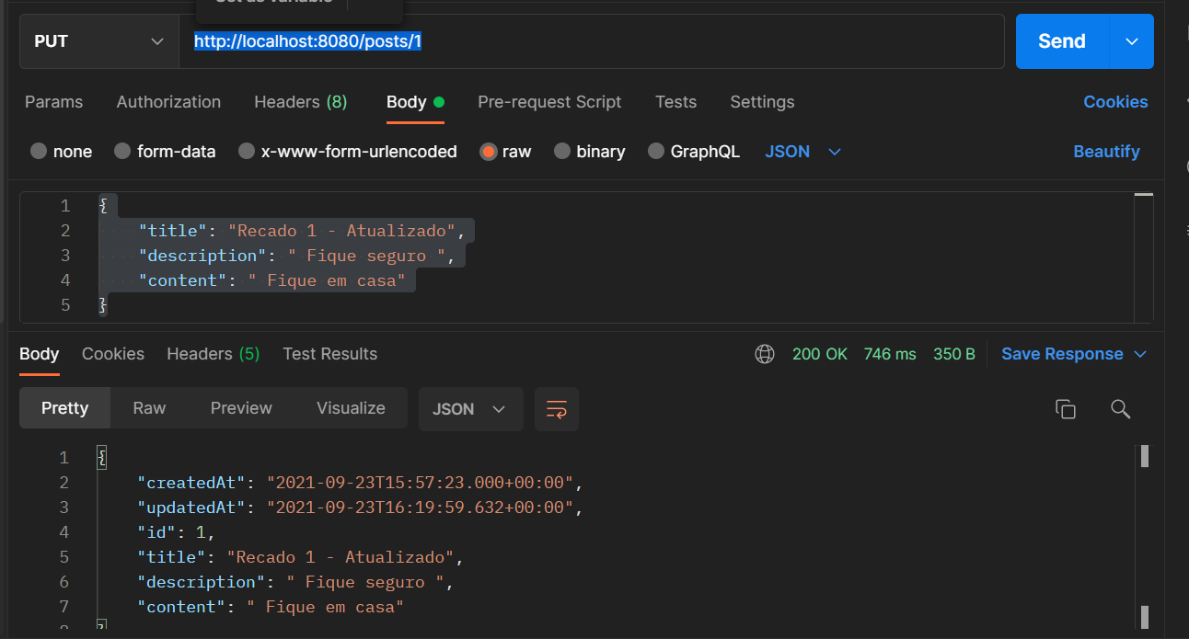
Spring JPA
Atualizando uma Postagem
Notes:
http://localhost:8080/posts/1
{
"title": "Recado 1 - Atualizado",
"description": " Fique seguro ",
"content": " Fique em casa"
}

Slide 27


Questions and Comments
What questions or comments do you have?

