Slide 1
Practical Application Development with Spring c/LomBok
Module 13: LOMBOK
Notes:
Duration: 1 hour, 30 minutes
Content: N/A
Notes to Instructor:
This module introduces Spring MVC Module. Complete coverage of this module is highly recommended. However in case there is not sufficient time to complete case study activities the module may be skipped.

Slide 2
Spring c/LomBok
Aplicação
Spring c/LomBok
Notes:
Aqui abrir uma aplicação juntamente com os alunos;

Slide 3
Spring c/LomBok
CRUD (acrónimo do inglês Create, Read, Update e Delete) são as quatro operações básicas (criação, consulta, atualização e destruição de dados) utilizadas em bases de dados relacionais (RDBMS) fornecidas aos utilizadores do sistema;
Notes:
Content: N/A
Notes to Instructor:

Slide 4
Spring c/LomBok
Criaremos um banco de dados MYSQL (free);
Iremos utilizar o JPA para persistência dos dados;
Vamos configurar o intialzr para criar o projeto no STS;
Criar o código;
Notes:
Content: N/A
Notes to Instructor:

Slide 5
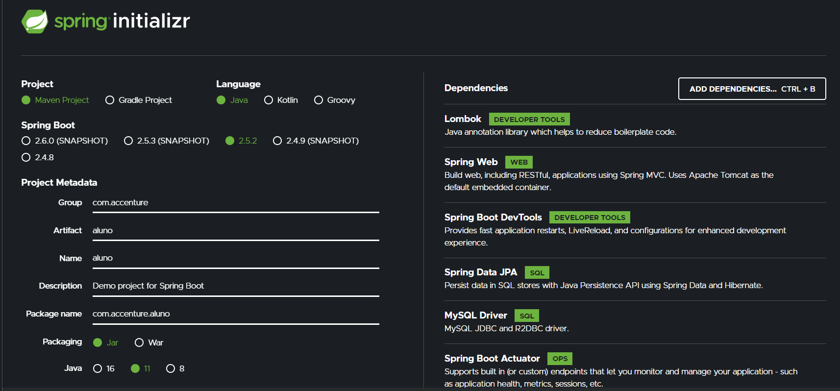
Spring c/LomBok
Starters;

Slide 6
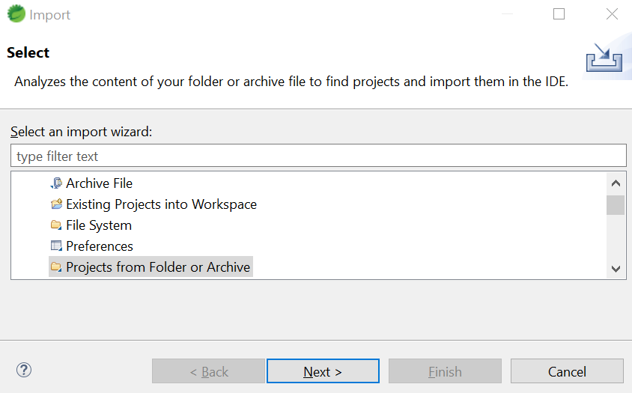
Spring c/LomBok
FILE ->Import → GENERAL → Project from folder or archive;
Notes:
Aqui abrir uma aplicação juntamente com os alunos;

Slide 7
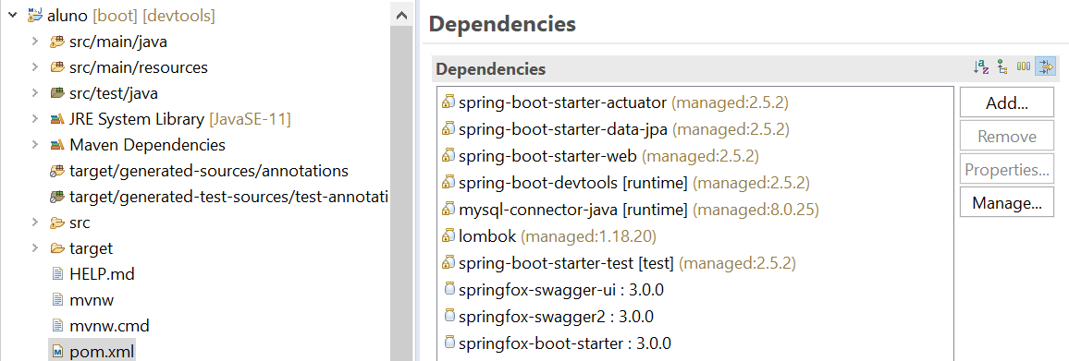
Spring c/LomBok
Estrutura dos pacotes e dependências;
Notes:
<?xml version="1.0" encoding="UTF-8"?>
<project xmlns="http://maven.apache.org/POM/4.0.0" xmlns:xsi="http://www.w3.org/2001/XMLSchema-instance"
xsi:schemaLocation="http://maven.apache.org/POM/4.0.0 https://maven.apache.org/xsd/maven-4.0.0.xsd">
<modelVersion>4.0.0</modelVersion>
<parent>
<groupId>org.springframework.boot</groupId>
<artifactId>spring-boot-starter-parent</artifactId>
<version>2.5.0</version>
<relativePath/> <!-- lookup parent from repository -->
</parent>
<groupId>com.accenture</groupId>
<artifactId>aluno</artifactId>
<version>0.0.1-SNAPSHOT</version>
<name>api</name>
<description>API Rest utilizando Spring Boot</description>
<properties>
<java.version>1.8</java.version>
</properties>
<dependencies>
<dependency>
<groupId>org.springframework.boot</groupId>
<artifactId>spring-boot-starter-actuator</artifactId>
</dependency>
<dependency>
<groupId>org.springframework.boot</groupId>
<artifactId>spring-boot-starter-data-jpa</artifactId>
</dependency>
<dependency>
<groupId>org.springframework.boot</groupId>
<artifactId>spring-boot-starter-web</artifactId>
</dependency>
<dependency>
<groupId>org.springframework.boot</groupId>
<artifactId>spring-boot-devtools</artifactId>
<scope>runtime</scope>
<optional>true</optional>
</dependency>
<dependency>
<groupId>mysql</groupId>
<artifactId>mysql-connector-java</artifactId>
<scope>runtime</scope>
</dependency>
<dependency>
<groupId>org.projectlombok</groupId>
<artifactId>lombok</artifactId>
<optional>true</optional>
</dependency>
<dependency>
<groupId>org.springframework.boot</groupId>
<artifactId>spring-boot-starter-test</artifactId>
<scope>test</scope>
</dependency>
<dependency>
<groupId>io.springfox</groupId>
<artifactId>springfox-swagger2</artifactId>
<version>3.0.0</version>
</dependency>
<dependency>
<groupId>io.springfox</groupId>
<artifactId>springfox-swagger-ui</artifactId>
<version>3.0.0</version>
</dependency>
</dependencies>
<build>
<plugins>
<plugin>
<groupId>org.springframework.boot</groupId>
<artifactId>spring-boot-maven-plugin</artifactId>
<configuration>
<excludes>
<exclude>
<groupId>org.projectlombok</groupId>
<artifactId>lombok</artifactId>
</exclude>
</excludes>
</configuration>
</plugin>
</plugins>
</build>
</project>

Slide 8
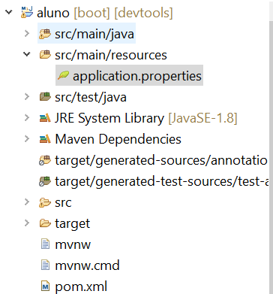
Spring c/LomBok
application.properties
Notes:
## Database Properties
spring.datasource.url = jdbc:mysql://localhost:3306/mydb?useSSL=false
spring.datasource.username = root
spring.datasource.password = root
## Hibernate Properties
spring.jpa.properties.hibernate.dialect = org.hibernate.dialect.MySQL5InnoDBDialect
spring.jpa.hibernate.ddl-auto = update

Slide 9
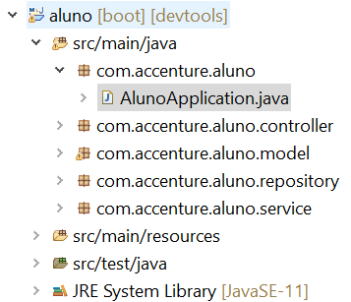
Spring c/LomBok
Criar a classe principal
AlunoApplication.java no pacote com.accenture.aluno
Notes:
package com.accenture.aluno;
import org.springframework.boot.SpringApplication;
import org.springframework.boot.autoconfigure.SpringBootApplication;
@SpringBootApplication
public class AlunoApplication {
public static void main(String[] args) {
SpringApplication.run(AlunoApplication.class, args);
}
}

Slide 10
Spring c/LomBok
LOMBOK
O Lombok é um framework para Java que permite escrever código eliminando a verbosidade. Seu uso permite gerar em tempo de compilação os métodos getters e setters, métodos construtores, padrão builder e muito mais

Slide 11
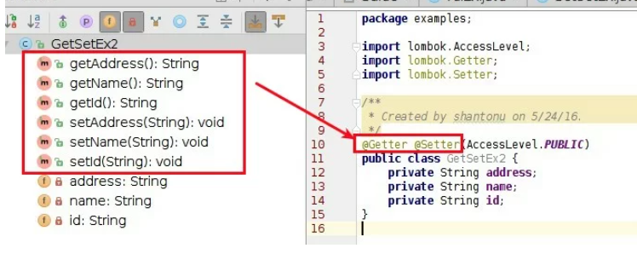
Spring c/LomBok
LOMBOK
@Getter @Setter: Ajuda a fazer getters e setters
Parâmetro: Enum AccessLevel
PUBLIC = Acessível ao público
MODULE, PACKAGE = mesmo que o padrão (sem usar nenhum modificador)
PROTECTED = mesmo que protegido
PRIVATE = mesmo que privado
NONE = não haverá implementação

Slide 12
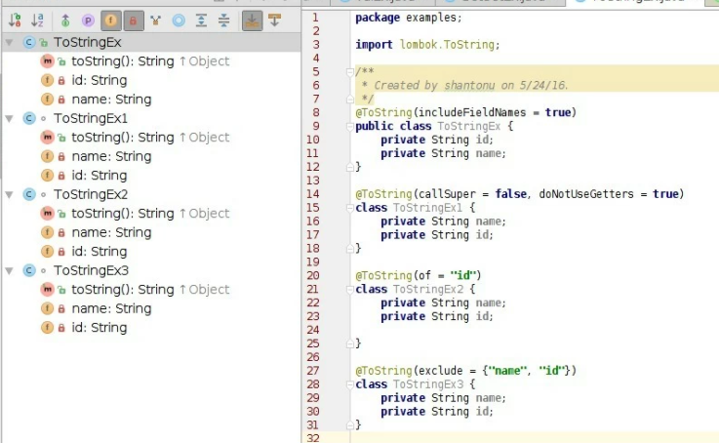
Spring c/LomBok
LOMBOK
@ToString: Esta é a implementação de toString (), podemos usar apenas para o nível de classe.
Parâmetros:
includeFieldNames (): tipo booleano => definir todas as inclusões de campos
callSuper (): tipo booleano => chamando super
doNotUseGetters (): tipo booleano => evite usar getters dos campos.
exclude (): array de strings de nomes de campo => definir exclusão de campo
of (): array de strings de nomes de campos => define quais devem ser adicionados

Slide 13
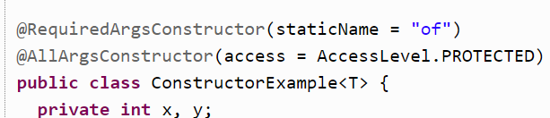
Spring c/LomBok
LOMBOK
@NoArgsConstructor: irá gerar um construtor sem parâmetros.
@RequiredArgsConstructor: gera um construtor com 1 parâmetro para cada campo que requer tratamento especial.
@AllArgsConstructor: gera um construtor com 1 parâmetro para cada campo em sua classe;

Slide 14
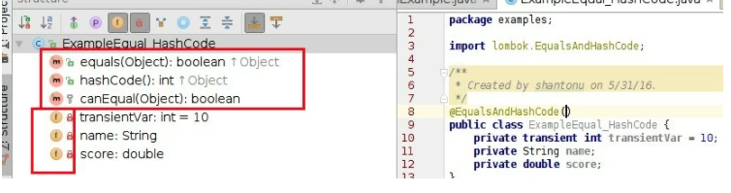
Spring c/LomBok
LOMBOK
@EqualsAndHashCode: É simplesmente adiciona equals (Object other) e hashCode () à classe.
Possui os mesmo parâmetros do @ToString;

Slide 15
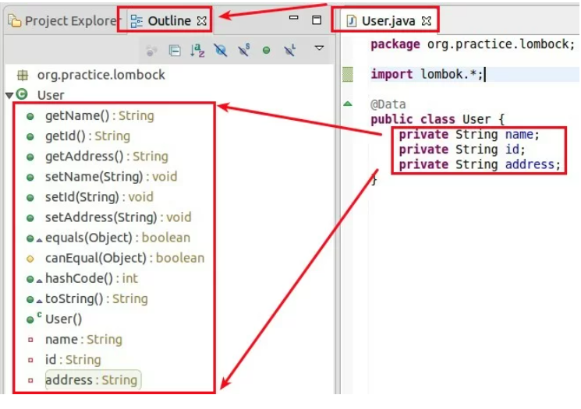
Spring c/LomBok
LOMBOK
@Data é uma combinação de múltiplas anotações
1. @Getter, 2. @Setter. 3. @RequiredArgsConstructor 4. @Tostring 5. @EqualsAndHashCode

Slide 16
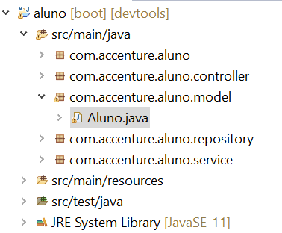
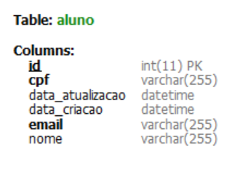
Spring c/LomBok
Criar a classe entidade com lombok
Aluno.java no pacote com.accenture.aluno.model
Notes:
package com.accenture.aluno.model;
import java.io.Serializable;
import java.util.Date;
import javax.persistence.Column;
import javax.persistence.Entity;
import javax.persistence.GeneratedValue;
import javax.persistence.GenerationType;
import javax.persistence.Id;
import javax.persistence.PrePersist;
import javax.persistence.PreUpdate;
import javax.persistence.Table;
import lombok.AccessLevel;
import lombok.AllArgsConstructor;
import lombok.Builder;
import lombok.Data;
import lombok.NoArgsConstructor;
import lombok.ToString;
@Data
@NoArgsConstructor
@AllArgsConstructor(access = AccessLevel.PRIVATE)
@Entity
@Table(name = "aluno")
public class Aluno implements Serializable {
private static final long serialVersionUID = 1L;
@Id
@GeneratedValue(strategy = GenerationType.AUTO)
private int id;
@Column(name="nome", nullable=false)
private String nome;
@Column(name="email", unique=true)
private String email;
@Column(name="cpf", unique=true)
private String cpf;
@Column(name = "data_criacao", nullable = false)
private Date dataCriacao;
@Column(name = "data_atualizacao", nullable = false)
private Date dataAtualizacao;
@PreUpdate
public void preUpdate() {
dataAtualizacao = new Date();
}
@PrePersist
public void prePersist() {
final Date atual = new Date();
dataCriacao = atual;
dataAtualizacao = atual;
}
}

Slide 17
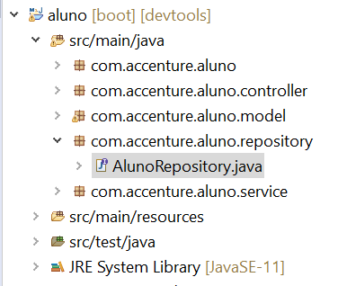
Spring c/LomBok
Criar a classe repositório
AlunoRepository.java no pacote com.accenture.aluno.repository
Notes:
package com.accenture.aluno.repository;
import org.springframework.data.repository.CrudRepository;
import com.accenture.aluno.model.Aluno;
public interface AlunoRepository extends CrudRepository<Aluno, Integer>{
}

Slide 18
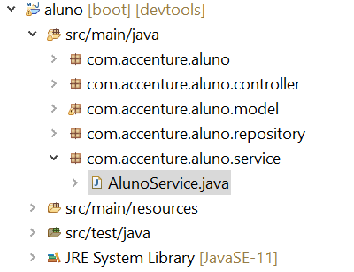
Spring c/LomBok
Criar a classe serviço
AlunoService.java no pacote com.accenture.aluno.service
Notes:
package com.accenture.aluno.service;
import java.util.ArrayList;
import java.util.List;
import org.springframework.beans.factory.annotation.Autowired;
import org.springframework.stereotype.Service;
import com.accenture.aluno.model.Aluno;
import com.accenture.aluno.repository.AlunoRepository;
//defining the business logic
@Service
public class AlunoService {
@Autowired
AlunoRepository alunoRepository;
//getting all student records
public List<Aluno> getAllAluno()
{
List<Aluno> alunos = new ArrayList<Aluno>();
alunoRepository.findAll().forEach(aluno -> alunos.add(aluno));
return alunos;
}
//getting a specific record
public Aluno getAlunoById(int id)
{
return alunoRepository.findById(id).get();
}
public void saveOrUpdate(Aluno aluno)
{
alunoRepository.save(aluno);
}
//deleting a specific record
public void delete(int id)
{
alunoRepository.deleteById(id);
}
}

Slide 19
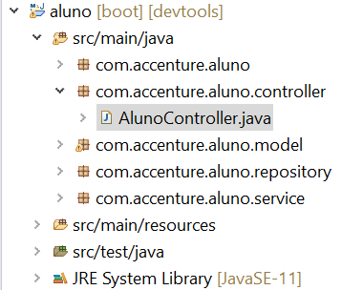
Spring c/LomBok
Criar a classe repository
AlunoController.java no pacote com.accenture.aluno.controller
Notes:
package com.acenture.alunocontroller;
import java.util.List;
import org.springframework.beans.factory.annotation.Autowired;
import org.springframework.web.bind.annotation.DeleteMapping;
import org.springframework.web.bind.annotation.GetMapping;
import org.springframework.web.bind.annotation.PathVariable;
import org.springframework.web.bind.annotation.PostMapping;
import org.springframework.web.bind.annotation.RequestBody;
import org.springframework.web.bind.annotation.RestController;
import com.accenture.aluno.model.Aluno;
import com.accenture.aluno.service.AlunoService;
//creating RestController
@RestController
public class AlunoController {
//autowired the StudentService class
@Autowired
AlunoService alunoService;
//creating a get mapping that retrieves all the alunos detail from the database
@GetMapping("/aluno")
private List<Aluno> getAllAluno()
{
return alunoService.getAllAluno();
}
//creating a get mapping that retrieves the detail of a specific aluno
@GetMapping("/aluno/{id}")
private Aluno getAluno(@PathVariable("id") int id)
{
return alunoService.getAlunoById(id);
}
//creating a delete mapping that deletes a specific aluno
@DeleteMapping("/aluno/{id}")
private void deleteAluno(@PathVariable("id") int id)
{
alunoService.delete(id);
}
//creating post mapping that post the aluno detail in the database
@PostMapping("/aluno")
private int saveAluno(@RequestBody Aluno aluno)
{
alunoService.saveOrUpdate(aluno);
return aluno.getId();
}
}

Slide 20
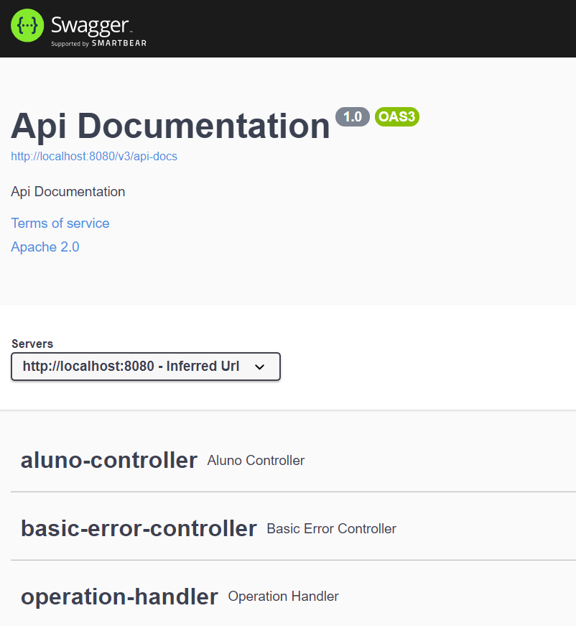
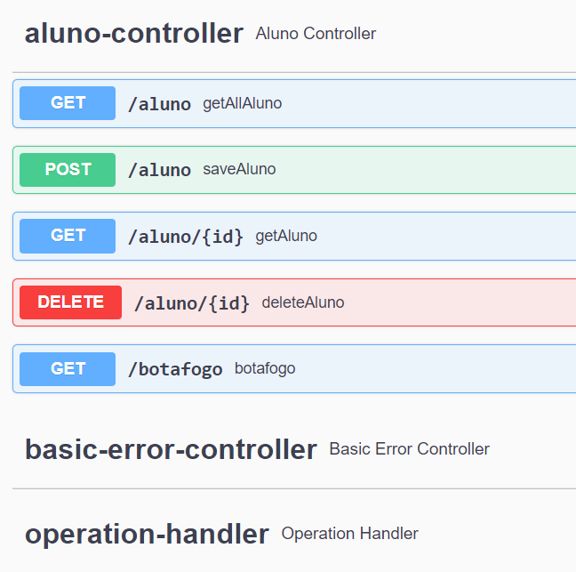
Spring c/LomBok
Testando POST
http://localhost:8080/swagger-ui/index.html#/
Notes:
package com.example.jpa.exception;
import org.springframework.http.HttpStatus;
import org.springframework.web.bind.annotation.ResponseStatus;
@ResponseStatus(HttpStatus.NOT_FOUND)
public class ResourceNotFoundException extends RuntimeException {
public ResourceNotFoundException() {
super();
}
public ResourceNotFoundException(String message) {
super(message);
}
public ResourceNotFoundException(String message, Throwable cause) {
super(message, cause);
}
}

Slide 21
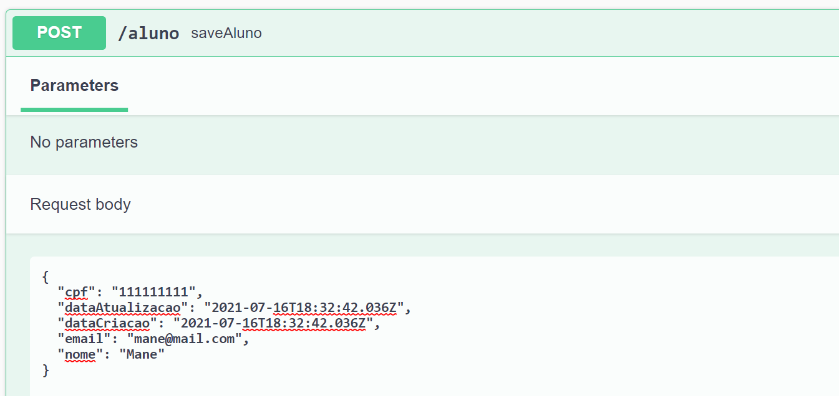
Spring c/LomBok
Testando POST
Notes:
package com.example.jpa.exception;
import org.springframework.http.HttpStatus;
import org.springframework.web.bind.annotation.ResponseStatus;
@ResponseStatus(HttpStatus.NOT_FOUND)
public class ResourceNotFoundException extends RuntimeException {
public ResourceNotFoundException() {
super();
}
public ResourceNotFoundException(String message) {
super(message);
}
public ResourceNotFoundException(String message, Throwable cause) {
super(message, cause);
}
}

Slide 22
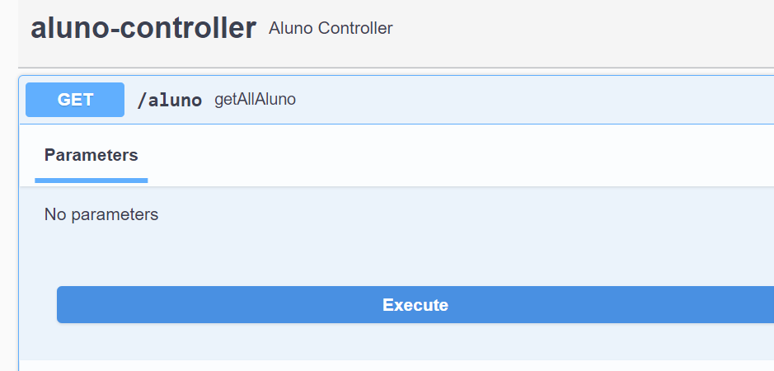
Spring c/LomBok
Testando GET
Notes:
package com.example.jpa.exception;
import org.springframework.http.HttpStatus;
import org.springframework.web.bind.annotation.ResponseStatus;
@ResponseStatus(HttpStatus.NOT_FOUND)
public class ResourceNotFoundException extends RuntimeException {
public ResourceNotFoundException() {
super();
}
public ResourceNotFoundException(String message) {
super(message);
}
public ResourceNotFoundException(String message, Throwable cause) {
super(message, cause);
}
}

Slide 23
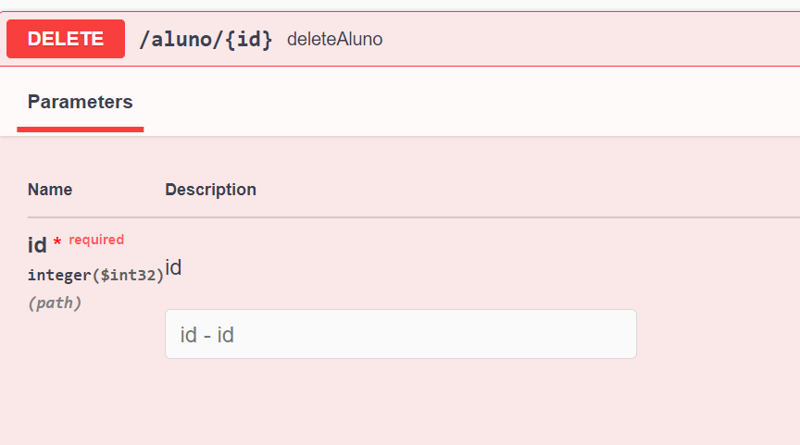
Spring c/LomBok
Testando DELETE
Notes:
package com.example.jpa.exception;
import org.springframework.http.HttpStatus;
import org.springframework.web.bind.annotation.ResponseStatus;
@ResponseStatus(HttpStatus.NOT_FOUND)
public class ResourceNotFoundException extends RuntimeException {
public ResourceNotFoundException() {
super();
}
public ResourceNotFoundException(String message) {
super(message);
}
public ResourceNotFoundException(String message, Throwable cause) {
super(message, cause);
}
}

Slide 24


Questions and Comments
What questions or comments do you have?

