Slide 1

Topic-Based Tourism Sentiment Analysis using BERTopic and Deep Learning
SOLEHAH NAJIIHAH BINTI ABD JAMAL
MCS231035

Slide 2
Outline
Background
Problem Statement
Objective
Literature Review
Research Methodology
Initial Findings (EDA)
References

Slide 3
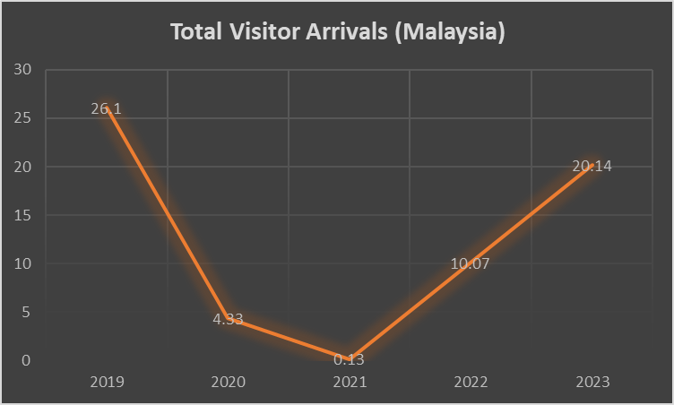
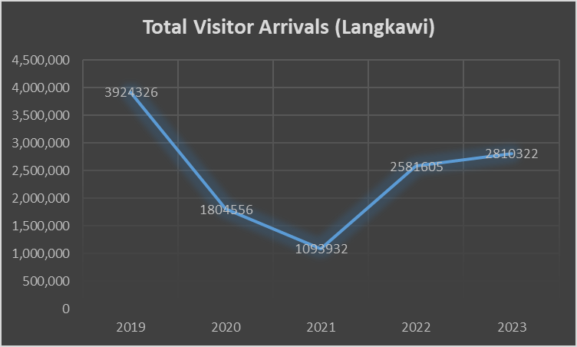
Background
Tourism Industry: one of contributing factors for Malaysia’s economic growth
Covid19: Heavily impact on tourism industry
User Generated Contents (UGC)
Sentiment Analysis
Travelers experience influence other travellers perceptions
Source: LADA

Slide 4
Background
Langkawi:
Langkawi Tourism Recovery Plan (T-REC) 2021-2022 - LADA
Geographically strategic (Kuah Jetty & Langkawi International Airport)
Nature (Beach)
Tourism surpassed agriculture & fishing
Market Report by Horwath HTL
Source: LADA

Slide 5
Problem Statement
Tourism Industry is affected by COVID19, resulting in drop numbers of tourists.
Travellers reviews have significance influence on travelers’ behaviour and perceptions on destinations.
Identify the aspects that drives a person’s feeling and the sentiment in reviews.
Leverage deep learning methods for sentiment analysis.

Slide 6
Objective
To determine the key topics from user reviews on the tourism industry in Langkawi, Kedah.
To develop LSTM algorithm and fine-tune BERT for sentiment analysis on chosen topics.
To evaluate the performance of LSTM and BERT in sentiment analysis.

Slide 7
SCOPE OF WORK
Online review sentiment analysis specifically in Langkawi, Kedah.
Web scraping from TripAdvisor and Google Map website limited to English language.
Employing LSTM and BERT for sentiment analysis.
Performance evaluation: Compare the performance of LSTM and BERT in sentiment analysis using precision, recall, F1-score and AUROC

Slide 8
Literature Review
Tourism Sentiment Analysis
Reference | Techniques | Results
Cao, Z., Xu, H., & Teo, B. S. X. (2023). Sentiment of chinese tourists towards malaysia cultural heritage based on online travel reviews. Sustainability, 15(4), 3478. | Chinese tourists sentiment towards Malaysia's cultural heritage CharCNN, LSTM, BiLSTM, and BERT | BERT outperforms other models 9 scenic spots identified Positive sentiments: cultural atmosphere, material culture, and scenic landscapes. Negative emotions: lack of cultural experiences, leading to feelings of boredom
Mehra, P. (2023). Unexpected surprise: Emotion analysis and aspect based sentiment analysis (ABSA) of user generated comments to study behavioral intentions of tourists. Tourism Management Perspectives, 45, 101063. | investigate emotions and sentiments derived from these comments may affect post travel behaviour ABSA and emotion analysis | Sad feelings are mostly caused by things like food and bathrooms in China, women's empowerment and alcohol in the UAE, traffic, hygiene, time, and poverty in India.

Slide 9
Literature Review
Topic-Based Sentiment Analysis
Reference | Techniques | Results
Ounacer, S., Mhamdi, D., Ardchir, S., Daif, A., & Azzouazi, M. (2023). Customer sentiment analysis in hotel reviews through natural language processing techniques. | Significance of customer reviews in influencing decisions in the tourism sector. Topic Modeling: Correlation Explanation Sentiment Analysis: LR, RG, NB, DT, KNN, SVM, ET (Extratree), AB,GB (Adaboost and Gradient Boost) | Logistic Regression + CountVectorizer ( precision (82%), recall (69.59%), accuracy (91%) and F1-score (73.27%)_ RandomForest + TF-IDF (precision (81.01%), recall (74.78%), accuracy (86%) and F1-score (76.59%).
Syamala, M., & Nalini, N. J. (2019, July). LDA and deep learning: a combined approach for feature extraction and sentiment analysis. In 2019 10th International Conference on Computing, Communication and Networking Technologies (ICCCNT) (pp. 1-5). IEEE. | Identify the exact preferences of good or bad based on the feature Topic Modeling: Latent Dirichlet Allocation (LDA) Sentiment Analysis: VADER, TextBlob (lexicon-based approach) | 4 topics identified TextBlob: 77.3% VADER : 72.6% Joint Sentiment/Topic: 69.6%

Slide 10
Literature Review
Tourism Sentiment Analysis
Reference | Techniques | Results
Abuzayed, A., & Al-Khalifa, H. (2021). BERT for Arabic topic modeling: An experimental study on BERTopic technique. Procedia computer science, 189, 191-194. | Topic Modeling: LDA, NMF, BERTopic Measurement:Normalized Pointwise Mutual Information (NPMI) pre-trained Arabic language models as embeddings for the BERTopic technique, including AraBERTV2.0, ARBERT, QARiB, and XLM-R | BERTopic were more closely related and relevant to each other, as evidenced by the higher NPMI scores.
Egger, R., & Yu, J. (2022). A topic modeling comparison between lda, nmf, top2vec, and bertopic to demystify twitter posts. Frontiers in sociology, 7, 886498. | Comparative analysis of the results produced by each algorithm on Twitter post Topic Modeling: LDA, Non-negative Matrix Factorization (NMF), Top2Vec, and BERTopic | LDA: failing to capture the nuances of the data effectively. Top2Vec: overlapping themes, less effective for clear topic differentiation. BERTopic: aligned with air travel and issues faced during the pandemic BERTopic and NMF: able to capture relevant insights

Slide 11
Research Methodology
Data Preparation
(Collection and Cleaning)
Web scraping from TripAdvisor using Instant Data Scraper, SimpleScraper and Apify
6 destinations: Langkawi Sky Bridge, Crocodile Adventureland Langkawi, Kilim Geoforest Park, Cenang Beach, Telaga Tujuh Waterfalls and Underwater World Langkawi
Datasets: 1,187

Slide 12
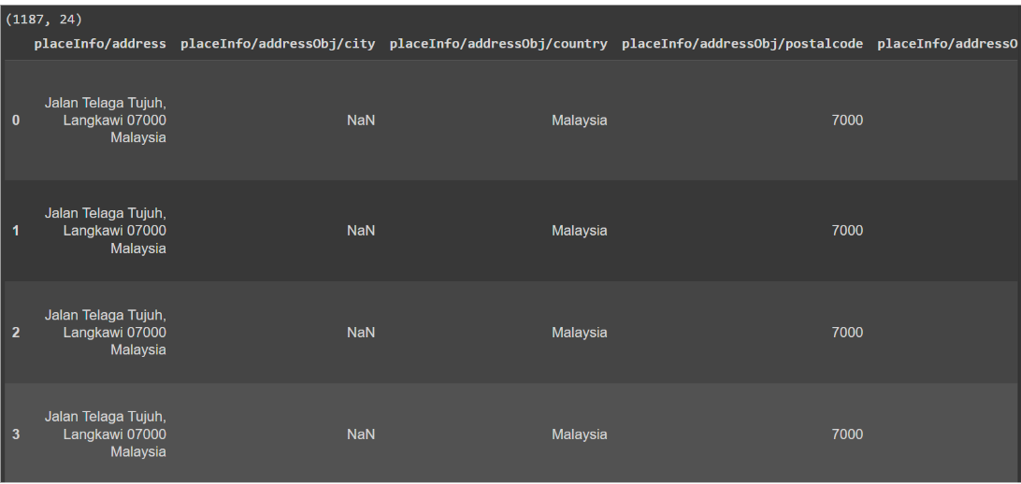
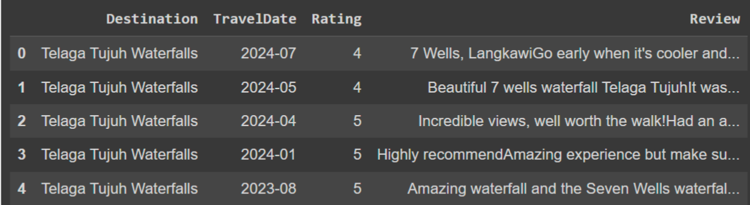
Research Methodology
Removing unwanted columns.
Renaming columns
Identify missing and duplicate rows, remove them

Slide 13
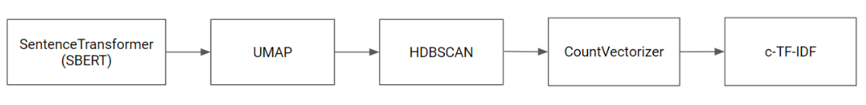
Research Methodology
Modeling
BERTopic: Identify topics in corpus
Default BERTopic model.
CountVectorizer and c-TF-IDF responsible for topic representations.
Hyperparameters:

Slide 14
Research Methodology
Modeling
BERT
bert-based-uncased
bertTokenizer
LSTM
Parameter | Value
Word vector dimension | 100
Kernel_size | 3
Filters | 100
Loss | Binary_crossentropy
Optimizer | adam
Activation | relu

Slide 15
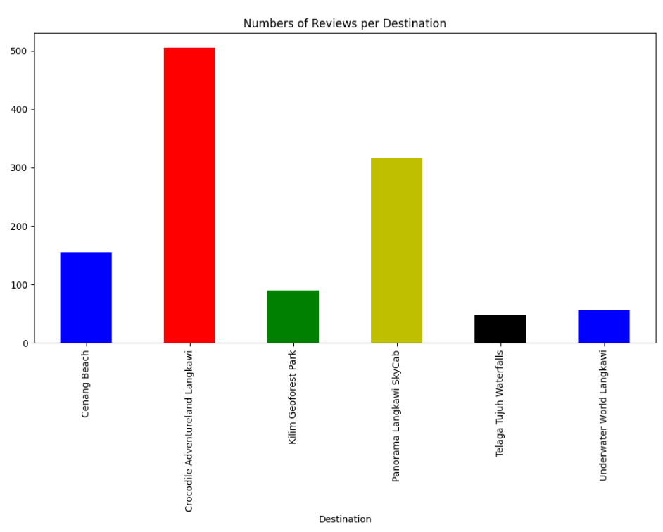
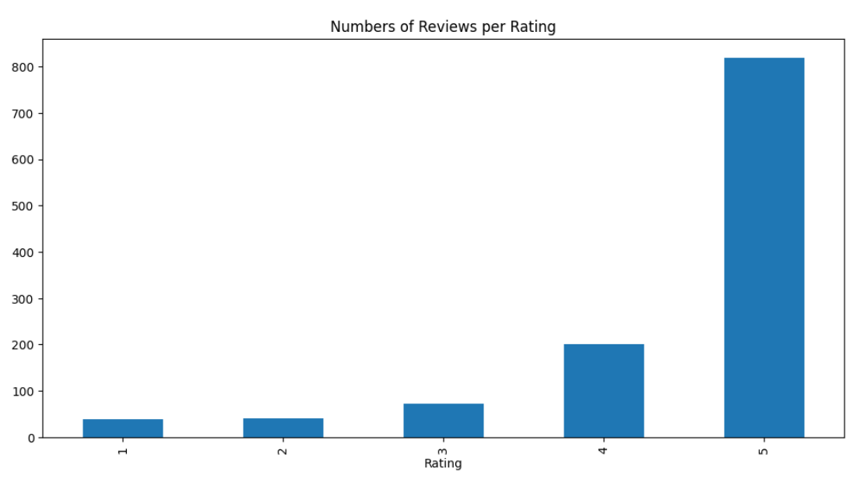
Initial Findings

Slide 16
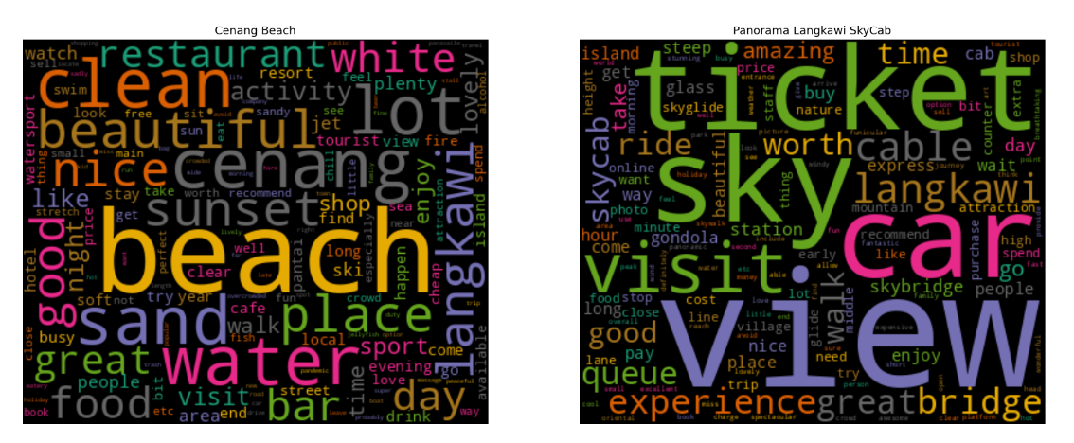
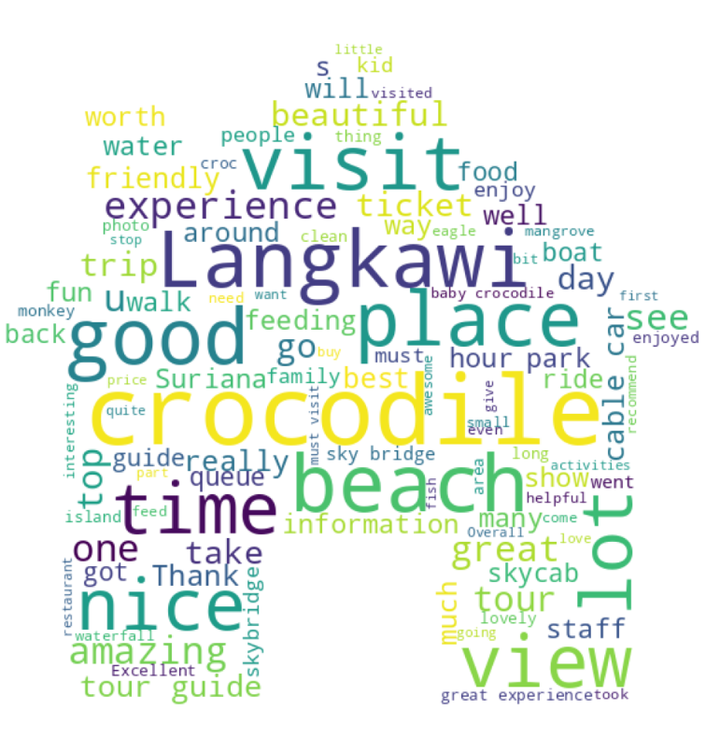
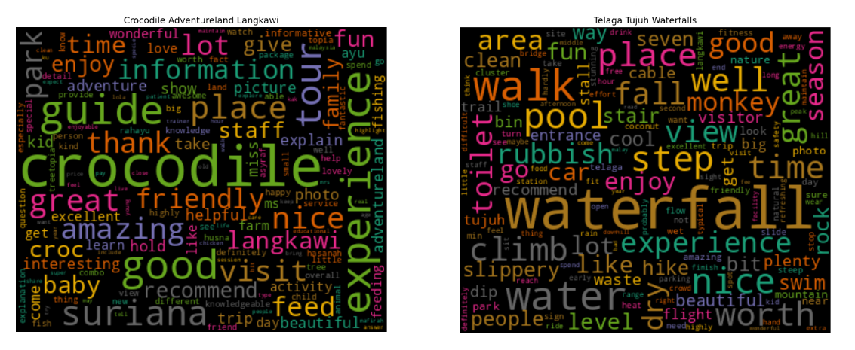

Slide 17
