Slide 1
Proposal of Prediction Of Polycystic Ovary Syndrome (PCOS) Diagnosis Using Artificial Neural Network Algorithm.
By :
Zainab Ali Albashah MCS231021

Slide 2
Introduction: What Is Polycystic ovary syndrome (PCOS)
Polycystic ovary syndrome, also known as PCOS is a medical disorder characterized by excessive production of androgens, which are male sex hormones typically seen in women in modest quantities.
Polycystic ovarian syndrome, or PCOS, is characterized by the presence of several tiny cysts, which are fluid-filled sacs, in the ovaries. Nevertheless, several women diagnosed with this illness have no signs of the presence of cysts, while some women unaffected by the disorder do indeed develop cysts. Ovulation is the process in which a fully developed egg is discharged from an ovary. This occurs to facilitate fertilization by a male sperm. If the egg is not fertilized, it is expelled from the body during menstruation.

Slide 3
Background of the Problem:
Polycystic Ovary Syndrome (PCOS) is a prevalent endocrine disorder that affects a significant proportion of women of reproductive age. Characterized by symptoms such as irregular menstrual cycles, hirsutism, acne, and polycystic ovaries, PCOS is a complex condition with multifactorial etiology, including genetic, hormonal, and environmental factors. The disorder not only impacts reproductive health but is also associated with metabolic abnormalities, such as insulin resistance, obesity, and an increased risk of type 2 diabetes and cardiovascular diseases.

Slide 4
Statement of the Problem
The diagnosis is often made based on the patient's signs, symptoms, and physical examination. With the acquisition of knowledge and practical skills, nearly all medical professionals possess the ability to effectively diagnose PCOS. Within the field of medicine, the process of determining the nature of a medical condition, known as diagnosis.
Dealing with PCOS can be challenging and repetitive. Predicting PCOS based on numerous elements or symptoms is a complex issue with multiple layers. This is due to the fact that such behavior can result in incorrect assumptions and unforeseeable outcomes.
As a result of this issue, the healthcare business generates a dataset for the purpose of analyzing diseases.
Notes:
Big data is an essential asset that needs to be processed and analyzed in order to extract knowledge. This knowledge can then be used to enhance decision-making and save expenses. Only relying on human intelligence is insufficient for accurate diagnosis. The diagnosing process will involve numerous challenges.

Slide 5
Research Questions:
What are the most common symptom of PCOS?
How accurately can a multiple regression model predict the presence of PCOS?
How can an Artificial Neural Network (ANN) be utilized to enhance the prediction of PCOS?
What insights can be gained from visualizing prediction outcomes using an interactive dashboard?
How can the findings from this research contribute to improving the diagnosis and management of PCOS in clinical practice?

Slide 6
Objectives of the Research:
To determine the impact of factors on PCOS, a multiple regression model will be employed.
To develop an Artificial Neural Network (ANN) model for the PCOS dataset.
To create an interactive dashboard that visualizes and compares the prediction outcomes of a regression model and an Artificial Neural Network (ANN).

Slide 7
Scope of the Study:
1
data collection and preprocessing the sourced datasets
To ensure data integrity and consistency
2
exploratory data analysis (EDA)
to uncover hidden patterns and trends within the PCOS datasets, thereby facilitating a deeper understanding of the data characteristics.
3
applying statistical methods to interpret initial findings and derive meaningful insights relevant to PCOS prediction and diagnosis.
statistical analysis
4
Develop model for PCOS prediction, leveraging the capabilities of neural networks to forecast the presence or absence of PCOS based on the features in the dataset.
artificial neural network (ANN)

Slide 8
Methodological Considerations in PCOS Research
& Identifying the Research Gaps
PCOS, first described in 1935 by Stein and Leventhal, was initially characterized by ovarian cysts. Over time, its definition has expanded to include a range of symptoms and metabolic concerns. Globally, PCOS affects 5-10% of reproductive-age women (Dai et al., 2022).
In Western countries, extensive research explores genetic, hormonal, and environmental factors influencing PCOS. However, disparities exist in research and healthcare access globally, impacting diagnosis and management, especially in developing regions. Different ethnic groups show varying rates of PCOS, with metabolic issues posing additional challenges. Emotional impacts such as body image concerns and infertility can also contribute to social stigma and mental health issues.

Slide 9
Literature Review/Problem Background
Historical Context and Global Perspectives
In PCOS research, methodologies vary widely, from clinical trials to population-based studies utilizing hormone profiling, ultrasound, and genetic analyses to identify PCOS markers. However, diverse study designs, sample characteristics, and diagnostic criteria pose challenges in synthesizing findings.
Some studies focus on biochemical aspects, while others emphasize clinical or metabolic impacts, highlighting the need for standardized diagnostic criteria
Identifying gaps in PCOS research is crucial. Long studies are lacking to track symptom progression and health risks over time, essential for evaluating management strategies. Psychosocial aspects, including anxiety, depression, and body image issues, are also underexplored despite their significant impact on patients. Culturally specific studies are needed to understand how PCOS manifests across populations and to develop culturally sensitive healthcare strategies.

Slide 10
Data Science Project Life Cycle
1
Problem Definition:
Clearly define the goal of analyzing PCOS symptoms using data-driven approaches. Focus on identifying specific questions and the potential impact of solutions on clinical decisions and patient outcomes.
2
Gather comprehensive data including clinical records, hormone levels, genetics, and lifestyle factors from credible sources relevant to the research objectives.
Data Collection:
3
Clean, standardize, and transform collected data to ensure quality. Perform feature engineering to create meaningful variables for modeling..
Data Preprocessing:
4
Exploratory Data Analysis (EDA):
Explore data structure and patterns using visualizations and descriptive statistics. Identify trends and correlations to inform hypotheses and model development.
5
Select and train machine learning algorithms, specifically Artificial Neural Networks (ANNs), capable of handling complex data relationships. Validate the model to ensure robust performance.
Modeling:

Slide 11
Data Science Project Life Cycle
6
Evaluation:
Assess model performance using metrics like accuracy, precision, recall, and F1-score. Compare models to identify the most effective in predicting PCOS and understanding risk factors.
7
Integrate the validated model into clinical settings for real-time PCOS prediction. Ensure accessibility and usability for healthcare professionals.
Deployment:
8
Monitoring and Maintenance:
Continuously monitor model performance post-deployment. Update and optimize as needed to accommodate new data and evolving patterns.
Modeling:

Slide 12
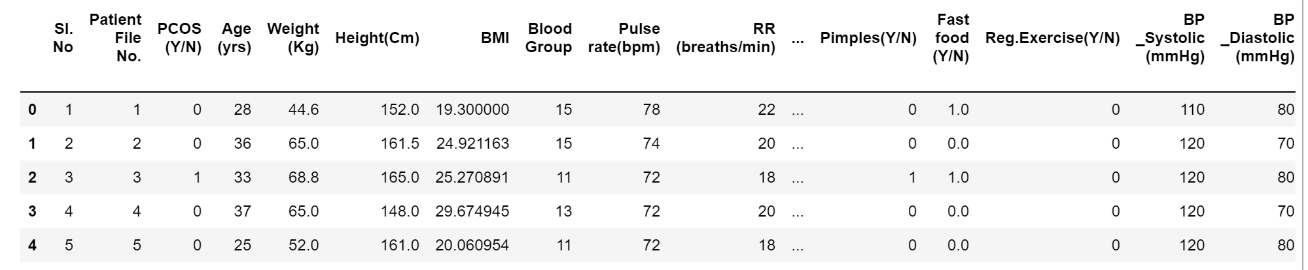
Data Sources and Collection Methods
The data for this study was sourced from Kaggle and they involve a combination of clinical records, patient surveys, and publicly available datasets on PCOS. The datasets included variables such as age, BMI, insulin levels, androgen levels, menstrual cycle regularity, and the presence of polycystic ovaries.

Slide 13
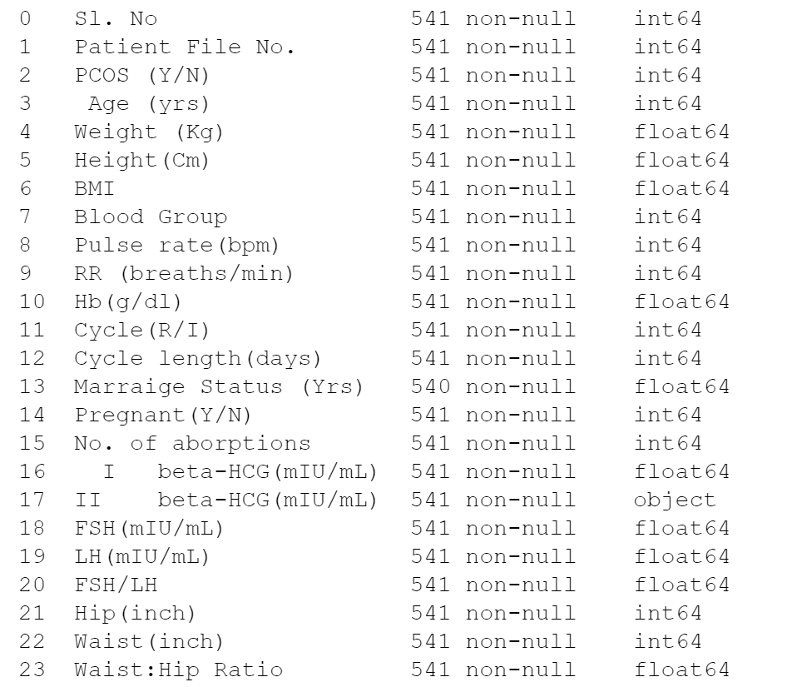
Data Pre-processing
Before analysis, the collected two datasets merging into one data underwent several pre-processing steps to ensure quality and consistency:
Data Cleaning:
Categorical Encoding:

Slide 14
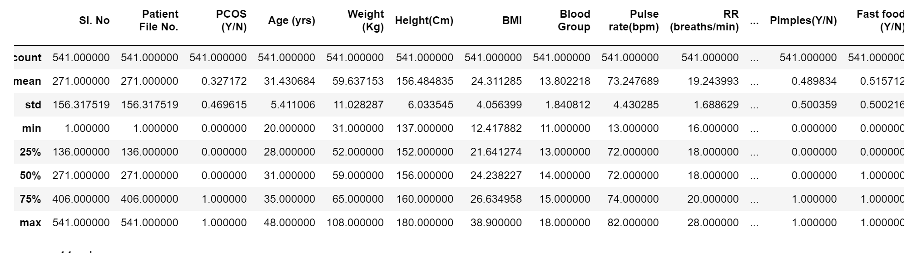
Exploratory Data Analysis (EDA)
Statistic Analyzing
Blood Group indications
A+ = 11
A- = 12
B+ = 13
B- = 14
O+ =15
O- = 16
AB+ =17
AB- = 18

Slide 15
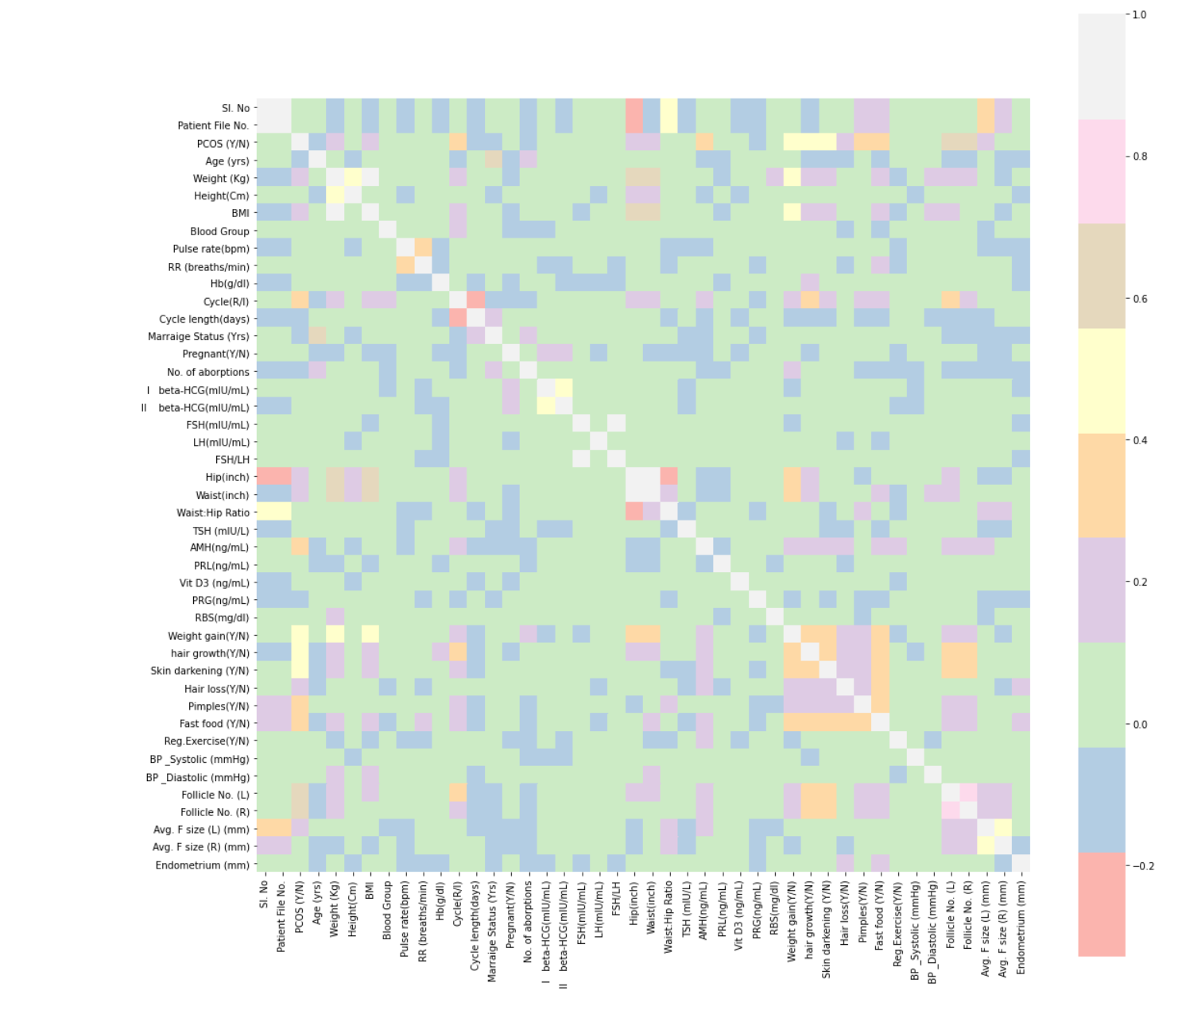
Exploratory Data Analysis (EDA)
Examining a correlation matrix of all the features
at the right of the figure, we can see there is a high correlation between weight gain, hair growth (in undesired spots), skin darkening, hair loss, pimples, and fast food, at the right of figure, at the middle we can see there is a correlation between hip, waist size, and waist-hip ratio when waist size increase the hip size increase also.

Slide 16
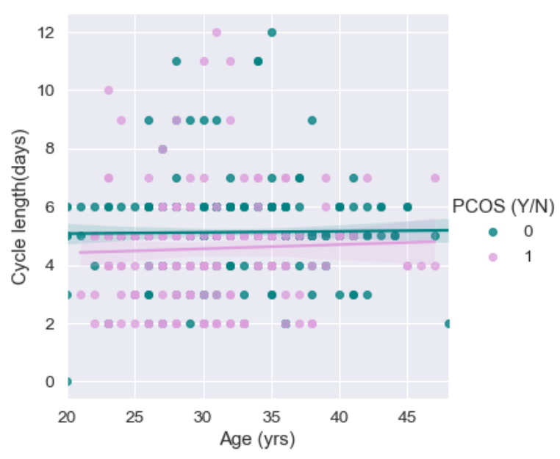
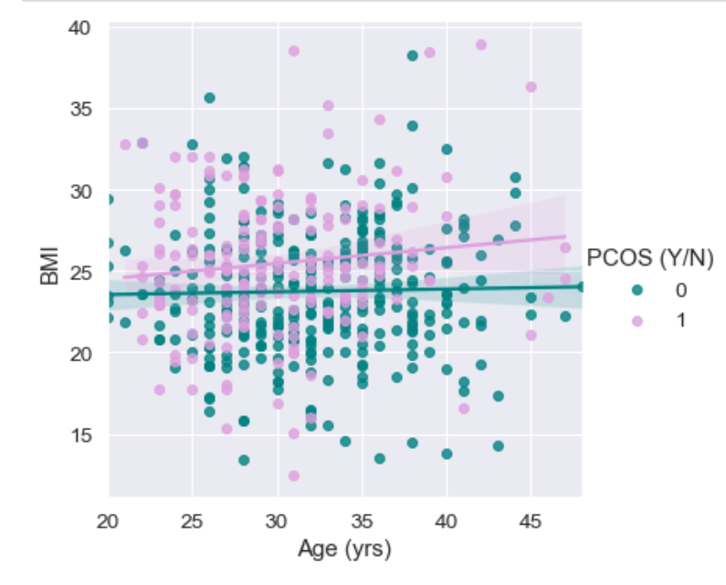
Exploratory Data Analysis (EDA)

Slide 17



