Slide 1

UNIVERSITI TEKNOLOGI MALAYSIA
PREDICTING STOCK MARKET TRENDS USING MULTI-SOURCE SENTIMENT ANALYSIS AND ADVANCED DEEP LEARNING ALGORITHMS
PREPARED BY : RAIAN HAFIZ NILOY
PREPARED FOR: PROF. MADYA.TS.DR.MOHD SHAHIZAN BIN OTHMAN

Slide 2

OUTLINES
Introduction
Literature Review
Methodology
Initial Findings
Discussion and Future Works
References

Slide 3
INTRODUCTION
Accurate prediction of stock market movement is very crucial for decreasing investment risks and increase profit
Stock prices are affected by economic, political, social and psychological factors
Traditional models rely on historical data but ignore sentiment-driven fluctuations
Sentiment analysis from news articles and social media posts can help to predict market movements

Slide 4
Problem Statement
Traditional stock prediction models rely solely on numerical data, missing sentiment impact.
Some Machine Learning models are computationally efficient but often cannot handle non-linear high-dimensional multi-featured data efficiently
Some advanced Deep Learning models are expert in handling complex data but show less accuracy
So, there is always a dilemma choosing between models

Slide 5
Research Objectives
To enhance the comprehensiveness of prediction by collecting and preprocessing sentiment data
To implement FinBERT for detailed sentiment analysis and develop LSTM networks for improving prediction accuracy
To rigorously assess the model’s performance with a number of evaluation metrics such as Accuracy, Precision, Recall, F1 score etc

Slide 6
Literature Review
Traditional Stock Market Prediction:
Early models: ARIMA (Box & Jenkins, 1970)
GARCH (Engle, 1982)
Linear Regression (Fama & French, 1992)
Limitations:
Cannot capture sentiment,
poor adaptability to financial market fluctuations.
Machine Learning Approaches:
(Huang et al., 2005; Chen et al., 2013).
Decision Trees,
Random Forests, and
SVMs
These models work well with structured
data
fail with textual sentiment.

Slide 7
Literature Review
Sentiment Analysis & Financial Markets:
Sentiment plays a crucial role in
stock price movement
(Loughran & McDonald, 2011)
Studies show financial sentiment
can predict stock market trends
(Bollen et al., 2011).
Deep Learning & NLP Models:
FinBERT outperforms traditional sentiment models
(Araci, 2019).
GPT-4 can extract complex sentiment cues
but has computational constraints
(Brown et al., 2020).
LSTM effectively captures sequential dependencies in stock trends
(Fischer & Krauss, 2018).

Slide 8
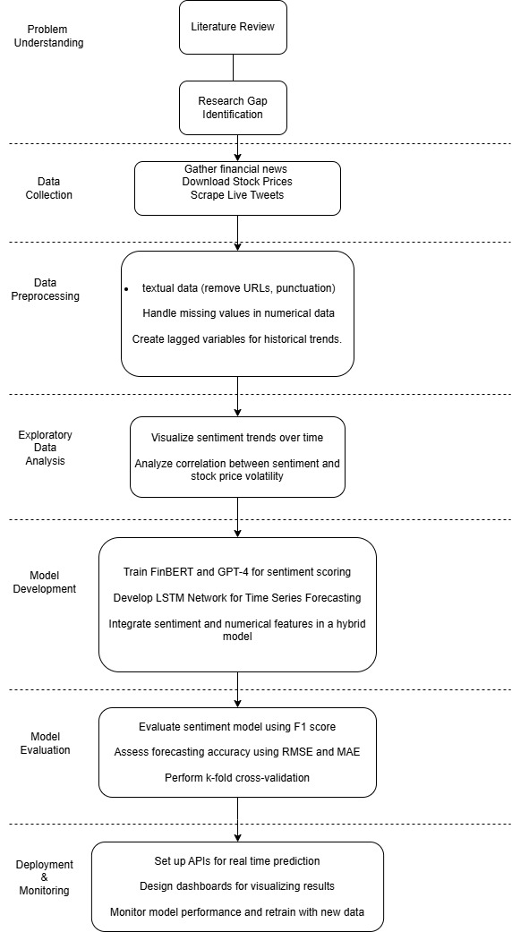
Research Methodology
Step-by-step approach followed in this study: 🔹 Step 1: Data Collection (Stock Prices + Financial News) 🔹 Step 2: Data Preprocessing (Cleaning, Feature Engineering) 🔹 Step 3: Sentiment Analysis (FinBERT) 🔹 Step 4: Machine Learning Model 🔹 Step 5: Evaluation & Results

Slide 9
Research Methodology
Data Collection
Stock Market Data: 15 NYSE-listed companies stock price for a period of 20 years
Sentiment Data: Financial news headlines from CNBC
Challenges Faced Original plan was to collect both data for 20 years, but sentiment data spanning 20 years was not found. So sentiment datset limited to 2018-2020

Slide 10
Research Methodology
Stock Data Preprocessing
Handling missing values, outliers
Creating technical indicators & lag features
Sentiment Data Preprocessing
Text Cleaning: Removing special characters, stopwords
Tokenization and Lemmatization

Slide 11
Initial Findings(EDA)
Feature Engineering
1. Stock Based Features
Lagged Prices – Previous stock prices as inputs
Technical Indicators – Moving averages, volatility, momentum indicators
2. Sentiment-Based Features
Aggregated Sentiment Scores over rolling time windows
Sentiment Trends - Capturing fluctuations in market mood

Slide 12
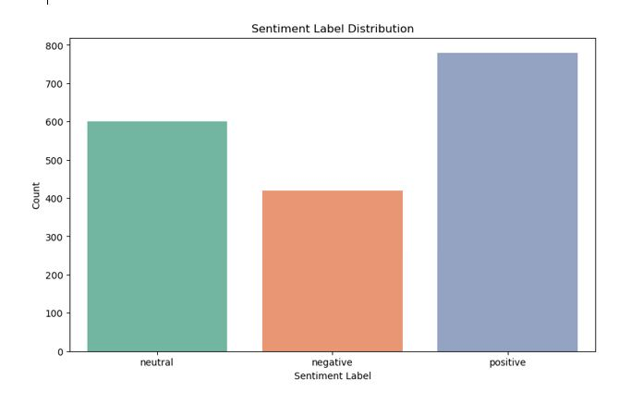
Initial Findings(EDA)
Sentiment Classification Using FinBERT
FinBERT assigns positive, neutral, or negative labels to headlines
Helps understand market sentiment trends
Why FinBERT?
Pretrained on financial texts, outperforming general sentiment models.
Understands market-specific language better than traditional NLP.

Slide 13
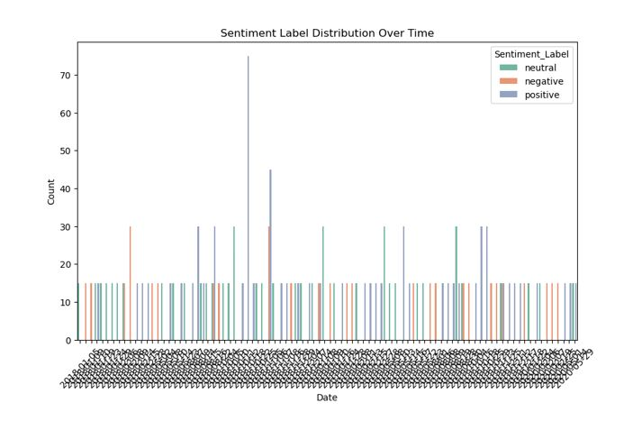
Initial Findings(EDA)
Key Observations
Negative sentiment is more frequent during financial crises or downturns.
Periods of high positive sentiment often precede stock price surges.
Neutral sentiment dominates in stable market conditions.
Why This Matters?
Understanding sentiment trends helps predict market movements.
Sentiment shifts can serve as an early indicator of volatility

Slide 14
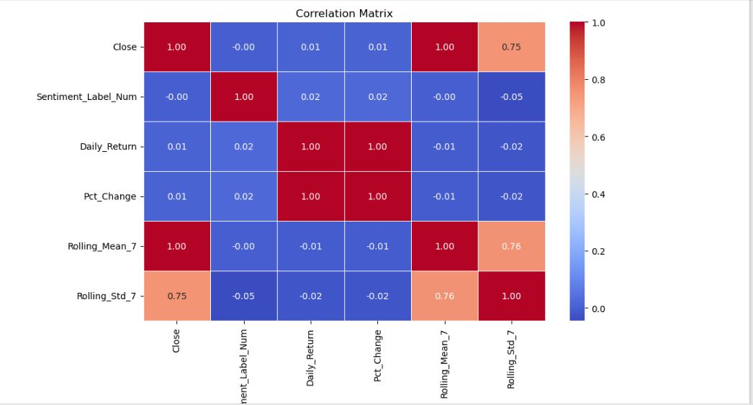
Initial Findings(EDA)
Correlation Between Sentiment & Stock Returns
Merged daily sentiment scores with corresponding stock returns.
Analyzed positive, neutral, and negative sentiment impact.
Positive sentiment correlates with short-term stock price increases.
Negative sentiment correlates with stock price drops and volatility spikes.
Neutral sentiment has minimal impact on daily stock returns.

Slide 15
Model Development
Machine Learning Model Selection
Reasons for choosing Random Forest:
Handles structured stock data well.
Can incorporate both numerical (stock indicators) & categorical (sentiment labels) features.
Robust against overfitting.

Slide 16
Model Development
Model Training & Testing
Train-test split: 80% training, 20% testing.
Feature Scaling: Standardized stock price data.
Sentiment Labels: Converted into numerical values for ML models.
Random Forest trained using stock indicators + sentiment features.

Slide 17
Model Development
Model Performance Evaluation
Key Metrics Used for Evaluation:
Accuracy – Measures how often the model correctly predicts stock movement.
Precision & Recall – Evaluates how well the model identifies positive and negative trends.
F1 Score – Balances precision and recall for overall performance assessment.

Slide 18
Model Development
Stock Price Forecasting with and without Sentiment Random Forest (without sentiment): Lower accuracy due to missing external influences. Random Forest (with sentiment): Improved accuracy as sentiment added predictive value.
Accuracy Scores of Different Models Random Forest (Stock Data Only): 51.35% Random Forest (Stock + Sentiment Data): 71.83% (Improvement)
Sentiment integration improved stock movement prediction accuracy.

Slide 19
Discussion & Future Works
Achievements
Combines sentiment analysis with machine learning for better predictions.
Uses FinBERT, a finance-specific sentiment model for accuracy.
Prediction accuracy is improved.
Limitations
Sentiment dataset limited to 2018-2020 (original plan was 20 years).
Real-time market predictions not implemented yet.
Stock market unpredictability remains a challenge despite improved accuracy.

Slide 20
Discussion & Future Work
Future Work
Expand data sources: Include social media (Twitter, Reddit) for better sentiment tracking.
Test deep learning models: Transformer-based models (GPT-4, BERT variants).
Develop real-time prediction systems: Implement sentiment-driven trading strategies.
Use alternative financial sentiment datasets: To improve training data diversity.
Potential Applications
Investment firms and traders can use sentiment-enhanced models for better decision-making.
Automated trading systems could incorporate real-time sentiment analysis.

Slide 21
References
Araci, D. (2019). FinBERT: A pre-trained language model for financial communications.
arXiv preprint arXiv:1908.10063.
Bengio, Y., Simard, P., & Frasconi, P. (1994). Learning long-term dependencies with gradient
descent is difficult. IEEE Transactions on Neural Networks, 5(2), 157–166.
Bollen, J., Mao, H., & Zeng, X. (2011). Twitter mood predicts the stock market. Journal of
Computational Science, 2(1), 1-8.
Box, G. E. P., & Jenkins, G. M. (1970). Time Series Analysis: Forecasting and Control. Holden-Day.
Cambria, E., Schuller, B., Xia, Y., & Havasi, C. (2013). New avenues in opinion mining and sentiment
analysis. IEEE Intelligent Systems, 28(2), 15-21.
Daas, P. J., Puts, M. J., Buelens, B., & van den Hurk, P. A. (2015). Big data as a source for official statistics.
Journal of Official Statistics, 31(2), 249-262.
Fischer, T., & Krauss, C. (2018). Deep learning with long short-term memory networks for financial market predictions. European Journal of Operational Research, 270(2), 654-669..

Slide 22
References
Goodfellow, I., Bengio, Y., & Courville, A. (2016). Deep Learning. MIT Press.
Hochreiter, S., & Schmidhuber, J. (1997). Long short-term memory. Neural Computation, 9(8), 1735-1780
Hyndman, R. J., & Athanasopoulos, G. (2018). Forecasting: Principles and Practice. OTexts.
Jobin, A., Ienca, M., & Vayena, E. (2019). The global landscape of AI ethics guidelines. Nature Machine Intelligence, 1(9), 389-399.
Kim, H., & Won, J. (2020). Hybrid models combining sentiment analysis and machine learning for stock price prediction. Expert Systems with Applications, 143, 113085.
Loughran, T., & McDonald, B. (2011). When is a liability not a liability? Textual analysis, dictionaries, and 10-Ks. The Journal of Finance, 66(1), 35-65.
Mittal, A., & Goel, A. (2012). Stock prediction using Twitter sentiment analysis. Stanford University Research Paper, 15(2), 1-5.

Slide 23
References
Nassirtoussi, A. K., Aghabozorgi, S., Wah, T. Y., & Ngo, D. C. L. (2014). Text mining for market
prediction: A systematic review. Expert Systems with Applications, 41(16), 7653-7670.
Sharpe, W. F. (1964). Capital asset prices: A theory of market equilibrium under conditions of risk.
The Journal of Finance, 19(3), 425-442.
Tetlock, P. C. (2007). Giving content to investor sentiment: The role of media in the stock market.
The Journal of Finance, 62(3), 1139-1168.
Taboada, M., Brooke, J., Tofiloski, M., Voll, K., & Stede, M. (2011). Lexicon-based methods for sentiment
analysis. Computational Linguistics, 37(2), 267-307.
Tsay, R. S. (2005). Analysis of Financial Time Series. John Wiley & Sons.
Brown, T. B., Mann, B., Ryder, N., et al. (2020). Language models are few-shot learners.
arXiv preprint arXiv:2005.14165.

Slide 24


THANK YOU
utmofficial
univteknologimalaysia
utm.my

Slide 25
YouTube Video Link
https://youtu.be/Y-0-bICWfD8

