Slide 1
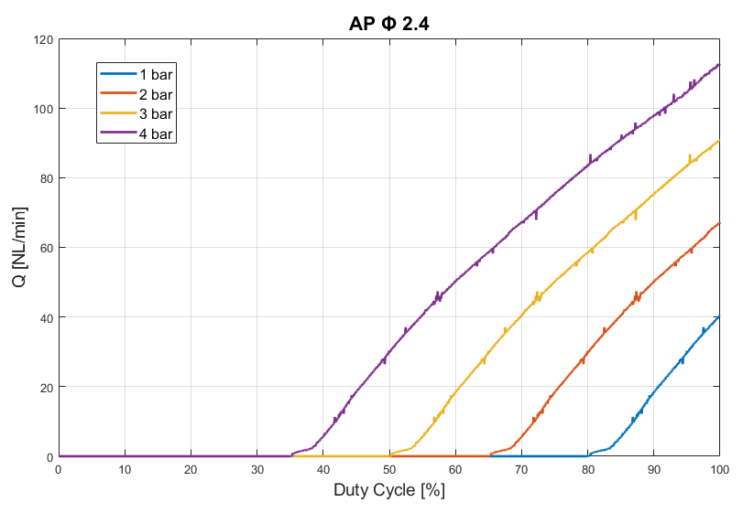
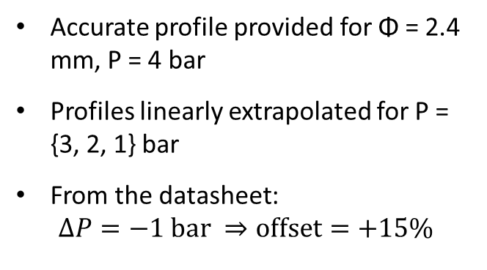
AP Inlet Valve Diagrams
Accurate profile provided for Φ = 2.4 mm, P = 4 bar
Profiles linearly extrapolated for P = {3, 2, 1} bar
From the datasheet: $∆P=−1 \text{bar} ⇒\text{offset}=+15\%$

Slide 2
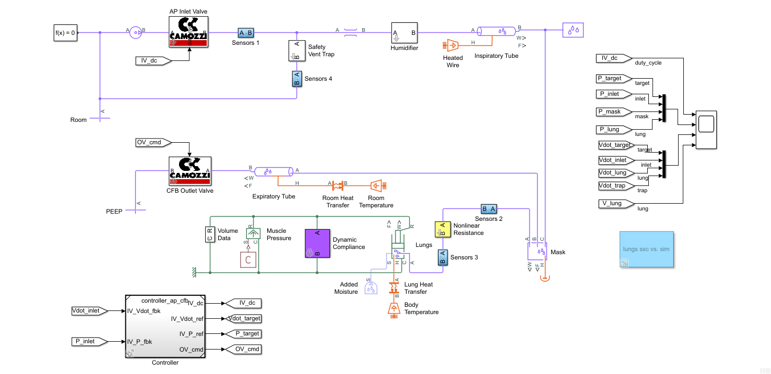
Simscape Model

Slide 3
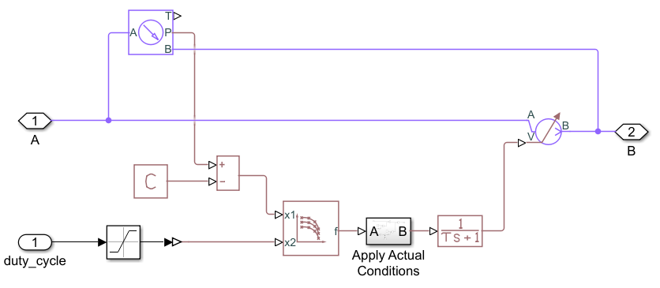
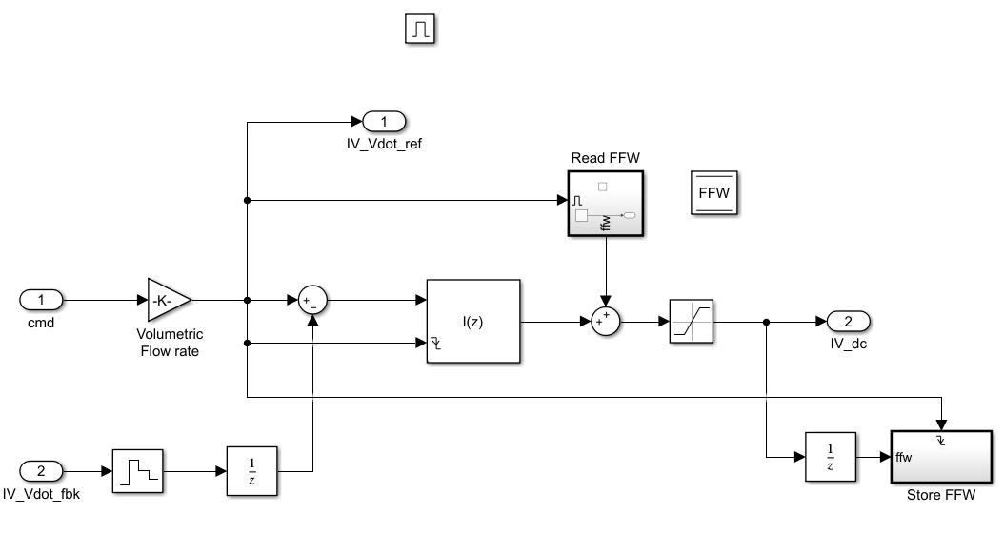
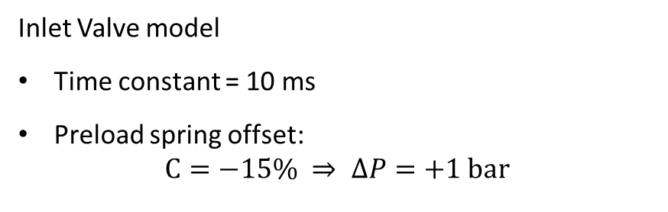
Simscape Model
Inlet Valve model
Time constant = 10 ms
Preload spring offset: $C=−15\% ⇒ ∆P=+1 \text{bar}$
Inlet Flow Controller Integrator + Adaptive FeedForward

Slide 4
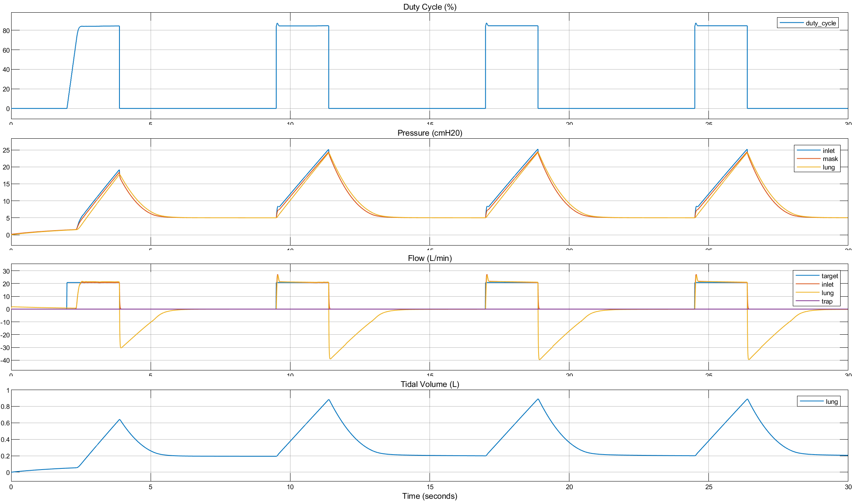

AP Inlet Valve Responses
$$P_{\text{supply}}=1.5 \text{bar}$$
$P_{\text{mask}}=25 \text{mbar} ⇒\text{duty} \text{cycle}=84\%$

Slide 5
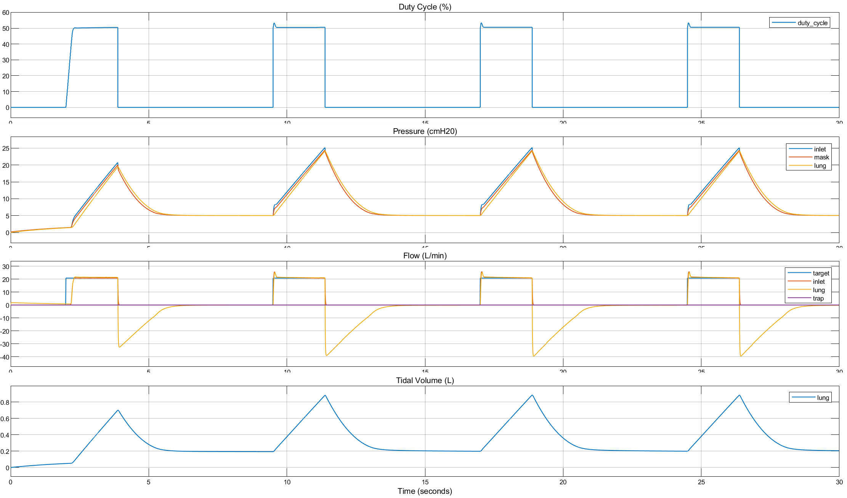
AP Inlet Valve Responses
$$P_{\text{supply}}=1.5 \text{bar}$$
$$P_{\text{mask}}=25 \text{mbar}\text{, }\text{duty} \text{cycle}=50\%⇒\text{spring} \text{preload} \text{offset}=−33\%$$

Slide 6
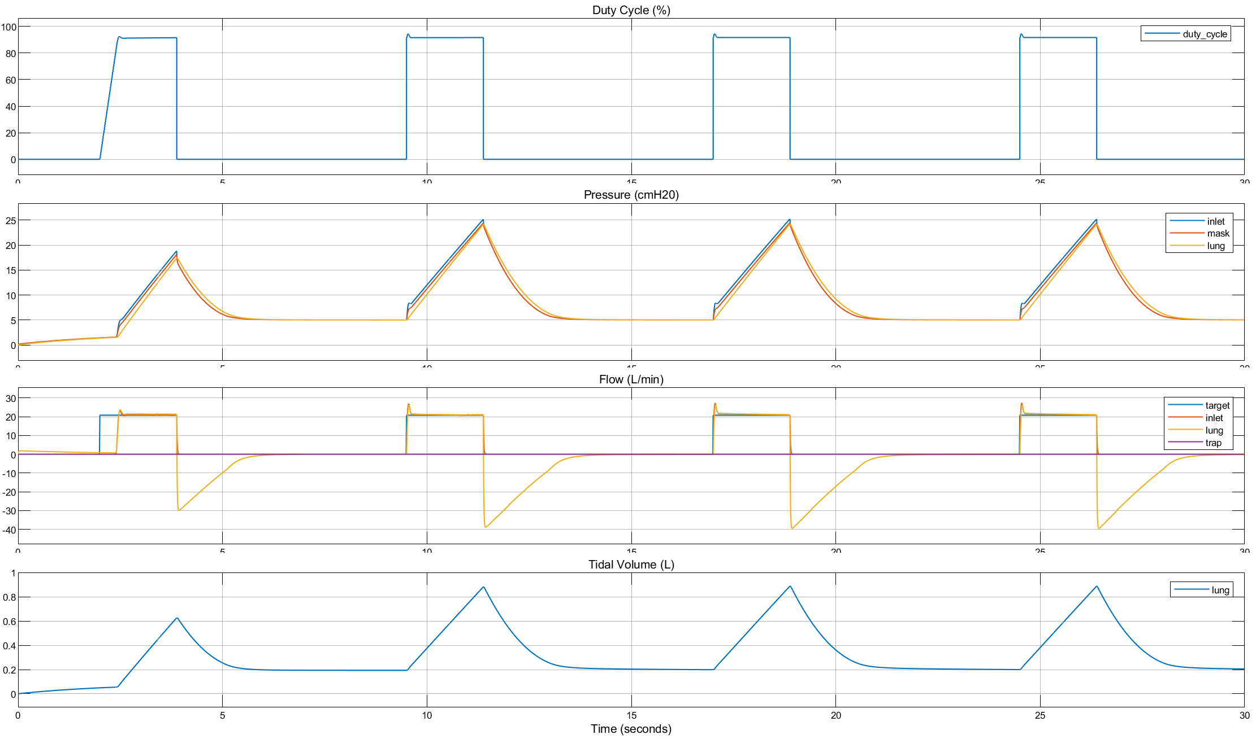

AP Inlet Valve Responses
$$P_{\text{supply}}=1 \text{bar}$$
$P_{\text{mask}}=25 \text{mbar} ⇒\text{duty} \text{cycle}=91\%$

Slide 7
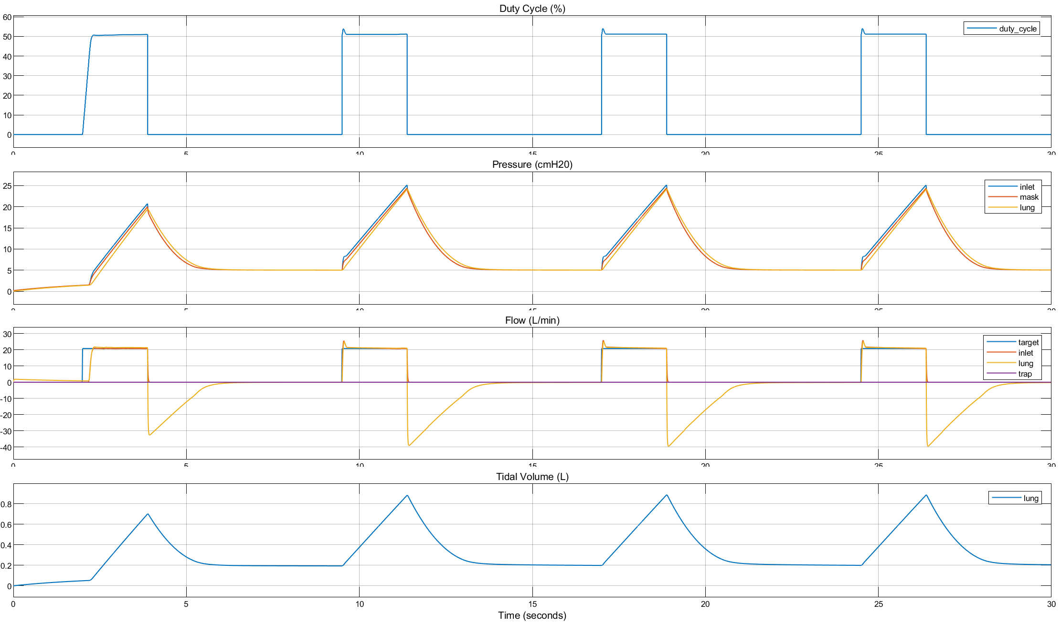
AP Inlet Valve Responses
$$P_{\text{supply}}=1 \text{bar}$$
$$P_{\text{mask}}=25 \text{mbar}\text{, }\text{duty} \text{cycle}=50\%⇒\text{spring} \text{preload} \text{offset}=−40\%$$

Slide 8
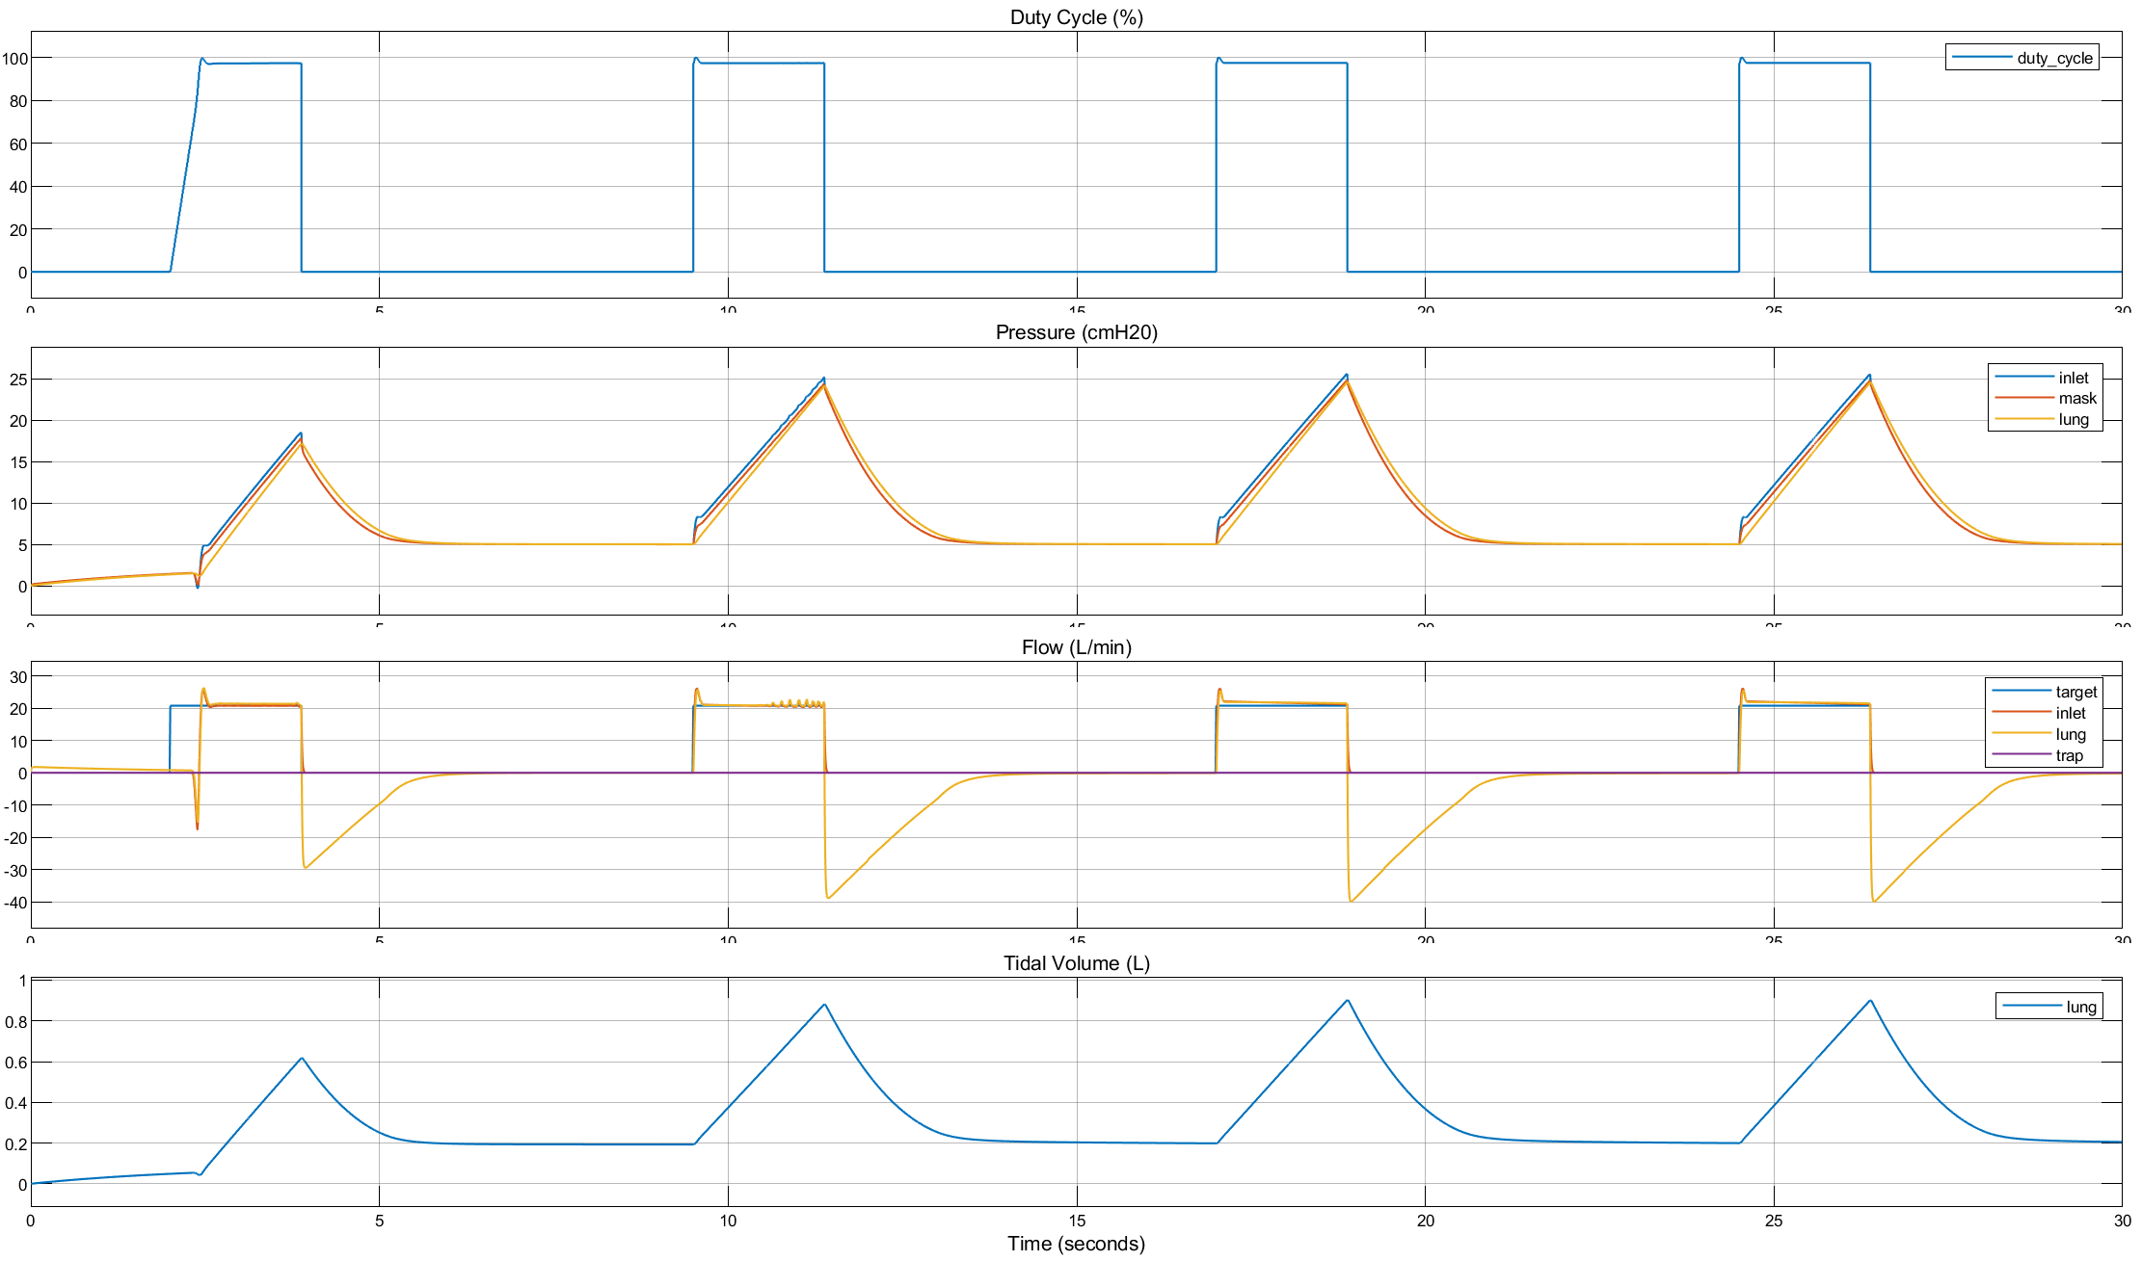

AP Inlet Valve Responses
🛑 close to 100%
$$P_{\text{supply}}=0.5 \text{bar}$$
$P_{\text{mask}}=25 \text{mbar} ⇒\text{duty} \text{cycle}=97\%$

Slide 9
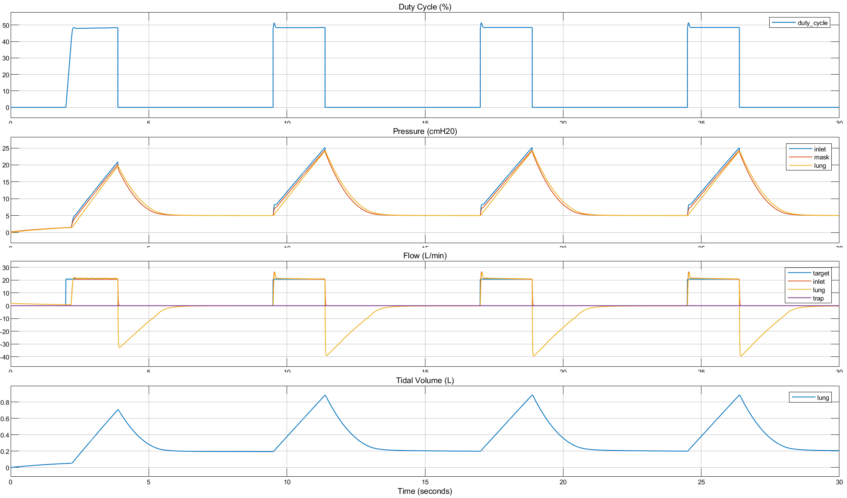
AP Inlet Valve Responses
$$P_{\text{supply}}=0.5 \text{bar}$$
$$P_{\text{mask}}=25 \text{mbar}\text{, }\text{duty} \text{cycle}=50\%⇒\text{spring} \text{preload} \text{offset}=−50\%$$

Slide 10

Tidal Volume Drop w/ Helmet
$$P_{\text{supply}}=1 \text{bar}$$
$$∆V=56 \text{cc}$$

Slide 11
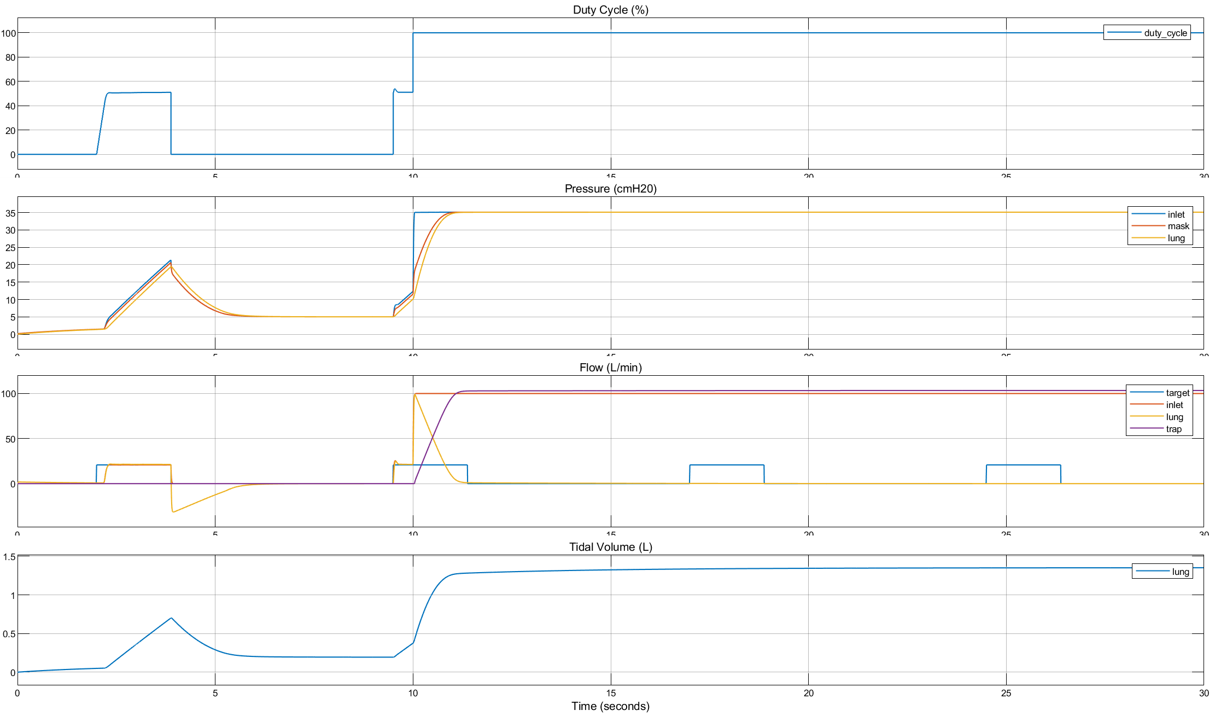
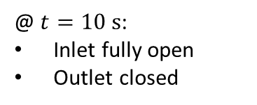
FMEA
$$P_{\text{supply}}=1 \text{bar}$$
$$P_{\text{mask}}=25 \text{mbar}\text{, }\text{duty} \text{cycle}=50\%⇒\text{spring} \text{preload} \text{offset}=−40\%$$
@ $t=10 \text{s}$:
Inlet fully open
Outlet closed

Slide 12
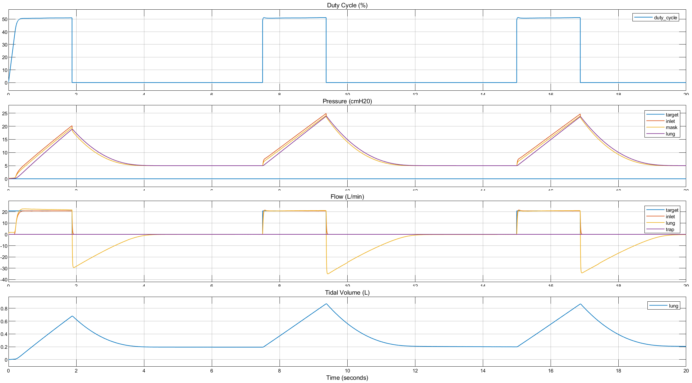
AP + CFB: Volume Control

Slide 13
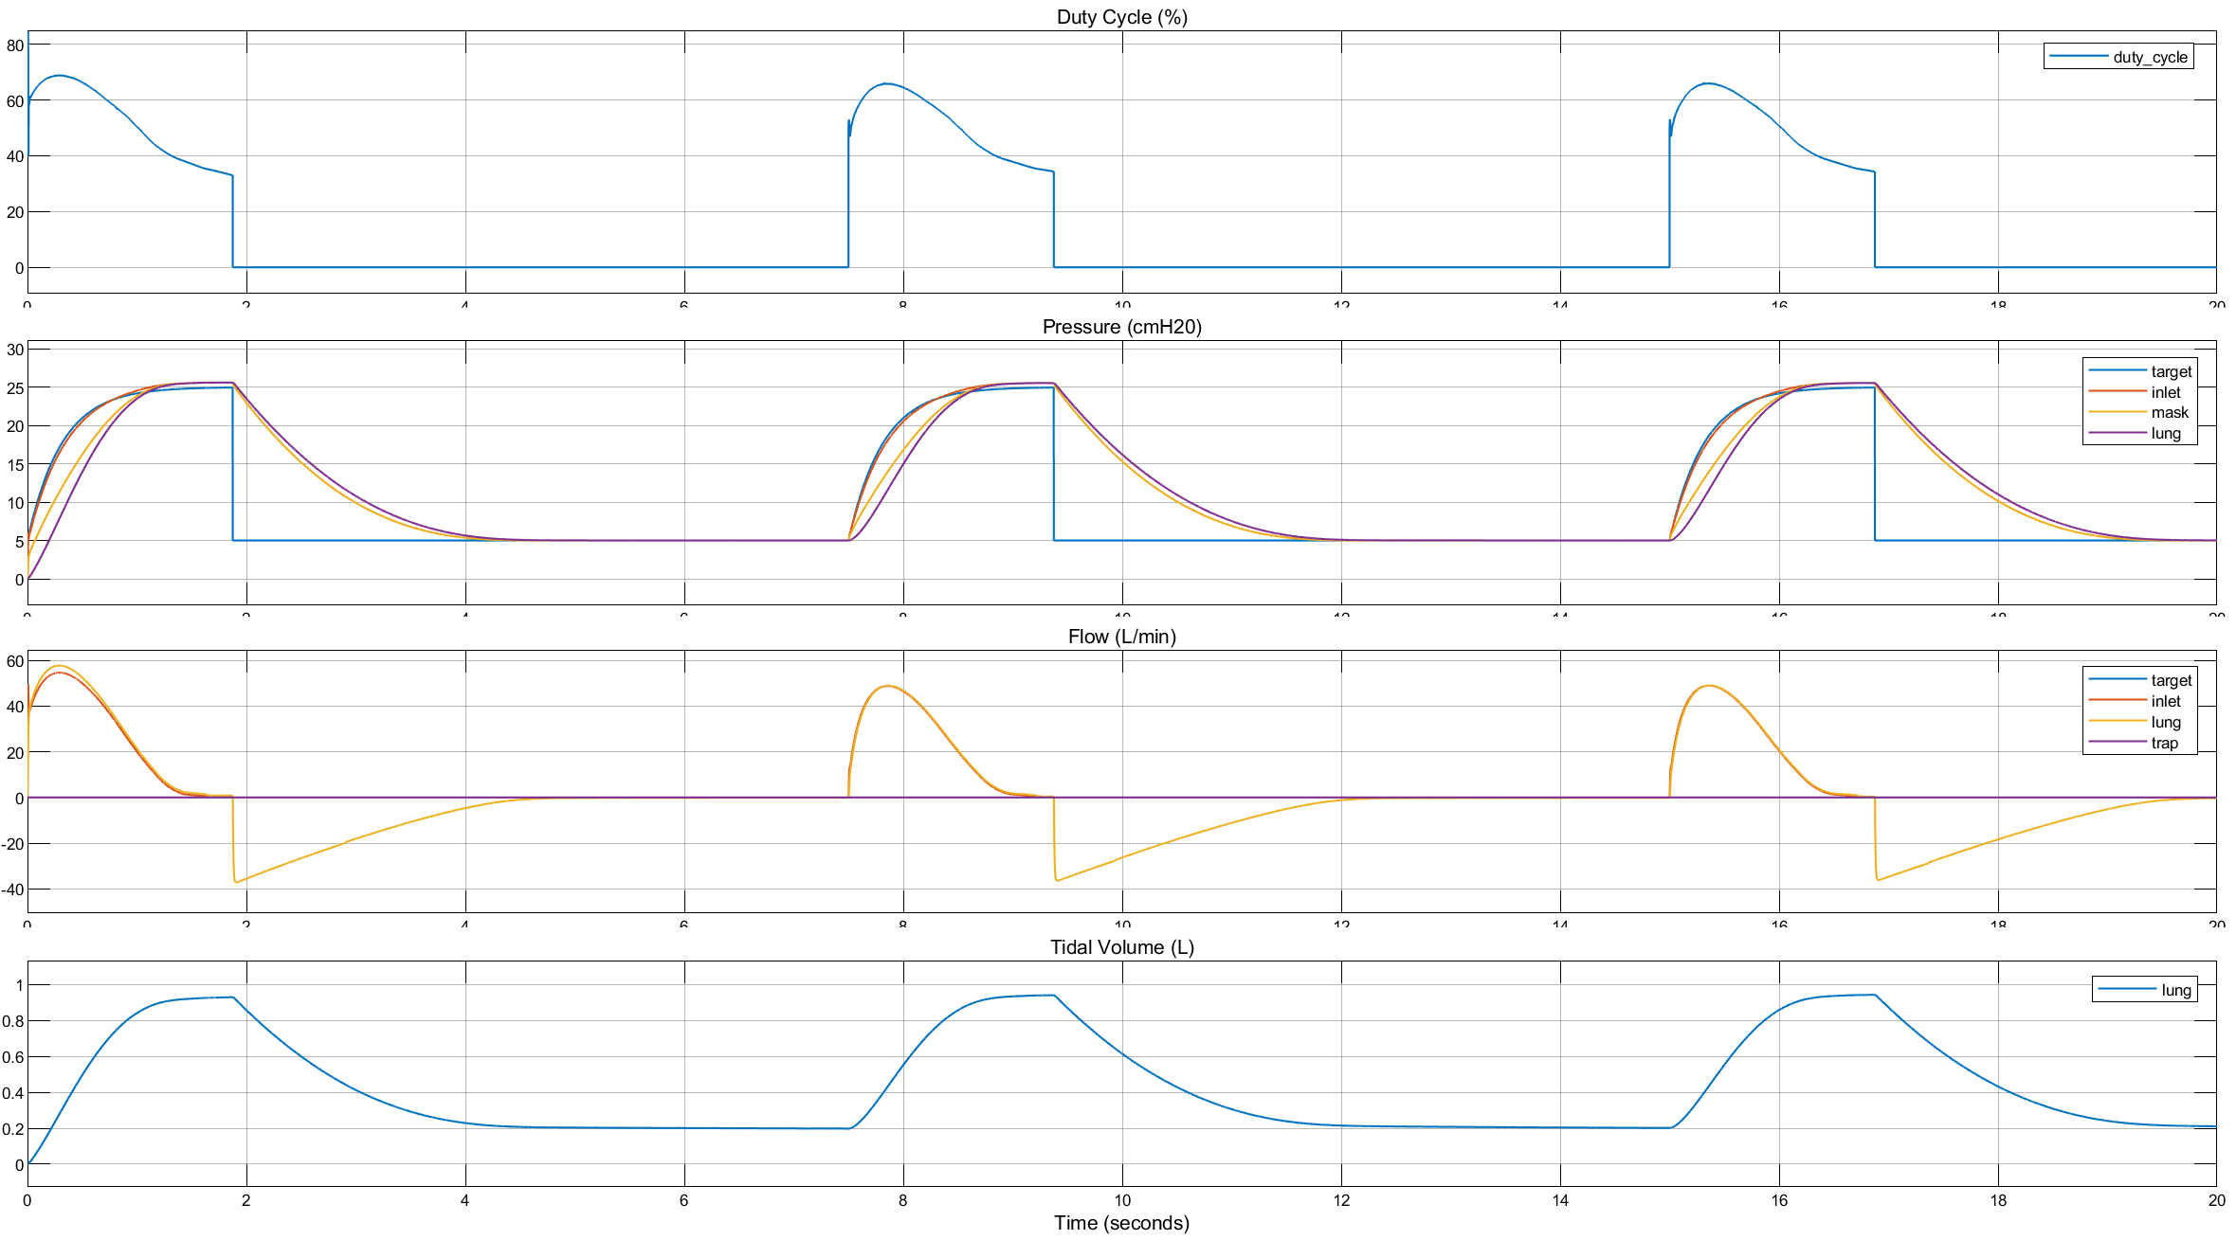
AP + CFB: Pressure Control

Slide 14
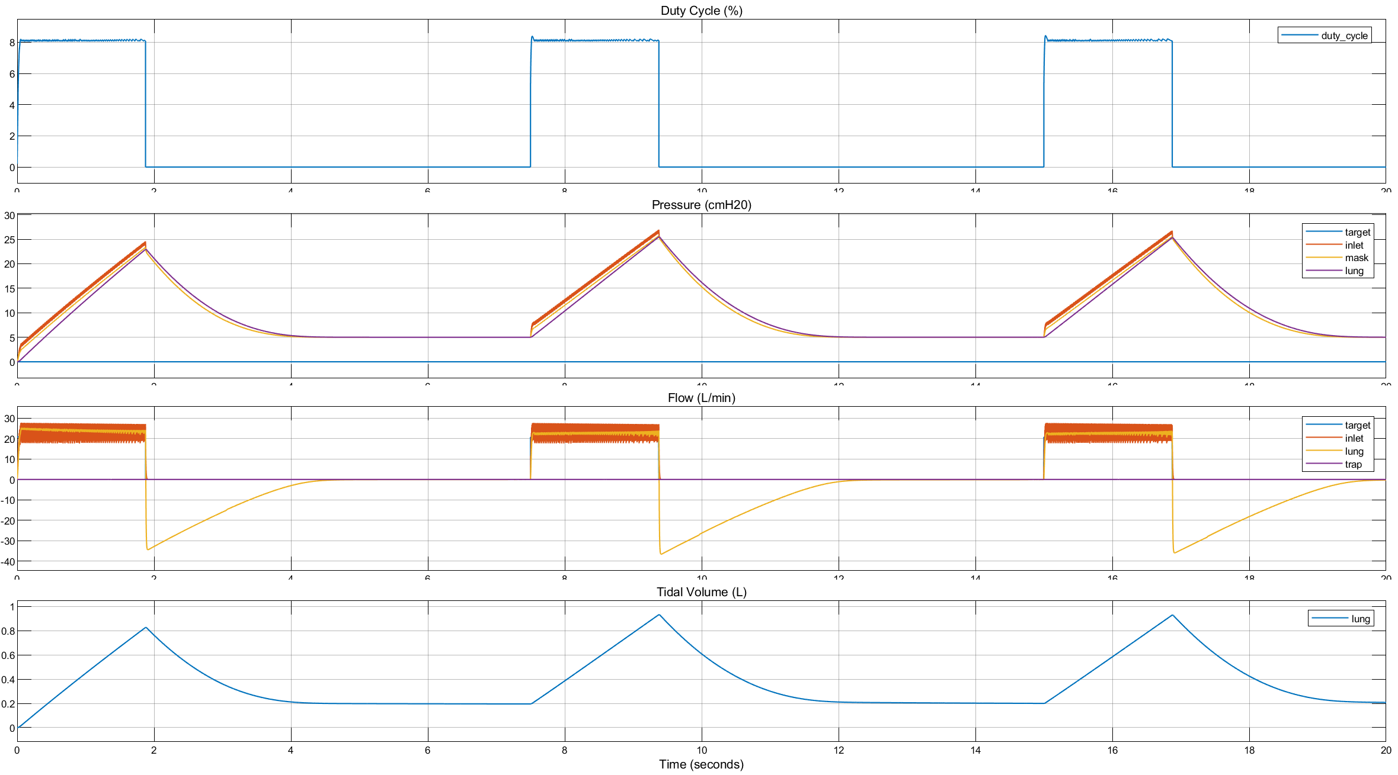
CFB + CFB: Volume Control

Slide 15
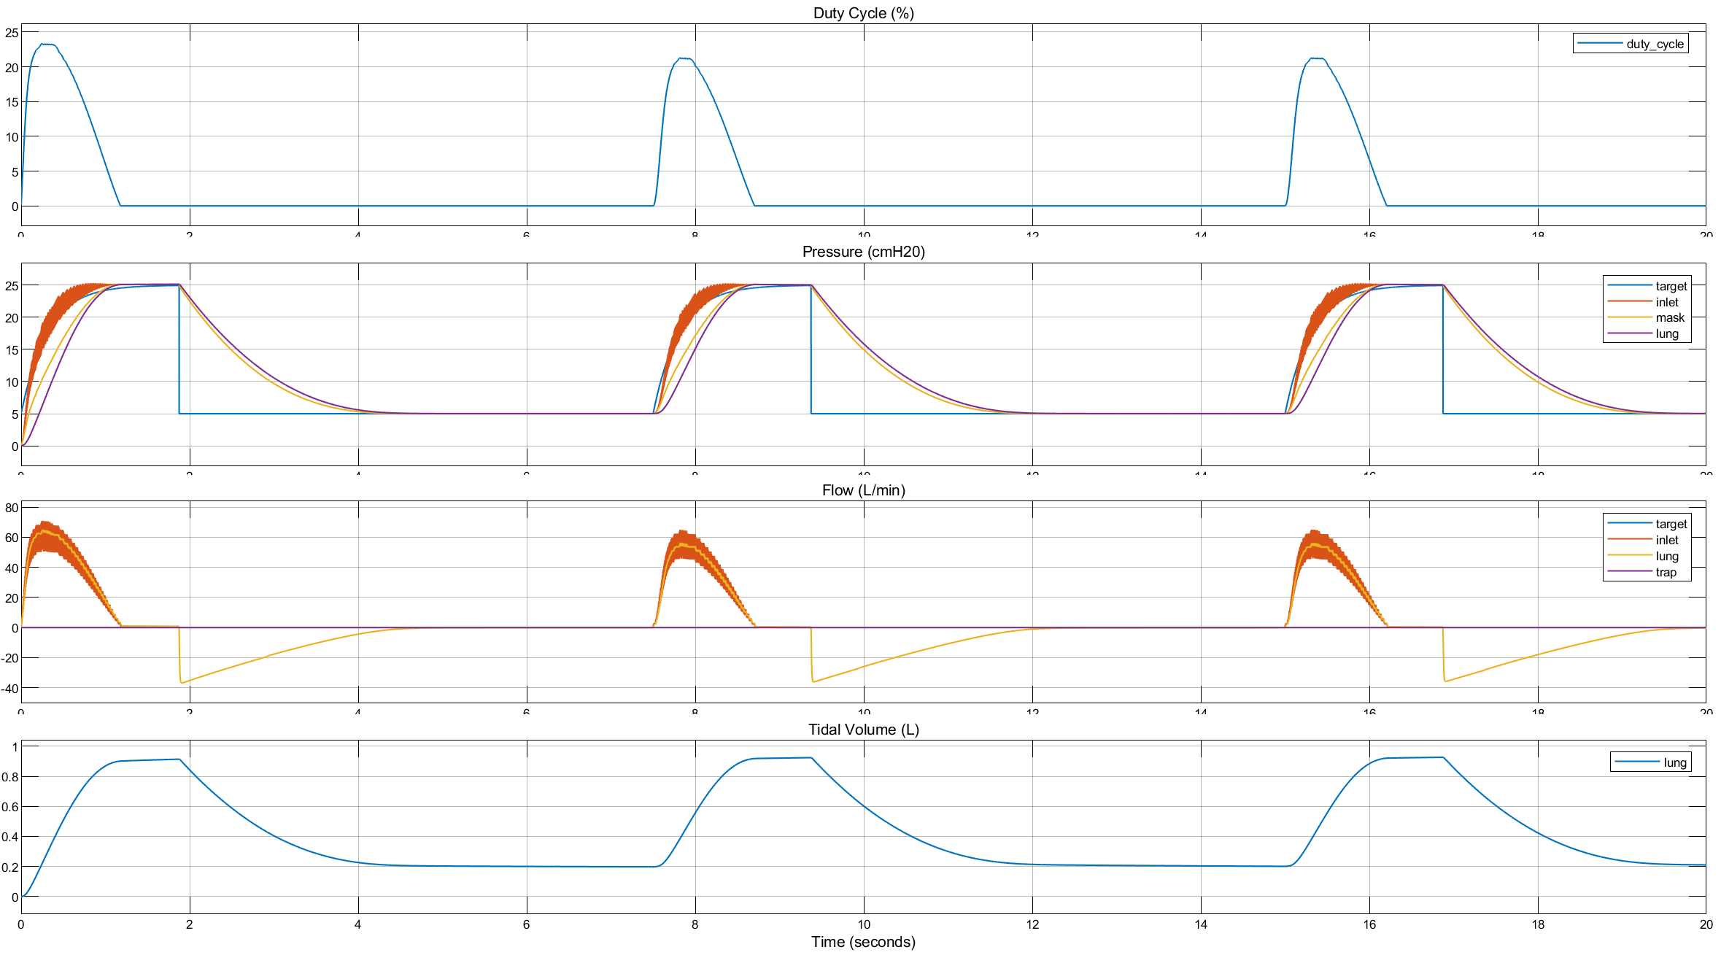
CFB + CFB: Pressure Control

Slide 16
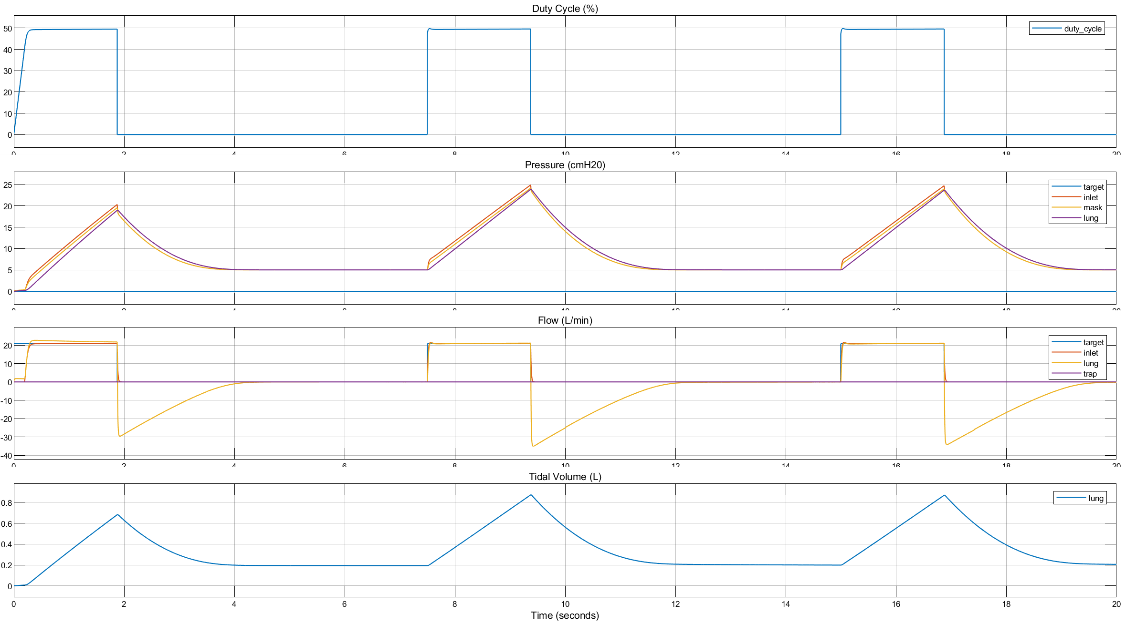
CP + CFB: Volume Control

Slide 17
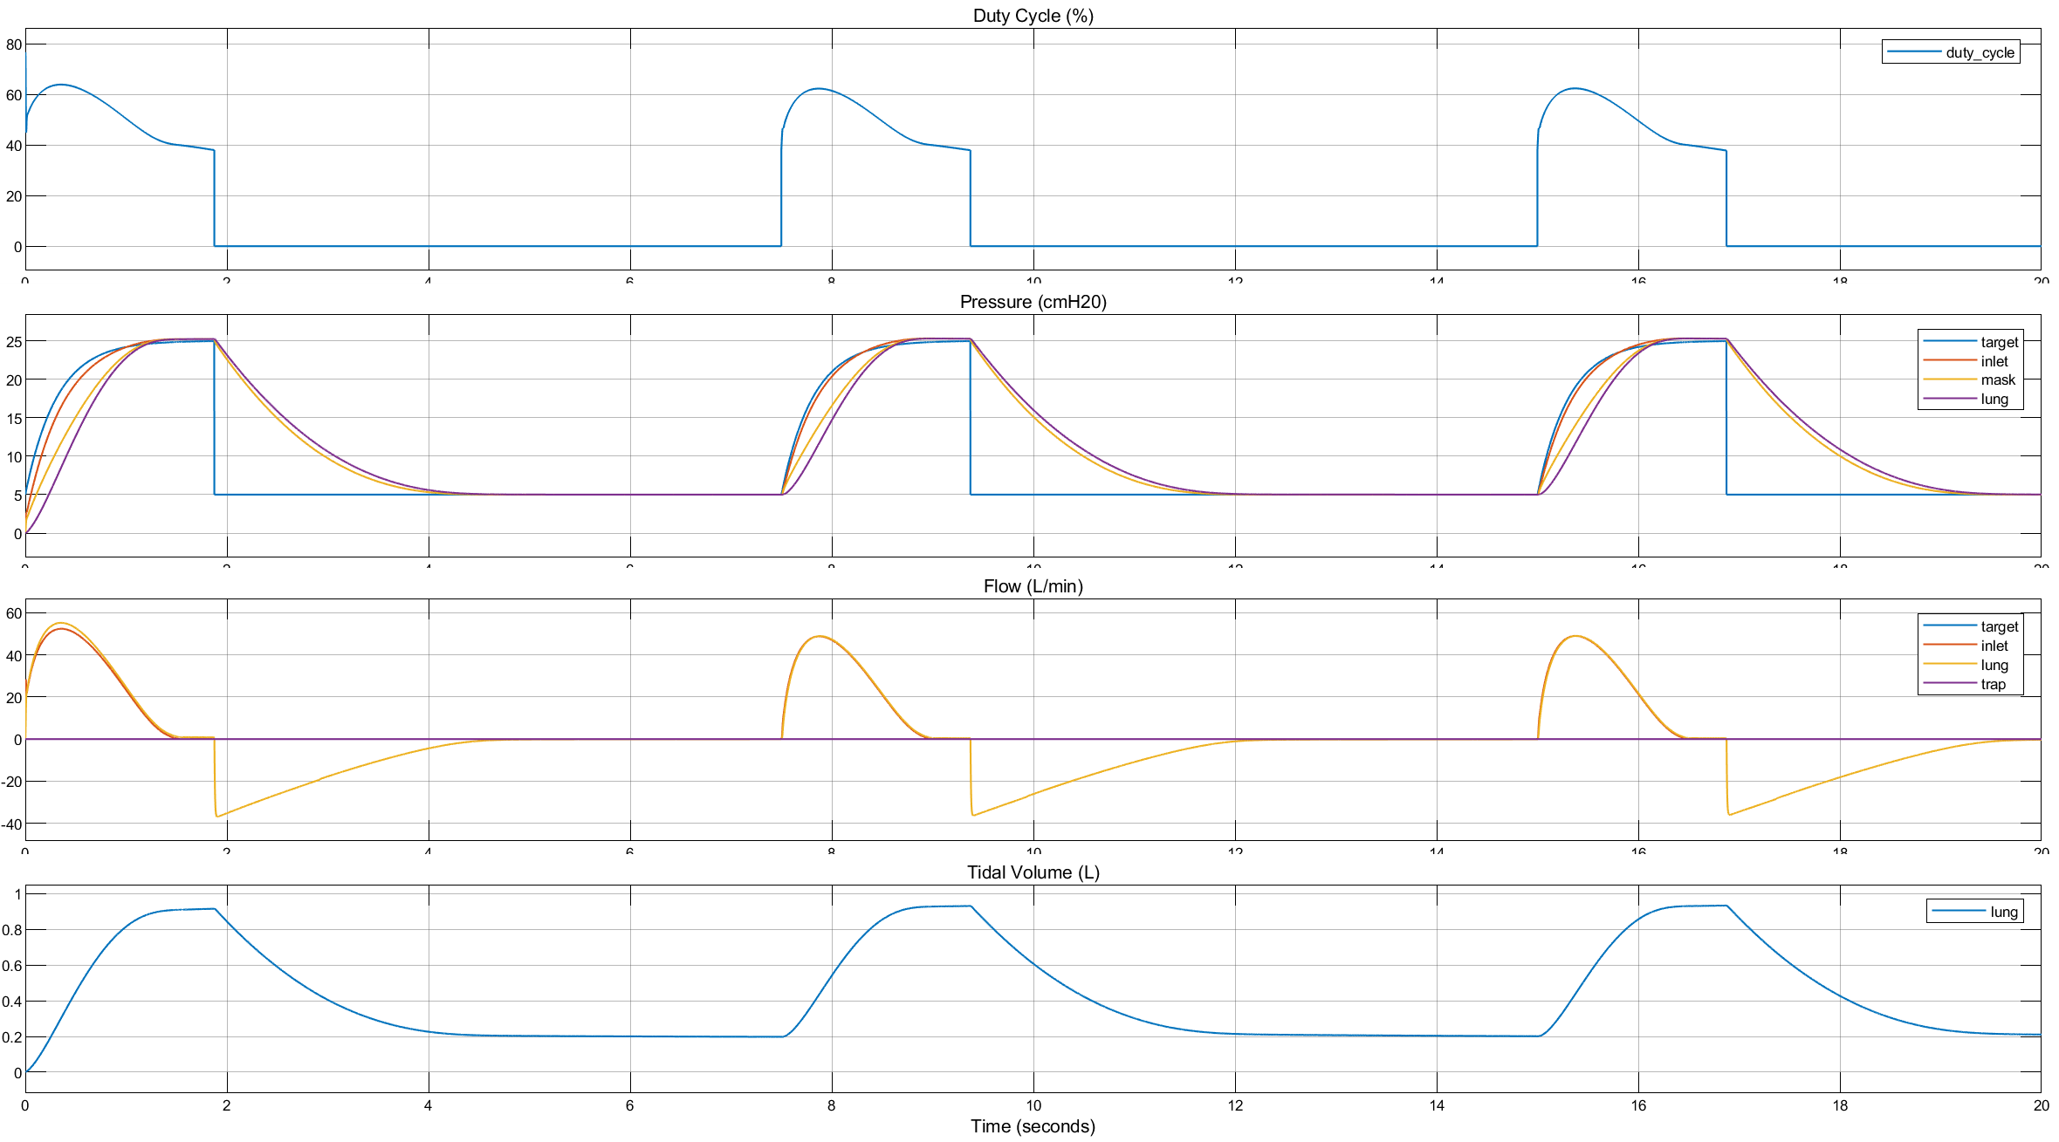
CP + CFB: Pressure Control

Slide 18
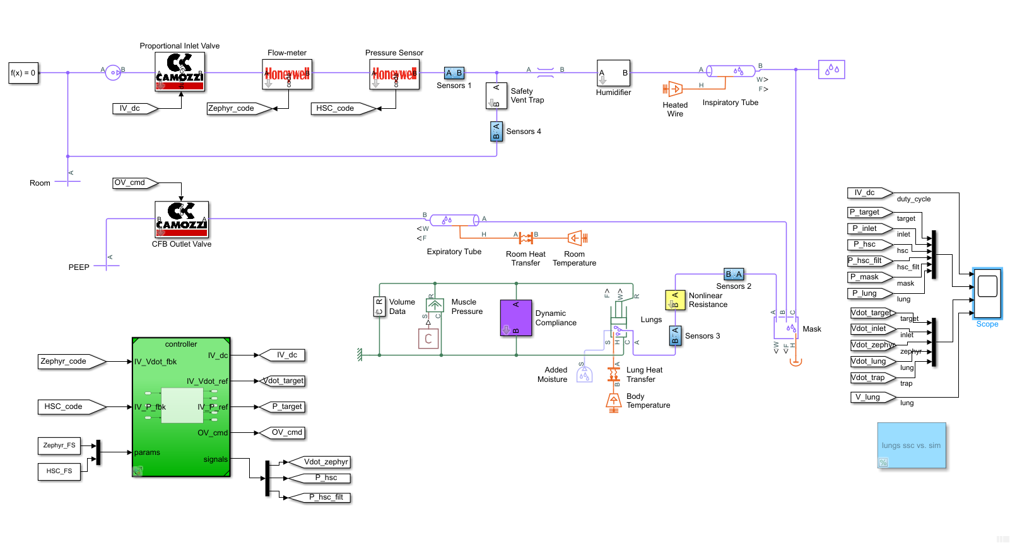
Simscape Model w/ sensors

Slide 19
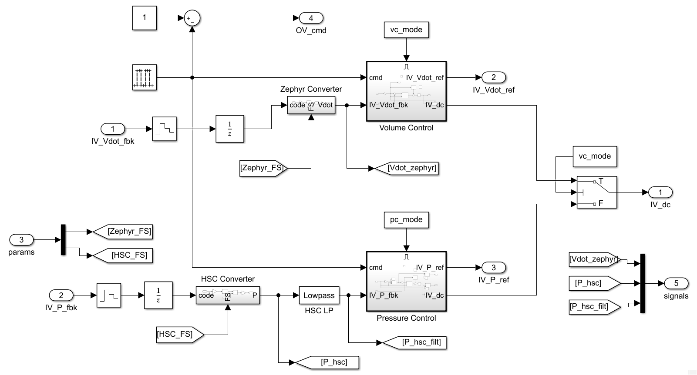
Controller

Slide 20
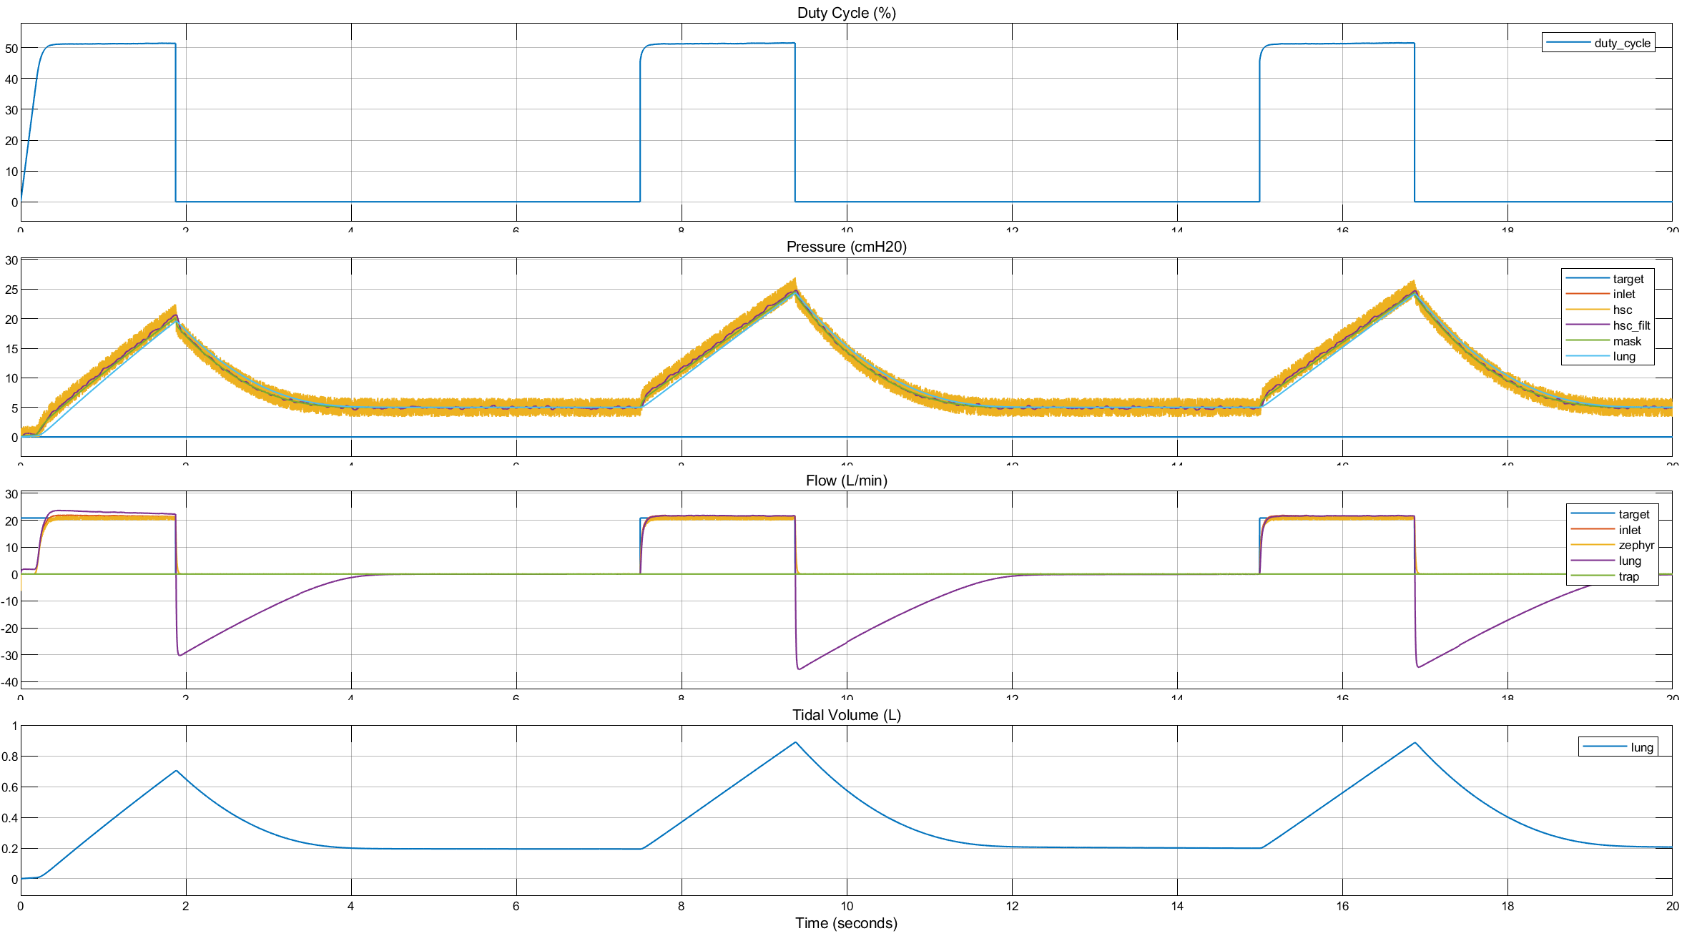
AP + CFB: Volume Control w/ sensors
@ 1 kHz

Slide 21
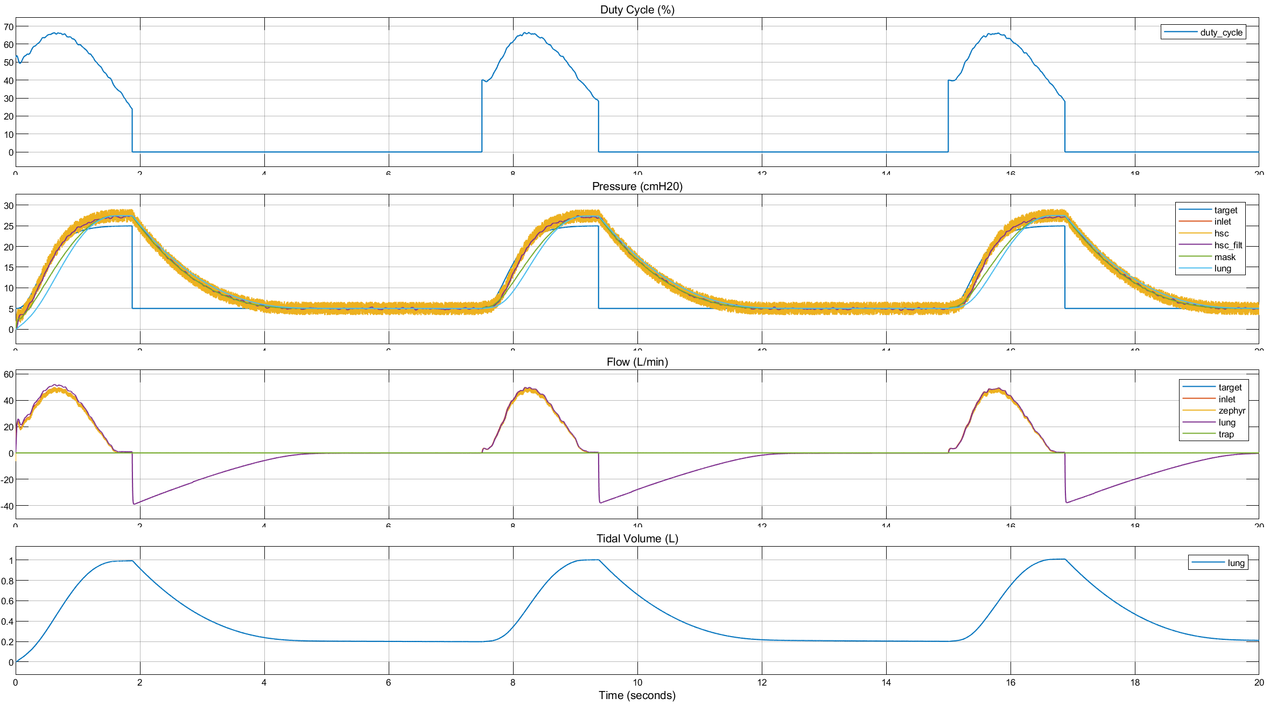
AP + CFB: Pressure Control w/ feedback-filtering, input-shaping
@ 1 kHz
Feedback Filtering
IIR 2nd order
5 Hz cutoff
25 dB attenuation
0.1 dB passband max ripple
Input Shaping
Minimum Jerk 3rd order

Slide 22
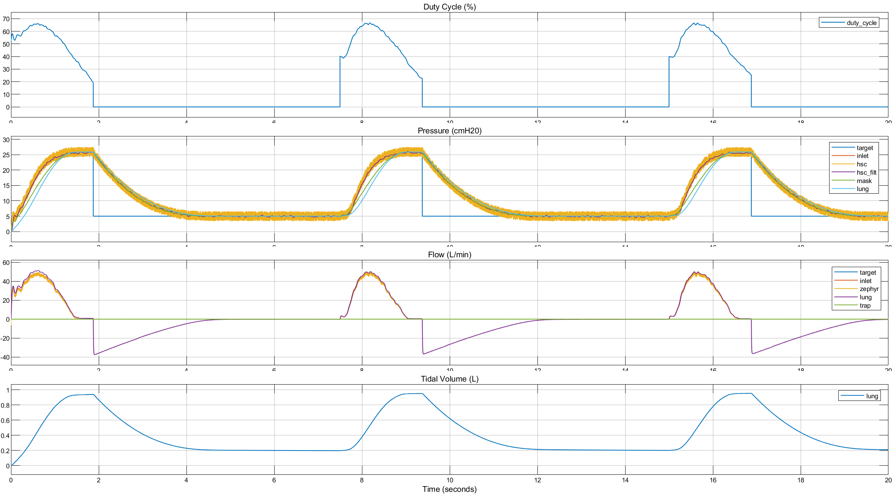
AP + CFB: Pressure Control w/ feedback-filtering input-shaping, gain-scheduling
@ 1 kHz
Gain Scheduling
Different I⁺ and I⁻ gains

Slide 23
AP + CFB: Pressure Control comparison w/ and w/o gain-scheduling

Slide 24
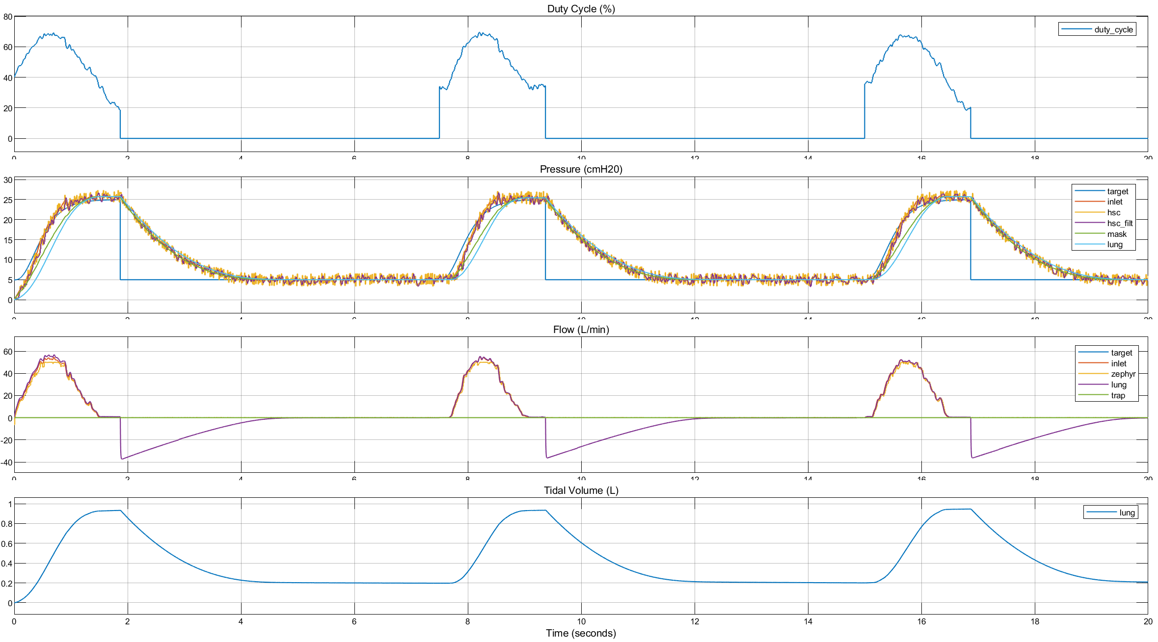
AP + CFB: Pressure Control w/ feedback-filtering input-shaping, gain-scheduling
@ 100 Hz
Feedback Filtering
IIR 2nd order
10 Hz cutoff
25 dB attenuation
0.1 dB passband max ripple
Input Shaping
Minimum Jerk 3rd order

Slide 25
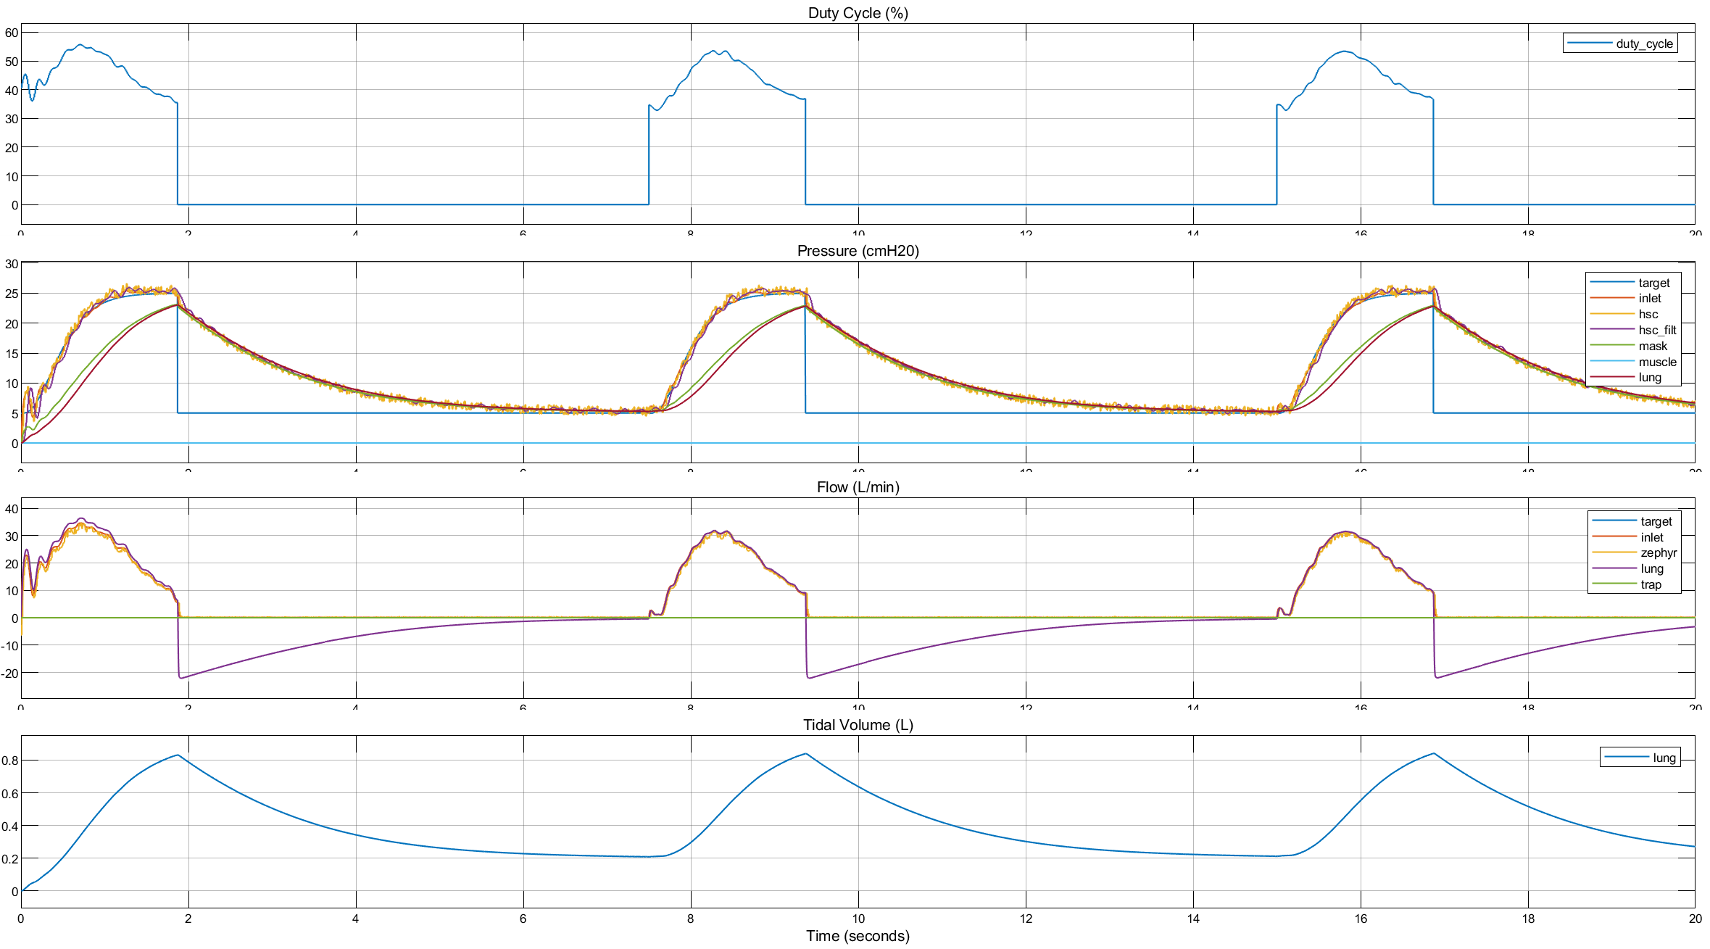
AP + CFB: Pressure Control w/ latest tabled values
@ 100 Hz
Feedback Filtering
IIR 3rd order
8 Hz cutoff
30 dB attenuation
0.5 dB passband max ripple
Input Shaping
Minimum Jerk 3rd order
Gain Scheduling is not required

Slide 26
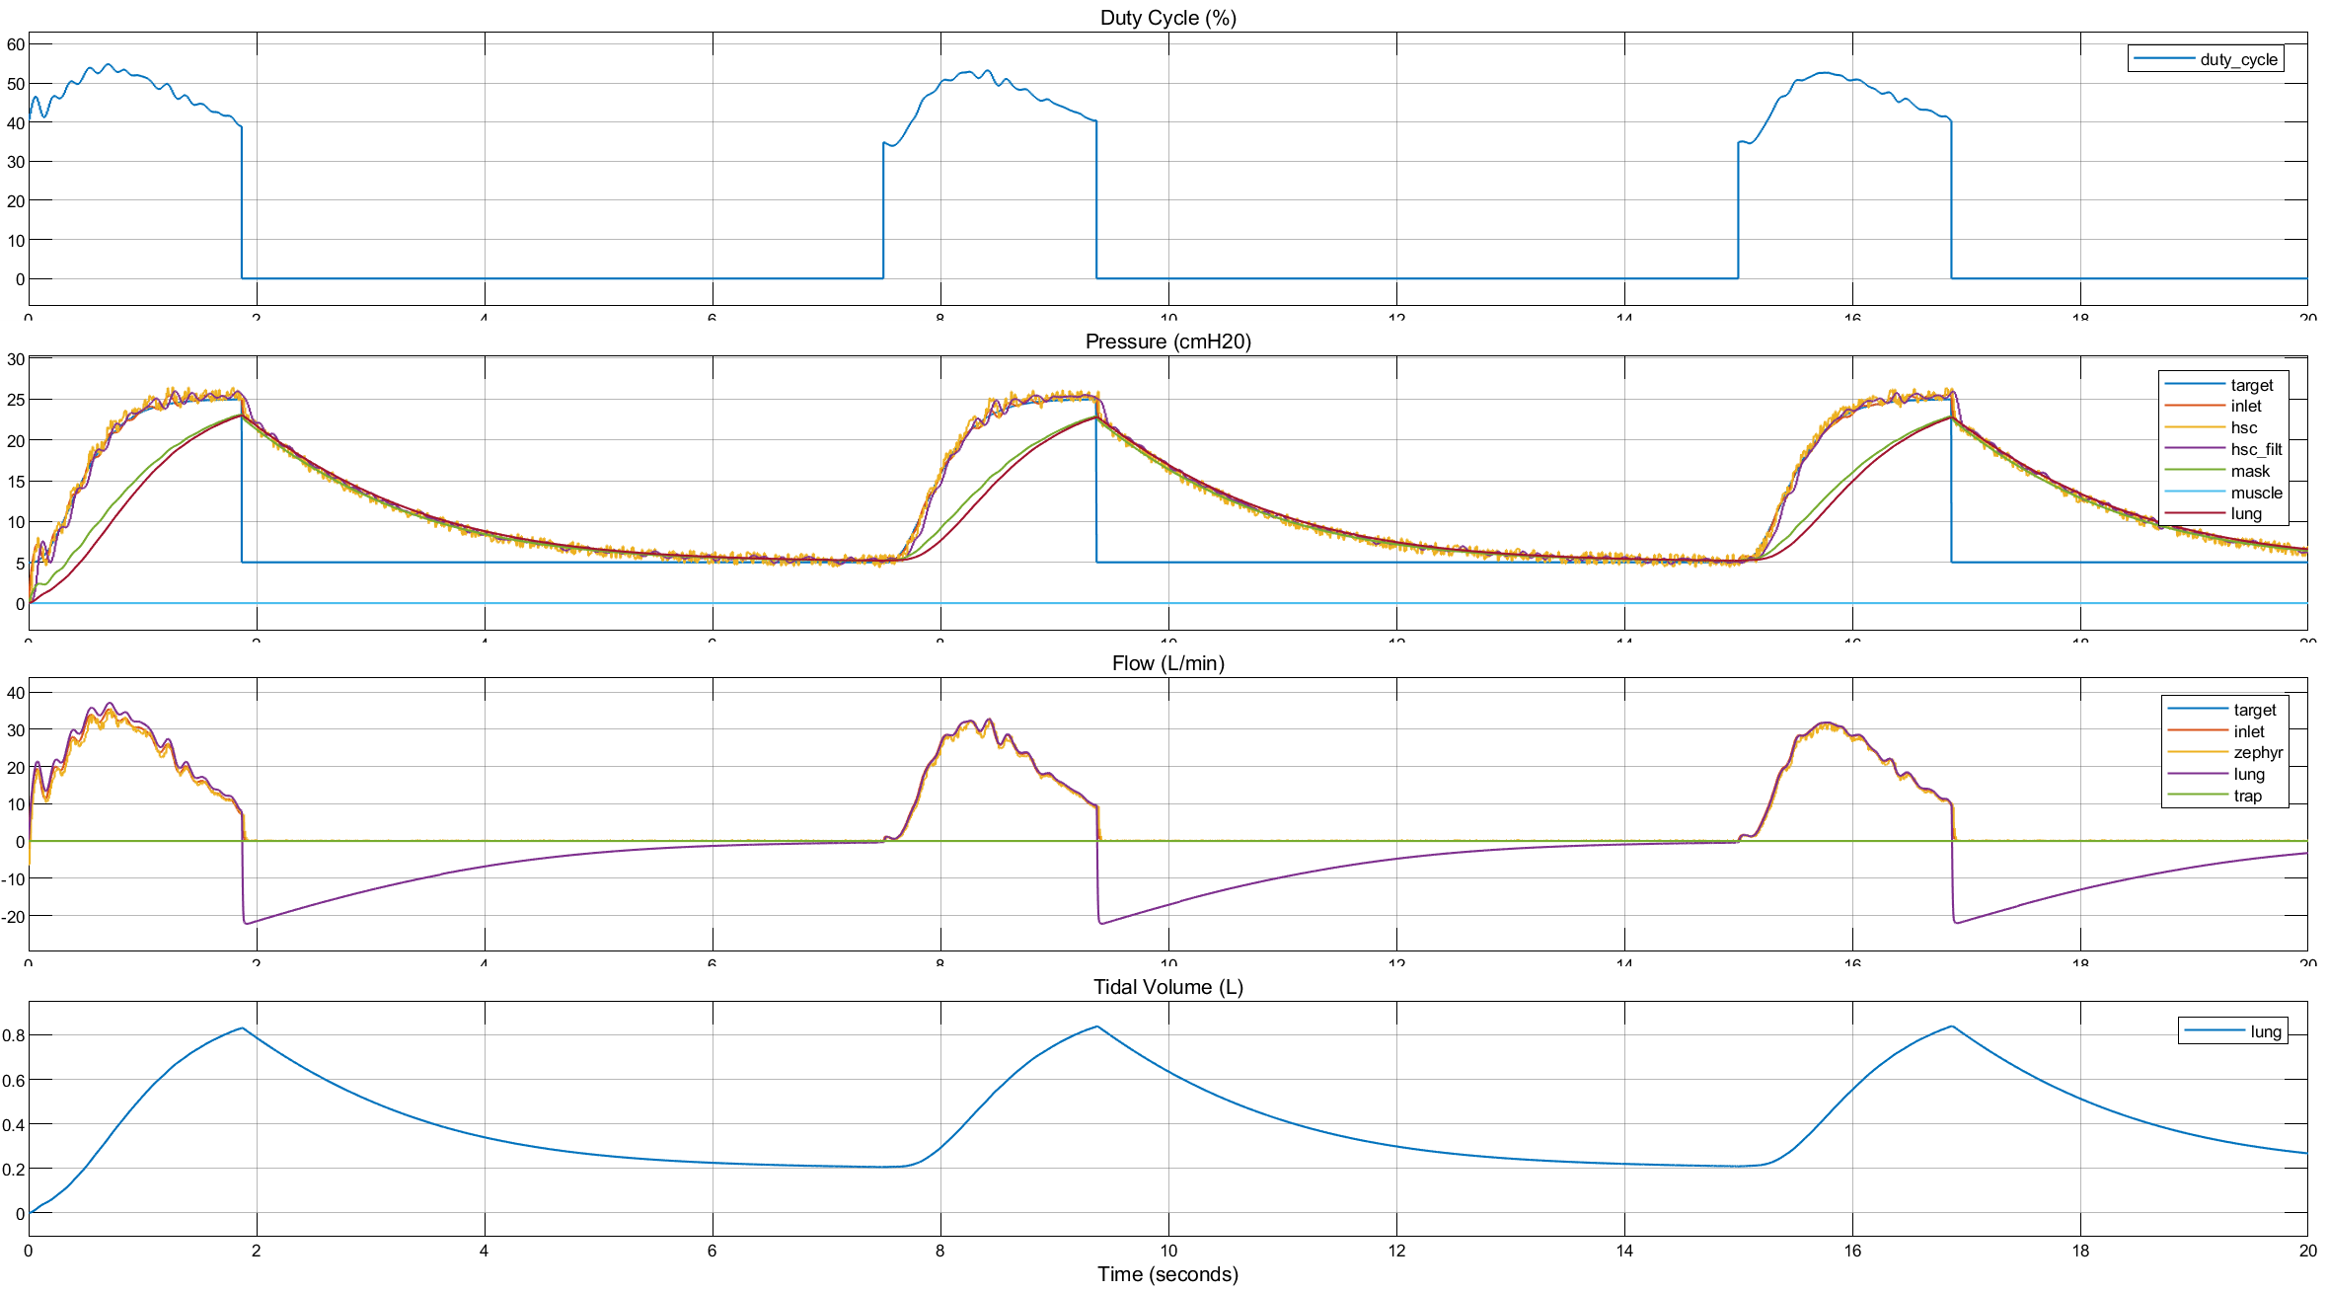
CP + CFB: Pressure Control w/ latest tabled values
@ 100 Hz
Feedback Filtering
IIR 3rd order
8 Hz cutoff
30 dB attenuation
0.5 dB passband max ripple
Input Shaping
Minimum Jerk 3rd order
Gain Scheduling is not required

Slide 27
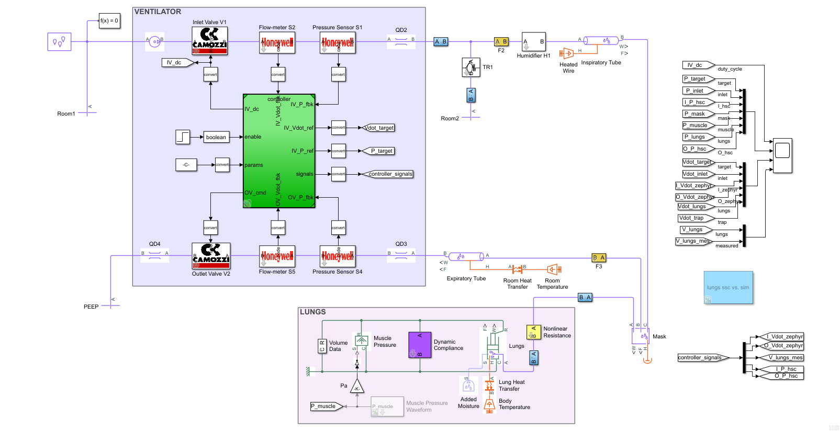
Simscape Model (update)

Slide 28
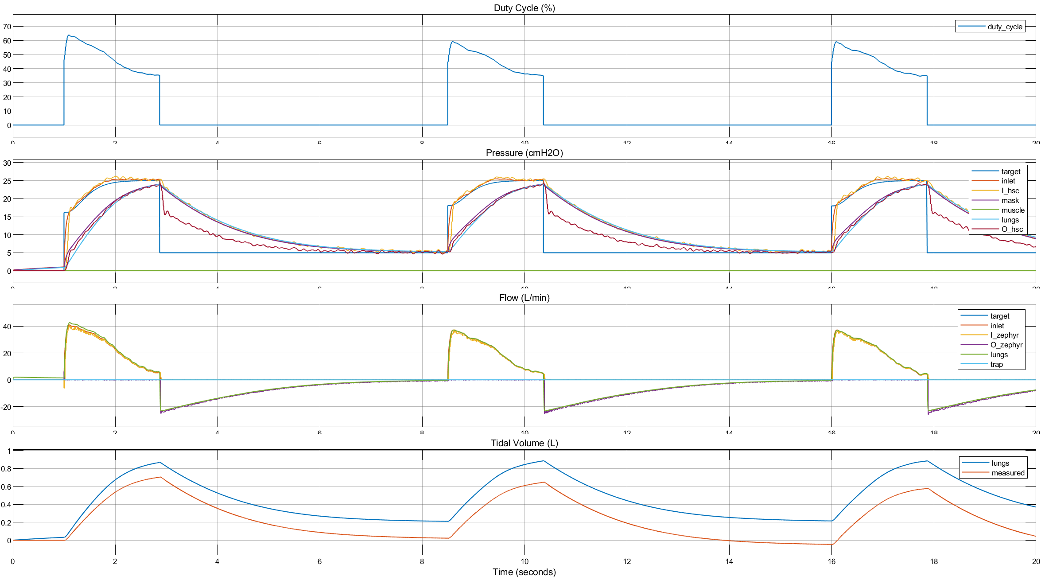
AP + CFB: Pressure Control w/ new pressure profiles from MVM

Slide 29
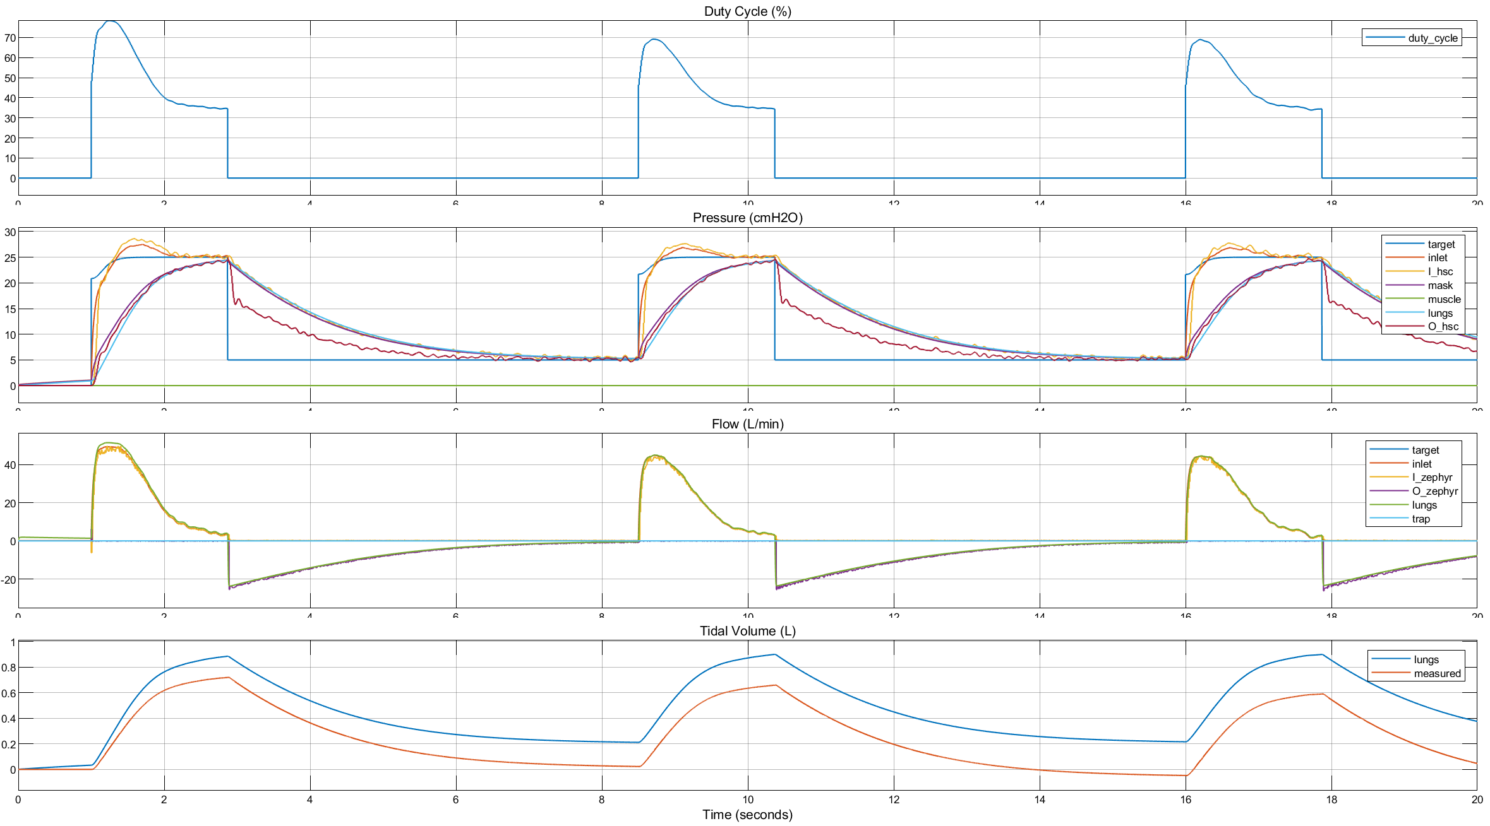
AP + CFB: Pressure Control w/ new pressure profiles from MVM

Slide 30
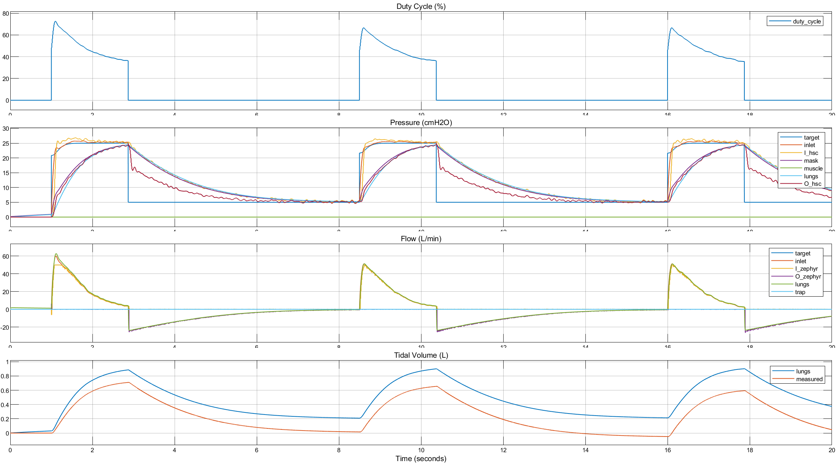
CP + CFB: Pressure Control w/ new pressure profiles from MVM

Slide 31
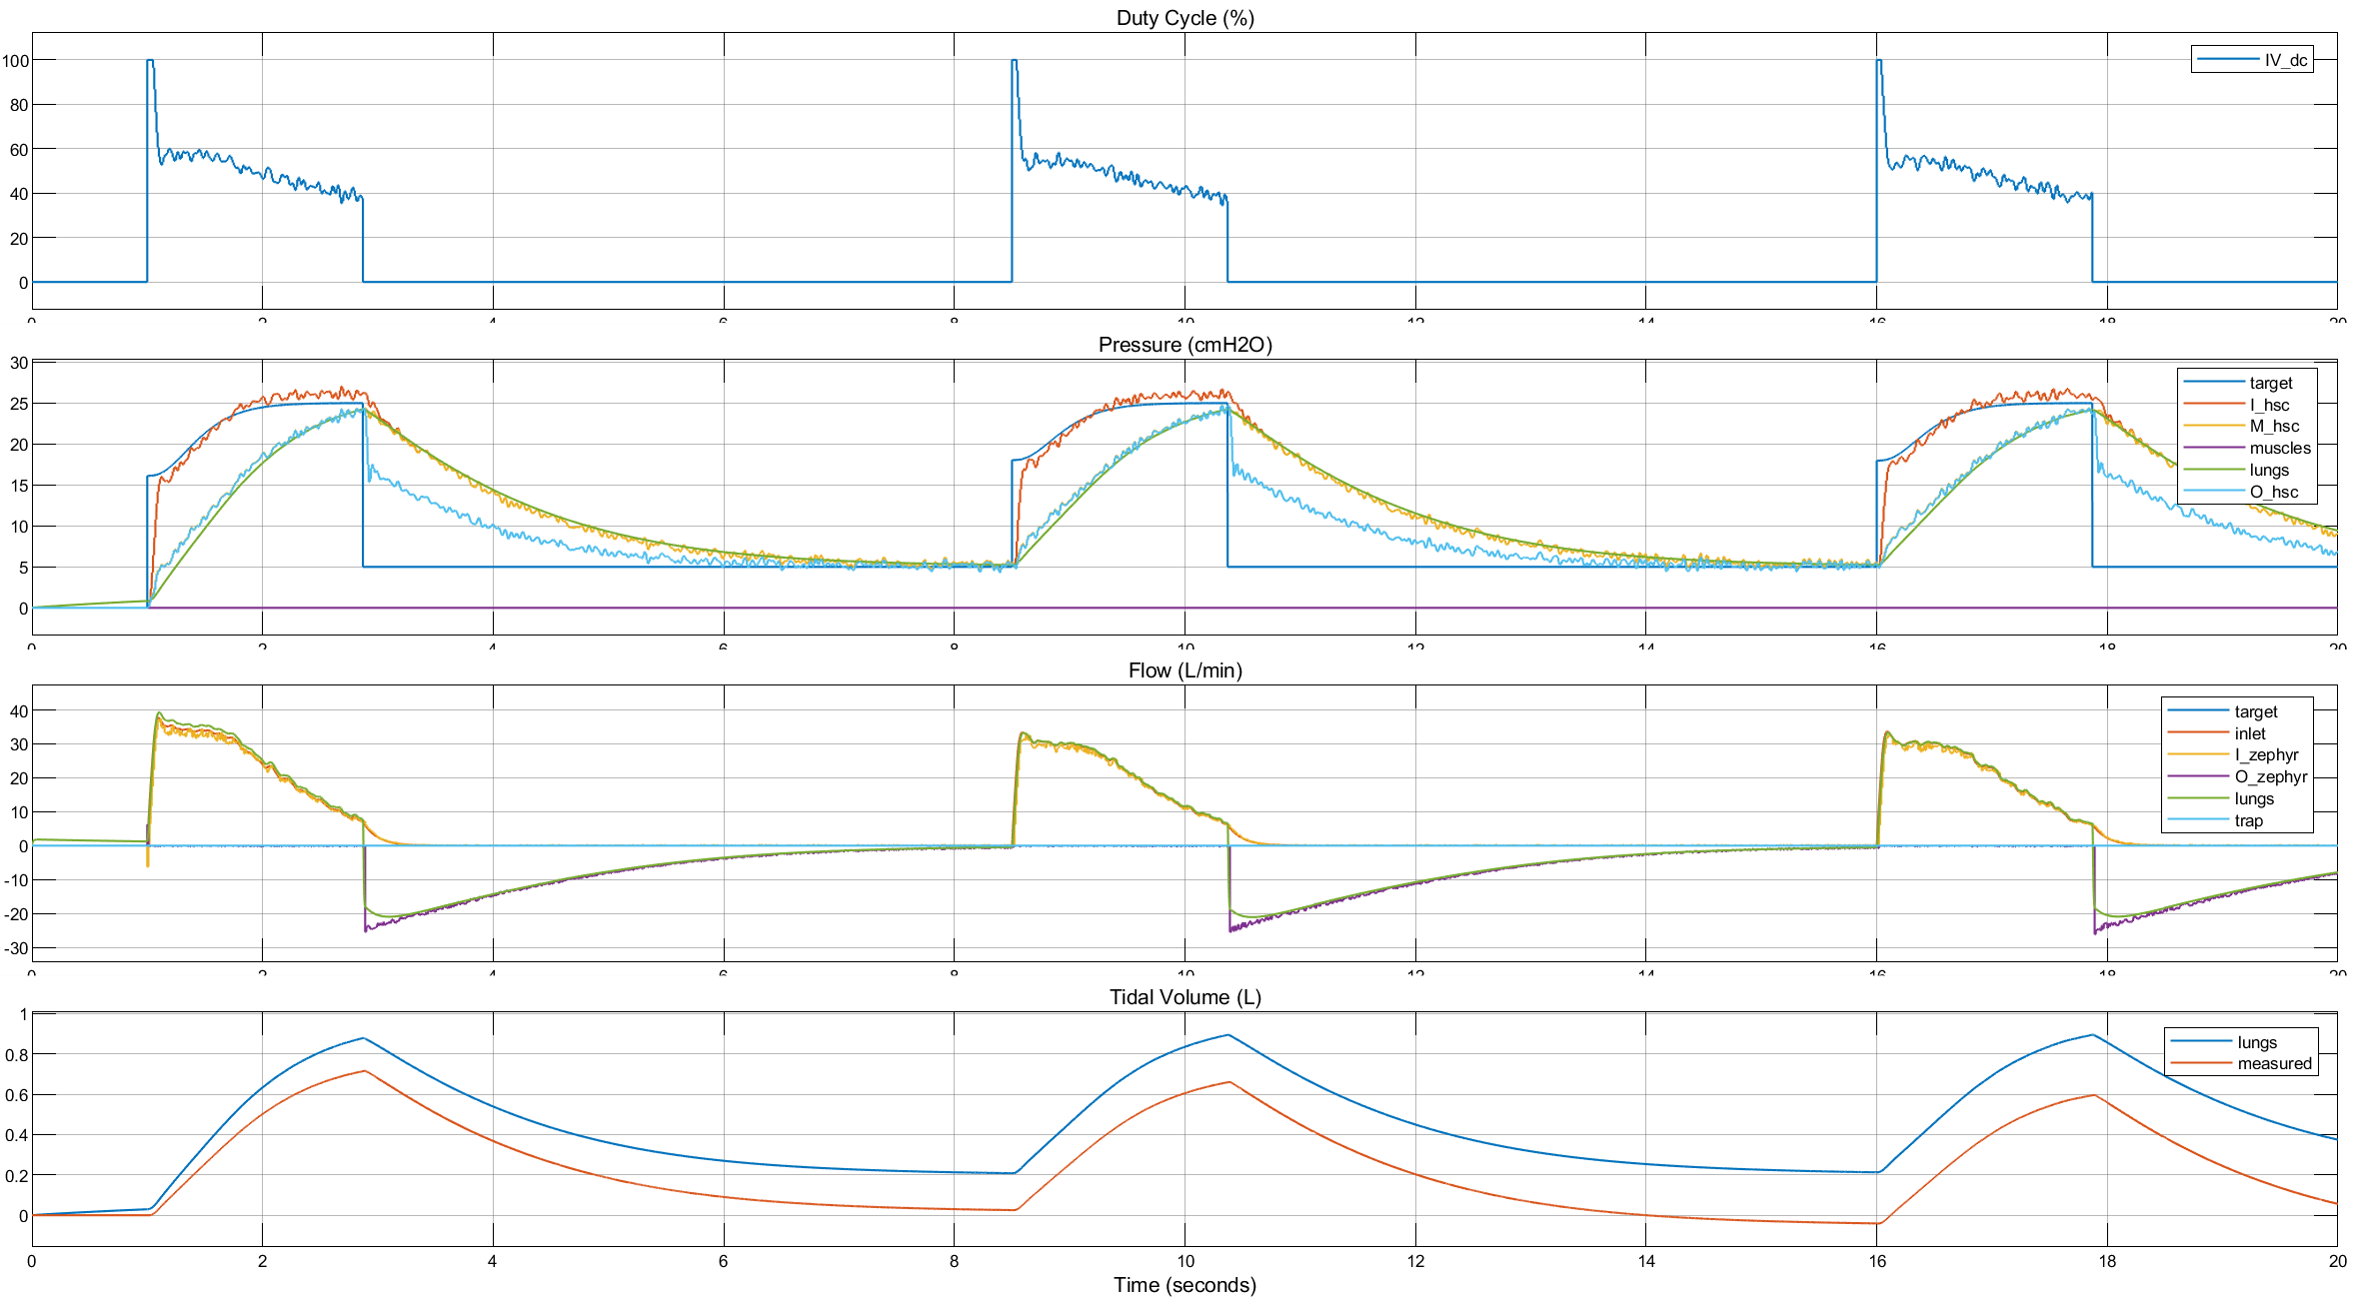
CP + CFB: Pressure Control w/ full dynamics
Feedback Filtering
IIR 3rd order
20 Hz cutoff
30 dB attenuation
0.5 dB passband max ripple
PID Controller
FFW = 40 (%FS)
P = 5 (%FS/cmH2O)
I = 10 (%FS/(cmH2O*s))

Slide 32
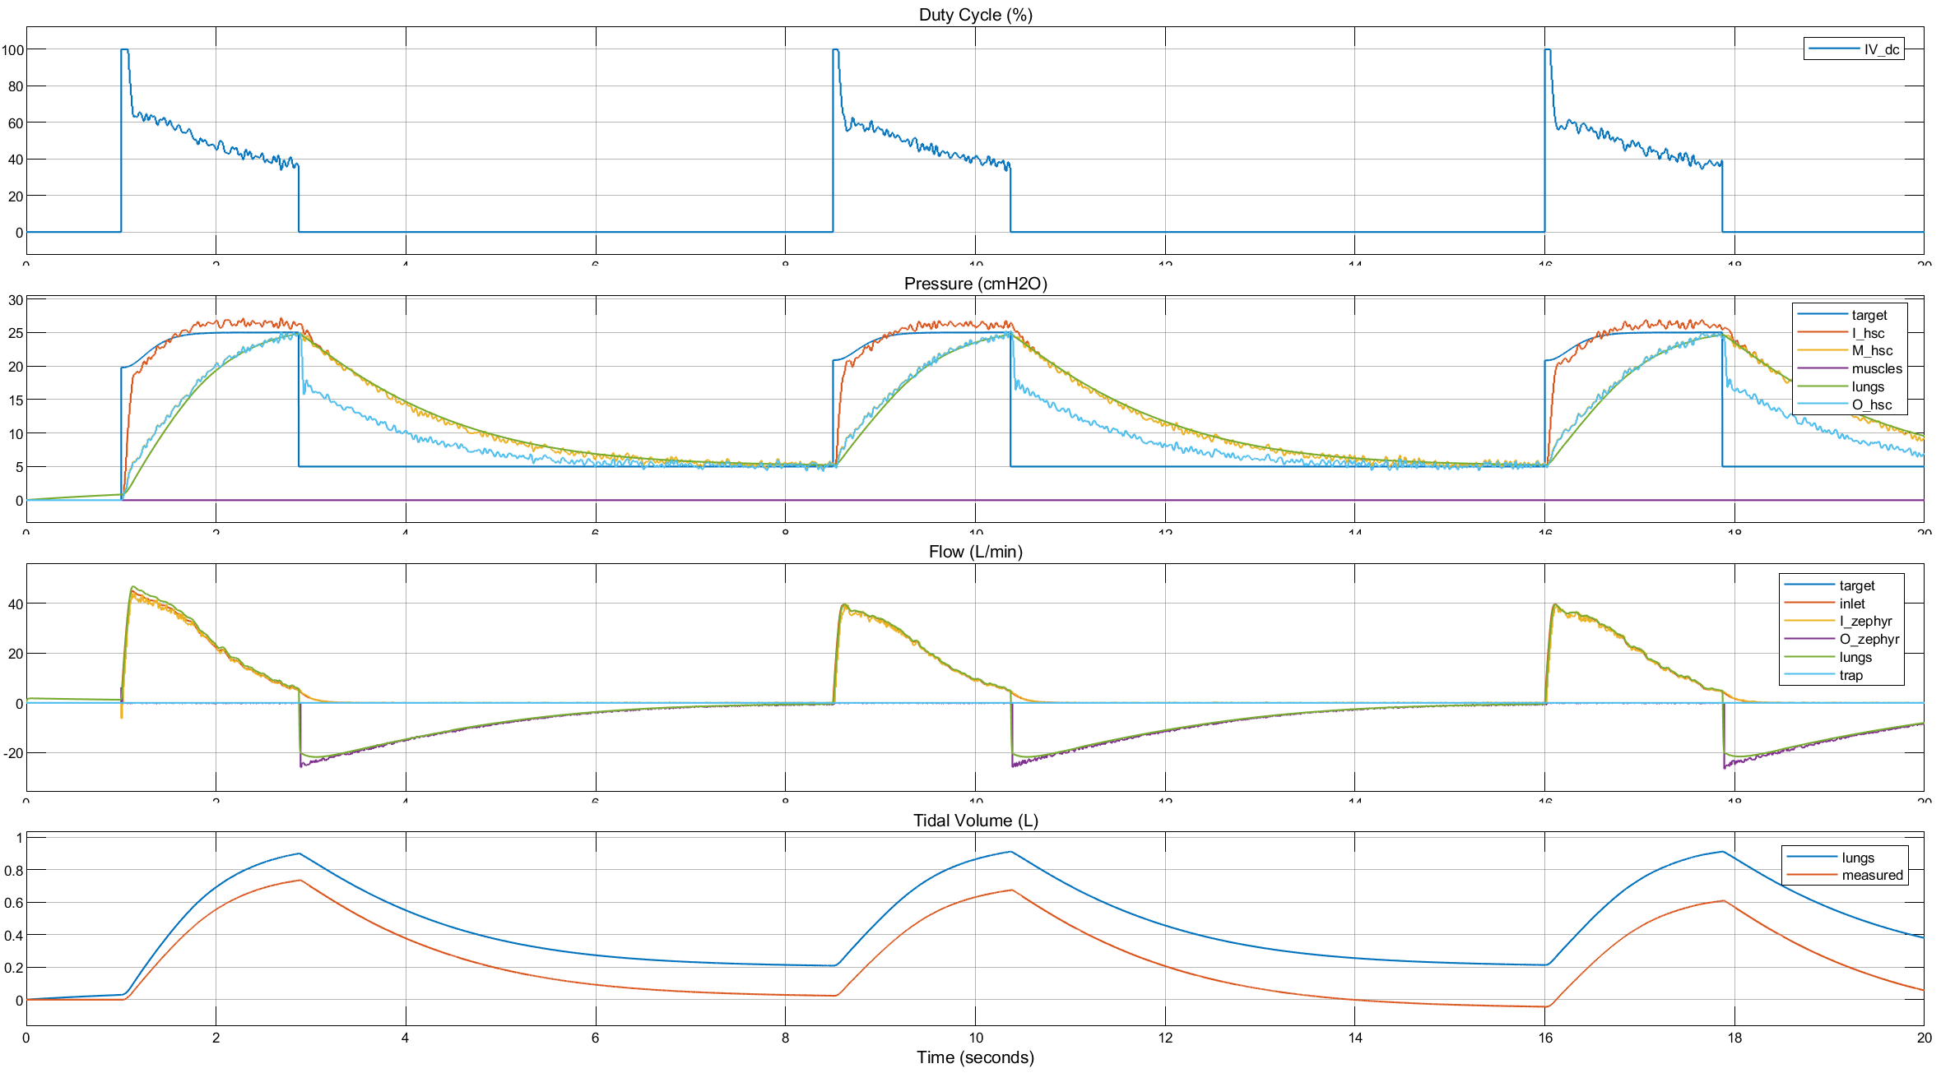
CP + CFB: Pressure Control w/ full dynamics
larger
Feedback Filtering
IIR 3rd order
20 Hz cutoff
30 dB attenuation
0.5 dB passband max ripple
PID Controller
FFW = 40 (%FS)
P = 5 (%FS/cmH2O)
I = 10 (%FS/(cmH2O*s))

Slide 33
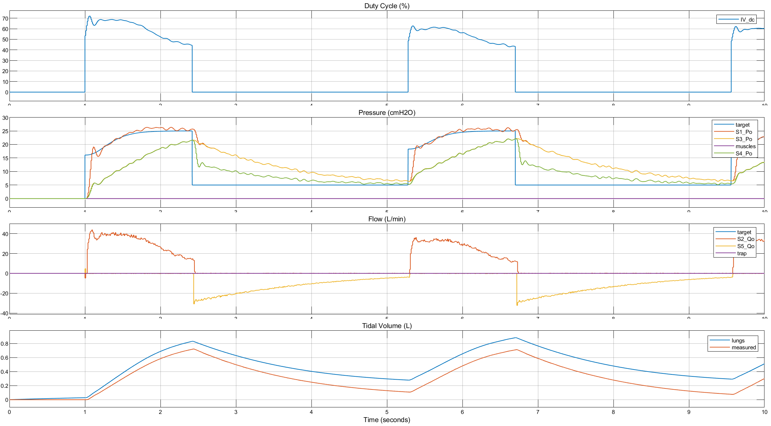
CP + CFB: Pressure Control w/ FOPDT representing full dynamics w/ Series 130 evo
Feedback Filtering
IIR 3rd order
10 Hz cutoff
30 dB attenuation
0.5 dB passband max ripple
PID Controller
FFW = 35 (%FS)
P = 1 (%FS/cmH2O)
I = 30 (%FS/(cmH2O*s))

