Slide 1

Text Classification and Keyword Identification of the Sustainable Development Goals
Andres Gomez

Slide 2
Outline
Problem/Dataset
Methods
Results
Summary/Conclusion

Slide 3

Problem statement
Sustainable Development Goals
17 broad goals addressing urgent economic, social, and environmental issues
Vast amounts of data being generated
Need for autonomy

Slide 4
Problem statement
Open Software Development Governance - Code Dataset (OSDG-CD)
Task
Apply TF-IDF feature extraction technique
Compare performance of Multinomial Naïve Bayes (MNB), Support Vector Machine (SVM), Logistic Regression (LR), and Random Forest (RF)
Identify keywords from each class
30,000 text excerpts over 15 SDGs
Average 90 words in length
Imbalanced classes
Respective ‘agreement’ score

Slide 5
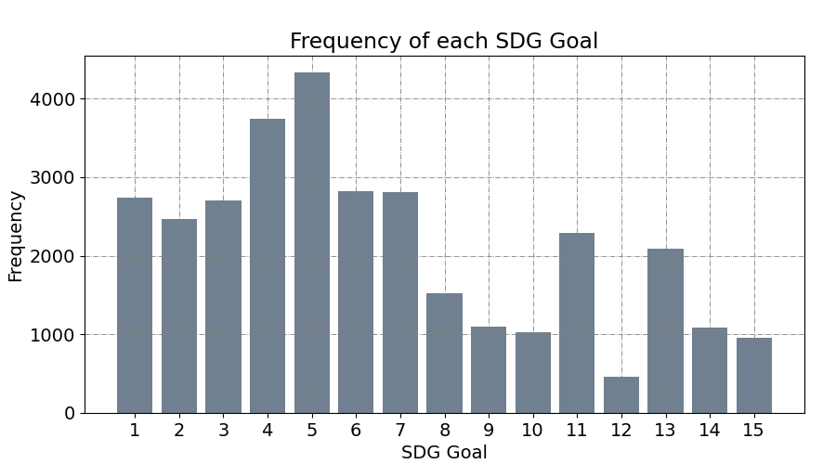
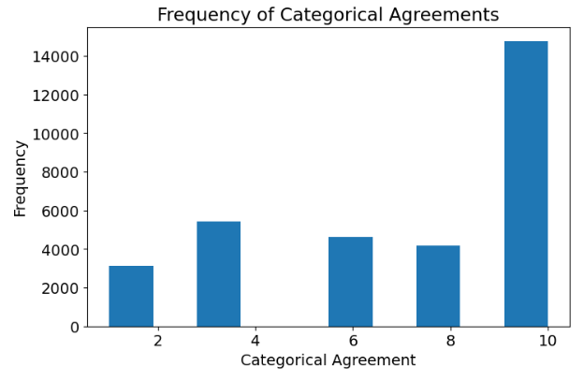
OSDG-CD
Agreement scores

Slide 6
Related work
Approaches
Matsui T et al., Tohoku-BERT model on the SDGs corpus database and reconstructed the algorithm to classify texts [2]
Guisiano J. et el. applied the BERT algorithm to the same dataset with an accuracy of 98% [3]
Morales-Hernandez et al compared several models and found that a combination of Label Powerset with a Support Vector Machine achieved an accuracy of 91% [4].

Slide 7
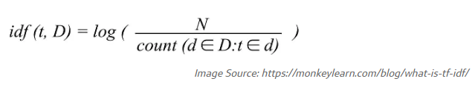
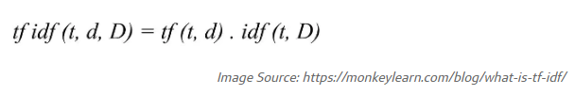
Methods
Feature extraction
Term frequency-inverse document frequency (TF-IDF)
What is term frequency?
What is inverse document frequency?
Putting it together

Slide 8
Methods
Classification and Hyperparameters
Multinomial Naïve Bayes (MNB)
Support Vector Machine (SVM)
Logistic Regression (LR)
Random Forest (RF)
TF-IDF: sublinear_df of [True, False], n_grams (1,2)
Grid search

Slide 9
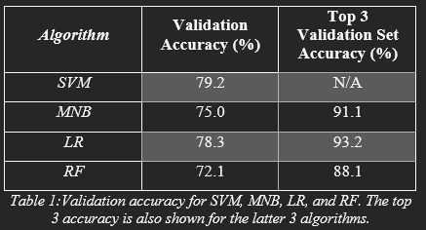
Results
Validation Performance

Slide 10
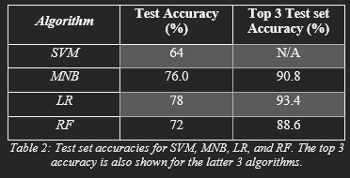
Results
Test Set Performance

Slide 11
Results
Keyword Identification
1. No Poverty
poverty, income, countries, children, social, poor, child, households, cent, household, deprivation, people, growth, rates, development, data, economic, population, employment, health
2. Zero Hunger
food, agricultural, countries, production, prices, land, price, farmers, agriculture, support, trade, development, policy, rural, market, policies, growth, use, farm, world
8. Decent Work and Economic Growth
employment, labour/labor, workers, work, countries, job, education, OECD, unemployment, growth, market, social, sector, economic, youth, policy, income, training, time, development

Slide 12
Summary
LR the second highest overall accuracy on the validation set and the highest top 3 accuracy
SVM obtained the highest overall accuracy on the validation set but generalized poorly
The LR model generalized the best to the test set, obtaining an overall accuracy of 78% and a top 3 accuracy of 93%.

Slide 13
References
[1] Osdg, et al. “OSDG Community Dataset (OSDG-CD).” Zenodo, 1 Oct. 2021, https://zenodo.org/record/5550238#.Y_AVNnbMKUl
[2]Matsui, Takanori, et al. “A Natural Language Processing Model for Supporting Sustainable Development Goals: Translating Semantics, Visualizing Nexus, and Connecting Stakeholders - Sustainability Science.” SpringerLink, Springer Japan, 4 Feb. 2022
[3] Guisiano, Jade Eva, et al. “SDG-Meter : a deep learning-based tool for automatic text classification of the Sustainable Development Goals.” HAL Open Source, 26 Jul 2022.
[4] Guisiano, Jade Eva, et al. “Automatic classification of multilabel texts related to Sustainable Development Goals (SDGs).” HAL Open Source, 27 Feb 2021.
[5] Morales-Hernandez, et al. “A Comparison of Multi-Label Text Classification Models in Research Articles Labeled with Sustainable Development Goals” IEEE Access, Vol 10. 17 Nov 2022

