Slide 1
论文解读：SafeDrop: Detecting Memory Deallocation Bugs of Rust Programs via Static Data-Flow Analysis
Authors: 张城铨
Email: chengquanzhang@smail.nju.edu.cn
Software Security and Compiler Technology Lab
Department of Computer Science, Nanjing University

Slide 2
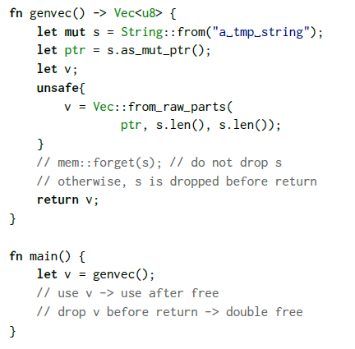
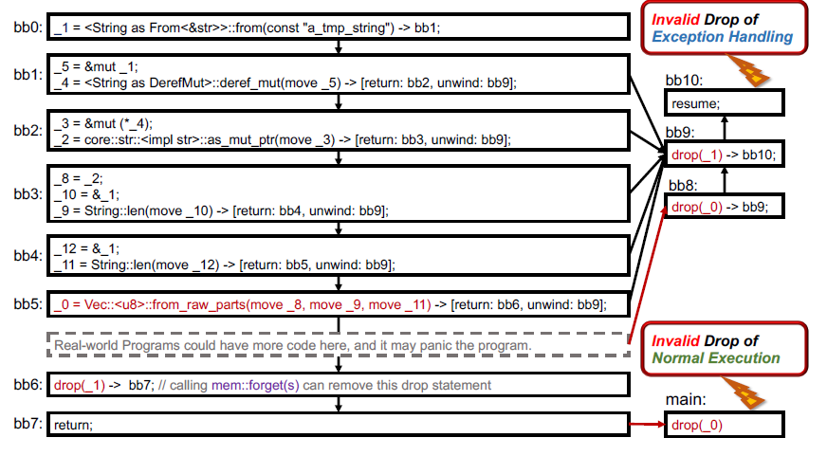
Motivation(1)
Rust enforces RAII and releases unused resources automatically.
The buggy drop() can be divided into 2 situations:
Invalid Drop of Normal Execution
_1
_5, _4
_3, _2
_8
_0

Slide 3
Root cause(1)
Rust assumes that each parameter should either
transfer its ownership to the callee (for Drop variable) or
duplicate a deep copy (for Copy variable).
Thus the return value would no longer share the ownership with the alive variables remained.
Save the borrow checker from the inter-procedural pointer analysis.
Key: the current Rust compiler does not add the alias checking support for raw pointers
What’s worse, the unsafe marker has been stripped away after lowering the code to MIR.
The Rust compiler cannot differentiate the safety boundary anymore.

Slide 4
Motivation(2)
Invalid Drop of Normal Execution
Invalid Drop of Exception Handling
_1
_5, _4
_3, _2
_8
_0

Slide 5
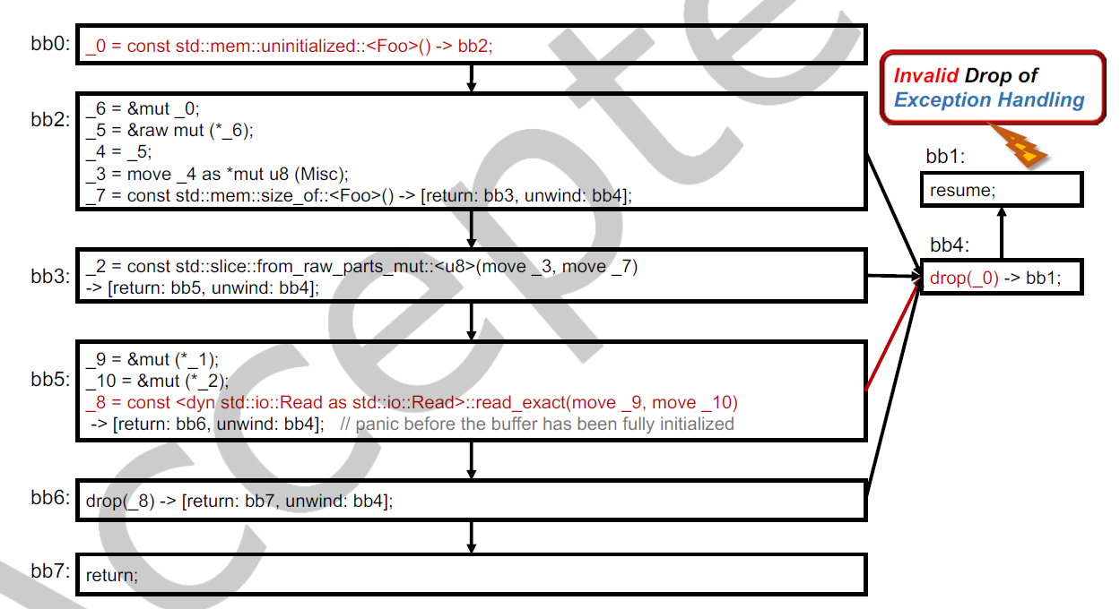
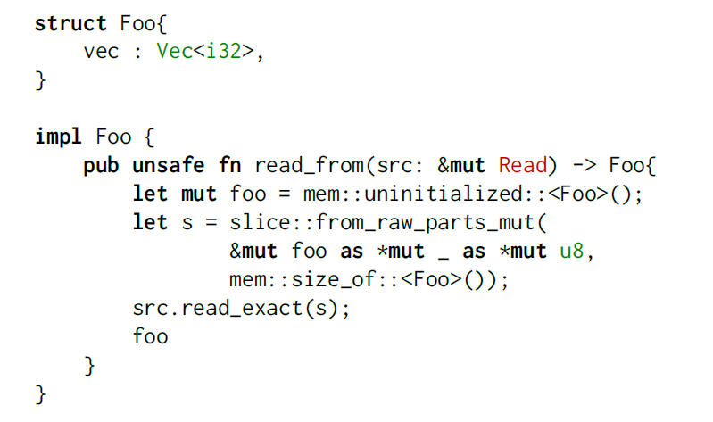
Motivation(3)
Invalid Drop of Normal Execution
Invalid Drop of Exception Handling
Notes:
If the program panics before the buffer has been fully initialized, the stack unwinding process would deallocate those uninitialized memories,

Slide 6
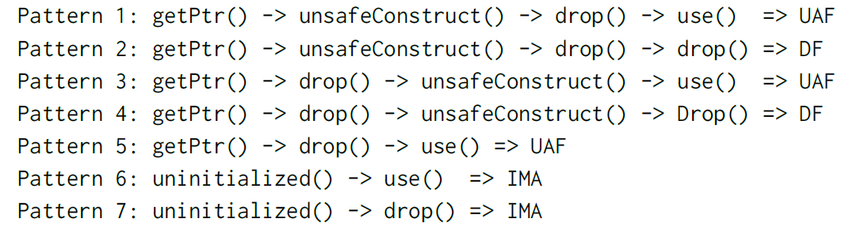
Problem Definition
Dropping buffers in use
falsely deallocates some buffers that will be accessed later, including use-after-free and double-free.
Dropping invalid pointers
dangling pointers: double free
pointers to uninitialized memory: invalid memory access
Typical Patterns

Slide 7
Research Challenges
Dynamic analysis
It is not easy to set up certain conditions to trigger buggy scenarios.
e.g., fuzzing can hardly generate test cases to cover all the panic unwinding paths.
There are also difficult memory modeling issues for path constraint extraction.
Static analysis
alias relationship involves
move
mutable borrow
immutable borrow
dereference
Only Drop variable will be automatically deallocated (traits of compound types can be derived from subtypes)
need to infer the traits of each type.
NP-hard alias analysis —— sacrifice precision —— false positive

Slide 8
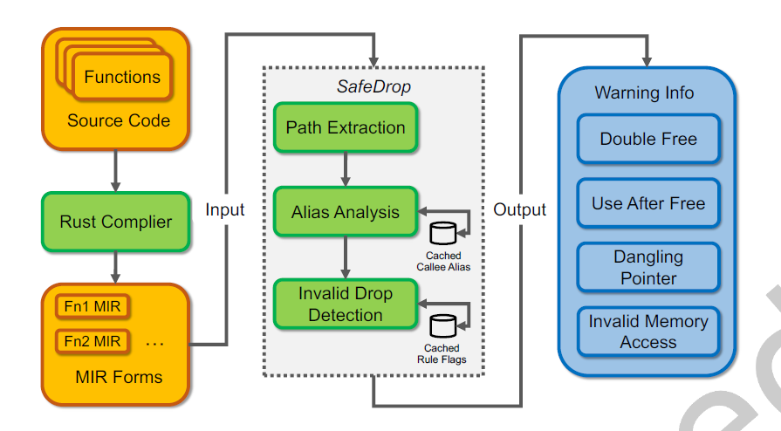
Approach
a path-sensitive data-low analysis approach
Input：MIR of each function
Output：warnings of potential bugs
3 essential steps
Path Extraction
Alias Analysis
Invalid Drop Detection

Slide 9
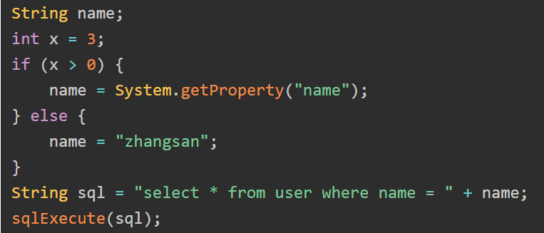
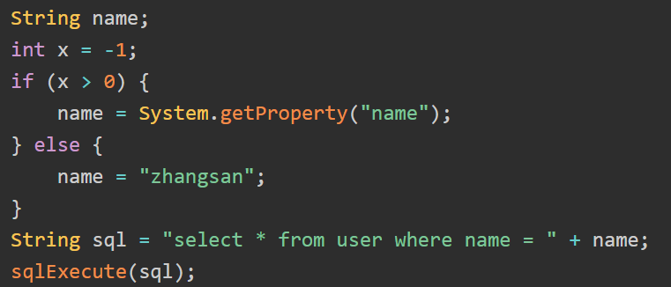
Path Extraction
a path-sensitive method instead of using the traditional semi-lattice scheme
Difference: take the path constraint into account rather than setting program states within semi-lattice model

Slide 10
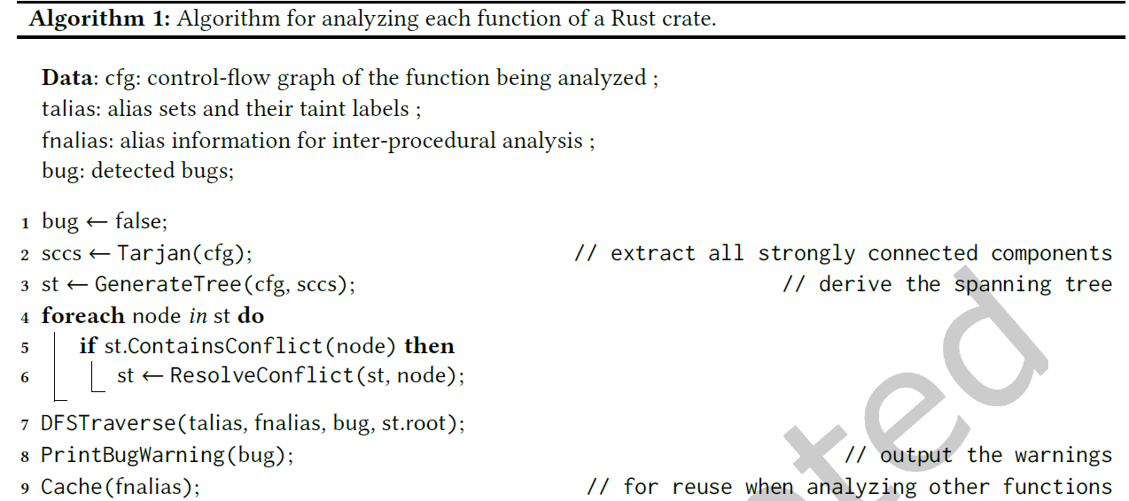
Path Extraction
Extract strongly connected component on CFG, and generate a spanning tree.
Traverse the tree and enumerate all valuable paths for MOP
a unique set of code blocks with an entrance and an exit
should not be the subset of another valuable path (select the bigger set)
Notes:
to avoid traversing cycled blocks repeatedly, just consider the maximum set of blocks (circle: strongly connected component)
do not need to differentiate unwinding paths from normal execution paths, and the algorithm works the same on both of them.

Slide 11
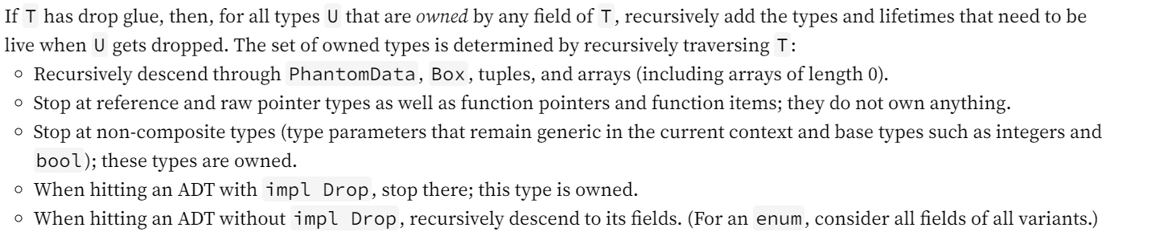

Alias Analysis
Intra-Procedural Alias Analysis
trace the Drop objects and their aliases
How to trace?
Check the assignment expression $Lvalue = Rvalue$
Not enough —— forget objects established with raw pointers
Trick: a type cannot implement both Copy trait and Drop trait at the same time
filter irrelevant objects of Copy trait except they contain raw pointers
Employ flow-sensitive analysis to each statement of a path iteratively and extract the alias relationship.
Notes:
checking if a newly created object is Drop and trace its aliases
// 指向关系
1 c = new C(); // c -> {𝑜1}
2 c.f = "x"; // c -> {𝑜1}, 𝑜1.f -> {"x"}
3 s = c.f; // c -> {𝑜1}, 𝑜1.f -> {"x"}, s -> {"x"}
4 c.f = "y"; // c -> {𝑜1}, 𝑜1.f -> {"y"}, s -> {"x"}
1 c = new C();
2 c.f = "x";
3 s = c.f;
4 c.f = "y";
//流非敏感中，指向关系表示了指针可能指向的所有对象：
// c -> {𝑜1}, 𝑜1.f -> {"x", "y"}, s -> {"x", "y"}

Slide 12
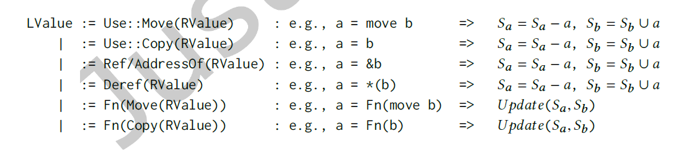
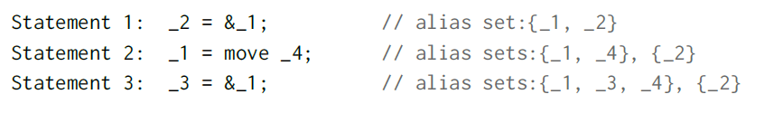
Alias Analysis
Intra-Procedural Alias Analysis
trace the Drop objects and their aliases
Rules of updating alias relationship
Example
Notes:
checking if a newly created object is Drop and trace its aliases
// 指向关系
1 c = new C(); // c -> {𝑜1}
2 c.f = "x"; // c -> {𝑜1}, 𝑜1.f -> {"x"}
3 s = c.f; // c -> {𝑜1}, 𝑜1.f -> {"x"}, s -> {"x"}
4 c.f = "y"; // c -> {𝑜1}, 𝑜1.f -> {"y"}, s -> {"x"}
1 c = new C();
2 c.f = "x";
3 s = c.f;
4 c.f = "y";
//流非敏感中，指向关系表示了指针可能指向的所有对象：
// c -> {𝑜1}, 𝑜1.f -> {"x", "y"}, s -> {"x", "y"}

Slide 13
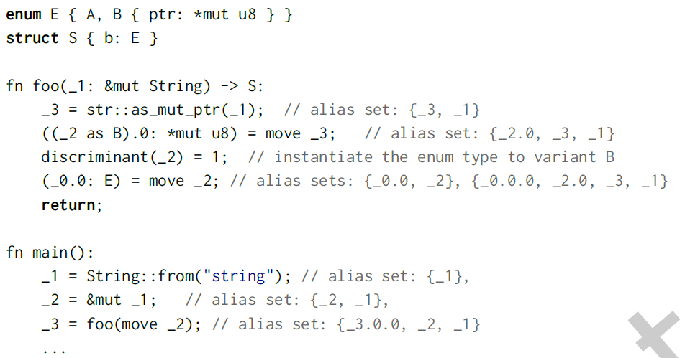
Alias Analysis
Inter-Procedural Alias Analysis
Handle function calls, i.e., alias of parameters and return values
Context-insensitive —— merge all possible alias relationships incurred in all paths
Example
Notes:
checking if a newly created object is Drop and trace its aliases
// 指向关系
1 c = new C(); // c -> {𝑜1}
2 c.f = "x"; // c -> {𝑜1}, 𝑜1.f -> {"x"}
3 s = c.f; // c -> {𝑜1}, 𝑜1.f -> {"x"}, s -> {"x"}
4 c.f = "y"; // c -> {𝑜1}, 𝑜1.f -> {"y"}, s -> {"x"}
1 c = new C();
2 c.f = "x";
3 s = c.f;
4 c.f = "y";
//流非敏感中，指向关系表示了指针可能指向的所有对象：
// c -> {𝑜1}, 𝑜1.f -> {"x", "y"}, s -> {"x", "y"}
field-sensitive

Slide 14
Bug Detection
a buggy path generally involves
a drop() statement
or the special unsafe constructor uninitialized()
Solution: label the alias sets as the tainted source and propagate the taint information
For the taint source generated from uninitialized(), update the tainted sets as untainted once the object has been initialized.
Rules
Use After Free: A variable being used in a statement is tainted.
Double Free: A variable being deallocated by drop() is tainted.
Invalid Memory Access: A variable being used or deallocated is tainted.
Dangling Pointer: A variable being returned by one function is tainted.
Notes:
tainted means the memory cannot be dropped

Slide 15
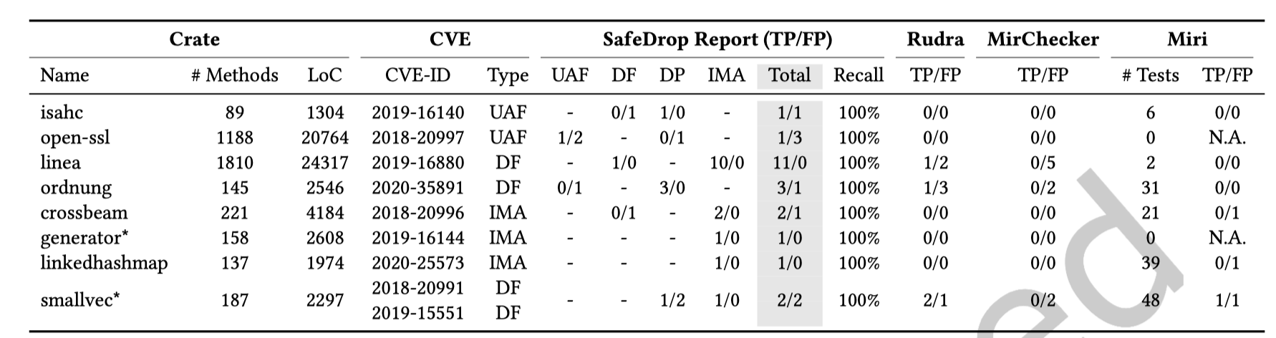
Evaluation: Effectiveness & Comparison
RQ1: How does it perform in detecting memory deallocation CVEs concerning recall and precision?
RQ3: Does SafeDrop perform better than other existing approaches, such as Rudra and MirChecker?

Slide 16
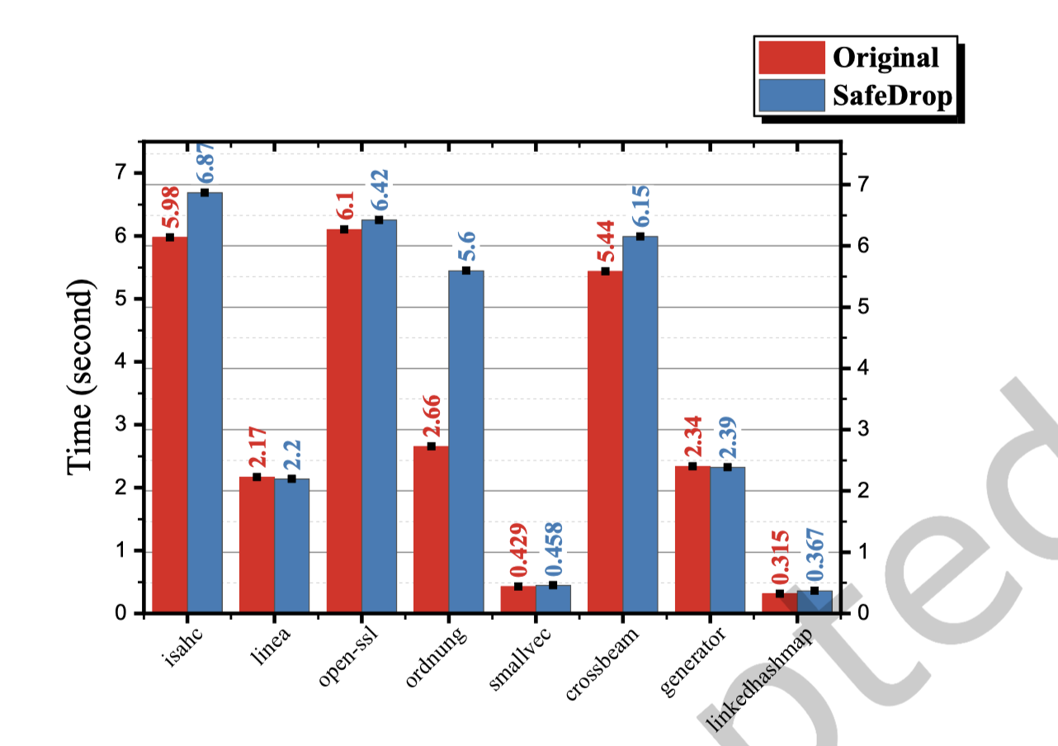
Evaluation: Efficiency
RQ2: How much overhead does SafeDrop introduce compared to the original compilation process?

Slide 17
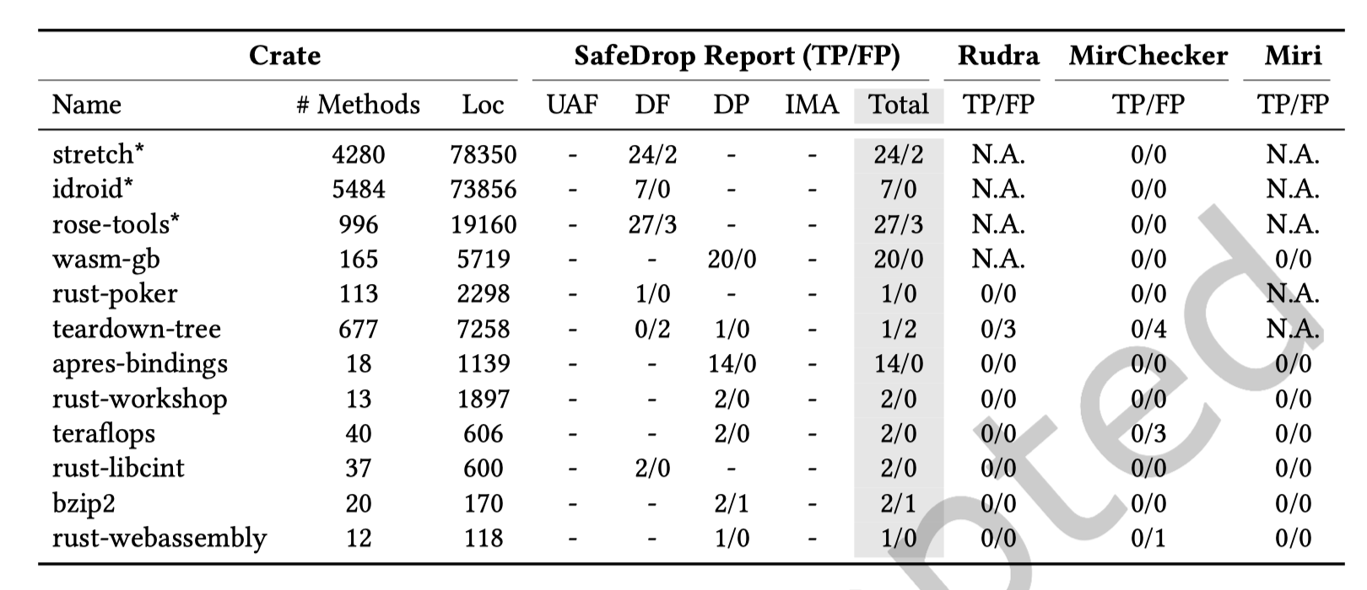
Evaluation: Usability
RQ4: Is it useful for helping developers in detecting unknown bugs from potentially many alarms?
Conduct these experiments on 50 more real-world Rust crates from GitHub
2.00 GHz Intel processor with the 18.04.1-Ubuntu operating system (Linux kernel version 5.4)
26 out of 103 bugs in three crates have been confirmed by developers.

