Slide 1

Lab Book 1.0. Waveguides
Student: Andrés Felipe Rodriguez Contreras

Slide 2
Instructions
General
SCRIPTS
From GitHub →
  Fork the repo: cccanvas-upv/pic-upv-lab1
  Clone the repo using VSCode
Run the Jupyter Notebook:
  WAVEGUIDES_Student.ipynb
W (width)
W (width)
Core
Core
h_core
h
(height)
Cladding
Cladding
Slab
h_slab
deep waveguide
shallow waveguide

Slide 3
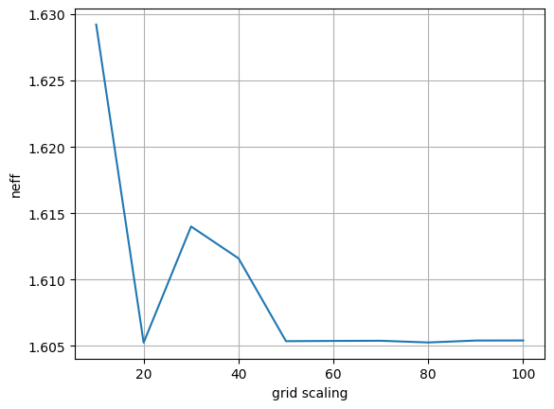
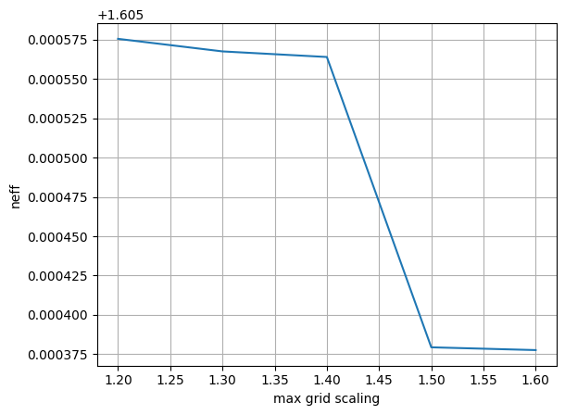
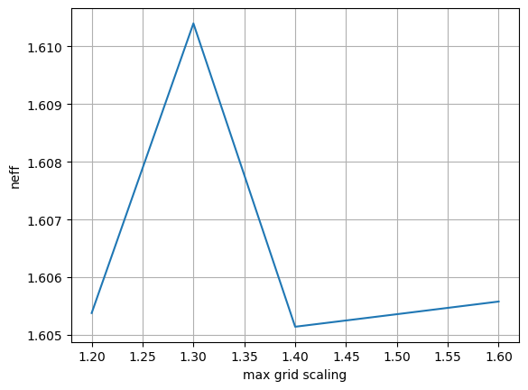
Learning outcome #1 – Convergence tests
DE waveguide, w = 1.2 µm, neff_TE0, wvl 1.55 µm.
Grid = 60 Grid = 50
deep waveguide
Paste neff_TE0 vs grid_resolution plot here
deep waveguide
Paste neff_TE0 vs max_grid_scaling plot here
Comment results, determine above which grid value the effective index calculation does not change significantly
it can be observed that the effective refractive index stabilizes at 1.605 just varying the grid value; this occurs starting from a `grid` value of 50. A higher grid resolution results in more subdivisions, which increases precision but also raises the computational cost. Values ​​of 50 and 60 were chosen for the grid, beacuse the result becomes stable from these points onward.
Regarding the variation of `max_grid_scaling`, as shown in the images, the value centers around neff = 1.6054. With a grid value of 50 which as previously noted, is already a stable point. The result doesn't become clearly defined through the `max_grid_scaling` parameter. In the other hand, with grid = 60 and `max_grid_scaling` values ​​greater than 1.5, a stable value for neff is obtained.

Slide 4
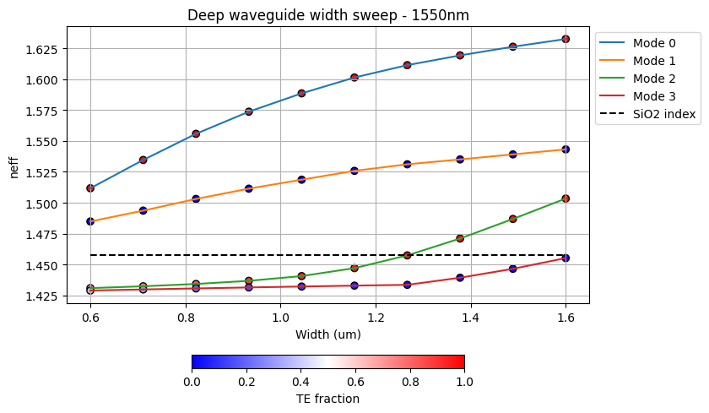
Learning outcome #2 – Width dependence
Width 0.6 - 1.6 µm (step 0.1 µm) – Wavelength 1.55 µm
deep waveguide
Paste plot here
As the width of the waveguide increases, the effective refractive index also increases, this occurs because the mode becomes better confined within the core, resulting in less power being dissipated into the cladding as the size grows. Furthermore, the polarization mode influences the effective index and is itself affected by the waveguide width, but not in the same way for all modes. For TE modes, there is a more significant change, which is related to how the field distribution within the core impact with the confinement.
Additionally, the presence of higher-order modes within the waveguide is undesirable, these modes emerge as the size of the waveguide is increased.

Slide 5
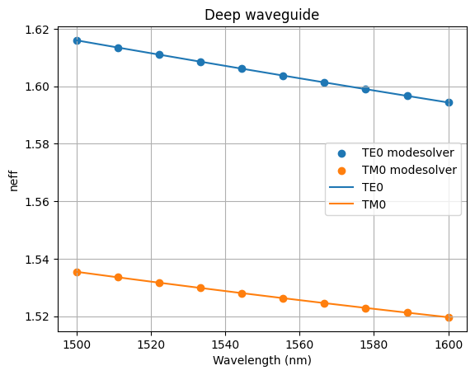
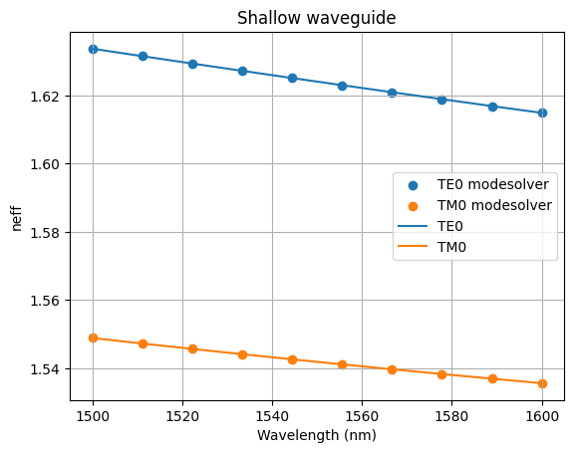

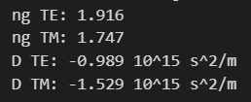

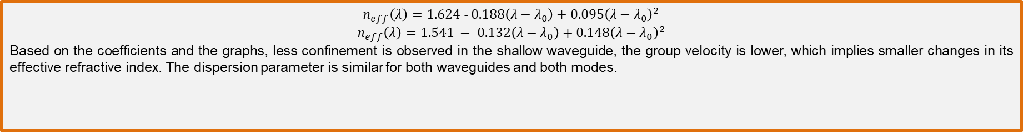
Learning outcome #3 – Waveguide compact model
Let’s model the waveguide using a second order polynomial:
$$n_{eff}\left(λ\right)=n_{1}+n_{2}\left(λ−λ_{0}\right)+n_{3}{\left(λ−λ_{0}\right)}^{2}$$
deep waveguide
neff_TE0 vs $λ$ with the second-degree polynomial fit
& neff_TM0 vs $λ$ with the second-degree polynomial fit
shallow waveguide
neff_TE0 vs $λ$ with the second-degree polynomial fit
& neff_TM0 vs $λ$ with the second-degree polynomial fit
slab: 150nm
$$n_{eff}\left(λ\right)=1.624 − 0.188\left(λ−λ_{0}\right)+0.095{\left(λ−λ_{0}\right)}^{2}$$
$$n_{eff}\left(λ\right)=1.541 − 0.132\left(λ−λ_{0}\right)+0.148{\left(λ−λ_{0}\right)}^{2}$$
Based on the coefficients and the graphs, less confinement is observed in the shallow waveguide, the group velocity is lower, which implies smaller changes in its effective refractive index. The dispersion parameter is similar for both waveguides and both modes.

Slide 6
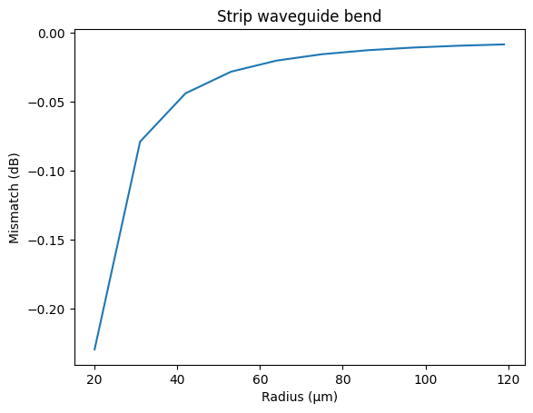
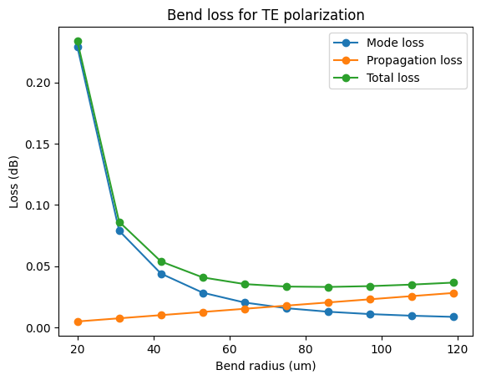
Learning outcome #4 – Bend waveguide radius vs. loss – deep
Find neff_TE0 for wvl 1.55 µm, width 1.0 µm for R=25,50,75,100, 125,150 µm
deep waveguide
Paste dB/90º neff_TE0 & neff_TM0 vs R
$α\left[\frac{dB}{90°}\right]=$ $R\frac{π}{2}α\left[\frac{dB}{µm}\right]$
Comment results, which is the safe radius, consider safe means less than 0.1 dB/90º.
As we already know that as the radius of a bend decreases, both mismatch and propagation losses increase. If a 0.1 dB limit is set for mismatch losses, the minimum radius is 30 µm; for total losses, this value approaches 40 µm. An optimal range would be between 70 µm and 100 µm, as this results in minimum loss values ​​of 0.04 dB.

Slide 7

Extras

Slide 8
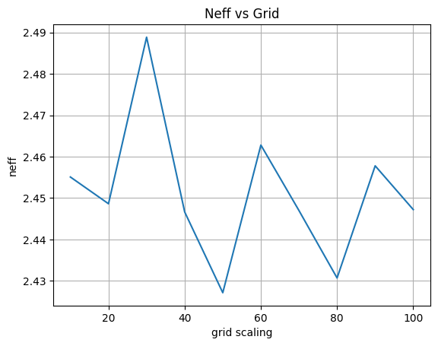
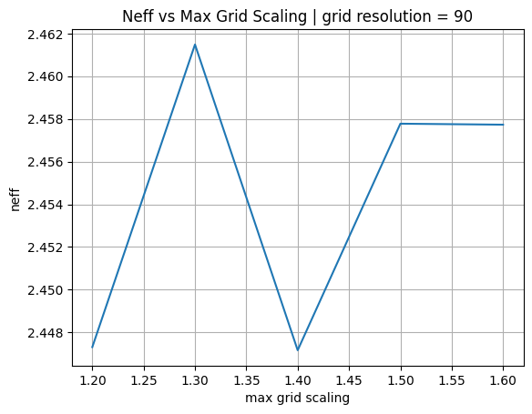
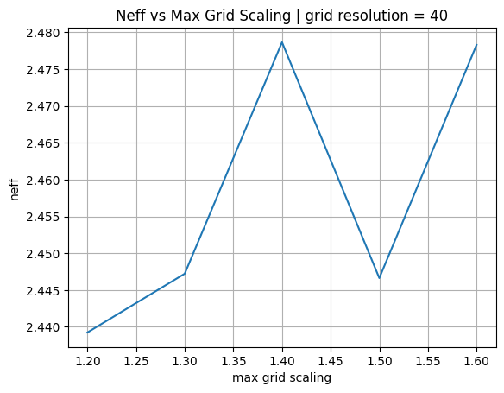
Extra– Convergence tests
DE waveguide, w = 0.5 µm, neff_TE0, wvl 1.55 µm.
deep waveguide
Paste neff_TE0 vs grid_resolution plot here
For the case of silicon as the core, when varying the grid size, the value does not stabilize at any point and keeps fluctuating, so a grid value of 40 was chosen, for which neff = 2.45 is the most frequently repeated value.
In the second plot, similar behavior appears, with many variations, so the grid value was changed to 90, where the value is observed to stop varying after 1.5.
For silicon as the core, the effective index values are highly dependent on the grid and max grid scaling variables, but in the case SixNx this doesn’tt occur.

Slide 9
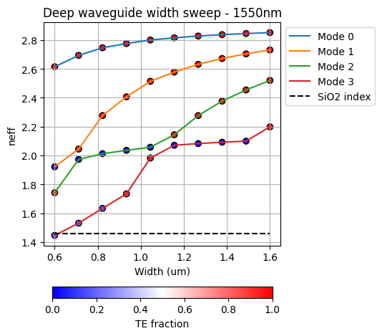
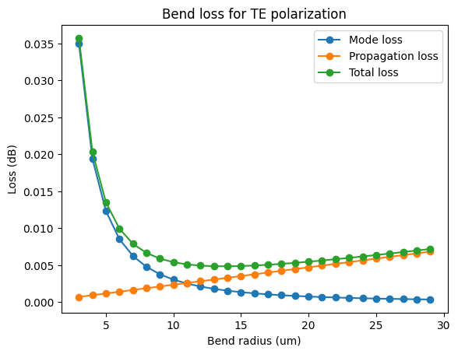
Extra– Width dependence and losses due to bends
Width 0.6 - 1.6 µm (step 0.1 µm) – Wavelength 1.55 µm | radius (3 µm -30 µm)
Width dependence: For silicon as the core, a behavior similar to the previous case is observed: the TE0 mode, which will be better confined, changes with respect to the width but tends to stabilize at a certain value. The other modes, on the other hand, increase their neff value, which means that with a larger width more modes will be transmitted.
Losses due to bends: Regarding bend loss, the total losses obtained are very small depending on the bend diameter; no value exceeds 0.1 dB. The range of minimum losses lies between 9 and 15 µm with 0.005dB. Compared with the previous case with the SixNx core, we can make larger bends without losing too much power. The light is much better confined in the waveguide, which can be seen from the effective index in the left plot: the neff values are approximately 2.6, as opposed to 1.6 in the previous case. Since the light is better confined, there are fewer losses. In conclusion, we observe that Si cores offer better performance given their neff, but care must be taken with the modes that travel through the guide.

Slide 10
Thank you

