Slide 1


CV’S
QUALIFICATION

Slide 2
67%
According to LinkedIn,
of HR managers say that automation has reduced hiring time by on average.
30%

Slide 3
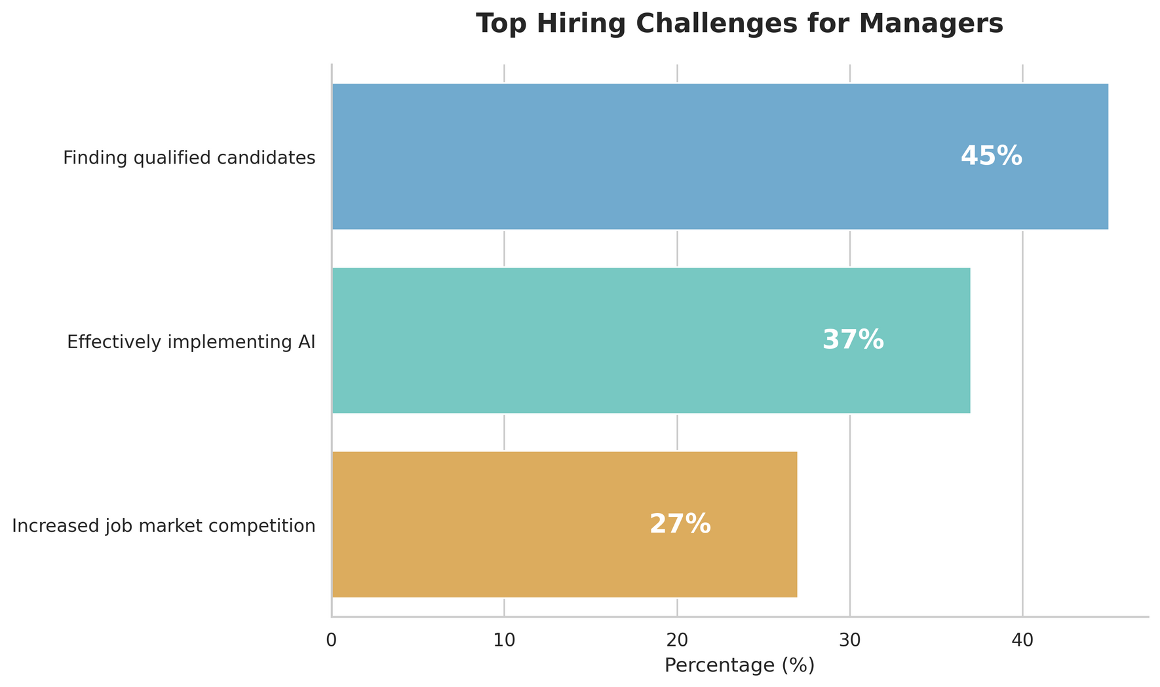
According to a survey conducted by Express Employment Professionals and Harris Poll

Slide 4
Harvard Business Review studies indicate that data-driven software can identify up to more POTENCIAL TALENT compared to traditional methods.
40%

Slide 5

Less time,
More candidates,
Better Quality

Slide 6
Only a tool
Our software won’t replace HR.
Empower the company.
Exclude garbage applications
Reduce the time in the workflow
Increase the quality of applicants
Exclude sensitive data

Slide 7
Our architecture
Flexible CV analyzing
Upload jobs at ANY TIME
AI analysis
Unbiased classification

Slide 8
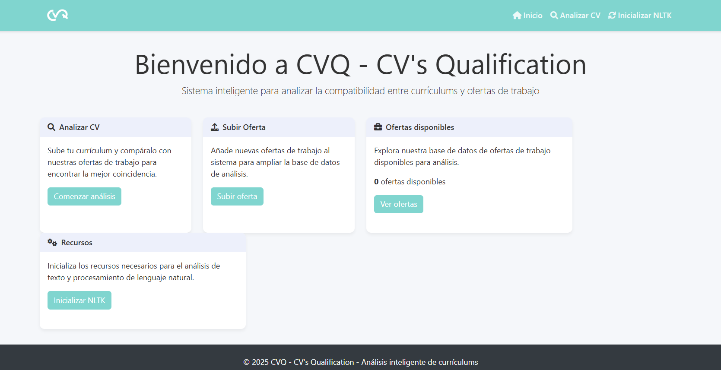

Slide 9
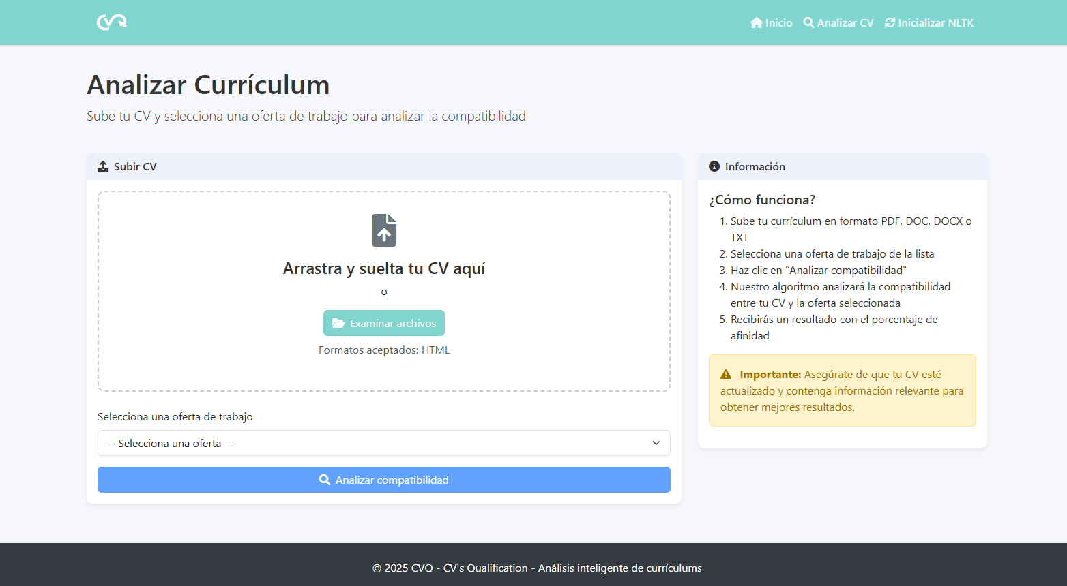

Slide 10
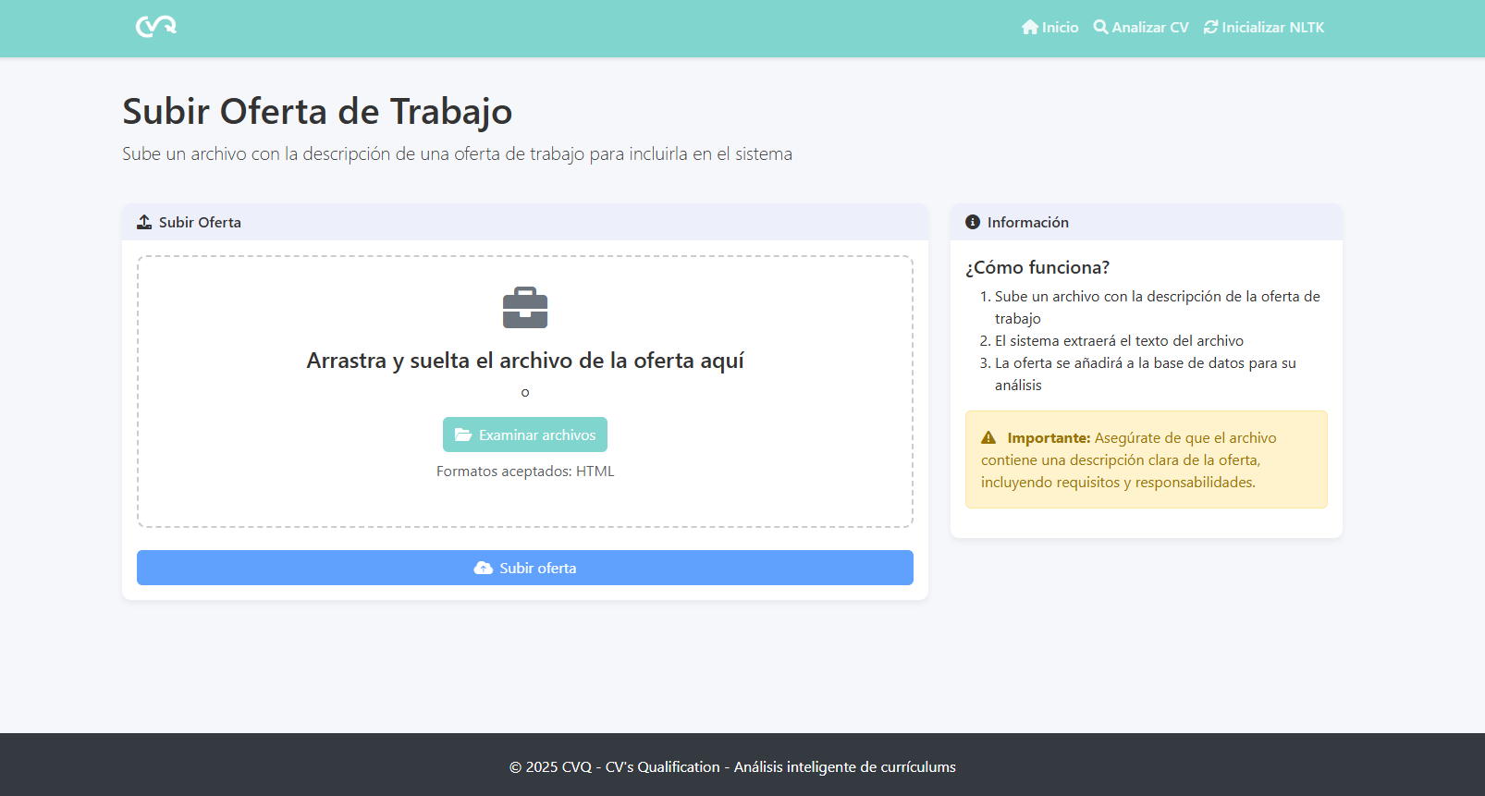

Slide 11
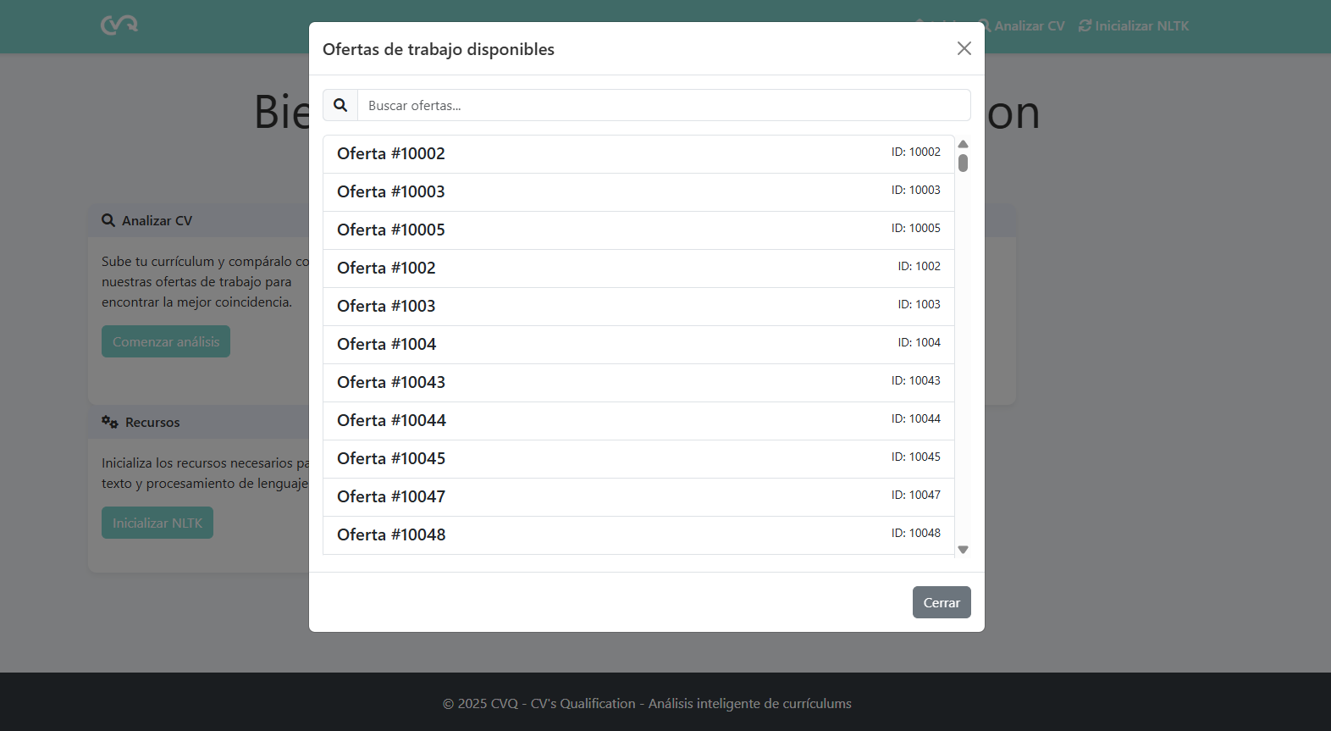

Slide 12
Thank you very much!
ANDRÉS MARTÍNEZ CABRERA
CARLOS MAUEL VÉLEZ
MIGUEL ANGEL TOVAR RODRÍGUEZ

