Slide 1




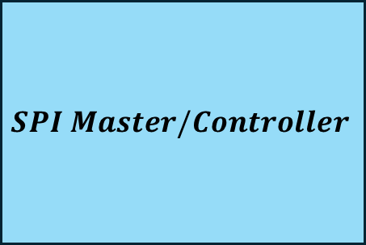





$$SPI Master/Controller$$
$$SCLK$$
$$SCLK$$
$$SPI Slave/Peripheral$$
$$\overline{SS}/\overline{CS}$$
$$\overline{SS/\overline{CS}}$$
$$MOSI/PICO$$
$$MOSI/PICO$$
$$MISO/POCI$$
$$MISO/POCI$$

Slide 2
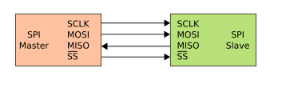
Pinout | Name | Description
SPI | Serial Peripheral Interface | Synchronous serial communication for short-distance wired communication
SCLK | Serial Clock | Clock signal from master
MOSI | Master Out Slave In | Serial data output from master
MISO | Master In Slave Out | Serial output from slave
SS/CS | Slave/Chip Select | Select signal from master to enable communication with a specific slave device
Transmission Mode: Full-Duplex (FDX)
Serial Protocol: Allows communication between master and slave both ways, simultaneously
SPI dedicates a MOSI line and a MISO line for communication between Master and Slave
Four logic signals: SCLK, SS, MOSI, MISO
MOSI on master device to MOSI on slave device, MISO on slave device to MISO on master device
Master device orchestrates communication with slave device(s) by driving the clock and chip select signals
Data Transmission:
Select slave device by pulling SS low (low: selected, high: not selected)
SPI clock cycle begins
Master sends signal to slave on MOSI, slave sends signal to master on MISO, both read signal from the other
8-bit words is most common, 16-bit words for touch-screen controllers, 12-bit words for dig2ana or ana2dig
Data stored in shift registers
SS for multiple salves requires an independent SS signal from the master for each slave device

Slide 3
SPI is a synchronous serial communication protocol where data is transmitted and received using a clock signal and separate lines for data input (MISO) and output (MOSI).
Enable SPI:
Use the raspi-config tool or modify the /boot/config.txt file to enable the SPI interface on the Raspberry Pi.
SPI0 CS Pins:
SPI0 uses GPIO 8 (CE0, pin 24) and GPIO 7 (CE1, pin 26) as its chip select lines.
CE0 and CE1 are the default chip select lines for SPI0.
SPI1 CS Pins:
SPI1 is not enabled by default and needs to be configured in the /boot/config.txt file.
To enable SPI1 and use three chip selects, you would add the following line to /boot/config.txt: dtoverlay=spi1-3cs
If SPI1 is enabled, it can utilize GPIO pins like 16, 17, 18, and 19 as chip select pins, depending on the configuration.
An example of enabling SPI1 and using three chip selects is: dtoverlay=spi1-3cs.
Using Multiple Chip Selects:
To use multiple SPI devices, you can activate the corresponding CS pin using GPIO control, and then use the SPI library to read from the selected device.
You can also create custom overlays to map additional chip select pins to specific GPIOs.
Device Tree Overlay (dtbo):
You may need to create or modify a device tree overlay file to describe the connection of the DW3000 to the Raspberry Pi's GPIO pins.
This allows the Raspberry Pi OS to recognize and configure the DW3000.

