Slide 1
BBC News Categorization Analysis
ITAI 2373: Final Project
Andres Daza & Taki Bouberi
Professor Anna Rachapudi
Notes:
---

Slide 2
Introduction
Notes:
---
This slide references information from the following file: https://gracechurchlive-my.sharepoint.com/personal/adaza_grace_one/Documents/Microsoft%20Copilot%20Chat%20Files/MT_PT_Andres%20Daza%20Catano%20%26%20Taki%20Boubekri_ITAI2373.pdf
Project Overview, Dataset Details

Slide 3
Project Dataset: BBC News
Project Overview
The goal of this project was to analyze the provided BBC News Dataset. We implemented a comprehensive NLP pipeline to process, analyze, and classify news articles into their respective categories.
News Article Categorization
Classification targets categories like business, tech, politics, sport, and entertainment for effective content management.
Project Impact
Automated categorization supports media monitoring, trend identification, and decision-making in large text datasets.
Notes:
---
This slide references information from the following file: https://gracechurchlive-my.sharepoint.com/personal/adaza_grace_one/Documents/Microsoft%20Copilot%20Chat%20Files/MT_PT_Andres%20Daza%20Catano%20%26%20Taki%20Boubekri_ITAI2373.pdf
The BBC News Categorization Analysis project aimed to develop a comprehensive NLP pipeline to classify news articles into predefined categories such as business, tech, politics, sport, and entertainment. The primary objective was to process and analyze the BBC News dataset using machine learning models to achieve accurate and reliable categorization. The pipeline included data preprocessing, feature extraction, model training, and evaluation. This project demonstrates practical applications of text classification in real-world scenarios, such as media monitoring and content management. By automating categorization, organizations can efficiently manage large volumes of text data, identify trends, and support decision-making processes. The project also emphasizes the importance of robust model selection and evaluation to ensure consistent performance across diverse datasets.

Slide 4

Dataset Details
Dataset Composition
  The BBC News dataset includes labeled articles in business, tech, politics, sport, and entertainment categories.
Training and Testing Data
  Training set has 1,490 records, and testing set has 735 records for balanced model development.
Text Preprocessing
  Preprocessing steps include tokenization, stop-word removal, and TF-IDF feature extraction to prepare data for ML.
Dataset Importance
  Understanding dataset structure is vital for choosing models and evaluation metrics for accurate classification.
Notes:
---
This slide references information from the following file: https://gracechurchlive-my.sharepoint.com/personal/adaza_grace_one/Documents/Microsoft%20Copilot%20Chat%20Files/MT_PT_Andres%20Daza%20Catano%20%26%20Taki%20Boubekri_ITAI2373.pdf
The dataset used for this project was the BBC News dataset, which consists of labeled news articles across five categories: business, tech, politics, sport, and entertainment. The training set included 1,490 rows, while the testing set contained 735 rows. Each record comprised an article ID, text content, and its corresponding category label. This dataset provided a balanced representation of different news domains, enabling the development of a classification model that generalizes well to unseen data. Proper preprocessing steps, such as tokenization, stop-word removal, and feature extraction using TF-IDF, were essential to prepare the text for machine learning algorithms. Understanding the dataset's structure and characteristics was critical for selecting appropriate models and evaluation metrics.

Slide 5
Model Comparison and Performance
Notes:
---
This slide references information from the following file: https://gracechurchlive-my.sharepoint.com/personal/adaza_grace_one/Documents/Microsoft%20Copilot%20Chat%20Files/MT_PT_Andres%20Daza%20Catano%20%26%20Taki%20Boubekri_ITAI2373.pdf
Models Evaluated, Performance Metrics and Results

Slide 6
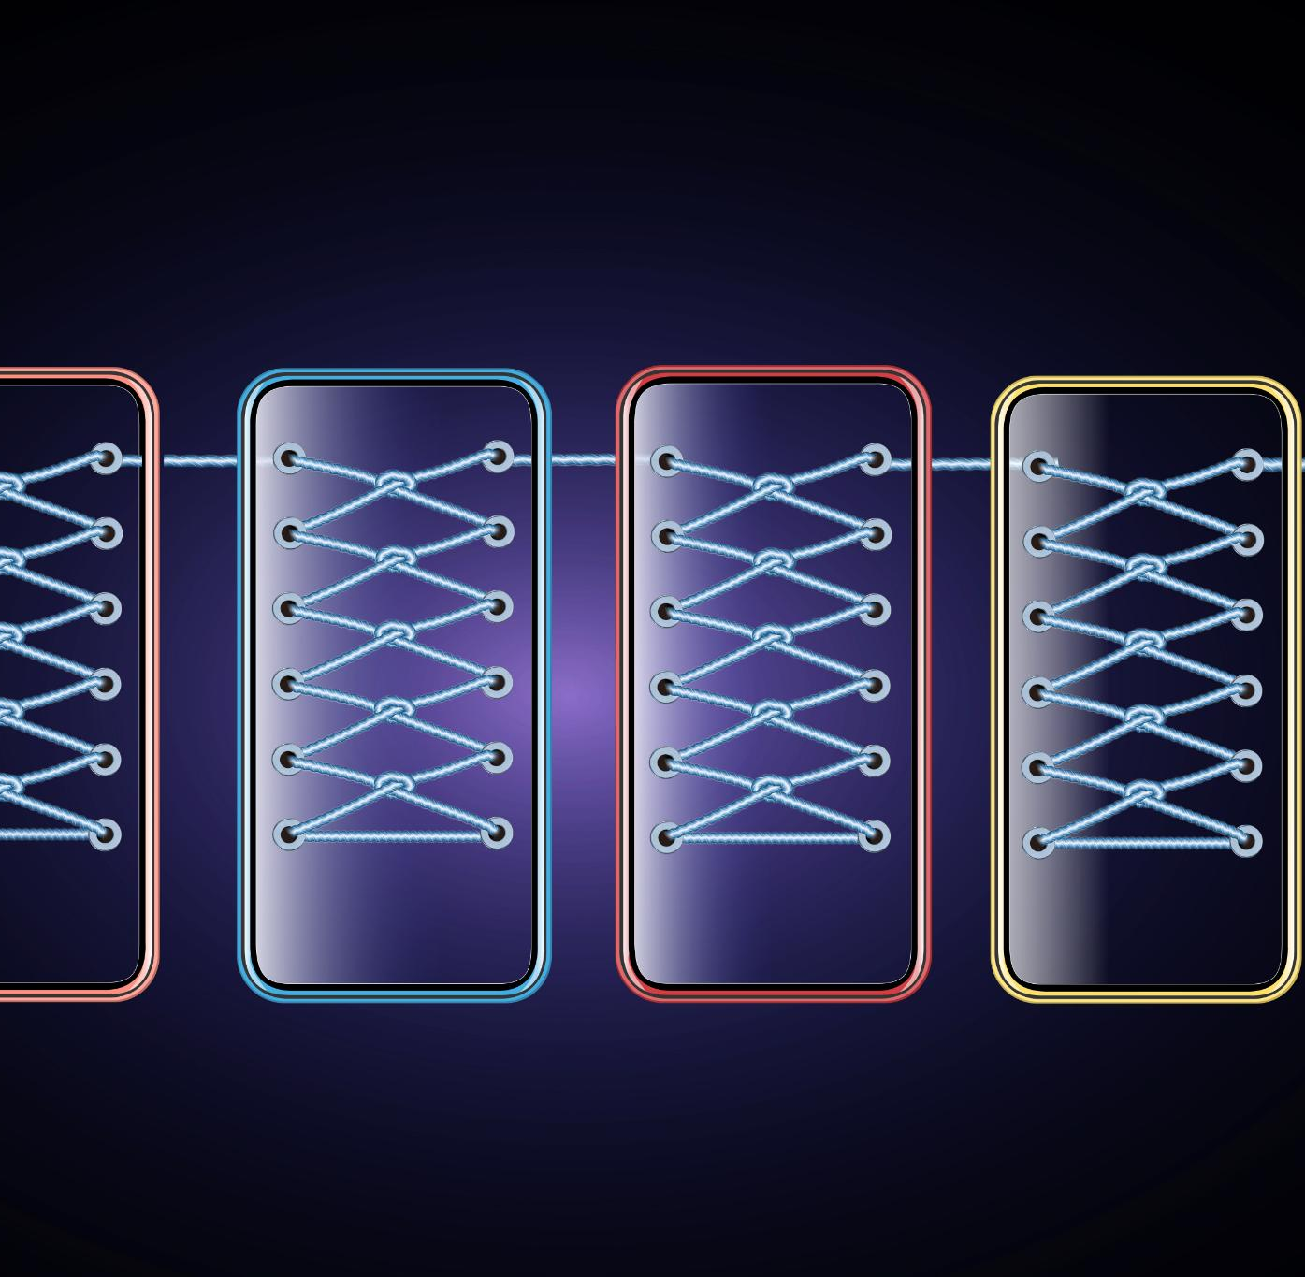
Models Evaluated
Naive Bayes Model
  Naive Bayes is a simple, efficient probabilistic classifier suited for text classification tasks.
Logistic Regression Model
  Logistic Regression handles binary and multiclass classification well, especially with high-dimensional text data.
Support Vector Machine
  SVM finds the optimal hyperplane for class separation but requires careful parameter tuning.
Notes:
---
This slide references information from the following file: https://gracechurchlive-my.sharepoint.com/personal/adaza_grace_one/Documents/Microsoft%20Copilot%20Chat%20Files/MT_PT_Andres%20Daza%20Catano%20%26%20Taki%20Boubekri_ITAI2373.pdf
Three machine learning models were evaluated for this project: Naive Bayes, Logistic Regression, and Support Vector Machine (SVM). Naive Bayes is a probabilistic classifier well-suited for text classification tasks due to its simplicity and efficiency. Logistic Regression, a linear model, is widely used for binary and multiclass classification problems and often performs well with high-dimensional data like text. SVM is a powerful algorithm that aims to find the optimal hyperplane for separating classes, but it can be computationally intensive and sensitive to parameter tuning. Comparing these models allowed the team to identify the most effective approach for categorizing BBC News articles based on accuracy and robustness.

Slide 7
Performance Metrics and Results
Model | Test Accuracy | CV Mean | CV Std
Naive Bayes | 0.7215 | 0.4740 | 0.0594
Logistic Regression | 0.7148 | 0.7567 | 0.0313
SVM | 0.3557 | 0.3574 | 0.0193
Notes:
---
This slide references information from the following file: https://gracechurchlive-my.sharepoint.com/personal/adaza_grace_one/Documents/Microsoft%20Copilot%20Chat%20Files/MT_PT_Andres%20Daza%20Catano%20%26%20Taki%20Boubekri_ITAI2373.pdf
The evaluation focused on key performance metrics, including Test Accuracy, Cross-Validation Mean (CV Mean), and Cross-Validation Standard Deviation (CV Std). Naive Bayes achieved the highest Test Accuracy at 0.7215, but its low CV Mean of 0.4740 and high standard deviation indicated potential overfitting and inconsistency. Logistic Regression delivered a slightly lower Test Accuracy of 0.7148 but demonstrated superior robustness with a CV Mean of 0.7567 and a low standard deviation of 0.0313, making it the most reliable model for future predictions. SVM performed poorly, with a Test Accuracy of 0.3557 and CV Mean of 0.3574, suggesting it was unsuitable for this dataset. These results highlight the importance of considering both accuracy and consistency when selecting models for text classification tasks.

Slide 8
Reflection and Future Directions
Notes:
---
This slide references information from the following file: https://gracechurchlive-my.sharepoint.com/personal/adaza_grace_one/Documents/Microsoft%20Copilot%20Chat%20Files/MT_PT_Andres%20Daza%20Catano%20%26%20Taki%20Boubekri_ITAI2373.pdf
Challenges and Applications, Ethical Considerations and Future Learning

Slide 9

Challenges and Applications
Technical Integration Challenges
  Integrating diverse NLP libraries and ensuring data compatibility posed significant technical challenges in the project.
Complex Data Handling
  Combining sentiment scores, TF-IDF features, and entity lists required careful data structuring and processing.
Real-World Applications
  The system supports media monitoring, content management, and business intelligence for efficient news categorization.
Value for Decision-Making
  Automated text analysis helps organizations identify key insights and gauge public sentiment for strategic planning.
Notes:
---
This slide references information from the following file: https://gracechurchlive-my.sharepoint.com/personal/adaza_grace_one/Documents/Microsoft%20Copilot%20Chat%20Files/MT_PT_Andres%20Daza%20Catano%20%26%20Taki%20Boubekri_ITAI2373.pdf
The project presented several technical challenges, particularly in integrating different NLP libraries and ensuring compatibility across various data processing steps. Combining diverse outputs such as sentiment scores, TF-IDF features, and entity lists required careful data handling and structuring. Despite these challenges, the system has significant real-world applications in media monitoring, content management, and business intelligence. Automating news categorization can help organizations manage large volumes of text efficiently, identify key information, and gauge public sentiment. These capabilities are valuable for decision-making and strategic planning in industries that rely on timely and accurate information.

Slide 10

Ethical Considerations and Future Learning
Ethical Risks and Responsibilities
  Address ethical risks like algorithmic bias, privacy concerns, and misinformation misuse with transparency and fairness.
Advanced Learning Techniques
  Future learning includes Topic Modeling, Transformers, BERT, and causal text analysis to enhance model capabilities.
Collaboration and Communication
  Prioritize teamwork through code reviews and effective communication for successful project delivery.
Notes:
---
This slide references information from the following file: https://gracechurchlive-my.sharepoint.com/personal/adaza_grace_one/Documents/Microsoft%20Copilot%20Chat%20Files/MT_PT_Andres%20Daza%20Catano%20%26%20Taki%20Boubekri_ITAI2373.pdf
Ethical considerations were an important aspect of this project. Potential risks include algorithmic bias in classification, privacy concerns related to entity extraction, and misuse in generating or analyzing misinformation. Addressing these issues requires transparency, fairness, and accountability in model development and deployment. Future learning goals include exploring advanced techniques such as Topic Modeling (LDA), implementing deep learning models like Transformers and BERT, and investigating methods for understanding causal relationships in text. Additionally, improving collaboration through consistent code reviews and effective communication will remain a priority for successful project execution.

Slide 11
Conclusion
Notes:
---
This slide references information from the following file: https://gracechurchlive-my.sharepoint.com/personal/adaza_grace_one/Documents/Microsoft%20Copilot%20Chat%20Files/MT_PT_Andres%20Daza%20Catano%20%26%20Taki%20Boubekri_ITAI2373.pdf
Summary and Closing Remarks

Slide 12
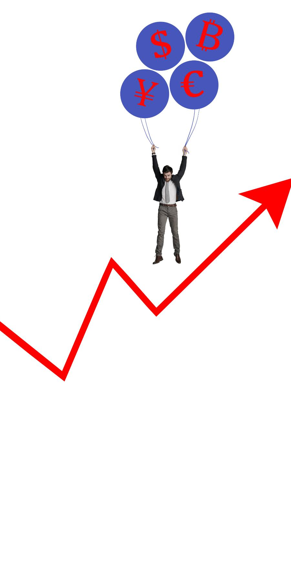
Summary and Closing Remarks
Machine Learning Model Performance
  Logistic Regression proved most robust, balancing accuracy and consistency in text classification tasks.
Challenges Faced
  Data integration, ethical considerations, and model evaluation were key challenges in the project.
Future Enhancements
  Focus will be on advanced NLP techniques and deep learning models to improve classification accuracy.
Ethical AI Importance
  The project highlights the importance of technical rigor combined with ethical responsibility in AI development.
Notes:
---
This slide references information from the following file: https://gracechurchlive-my.sharepoint.com/personal/adaza_grace_one/Documents/Microsoft%20Copilot%20Chat%20Files/MT_PT_Andres%20Daza%20Catano%20%26%20Taki%20Boubekri_ITAI2373.pdf
The BBC News Categorization Analysis project successfully demonstrated the application of machine learning techniques to text classification tasks. Logistic Regression emerged as the most robust model, balancing accuracy and consistency, while Naive Bayes showed potential but lacked reliability. SVM was unsuitable for this dataset. The project highlighted key challenges in data integration, ethical considerations, and the importance of model evaluation. Future improvements will focus on advanced NLP techniques and deep learning models to enhance performance. Overall, this work underscores the value of combining technical rigor with ethical responsibility in developing AI systems for real-world applications.

