Slide 1


LOAN PREDICTION
Is it possible to predict loan
metrics accurately?
By Andrés Genta

Slide 2
CONTENTS
EDA
Machine Learning models
Visualization in Tableau
Conclusions
Goals & Data Collection
Loan process

Slide 3

Goals & Data Collection
The dataset used in this project was taken from Kaggle
Our aim for this project is to be able to predict some important characteristics of loans, and do visualizations to improve our understanding

Slide 4
Features of the dataset
Loan id
No of dependents
Education
Self employed
Income
Loan amount
Cibil score
Residential assets value
Commercial assets value
Luxury assets value
Bank assets
Loan status
Loan term
data.shape
(4269,13)

Slide 5
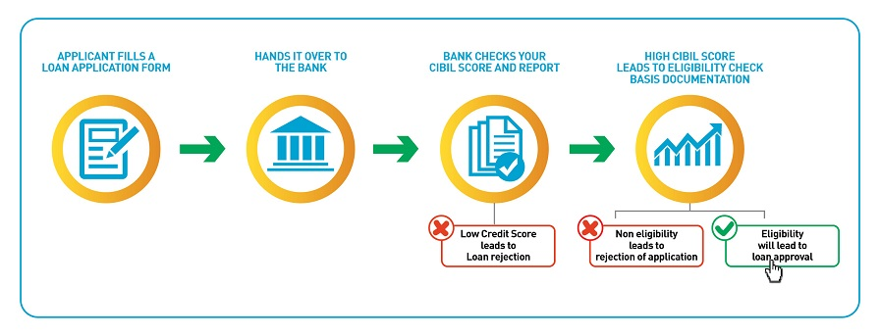
Simplified diagram of the Loan Procedure

Slide 6
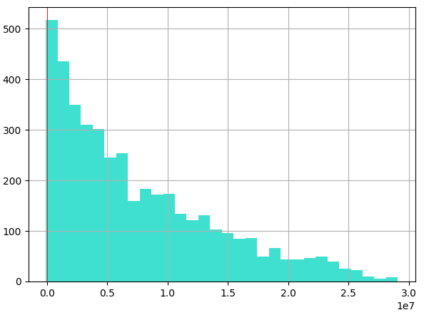
EDA
Data Cleaning:
The dataset was quite clean, it had no nulls and duplicates. However, it had some negative values that were incorrect, so I imputed them
Residential assets value Histogram
All of those negatives
Had the exact same value:
-100,000. Although it is possible that residential assets can have negatives, I believe it was a systematic mistake (that is why I imputed with the median, by looking at the distribution)

Slide 7
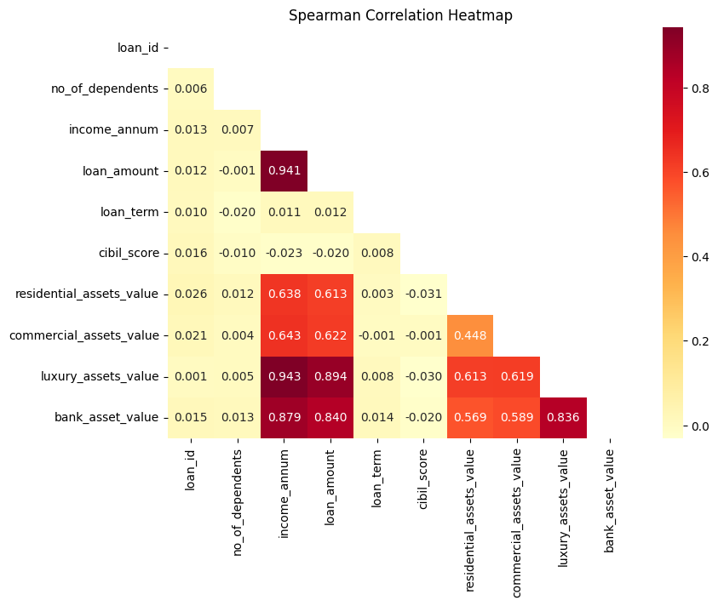
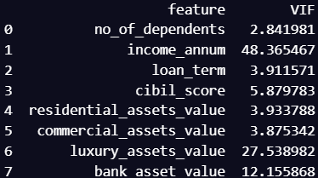
More EDA: correlations of numerical features

Slide 8
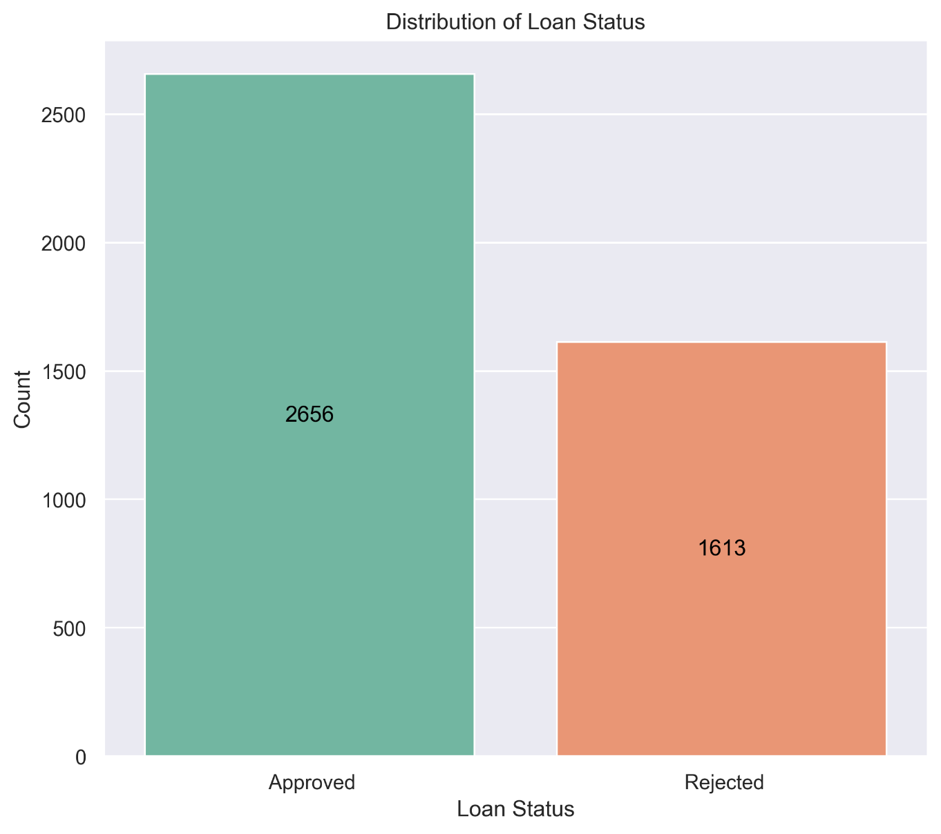
There is some imbalance but it is clear that most clients are meeting the bank requirements

Slide 9
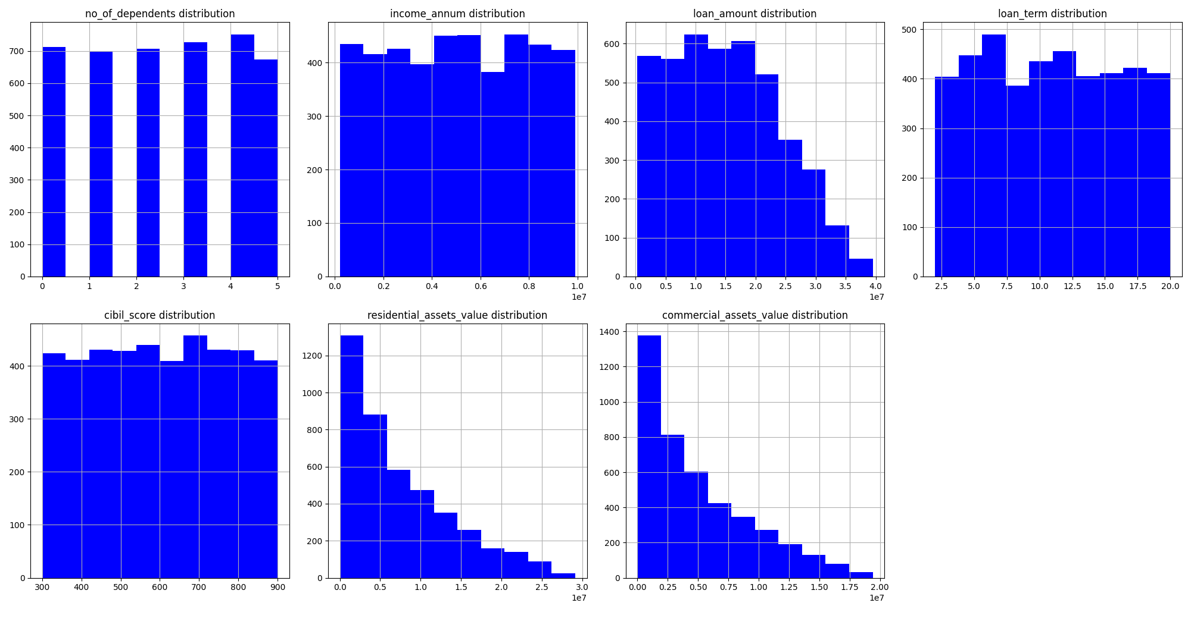
Histograms of numerical variables

Slide 10
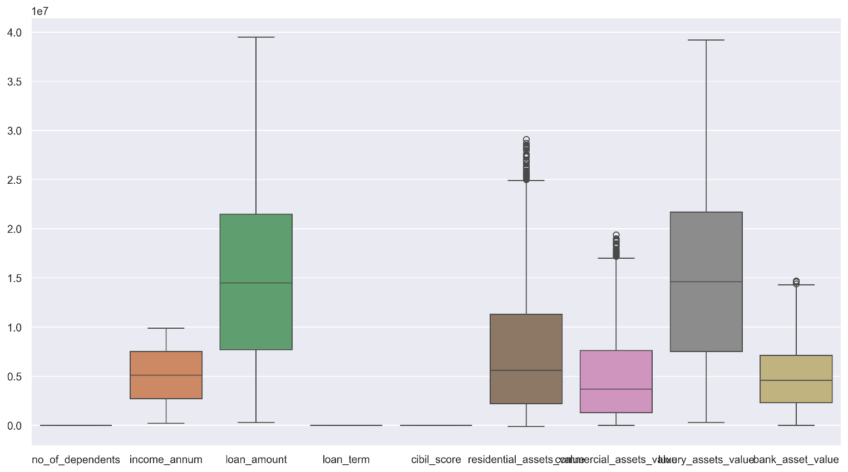
Boxplots/Outliers

Slide 11
MODELS USED
Logistic Regression
KNN
Random Forest
Linear and
Polynomial Regressions
Using RFE/PCA
Classification models to predict Loan Status
Regression models
to predict Loan Amount

Slide 12
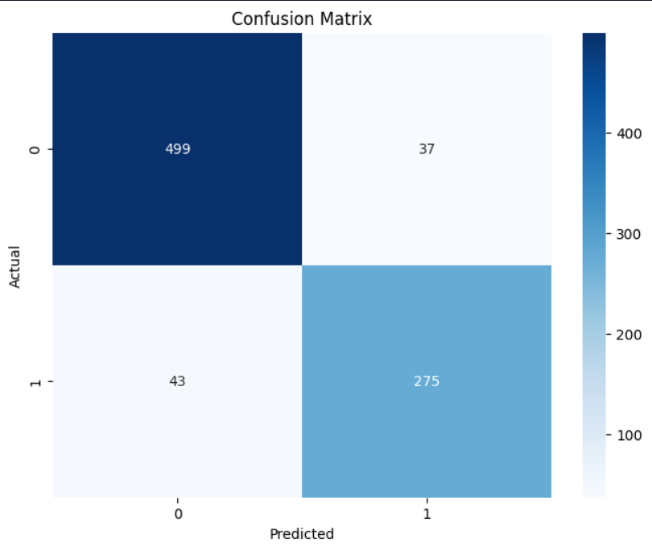
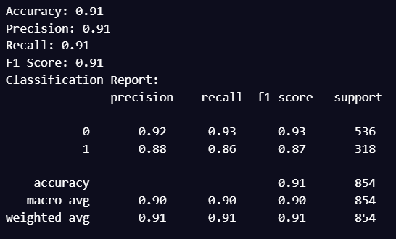
Classification Models 1) Logistic Regression

Slide 13
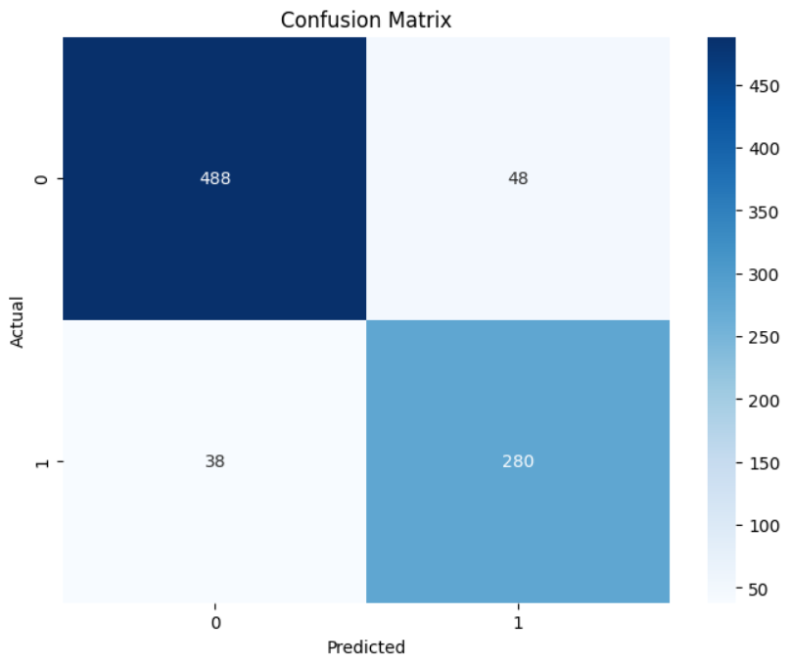
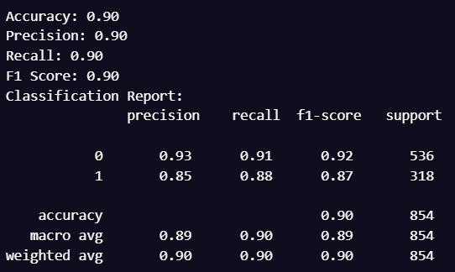
2) KNN

Slide 14
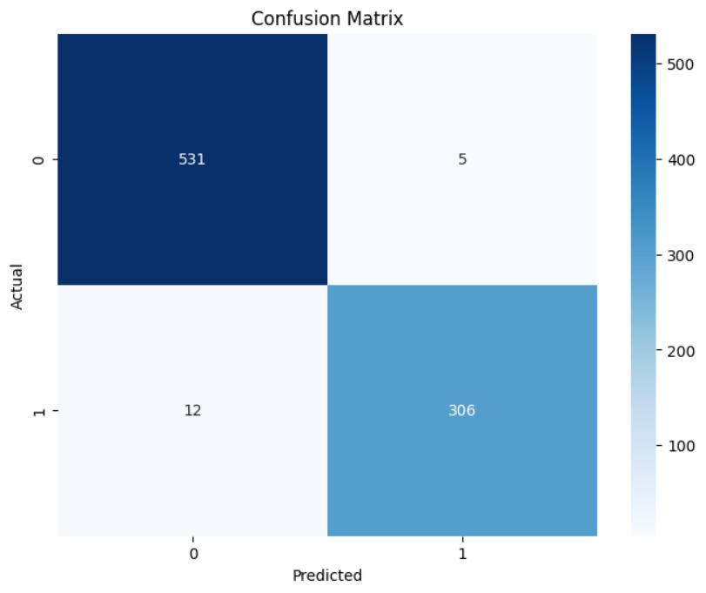
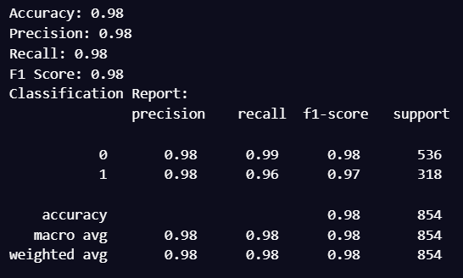
3) Random Forest

Slide 15
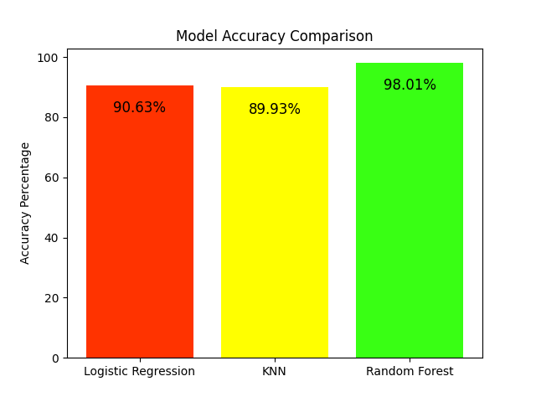

Slide 16
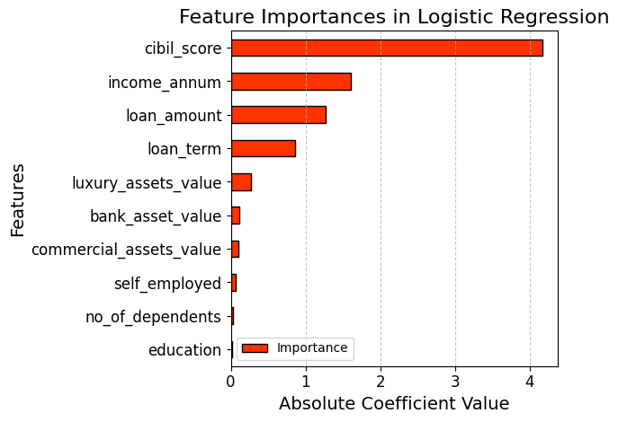
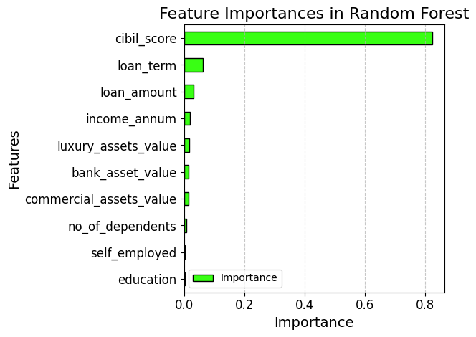
FEATURE IMPORTANCES

Slide 17
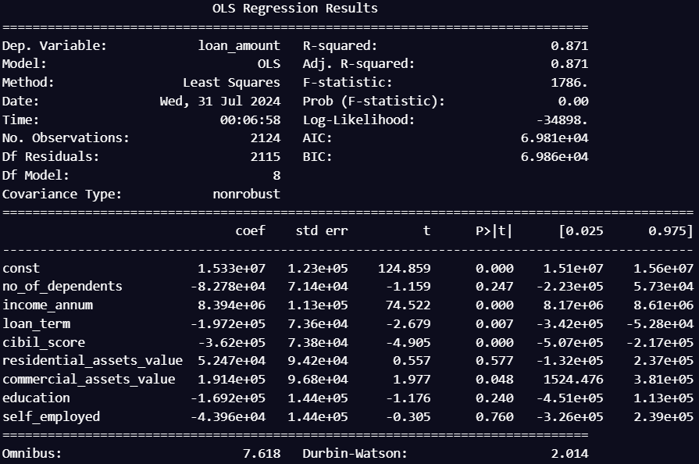
Regression Models
First Linear Regression Model
We trained this model with a subset of approved data,
in order to later on use it to make predictions with rejected data
MSE=1.09x10^13

Slide 18
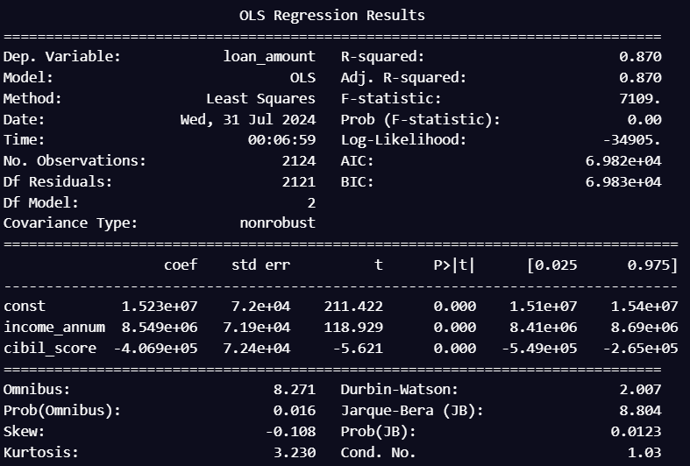
Regression Models
Final Linear Regression Model, using RFE
Mean R2 Cross Validation score=0.87
Standard deviation of R2=0.01
MSE=1.08x10^13
Using PCA: R2=0.73, p values~0
but the MSE was 2.2x10^13 → Bad model
Using Polynomial Regression: results
were a complete disaster, unless we
use a degree=1, which is the same as
the linear regression

Slide 19
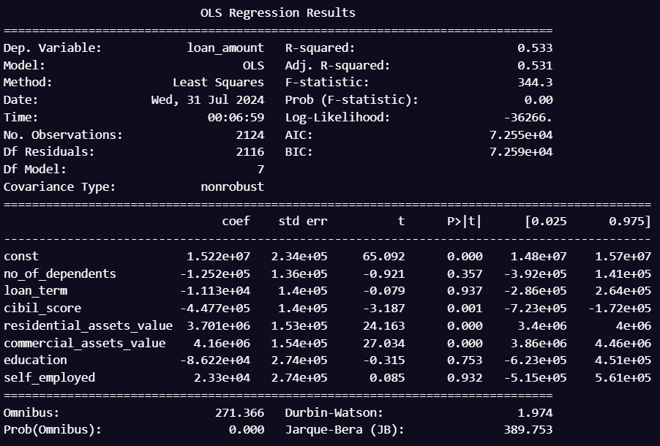
What happens if we remove the variable Income?
There is room for improvement but clearly this model
is inferior to the others
It could be useful to improve it
if we lived like 20 years ago, but not the satandars of banks of the present

Slide 20
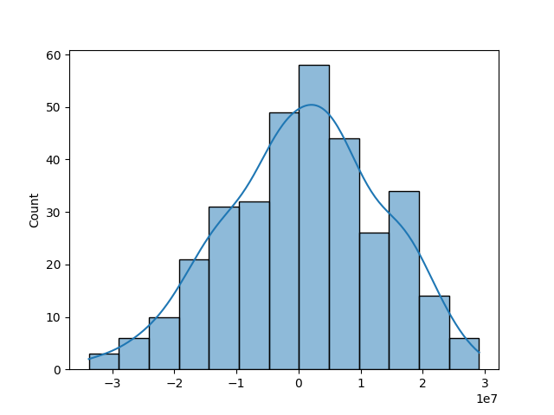
Predictions on the rejected subset
Loan amount predictions – actual values
The positive side of the histogram
does not make sense. Let’s check
how the features behave for both
the positive and negatives sides.
But first we will do a feature
importance to see which variables
are more relevant
Note: it could also be because of mistakes by the bank

Slide 21
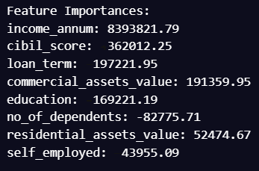

Slide 22
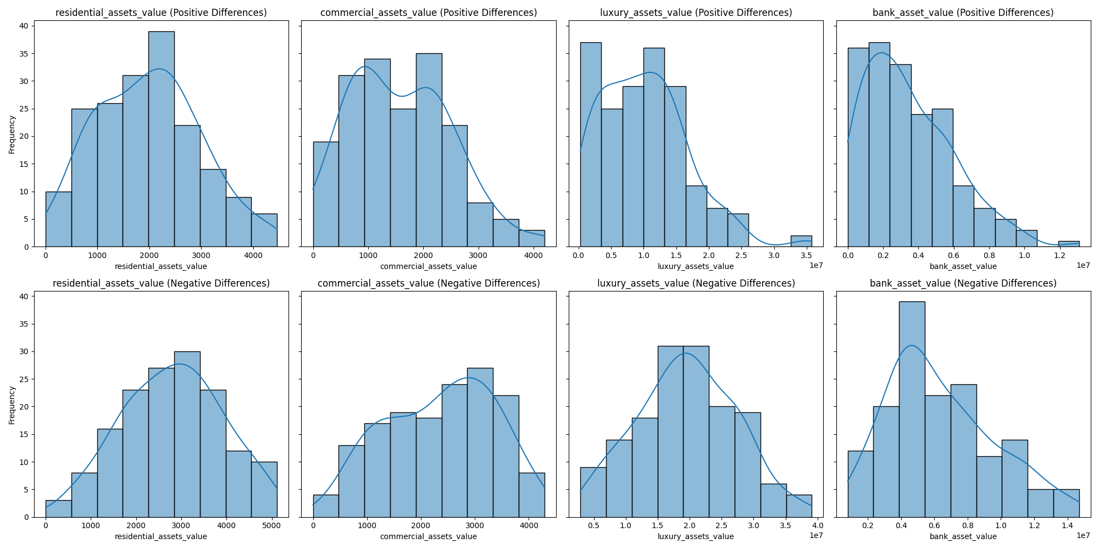
Assets for both sides of the Histogram

Slide 23
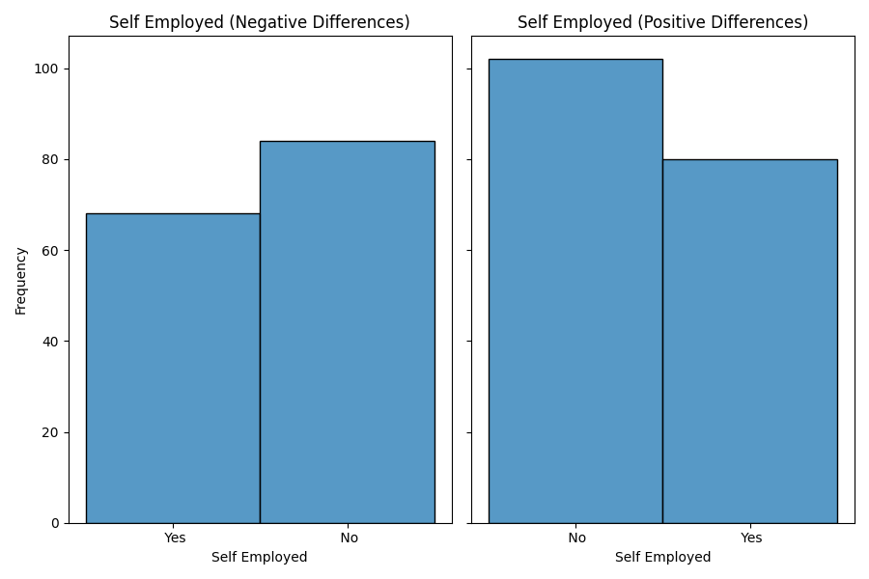
Self Employed for both sides
This is quite reasonable,
but this variable was the least important of the feature importances, so this argument is not enough

Slide 24
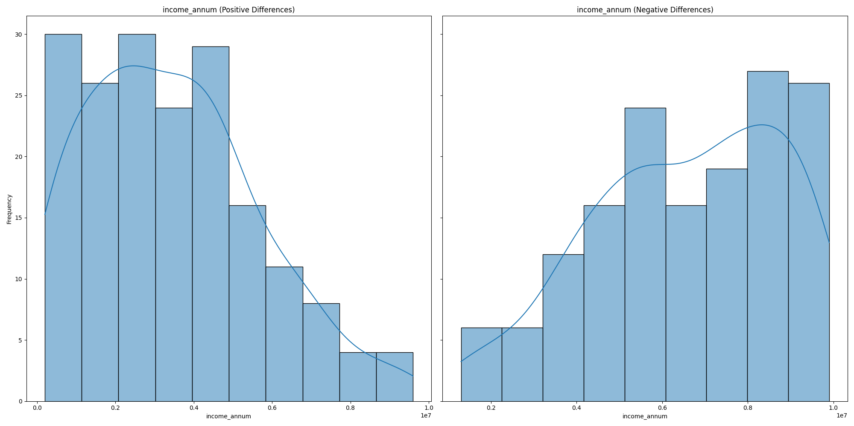
Income for both sides
This makes a lot of sense and explains
the positive side of the first histogram

Slide 25
CONCLUSIONS
We did Exploratory Data Analysis on the features of this dataset and saw how each feature is distributed.
The Income variable has more importance than I expected
It is possible to predict the variables loan amount and loan status, but it is important to consider what variables represent a risk for the bank (like the income in this case)
We got good accuracy for all the models, having the linear regression using RFE and the logistic regression as our final models

