Slide 1
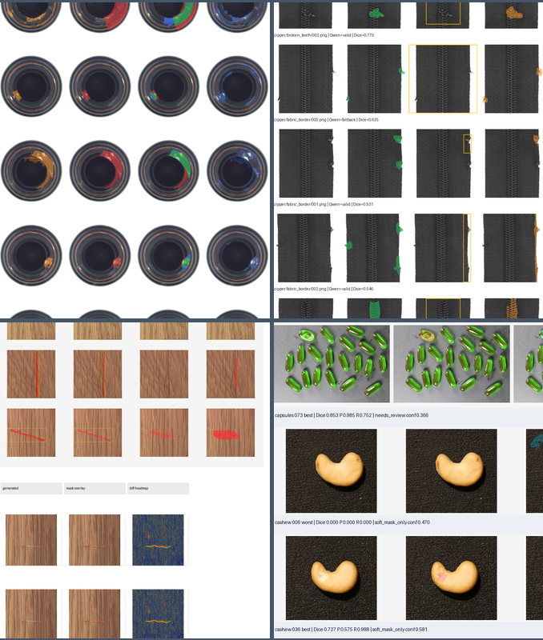
FINAL RESEARCH CHECKPOINT
Automatic industrial defect pseudo-mask pipeline
Architecture, reproduced results, generalization evidence, and honest limitations
1,476 images
5 data sources
292 tests
Frozen V4.2f rerun | August 2026

Slide 2
Executive conclusion
SUMMARY
The research implementation is complete. Further tuning on the same exposed data is unlikely to strengthen the paper.
+0.095
0.366
0.159
-0.001
locked selector Dice gain
macro selected Dice
locked VisA Dice
synthetic pixel-AP delta
confirmed on unseen categories
-0.006 vs V4.2d
generalization gate failed
95% CI crosses zero
Confirmed contribution
Negative result
Paper-ready position
Real-candidate, leave-category-out selector calibration reduces regret with a confidence interval excluding zero.
The generic auto-mask architecture does not transfer at release quality to locked VisA categories.
Present the method, validated selector result, null synthesis utility, and measured failure modes without overclaiming.
Decision: freeze the architecture and move from model development to paper packaging.
ImgGen v2 | Final Pipeline Result
02

Slide 3
Why automatic pseudo-masks matter
MOTIVATION
Many controllable industrial defect-generation workflows begin with a manually supplied bounding box or pixel mask.
1
Inspect
2
Annotate
3
Generate
4
Train
Find the defect
Draw box or mask
Diffusion / inpaint
Use image-mask pairs
Cost
Consistency
Project objective
Pixel masks require skilled labor and are difficult to scale across parts and factories.
Boxes and masks vary by annotator, especially for fuzzy, broad, or low-contrast defects.
Infer uncertainty-aware, purpose-specific pseudo-masks from normal images and a few unlabeled defects.
The project removes manual spatial annotation from the user workflow, but does not claim automatic masks are human ground truth.
ImgGen v2 | Final Pipeline Result
03

Slide 4
Research questions and claim boundaries
FRAMING
RQ1
Can normal-reference and multimodal evidence generate useful automatic pseudo-masks?
RQ2
Can a category-agnostic selector choose the right candidate under domain shift?
RQ3
Do selected masks produce visible, low-leakage synthetic defects?
RQ4
Does the synthetic corpus improve an independent downstream student?
Confirmed: selector calibration. Mixed: mask architecture and visual synthesis. Null: downstream synthetic utility.
ImgGen v2 | Final Pipeline Result
04

Slide 5
End-to-end research pipeline
ARCHITECTURE
1
Inputs
2
Localize
3
Evidence
4
Propose
5
Select
6
Generate
normal + few defects
Qwen soft regions
DINO / residual / texture
binary + soft candidates
calibrated rank + abstain
SD1.5 + critic
Outputs are role-specific
Evidence is auditable
Claims are gated
● eval_tight
● training_soft / medium
● uncertainty_map
● inpaint_soft
● candidate metadata
● source reliability
● selection confidence
● visual contact sheets
● official-mask firewall
● leave-source-out folds
● preregistered thresholds
● locked evaluation
The architecture is complete; the measured evidence determines which components remain experimental.
ImgGen v2 | Final Pipeline Result
05

Slide 6
Automatic mask generation core
ARCHITECTURE
Context
Evidence
Candidates
Decision
defect image
DINO memory
fused quantiles
candidate features
up to 16 normals
registered residual
components
list ranking
Qwen soft prior
MuSc rarity
SAM2 refinement
risk calibration
foreground estimate
FFT / texture
posterior compact
hard / soft / review
PatchCore guided
uncertainty contours
Zero-shot rule: category and defect names do not route the generic headline path; official masks never create candidates.
ImgGen v2 | Final Pipeline Result
06

Slide 7
One defect, multiple mask roles
PSEUDO-LABELS
positive_core
eval_tight
training_medium
training_soft
high-confidence pixels
conservative binary evaluation
hard line-like training
fuzzy uncertainty-aware target
possible_region
uncertainty_map
inpaint_soft
supported outer extent
source and boundary disagreement
soft generation envelope
Ambiguous pixels are down-weighted in Phase 3 and Phase 5 instead of being treated as certain foreground.
This is an engineering strength; downstream gains still require independent validation.
ImgGen v2 | Final Pipeline Result
07

Slide 8
Evaluation firewall and scientific integrity
PROTOCOL
Runtime and evaluation data are separated before execution.
A
Runtime tree
B
Sealed outputs
C
Locked evaluate
normal + unlabeled defect images
masks + hashes + manifests
official masks opened afterward
Content hashes
Leave-source-out
Preregistration
Negative results
datasets, configs, models, reports
five exposed sources, no in-fold labels
thresholds fixed before result access
failed gates retained and reported
This firewall is part of the contribution: it prevents benchmark masks from silently becoming training signals.
ImgGen v2 | Final Pipeline Result
08

Slide 9
Evidence base
PROTOCOL
Dataset | Images | Categories | Role
MVTec development | 144 | 5 | exposed development
VisA | 1,200 | 12 | locked once, then exposed for V4
BTAD | 60 | 3 | external development
KSDD2 | 60 | 1 | external development
Kodytek wood | 12 | 1 | external development
V4.2f total | 1,476 | 10 source categories | leave-dataset-out
Development evidence
V4.2f compares proposal and selection behavior across five complete source-held-out folds.
Locked evidence
MVTec locked categories confirm selector benefit but reject release quality. VisA exposes severe transfer failure.
Interpretation rule
VisA can no longer support another locked claim. A future confirmatory run needs a new untouched benchmark.
More tuning on these exposed sets would increase researcher degrees of freedom without creating stronger evidence.
ImgGen v2 | Final Pipeline Result
09

Slide 10
Confirmed contribution: real-candidate selector calibration
RESULTS
Train the selector on real labelled candidates instead of synthetic corruptions. Confirmed twice.
+0.095
+0.194
Same candidates, different selector
Each arm is scored on an identical, hash-verified candidate pool, and every category is predicted by calibration trained without it.
locked Dice gain, 10 unseen categories
development regret reduction, 5 categories
95% CI [+0.045, +0.144] - the decisive test
95% CI [+0.101, +0.301]
Development mean selection regret
Development mean selected Dice
Synthetic calibration
0.351
Synthetic calibration
0.225
Real calibration
0.157
Real calibration
0.469
The locked result is the load-bearing one: it holds on categories never used during development.
ImgGen v2 | Final Pipeline Result
10

Slide 11
The sealed test: locked MVTec categories
GENERALIZATION
10 categories were never touched during development. Official masks opened once, after outputs were sealed.
+0.095
0.317
0.562
selector Dice gain on unseen categories
locked macro Dice
candidate oracle Dice
95% CI [+0.045, +0.144], P(<=0) = 0.0001
below the 0.55 release target
selection leaves 0.245 Dice unused
Locked selected Dice by selector
What it confirms
Synthetic calibration
0.221
The selector contribution transfers to categories it never saw. This is the paper's primary claim.
Real calibration
0.316
What it rejects
The full mask architecture is not release-ready, and selection still leaves most of the ceiling unused.
839 images, 29,584 sealed candidates, one-shot evaluation - re-running it is forbidden by the sealed configuration.
ImgGen v2 | Final Pipeline Result
11

Slide 12
V4.2f reproduced headline result
RESULTS
0.489 -> 0.502
0.372 -> 0.366
32,244
macro oracle Dice
macro selected Dice
held-out candidates
gain +0.0134
change -0.0057
15.92% growth
Better candidates, no better output: even a perfect ranker on this pool would add only +0.136 macro Dice.
Proposal result
Selection result
Decision
All five source oracles are non-regressive. New contours become strict oracle winners on 125 images.
Only 12 new contours are selected. Kodytek falls back to its weaker baseline after refitting.
Keep the mechanism as research infrastructure, leave it default-off, and preserve V4.2d fallback.
Rerun status: succeeded; cache hit: True; elapsed: 2072.8 s
ImgGen v2 | Final Pipeline Result
12

Slide 13
V4.2f result by source
RESULTS
Best behavior
BTAD and MVTec obtain small selected gains; KSDD2 safely abstains at baseline.
Main regression
Kodytek selected Dice drops 0.3625 -> 0.3164 because the refitted fold no longer overrides.
Binding failure
VisA oracle barely moves and selected output remains at the weak baseline.
ImgGen v2 | Final Pipeline Result
13

Slide 14
Candidate-quality sprint evolution
ABLATION
Sprint | Candidates | MAE | Regret
V4.2d | 27,816 | 0.0857 | 0.1165
V4.2e | 41,638 | 0.1021 | 0.1433
V4.2f | 32,244 | 0.0908 | 0.1356
Interpretation
V4.2f recovers almost all V4.2e oracle gain with 22.6% fewer candidates, but neither proposal family passes deployment.
The widening oracle-selection gap is the reason to stop fixed candidate sweeps.
ImgGen v2 | Final Pipeline Result
14

Slide 15
V4.2f preregistered gate audit
DECISION
Gate | Target | Observed | Result
VisA oracle gain | >= +0.030 | +0.0018 | FAIL
Macro oracle gain | >= +0.010 | +0.0134 | PASS
Per-source oracle | no regression | all non-regressive | PASS
Candidate growth | <= 20% | 15.92% | PASS
Selected regression | <= 0.005 | 0.00571 | FAIL
Expected-IoU MAE | <= 0.12/source | Kodytek 0.1264 | FAIL
Proposal mechanism
The bounded contour family is valid and efficient. Macro ceiling improvement is real.
Primary endpoint
The intended cross-domain VisA boundary problem remains essentially unchanged.
Promotion decision
No deployment. Do not round the near-miss selected guard into a pass.
ImgGen v2 | Final Pipeline Result
15

Slide 16
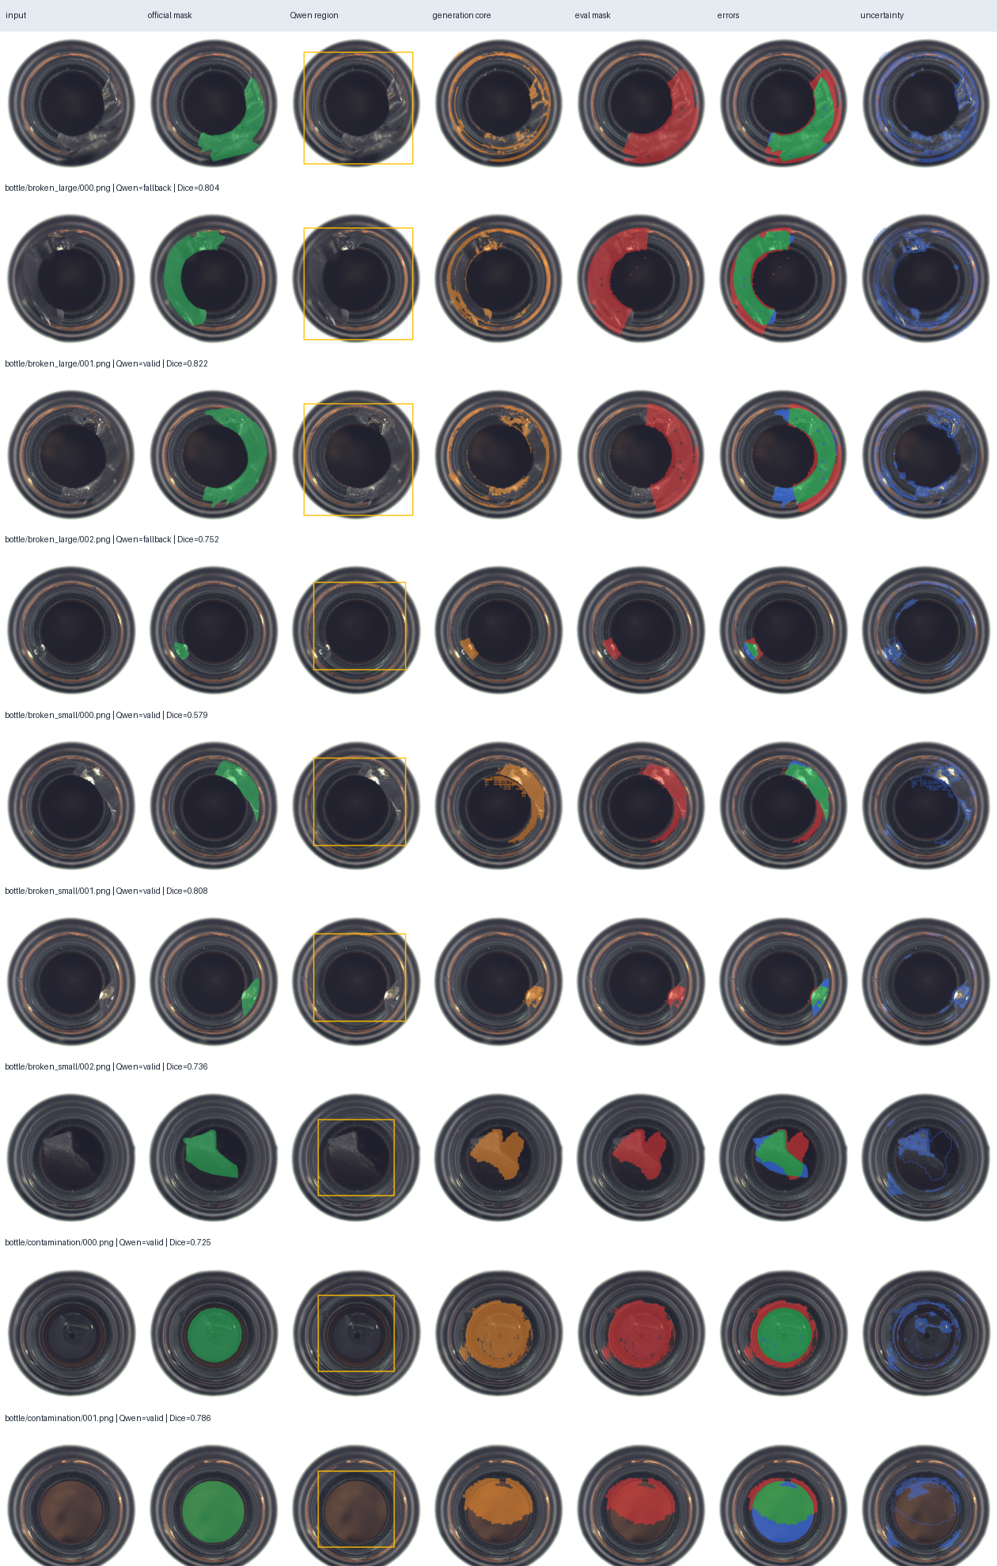
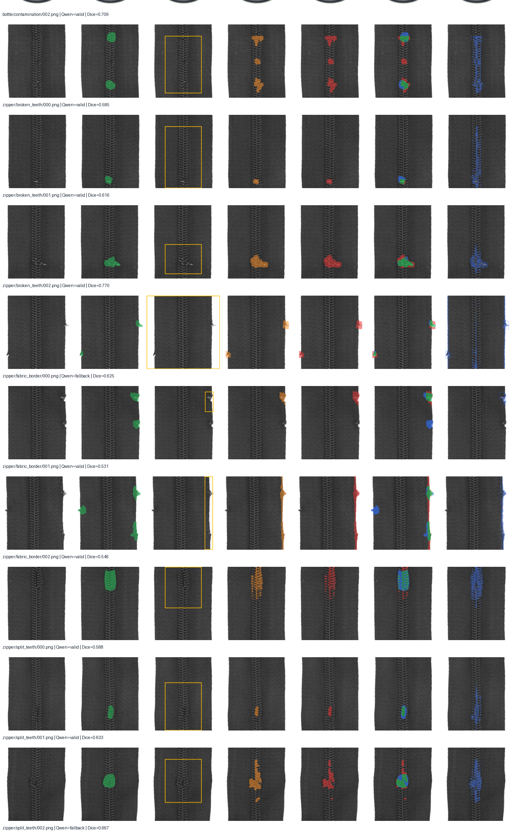
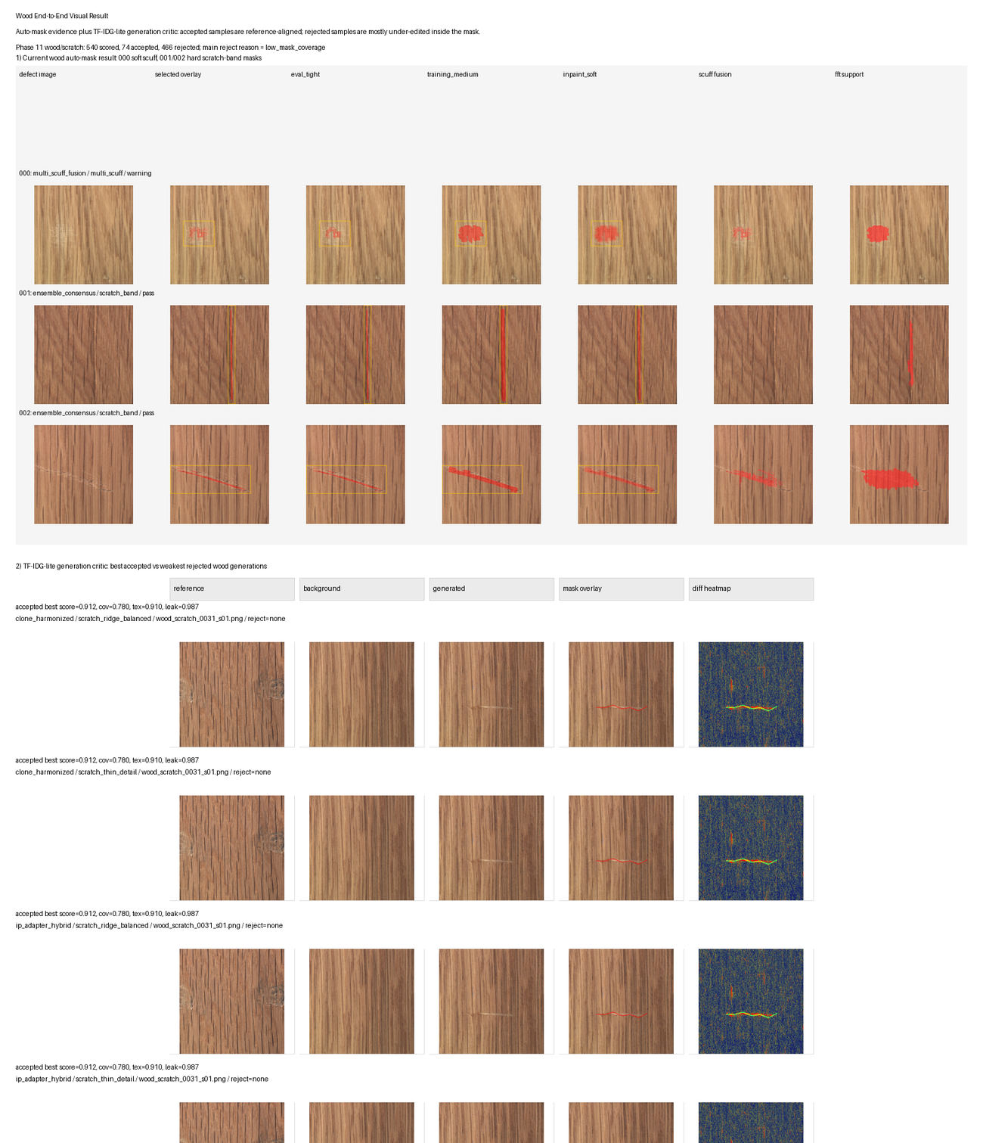
Visual evidence: MVTec and wood
QUALITATIVE
Bottle
Zipper
Wood
Curved rims and contamination show both tight successes and over-segmented masks.
Repeated tooth geometry is localized well in some cases; border and tiny defects remain difficult.
Morphology routing separates hard scratches from fuzzy soft-label scuffs.
Visual masks are pseudo-labels. Official masks appear only in evaluation overlays.
ImgGen v2 | Final Pipeline Result
16

Slide 17
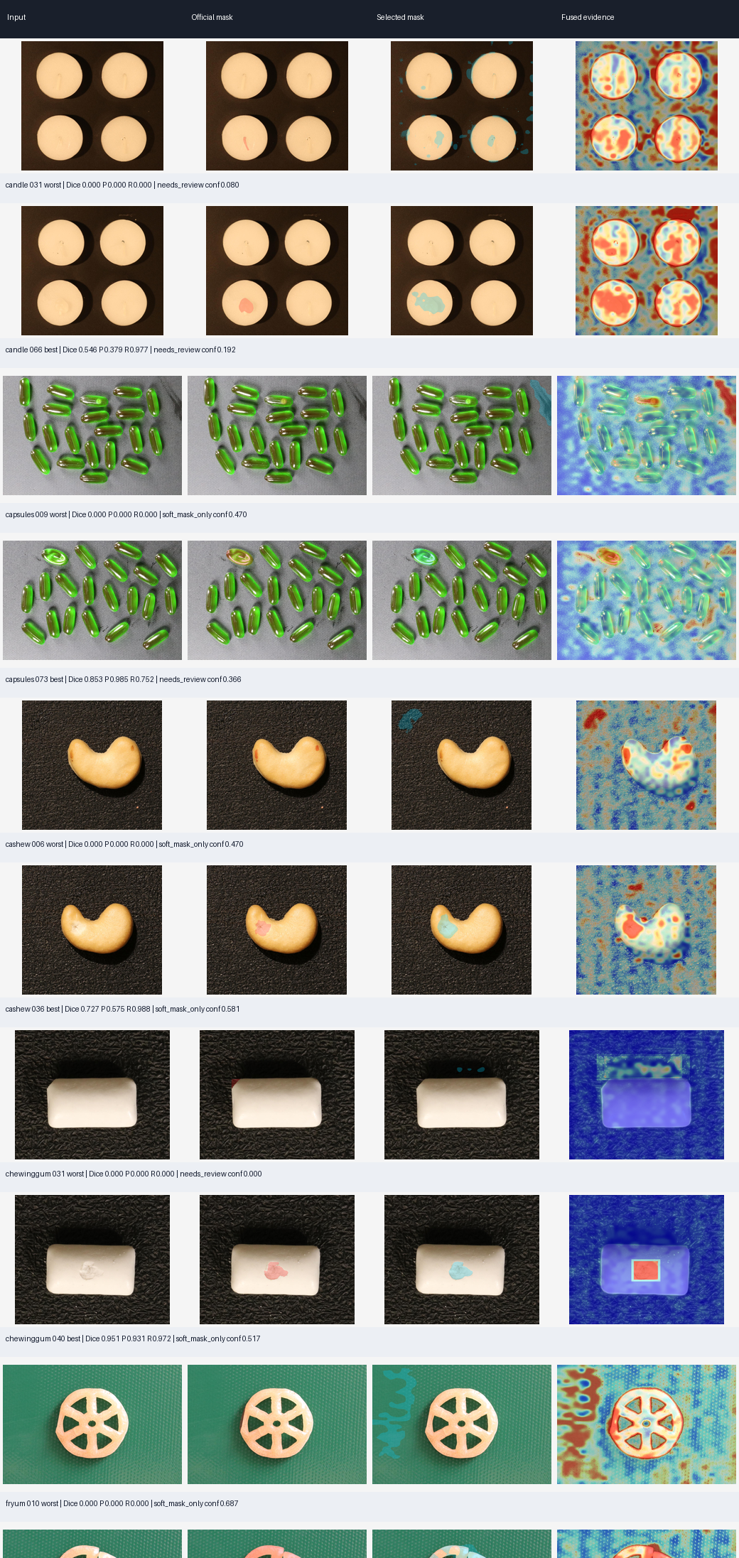
Locked VisA transfer: the architecture-level failure
GENERALIZATION
0.159
macro Dice
95% CI [0.094, 0.250]
0.590
search-region recall (frozen runtime)
localization also transfers weakly
0.527
accepted coverage
quality confidence is miscalibrated
High recall often comes with broad masks; only chewing-gum exceeds 0.30 category Dice.
This is the frozen runtime region. The later V4 slides rebuild a wider evidence envelope, so their recall figures are not comparable.
ImgGen v2 | Final Pipeline Result
17

Slide 18
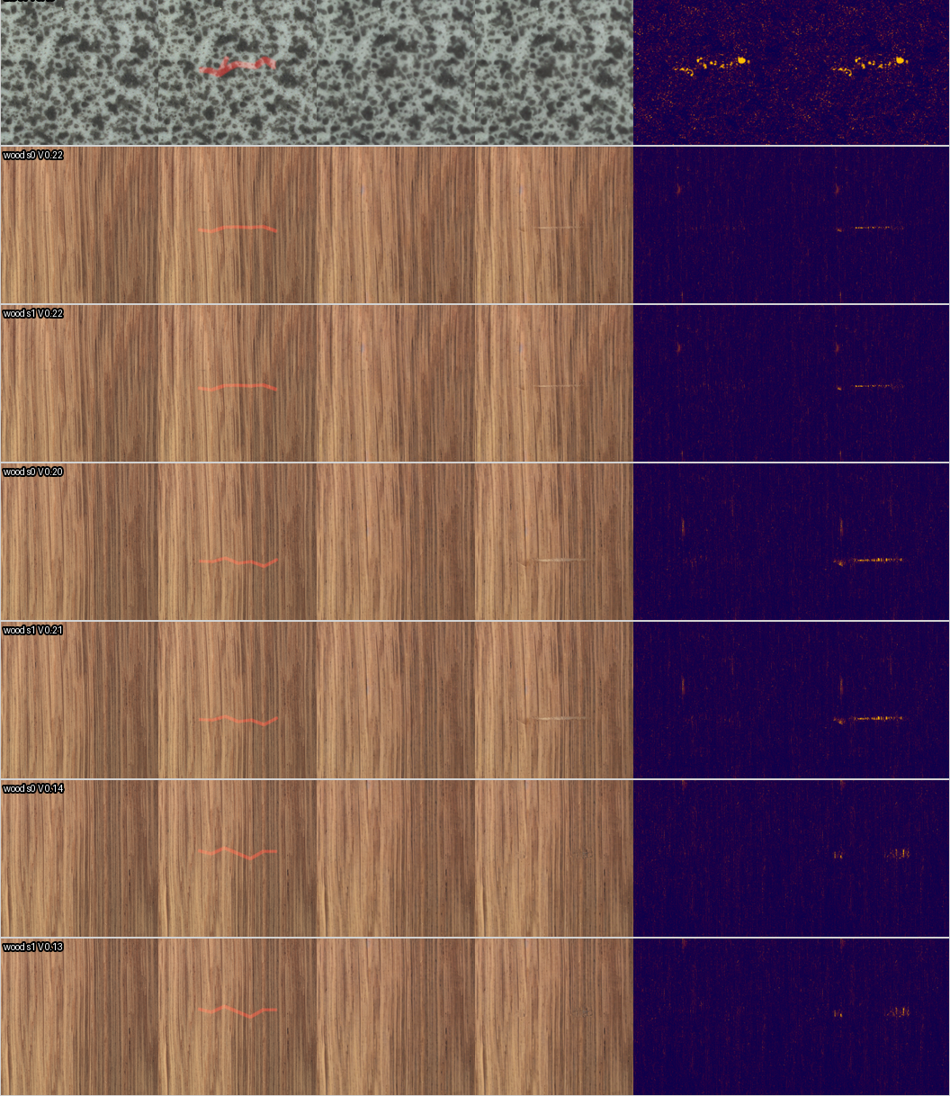
Synthetic generation: visible, not yet validated
GENERATION
+0.029
visibility-score gain
95% CI [+0.011, +0.049]
10 -> 14
critic acceptance
18 matched inputs
Important caveat
The critic is not an independent human judge. Two-reviewer blind validation remains incomplete.
Generation capability is demonstrated; a general perceptual-quality claim is not.
ImgGen v2 | Final Pipeline Result
18

Slide 19
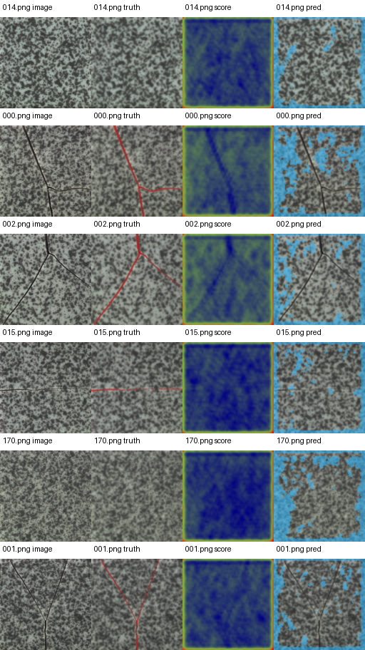
Independent downstream utility: null result
EVALUATION
-0.0015
5
pixel-AP delta
paired training seeds
95% CI [-0.0414, +0.0403]
byte-identical replay verified
Fair comparison
Promotion gate
Same ResNet18 U-Net, matched optimizer steps, paired seeds, and no PatchCore fusion.
Failed: the mean gain is below +0.02 and the bootstrap interval includes zero.
Conclusion: synthetic generation is optional augmentation, not a proven detector improvement.
A nondeterministic-training defect was found mid-study, fixed, and the null re-measured; the decision held.
Gate passed: False
ImgGen v2 | Final Pipeline Result
19

Slide 20
What the project contributes, and what it does not
DISCUSSION
Defensible contributions
Measured limitations
● End-to-end annotation-free pseudo-mask workflow
● Frozen multimodal and normal-reference evidence field
● Purpose-specific hard, soft, and uncertainty masks
● Real-candidate selector calibration with positive CI
● Official-mask firewall and reproducible manifests
● Honest negative-result and abstention reporting
● Generic masks do not transfer at release quality
● Candidate oracle remains low on VisA
● Selection destabilizes when candidate pools expand
● Qwen localization can still fail under domain shift
● Generation critic lacks completed human validation
● Synthetic utility confidence interval includes zero
The limitations do not invalidate the work; they define the correct scope of the paper.
ImgGen v2 | Final Pipeline Result
20

Slide 21
Recommended paper positioning
CONCLUSION
A rigorous study of automatic pseudo-label generation for scarce-data industrial defects, showing where uncertainty-aware selection helps and where current multimodal evidence fails to generalize.
Lead claim
System claim
Real-candidate calibration improves candidate choice under matched pools.
The full automatic pipeline runs reproducibly from inputs through visual evidence.
Negative finding
Scientific value
Generic transfer and synthetic downstream utility do not meet promotion gates.
The project localizes failure to proposal quality, calibration transfer, and domain shift.
Do not market V4.2f as a deployed improvement. Use it as a preregistered boundary on diminishing returns.
ImgGen v2 | Final Pipeline Result
21

Slide 22
Final checkpoint and reproducibility
CONCLUSION
292
1,476
32,244
2073s
automated tests
V4.2f images
candidate records
cache-hit rerun
all passing
five source-held-out folds
bounded +15.92% pool
succeeded
Frozen checkpoint
19bf4bf Complete V4.2f uncertainty-contour study
Model SHA-256
c5a6c9de23a7720c79ec4740bdfab70aa897b33203eadd966f78ce48f5d0a2ad
Metrics SHA-256
06717691fc2ec0bd94866fbbbf8b17e01c656f5661a5cc9b8532ca6fd3b0e4c8
Final action: freeze architecture, preserve failed gates, and package the paper figures, tables, limitations, and reproducibility commands.
No additional same-data contour or selector tuning is recommended.
ImgGen v2 | Final Pipeline Result
22

