Slide 1
Import License Key
IBM Rational software architect

Slide 2
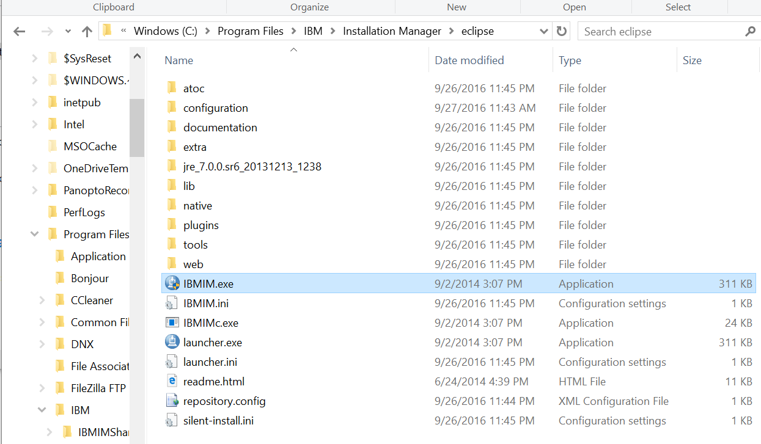
Find IBM Installation manager - IBMIM.exe

Slide 3
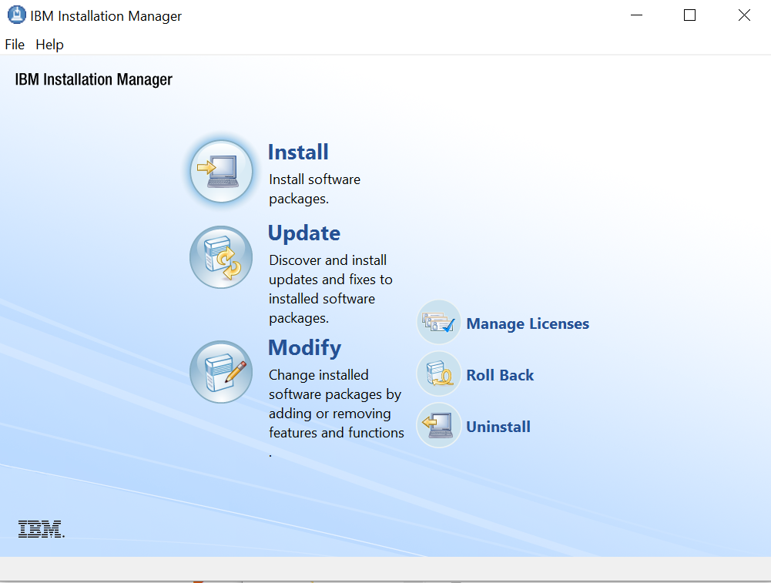
Manage Licenses

Slide 4
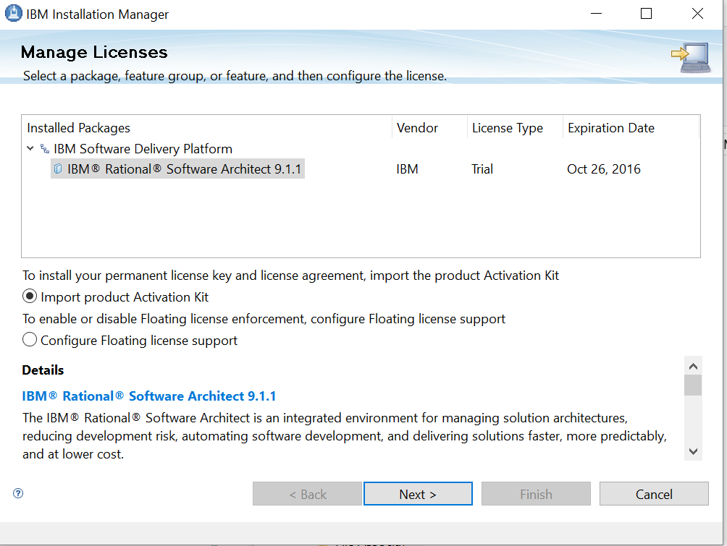
Manage Licenses
Import product Activation Kit

Slide 5
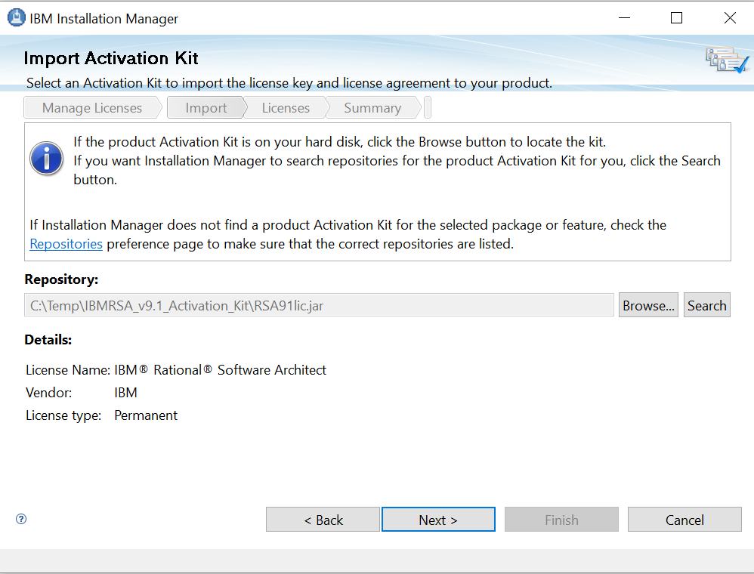
Input the license key
C:\Temp\IBMRSA_v9.1_Activaion_Kit
RSA91lic.jar

Slide 6
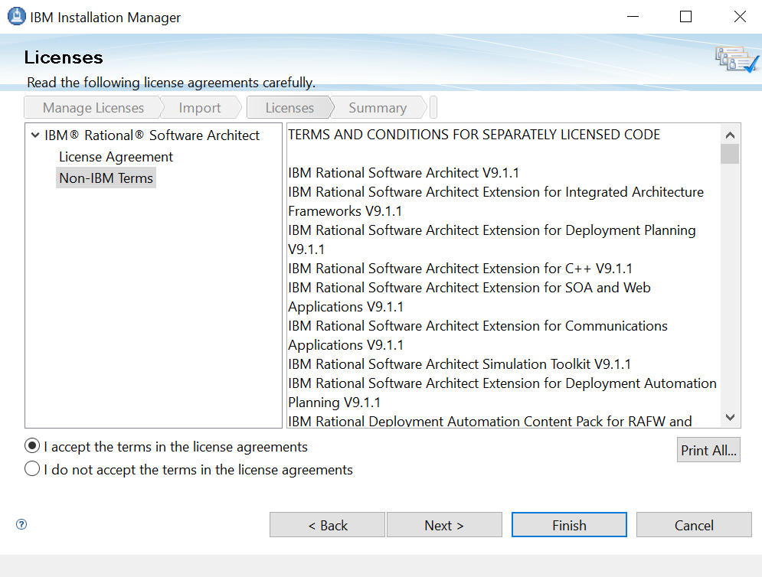
Manage Licenses
Accept license agreements

Slide 7
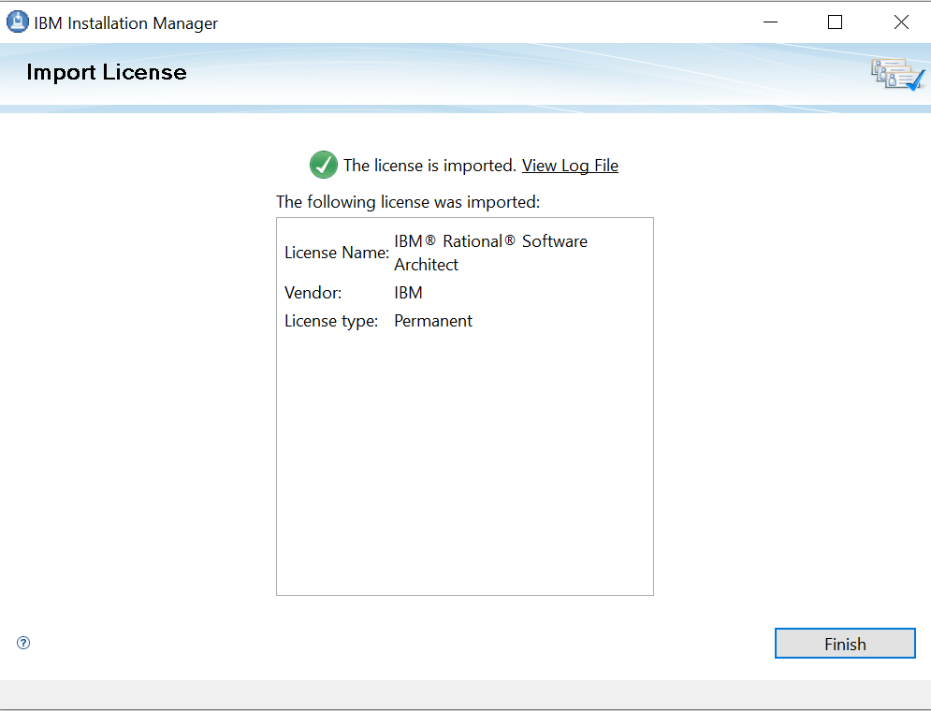
Successful
Permanent

Slide 8
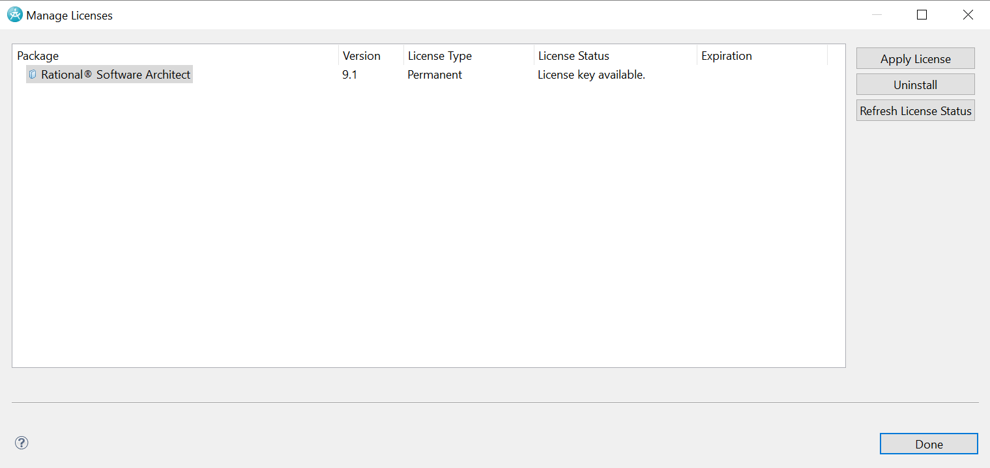
Verify
Launch the IBM Rational Software Architect again
Help → Manage License

